Slide 1
Advanced Change Detection -1
Change Detection Principles and Intro to Earth Engine

Slide 2
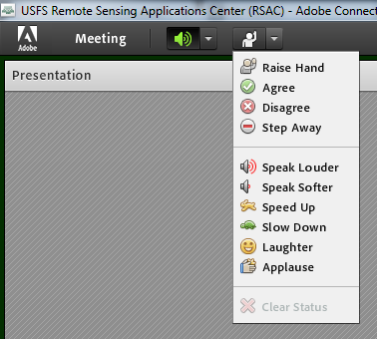
Housekeeping
Adobe Connect
  Quick orientation to interface
Please dial *6 to mute your phone
  Question or comment?
    Un-mute by dialing *6 again
    “Raise” your hand
    Send a chat

Slide 3

Course Format & Learning Styles
Many different learning styles: visual, auditory, kinesthetic, etc.
Webinar format seeks to address a variety of learning styles
  PPTs, live demonstrations, step-by-step exercises
  Content may be repetitive for some people
  Feel free skip formats that don’t serve your learning style

Slide 4
Prerequisites
Courses or knowledge equivalent:
  Introduction to change detection
  Geospatial scripting in JavaScript and Google Earth Engine
Google Chrome browser
Google Earth Engine account:
    https://signup.earthengine.google.com/

Slide 5
Course Agenda
Advanced change detection concepts & image processing in Earth Engine
      Lecture TIME, Exercise TIME
Explore advanced change detection methods & data products
      Lecture TIME, Exercise TIME
Fitting change algorithms in EE
      Lecture TIME, Exercise TIME
Mapping change in EE
      Lecture TIME, Exercise TIME
Notes:
Mention that everyone should have completed the prerequisites and ensure that everyone has an Earth Engine account: https://signup.earthengine.google.com/#!/

Slide 6
Course Objectives
  Deeper understanding of remote sensing change detection
  Skills and tools for image processing in EE
  Awareness and understanding of state-of-the-art remote sensing change monitoring programs and data products
  Experience implementing an advanced change detection algorithm in EE

Slide 7
Technical Topics Covered
Image processing in Earth Engine
    Review image processing in EE and generate composite image time-series and indices.
Time-series based change algorithms
    Explore time-series based change mapping methods
Use LandTrendr in EE to map change
    Implement the LandTrendr algorithm, fit parameters, and explore results in multiple ways

Slide 8
Exercises for today
Exercise 1: Process and explore Landsat time series
  Optional – review image processing in GEE
Exercise 2: Basic trend analysis
Exercise 3: LandTrendr in GEE: Model fitting
Exercise 4: LandTrendr in GEE: Disturbance mapping
Notes:
I moved this up here so that we can give them an outline or syllabus of sorts. We can go over this very quickly without much detail and elaborate later.

Slide 9
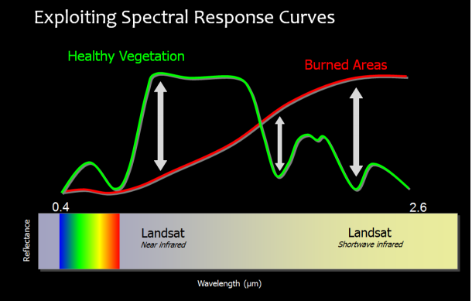
Remote Sensing Change Detection
What is remote sensing change detection?
  Landscape changes can be measured in the spectral values of pixels in multiresolution satellite imagery
Notes:
Placeholder image – Get the image from intro to change detection PPT

Slide 10
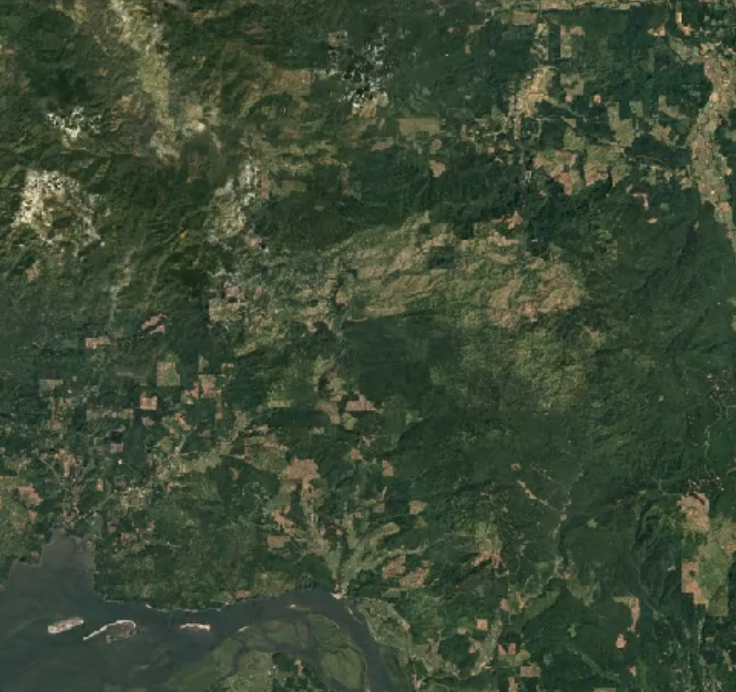
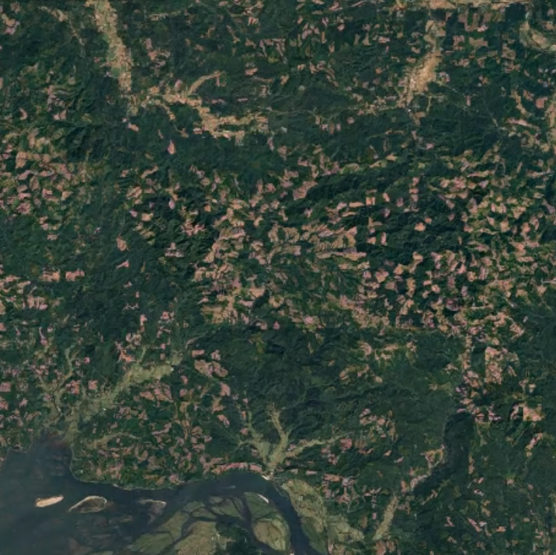
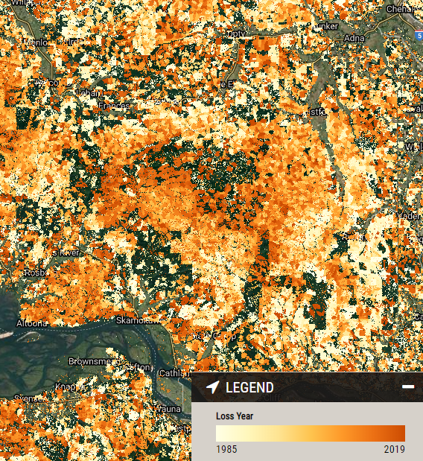
Change Detection Goals
Map the location, type and timing of change
Quantify change
Assess accuracy

Slide 11
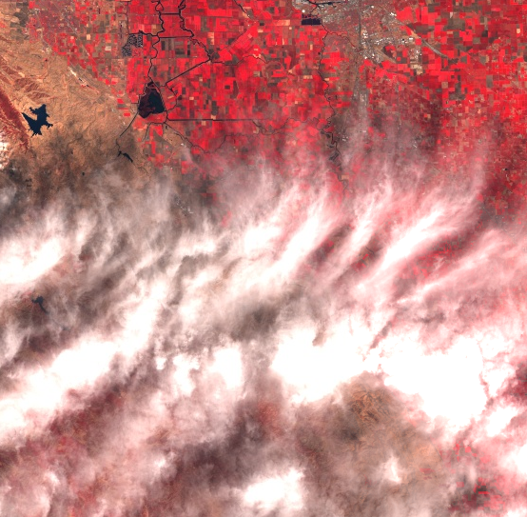
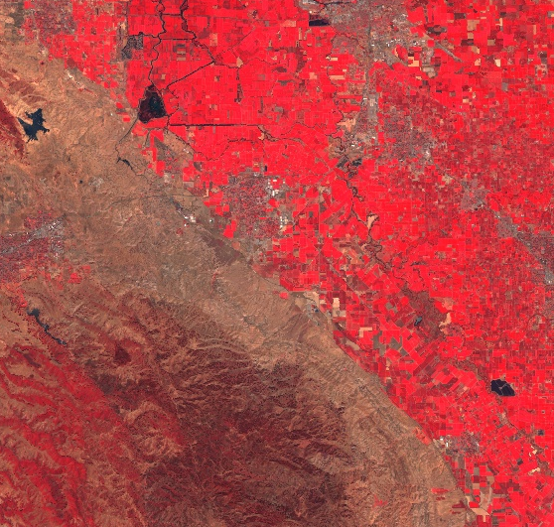
Change Detection Challenges
Separating the signal from the noise!
  Noise from clouds, image effects, seasonal variation, etc.
  ‘Real’ change?

Slide 12
Change Detection Methods
Image interpretation (visual)
Two-date (image differencing)
Modeling (classify change)
Multidate time series
  Analysis of spectral/temporal trajectories
  Includes methods covered in this course
Notes:
While discussing/presenting, hint at some limitations and historical context explaining how methods have become increasingly sophisticated as more and more data and analysis tools become available.
Emphasize that this course focuses on multidate time series change detection

Slide 13
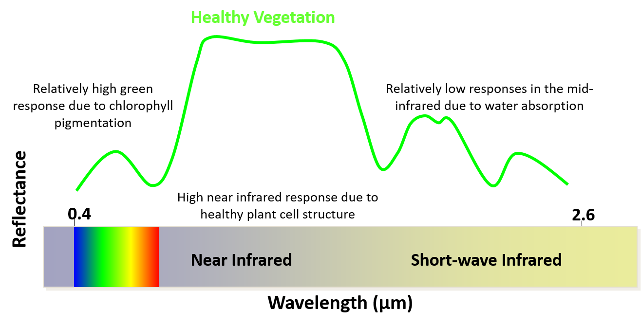
Review of Spectral Signatures

Slide 14
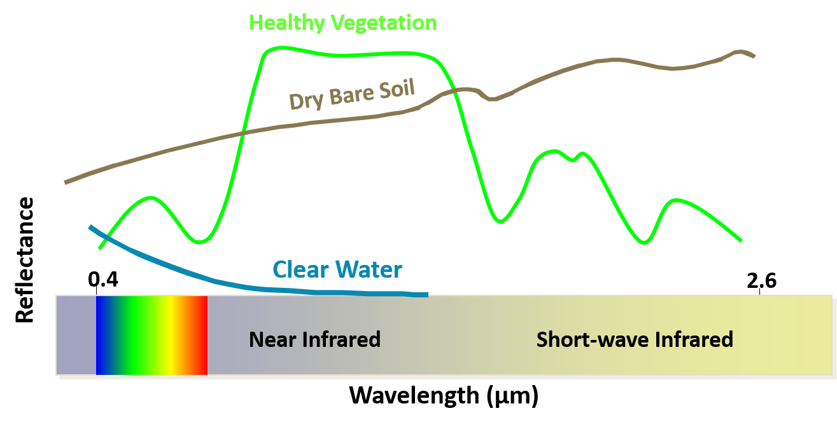
Review of Spectral Signatures

Slide 15
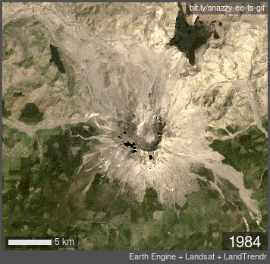
Change mapping is complicated
Change is usually a continual process operating on multiple timescales
  Time series imagery can help us capture these dynamics provided we can analyze them

Slide 16
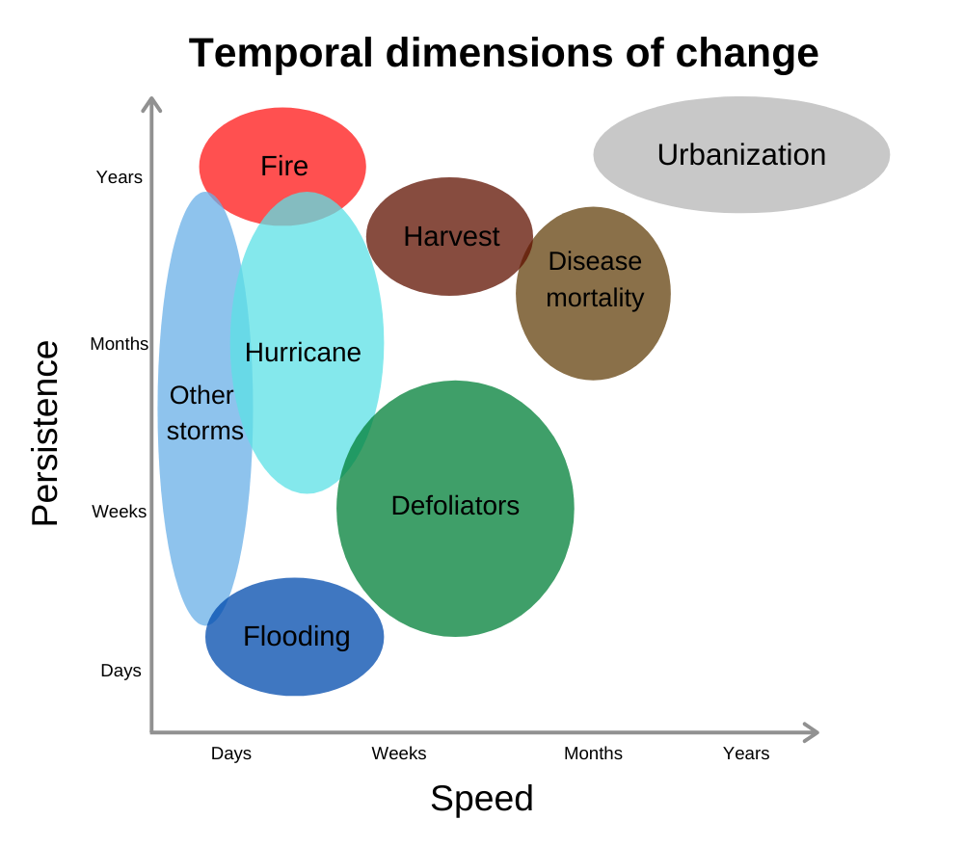
Temporal characteristics
  What does change look like from an Earth observation perspective?
Notes:
We are often interested in annual trends or changes that occur over long time periods. Whereas seasonal trends are usually driven by annual temperature or precipitation and not always of interest to managers wanting to understand how the landscape is changing.
Talk about the temporal characteristics of these different types of change and also SUCCESSION… Disturbance and recovery, sometimes things don’t return to the way they were…

Slide 17
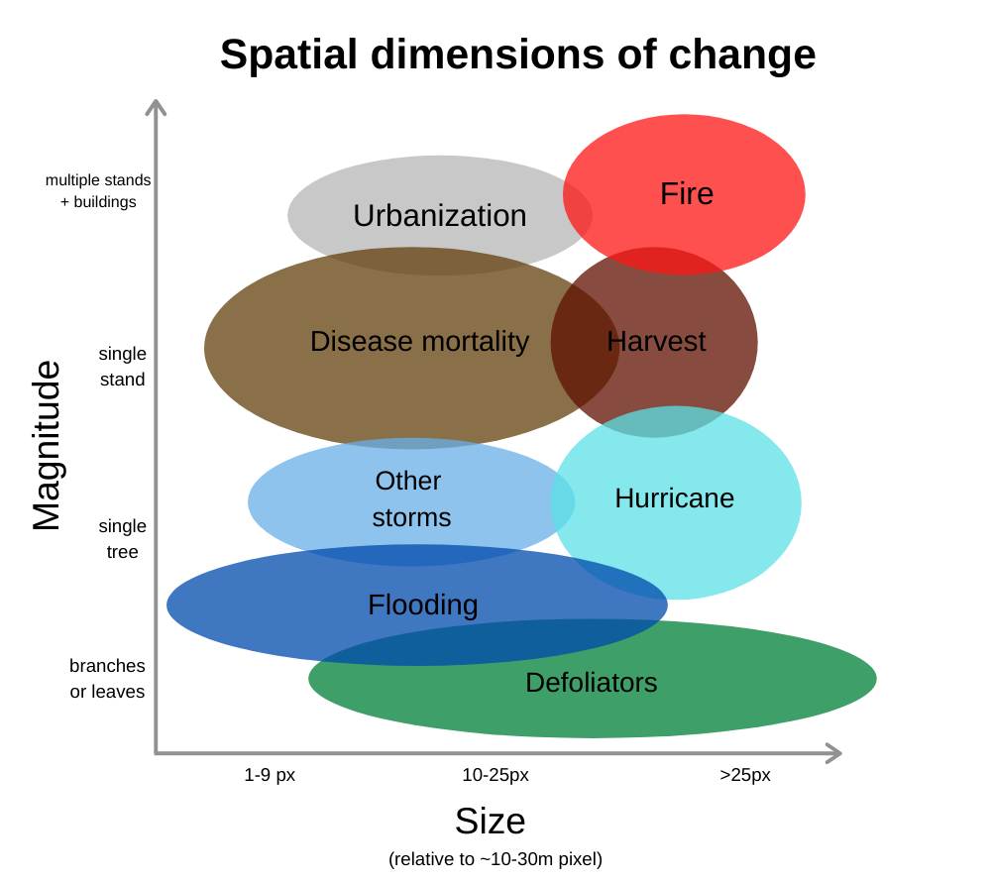
Spatial & spectral characteristics
  What does change look like from an Earth observation perspective?
Notes:
Explain the graph but focus on the spectral magnitude of change

Slide 18
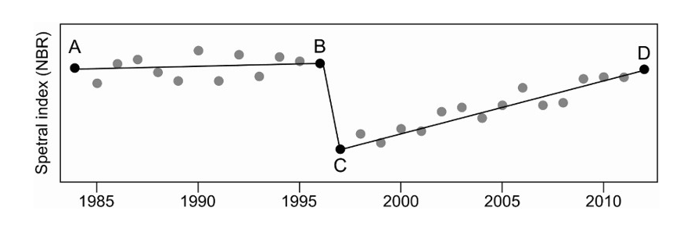
Change & ecology are complex
“Conventional single date (PI) and multi-date approaches have been missing the full picture”
Hermosilla et al 2016 https://doi.org/10.1080/17538947.2016.1187673
Notes:
Key point here to discuss is that methods have been evolving. Use this figure and the points to discuss two date vs. trend vs segmentation.

Slide 19
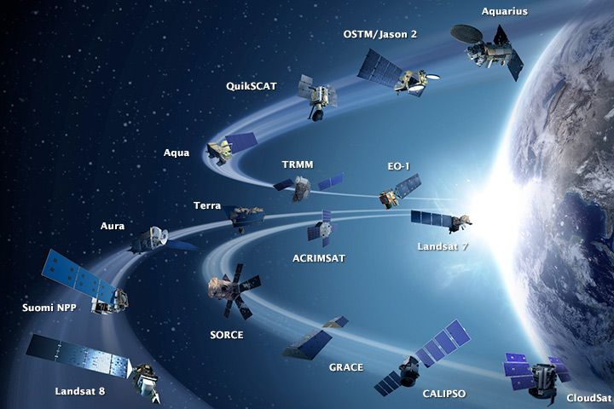
Modern methods
Methods evolve to leverage more data
  In the past, computing power and data storage were largely limiting factors but no more…
earthobservatory.nasa.gov
Notes:
Discuss limitations and advantages of different approaches

Slide 20
Satellite time series
Modern methods can capture the bigger and more complex ecological picture thanks to:
  Data availability
    Landsat (30+ years)
    MODIS (18+ years)
  Computing power and cloud-based platforms like Google Earth Engine

Slide 21
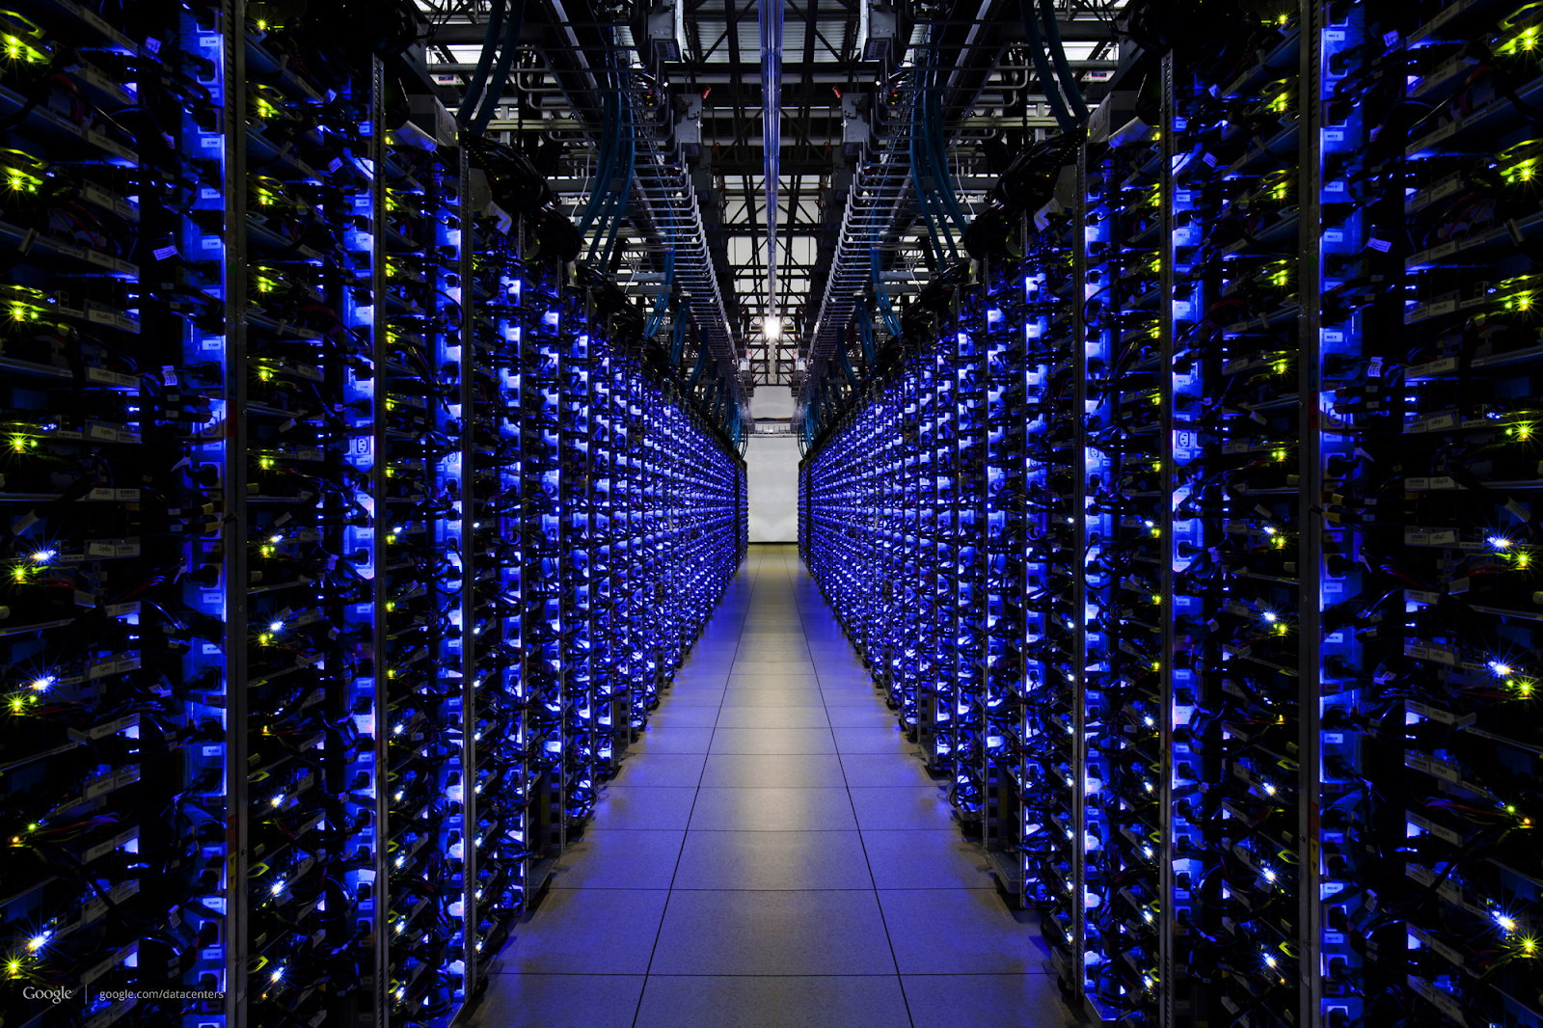
Earth Engine
Massive computation
Scientific algorithms
Customized for geospatial data
APIs for developers
Slide and photo credit: Google Earth Engine

Slide 22
What is EE?
“Cloud-based platform for planetary-scale environmental data analysis.”
Data, computing power, API’s and a code editor
What that means:
    Access to analytical tools and the flexibility to create your own
    Advanced change detection methods available as algorithms in EE
Keep only one of these: this or the next

Slide 23
What is Earth Engine?
  Google's platform for scientific analysis of large-scale Earth observation data
  Two major components:
    A collection of scientific data
    The computational power to work with data at large scales
  API provides an interface through which you express operations for Earth Engine to perform
Slide adapted from Google Earth Engine

Slide 24



Earth Engine Components
Data
An exhaustive catalog of remote sensing datasets, including multispectral, radar, aerial, climate, land cover, and vector.
Computation
Co-located data storage and computation
API & Code Editor
Rich JavaScript API, and support for Python, hosted on GitHub.
No software to download or keep up to date. All you need is a modest internet connection.
Slide adapted from Google Earth Engine with icons from Flaticon.com

Slide 25





How does Earth Engine work?
Client
Server
Request
filter
add
distance
{ }
JS
join
Response
reduce
mosaic
addBands
select
simpleCloudScore
convolve
Slide adapted from Google Earth Engine with icons from Flaticon.com
Notes:
You write code on the client which in this case is the Earth Engine code editor. This code gets translated to JSON and sent as a request for processing on the server. Google Earth Engine distributes the processing across several servers and sends the response back to the client as a JSON object.

Slide 26
How does Earth Engine work?
  The Earth Engine API allows us to write scripts defining our analysis on the client (the browser) and run our analysis on the server and Google has awesome servers!
Request
filter
add
distance
{ }
JS
join
Response
reduce
mosaic
addBands
select
simpleCloudScore
convolve
Slide adapted from Google Earth Engine with icons from Flaticon.com
Notes:
Make the point that processing on the Google servers is distributed and processed in parallel and ‘as needed’ or lazy. This means that some of the behavior is quite different from a normal GIS.
“How does it work? The code you write in the Code Editor gets turned into an object representing the set of instructions which is then sent to Google for processing. The analysis you requested is then run in parallel on many computers. What you get back in your browser is only what you request, for example a statistic or chart printed to the console or small RGB tiles to display on the Map. This is low bandwidth, but it's as if you have access to a supercomputer for geospatial analysis.”

Slide 27
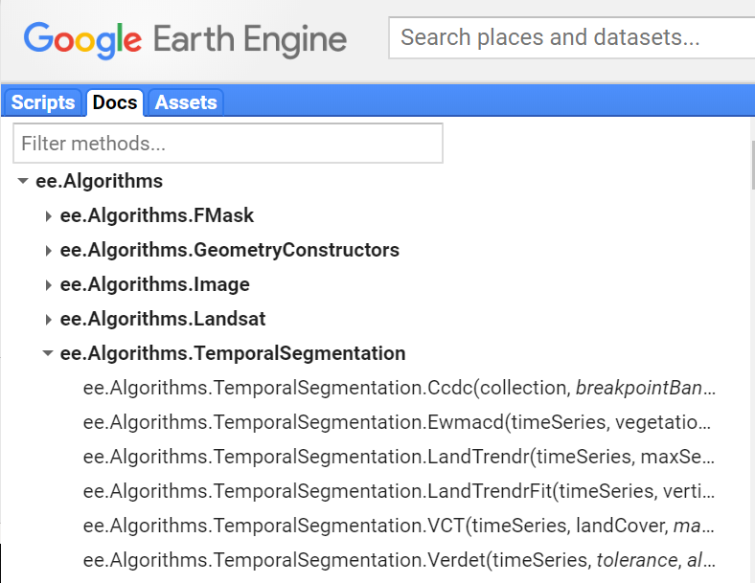
Earth Engine API & Code Editor
  Environment for developing and managing code
    Git enabled repositories for version control & sharing
  JavaScript methods for remote sensing data

Slide 28
Earth Engine is not your typical GIS
Key points
  Cloud-based
  ‘Lazy’ or deferred execution
  Image resolution (scale) and map projections are handled differently in EE
Notes:
You don’t need to know the details but you need to know that EE is different and having the basic understanding of the relationship between the client and the server is helpful
Deferred execution – means that your code is translated into JSON objects representing instructions to get a particular output. The EE client library sends these to the server (Google) and handles/waits for the response. No processing is done on the server until that result is explicitly requested

Slide 29
Client vs. Server Objects
    ‘Normal’ JavaScript objects and primitives AND server objects that you manipulate via client-side ‘proxy’ objects.
    “Proxy” or server objects start with ee. and any methods on that are server functions.
ee.Image("LANDSAT/LC8_L1T_TOA/LC80450322014244LGN00");
    Loops, conditionals don’t work on server objects
    More info: https://developers.google.com/earth-engine/client_server
Notes:
If you are familiar with writing JavaScript for web development or building server-side applications with Node, you will want to be aware that things are a bit different in GEE.
Client vs server –
Deferred execution – means that operations are translated into a JSON objects representing instructions to get a particular output. The client library sends these to the server (Google) and handles/waits for the response.

Slide 30
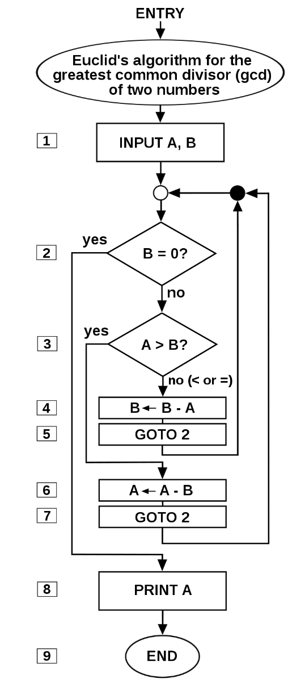
Earth Engine algorithms
What is an algorithm?
    Like a recipe most of the time…
    Input + parameters → output
Relevant examples in EE
    Radiometric calibration
    Cloud masking
    Compositing
    Temporal segmentation
      i.e., time series change analysis
https://en.wikipedia.org/wiki/Algorithm

Slide 31
Algorithms & methods today
Image processing & preparation
  Landsat algorithms
Time series analysis methods
  Linear trend analysis
  LandTrendr
All in Earth Engine!
Notes:
All of these are multi date methods using lots of image data (timeseries) and require a lot of processing power

Slide 32

Preparation & Image Processing
    Cloud masking, compositing
Slide and photo credit: Google Earth Engine

Slide 33




Image Processing Parameters
Seasonal dates | Radiometric correct | Cloud masking | Compositing
    There is often a tradeoff with seasonal date selection. The more tightly you define your season, the less ‘noise’ you will have from phenology; however, you will likely get fewer cloud free observations!

Slide 34
Course Example – Dixie National Forest
Was there a relationship between burn severity and spruce beetle kill patterns in Utah’s Dixie NF?
  Spruce beetle outbreak began in the 1990’s
  Fire occurred in 2017
  Though we can’t answer that question exactly, we can do a change detection analysis to provide insight.
Notes:
https://archive.sltrib.com/article.php?id=5419056&itype=CMSID

Slide 35
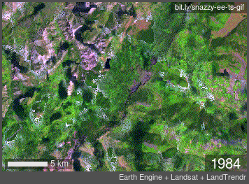
Dixie National Forest change
Notes:
Slow decline due to spruce beetle and drought and then a stand replacing wildfire

Slide 36
Exercises for today
Exercise 1: Process and explore Landsat time series
  Optional – review image processing in GEE
Exercise 2: Basic trend analysis
Exercise 3: LandTrendr in GEE: Model fitting
Exercise 4: LandTrendr in GEE: Disturbance mapping

Slide 37
Demo and exercise steps
Set up GEE environment
Prepare an image time series
Filter images to a desired location
Mask (remove) clouds and shadows
Inspect values in the time-series
Load LT-GEE module with more processing and analysis methods

Slide 38
Demo
Break for the demo, provide link to the exercises and meeting time to reconvene
  PUT THE LINKS TO THE EXERCISES IN HERE AND TIMES, ETC.

Slide 39
Demo outline
  Background
      Look at MTBS fire perimeter, show something about spruce beetle outbreak, look at EE timelapse to make the case that the data are noisy and it’s hard to see
  In EE
      Reorient them to code editor UI
      Create repo and script –
        Show settings under gear icon and how to clone repot. Note that they can work locally if they want
      Create an image collection and filter dates
      Create a single median composite of Landsat images with clouds masked using the simple cloud score
      Add LT-GEE module and discuss modules
      Create LTS
      Run transformations to look at NBR
      Add a plot
      Create basic linear trend

Slide 40
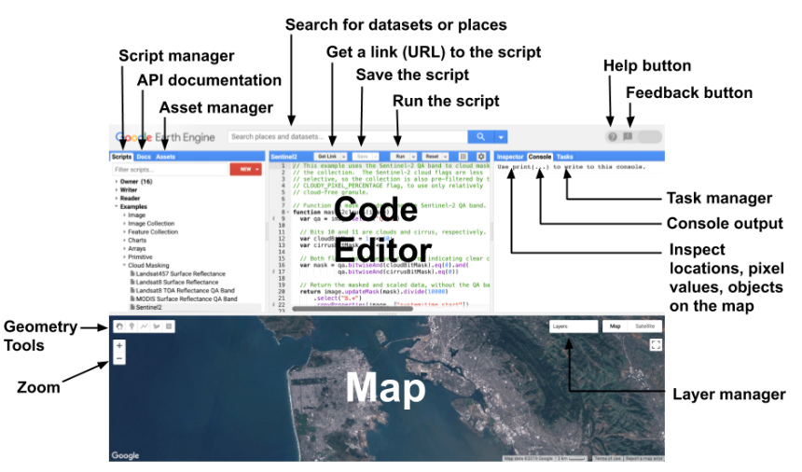
Demo – Review the EE Code Editoro
Image and more info: https://developers.google.com/earth-engine/playground

