Slide 1
Advanced Change Detection -2
Time Series Analysis

Slide 2
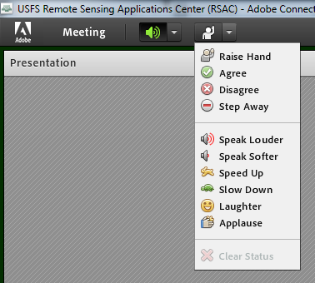
Housekeeping
Adobe Connect
  Quick orientation to interface
Please dial *6 to mute your phone
  Question or comment?
    Un-mute by dialing *6 again
    “Raise” your hand
    Send a chat

Slide 3
Course Agenda
Advanced change detection concepts & image processing in Earth Engine
      Lecture TIME, Exercise TIME
Explore advanced change detection methods & data products
      Lecture TIME, Exercise TIME
Fitting change algorithms in EE
      Lecture TIME, Exercise TIME
Mapping change in EE
      Lecture TIME, Exercise TIME
Notes:
Mention that everyone should have completed the prerequisites and ensure that everyone has an Earth Engine account: https://signup.earthengine.google.com/#!/

Slide 4
Lecture objectives
Understand the spectral trajectories associated with different kinds of landscape change
Understand that the analytical method you choose will be determined by the type of change you’re trying to quantify.
Gain exposure to varied change detection methods
Basic understanding of a linear fit change analysis in Earth Engine

Slide 5
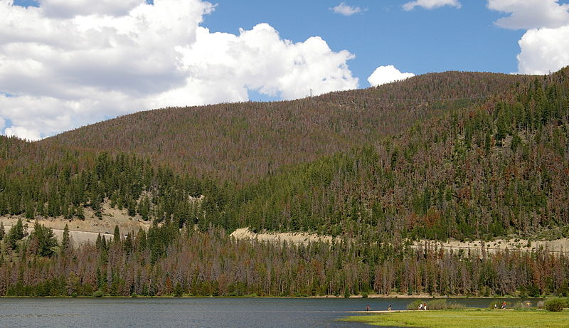
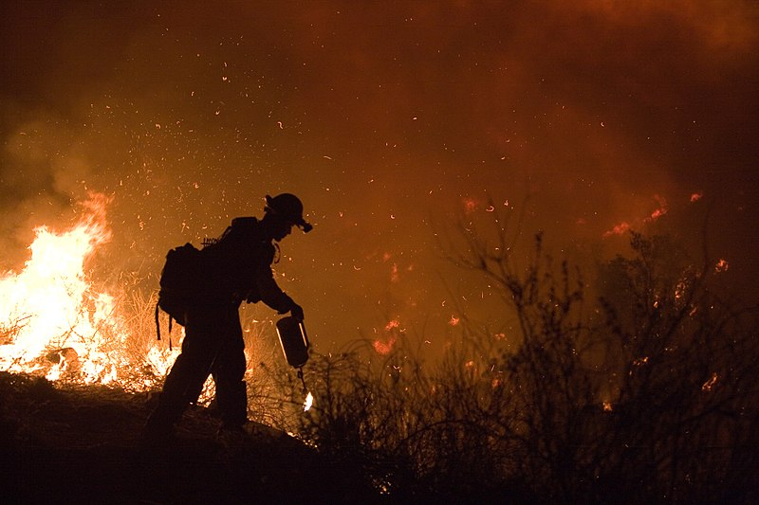
Change analysis with time series
Effective for mapping disturbance patterns
  Look at the big picture
Many different methods
  Two general approaches involved: Look for trends or deviations in the time series
Wikimedia commons
Wikimedia commons

Slide 6
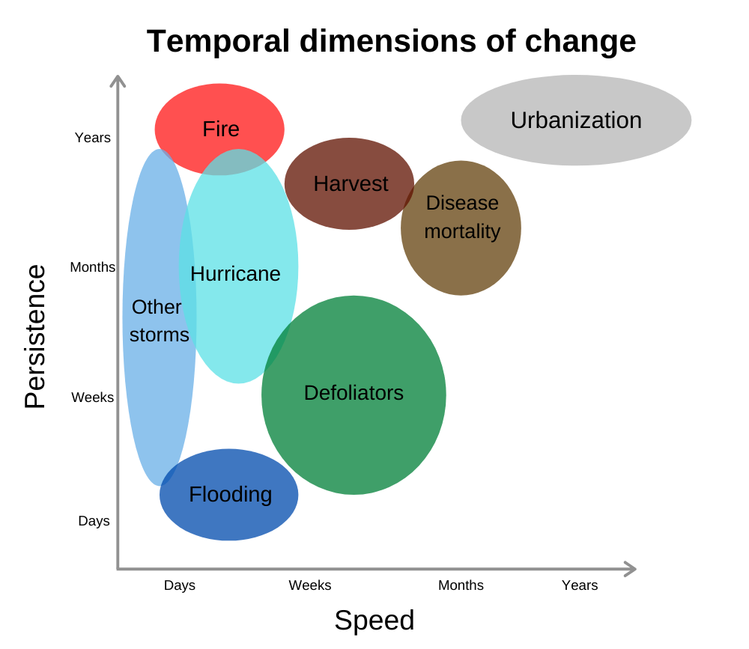
Temporal dimensions of change
  What does change look like from an Earth observation perspective?
Notes:
Remind learners of the temporal dimensions of change, and how lots of factors about the disturbance + our earth observation system will affect how changes can be detected. For example, if we have a satellite with a longer return interval, like Landsat, (particularly if we can’t use cloudy images), we might miss observing particular phenomena

Slide 7
Temporal dimensions of change
Intra-annual (within-year)
  Seasonal changes (e.g., green-up)
  Drought
Inter-annual (multiple years)
  Phenology shift (e.g., earlier green-up)
  Beetle kill
  Urbanization
  Fire
Notes:
Some dynamics can only be observed and quantified through multiple observations within a year, or a season. Other dynamics are better understood through multiple observations over multiple years.

Slide 8
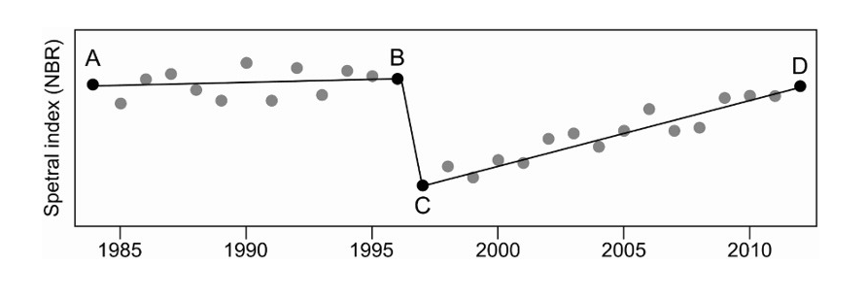
Change & ecology are complex
“Conventional single date (PI) and multi-date approaches have been missing the full picture”
Hermosilla et al 2016 https://doi.org/10.1080/17538947.2016.1187673
Notes:
Key point here to discuss is that methods have been evolving. Use this figure and the points to discuss two date vs. trend vs segmentation.

Slide 9
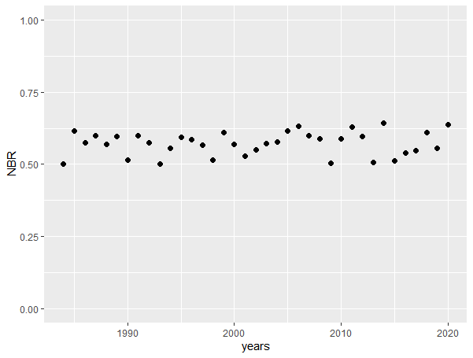
Spectral trajectories
Notes:
Show a bunch of made up spectral trajectories increasing in complexity to plant the seeds for understanding different methods.
The point of this slide is stable trajectory with random noise.

Slide 10
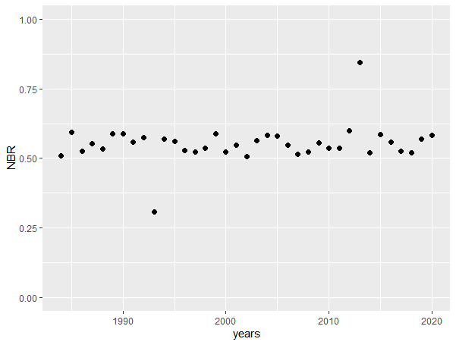
Spectral trajectories
Notes:
The point here is stable trajectory with random noise and some noisy noise from a few ‘bad’ images. This is why we mask clouds, etc.

Slide 11
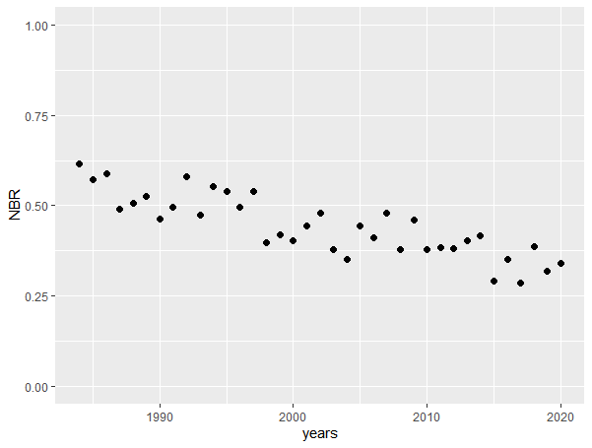
Spectral trajectories
Notes:
Point here is slow decline with expected random noise.

Slide 12
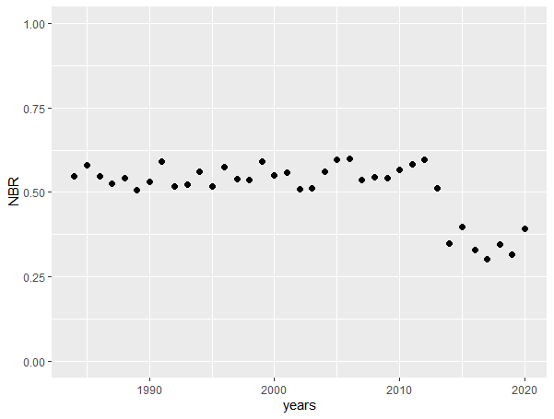
Spectral trajectories
Notes:
Abrupt change (e.g., harvest, fire, development, etc.)

Slide 13
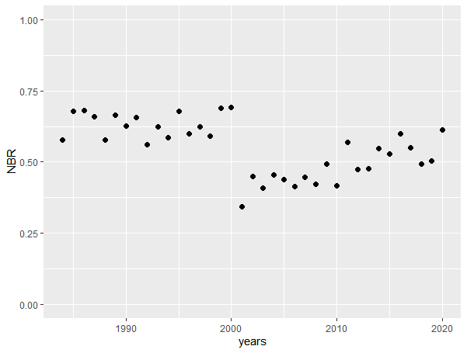
Spectral trajectories
Notes:
Abrupt change with slow, steady recovery.

Slide 14
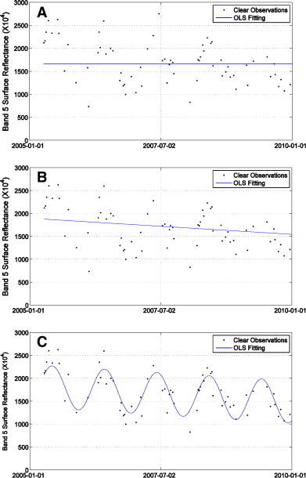
What kind of change do we want to capture?
Interannual – long term change
Intra-annual – includes seasonal dynamics
Notes:
SOMETHING TO MAKE THE LINK BETWEEN SEASONAL/INTERANNUAL VARIATION TO INTRA-ANNUAL VARIATION? THEN CIRCLING BACK TO MODEL FITTING… ALGORITHMS FUNCTION ON/CAPTURE DIFFERENT TIMESCALES.

Slide 15
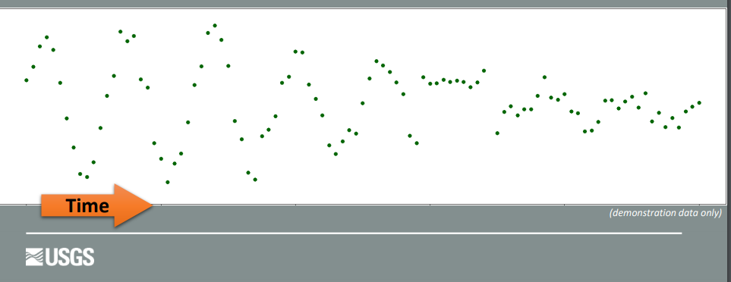
Spectral trajectories
Remake this intra-annual (all observations) style trajectory so that it matches the previous slides JUST to make the point that we are no longer limited to seasonal composites.
Remake this slide taken from here: https://prd-wret.s3-us-west-2.amazonaws.com/assets/palladium/production/s3fs-public/atoms/files/LCMAP_workshop_pres3_w_alt_text-3.pdf

Slide 16
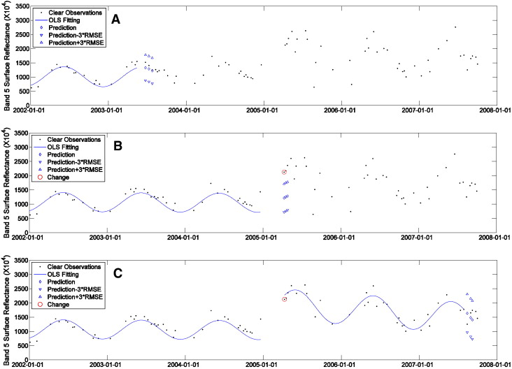
Spectral trajectories
Remake this slide taken from here: https://prd-wret.s3-us-west-2.amazonaws.com/assets/palladium/production/s3fs-public/atoms/files/LCMAP_workshop_pres3_w_alt_text-3.pdf

Slide 17
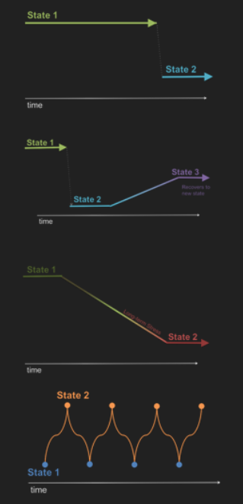
Spectral trajectories
Slide credit: Gorelick et al GEO for Good Summit 2019
Notes:
Here is another representation of different forms spectral trajectories can take.
When you begin an analysis, it’s important to know what kind of change you’re attempting to capture– so that you can select a method that’s appropriate to quantify it.

Slide 18
Separating the signal from the noise
Image selection & processing is the first step
Analysis algorithms seek to do the rest…
  Subtler change signals are harder to separate
  With more data, subtler signals can emerge

Slide 19
Examples of change:
In the following slides, what kind of change do you see?

Slide 20
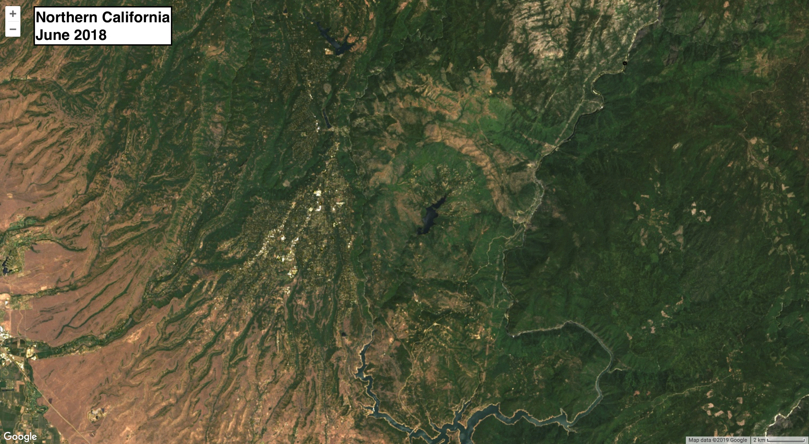
Notes:
Camp Fire, northern California. Large burned area, a rapid change with long-lasting effects.

Slide 21
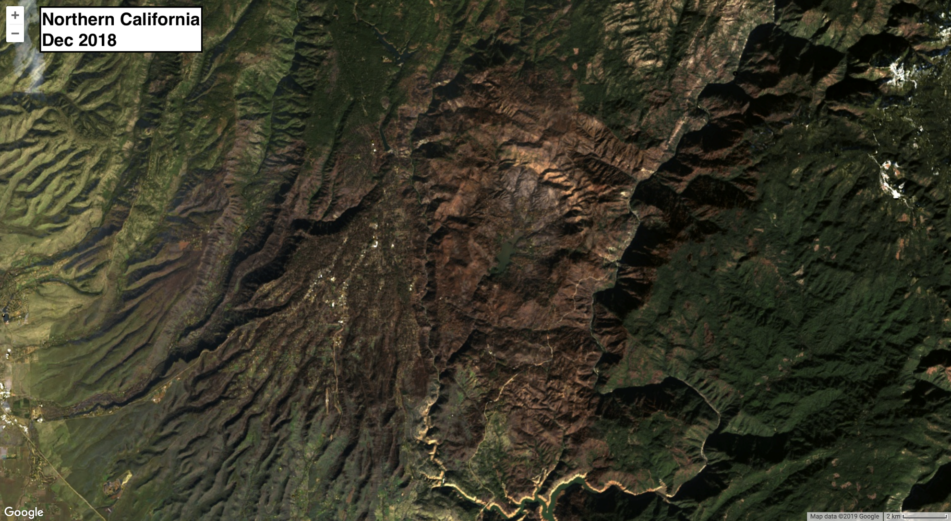
Notes:
Camp Fire, northern California. Large burned area, a rapid change with long-lasting effects.

Slide 22
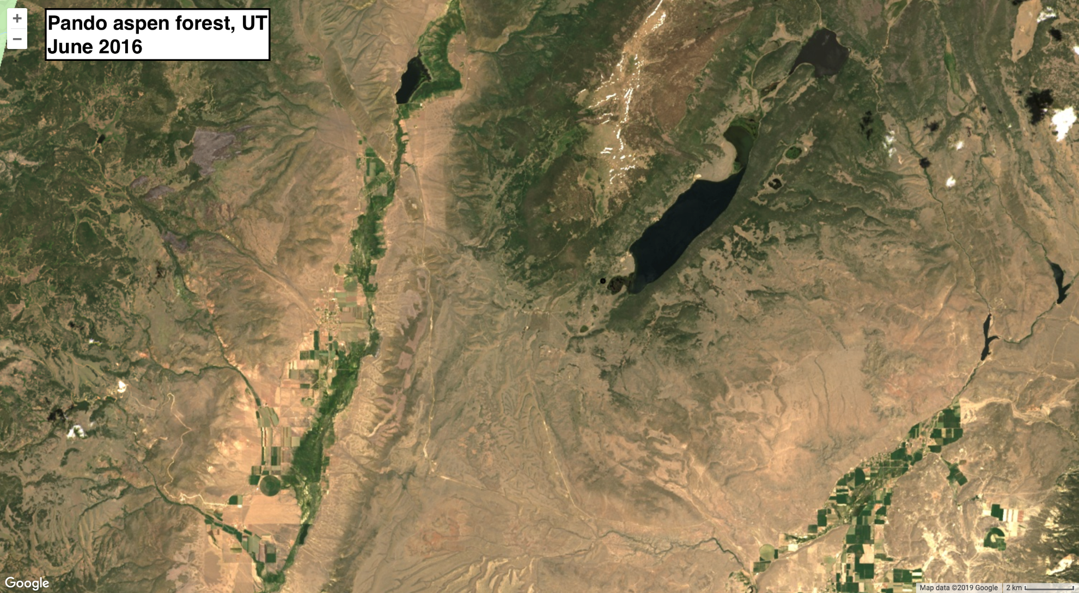
Notes:
Pando aspen forest. Seasonal changes in foliage color that recur every year. Different years were selected here for image quality / emphasis.

Slide 23
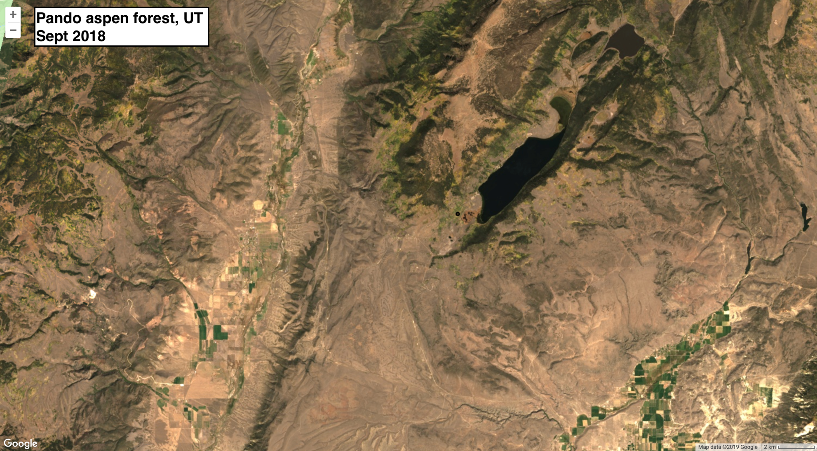
Notes:
Pando aspen forest. Seasonal changes in foliage color that recur every year. This is an example of a seasonal cycle of change. Different years were selected here for image quality / emphasis.

Slide 24
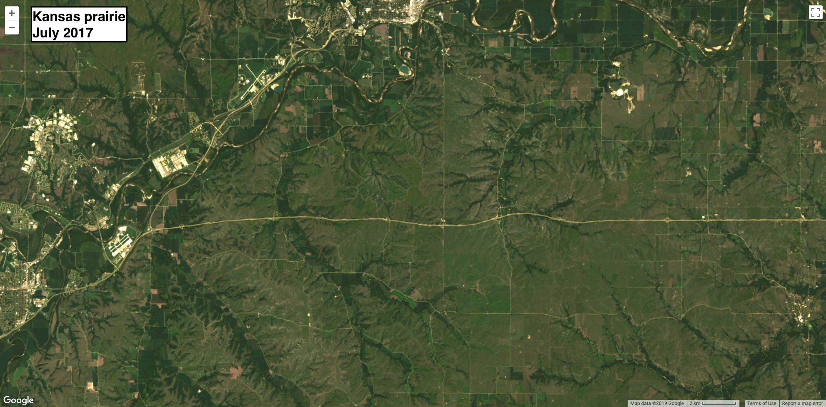
Notes:
Kansas prairie. Two images taken roughly the same time of year, showing drought effects in 2018. This is an example of a single-year deviation that represents a change to the normal seasonal cycle, and should be more or less back to “normal” the following year (barring cascading effects)

Slide 25
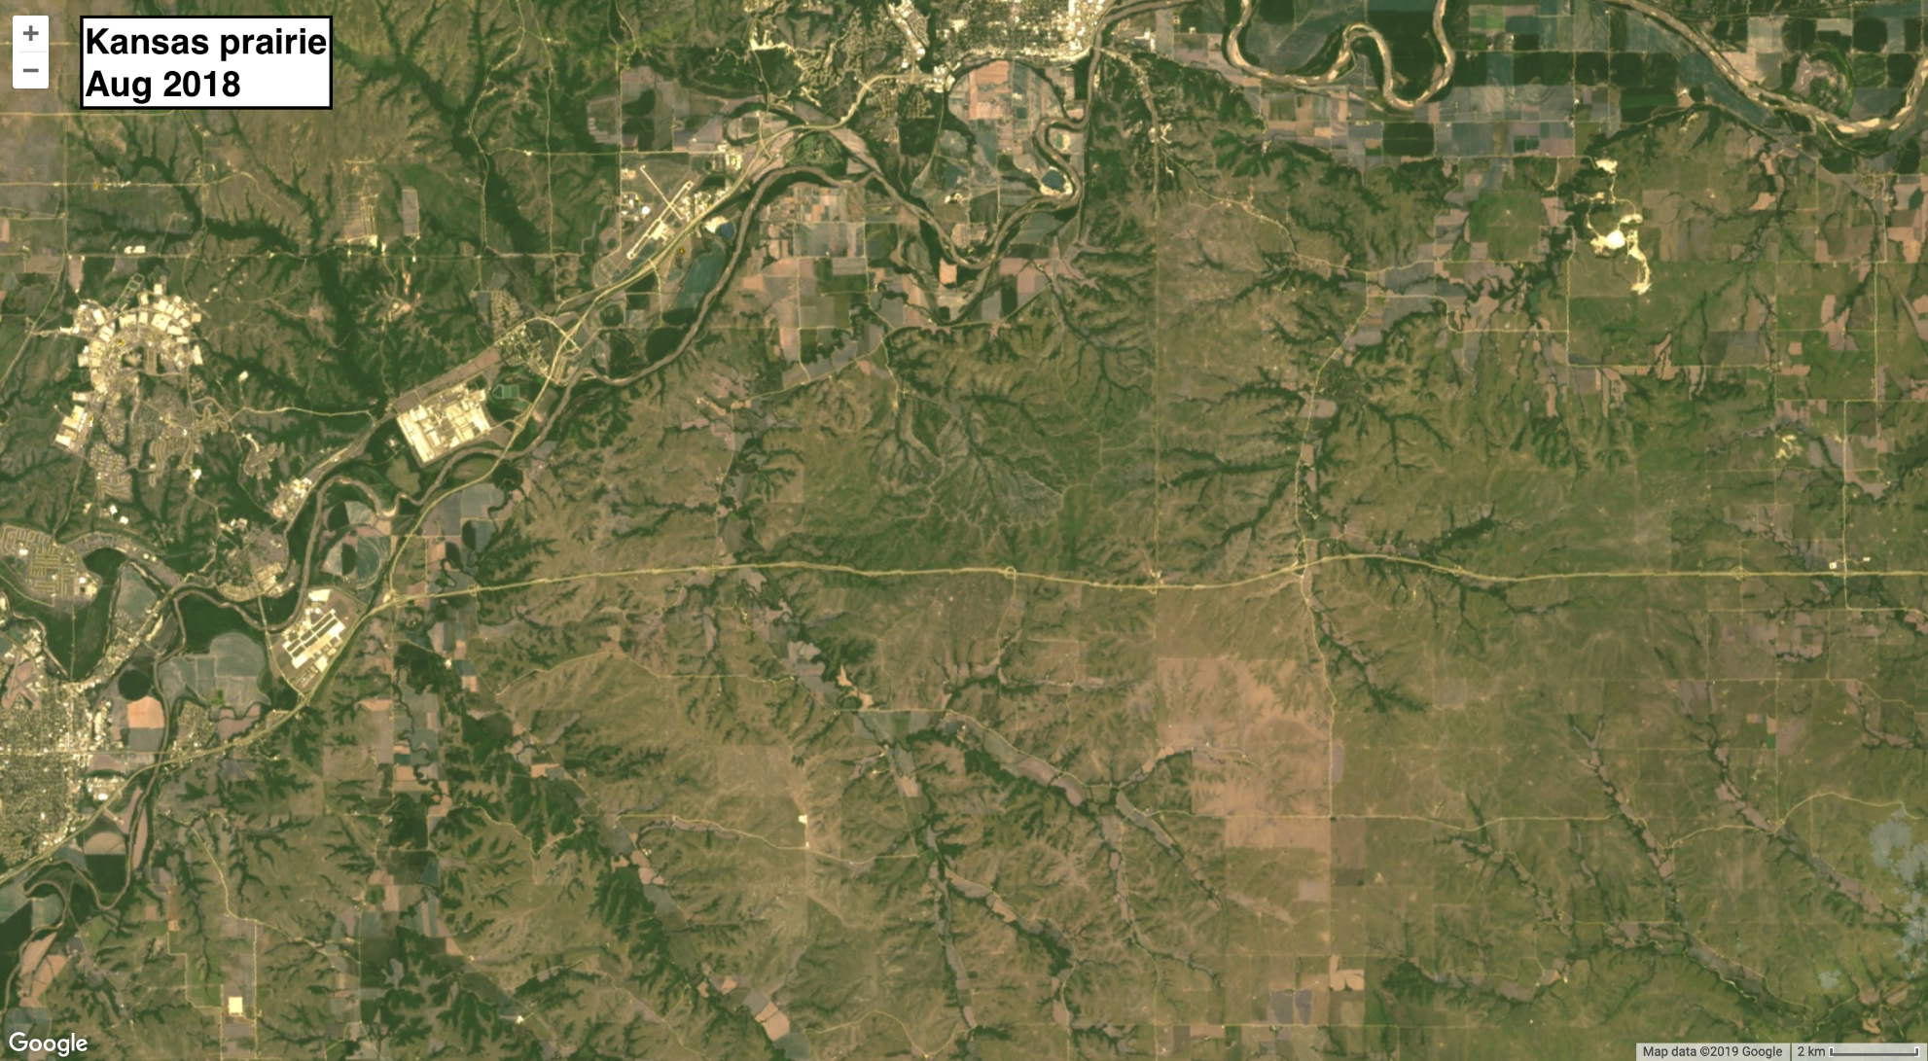
Notes:
Kansas prairie. Two images taken roughly the same time of year, showing drought effects in 2018. This is an example of a single-year deviation that represents a change to the normal seasonal cycle, and should be more or less back to “normal” the following year (barring cascading effects)

Slide 26
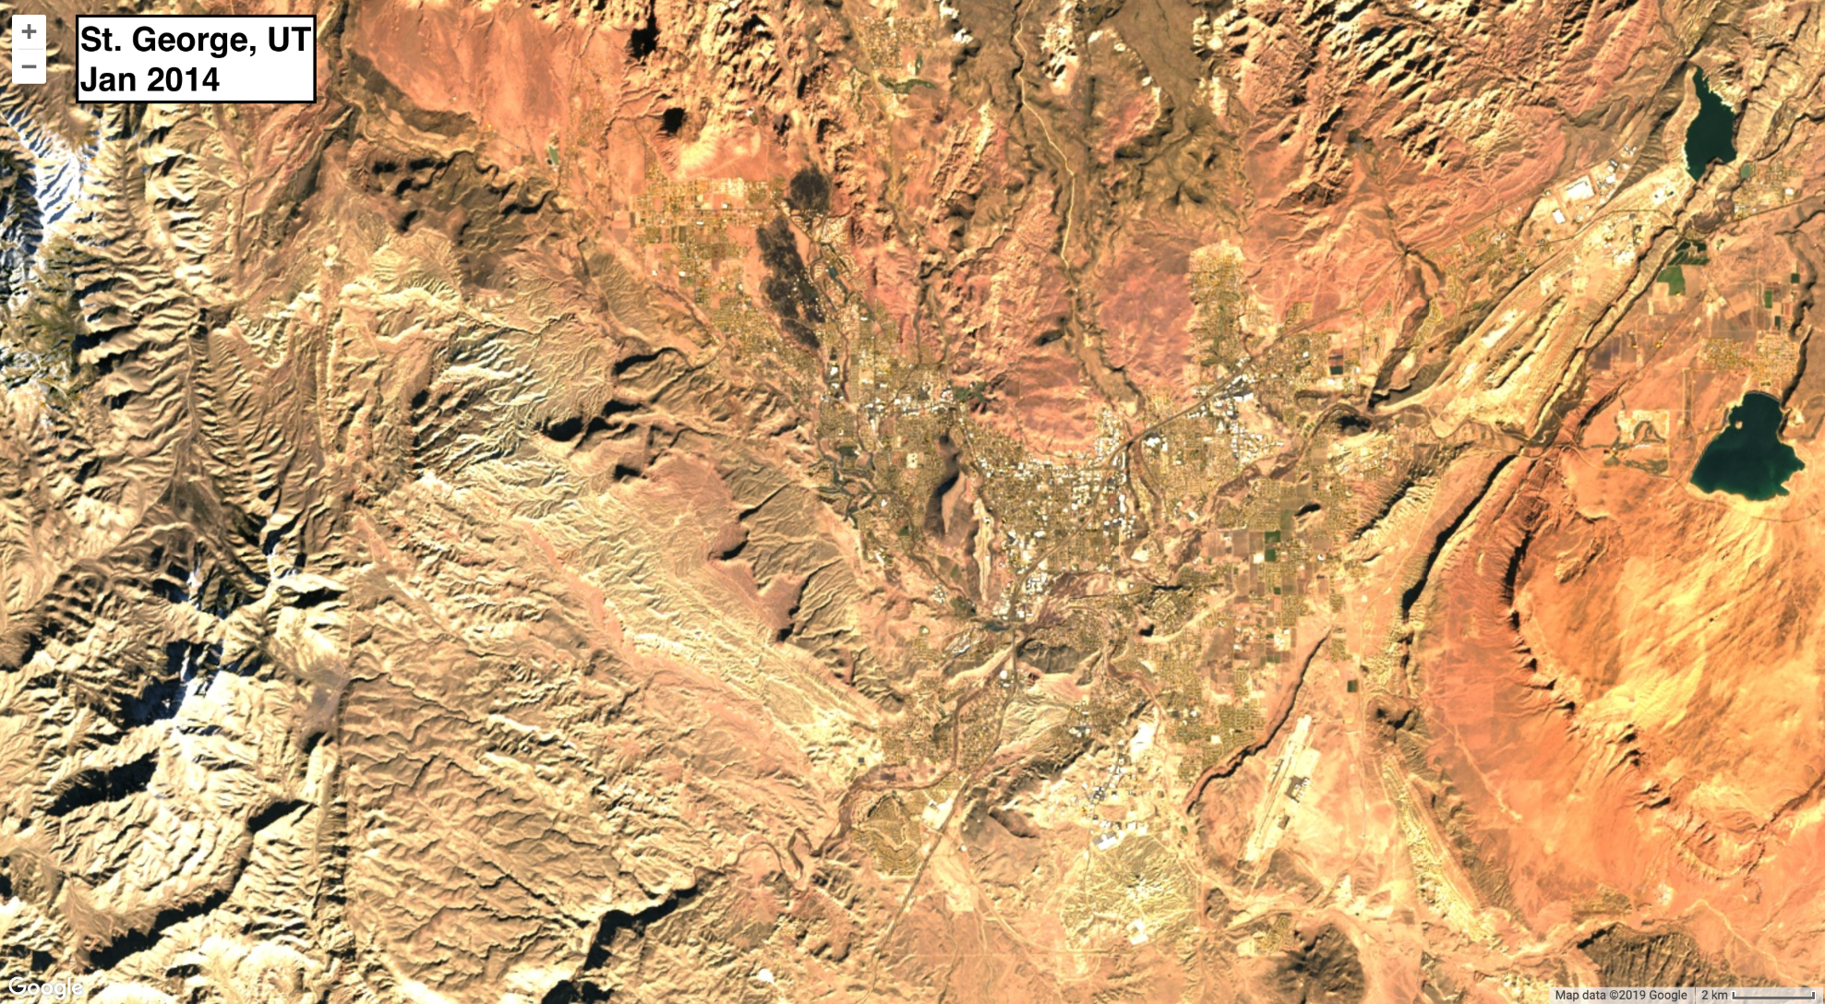
Notes:
Urbanization around St George, UT. A long-term process with long-lasting effects.

Slide 27
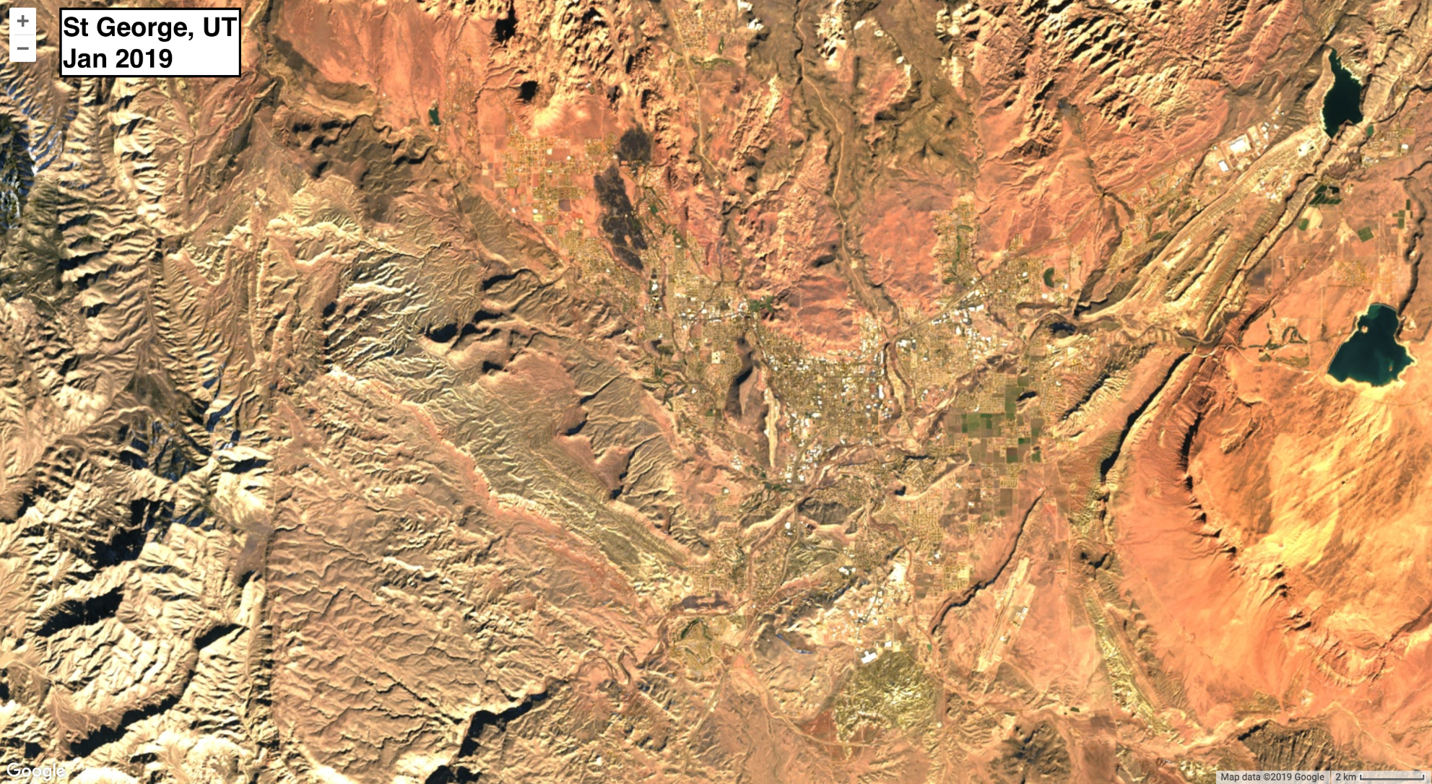
Notes:
Urbanization around St George, UT. A long-term process with long-lasting effects.

Slide 28
Examples of change:
- All of these changes are represented here as the difference between two dates– but would look very different when represented as time series!

Slide 29
Time series methods
There are many new algorithms for analyzing Landsat time series:
  “…sophisticated workflows that consist of a logical sequence of processes and rules, multiple statistical functions, and parameter sets that must be calibrated to accurately classify disturbance.”
    -Cohen et al 2018
Advantages and disadvantages to different methods

Slide 30
Time series methods
Algorithm | Time Series | Targeted Disturbance | Basic Approach | Environment
LandTrendr | Annual | Forests only. Events and trends. | Temporal segmentation | EE
CCDC | All images | All cover types. Events. | Multi-year departures | EE
EEWMACD | All images | Forests only. Events. | Multi-year departures | EE
VCT | Annual | Forests only. Events. | Multi-year departures | EE
VeRDET | Annual | Forests only. Events and trends. | Spatial and temporal segmentation. | EE
ITRA | Annual | Woody vegetation. Gradual trends. | Slope through time | Not in EE
MIICA | Annual | All cover types. Events. | Bi-temporal differencing | Not in EE
Table adapted from: Cohen et al 2017
Notes:
All of these are pixel-based time series methods:
LandTrendr (Landsat-based detection of trends in disturbance and recovery)
ITRA (Image trends from regression analysis)
VCT (Vegetation change tracker)
EWMACD (Exponentially weighted moving average change detection)
MIICA (Multi-index integrated change analysis)
CCDC (Continuous change detection and classification)
VeRDET (Vegetation regeneration and disturbance estimates through time)
Though several of these algorithms are implemented in Earth Engine, LandTrendr is the best documented and most stable with CCDC quickly becoming more established.

Slide 31
CCDC
Continuous Change Detection and Classification
    Pixel-based analysis of ALL Landsat data
    Fits models using sines and cosines
    Identifies breaks (change)
    Classifies landcover
  Inputs
    All available clear Landsat observations
Learn more about the algorithm from LCMAP or Zhu et al 2014

Slide 32
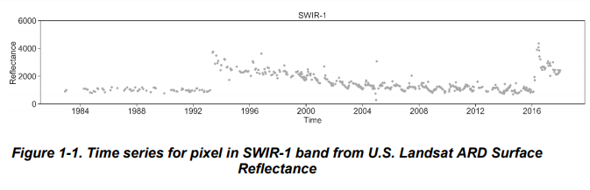
CCDC
LCMP CCD Algorithm Description Document 2020

Slide 33
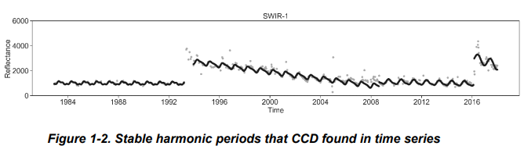
CCDC
LCMP CCD Algorithm Description Document 2020

Slide 34
Simple time series change detection in EE
Calculate linear regression
  “computes the least squares estimate of one variable with a constant term”
Inputs:
  Time series of images
  Images have two bands: variable of interest, and time
    E.g., change in NBR over time
Outputs:
  Image with 2 bands representing slope and intercept

Slide 35
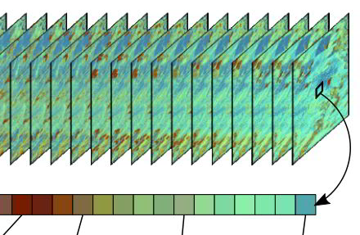
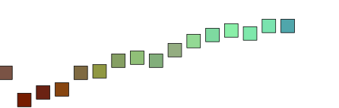
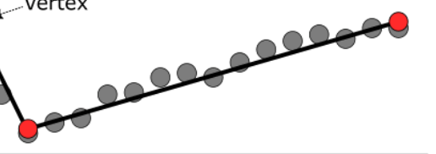
Simple time series change detection in EE
spectral index
time
spectral index
time
Adapted from the LT-GEE Guide
Notes:
We are fitting a linear regression to a time series of images, in order to assess a simple version of change over time.
Specifically, we’re fitting a separate regression model to each pixel in the time series.
The quantitative outputs of this model are, for each pixel, the slope and the intercept.

Slide 36
Simple time series change detection in EE
spectral index
time
- slope
- intercept
spectral index
time
Adapted from the LT-GEE Guide
Notes:
We are fitting a linear regression to a time series of images, in order to assess a simple version of change in one variable over time.
Specifically, we’re fitting a separate regression model to each pixel in the time series.
The quantitative outputs of this model are, for each pixel, the slope and the intercept.

Slide 37
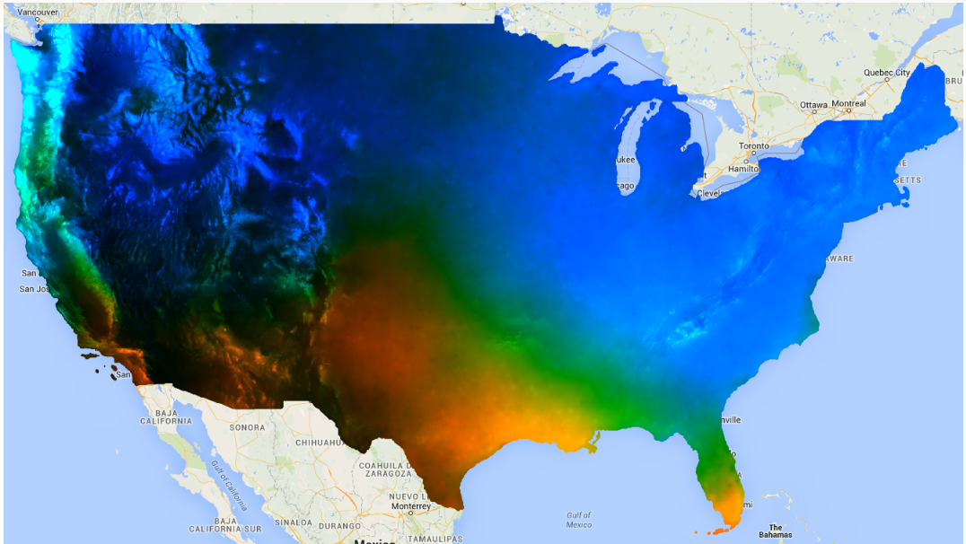
Simple time series change detection in EE
Example: linearFit() method applied to projected precipitation, 2000-2050.
  blue = more precip , red = less precip
Value of the slope is used for visualization parameters
Playing with
via GEE documentation for Linear Regression

Slide 38
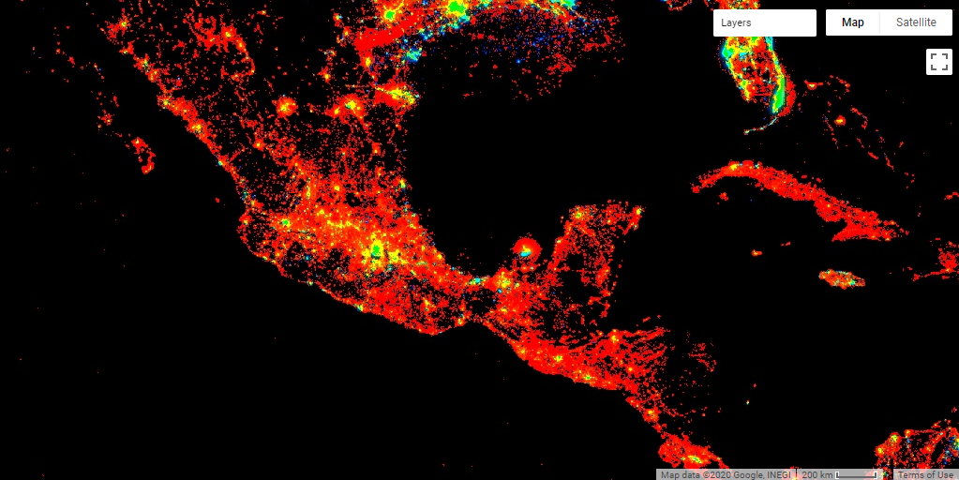
Simple time series change detection in EE
Trends in city lights in Mexico City 1992-2014
green = increase, red = no change, blue = decrease
Adapted from code by Jamon Van Den Hoek
Notes:
Let’s also add the code to this example.

Slide 39
Landsat-based detection of trends in disturbance and recovery (LandTrendr)
Pixel-based temporal segmentation of annual time series
Inputs
  Annual time series (doesn’t look at change within a year)
  Set of parameters
Outputs
  Annual info about change segments, fitted values
  Can be used to identify timing, duration, and speed of landscape change
  Can be processed into pixel-based time series, maps of disturbance
Link to original paper: Kennedy et al 2010
Notes:
Option to introduce LandTrendr here… but might distract from description of simple time series analysis.

Slide 40
Exercises for today
Exercise 1: Process and explore Landsat time series
  Optional – review image processing in GEE
Exercise 2: Basic trend analysis
Exercise 3: LandTrendr in GEE: Model fitting
Exercise 4: LandTrendr in GEE: Disturbance mapping
Notes:
I have repeated this slide in each to remind students of where we are and where we are going.

Slide 41
Demo and exercise steps
Open script from exercise 1
Transform a time series to create vegetation indices
Plot a time series as a chart
Use a native EE function to perform a linear trend analysis

Slide 42
Demo
Break for the demo, provide link to the exercises and meeting time to reconvene
  PUT THE LINKS TO THE EXERCISES IN HERE AND TIMES, ETC.

Slide 43
Demo
In another, non Dixie NF area:
  Pixel
    Start with known point and run with default parameters
    Adjust seasonal windows to get good start/stop
    Show despiking

Slide 44
Additional Resources
LandTrendr
  https://www.youtube.com/watch?v=H4sV7D0jX6I

