Slide 1
Advanced Change Detection -3
LandTrendr and Model Fitting

Slide 2
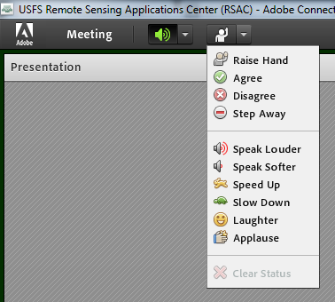
Housekeeping
Adobe Connect
  Quick orientation to interface
Please dial *6 to mute your phone
  Question or comment?
    Un-mute by dialing *6 again
    “Raise” your hand
    Send a chat

Slide 3
Course Agenda
Advanced change detection concepts & image processing in Earth Engine
      Lecture TIME, Exercise TIME
Explore advanced change detection methods & data products
      Lecture TIME, Exercise TIME
Fitting change algorithms in EE
      Lecture TIME, Exercise TIME
Mapping change in EE
      Lecture TIME, Exercise TIME
Notes:
Mention that everyone should have completed the prerequisites and ensure that everyone has an Earth Engine account: https://signup.earthengine.google.com/#!/

Slide 4
Lecture objectives
Gain understanding of LandTrendr
  Inputs
  Outputs
  Algorithm
  Parameters
Understand considerations for parameter fitting

Slide 5
Landsat-based detection of trends in disturbance and recovery (LandTrendr)
Pixel-based temporal segmentation of annual time series
Inputs
  Annual time series (doesn’t look at change within a year)
  Set of parameters
Outputs
  Produces many complex outputs! Main derivates include:
  Year of detected change
  Magnitude of detected change
  Duration of detected change
Link to original paper: Kennedy et al 2010

Slide 6
Landsat-based detection of trends in disturbance and recovery (LandTrendr)
Pixel-based temporal segmentation of annual time series
Inputs
  Annual time series (doesn’t look at change within a year)
  Set of parameters
Outputs
  Produces many complex outputs! Full outputs include:
    Annual info about change segments, fitted values
    Timing, duration, and speed of landscape change
    Can be processed into pixel-based time series, maps of disturbance
Link to original paper: Kennedy et al 2010

Slide 7
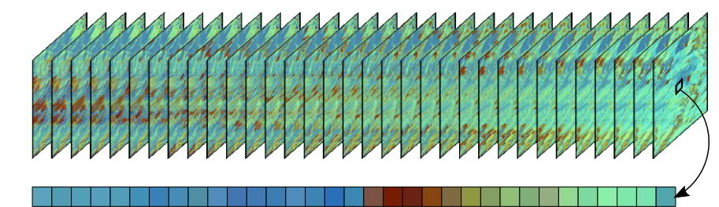
Landsat-based detection of trends in disturbance and recovery (LandTrendr)
Graphic: https://emapr.github.io/LT-GEE/landtrendr.html

Slide 8
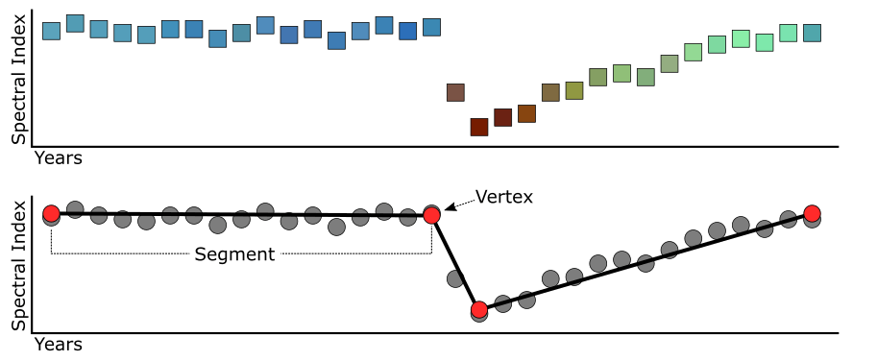
Landsat-based detection of trends in disturbance and recovery (LandTrendr)
Graphic: https://emapr.github.io/LT-GEE/landtrendr.html

Slide 9
LandTrendr Algorithm
Steps:
  Fit multiple linear models to get one model representing the full trajectory
  Iteratively simplify that model
  Compare to find the ‘best’ model based on statistics
  Remove change that is likely noise

Slide 10
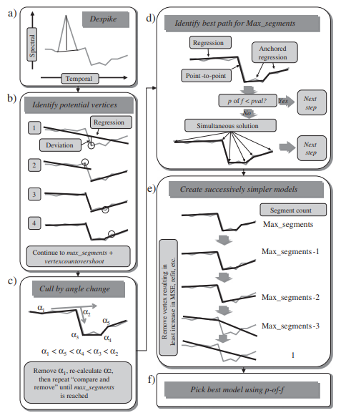
LandTrendr Algorithm
a) remove spikes
b) identify potential vertices
c) ignore low-angle changes
d) choose best path to connect vertices
e) create simplified models
f) pick best model
Figure from Kennedy et al 2010 https://doi.org/10.1016/j.rse.2010.07.008
Notes:
Emphasize that understanding the nitty gritty here isn’t critical– but basically, we’re finding the best way to connect the important changes in the time series. The parameters we choose and set later will help us decide what to include, and what to ignore, as we’re identifying spikes and changes.

Slide 11
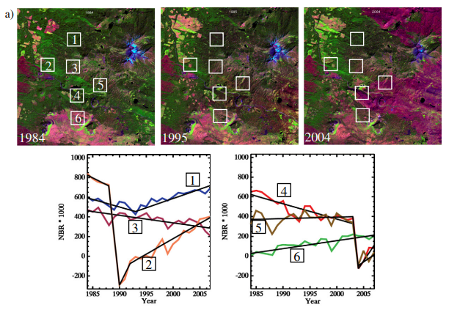
LandTrendr Results
Insects
Harvest
Insects
Insects→Fire
Stability→Fire
Fire recovery
Note – High NBR is healthy veg, low NBR is often ground or burn
Figure from Kennedy et al 2010 https://doi.org/10.1016/j.rse.2010.07.008

Slide 12
LandTrendr in Earth Engine
Tools & resources
  Stable, published implementation of the algorithm in EE
    Kennedy et al 2018
  Well-documented public code repository including a module of helper functions, example scripts and more
    https://emapr.github.io/LT-GEE/
  User interface (UI) tools for exploratory analysis with LT-GEE
Notes:
In this course, we will focus on using the LT-GEE algorithm in EE

Slide 13
LandTrendr in GEE
Inputs
  Processed Landsat time series
  Set of analysis parameters
Outputs
  Annual info about change segments, fitted values
  Can be used to identify timing, duration, and speed of landscape change
  Can be processed into pixel-based time series, maps of disturbance

Slide 14


LT-GEE parameters
Annual LTS
  Radiometrically corrected, clouds/shadow masked seasonal composites
  Composite parameters
Analysis parameters
  Related to fitting and noise reduction

Slide 15
Getting the fit right with LT-GEE
Fit & evaluate points in known areas
    Use expert knowledge
    Adjust seasonal dates, spectral indices and algorithm parameters
Find good values for key fitting parameters:
    Maximum number of segments
    Spike threshold
    Recovery threshold
Run in map-mode in a few areas and look for problems
Notes:
Summary the fitting guide from GEO4Good
https://docs.google.com/document/d/1yP9CElecWCG6EGPHkEAXq5lImEJ528FOphHH3gqXSHc/edit

Slide 16
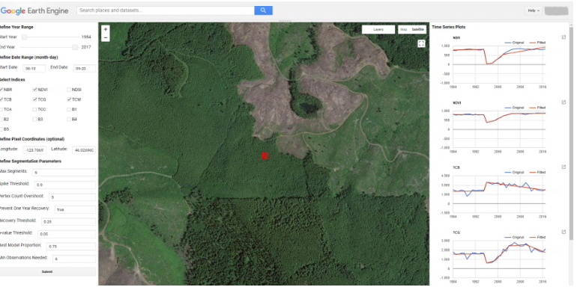
LT-GEE User Interface tools
  UI LandTrendr Pixel Time Series Plotter
Notes:
Use these tools to find and test parameters – look at observed vs. fitted time series for individual pixels.

Slide 17
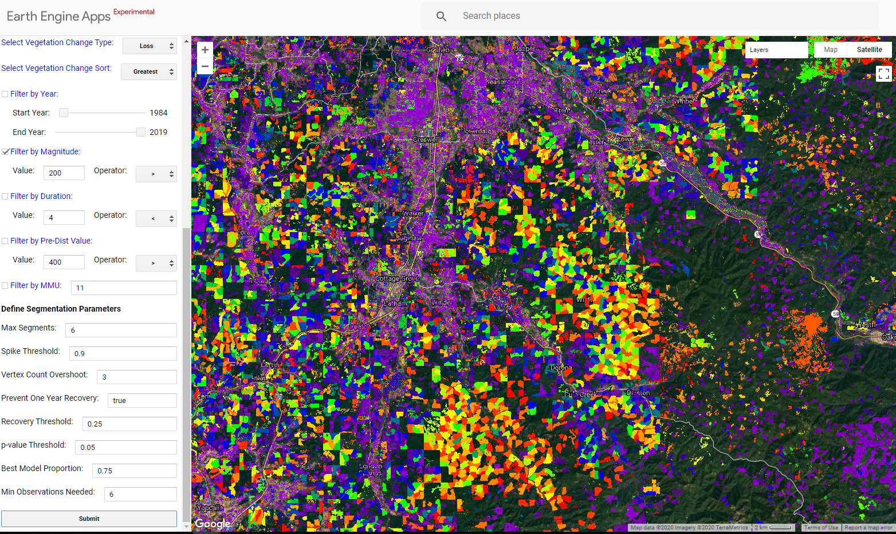
LT-GEE User Interface tools
  UI LandTrendr Change Mapper
Notes:
Use these tools to find and test parameters– look at a landscape map of change.

Slide 18
Demo and exercise objectives
Use LT-GEE UI tools to find suitable segmentation and change mapping parameters.
    Explore changes on the Dixie NF
      Use the point-based UI tool first
      Then use the change mapper
      Try different parameters…
Notes:
At the end, you should have a set of parameters for the next exercise

Slide 19
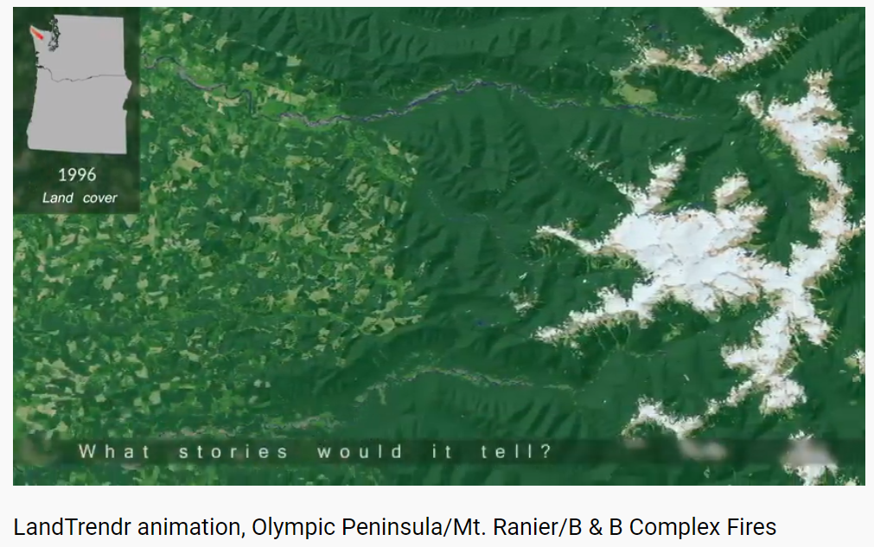
Additional LandTrendr examples
LandTrendr
  https://www.youtube.com/watch?v=H4sV7D0jX6I
  https://www.youtube.com/watch?v=3on-WliMkv8
Notes:
These example videos are provided just for fun! And help explore some additional applications and contexts for the LandTrendr algorithm.

Slide 20
Exercises for today
Exercise 1: Process and explore Landsat time series
  Optional – review image processing in GEE
Exercise 2: Basic trend analysis
Exercise 3: LandTrendr in GEE: Model fitting
Exercise 4: LandTrendr in GEE: Disturbance mapping
Notes:
I moved this up here so that we can give them an outline or syllabus of sorts. We can go over this very quickly without much detail and elaborate later.

Slide 21
Demo and exercise steps
Access LT-GEE point fitting app
Use it to get parameters
Access LT-GEE mapping app
Use it to check parameters and visualize change to make sure that model fit is working

