Slide 1
Advanced Change Detection -4
LandTrendr, Change Mapping, and Scripting

Slide 2
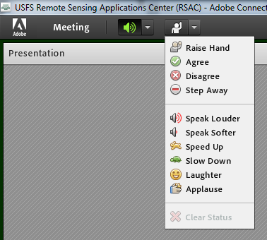
Housekeeping
Adobe Connect
  Quick orientation to interface
Please dial *6 to mute your phone
  Question or comment?
    Un-mute by dialing *6 again
    “Raise” your hand
    Send a chat

Slide 3
Course Agenda
Advanced change detection concepts & image processing in Earth Engine
      Lecture TIME, Exercise TIME
Explore advanced change detection methods & data products
      Lecture TIME, Exercise TIME
Fitting change algorithms in EE
      Lecture TIME, Exercise TIME
Mapping change in EE
      Lecture TIME, Exercise TIME
Notes:
Mention that everyone should have completed the prerequisites and ensure that everyone has an Earth Engine account: https://signup.earthengine.google.com/#!/

Slide 4

Lecture objectives
Introduction to change detection platforms
Understand uses and applications of the skills developed in previous courses
Introduction to best practices + resources for coding
Photo by Jan Huber on Unsplash

Slide 5
Building LTS Tools
Algorithms are methods/instructions to solve a problem
  Can be implemented in different venues if the necessary tools are available
  You have been learning EE tools & algorithms
  Someday you may write your own!
Let’s look at a few programs and projects using LTS algorithms and Earth Engine
Notes:
The most important part is defining/understanding the problem.
Originally LandTrendr was written in IDL and then moved over to Google Earth Engine.
All the UI tools you explored in the last exercise are just GUI’s built on EE.
You could write your own algorithms, use and customize existing published algorithms and ultimately, if you wanted to, create your own web applications that use or serve the data products derived
That is difficult and takes a lot of knowledge, resources and time and has been done by others…

Slide 6
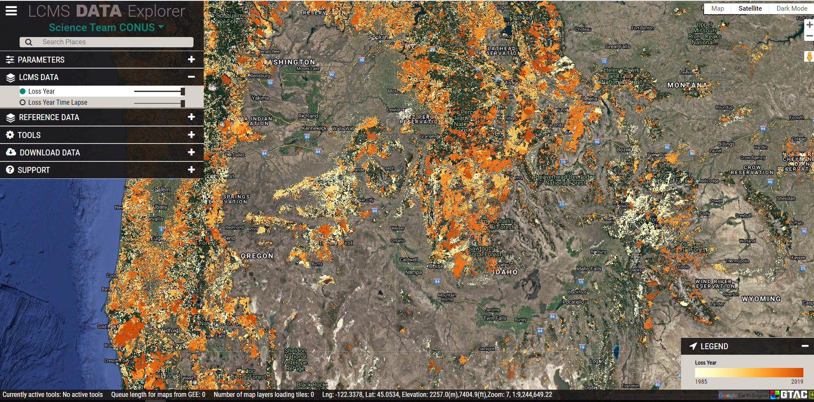
Time series methods used to support management & conservation
Landscape Change Monitoring System (LCMS)
    Ensemble model integrating multiple methods
http://lcms.forestry.oregonstate.edu/

Slide 7
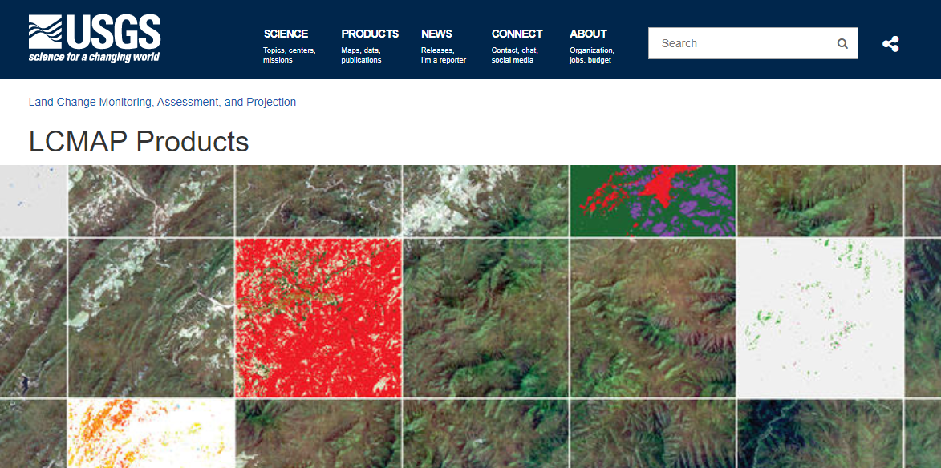
Time series methods used to support management & conservation
Land Change Monitoring, Assessment & Projection
    New suite of data products available in Earth Explorer
    Several layers derived CCDC
https://www.usgs.gov/land-resources/eros/lcmap/

Slide 8
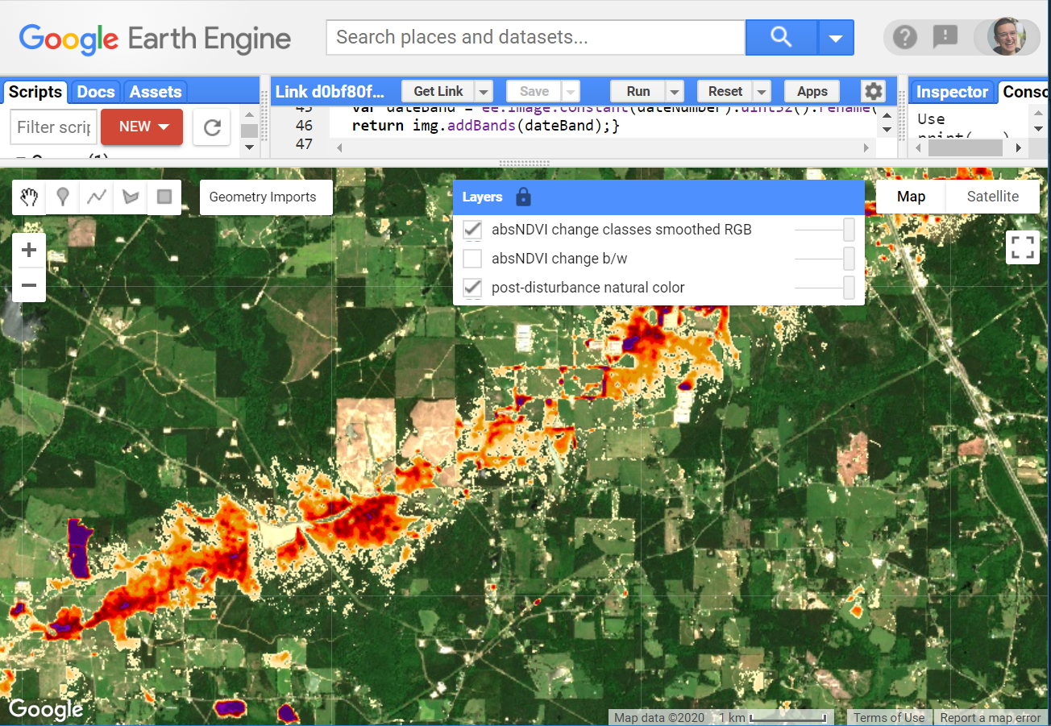
Time series methods used to support management & conservation
HiForm https://hiform.org
  High-resolution imagery
  Within-year change + near real time change detection

Slide 9
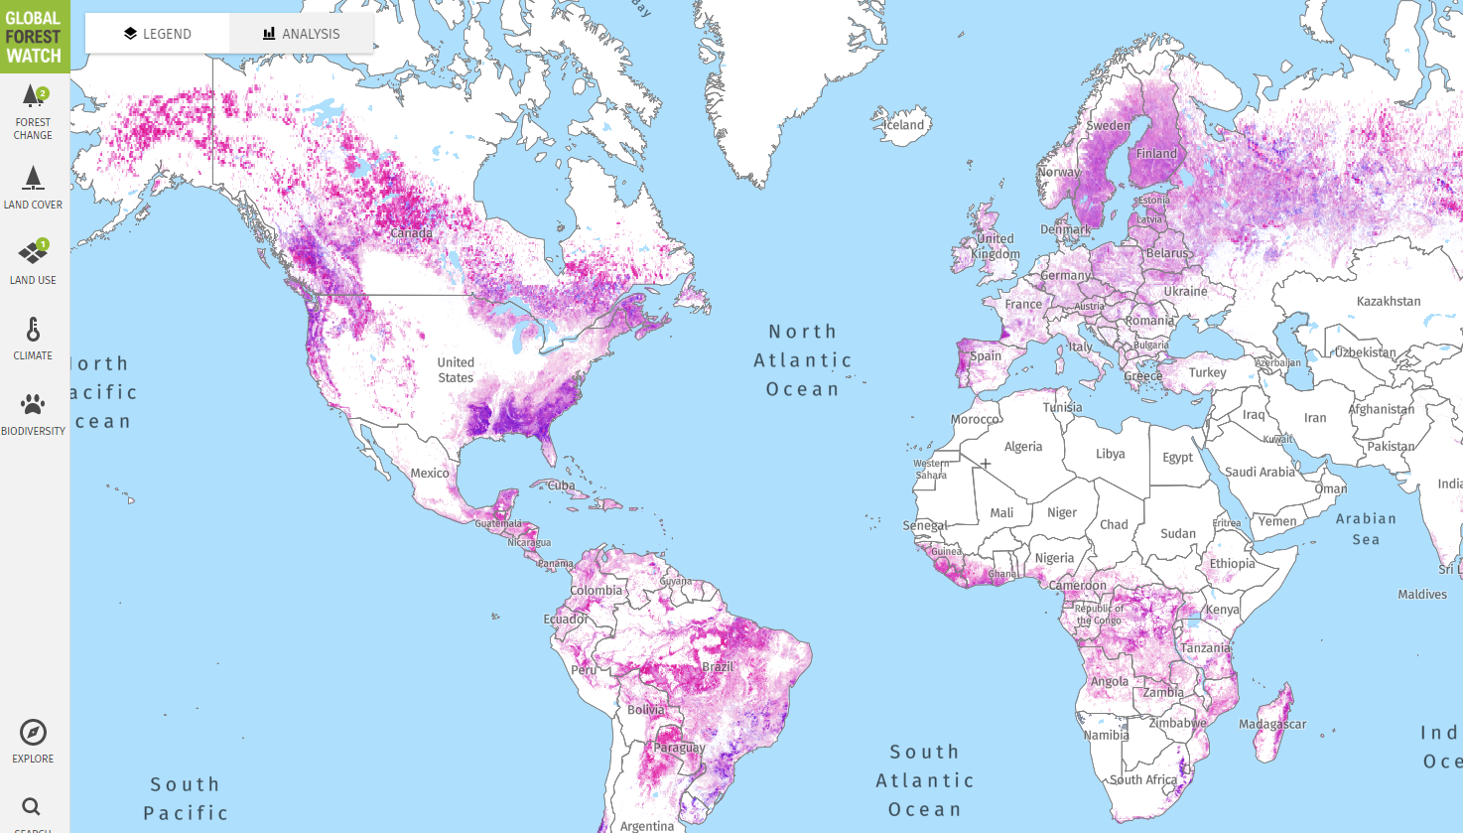
Time series methods used to support management & conservation
Global Forest Watch
    Image interpretation and machine learning methods to classify change from Landsat time series.
https://www.globalforestwatch.org/
Notes:
This analysis was done in and Earth Engine and relied on the supermassive computing capabilities of this platform. Machine learning approaches are quite powerful but some interpretability is lost as the ‘learning algorithm’ can be kind of a black box and you can’t get exactly the same result with the same parameters each time. These data are available in Earth Engine https://developers.google.com/earth-engine/datasets/catalog/UMD_hansen_global_forest_change_2018_v1_6

Slide 10
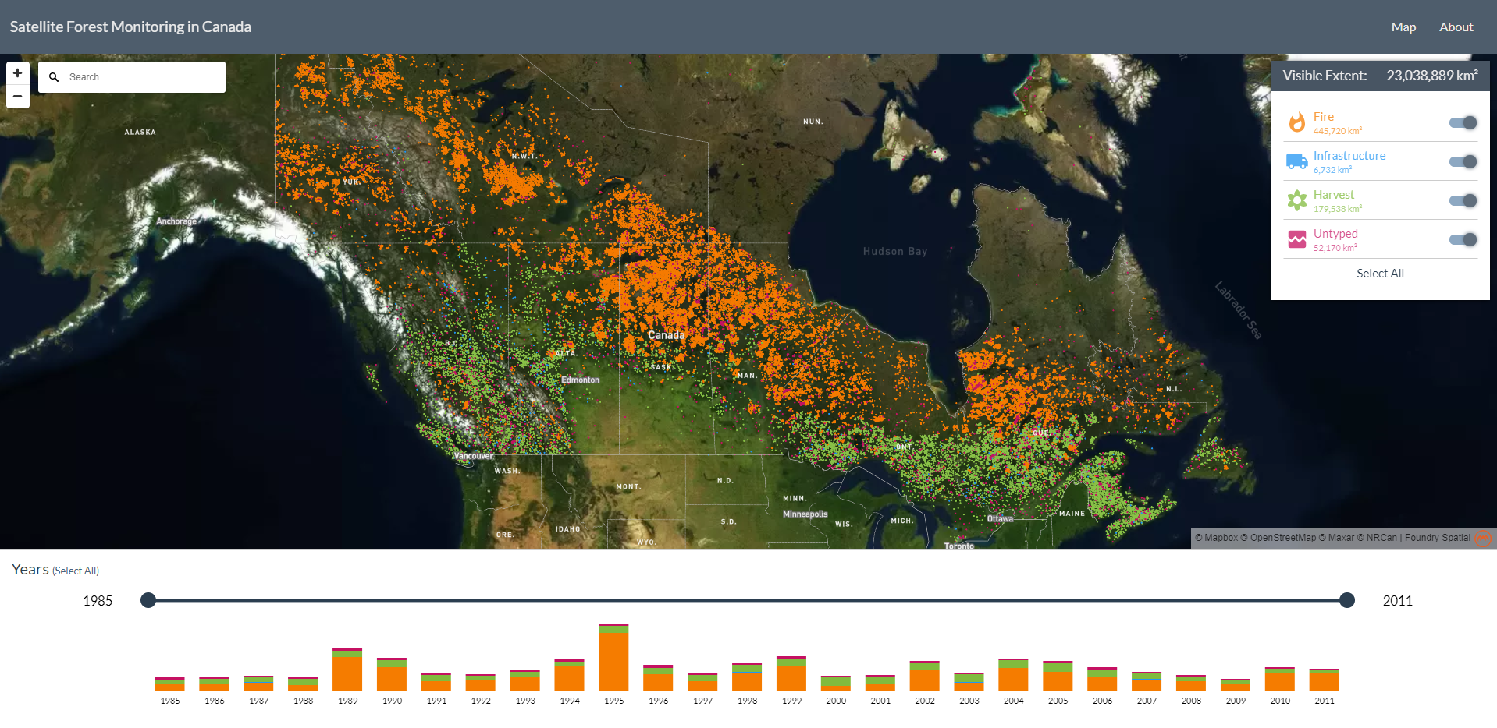
Time series methods used to support management & conservation
Satellite Forest Information for Canada
    Composite2Change (C2C) algorithm used to map forest disturbance across Canada
https://forests.foundryspatial.com/
Notes:
These data are available: https://opendata.nfis.org/mapserver/nfis-change_eng.html

Slide 11
Time series methods used to support management & conservations
Other data products & tools
  ForWarn II https://forwarn.forestthreats.org/
  AppEEARS, LCMS, FHAAST, Composite2Change in Canada OTHERS???? ForWarn
  TRY TO COME UP WITH A GOOD LIST OF PROGRAMS AND APPLICATIONS
  Let’s try to get a few more or leave this for the future?
Notes:
L

Slide 12


Learning to Develop in Earth Engine
If you want to master Earth Engine development, learning JavaScript will help to a point…
EE !== JS

Slide 13





Learning to Develop in Earth Engine
Remote sensing, GIS, JavaScript knowledge required but mostly learn EE!
EE !== JS

Slide 14
Learning to code – Whiteboard Sessions
You can’t code what you don’t understand
Identify & draw
  The goal, constraints, tools (data, methods, etc.), assumptions and sketch out general solution/approach
Outline code
  Pseudocode
  Modularize

Slide 15
Whiteboard Canvas Layout
1. Goal (objectives, outputs, validation)
2. Users
5. Solution Space
3. Problem Space (constraints, available tools, etc.)
4. Assumptions
Adapted from: Practical whiteboarding for designers
Notes:
Top of the whiteboard is where you write down the ultimate goal or objective you are trying to achieve. What do you need to produce and how will you know if you were successful?
Who is going to use our tool or script and how do we facilitate them or meet their needs?
What data, tools are available and what constraints exist for getting things done?
Insight on assumptions will often come from identifying/outlining the previous 3.
This is where you start sketching

Slide 16
Learning to code - Adapting
“If you want to get better at programming, there are two things you need to do: Write code and read everything!”
      -freeCodeCamp article
  Start with official docs & tutorials
  Articles
  Papers
  Other people’s code

Slide 17
Learning to code - Adapting
  Start with official docs & tutorial
      https://developers.google.com/earth-engine/
  Articles
      https://medium.com/google-earth
  Papers
      Focus on methods presented in literature (e.g., LandTrendr described in detail in Kennedy et al 2020)
  Other people’s code
      https://groups.google.com/forum/#!forum/google-earth-engine-developers
      https://github.com/gee-community

Slide 18
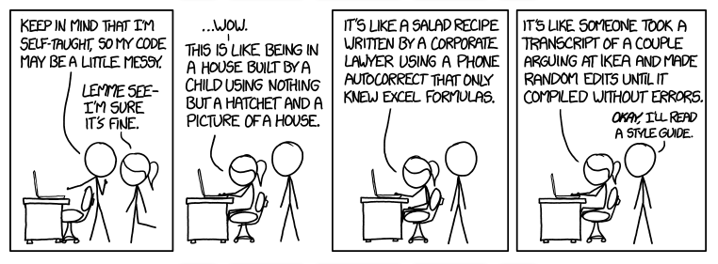
Learning to code
Invest in learning conventions & patterns
https://xkcd.com/1513/
Notes:
Learn the style and patterns of EE. Look to the docs and prolific EE developers for inspiration and examples.

Slide 19
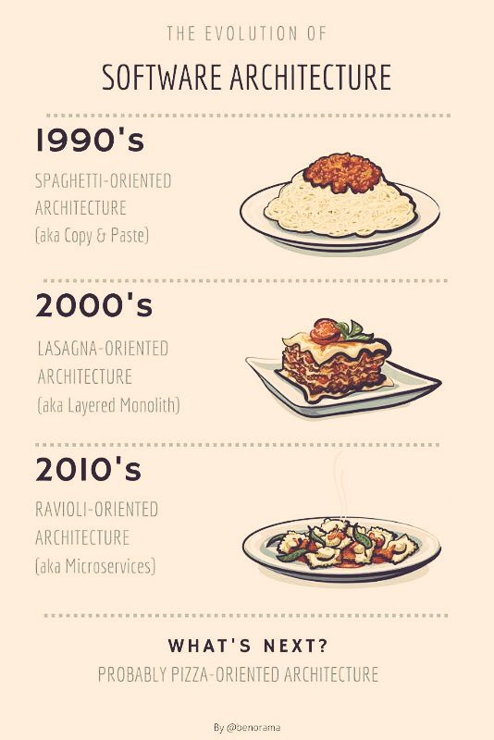
Learning to code
https://medium.com/@benorama/the-evolution-of-software-architecture-bd6ea674c477
Notes:
This comic may also describe the evolution of your code as you learn!

Slide 20
Learning to code - Practice
Programming languages are languages
  Therefore, practice like you would practice your Spanish, Japanese or Swahili!
Practice coding with tutorials & challenges:
    https://www.w3schools.com/js/
    https://www.codecademy.com/learn/introduction-to-javascript
    https://edabit.com/challenges/javascript
    https://www.codewars.com/
  There are many resources!
Notes:
Just like you would ‘train’ for a sporting event, train with coding. Start with small challenges, progress.

Slide 21
Additional Resources
Change detection
      Introduction to Change Detection
JavaScript and Earth Engine
      Geospatial Scripting in JavaScript and Earth Engine
      Earth Engine lecture: Code editor & JavaScript
Advanced topics in Earth Engine time series analysis
      Slides from LandTrendr & CCDC in Earth Engine lecture
      Time Series Analysis in Earth Engine lecture
      Time series visualization analysis with Earth Engine, Pandas, Altair and Colab

Slide 22
Back to change analysis with LT-GEE!
Let’s run LandTrendr in the code editor with code this time!
Putting the pieces together:
  Reviewed/practiced with simple EE algorithms
  Found analysis parameters with UI tools
  Now we will write the JavaScript code run LandTrendr and get data

Slide 23
Exercises for today
Exercise 1: Process and explore Landsat time series
  Optional – review image processing in GEE
Exercise 2: Basic trend analysis
Exercise 3: LandTrendr in GEE: Model fitting
Exercise 4: LandTrendr in GEE: Disturbance mapping

Slide 24
Demo and exercise steps
Review API documentation
Understand and adapt an example analysis script
Setup and run a full LandTrendr analysis script in the EE Code Editor
Download a disturbance map

Slide 25
Demo
Break for the demo, provide link to the exercises and meeting time to reconvene
  PUT THE LINKS TO THE EXERCISES IN HERE AND TIMES, ETC.
THIS IS THE LAST LECTURE/EXERCISE SO I NEED ALL THE GOOD COURSE WRAP UP MATERIALS.

Slide 26
Conclusion
PLACEHOLDER
How do we want to wrap this up?

