Slide 1
Introduction to Change Detection Lecture 2: Image Correction
Instructor: Lila Leatherman (they/them)
November 17-18, 2020

Slide 2
Course Agenda
Day 1 – Morning
10:00-10:45 – Presentation: Course overview and image selection and preparation
10:30-10:45 – Demonstration: Overview of GEE
11:00-11:10 – Break
11:10-11:30 – Presentation: Image correction
11:30-12:00 – Demonstration: Creating cloud-free composites in EE
Tasks to complete before the next session: Exercise 1 + 2
Day 1 – Afternoon
2:00-2:30 – Presentation: Band ratios and image transformations
2:30-3:00 – Demonstration: Identifying significant landscape change
3:00-4:00 – Q&A and Exercise Help
Tasks to complete before next session: Exercise 3

Slide 3
Course Agenda
Day 2 – Morning
10:00-10:45 – Presentation: Image standardizations and image differencing
10:30-11:00 – Demonstration: Calculating z-scores
11:00-11:10 – Break
11:10-11:30 – Presentation: Change thresholding and discussion of accuracy assessment
11:30-12:00 – Demonstration: Exploring histograms and creating change maps
Tasks to complete before the next session: Exercise 4 + 5
Day 2 – Afternoon
2:00-2:30 – Q + A and Exercise Help
2:30-3:00 – Presentation: Change detection applications within USFS
3:00-4:00 – Final Q + A; help with course-related projects/ideas

Slide 4
Lecture outline:
Goals of image correction
Components of image correction
Earth-sun-sensor relationships
Atmospheric effects
Surface reflectance
Cloud-masking
Demo of image correction in GEE

Slide 5
Image Pre-processing
Goal: Ensure that each pixel records the same type of measurement at the same geographic location through time
Assumption:
Spectral properties of non-changed areas are stable
Motivation:
Inadequate pre-processing results in false positives

Slide 6
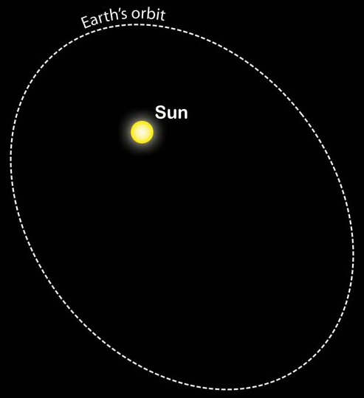
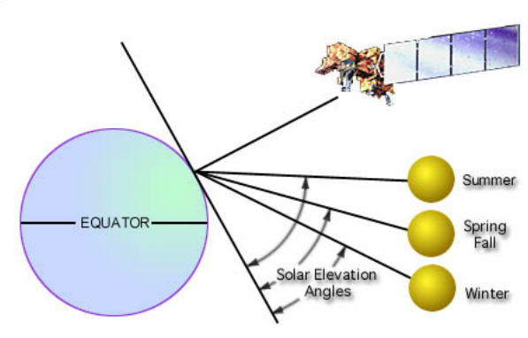
Earth-Sun-sensor relationships
Variable through time
Influence incident EMR
Earth-sun distance
Solar incident angles
Sensor position
Notes:
Three different components, constantly in different positions, and that effects the quality of the reflectance in the image
All images collected come with metadata that include
Image date
Time of day
Other sensor information
All of these affect the reflectance
So we need to calculate
Distance of earth from sun, based on the day of the year / julian day
Lots of lookup tables for this
Solar incident angles and sensor position are included in metadata
You don’t have to do any of this yourself, these corrections and pre-processing are all done on the back end.
But: still important to understand that they’re happening!

Slide 7
Reflectance at Top-of-atmosphere
First correction:
Digital Numbers → Radiance → Reflectance (TOA)
Calculated using:
Sensor calibration coefficients
Earth-sun distance
Mean solar exo-atmospheric irradiance
Solar zenith angle
Top of atmosphere reflectance differs from surface reflectance…
Notes:
When we get imagery data, it comes in digital numbers, or DNs
Eg. Landsat is 8-bit data = 2^8 = 256 different values
DNs are unitless information – contextual, but don’t apply magnitude
Eg, colder than yesterday—but doesn’t tell you degrees
DNs are converted to Radiance, refers to amount of energy. Then convert to reflectance and top-of-atmosphere reflectance – which record the actual magnitude of energy that is being recorded
TOA – removes all atmospheric effects
Compared to surface reflectance, which does include atmospheric effects
Behind the scenes, Google Earth Engine uses these parameters to do this pre-processing
TOA – takes into account the previously mentioned factors and normalizes them to the same scale – reflectance…
Sensor calibration coefficients: gain, bias
sensor specific, differences between how hardware records intensity of radiation… ask your local engineer
Gain = is a multiplier
Bias = is a shift (plus or minus)
Mean solar exo-atmospheric irradiance – The irradiance from the sun at the top of the earth’s atmosphere… sun puts out a certain amount of power and…
There are different ccalculations for that but we use one from Thuillier et al 2003
All the metadata reports include solar elevation but what you need is solar zenith… which is 90-solar elevation (watch your units- radians vs degrees)

Slide 8
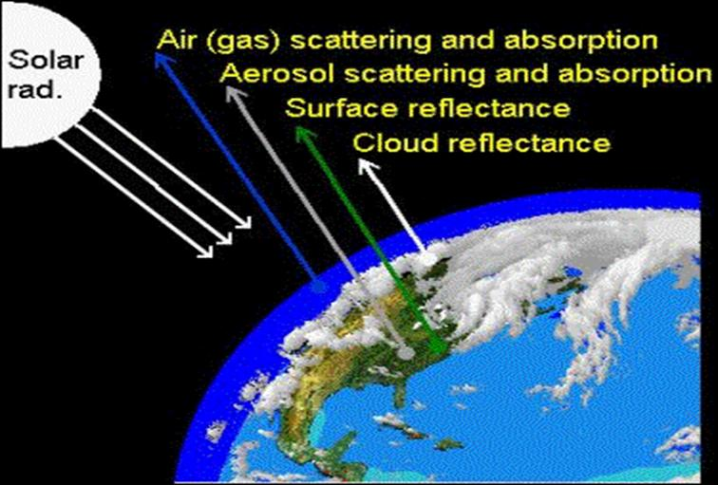
Atmospheric Effects
Another source of ‘noise’
Atmosphere selectively scatters, absorbs and transmits light
Notes:
Scattered, absorbed or transmitted depending on EM wavelength, atmospheric path length and atmospheric conditions
Atmospheric scatter adds brightness to a scene and to compensate, we will subtract brightness from the scene.
For change detection, it may be most robust to correct imagery to surface reflectance by compensating for atmospheric effects.

Slide 9
Surface Reflectance Correction Methods
A few approaches:
Dark object subtraction (DOS)
Atmospheric modeling
Radiative transfer models
Image-to-image normalization
Histogram matching
Regression using pseudo-invariant features
Notes:
Two approaches for change detection:
Atmospheric correction: histogram minimum involves calculating stats for eacTry to remove the effects of the atmosphere or simply normalize one image to the other (slave image and reference image)
These are just a
Surface reflectance correction methods
Dark object subtraction
Straightforward, more common
Atmospheric modeling
Complex—requires atmospheric data for the time and location where the image was required
Image to image
Comparing one image to another that were collected in the same area
Basically, want to use linear regressions to make the images match each other
few examples…

Slide 10
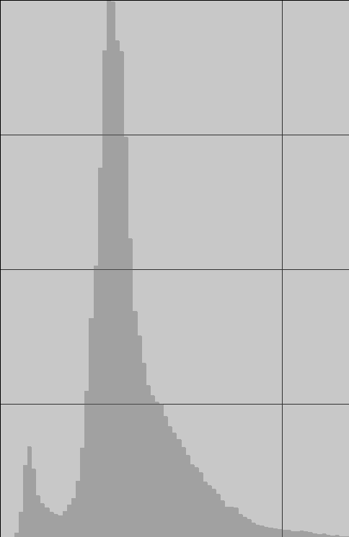
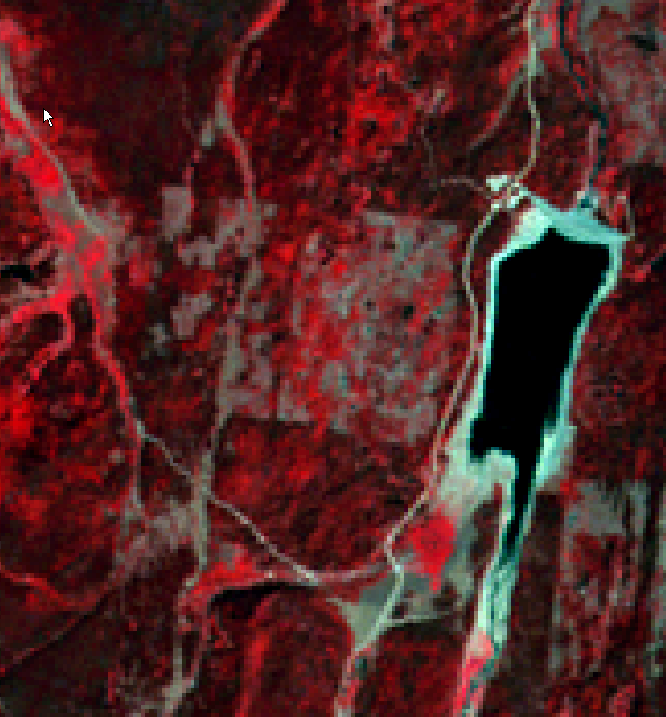
Dark object subtraction (DOS))
Dark objects can be deep lakes or very dark shadows
DOS involves identifying the value associated with these areas and subtracting it from all pixels in the image.
Frequency
Jump
Pixel Value
DOS value
Automated using RSAC tools…
Notes:
Theoretically should have zero reflectance
Done for each band
Operates under the premise that dark objects absorb all light, should have a reflectance close to 0
So if you looked at the reflectance, it should be close to zero across all bands for each pixels
If the reflectance is higher, you can subtract that increased value from the other reflectance values that you obtain—assuming that those higher values are due to atmospheric effects, so by subtracting them, you subtract out the effects
Not perfectly accurate because dark bodies get brighter when there are atmospheric effects, and bright things get darker when there are atmospheric effects

Slide 11
Masking
Clouds and their shadows
Lead to false positives in change detection.
Snow and water
Seasonal variation
Result in false positives (If not part of your research question)
Notes:
Remove clouds and their shadows
Do our best to avoid them and we can apply masks to do that work for us
Remove snow and water—not necessarily landcover, just sitting on top of landcover
Fmask cloud algorithm masks the clouds and also their shadows
We fill in the cloudy areas with images of the same area taken at a different time

Slide 12
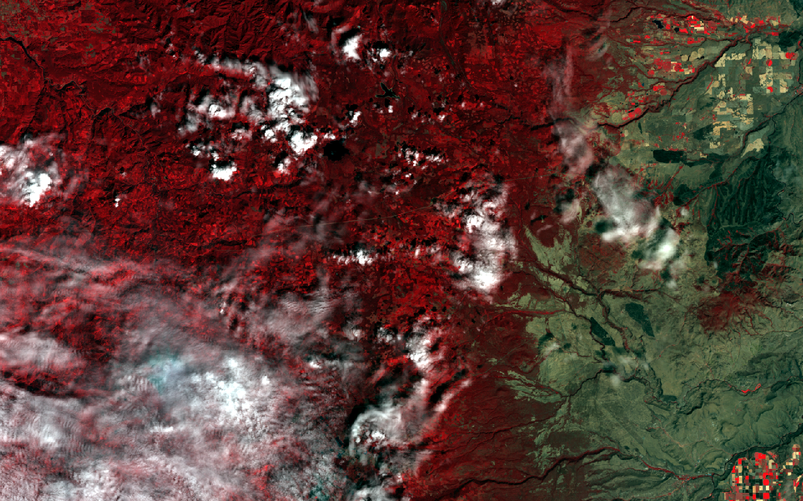
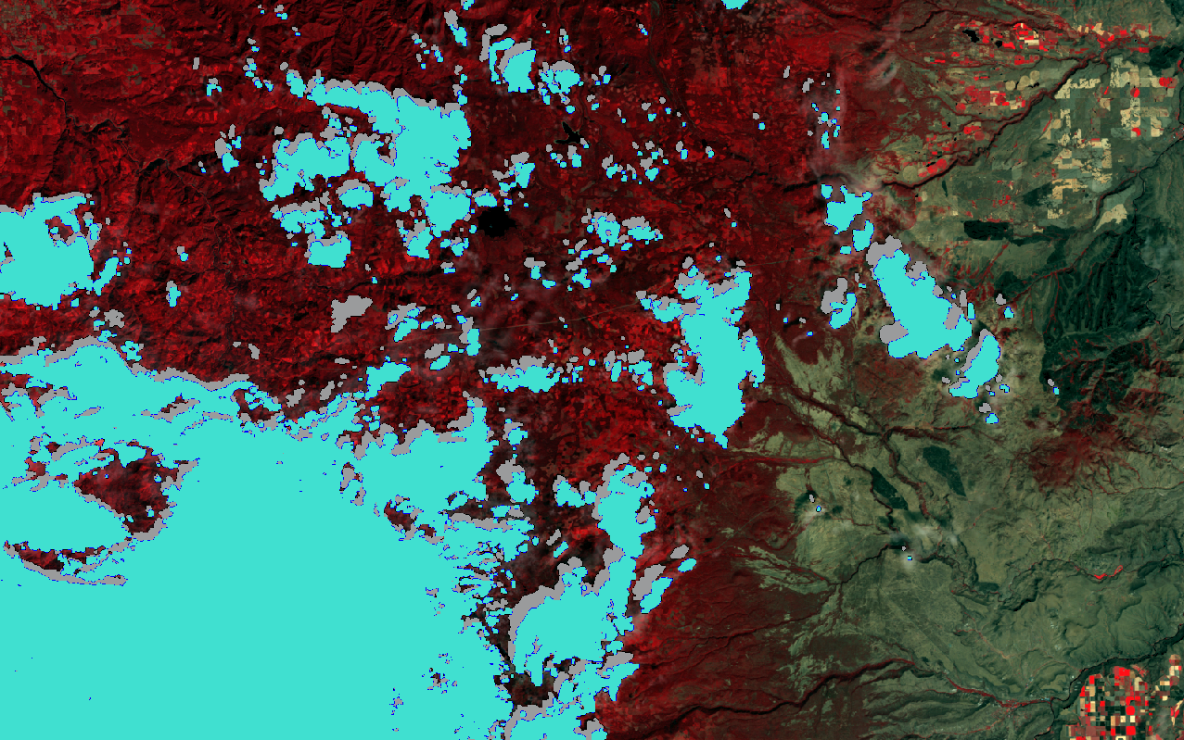
Masking
Clouds
Cloudy Landsat image
Shadows

Slide 13
Image preprocessing
Function Mask (fmask)
Identify clouds, shadows and water- Memory intensive process
Exercises 1 + 2 – creating cloud-free composites in GEE

Slide 14
Image preprocessing
Google Earth Engine can do all of the heavy lifting for us!
Eliminates the manual processing steps
Exercises 1 + 2 – creating cloud-free composites in GEE

Slide 15
Demonstration
Exercise 2: Cloud-free composites in GEE

