Slide 1
Introduction to Change Detection Lecture 3: Band ratios and image transformations
Instructor: Lila Leatherman (they/them)
November 17-18, 2020

Slide 2
Course Agenda
Day 1 – Morning
10:00-10:45 – Presentation: Course overview and image selection and preparation
10:30-10:45 – Demonstration: Overview of GEE
11:00-11:10 – Break
11:10-11:30 – Presentation: Image correction
11:30-12:00 – Demonstration: Creating cloud-free composites in EE
Tasks to complete before the next session: Exercise 1 + 2
Day 1 – Afternoon
2:00-2:30 – Presentation: Band ratios and image transformations
2:30-3:00 – Demonstration: Identifying significant landscape change
3:00-4:00 – Q&A and Exercise Help
Tasks to complete before next session: Exercise 3

Slide 3
Course Agenda
Day 2 – Morning
10:00-10:45 – Presentation: Image standardizations and image differencing
10:30-11:00 – Demonstration: Calculating z-scores
11:00-11:10 – Break
11:10-11:30 – Presentation: Change thresholding and discussion of accuracy assessment
11:30-12:00 – Demonstration: Exploring histograms and creating change maps
Tasks to complete before the next session: Exercise 4 + 5
Day 2 – Afternoon
2:00-2:30 – Q + A and Exercise Help
2:30-3:00 – Presentation: Change detection applications within USFS
3:00-4:00 – Final Q + A; help with course-related projects/ideas

Slide 4
Lecture outline:
Review of spectral signatures
Band ratios
NDVI
NBR
Image transformations
Tasseled-cap transformations
Demo of band ratios and transformations in ArcMap

Slide 5
Introduction
Image Differencing
Two-date method of locating change
Input types:
Bands
Classification
Transformations
Notes:
Recap: two-date method of locating change
Not subtracting raw images: Inputs can be:
Bands, eg b5
Classification – change in land cover type
Transformations – NDVI, NBR

Slide 6
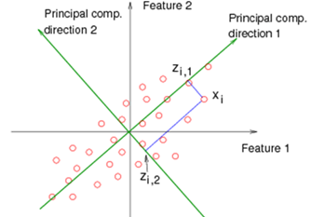
Spectral Image Enhancements
Simple mathematical:
Band1
- Band 2
Ratio =
Band1
+ Band 2
Complex spectral:
Notes:
Can be simple mathematical
Or more complex
Like calculating principal components
In this analysis, we’re going to be doing Tasseled Cap, aka Kauth-Thomas

Slide 7
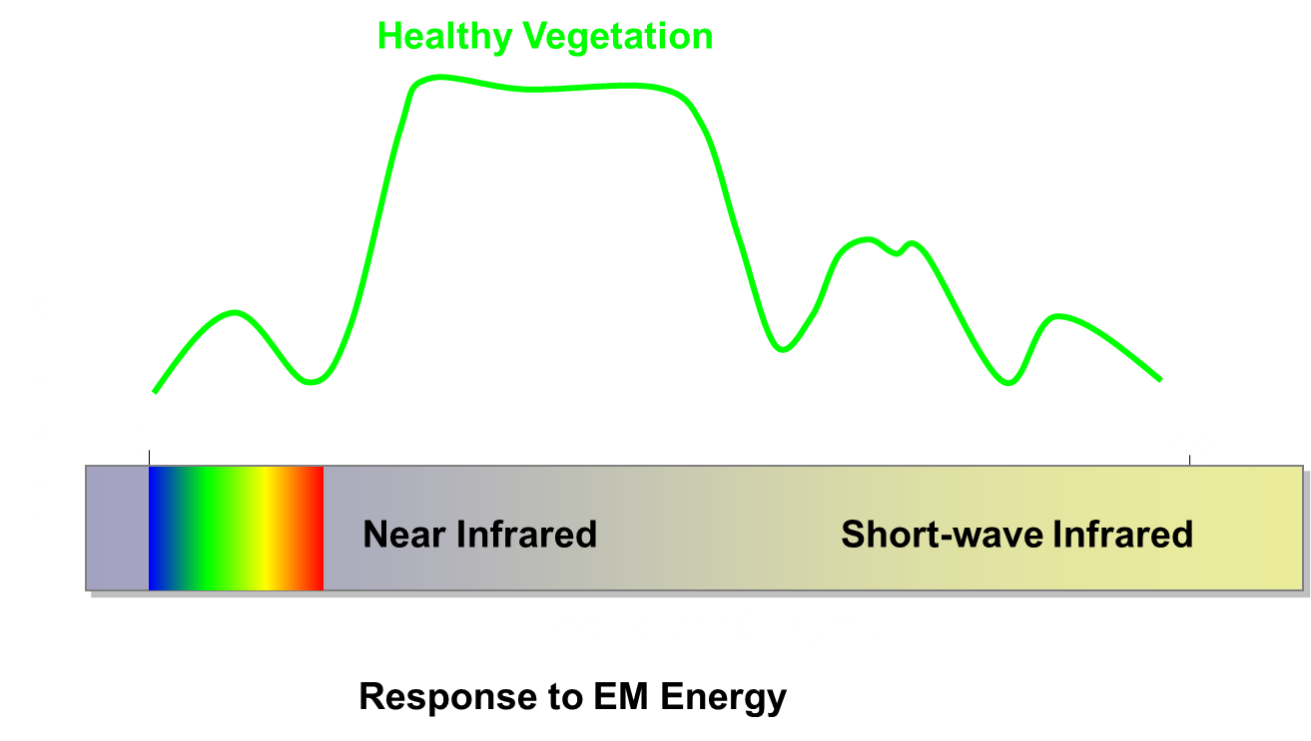
Review of Spectral Signatures
Graphically, the spectral reflectance of green vegetation in the visible wavelengths may be represented as shown...
Notes:
We can take advantage of band ratios in 2 ways:
1st, discrimination of vegetation vs. non-vegetation areas, or classifying vegetation, water, urban areas, bare soil, etc.

Slide 8
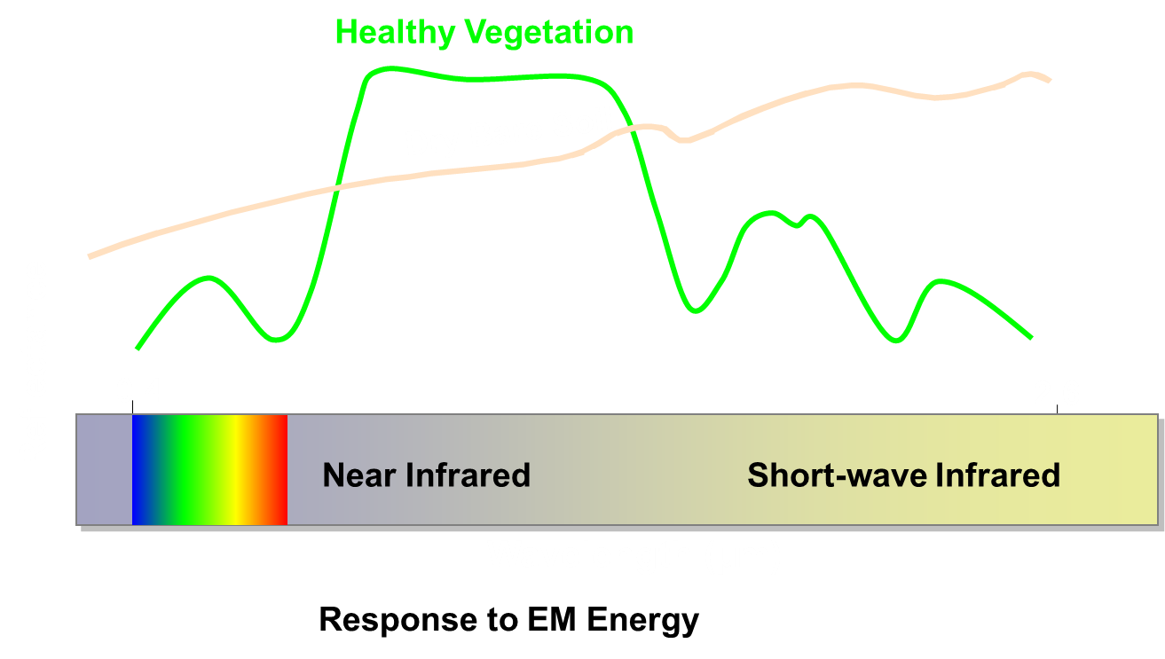
Review of Spectral Signatures
Graphically, the spectral reflectance of green vegetation in the visible wavelengths may be represented as shown...
Notes:
We can take advantage of band ratios in 2 ways:
1st, discrimination of vegetation vs. non-vegetation areas, or classifying vegetation, water, urban areas, bare soil, etc.

Slide 9
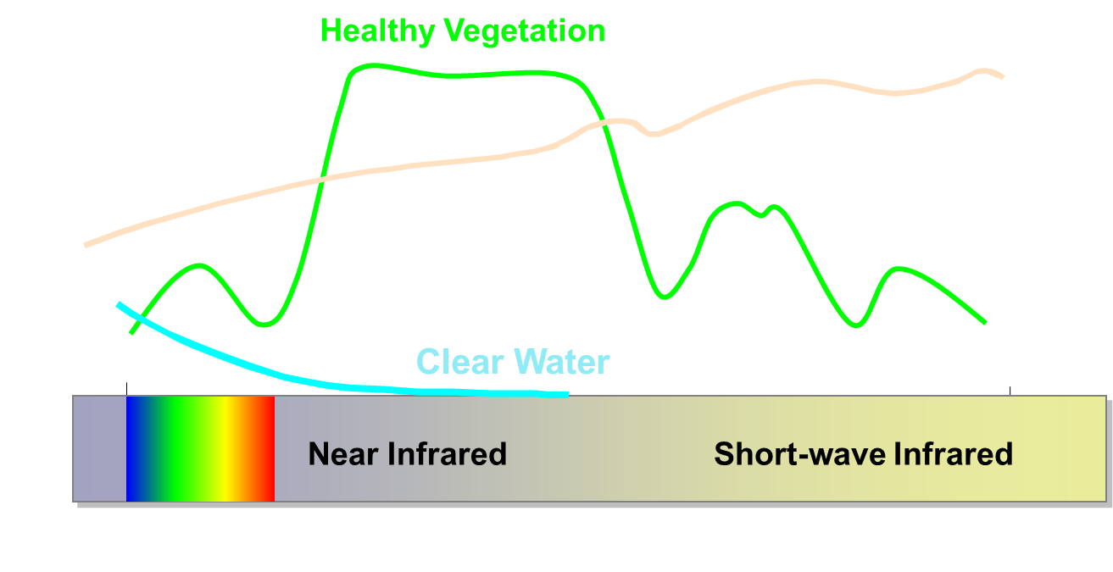
Review of Spectral Signatures
Graphically, the spectral reflectance of green vegetation in the visible wavelengths may be represented as shown...
Notes:
We can take advantage of band ratios in 2 ways:
1st, discrimination of vegetation vs. non-vegetation areas, or classifying vegetation, water, urban areas, bare soil, etc.

Slide 10
Review of Spectral Signatures
As vegetation becomes unhealthy, spectral response curve changes.
Notes:
2nd: As vegetation becomes unhealthy or senesces, its response to near-IR wavelengths is reduced, similar to how we see here.

Slide 11
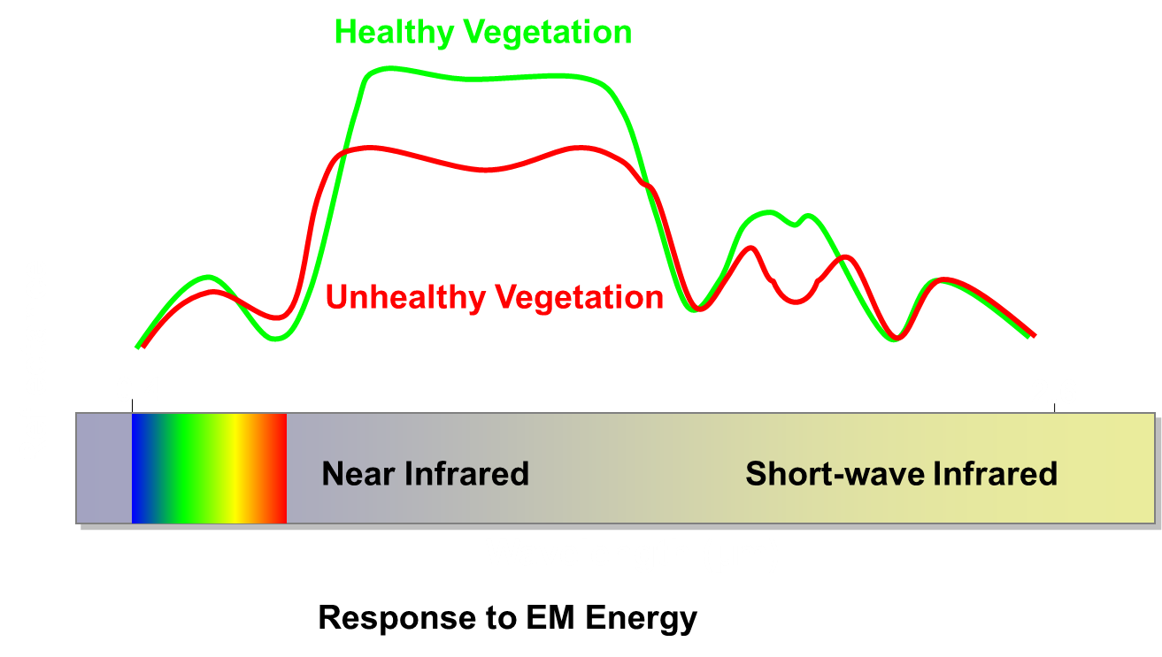
Review of Spectral Signatures
As vegetation becomes unhealthy, spectral response curve changes.
Notes:
2nd: As vegetation becomes unhealthy or senesces, its response to near-IR wavelengths is reduced, similar to how we see here.

Slide 12
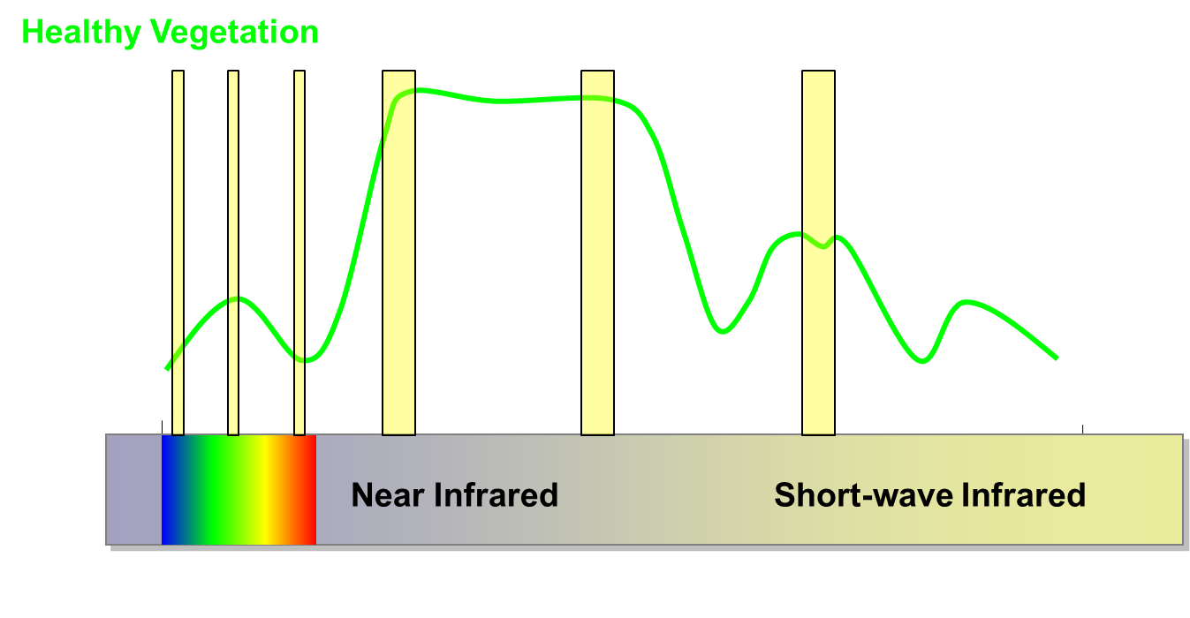
Band Ratios
Sensors capture discrete spectral information in ‘bands’ in a small portion of the full spectrum.

Slide 13
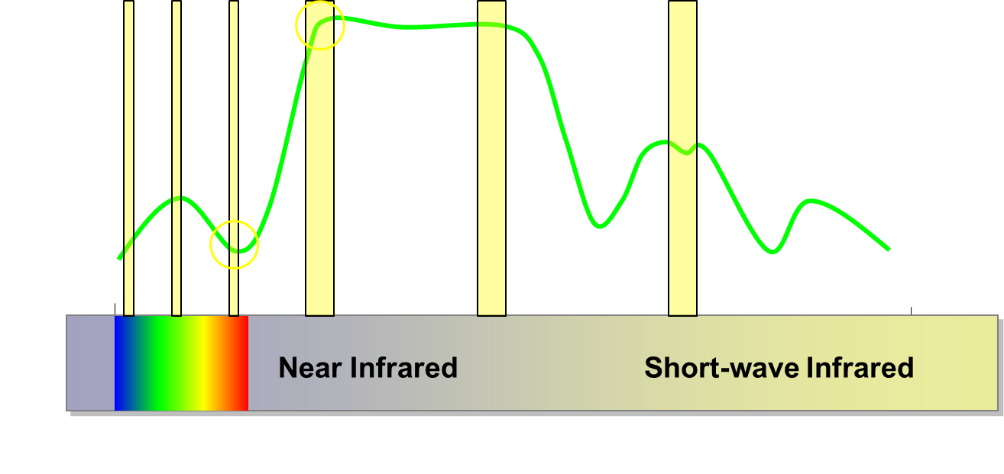
Band Ratios
We can read these values for each pixel, and then do the math for each pixel throughout the entire image.

Slide 14
Band Ratios
The simple vegetation ratio is simply Red / NIR, and would be:
43/183 = 0.23

Slide 15
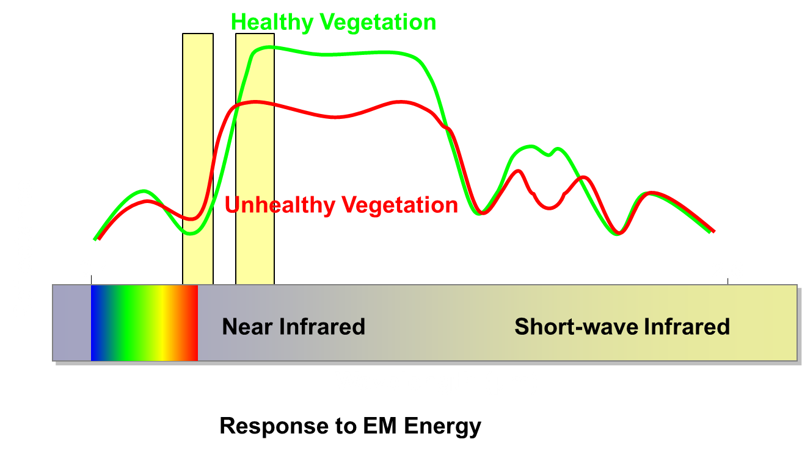
Normalized Difference Vegetation Index
We make use of the spectral response of vegetation to obtain information about the vegetation…
Notes:
For NDVI, we look again at the red and NIR bands.

Slide 16
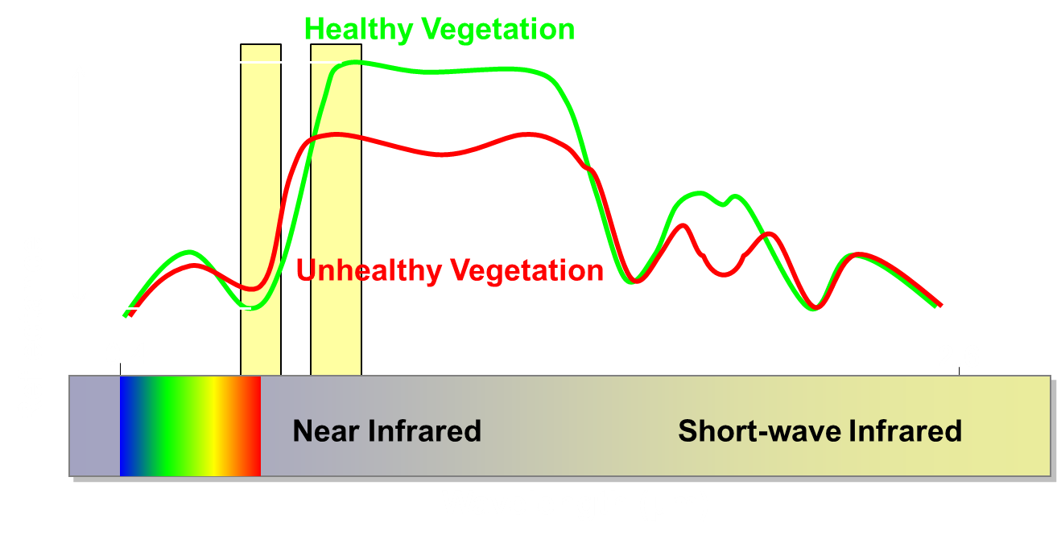
Normalized Difference Vegetation Index
We make use of the spectral response of vegetation to obtain information about the vegetation…
Response to EM Energy

Slide 17
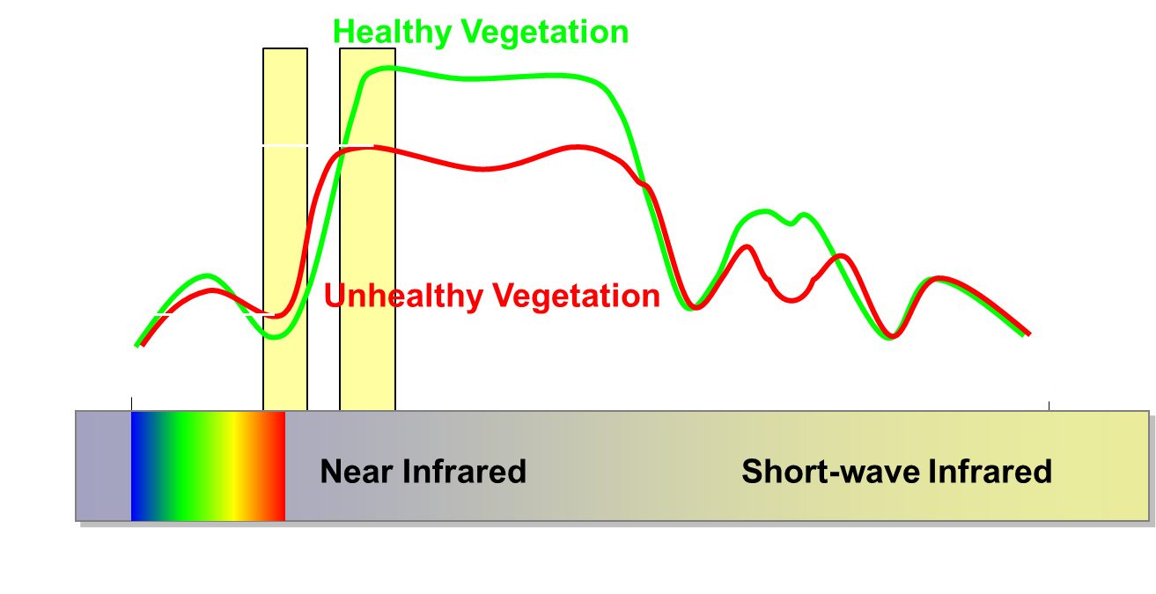
Normalized Difference Vegetation Index
NDVI is lower for unhealthy vegetation
Response to EM Energy
Notes:
[Watch the multiple animations in this slide. Let them work, and then describe; don’t anticipate.]
Add calculation of respective NDVI

Slide 18
Normalized Burn Ratio (NBR)
Works on a similar concept as NDVI
The red band is replaced with a short-wave infrared (SWIR) band
Band 7 for Landsat
Most other sensors have a corresponding band
Improved method for delineating burned areas

Slide 19
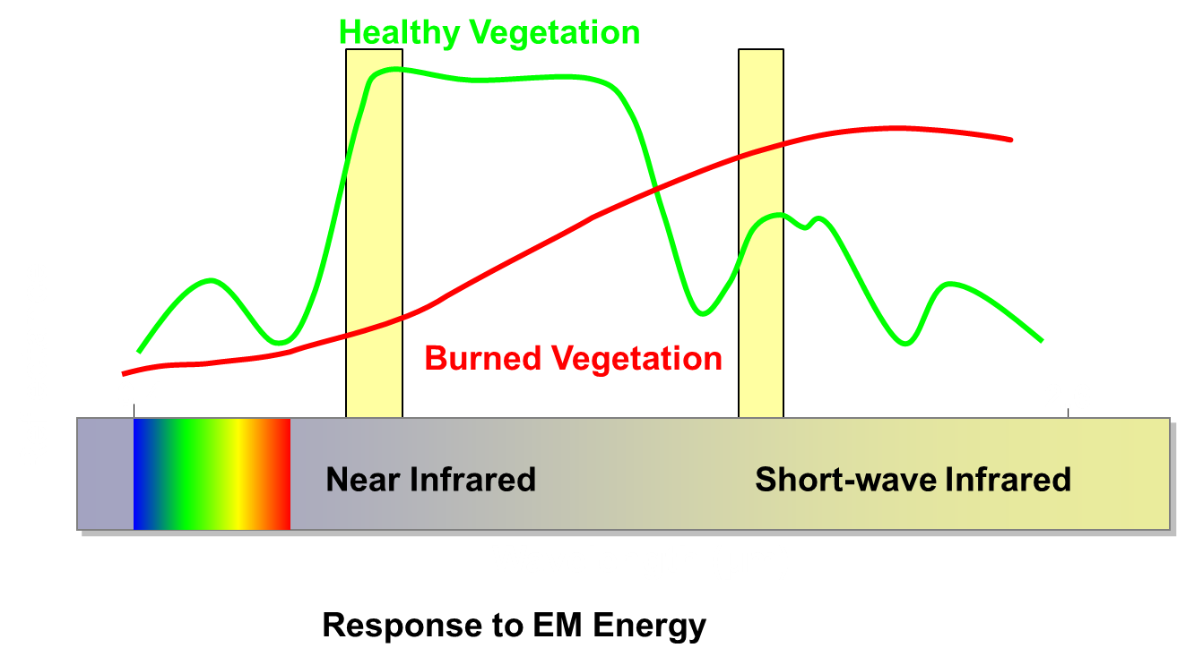
Normalized Burned Ratio (NBR)
Burned vegetation has a much different response curve.

Slide 20
Normalized Burned Ratio (NBR)
We typically use the differenced NBR (dNBR) to provide a quantitative measure of absolute change

Slide 21
Band Ratios
We take advantage of these ratios to extract information from the imagery
Several indices have been created for vegetation analysis based on band ratios.
The following are a brief survey of indices based on Landsat bands:
Index name | Equation | Use
NDVI | (B4 – B3) / (B4 + B3) | Vegetation health
Moisture Stress Index | B5 / B4 | Indicates stress due to low moisture amounts
Leaf Water Content | -log(1- (B4-B5)) / -log(1-(B4’-B5’)) | Assess water stress
Soil Adjusted Vegetation Index (SAVI) | ((1+L)*(B4–B5)) / (B4+B5+L) | Removes effect of soil within pixel; value of L can vary, but 0.5 is typical
Atmospherically Resistant Veg. Index (ARVI) | B4-(B3-(B1-B3)) / B4+(B3-(B1-B3)) | All terms use a special atmospherically corrected value.
B4’ and B5’ indicate response when leaves are at max water content

Slide 22
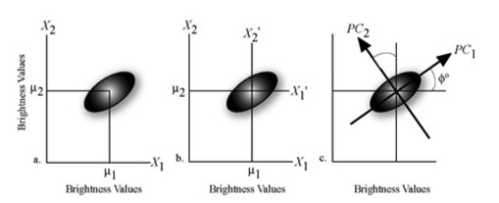
Image Transformations
What are they?
Linear transformation of multidimensional data
Applies scalars (coefficients) and constants
e.g., principal components
Reduces data dimensionality
Captures as much variation in the data as possible in two or three bands
Typically done with data with much higher dimensionality.
Notes:
Move this to talk 4!
Like principal components but components are related to geophysical properties of the scene. First component is ‘soil brightness’, second component is ‘greenness’ and the third component ‘wetness’.
Explain feature space – pixel
This transformation reduces the Landsat reflectance bands to three orthogonal indices called brightness, greenness and wetness

Slide 23
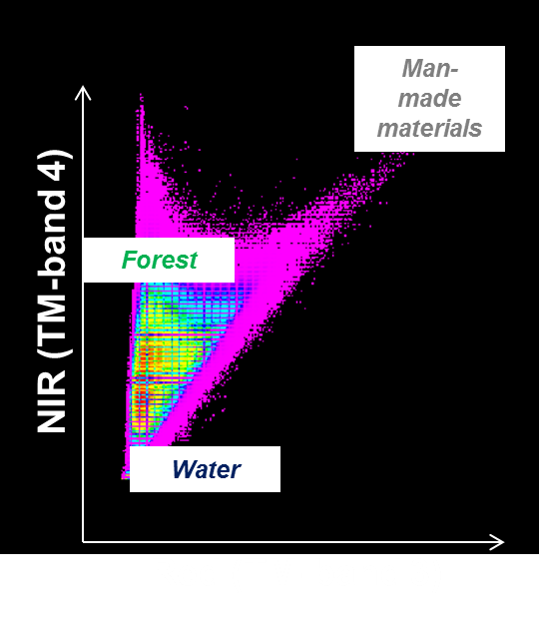
Image transformation – Tasseled Cap
Linear spectral transformation
Extracts components related to geophysical properties
First 3 bands of new image
Brightness
Greenness
Wetness (third orthogonal axis)
Uses coefficients specific to sensor
Red
Notes:
Move this to talk 4!
Like principal components but components are related to geophysical properties of the scene. First component is ‘soil brightness’, second component is ‘greenness’ and the third component ‘wetness’.
Explain feature space – pixel
This transformation reduces the Landsat reflectance bands to three orthogonal indices called brightness, greenness and wetness
Consider replacing tasseled cap plot

Slide 24
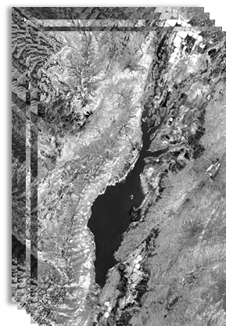
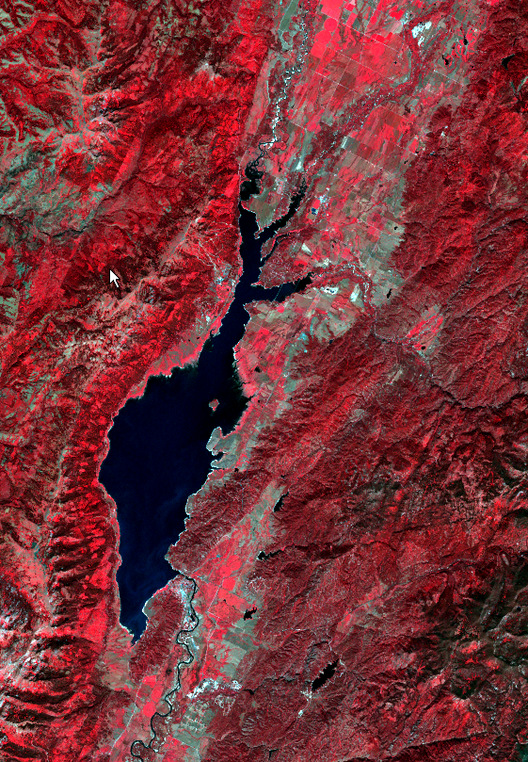
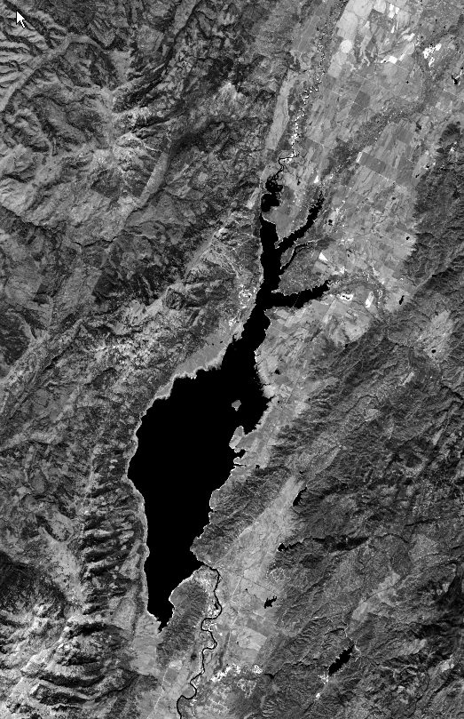
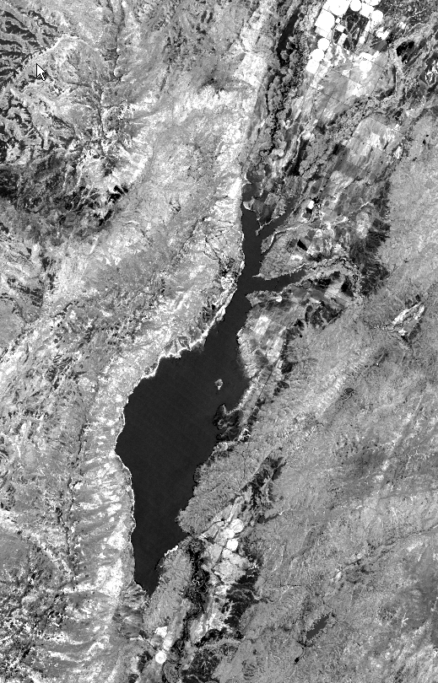
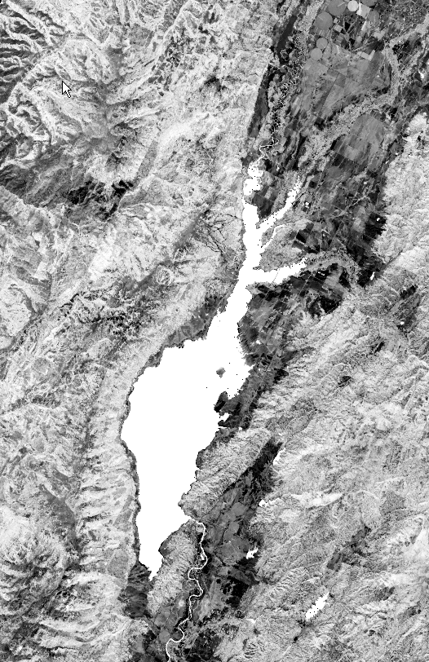
Image transformation – Tasseled Cap
7-band Landsat TM5 image
3-band Tasseled Cap image
Brightness
Greenness
Wetness
Notes:
Upper right image: we normally use red, green, blue, or NIR, red, green as shown here to view data.

Slide 25
Image transformation – Tasseled Cap
7-band Landsat TM5 image
Notes:
Upper right image: we normally use red, green, blue, or NIR, red, green as shown here to view data.

Slide 26
Image transformation – Tasseled Cap
3-band Tasseled Cap image
Brightness
Greenness
Wetness
Notes:
Upper right image: we normally use red, green, blue, or NIR, red, green as shown here to view data.

Slide 27
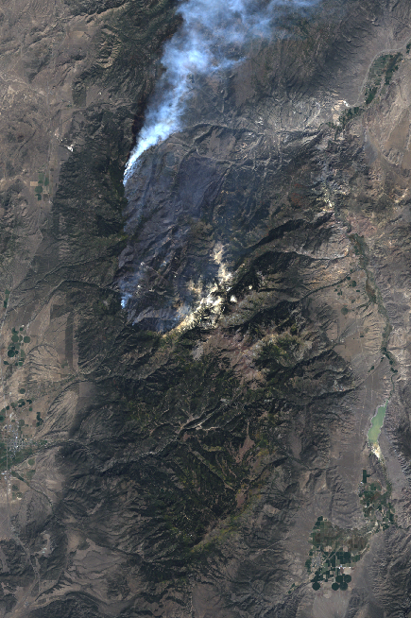
Using image enhancements to map change
In Exercise 3, you will
learn how to create band ratios and image transformations using ArcGIS
investigate how certain landscape features appear through the lenses of different image enhancements
observe differences in images/bands when landscape changes have occurred

Slide 28
Demonstration
Exercise 3: Image Enhancements in ArcGIS

