Slide 1
Introduction to Change Detection Lecture 4: Image standardization and thresholding
Instructor: Lila Leatherman (they/them)
November 17-18, 2020

Slide 2
Housekeeping
Keep video off and stay on mute
If you have questions:
Raise hand in Teams
Respond in chat box
Q + A at the end
Closed captions are available
Take care of your body!

Slide 3
Software and Data for Exercises 4 & 5
Required Software:
ArcGIS 10.x
Required Data for Exercises 4:
Outputs from exercise 3
Required Data for Exercise 5:
Outputs from exercise 4

Slide 4
Course Agenda
Day 1 – Morning
10:00-10:45 – Presentation: Course overview and image selection and preparation
10:30-10:45 – Demonstration: Overview of GEE
11:00-11:10 – Break
11:10-11:30 – Presentation: Image correction
11:30-12:00 – Demonstration: Creating cloud-free composites in EE
Tasks to complete before the next session: Exercise 1 + 2
Day 1 – Afternoon
2:00-2:30 – Presentation: Band ratios and image transformations
2:30-3:00 – Demonstration: Identifying significant landscape change
3:00-4:00 – Q&A and Exercise Help
Tasks to complete before next session: Exercise 3

Slide 5
Course Agenda
Day 2 – Morning
10:00-10:45 – Presentation: Image standardizations and image differencing
10:30-11:00 – Demonstration: Calculating z-scores
11:00-11:10 – Break
11:10-11:30 – Presentation: Change thresholding and discussion of accuracy assessment
11:30-12:00 – Demonstration: Exploring histograms and creating change maps
Tasks to complete before the next session: Exercise 4 + 5
Day 2 – Afternoon
2:00-2:30 – Q + A and Exercise Help
2:30-3:00 – Presentation: Change detection applications within USFS
3:00-4:00 – Final Q + A; help with course-related projects/ideas

Slide 6
Lecture outline:
Image differencing review
Methods of change detection
Image standardization
Calculating z-scores
Demo of calculating z-scores in ArcMap

Slide 7
Creating a change map
Review:
You have learned how to select and prepare your data and analyze spectral changes…
Next steps:
Create difference image
Standardize difference image
Threshold standardized difference image
Evaluate change output

Slide 8
Image Differencing
Use raster math to calculate a difference image
Pixel values in change image represent spectral change (positive/negative)
Time 1
Time 2
Time 1 - Time 2
-
=
Band n, Image A
Band n, Image B
Difference Image
Notes:
In the difference image, positive and negative values represent increases or decreases in brightness…

Slide 9
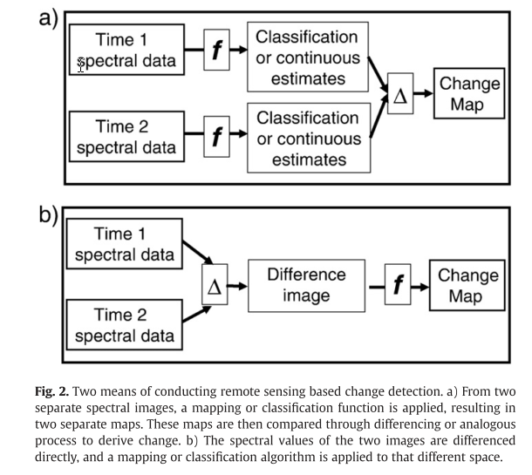
Means of conducting change detection
Kennedy et al. 2009
Notes:
Kim – get figure for “drilling through” a pixel through a time series
We can do this two different ways:
Compute differencing after making classifications
Example, looking at change in independent land use / land cover maps
Subtracting categorical values
Not ideal! This is hard because the changes are already classified, hard to compare classes to classes, but sometimes might be all you have to work with
Calculate difference on spectral values directly to calculate magnitude of change
What we’re doing today is… basically b. not using raw spectral values, but we DID still apply functions to our data

Slide 10
Image Standardization
How do we standardize our data?
Radiometric and atmospheric corrections
Image enhancements, such as NBR and NDVI
Calculating Z-scores
Why is this important?
Accounts for differences between images
Illumination, time, space
Allows for the direct comparison of images
Creates direct measurements that are transferable across studies
Notes:
All about putting things in context. We’ve done some standardizing by creating these indices, but a change or decrease of, like -0.1 in NDVI still doesn’t mean much
So, we standardize our outputs using Z scores
Lots of different standardization steps:
Radiometric and atmospheric connections – sensor / raw image
Image enhancements, such as NBR and NDVI
Z-scores
Basically, the number of standard deviations a value is, above or below a population mean is this pixel
So,
Zero means area probably didn’t change at all
Positive 1: one standard deviation increase in change
Negative 3: big decrease
Allow us to compare and interpret across space and time
Calculated as the difference minus the mean, over the standard deviation

Slide 11
The Standard Score (z-score)
can be calculated from the raw difference values for each pixel in an image using the equation below, where:
x represents the difference value for a pixel
mu μ represents the estimated (observed) mean of the difference values of all pixels in the image
sigma σ represents the estimated (observed) standard deviation of the difference values of all pixels in the image

Slide 12
Demonstration
Exercise 4: Image Differencing and Calculating z-scores

Slide 13
Course Agenda
Day 2 – Morning
10:00-10:45 – Presentation: Image standardizations and image differencing
10:30-11:00 – Demonstration: Calculating z-scores
11:00-11:10 – Break
11:10-11:30 – Presentation: Change thresholding and discussion of accuracy assessment
11:30-12:00 – Demonstration: Exploring histograms and creating change maps
Tasks to complete before the next session: Exercise 4 + 5
Day 2 – Afternoon
2:00-2:30 – Q + A and Exercise Help
2:30-3:00 – Presentation: Change detection applications within USFS
3:00-4:00 – Final Q + A; help with course-related projects/ideas

Slide 14
Lecture outline:
Image differencing example and discussion
Thresholding
Change histograms
Methods of change thresholding
Evaluation and accuracy assessment
Importance of accuracy assessment
Site vs. non-site-specific accuracy assessment
Error matrices
Limitations
Demo: Exploring histograms and creating change maps

Slide 15
Objectives
Gain awareness of image differencing techniques
Understand the need to standardize data
Explore histograms of difference images
Gain awareness about different thresholding options
Review accuracy assessment options

Slide 16
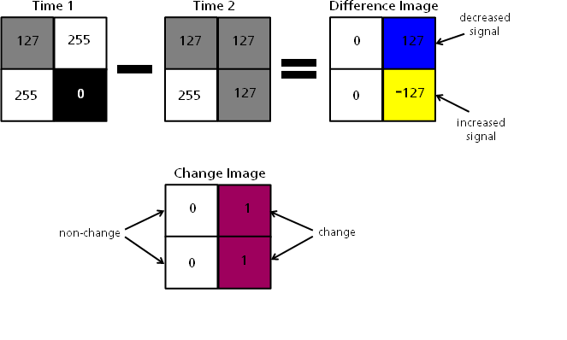
Image Differencing
Notes:
2x2 mock-up of image differencing – this is what is happening in the raster calculator, just on a much smaller scale!
Time 1: eg, NDVI values two very high, one medium, one zero
Time 2: we see that one pixel increased in value, one pixel decreased in value, even if they were all the same value
Difference image is the results of subtracting time 1 from time 2, like we did here
Pixels that don’t change might not have values of exactly 0
You can subtract in either order, depending on the sign of output that’s more intuitive to you

Slide 17
Change Histograms
Distribution of pixel values in change image (Time1-Time2)
Rarely will a pixel have exactly the same value in both images
Changed pixels deviate most from the central tendency
Classify change in pixels to separate “real change” from noise.
E.g., apply thresholds
0 (no change)
Notes:
Even if images are well corrected and well matched, rarely would we expect a pixel to have the same value in time 1 and time 2 images. The distribution of change pixel values will most likely follow normal distribution, with the mean pixel value centered on zero and ‘true change’ depicted by pixels some distance from this mean.
We use histograms to identify where change pixels are
If we plot all the values we find in a difference image, most will fall in the middle. More “significant” change, or less common values, will fall on the tails of the bell curve
The assumption is that noise will fall in the middle of the bell curve
Identifying where the “threshold” should be placed to identify the z score values that correspond to “real change”
More an art than a science!
This is super good for very significant change but less good when the change you’re interested in might look like noise

Slide 18
Change Thresholding
Manual
Hand digitizing
Manual threshold placement
Automated
Algorithm placement
Defined thresholds based on empirical research
Semi-automated
Classifying change
Notes:
Manual
Hand digitizing to id where change is—not looking at histogram at all
Manual threshold placement, which is what we’re doing today—fiddle with it until it “looks right”
Automated
Use an algorithm to help you choose the threshold
Or use pre-determined thresholds based on empirical research for a similar area
Semi-automated
Use something like random forests, with inputs of training data, to help you classify areas of change
Still biased by our selection of training data points

Slide 19
Evaluation of Change Maps
In spite of our efforts, change maps likely contain errors…
Accuracy assessment – Evaluate the correctness of the change map produced
Compare the change map to reference data
Independent training and reference data
Many assessment options depending on goals and resources
Notes:
Careful analysis and post-processing can improve accuracy.
Change maps will still likely contain errors and these should be addressed in an accuracy assessment.
Does my map agree with reference data… It’s not really an accuracy assessment, it’s an agreement assessment… Reference data can have problems
Evaluate the correctness of change map produced by:
Comparing against reference data that could be:
Take map out into the field to validate that you can see change on the ground
Use higher-res data like NAIP or worldview to confirm if pixels mapped as change still appear as such when you add more detail

Slide 20
Importance of Accuracy Assessments
Accuracy assessments are essential parts of all modeling exercises, remote sensing or otherwise.
They allow users to compare different change detection approaches.
They provide information on the reliability and usefulness of change detection techniques
They support the use of change map for decision-making.
Notes:
Accuracy assessments are super important, especially when sending folks into the field. Don’t want people to waste time or resources, or give people a bad product
Accuracy assessments:
Allow us to compare different change detection approaches.
E.g., have a reference data that might be for a difference change detection approach
Eg, ADS v deltaviewer
Help us know we’re using good products
Also give us confidence in making good mgmt. decisions

Slide 21
Site vs. Non-Site Specific Accuracy
Non-Site
No locational component
Total acreage by category comparison between a change map and some reference data (e.g. FIA data)
Site
Locational/Spatial component
Use of error matrix to represent errors of omission and commission of change (spatial error)
Notes:
Non-site—no about actual location, just general acreage
Site-specific – does have locational information, can help you create an error matrix

Slide 22
Non-Site Specific Accuracy
Classified Image #1
Reference Data
Change = 1,200 acres
Classified Image #2
Change = 1,000 acres
Change = 1,200 acres

Slide 23
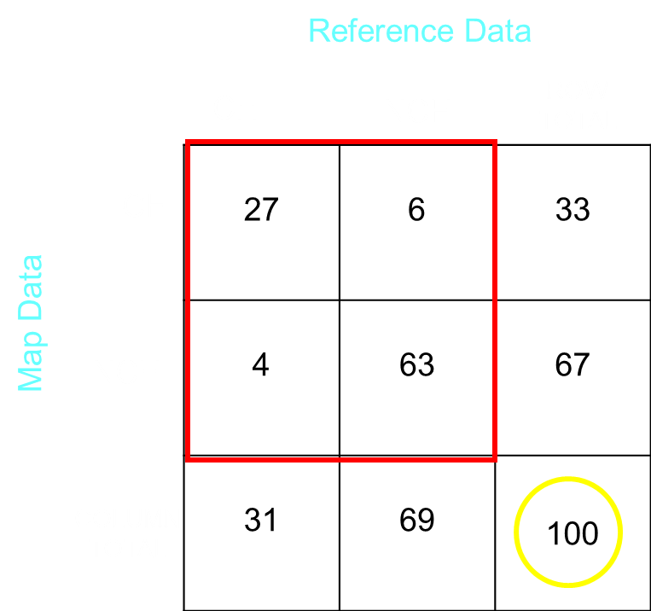
Change Map- Error Matrix
CH = Changed
NCH = Not Changed
Notes:
Quantify errors in an error matrix
Error matrix:
Overall accuracy, co-mission and omission
We have a whole course dedicated to these!
Basically, you plot how many pixels represent change, versus non change—for the reference data and the map data—and where there’s agreement between the data sets
Correct pixels are in the places where the categories meet; incorrect pixels show where something was classified as something else
Error matrices are important and more straightforward than they look

Slide 24
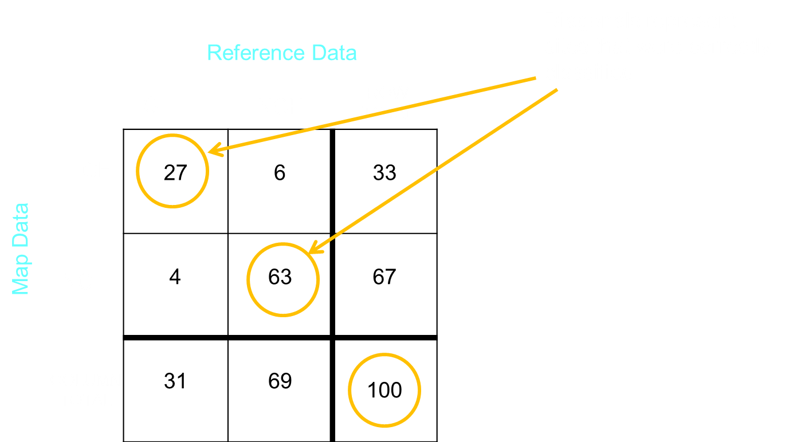
Change Map- Error Matrix
CH = Changed
NCH = Not Changed
Overall Accuracy =
27 + 63 = 90
90/100 * 100 = 90%
Notes:
Quantify errors in an error matrix
Error matrix:
Overall accuracy, co-mission and omission

Slide 25
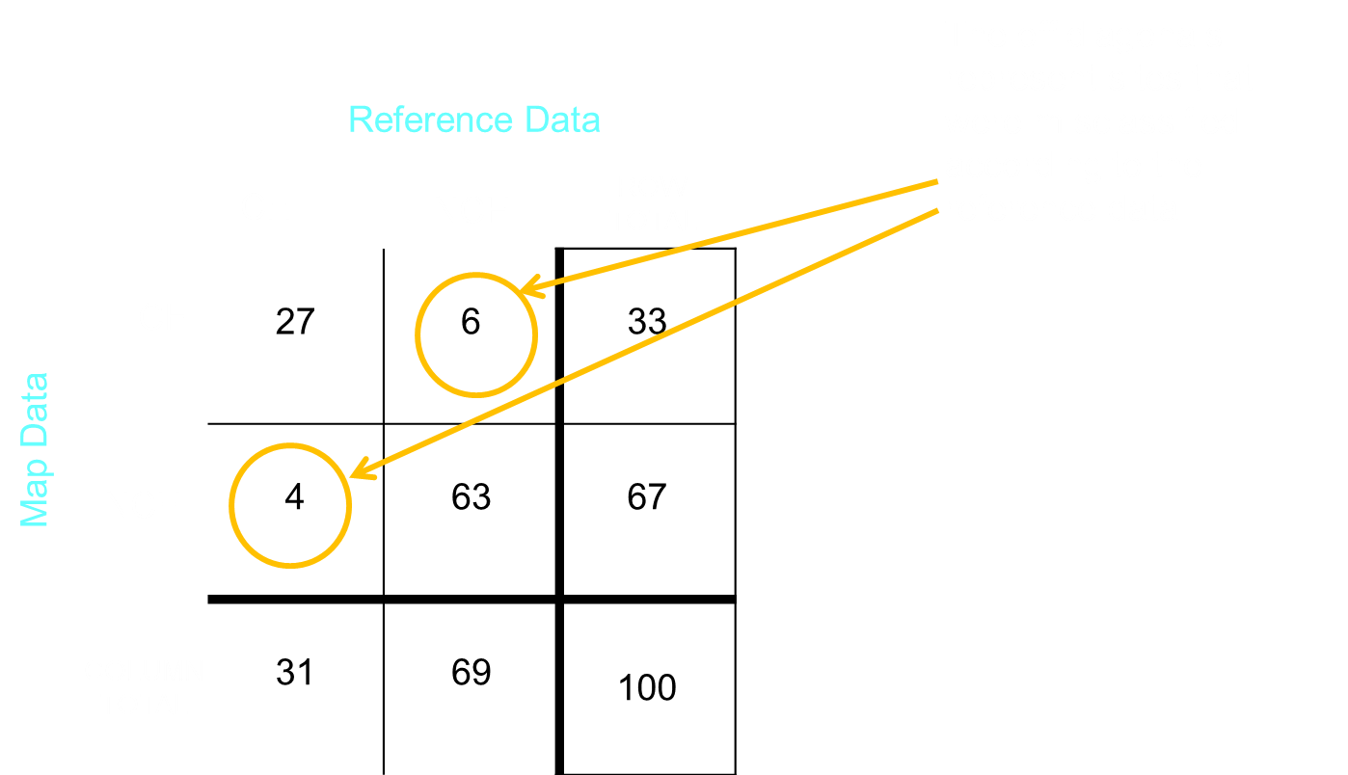
Change Map- Error Matrix
Notes:
Quantify errors in an error matrix
Error matrix:
Overall accuracy, co-mission and omission

Slide 26
Change Map- Error Matrix
Omission: CH in the reference data, NCH on the Map
Comission: NCH in the reference data, CH on the map
Notes:
Quantify errors in an error matrix
Error matrix:
Overall accuracy, co-mission and omission

Slide 27
Site Specific Accuracy - Summary
It’s more complicated than simply reporting overall accuracy…
Consider the relative costs of omission vs commission errors
These considerations should influence your choice of analysis methods, thresholds, post processing steps, etc.

Slide 28
Limitations
Doesn’t consider the accuracy of the change blob boundaries
With multiple change classes:
Makes no distinction for the magnitude of error
Assumes each site can only be assigned to one map category
Notes:
Error matrices don’t consider the accuracy of the boundaries
So, doesn’t consider the location of the overprediction pixels, even if you were to get one whole side right, or if you’re one pixel off—error matrix will treat misclassified pixels the same, doesn’t give you partial credit
With multiple change classes: doesn’t distinguish for the magnitude of error
Classifying incorrectly within class, versus classified as the wrong class entirely
Forest fire pixel. Difference between classifying change as: Forest changes to development vs. forest changes to shrub or grass
One is much more wrong than the other!
Again, no partial credit
Each site can only be assigned to each map category
This is more important in determining your map categories
But in error matrix, pixels are big! Area might contain more than one landcover type and only be…. Partially wrong. There is complexity within the pixels
It’s a little wrong to call a tomato a vegetable, it’s a lot wrong to call a tomato a hammer… (James cannot take complete credit for this quote, as much as he would like to.)

Slide 29
Assessment Options
Best Option –
Quantitative evaluation with field-collected reference data – many points from a designed sample (i.e., stratified vs. random).
Requires time, money and resources.
Mid-level Option –
Computer validation of the map, using ancillary GIS layers and photo interpretation.
Qualitative assessment of map product in the field.
Low-level option
No quantitative/qualitative accuracy assessment is done of the map product… Rather, quality of the product is inferred by the quality of the process.
Assumption: If the logic and data are sound, the output are reasonable
Notes:
Best option:
- quantitative field evaluation with field-collected referenced data—
Many points from a designed sample
Takes a lot of $$ to do field collection of reference data
Mid-level option (most frequently used at GTAC):
Computer validation of the map, using ancillary GIS layers and photo interp – create a digitally derived reference set
After that computer validation, you can take it out into the field and give it a peek qualitatively
Low-level option
No quantitative / qualitative accuracy assessment; just assume / justify that because inputs are sound, output is sound. This is not the case!

Slide 30
Demonstration
Exercise 5: Exploring Histograms and Creating Change Maps

