Slide 1
Introduction to Change Detection Lecture 5: Data access + applications
Instructor: Lila Leatherman (they/them)
November 17-18, 2020

Slide 2
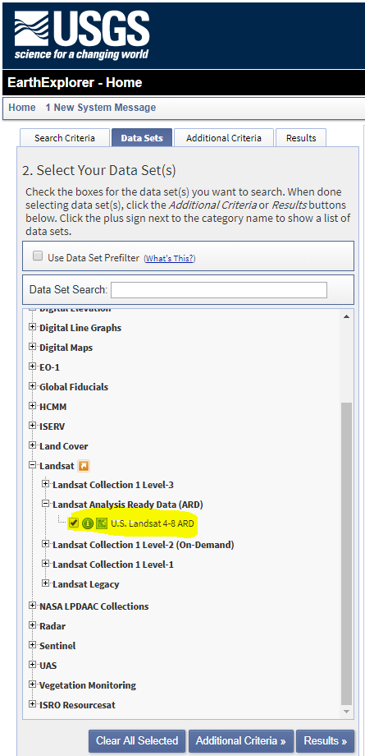
Data Resources – For your own projects
There is preprocessed Landsat data all over the place!
Analysis Ready Data (ARD)
Level-2 Data Products
Google Earth Engine
Ancillary Data:
Landcover data (Landsat derived)
NLCD
Landfire
And many more…

Slide 3
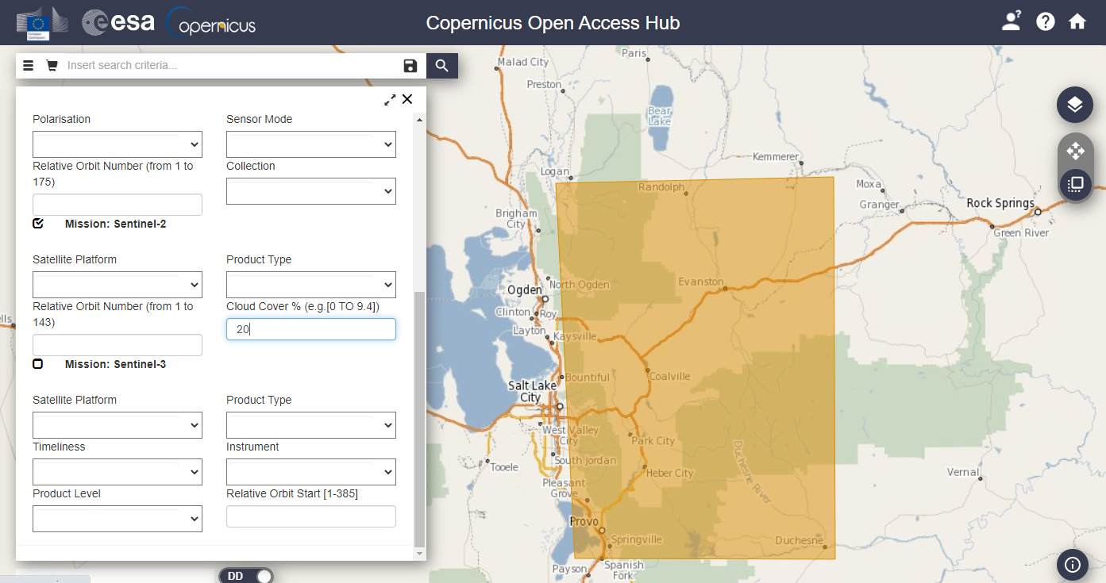
More data resources
Sentinel-2 Data
Copernicus via the European Space Agency
Notes:
Free to make an account!

Slide 4
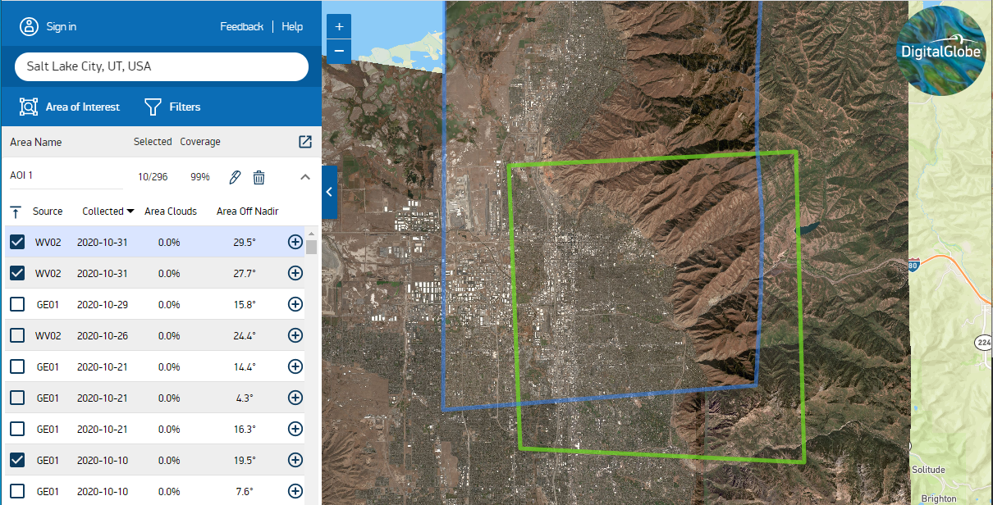
More data resources
WorldView data
Digital Globe – Discover to browse , EVWHS to download
Notes:
Need a federal sponsor for an account

Slide 5
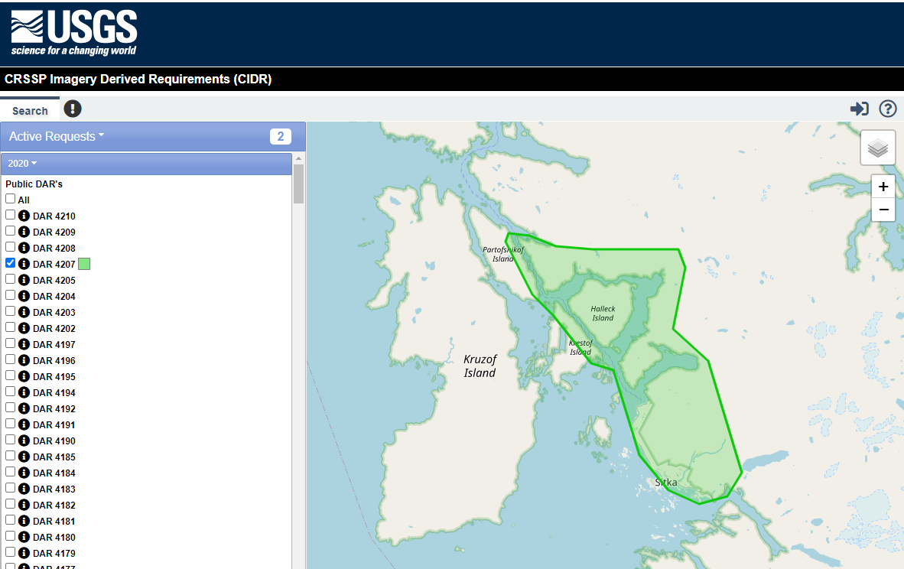
More data resources
CIDR request portal

Slide 6
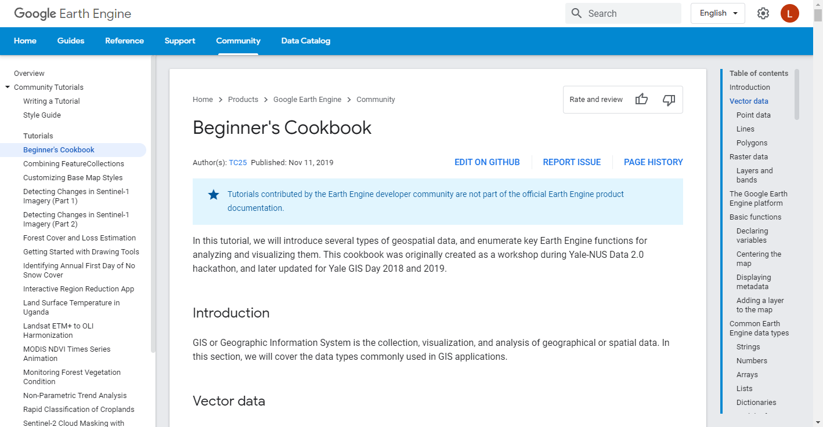
More data resources
Google Earth Engine tutorials
From GEE
From GTAC

Slide 7
More data resources
Tutorials on image access developed for FHP
Obtaining Remotely Sensed Imagery webinar + self-paced tutorial

Slide 8
Data Resources - Disturbance Mapping Projects
USFS/partner programs
Fire Mapping
BAER (Burned Area Emergency Response), RAVG (Rapid Assessment of Vegetation after wildfire), MTBS (Monitoring Trends in Burn Severity) and more…
Forest Health and Disturbance Monitoring
FHAAST (Forest Health Assessment and Applied Sciences Team)
More programs and partnerships
USGS/NASA, research institutions, Google Earth Engine, etc.

Slide 9
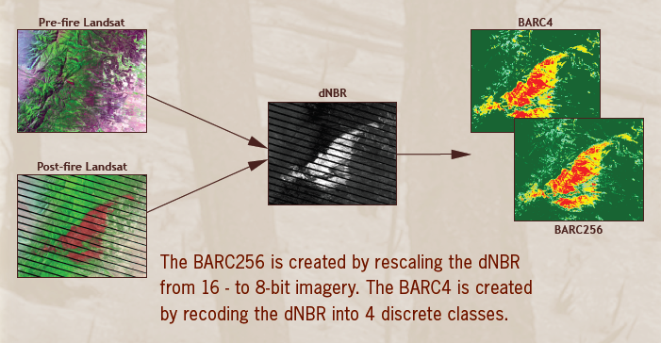
Fire Effects Data Products - BAER
Burned Area Reflectance Classification (BARC)
1-7 days post containment
Notes:
Delivered to BAER teams upon request. First approximation of burn severity which can be used to identify hazards from flooding, landslides, etc. BARC is classified dNBR difference image.

Slide 10
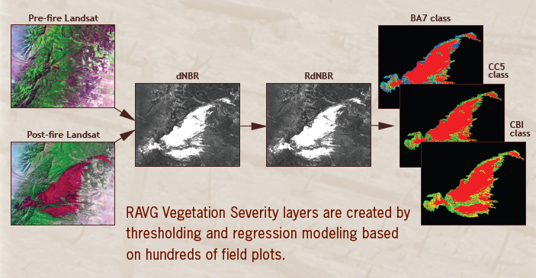
Fire Effects Data Products - RAVG
RAVG Severity layers and tables
30-45 days post containment
All fires >1000 acres on USFS land
Notes:
Primary audience for RAVG data are regional silviculturists who need to communicate yearly reforestation and restoration needs.
Uses established regression models that relate calibrated NBR difference layers to field plot data in order to estimate changes in forest inventory parameters such as canopy cover and basal area.
Data is available via the RAVG website which you can get to via RSAC websites.

Slide 11
Fire Effects Data Products - MTBS
Burn Severity layers from MTBS
Assessed 12-18 months post containment
All fires >1000 acres on USFS land
Notes:
Long term monitoring of fire severity effects. Thresholds applied to the calibrated NBR difference image to create fire severity maps with low, medium and high severity burns

Slide 12
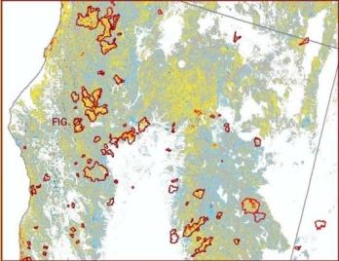
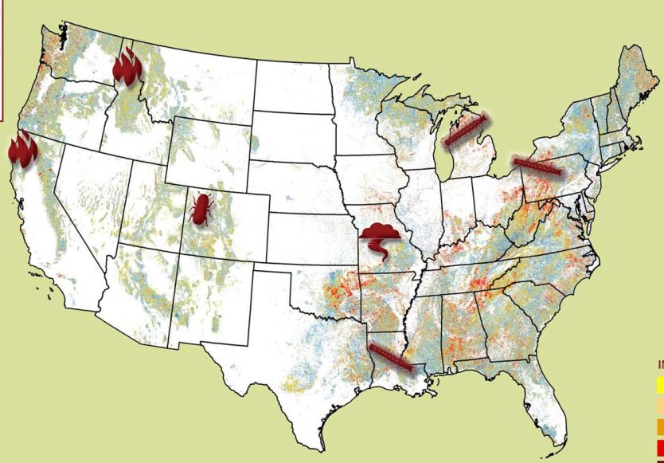
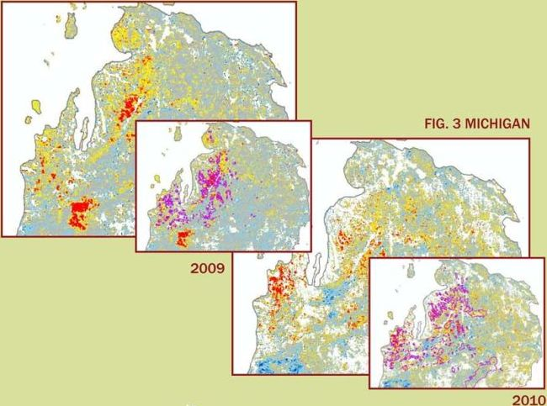
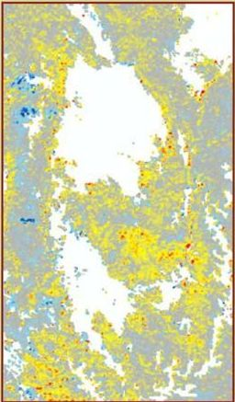
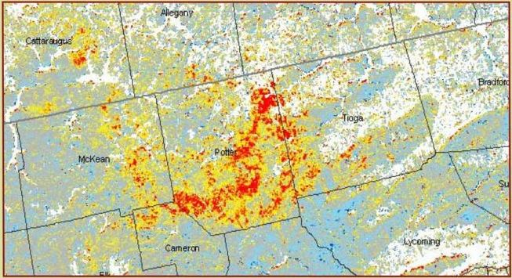
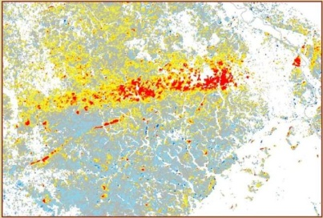
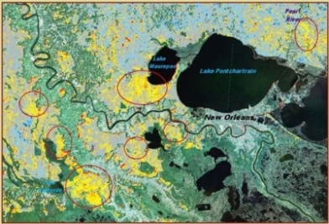
Near Real-Time Forest Disturbance Program MODIS-Scale Application
USFS RTFD program provides the state and local forestry aerial sketch-mapping community with timely information to assist in flight mission planning.
Delivers near-weekly results (every 8 days) of change detection analysis
MODIS-based, 500m resolution
All land ownerships, but limited to forested area
Will improve Aerial Detection Survey program efficiency
Northern California fire scars
Michigan 2009 and 2010 Forest Tent Caterpillar
MODIS Disturbance Detection:
Aug 29 – Sept 13, 2010 compositing period
CO Mountain pine beetle
Pennsylvania 2010 Forest Tent Caterpillar
Missouri 2009 Storm Damage
Louisiana 2010 Forest Tent Caterpillar

Slide 13
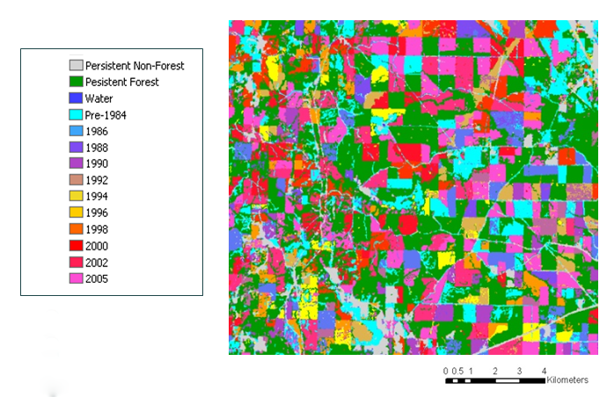
North American Forest Dynamics (NAFD)
Forest Disturbance and Regrowth Data
Products from analyses of Landsat time series
Vegetation Change Tracker (VCT) Algorithm
Data available for 55 areas in the US
NAFD project summary and data access
Notes:
The NAFD project uses the Vegetation Change Tracker (VCT), an automated forest change analysis algorithm, on temporally dense (annual or biennial) Landsat Time Series Stack (LTSS) of images and produces forest disturbance data products (Huang et al. 2010). The VCT algorithm was designed specifically for mapping forest change using LTSS. The algorithm consists of two major steps: 1) individual image analysis and 2) time series analysis. VCT produces a disturbance product where each pixel is labeled as either a static land class (persistent non-forest, persistent forest, or persistent water) or with the year of change for disturbed forest pixels.

Slide 14
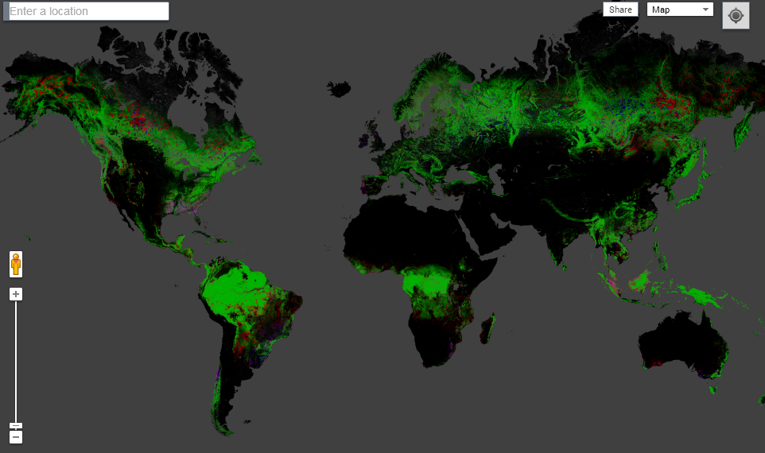
Hanson’s Map of Global Forest Change

Slide 15
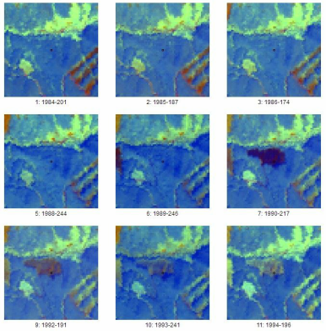
Tools for validation – TimeSync
Online tool facilitating human interpretation of Landsat time series
Useful for:
Validating change detection output
Estimating change from samples
Users get to interpret both images and plots

Slide 16
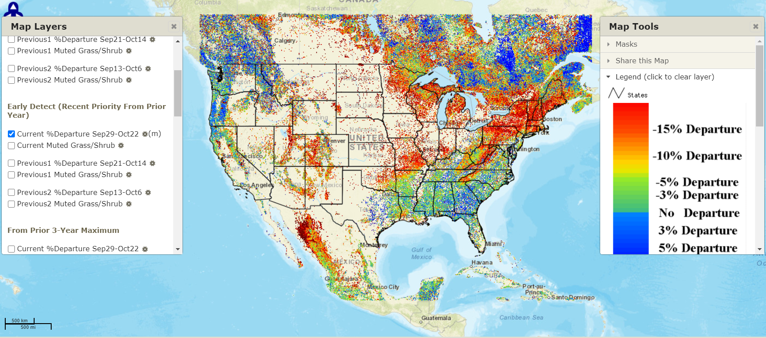
ForWarn
https://forwarn.forestthreats.org/fcav2/
Notes:
ForWarn is a vegetation change recognition and tracking system that uses high-frequency, moderate resolution satellite data. It provides near real-time change maps for the continental United States that are updated every eight days.
ForWarn relies on daily eMODIS and MODIS satellite data
It tracks change in the Normalized Difference Vegetation Index (NDVI)
Coverage extends to all lands of the continental US
Products are at 232 meter resolution (13.3 acres or 5.4 hectares)
It has NDVI values for 46 periods per year (at 8-day intervals)
It uses a 24-day window with 8-day time steps to avoid clouds, etc.
The historical NDVI database used for certain baselines dates from 2000 to the present
The different forest change products relate to the length of the baseline and the compositing method used to display percent NDVI departure. They are:
Change using a 1-Year Baseline (recent disturbances, 1yr or less);
Early Detect 1-Year Baseline (disturbance resolved in as few as 8-days);
Change using a 3-Year Baseline (3-year old disturbances);
Change using a 5-Year Baseline (5-year old disturbances);
Change using a 10-Year Baseline (10-year old disturbances);
Change using an All-Year Baseline (all disturbances since 2000);

Slide 17
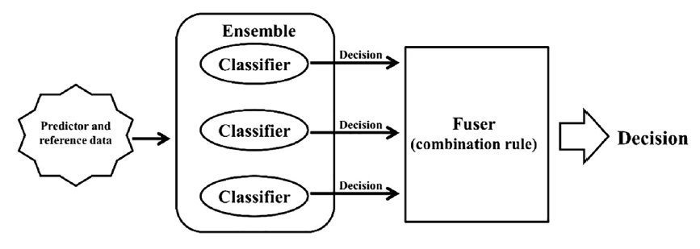
Land Change Monitoring System (LCMS)
The LCMS approach takes advantage of the differences between change detection methods by combining them using an ensemble classifier

Slide 18
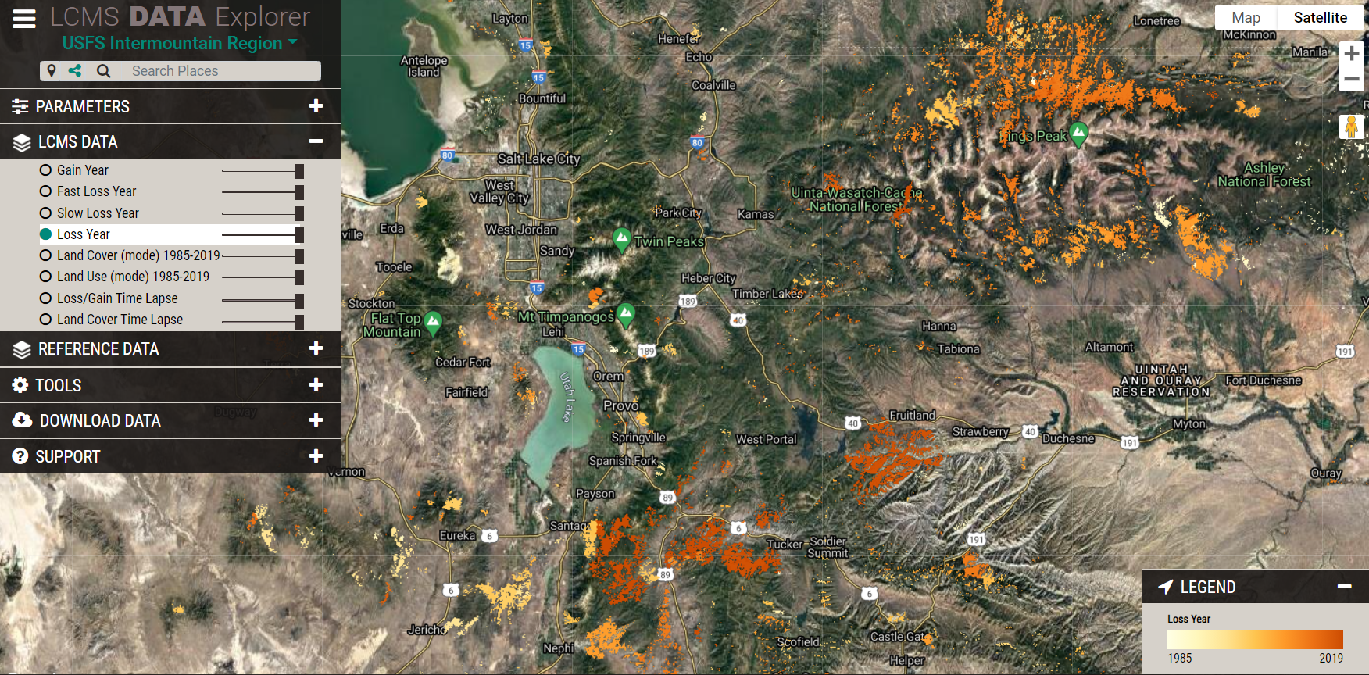
Landscape Change Monitoring System (LCMS)
https://apps.fs.usda.gov/lcms-viewer/
Notes:
The Landscape Change Monitoring System (LCMS) is a remote sensing-based system for mapping and monitoring landscape change across the United States. LCMS produces annual maps depicting change (vegetation loss and vegetation gain), land cover, and land use from 1985 to present that can be used to assist with a wide range of land management applications.
Purpose
With the help of regional and national forest staffs we have identified many applications of LCMS data, including forest planning and revision, updating existing vegetation maps, assessing landscape conditions, supporting post-fire recovery, and meeting some broad-scale monitoring requirements.
LCMS uses an ensemble modeling approach to generate a “best available” map covering multiple disturbance processes and diverse cover types. Vegetation loss and gain, land cover, and land use are modeled using predictor layers derived from several change-detection algorithms (LandTrendr, VeRDET, and CCDC) as well as annual Landsat image composites. Training data is identified using a stratified random sample and is photo-interpreted using the TimeSync visualization software and other relevant geospatial layers. Because no algorithm is expected to perform best in all situations, this approach provides a framework for intelligently assimilating the varied strengths of existing change-detection algorithms into one comprehensive change map that leverages advances in time series-based change detection techniques, Landsat data availability, cloud-based computing power, and big data analysis methods.

Slide 19
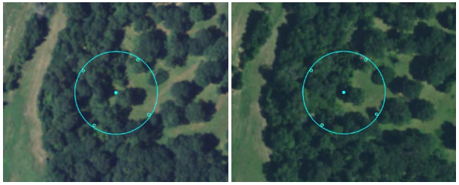
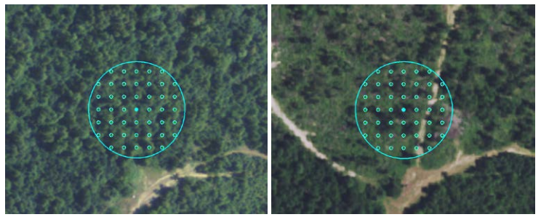
Image-Based Change Estimation (ICE)
No change
What is it?
Sampling approach using image-based interpretations to quickly estimate land cover and land use change
When no change present, 5 points
When change present, 45 points
All points attributed with LULC
Completed for all lower 48 states
Interpretation cycle follows NAIP’s schedule
Change

Slide 20
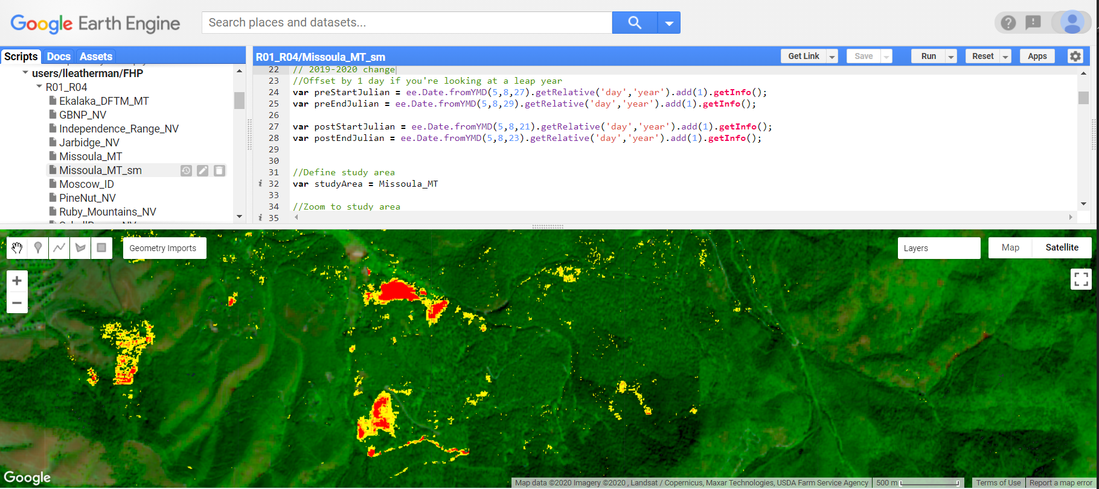
DeltaViewer Overview
Basic two-date change detection
On an as-requested basis
Implemented in Google Earth Engine (GEE)
Used in FHP to fill the gap left by aerial surveys grounded by COVID

Slide 21
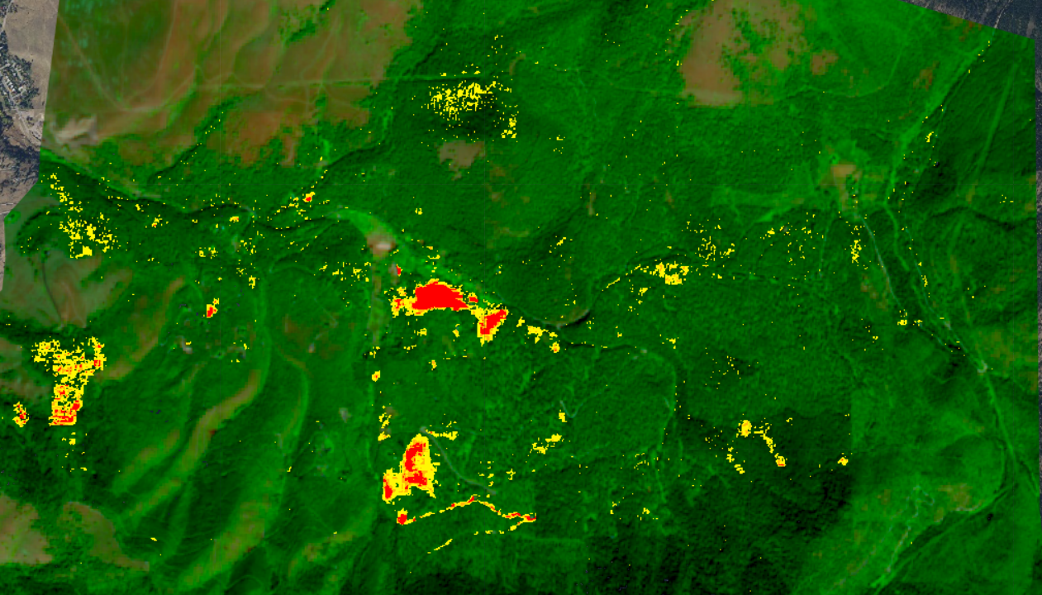
Delta Viewer
Missoula, MT – Pattee Canyon, Douglas Fir Tussock Moth
Post-event Sentinel-2 Imagery
False color + change product
2020-08-21

Slide 22
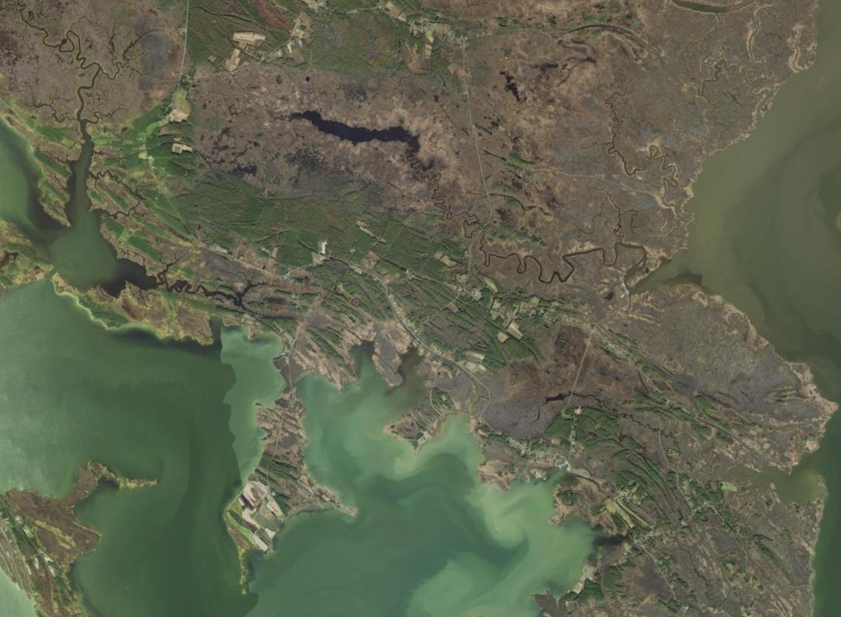
Saltwater Intrusion– DelMarVa Peninsula

Slide 23
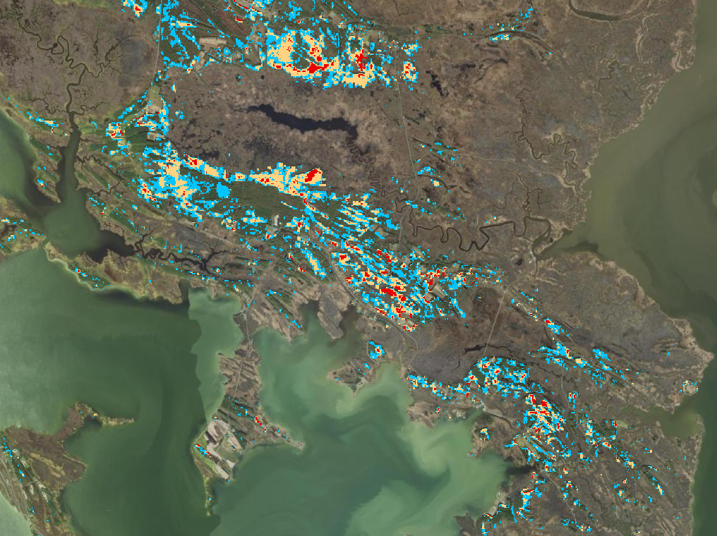
Saltwater Intrusion – DelMarVa Peninsula
Change between 2017 and 2020
2017 image: 7/30
2020 image: 7/14

Slide 24
GTAC Remote Sensing Contacts
Point of Contact | Specialization | Email
Indigo Catton | Image interpretation, data portals, ArcGIS Pro, segmentation | indigo.catton@usda.gov
Kain Kutz | Object-based Image Analysis, Raster Geoprocessing, UAS | kain.kutz@usda.gov
Lila Leatherman | Change detection, Image classification, R & Earth Engine scripting, modeling | Lila.Leatherman@usda.gov
Jeremy Webb | Aerial Photography, Photogrammetry, UAS | jeremy.webb@usda.gov
Mark Hammond | ERDAS and Data Services, Photogrammetry | mark.hammond@usda.gov
Shiona Howard | Lidar Acquisition, Analysis, and Support, Python scripting | Shiona.Howard@usda.gov
Geospatial Training and Awareness page

Slide 25
Questions?
Lila.Leatherman@usda.gov

