Slide 1
Introduction to Google Earth Engine
Nolan Cate
December 5, 2017

Slide 2
Housekeeping
Instructor: Nolan Cate
Contractor, USDA Forest Service, Geospatial Technology and Applications Center (GTAC)
If dialed into teleconference:
Please mute your phone
Do not put the call on hold
Question or comment?
Unmute by dialing *6
Send a chat
Notes:
In this quick presentation and demo - you’ll learn what Earth Engine is, and how you can access data and conduct spatial analysis with it. There are two platforms you can choose to interact with Earth Engine – and we’ll briefly explore both today. Since we are limited on time and we have a lot to cover, I’ll address questions at the end of the presentation. Also, because we have such a large group I’ve muted everyone to cut down on white noise. However, do feel free to type them into the chat pod and Nolan will compile them while I demonstrate the software. You can also press star 6 on their phone to unmute and ask a question – however, please leave these questions until the end of the demonstration.

Slide 3
Agenda for Today:
10:00 – 11:15: Earth Engine Overview & Common Objects (ppt and demo)
11:15 – 1:00: BREAK – Exercise 1 & 2
1:00 – 1:30: Cloud masking and the RAVG case study (ppt and demo)
1:30 – 3:50: BREAK –Exercise 3 & 4
3:50 – 4:00: Wrap-up and Discussion

Slide 4
Tips: Different Levels of Programming Experience
Material Goal: work with a diversity of skill levels
Beginner coder: take it slow… might not finish all the exercises
Advanced coder: can move quickly through pieces that you are already comfortable with and begin applying it to your own projects.

Slide 5
Earth Engine Overview
What is Google Earth Engine?
Example Applications
Two Platforms:
Code Editor
Explorer
Demo
Notes:
In this quick presentation and demo - you’ll learn what Earth Engine is, and how you can access data and conduct spatial analysis with it. There are two platforms you can choose to interact with Earth Engine – and we’ll briefly explore both today. Since we are limited on time and we have a lot to cover, I’ll address questions at the end of the presentation. Also, because we have such a large group I’ve muted everyone to cut down on white noise. However, do feel free to type them into the chat pod and Nolan will compile them while I demonstrate the software. You can also press star 6 on their phone to unmute and ask a question – however, please leave these questions until the end of the demonstration.

Slide 6
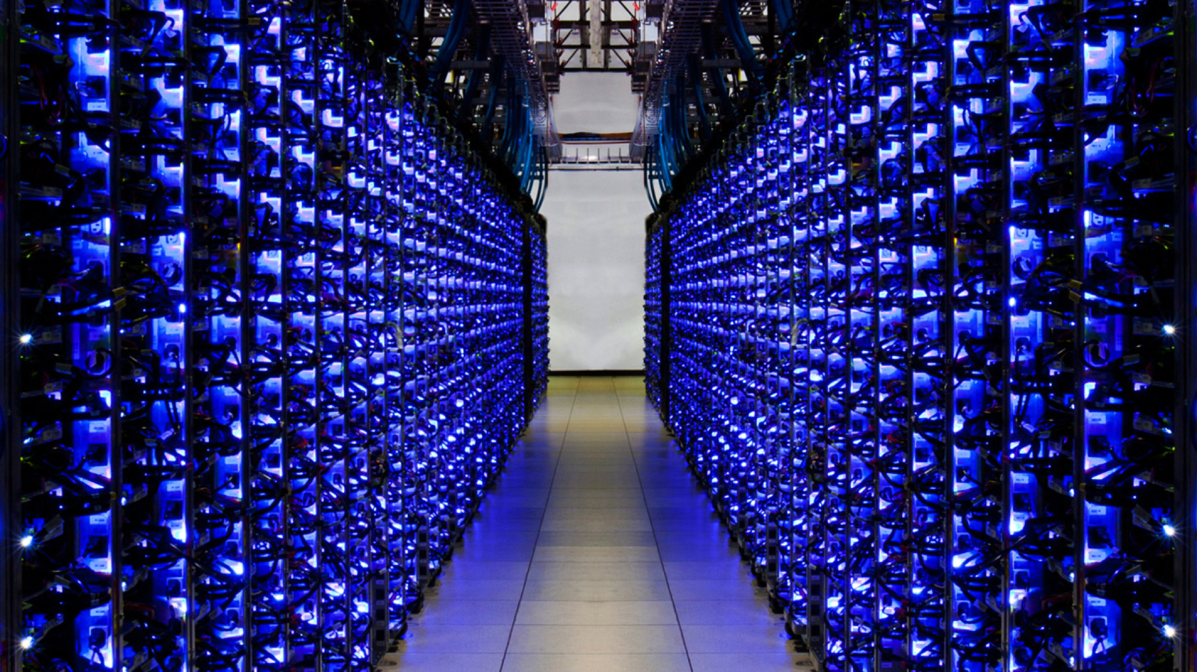
What is Earth Engine?
A cloud-based geospatial processing platform for executing large-scale environmental data analysis.
Remote Sensing Archive:
Petabytes of data in one location
Photo courtesy of Google Earth Outreach
Notes:
It is a cloud-based geospatial processing platform for executing large-scale environmental data analysis. Applications of environmental analyses in Earth Engine include detecting deforestation, classifying land cover, and urban mapping.

Slide 7
What it’s not …
Notes:
There has been a lot of confusion lately about the differences between Google Earth, Earth Engine, and Maps Engine. While Google Earth uses products created in Earth Engine (for example, a global cloud-free Landsat mosaic at 15m resolution), they are not directly connected.

Slide 8
Why is it such a powerful image analysis software?
Public data catalog: vast amounts of publicly available data (you don’t need to store data)
Processing power (computation engine):
Distributed computation power
Cloud processing (Google’s computer clusters)
Comprehensive toolset to analyze data: scientific algorithms ready for use & the building blocks to create your own
Interactive development platforms:
Explorer
Code Editor
Save and share work routines
Notes:
Three aspects of Earth Engine make it quite powerful as a geospatial processing tool. The first is its extensive public data catalog, the second is the processing power of the computation engine, and the third is its interactive development platforms.

Slide 9
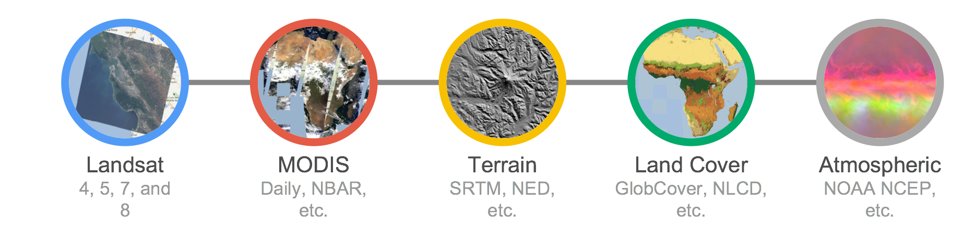
1. Earth Engine Public Data Catalog
Imagery
Geophysical
Climate & Weather
Demographic
Vector Data
Image: Dave Thau
Notes:
In the data catalog, there is over 40 years of current and historical imagery and data in the Earth Engine data library. Available data sets include
Imagery – these imagery sets include both raw and pre-processed, georeferenced data products that are ready for use. Examples include NAIP, comprehensive Landsat archive, and MODIS data and ancillary products such as global composites and max NDVI.
Geophysical data – such as digital elevation models, surface temperature, and land cover
Climate and weather – NASA’s TOMS atmospheric data and – forecast weather and climate model data
Demographic data – such as population density estimates
Users are also able to load in their own data – both imagery and vector files to use for analysis.

Slide 10
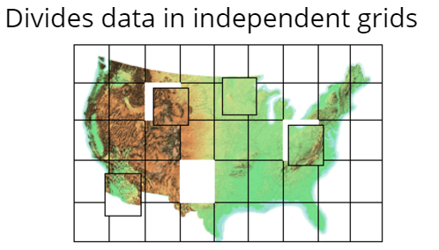
2. Computation Engine
“The computation engine is a just in time distributed computation model, ...”
Notes:
This means that the analysis requests are sent out to many different computers; each computer runs the calculations on a small area (small number of pixels) and returns the results. Requests are also efficient – it only computes for the input data of your requested values or to the extent of your screen. Results are then cached so that multiple requests for the same image or values do not result in re-computation. This results in:
– unprecedented speed: reduce processing times by orders of magnitude by using the cloud-based computing power
– Ease of use and lower costs. Online platform with easy access to data, scientific algorithms, computational power.

Slide 11
2. Computation Engine
“The computation engine is a just in time distributed computation model, a cloud-based processing infrastructure that automatically parallelizes analyses on many CPUs across many computers in Google’s data centers.”
Storage Clusters (petabytes of data)
Computing clusters (1,000’s of CPUs
Notes:
This means that the analysis requests are sent out to many different computers; each computer runs the calculations on a small area (small number of pixels) and returns the results. Requests are also efficient – it only computes for the input data of your requested values or to the extent of your screen. Results are then cached so that multiple requests for the same image or values do not result in re-computation. This results in:
– unprecedented speed: reduce processing times by orders of magnitude by using the cloud-based computing power
– Ease of use and lower costs. Online platform with easy access to data, scientific algorithms, computational power.

Slide 12
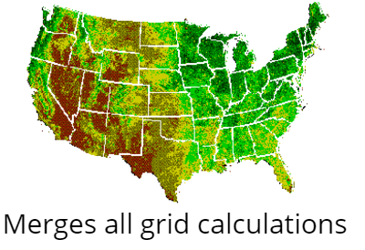
2. Computation Engine
Storage Clusters (petabytes of data)
Computing clusters (1,000’s of CPUs
Notes:
This means that the analysis requests are sent out to many different computers; each computer runs the calculations on a small area (small number of pixels) and returns the results. Requests are also efficient – it only computes for the input data of your requested values or to the extent of your screen. Results are then cached so that multiple requests for the same image or values do not result in re-computation. This results in:
– unprecedented speed: reduce processing times by orders of magnitude by using the cloud-based computing power
– Ease of use and lower costs. Online platform with easy access to data, scientific algorithms, computational power.

Slide 13
2. Computation Engine
Unprecedented speed: reduce processing times by orders of magnitude by using the distributed, cloud-based computing power
Ease of use and lower costs: online platform with easy access to data, scientific algorithms, computational power.
Notes:
This means that the analysis requests are sent out to many different computers; each computer runs the calculations on a small area (small number of pixels) and returns the results. Requests are also efficient – it only computes for the input data of your requested values or to the extent of your screen. Results are then cached so that multiple requests for the same image or values do not result in re-computation. This results in:
– unprecedented speed: reduce processing times by orders of magnitude by using the cloud-based computing power
– Ease of use and lower costs. Online platform with easy access to data, scientific algorithms, computational power.

Slide 14
Example Application
Resource Need:
Map all change between 2000 – 2010 over a specific forest
Extent of change
Year of occurrence
How would you accomplish this task?

Slide 15
Traditional Method
Select Area of Interest
Find WRS path/row(s) – assume an area of 4 scenes
Data Prep:
Download and store all Landsat during growing season (1 GB / zipped scene)
Extract and layer stack all Landsat (1.75 GB / scene)
~48 scenes per year * 11 years = ~528 scenes, or 924 GB
Apply atmospheric correction (924 more GB)
Normalize scenes
Apply FMASK or similar to remove clouds and shadows
Create composite and mosaic by year
Generate vegetation index per year (NDVI and/or NBR)
Analysis:
Build spatial model in ERDAS to compare year pairs
Generate change layer
Classify pixels > certain value as “change”
Build spatial model to apply year attribute to each pixel
Repeat for each year pair
Build spatial model to stack all attributed change layers into a single raster image, with the most recently changed pixel on top
Apply color ramp visually demonstrating change
Notes:
To solve the resource problem in question using traditional methods, we’d need to find and download individual Landsat scenes. Because of clouds, we’d look to download all images acquired during a growing season so we could use the best possible pixel during a year in our cloud-free composite. The amount of data needed to do such a process is mind-boggling (~1TB just to extract the necessary Landsat scenes in a relatively small area of interest, such as a district). Then we need to start doing the necessary data prep, such as image normalization, atmospheric correction, cloud-shadow busting, compositing, etc. Finally, we need to generate vegetation indices for each scene to help facilitate the change mapping.
With the data prep done, we would then start creating models to classify / threshold each pixel into change/no-change, then attribute each pixel with “when” the change occurred. Finally, we’d need to stack all the change layers back together with the most recent changed pixel on top and then display that spatially. Whew! This would take months to accomplish this process.

Slide 16
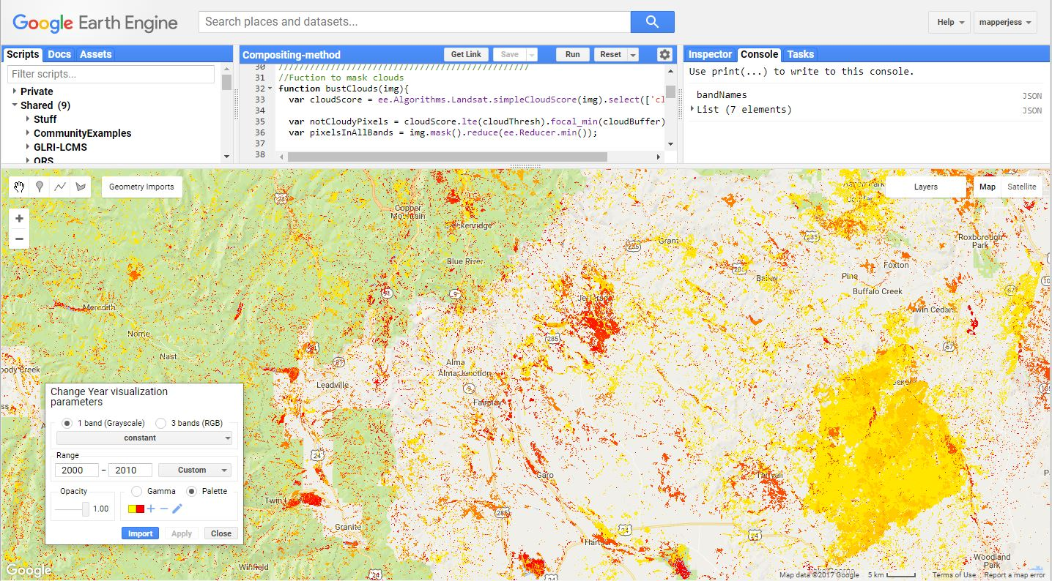
In Earth Engine
It took an experienced geospatial programmer ~1 hour and 100 lines of code to get the same result
Notes:
The new method took an experienced geospatial programmer about an hour and ~100 lines of code to generate a raster layer showing the extent of landscape change thematically colored by year of change (in this case, yellow changed closer to the year 2000 and red colors changed closer to 2010.
Users can change the AOI very simply and run this same process anywhere in the world, then export the results to a raster TIFF image.
This represents an extremely dramatic improvement in efficiency. In fact, it allows us to ask new questions.

Slide 17
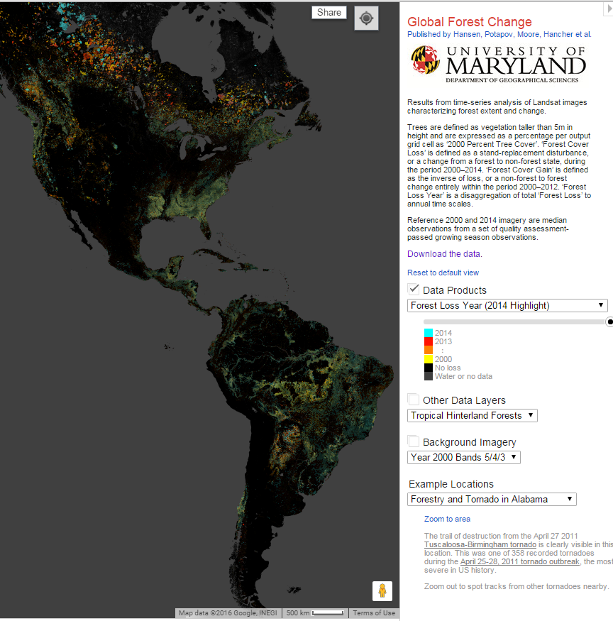
Example Application
Classifying land cover conditions and change detection:
Video of deforestation in Brazil https://earthengine.google.com/timelapse/?location=rondonia
Global Forest Change Map, Hansen et al http://earthenginepartners.appspot.com/science-2013-global-forest
Notes:
It is a cloud-based geospatial processing platform for executing large-scale environmental data analysis. Applications of environmental analyses in Earth Engine include detecting deforestation, classifying land cover, and urban mapping.

Slide 18
Earth Engine Costs
It’s free
An excerpt from their website:
“Why is Google working on Earth Engine?
Google's mission is to organize the world's information and make it universally accessible and useful. In line with this mission, Earth Engine organizes geospatial information and makes it available for analysis. More generally, Google strives to make the world a better place through the use of technology. Earth Engine’s technical infrastructure powers humanitarian, scientific, and environmental initiatives which Google is proud to support.”

Slide 19
When to use Earth Engine
EE Benefits:
Good for projects that requires:
Data coverage for a large region
Extensive data library
High speed, intensive processing capacity
Advanced raster processing tools
EE Limitations:
Better suited to image analyses than vector-based analyses
Analysis based on pixel spatial relations are harder to complete (because of the processing on multiple CPU’s). Image segmentation and hydrologic modeling options are limited

Slide 20
How GTAC uses Earth Engine
Streamline & Share GIS/RS workflows
Develop novel methods and algorithms
Bridge gap between literature & application
Create applications to deliver data & analysis capabilities to non Earth Engine users

Slide 21
Examples: GTAC use of Earth Engine
Robust cloud-shadow masking
Who: USFS Northern Research Station for EPA Great Lakes Restoration Initiative (GLRI)
Target: Robust cloud shadow removal
Where: Great Lakes Basins - now being utilized in nearly all EE-based projects
When: 1984-2014
Automated retrospective annual forest disturbance detection
Who: USFS Forest Health Technology Enterprise Team (FHTET) Operational Remote Sensing
Target: Both perennial and ephemeral forest disturbance events
Where: Continental US
When: Currently a pilot project intended to be implemented annually
Automated deforestation and degradation detection
Who: Lowering Emissions in Asian Forests (LEAF) / UN REDD+
Target: Perennial forest disturbance events with effects that persist > 2 years
Where: Madang, Papua New Guinea; Houaphan, Laos; Measa Kongma, Thailand; Lamdong, Vietnam
When: 2000-2014
Notes:
Some of the major remote sensing analyses we’ve performed in Earth Engine are shown on this slide. The cloud-shadow masking we perform for the GLRI project is now used in nearly all our other projects due to its effectiveness.

Slide 22
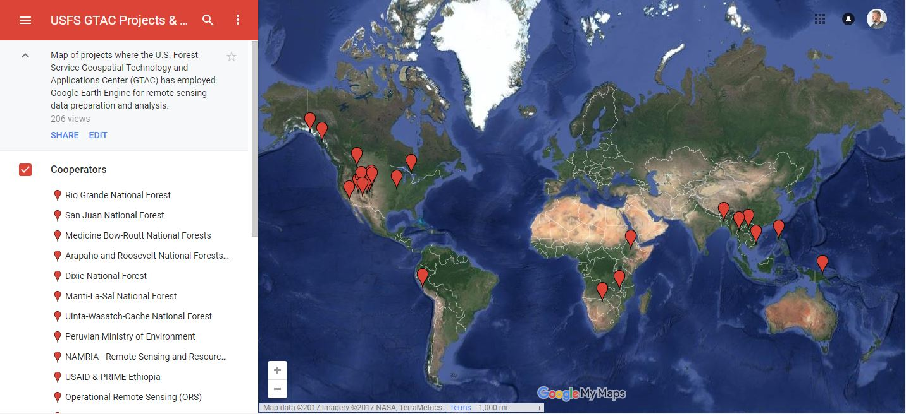
Where We Use Earth Engine

Slide 23
USFS EE Use Considerations
Google Earth Engine is a free platform that anybody can set up an account with. If you plan on using it for operational purposes, please email jesstclark@fs.fed.us and/or dvanderzanden@fs.fed.us
Google offers 256 gigabytes of extra storage space per user, plus 10 terabytes of shared storage space in addition to the data catalogs already considerable size.
Make sure you consider the sensitivity and privacy of any data you upload. Sensitive data (e.g. FIA plots) should be kept within the USFS, and not exposed to GEE.

Slide 24
3. Two Platforms
Graphical User Interface (Explorer)
https://explorer.earthengine.google.com/#workspace
User friendly way to begin exploring and analyzing data
Application Program Interface (Code Editor)
https://code.earthengine.google.com/
Powerful geospatial tool to create complex custom analysis
Requires some programming knowledge
Supports both JavaScript and Python*
Notes:
Earth Engine’s geospatial processing algorithms and API interface enables interactive algorithm development. These include basic spatial analysis operations (overlay, map algebra, vector based extraction of image statistics, etc.) and more advanced algorithms such as image classification, terrain modeling, and time series analysis.
Results can be reported as charts, maps, tables, or image exports. Google Earth Engine algorithms and user-submitted sample scripts – are constantly being added, enhanced, and updated – enabled by an open source environment.
Highly interactive algorithm development – a web based IDE for rapid proto-typing and visualization of complex spatial analyses across the world. Read more here: https://earthengine.google.com/platform/
Two Platforms
Explorer - a light-weight web app with point and click processing.
Code Editor - an IDE where users can program analysis scripts in either JavaScript or python. This allows the user to take advantage of a larger suite of Earth Engine processing algorithms and methods and create more complicated workflows.
Both platforms include a mapping window for instant visualization of results and data export capabilities. You have to register to access computational power in either platform; although you can visualize data in the Explorer without having an account.

Slide 25
Explorer Platform
A point and click platform:
Audience: non-programmers
Basic analysis functionality
Per pixel math (~ESRI’s raster calculator),
Neighborhood algorithms,
Terrain algorithms, etc
Save and share workspace
Explore and export data

Slide 26
Explorer Platform
Cons:
Limited analysis power:
subset of tools

Slide 27
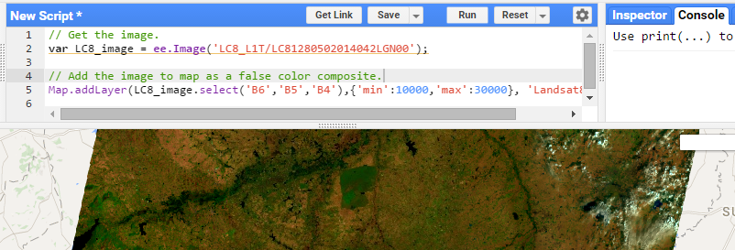
Code Editor
What is it?
Web based IDE for the Earth Engine API
Access many pre-made geospatial tools
JavaScript
Python

Slide 28
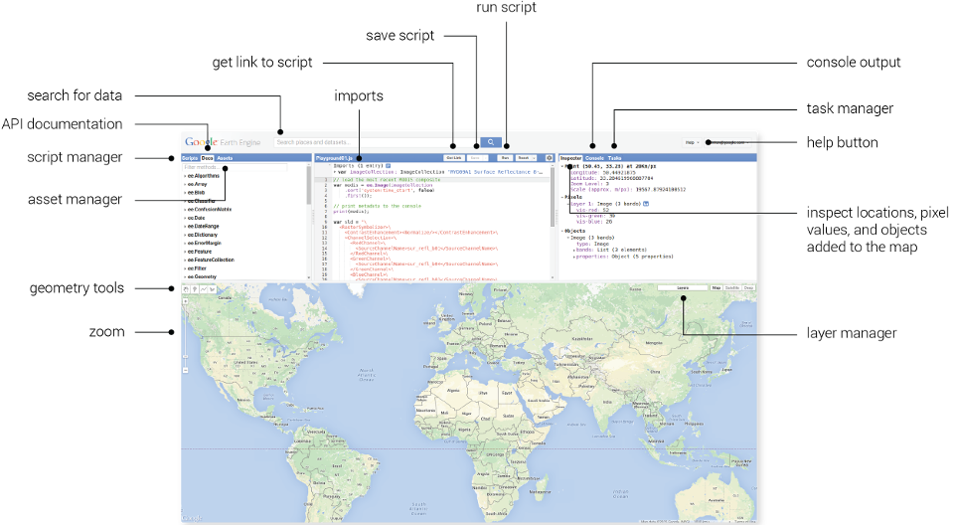
Code Editor Interface
Notes:
Point out the
Data search bar – this is similar to the one we saw in Explorer
Scripts and docs –
Scripts Manager - a wide variety of preloaded example scripts to provide simple examples of API usage;
Shared and your scripts can also be saved here – in the private scripts area;
Documentation List – a searchable list of documentation for the predefined GEE object types and methods (functions).
Text editor – write and edit code here. Click run to execute script.
Map output area – visualize the results of your query or analysis
Information panel - inspector, console, and tasks.
Inspector - locate information about the layers in your map,
Console - return messages as the scripts run and record any errors,
Manage the exporting of data and results to your google drive.
The Help dropdown menu in the upper right hand corner of the screen has many nice documents. The Feature Tour is a nice introduction that points out the different panels and features of the Code Editor.

Slide 29
Registration Process
Sign up for an Evaluator account:
Register here: https://earthengine.google.com/signup/
It may take up to one week to be granted access
If you don’t have access to the developers forum, sign up here:
https://groups.google.com/forum/#!forum/google-earth-engine-developers.
Notes:
Earth Engine’s geospatial processing algorithms and API interface enables interactive algorithm development. These include basic spatial analysis operations (overlay, map algebra, vector based extraction of image statistics, etc.) and more advanced algorithms such as image classification, terrain modeling, and time series analysis.
Results can be reported as charts, maps, tables, or image exports. Google Earth Engine algorithms and user-submitted sample scripts – are constantly being added, enhanced, and updated – enabled by an open source environment.
Highly interactive algorithm development – a web based IDE for rapid proto-typing and visualization of complex spatial analyses across the world. Read more here: https://earthengine.google.com/platform/
Two Platforms
Explorer - a light-weight web app with point and click processing.
Code Editor - an IDE where users can program analysis scripts in either JavaScript or python. This allows the user to take advantage of a larger suite of Earth Engine processing algorithms and methods and create more complicated workflows.
Both platforms include a mapping window for instant visualization of results and data export capabilities. You have to register to access computational power in either platform; although you can visualize data in the Explorer without having an account.

Slide 30
Some Code Editor Benefits
Allows user to create extremely complex workflows (batch tasks) using
any data in Earth Engine, and
its extremely high speed computation engine
Workflows can be shared easily between users

Slide 31
Some Code Editor Cons
Requires programming knowledge
Need to learn how to use GEE classes and methods

Slide 32
Common Classes
Images
Image Collections
Feature Collections
Geometries

Slide 33
Break for Demo

Slide 34
Questions?

