Slide 1
Introduction to
Google Earth Engine
Nolan Cate
December 5, 2017

Slide 2
Housekeeping
Instructor: Nolan Cate
  Contractor, USDA Forest Service, Geospatial Technology and Applications Center (GTAC)
If dialed into teleconference:
  Please mute your phone
  Do not put the call on hold
Question or comment?
    Unmute by dialing *6
    Send a chat
Notes:
In this quick presentation and demo - you’ll learn what Earth Engine is, and how you can access data and conduct spatial analysis with it. There are two platforms you can choose to interact with Earth Engine – and we’ll briefly explore both today. Since we are limited on time and we have a lot to cover, I’ll address questions at the end of the presentation. Also, because we have such a large group I’ve muted everyone to cut down on white noise. However, do feel free to type them into the chat pod and Nolan will compile them while I demonstrate the software. You can also press star 6 on their phone to unmute and ask a question – however, please leave these questions until the end of the demonstration.

Slide 3
Agenda for Today:
10:00 – 11:15: Earth Engine Overview & Common Objects (ppt and demo)
11:15 – 1:00: BREAK – Exercise 1 & 2
1:00 – 1:30: Cloud masking and the RAVG case study (ppt and demo)
1:30 – 3:50: BREAK –Exercise 3 & 4
3:50 – 4:00: Wrap-up and Discussion

Slide 4
Tips and Tricks
Browser Choice: Google Chrome works better than Explorer

Slide 5
Tips and Tricks
Notepad ++ for (some) color coding
  Set language to JavaScript
Multiline codes (not space, return sensitive)
    Map.addLayer(L8_StudyArea,
    {'bands': ['B4', 'B3', 'B2'],
    'min': 6000,
    'max': 18000},
    “Landsat 8 image”);

Slide 6
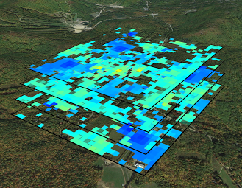
Spatial Data in GEE .
  Images (raster) objects
    ee.Image
      An image refers to a single raster (usually with multiple bands. e.g., one Landsat scene)
    ee.ImageCollection
      An image collection refers to a set of Earth Engine images (multiple rasters)
  Vector objects (points, lines, polygons or tables)
    ee.Geometry or ee.Feature
    ee.FeatureCollection (multiple features)
Image: Global Snow Observatory

Slide 7
Methods and Algorithms
Functions: are actions that can be applied to data
  E.g., exporting image objects stored as variables
Methods: are functions that are tailored to specific classes
  E.g., adding numbers
Algorithms: provide some commonly used (higher) level functions
  E.g., Landsat specific processing

Slide 8
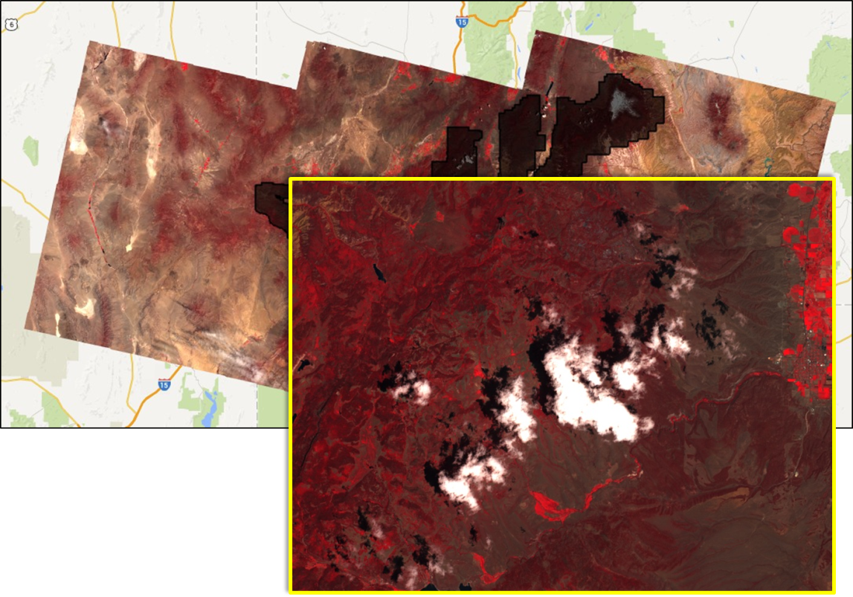
Processing & Analysis in Code Editor
Custom functions
    Multiple Earth Engine and JavaScript functions can be combined to create custom algorithms
Example: use spectral and thermal values to identify and remove pixels that are likely to represent clouds and/or shadows.

Slide 9
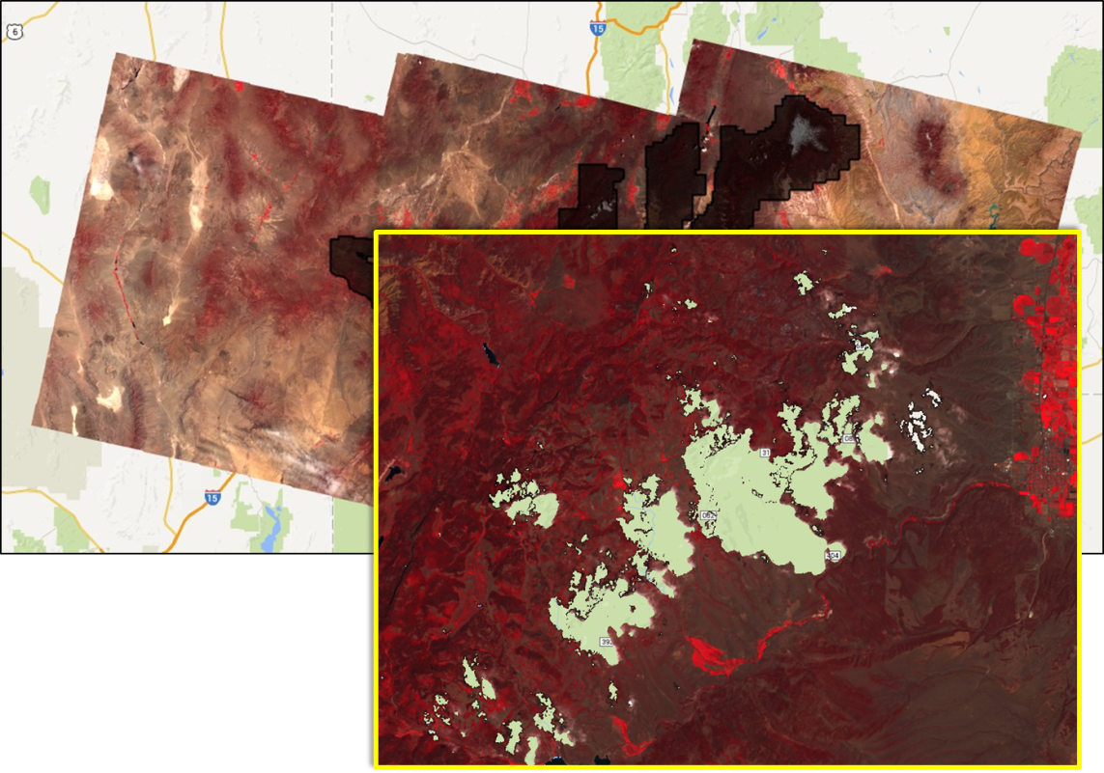
Processing & Analysis with GEE
Custom functions
    Multiple Earth Engine and JavaScript functions can be combined to create custom algorithms
Example: use spectral and thermal values to identify and remove pixels that are likely to represent clouds and/or shadows.

Slide 10
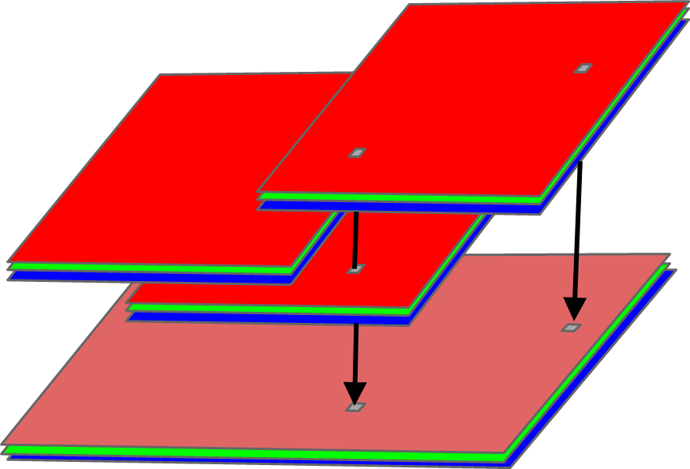
Processing & Analysis with GEE
Reducing collections
  applies a reducer to all of the bands of an image.
  the reducer must have a single input and will be called at each pixel to reduce the stack of band values.
  the output image will have one band for each reducer output.
Median Image
AOI
AOI mean = X

Slide 11
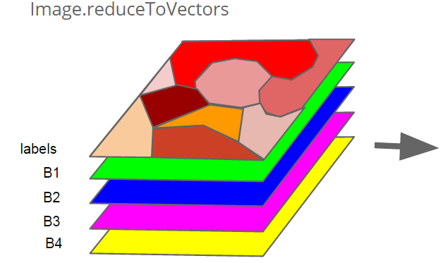
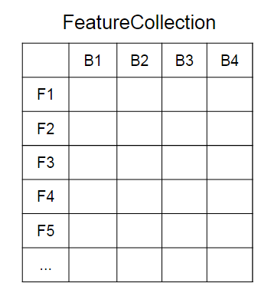
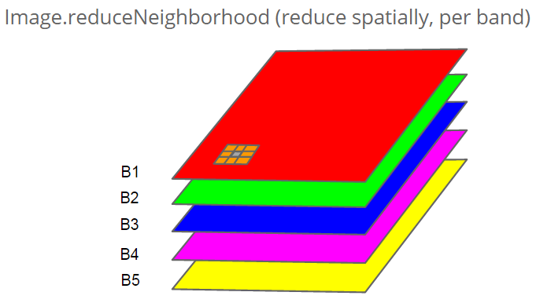
Processing & Analysis with GEE
Reducing areas (e.g., region, neighborhood)
  Apply a reducer to all the pixels in a specific region/feature (similar to zonal stats).

Slide 12
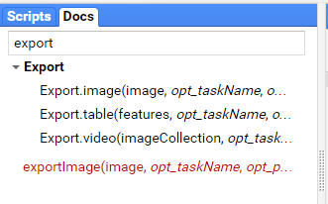
Exporting GEE data & results
  No data is saved unless you export it
  You can export
    Images (what we’ll be working with in this workshop)
    Tables
    Videos

Slide 13


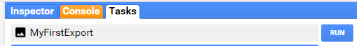
Exporting GEE data & results
  Steps to export (image) data:
    Get a result (e.g., create a cloud free composite)
    Use the export function in your script to initiate a ‘task’
    Send the task to your
    Google Drive

Slide 14
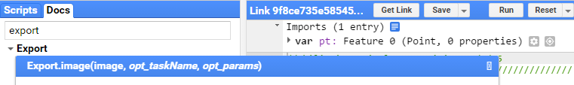
Exporting GEE data & results
  Export parameters for images
  Optional (the commonly used parameters):
    Coordinate Reference System (CRS): set the projection with this parameter.
      More information here on setting EPSG - http://spatialreference.org/ref/epsg/
    Scale: resolution in meters per pixel
      Note - Landsat images are 30 m/pixel
    Spatial extent: specify the region for which you would like to save the image
      Default: region in the map output window at the time the Export.image() statement is called
      Optional: can specify either a
        Linear ring
        Polygon coordinates
    Refer to the documentation for more input options

Slide 15
Cloud Masking (Ex. 3)
function name_of_function (parameter_1, parameter_2) {
// code to execute
// more code to execute
}
// call the function
name_of_function(input_1, input_2);

Slide 16
RAVG (Ex. 4)
Products to assess post-fire vegetation conditions of forests
Fires result in direct losses of vegetative cover
Helps to identify areas for reforestation treatments after a fire
  re-establish forest cover and
  restore associated ecosystem services

Slide 17
Planning your script
What’s your workflow?
Draft it out in English:
  Flowcharts or
  Sentences/phrases
Then convert to JavaScript/Earth Engine statements

Slide 18
Planning a Script

Slide 19
Work piece by piece: Ex 4.

Slide 20
Work piece by piece: Ex 4.

Slide 21
Demo

Slide 22
Agenda for Today:
10:00 – 11:15: Earth Engine Overview & Common Objects (ppt and demo)
11:15 – 1:00: BREAK – Exercise 1 & 2
1:00 – 1:30: Functions and the RAVG case study (ppt and demo)
1:30 – 3:50: BREAK –Exercise 3 & 4
3:50 – 4:00: Wrap-up and Discussion

Slide 23
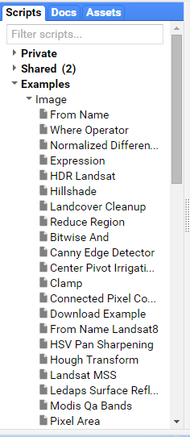
Resources
There are some great resources and sample scripts:
Earth Engine Documentation: https://developers.google.com/earth-engine/
Example Scripts in Code Editor
Developer’s Forum: https://groups.google.com/forum/#!forum/google-earth-engine-developers
Other Resources: https://developers.google.com/earth-engine/tutorials

Slide 24
Additional Resources
GTAC Resources:
Look for additional GTAC course offerings in GEE and other scripting courses.
Google Resources:
https://earthengine.google.com/
https://developers.google.com/earth-engine/
https://developers.google.com/earth-engine/tutorials

Slide 25
Questions?
Feedback: please take our survey!
Based on your feedback, we will
Modify this course and
Offer follow up courses in the fall to meet specific needs of participants (e.g., land cover change assessment in GEE)

Slide 26
USFS and Earth Engine
Geospatial Technology and Applications Center
Contact Nolan Cate: ncate@fs.fed.us

