Slide 1
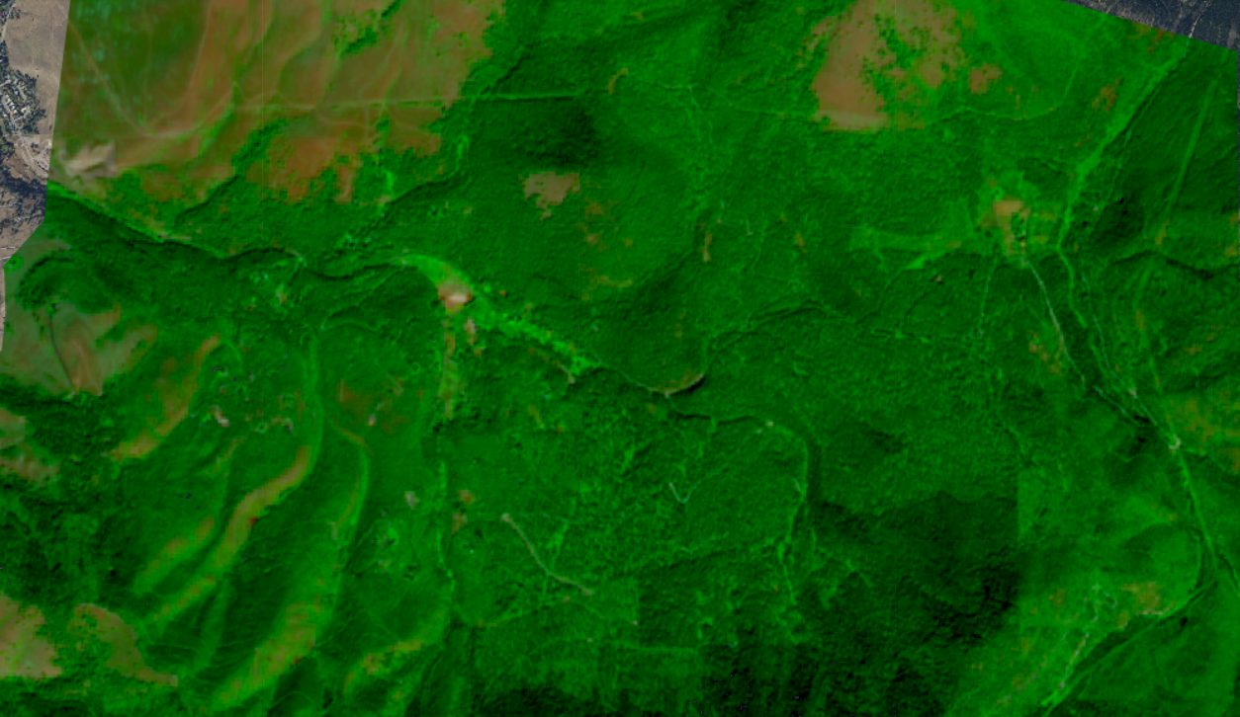
Overview of Remote Sensing in the USFS
Lila Leatherman (they/them)
Remote Sensing Specialist
lila.leatherman@usda.gov
The webinar will start at 10 am MT.
Before we begin, you’re invited to introduce yourself in the chat with your name, pronouns, role/region, and something you’re looking forward to learning more about today.
Jan 28, 2021
Notes:
Add picture

Slide 2
Housekeeping
Keep video off and stay on mute
If you have questions:
  Raise hand in Teams
  Respond in chat box
  Q + A at the end
Closed captions are available
Take care of your body!

Slide 3
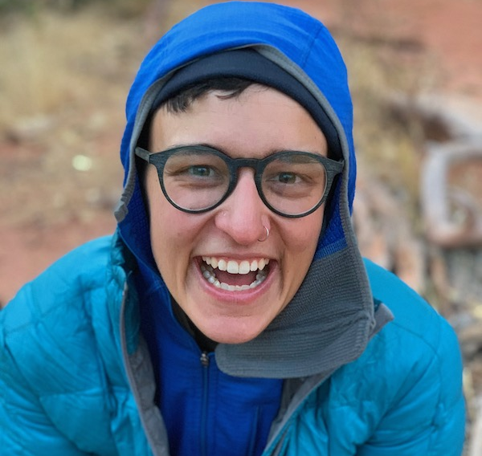
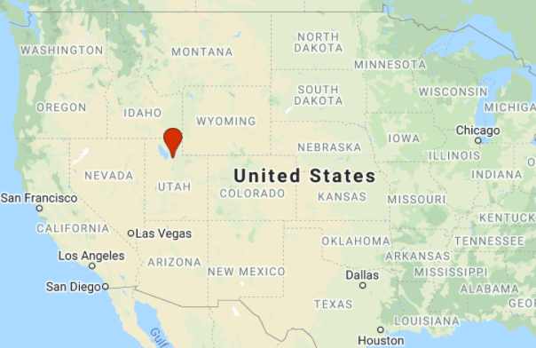
Personal intro
Lila Leatherman (they/them)
Remote Sensing Specialist
Oberlin College, Oregon State Univ.
Spatiotemporal stats, ecophysiology, biogeography, hyperspectral imagery, Google Earth Engine
Grasses, climate change
Trail runner, rock climber, newbie mountain biker
Notes:
Personal intro—
Invite people to introduce themselves with name, pronouns if they want, location, one thing they’re excited to learn more about

Slide 4
Objectives
Increase awareness about available remote sensing technologies
Review appropriate applications
Create realistic expectations about the information RS can provide (GIS products)
Increase awareness of additional remote sensing resources
Notes:
Creating appropriate / realistic expectations—RS can’t solve everything, is not a silver bullet that alone will able to accomplish monitoring tasks, classification, etc. it’s a useful tool, but we want to make sure that
Passive sensors record whatever light is emitted and that they receive
Active sensors emit energy, record what they return, as well as the strength of the return and how long it takes to get back

Slide 5
Outline
Remote Sensing Basics - Why, What, How
Remote Sensing Data and Applications
  Satellite Imagery
    Sensor and Data characteristics
    Demo: Viewing multispectral satellite imagery
    Typical Data Processing Workflows
    Remote Sensing Products
  Aerial Photography
    Sensor and Data characteristics
    Typical Data Processing Workflows
    Remote Sensing Products
  Airborne Lidar
    Sensor and Data characteristics
    Typical Data Processing Workflows
    Remote Sensing Products
RS Project Considerations
RS Contacts & Resources
Accessing RS imagery
Accessing additional training opportunities

Slide 6
Outline
Remote Sensing Basics - Why, What, How
Remote Sensing Data and Applications
  Satellite Imagery
    Sensor and Data characteristics
    Demo: Viewing multispectral satellite imagery
    Typical Applications
    Remote Sensing Products
  Aerial Photography
    Sensor and Data characteristics
    Typical Data Processing Workflows
    Remote Sensing Products
  Airborne Lidar
    Sensor and Data characteristics
    Typical Data Processing Workflows
    Remote Sensing Products
RS Project Considerations
RS Contacts & Resources
Accessing RS imagery
Accessing additional training opportunities
Optical
“Passive”
Laser Sampling
“Active”

Slide 7
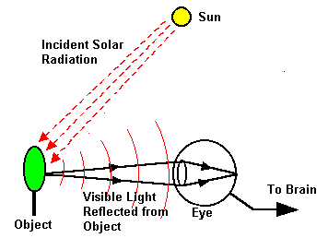
Remote sensing basics
The human eye and brain is a very effective and complex remote sensing sensor.
We derive information using the following image attributes:
  Size
  Shape
  Tone/color
  Texture
  Shadow
  Association
  Pattern
Notes:
Our eye is already a remote sensing sensor, recording and interpreting all of this information in order to figure out what we’re looking at – based on the attributes listed

Slide 8
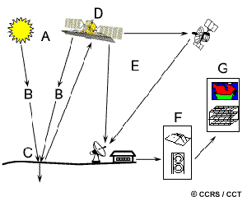
Remote sensing basics
Remote sensing technology attempts to duplicate that process
Generally uses only a couple of the attributes listed previously
Advantages of technology:
  Virtually unlimited storage capacity
  Computer processing power
  Automated processing
  Large landscapes at multiple scales
  Analyze the full EM spectrum
Notes:
Remote sensing technology attempts to duplicate the same process, but we can only use a couple of the attributes – color, texture, etc.
Remote sensing technology has a lot more components!
Walk through the components of figure in schematic – sun to eart to satellites to info relay to storage to analysis
Walk through advantages – each bullet point gets an extra sentence or two
Analyze full EM spectrum

Slide 9
Remote sensing basics
Why is remote sensing valuable?
  Remotely sensed data are tools to help us make better resource management decisions
Questions it can answer:
  Classification – what is it?
  Inventory – how much is there?
  Mapping – where is it?
  Monitoring – has it changed?
Notes:
Questions it can answer
(give examples of each)

Slide 10

Questions for Remotely Sensed Data
Monitoring
Mapping
Inventory
Classification
Notes:
Mapping: coexists with other questions
Monitoring: give example of application
Questions for remotely sensed data:
Mapping + classification
Inventory + classification:
FIA data
Inventory x classification x monitoring:
FIA data one plot to another, change over time
Not always mapping!
Might be creating a tabular data output
E.g., how many acres are one cover class
How many trees
Time series of how a single point has changed over time

Slide 11
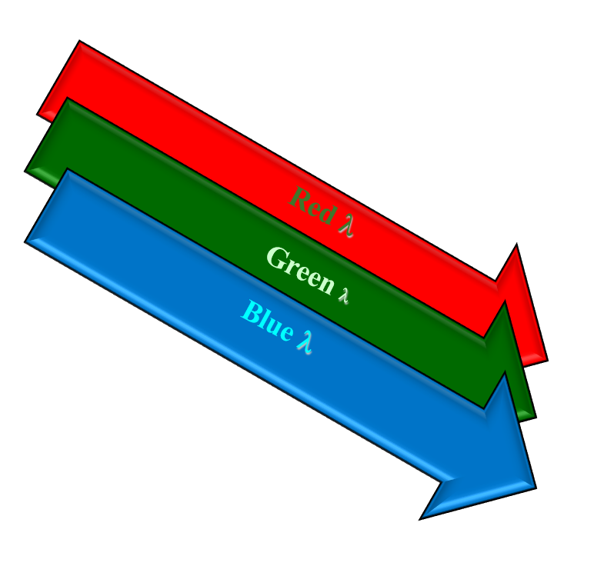
Optical Remote Sensing Basics
The sun radiates the earth with nearly equal amounts of blue, green, and red wavelength light.
Notes:
Sun radiates the earth with basically equal proportions of red, green, and blue light.

Slide 12
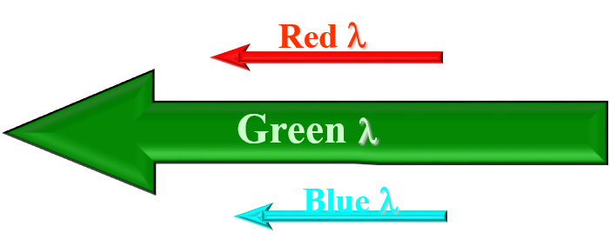
Optical Remote Sensing Basics
The sun radiates the earth with nearly equal amounts of blue, green, and red wavelength light.
Because of its physical properties, the tree reflects and absorbs differing amounts of the incoming light...
The tree absorbs much of the red and blue wavelengths and reflects much of the green.
Notes:
But, the tree’s physical properties mean that it absorbs a lot of the red and blue light—but reflects the green light.

Slide 13

Optical Remote Sensing Basics
The sun radiates the earth with nearly equal amounts of blue, green, and red wavelength light.
Because of its physical properties, the tree reflects and absorbs differing amounts of the incoming light...
The tree absorbs much of the red and blue wavelengths and reflects much of the green.
…and we perceive the tree as green...
Notes:
Which is why we see / perceive the tree as green
This is the basics / essentials of how remote sensing works—relies on the principle that different objects or structures reflect different kinds and wavelengths of light, depending on their physical properties.
Similar categories of targets behave in predictable ways.

Slide 14
Optical Remote Sensing Basics
The sun radiates the earth with nearly equal amounts of blue, green, and red wavelength light.
Because of its physical properties, the tree reflects and absorbs differing amounts of the incoming light...

Slide 15
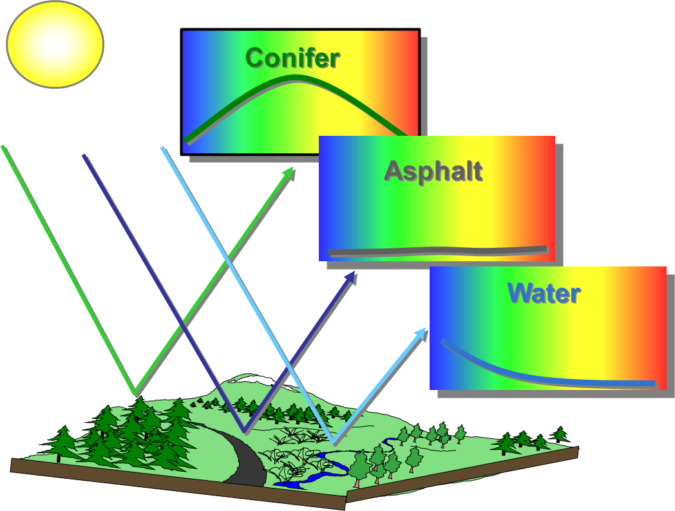
Optical Remote Sensing Basics
Remote sensing relies on the fact that different targets have unique responses to electromagnetic (EM) energy—allowing us to spectrally distinguish one target from another.
Notes:
Miniature mock-up EM spectrums for three different targets, showing basic amounts and kinds of light that are being reflected. So, if the line is higher, then the target is reflecting more light. – walk through each for blue, green, red
Conifers absorb a lot of blue and red light, but reflect it in the green
Asphalt, super dark—when you walk on it on a hot day, it is hot to the touch because it is absorbing all of that energy, and has very low reflectance in blue, in green, in red
Water – blue light is a higher frequency-, shorter wavelengths, while green and red light have lower frequencies and longer wavelengths. For water, increasingly longer wavelengths are more readily absorbed, while blue light and shorter wavelengths are reflected
These three categories make up the majority of what we see in a given landscape: veg, developed areas, and water

Slide 16
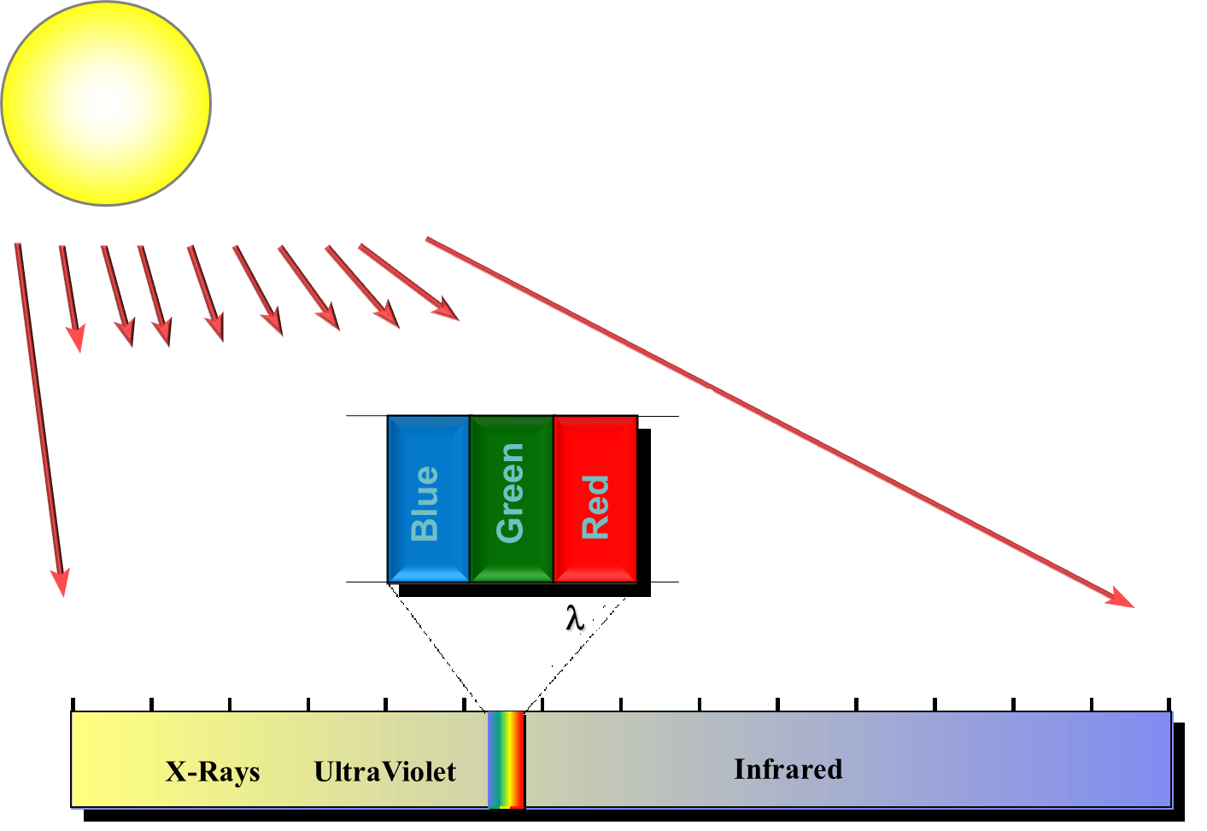
Optical Remote Sensing Basics
The sun emits EM energy across the entire spectrum, not just the visible….
Notes:
Update spectrum diagram to align better visually with next slide

Slide 17
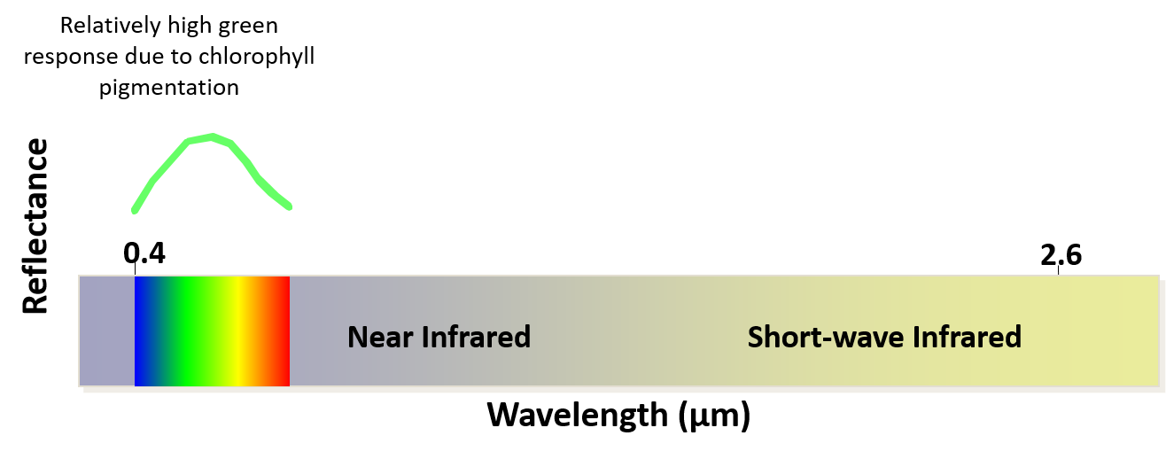
Review of Spectral Signatures
Graphically, the spectral reflectance of green vegetation in the visible wavelengths may be represented as shown:
Notes:
X or horizontal is the wavelength, y or vertical is reflectance—or how much light is being reflected
Review spectral signature of vegetation
Healthy green veg absorbs blue and red light, chlorophyll pigmentation reflects green light
But this is only visible light—there’s a lot more information in the rest of the spectrum

Slide 18
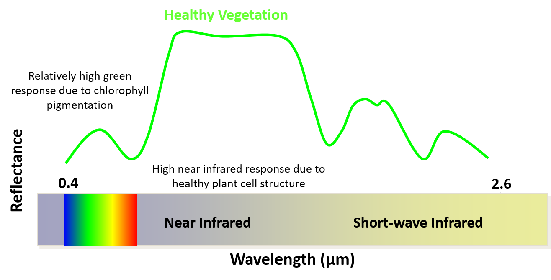
Review of Spectral Signatures
Notes:
NIR—really strong reflectance here, much stronger than the signal reflected in the visible spectrum—we just can’t see it with our naked eyes.
Due to healthy plant cell structure and plant physiology
Healthy veg reflects NIR more than any other part of the spectrum

Slide 19
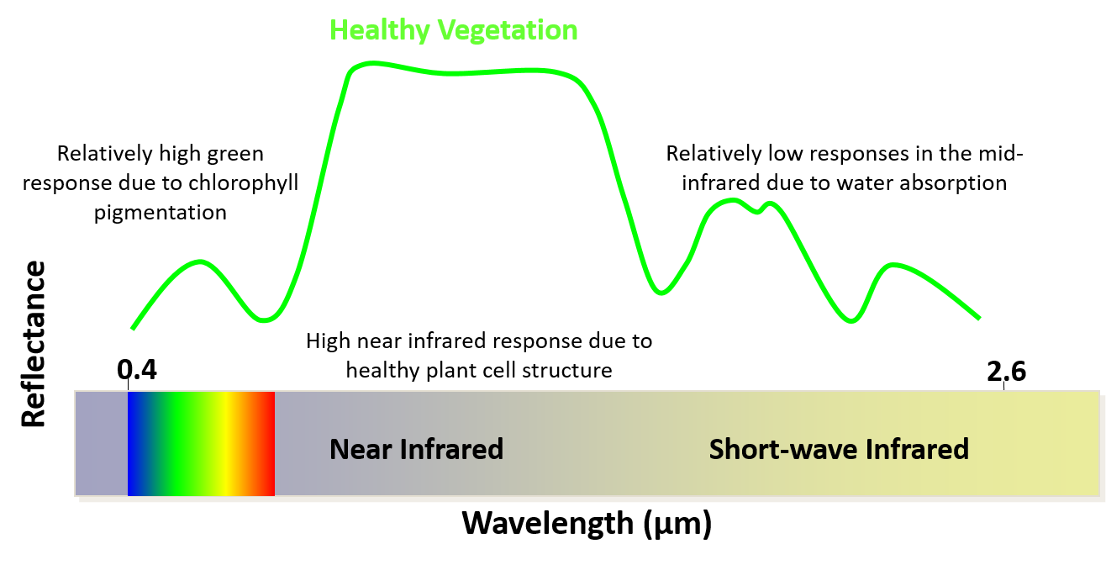
Review of Spectral Signatures
Notes:
SWIR – sensitive to presence of water. Also sensitive to presence of plant / veg components like cellulose and lignin
We know that healthy plants are wet- you get a wet spot on your pants from sitting on grass.
Lower SWIR reflectance means that it’s absorbing more water.

Slide 20
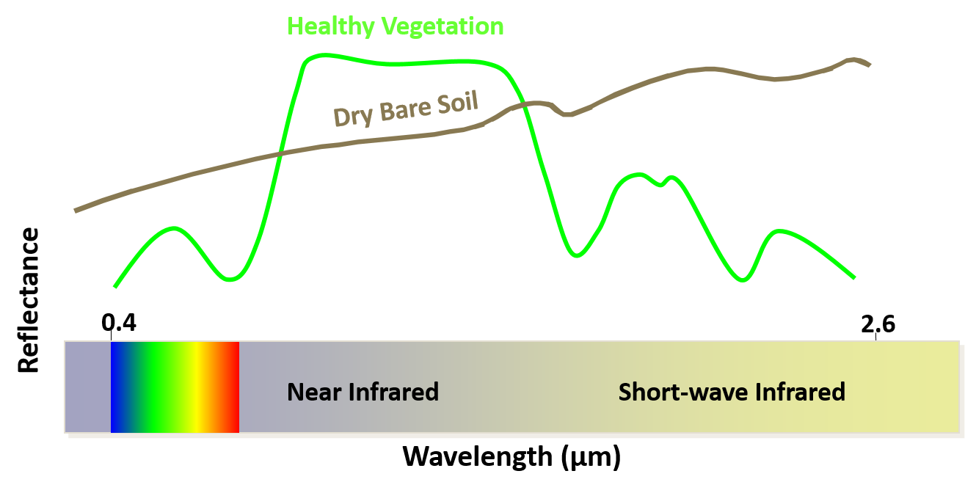
Review of Spectral Signatures
Notes:
Soil reflects strongly in visible light—you can think about looking at dirt or sand on a hot sunny day, and it hurts your eyes – this is that high reflectance
Lower reflectance in NIR compared to healthy veg
Higher reflectance in SWIR bc less water

Slide 21
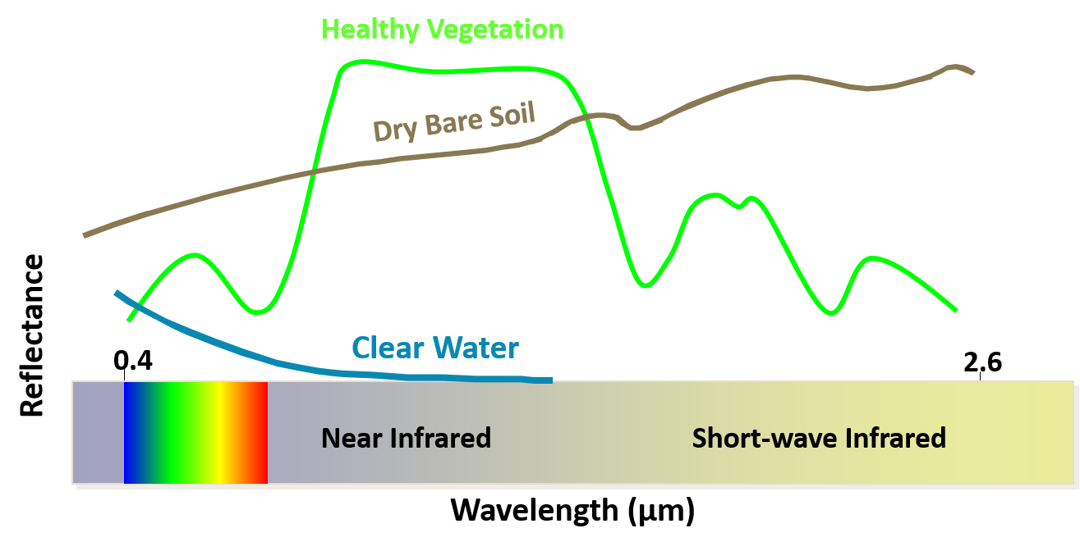
Review of Spectral Signatures
Notes:
Shorter wavelengths of light don’t penetrate water, as wavelengths increase, there is increasing absorption until we reach the SWIR where there’s complete absorption of light
And relating back to the vegetation, obviously vegetation is less wet than water, but these dips in the spectral signature of vegetation are caused by the water in a plant absorbing more water
You can imagine that a dead or dying plant would have a spectral reflectance curve that might be intermediate in some way between healthy vegetation and dry bare soil

Slide 22
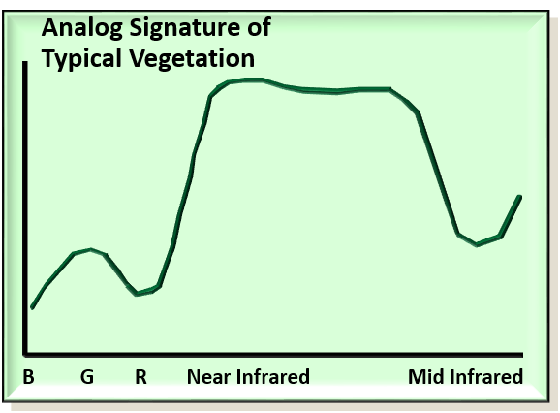
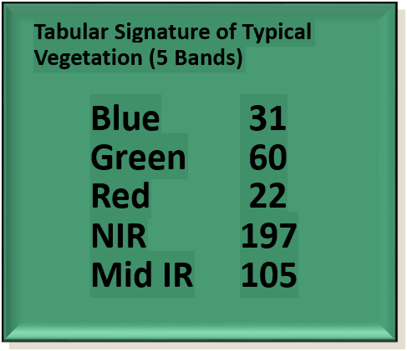
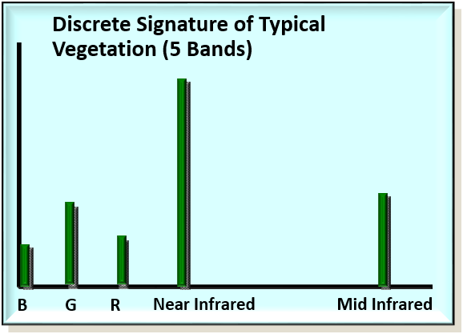
Optical Remote Sensing Basics
Notes:
Spectral signatures, spectral response curves, or analog signatures
Can plot the whole smooth curve, but we don’t usually have data at all of these points—need a hyperspectral signature
Usually, data come as values for discrete “bands” which represent a single point within these different areas of a spectrum
The tabular signature is a little harder to interpret, requires a little more expertise and context, and this is why data viz is so important
Will review this more in a demo

Slide 23
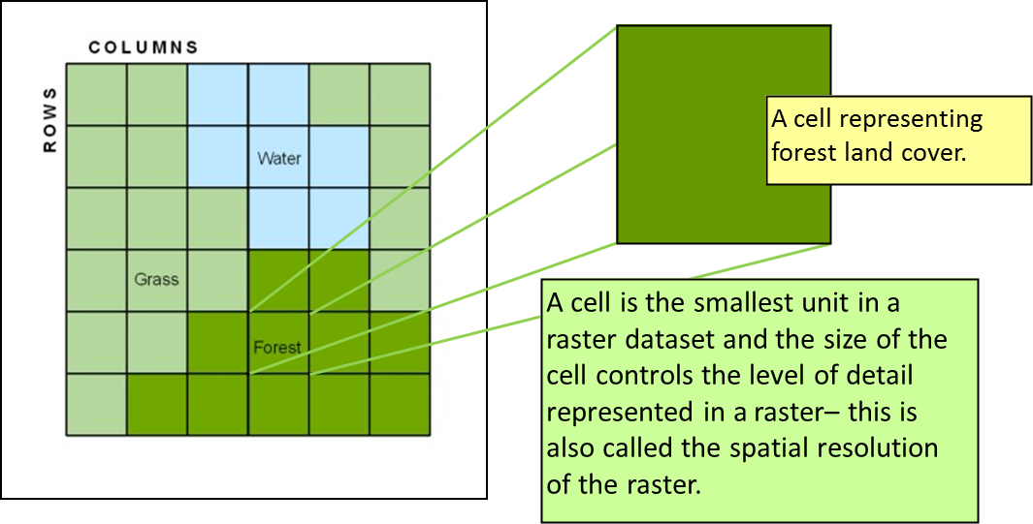
What is a raster?
A grid of data – with rows and columns, made up of cells or pixels
Cells/pixels represent information
  Land cover, photograph, elevation data

Slide 24

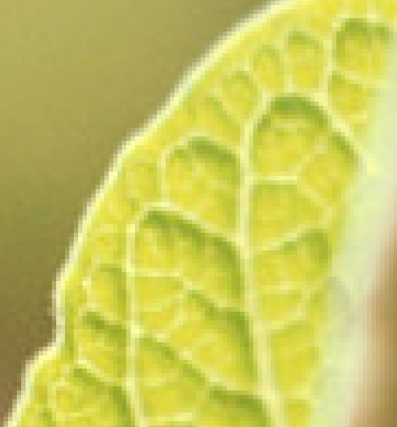
A raster is composed of rows and columns made up of cells, or pixels. Even in this photograph, it is apparent, once you zoom in, that it is composed of pixels (aka picture elements). Digital photographs, like this one, store three values in each pixel (red, green, and blue).
Notes:
Will review this more in a demo
What is a raster
Could be a digital photograph

Slide 25
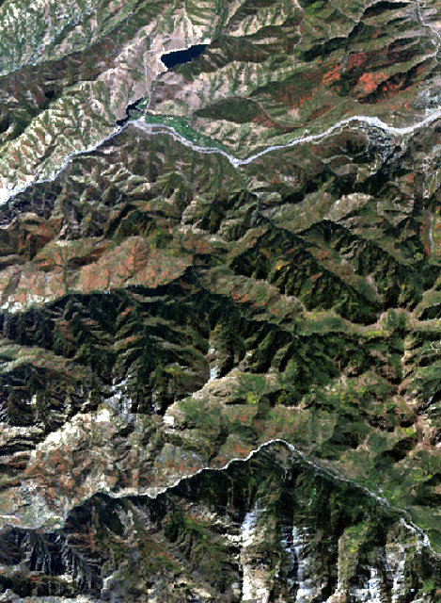
Remote Sensing Basics
Landsat imagery displayed in True Color (RGB = RED, GREEN, BLUE)
Notes:
contrast to digital photographs, which store image as combination of 3 different band values, raster images obtained from remote sensing store each of the bands in different grayscale images, and we can recombine bands differently to show different kinds of information

Slide 26
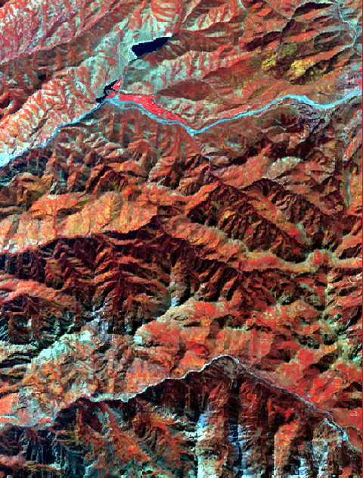
Remote Sensing Basics
Landsat imagery displayed in False Color/ Color Infrared (RGB = NIR, RED, GREEN)
Notes:
False color, when things appear red, it’s actually because they’re reflecting a lot of NIR light
So, veg appears red because it’s reflecting a lot of NIR
Gives us a way to interpret imagery with our eyes, using those bands that are collected outside the visible light spectrum.
Our eyes and other remote sensing techniques have to work together
Easier to see nuance and differences in vegetation when we’re using these different ~band combinations~

Slide 27
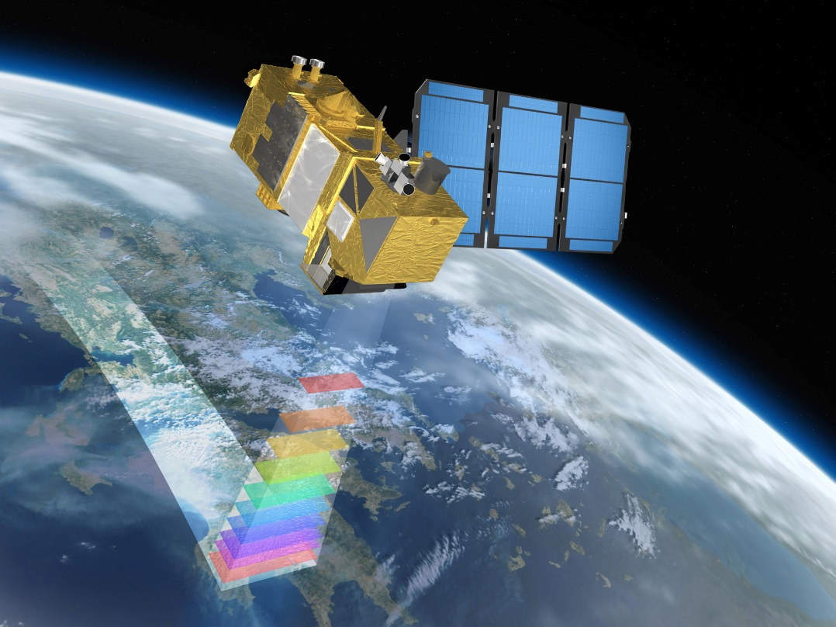
Satellite Data Attributes
Space-borne platform
Generally Optical (UV to Thermal IR on EM spectrum) Passive
Resolution
  Generally “Coarse Spatial Resolution”
  High Temporal Resolution
  Large ground area extent
Inexpensive or free
Notes:
Satellite data attributes
Usually optical, and passive—so they’re only collecting information that’s reflected off the earth’s surface, lit by the sun—daytime only
“coarse spatial resolution” means different things to different people, we have relatively coarse info when collected from space
High temporal resolution because these sensors are constantly orbiting the earth
Larger ground
Landsat data became free in 2003 – free for user to obtain

Slide 28
Live Demo: Satellite Imagery
Multispectral imagery & spectral signatures

Slide 29
Sensor characteristics
Spectral resolution
Spatial resolution
Swath width / footprint size
Radiometric resolution
Temporal resolution
Notes:
Add graphics to clarify

Slide 30
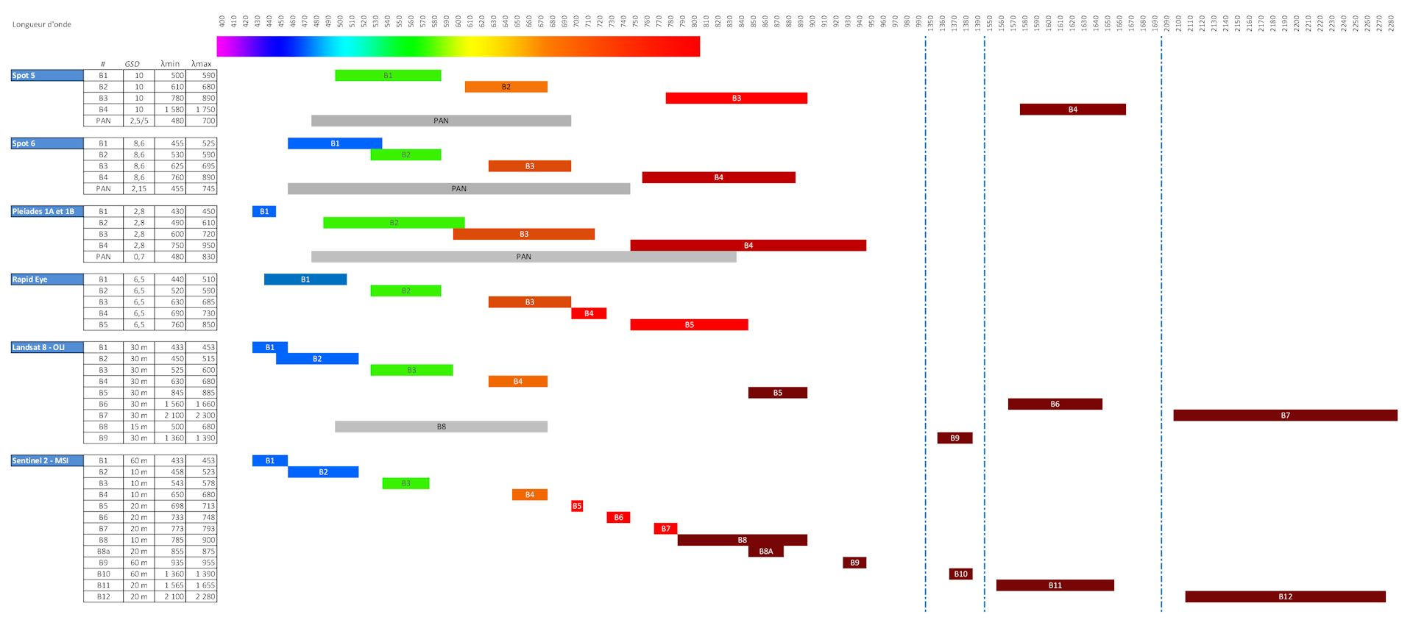
Sensor Characteristics
Spectral resolution, or sensitivity, can be defined as the bandwidth (size), number, and position of specific wavelength bands that a sensor system can record.
Link to image source
Notes:
Spectral resolution
Comparing the band characteristics of different sensors
just because different sensors have the same number of bands or labels for their bands, it doesn’t mean that they’re recording the same information
Goal is to note that different satellites capture different suites of bands that give us different information

Slide 31
Sensor Characteristics
Spatial resolution is the size of the smallest object that can be detected by a satellite. In terms of the image produced, the spatial resolution is the distance on the ground that corresponds to one side of one pixel in the image.
Spatial resolution for satellite data is controlled by:
  Orbital Height
  Quality of Optics
  IFOV (Instantaneous Field of View)
Notes:
Spatial resolution
Orbital height – how far above an earth’s surface is the satellite / sensor – the further away it is, the larger the field of view is, the larger the pixels are
Higher resolution sensors tend to be closer to the earth
Quality of optics
Think about iphone camera, old ones look like they’re taken on a potato
IFOV
What you see when you look out the window
Higher up a sensor is, often the larger the field of view is

Slide 32
Sensor Characteristics
Spatial Resolution and Extent (Area) tradeoff
Larger
e.g., MODIS
Extent (Swath width)
e.g., Landsat
Smaller
e.g., WorldView
Smaller Pixel Size
Larger Pixel Size
Spatial Resolution
Notes:
This is relevant for remote sensing, when you’re choosing the type of imagery you want to use for a project. So, you might want a larger view of the landscape, MODIS is used for lots of applications, it’s also been around a long time. But, there’s a trade-off with smaller pixels
Note that as these shift, other things that also shift are:
The phenomena that can be observed
The size required to store the image
The cost / accessibility of the data
Worldview has a spatial resolution of ~2m and swath width of about 13km, while MODIS has a spatial resolution of 250m and a swath width of >2k km

Slide 33

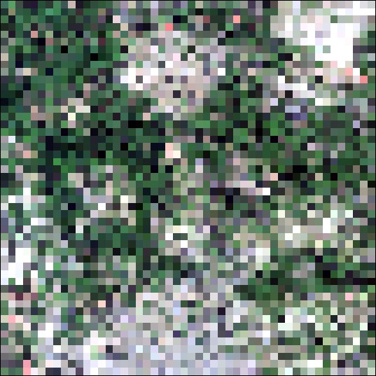
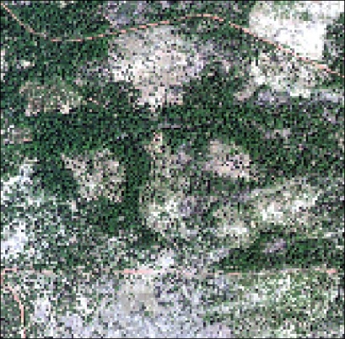
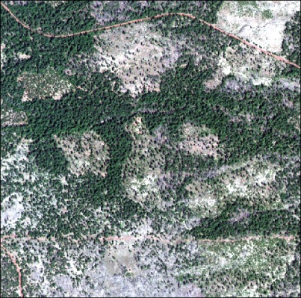
Sensor Characteristics
Simulated MODIS, Landsat, Sentinel-2, WorldView-2 data.
MODIS 250m
Landsat 7 30m
Sentinel-2 10m
WorldView-2 2m
Notes:
Walk through things you can see, or can’t see, in each image—from MODIS to Worldview
Just because there’s more information, it doesn’t mean that you need more information.
General goal / guideline: choose the coarsest resolution that will meet your needs. Increases storage space and computation time exponentially to use larger images
Ex.
Am I mapping roads? Am I interested in land cover? Am I interested in a broader, or ecoregion scale analysis?

Slide 34
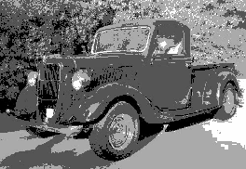
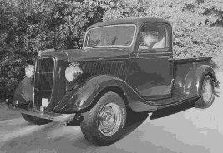

Sensor Characteristics
Radiometric resolution is the number of intensity levels that a sensor system is capable of discriminating in any given bandwidth. Also referred to as “bit depth”
Higher radiometric resolution will provide better discrimination of subtle details in an image.
Landsat 8 has outputs 12-bit data, which contains up to 4096 unique values.
2¹ = 2 levels
2² = 4 levels
2⁴ = 16 levels
2⁸ = 256 levels
Notes:
Also referred to as “bit-depth”
You’ve probably heard of 8-bit data—or old, 8-bit video game music—there’s less depth and variety that can be conveyed by the format the data are stored in, compared to, say, hearing a recording of a symphony.
The bit refers to the exponent to which two is raised. So, one-bit data is 2 to the first power.
Increasing our bit depth makes exponentially more information available to us
But do you really need all of that bit depth? Eg cover map, vs imagery

Slide 35
Sensor Characteristics
Temporal Resolution is how often a sensor can record imagery over a particular area
Temporal Resolution depends on:
  Orbital characteristics
  Image swath width / footprint
  Off-nadir viewing capabilities (i.e., pointable optics)
  Number of satellites in the family
A finer temporal resolution is almost always desirable!
Notes:
Closer sensors image the earth less frequently, smaller field of view, revisits same location less frequently than a sensor that is in higher orbit, and often has a larger field of view
Footprint
Nadir = point directly below a satellite or sensor. top-down, downward-facing viewing capabilities.
Figures / graphics would be helpful here

Slide 36
Sensor Characteristics
Sensor | Number of Bands | Spatial Resolution | Temporal Resolution | Radiometric Resolution | Swath width/Footprint
MODIS | 36 | 250 m, 500 m, 1000 m | *1 day | 4096 | 2330 km swath width
Sentinel-2 | 13/1 | 10 m, 20 m, 60 m | *5 days | 4096 | 290 km swath width
Landsat 5 & 7/Pan | 7/1 | 30 m/15 m | *8 days | 256 | 34,225 km² footprint
Landsat 8/Pan | 10/1 | 30 m/15 m | 16 days | 4096 | 34,225 km² footprint
SPOT 5/Pan | 3/1 | 20 m/10 m | *2-3 days | 256/256 | 3600 km² footprint
IKONOS/Pan | 4/1 | 4 m/1 m | ~3 days | 2048/2048 | 11.3 km swath width
QuickBird/Pan | 4/1 | 2.4 m/0.6 m | 2-11 days | 2048/2048 | 16.4 km swath width
Notes:
Use a table like this to make a decision about what kind of imagery you might want to use for a specific application
Compare trade-offs between, eg.g, spatial and temporal resolution

Slide 37
Appropriate uses of satellite data
Vegetation mapping
Land cover and land use change
Fire mapping
Change detection (e.g., insect, disease, storm damage)
Important considerations when using satellite imagery:
  Cannot map things smaller than spatial resolution (scale of information)
  Gradual changes may be more difficult to capture (what indicates significant change – what is the threshold?)

Slide 38
Vegetation Mapping
Vegetation mapping is the process of delineating the geographic distribution, extent, and landscape patterns of vegetation types and/or structural characteristics.
Patterns of vegetation types cannot be recognized until the types have been defined and described.
Consequently, consistent mapping of vegetation types requires that a vegetation classification be developed beforehand.
Any mapping based on vaguely defined types will be inconsistent, hard to validate, and difficult to compare with other vegetation maps.

Slide 39
Vegetation Mapping
What vegetation characteristics do we typically map using remote sensing?
Dominance type
  E.g., conifer, aspen, shrub, etc.
  Optical remote sensing
Canopy cover
  Potentially
    Size class (typically least accurate, exception when measured with lidar)
    Age class (typically least accurate, exception when measured with lidar)
  Usually need lidar

Slide 40
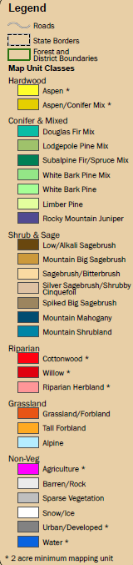
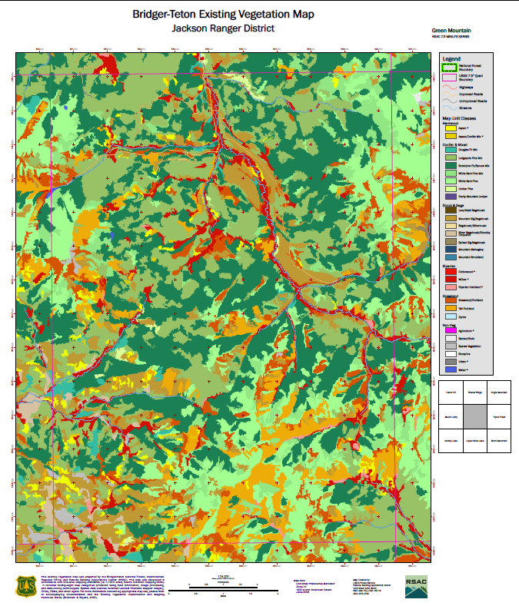
Vegetation Mapping
Developing Classification & Drafting the Map
Create exhaustive list of classes
  Should be mutually exclusive
Evaluate classification outputs at each mapping level
  Life-form, dominance type, sub-type, canopy cover, and size class
Review with local specialists and make refinements
  Creating meaningful outputs from classification results
Notes:
Should be mutually exclusive; e.g., a given area can only be classified as one class
Evaluate classification outputs at each mapping level – what is meant by this?
Eg, NLCD = National Land Cover Database provides this information for CONUS

Slide 41
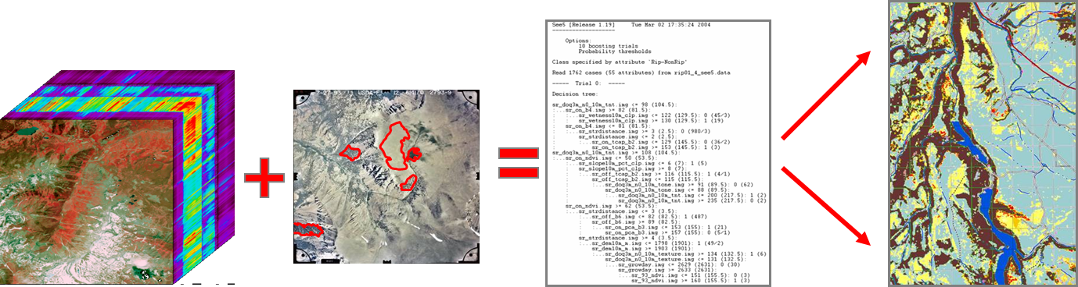
Image Classification
Unsupervised
Supervised
Sophisticated data-mining incorporates all data layers to create complex decision-trees
Input image stack
Field & PI training sites
Algorithm develops rulesets to classify veg
Applied to image stack to classify & label segments
Notes:
Unsupervised = without training data
Supervised = with “training data,” or points on the ground where we know the class of the land cover

Slide 42
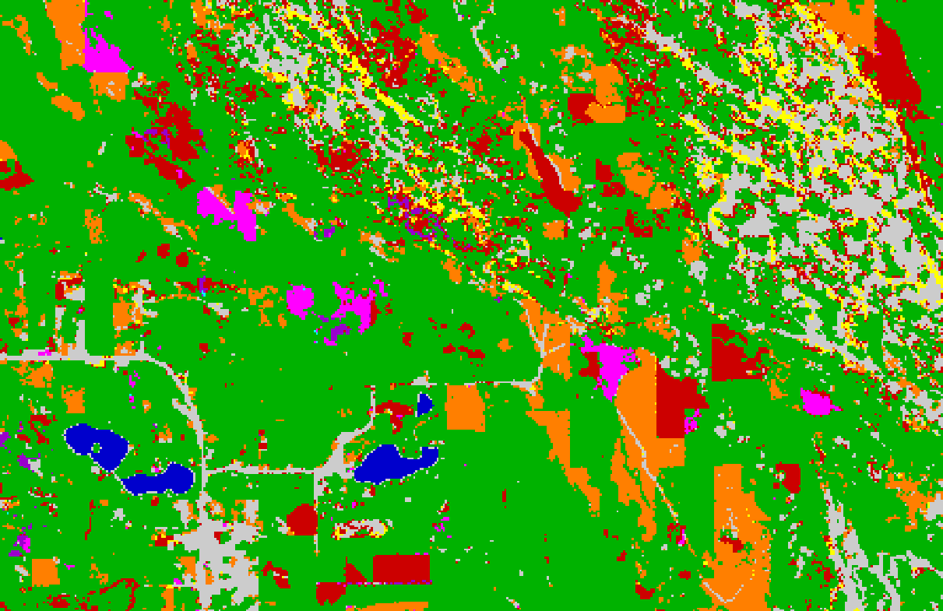
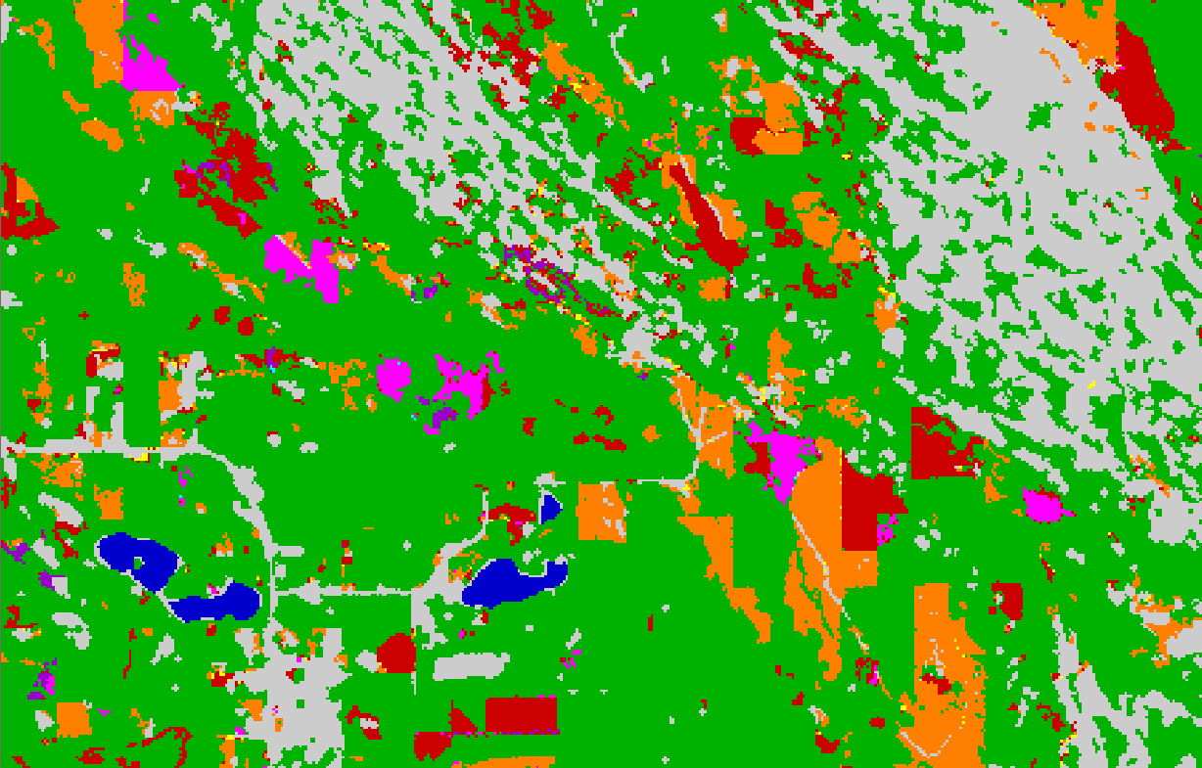
Post GIS Processing
Implementing Minimum Map Unit (MMU)
Clump and Eliminate
Notes:
Mmu – raster size
Can’t capture all detail
Group, fill holes, eliminate single pixels that don’t reflect meaningful trends based on the pixel size of the image you’re able to collect
Swap this or add additional photos that better reflect the actual process of veg classification

Slide 43
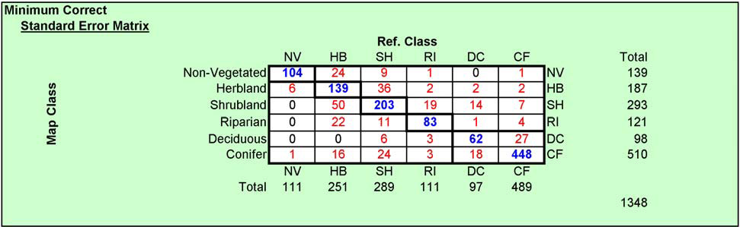
Accuracy Assessment
Error Matrix
Standard way of presenting results of an accuracy assessment
Errors of Omission (Producer’s Accuracy)
  The percentage of time a class identified on the ground is classified into the same category on the map.
Errors of Commission (User’s Accuracy)
  The percentage of time a class identified on the map is classified into the same category on the ground.
Notes:
Whole class on accuracy assessment– not being offered this season, but you can watch a recording
Revisit + clarify
Errors of Omission – false negative
Errors of Comission – false positive
Compares ground data with remotely-sensed classification
Diagonal elements: classified correctly
Off-diagonal elements: classified incorrectly
Omission and commission are calculated for each class
Omission: describes when pixels that are one class on the ground, are classified as another class on the map. E.g., when an urban pixel gets categorized as a shrubland pixel.
Comission: describes how many , are actually another class on the ground. E.g., the flip
Errors of omission in one category will be counted as errors of commission in another category

Slide 44
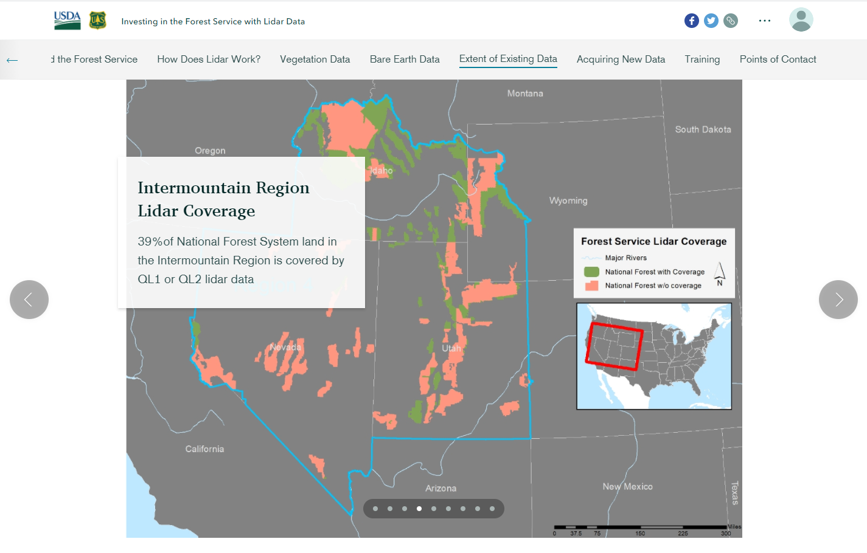
Final Products
Hard copy and digital maps
Reports
Summaries
Story maps
Dashboards

Slide 45
Vegetation Mapping
Vegetation mapping entails trade-offs that consider:
  Resolution (spatial and spectral)
  Accuracy (thematic and spatial)
  Cost
  Time
  Area of extent
The overall goal is constrained optimization, not perfection!
Notes:
Rephrase “The overall goal is constrained optimization, not perfection!”
Thematic accuracy: how accurately we can classify to a class of interest, e.g. evergreen to evergreen
Spatial accuracy… ? Would follow from spatial resolution I guess. How certain we are about training points etc

Slide 46
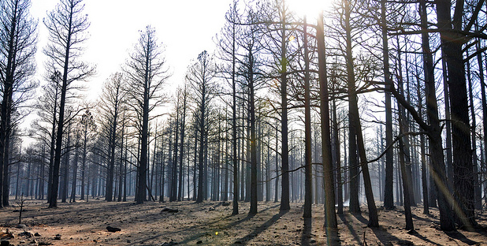
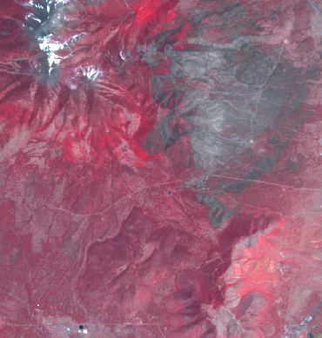
Change detection
Identifying landscape change from remotely sensed images
    Analyze images from different times to map/quantify change
    Assumption:
      Landscape change -> Spectral change
Coconino NF – Schultz fire effects
Landsat TM5 image – 1 year post fire

Slide 47
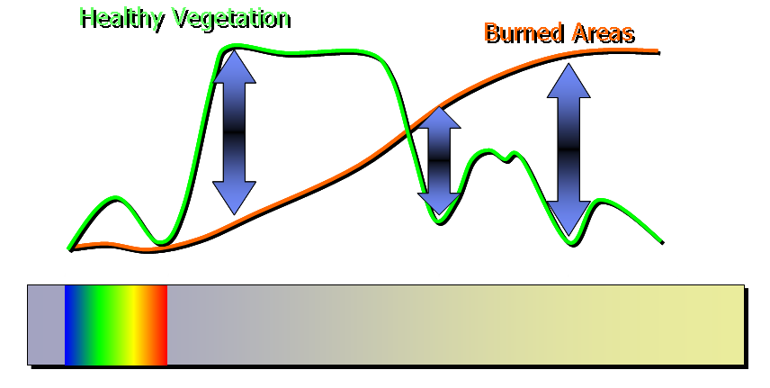
Change detection
Exploiting spectral response curves…
Visible
NIR
SWIR

Slide 48
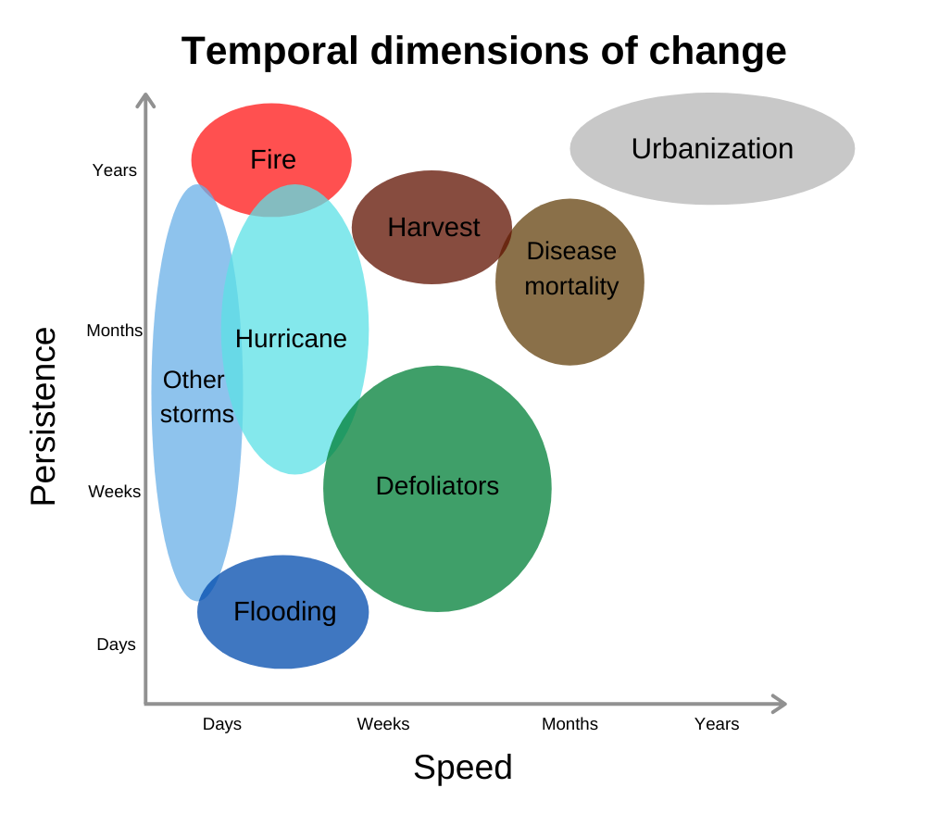
Temporal characteristics
  What does change look like from an Earth observation perspective?
Notes:
We are often interested in annual trends or changes that occur over long time periods. Whereas seasonal trends are usually driven by annual temperature or precipitation and not always of interest to managers wanting to understand how the landscape is changing.
Talk about the temporal characteristics of these different types of change and also SUCCESSION… Disturbance and recovery, sometimes things don’t return to the way they were…

Slide 49
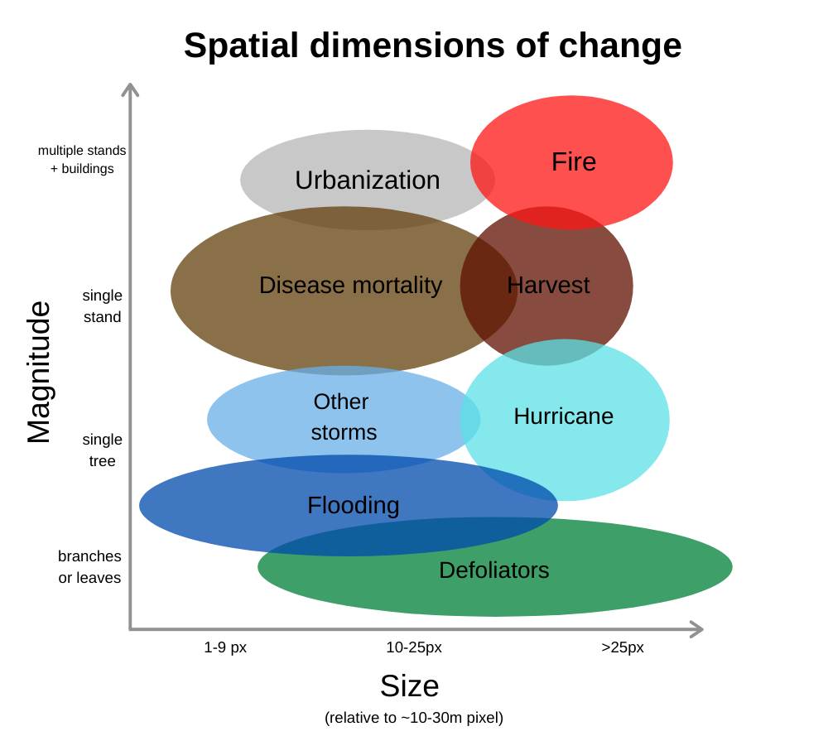
Spatial & spectral characteristics
  What does change look like from an Earth observation perspective?
Notes:
Explain the graph but focus on the spectral magnitude of change

Slide 50
Common remote sensing indices
(near-infrared) – (red)
NDVI =
(near-infrared) + (red)
(near-infrared) – (shortwave-infrared)
NDMI =
(near-infrared) + (shortwave-infrared)
(near-infrared) – (shortwave-infrared)
NBR =
(near-infrared) + (shortwave-infrared)

Slide 51
Fire Mapping
Operational Fire Support at GTAC
  Post-fire Assessment – Emergency, Rapid, and Extended Timing
Burned Area Emergency Response (BAER)
      Emergency Assessment
Rapid Assessment of Vegetation Condition after Wildfire (RAVG)
      Rapid Assessment
Monitoring Trends in Burn Severity (MTBS)
    National Fire Plan (NFP) and Healthy Forest Restoration Act (HFRA)
      Extended Assessment
Notes:
Remove dates
Link to program website
Updated links:
BAER: https://fsapps.nwcg.gov/baer/home
RAVG: https://fsapps.nwcg.gov/ravg/
MTBS: https://www.usgs.gov/centers/eros/science/monitoring-trends-burn-severity?qt-science_center_objects=0#qt-science_center_objects

Slide 52
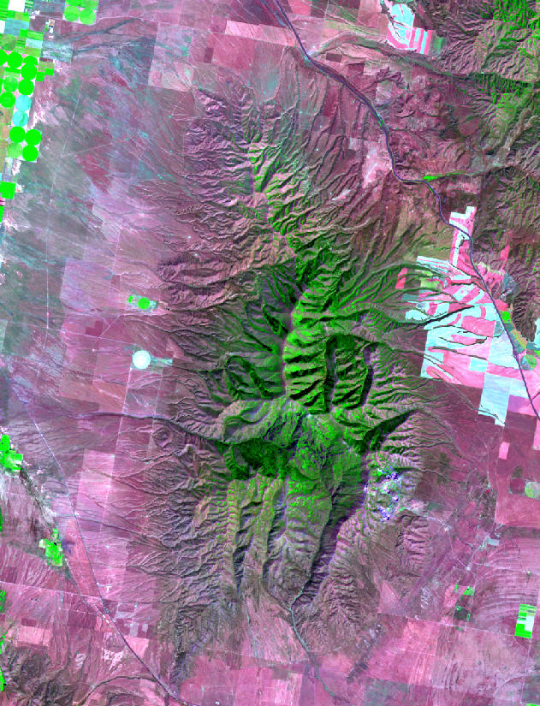
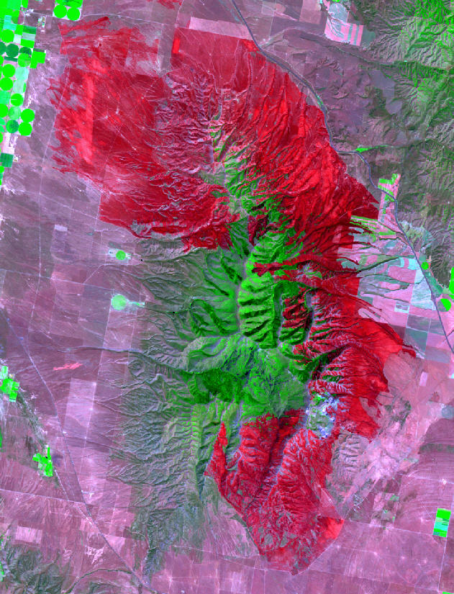
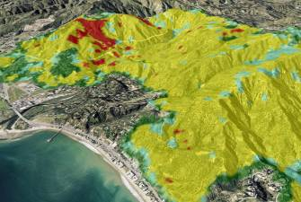
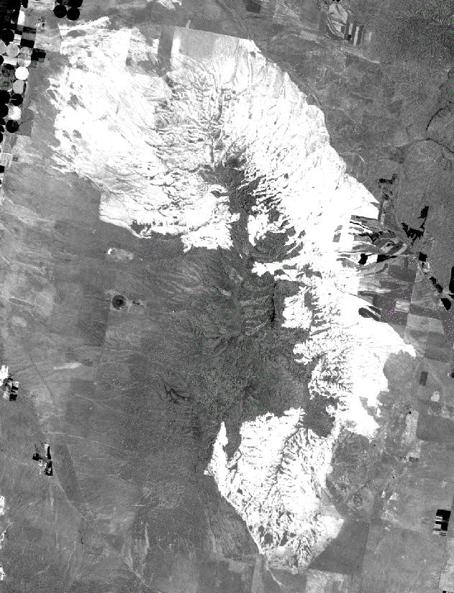
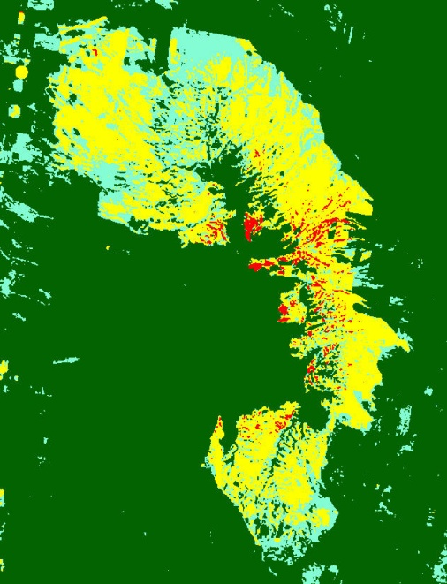
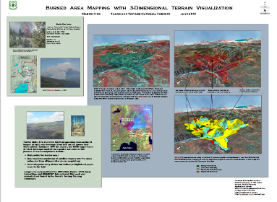
Burned Area Emergency Response (BAER)
Pre-fire Image
Post-fire Image
3D Visualizations
dNBR or dNDVI Image
BARC Image
Map Products
Notes:
dNBR = image 1 - image 2
BARC = take that differenced image and classify it, in terms of burn severity
BARC = Burned Area Reflectance Classification

Slide 53
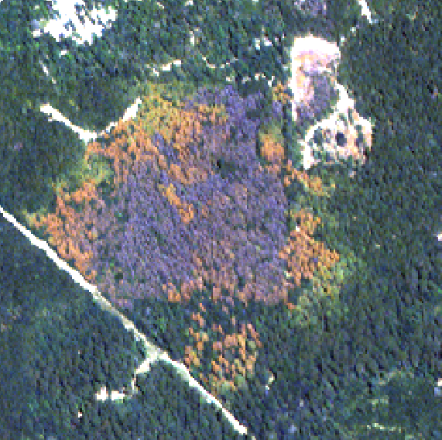
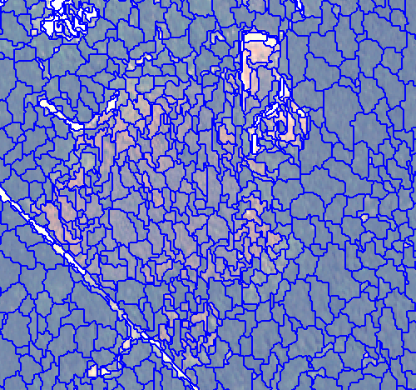
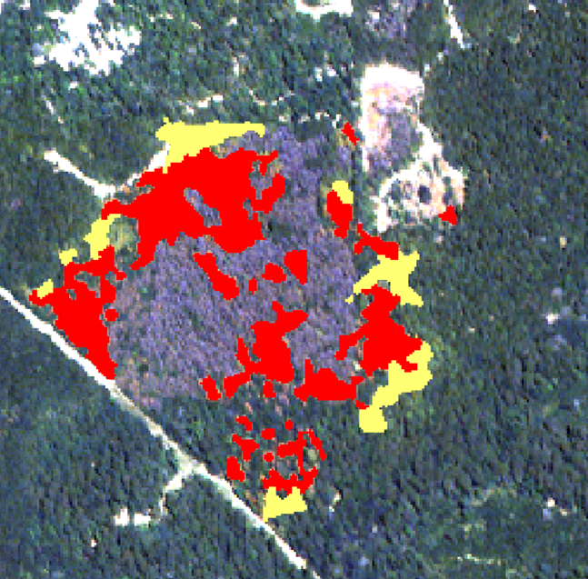
Southern Pine Beetle detection
eCognition – Segmentation and Classification
ArcMap
SPB Polygons
Band Combination:
Band 5 (red) – Red
Band 4 (yellow) – Green
Band 1 (coastal blue) – Blue
Notes:
Example of OBI analysis
Kain worked on this project
WV2 band combos
Found combo that distinguished disease/stress v mortality
Comparing color, texture, size, shape rather than just pixel values
Red = dying / goners, yellow = spread direction

Slide 54
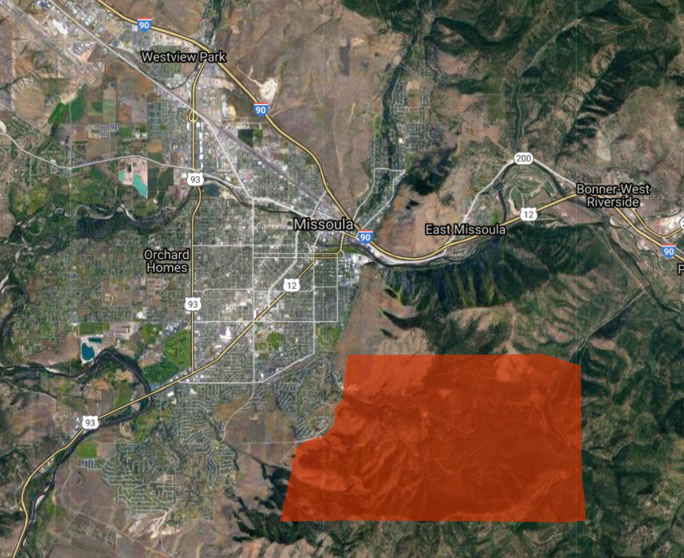
Missoula, MT – Pattee Canyon
Douglas Fir Tussock Moth
NAIP 2017

Slide 55

Missoula, MT – Pattee Canyon
Douglas Fir Tussock Moth
NAIP 2017

Slide 56

Missoula, MT – Pattee Canyon
Douglas Fir Tussock Moth
Pre-event Sentinel-2 Imagery
False color composite
2019-08-27

Slide 57
Missoula, MT – Pattee Canyon
Douglas Fir Tussock Moth
Post-event Sentinel-2 Imagery
False color composite
2020-08-21

Slide 58

Missoula, MT – Pattee Canyon
Douglas Fir Tussock Moth
Post-event Sentinel-2 Imagery
False color + change product
2020-08-21

Slide 59


Ground validation
Missoula, MT – Tussock Moth defoliation
Aerial photos Aug. 2020
DeltaViewer output Aug 2019-Aug 2020

Slide 60

Saltwater Intrusion– DelMarVa Peninsula

Slide 61

Saltwater Intrusion – DelMarVa Peninsula
Change between 2017 and 2020
2017 image: 7/30
2020 image: 7/14

Slide 62

ForWarn
https://forwarn.forestthreats.org/fcav2/
Notes:
ForWarn is a vegetation change recognition and tracking system that uses high-frequency, moderate resolution satellite data. It provides near real-time change maps for the continental United States that are updated every eight days.
ForWarn relies on daily eMODIS and MODIS satellite data
It tracks change in the Normalized Difference Vegetation Index (NDVI)
Coverage extends to all lands of the continental US
Products are at 232 meter resolution (13.3 acres or 5.4 hectares)
It has NDVI values for 46 periods per year (at 8-day intervals)
It uses a 24-day window with 8-day time steps to avoid clouds, etc.
The historical NDVI database used for certain baselines dates from 2000 to the present
The different forest change products relate to the length of the baseline and the compositing method used to display percent NDVI departure. They are:
Change using a 1-Year Baseline (recent disturbances, 1yr or less);
Early Detect 1-Year Baseline (disturbance resolved in as few as 8-days);
Change using a 3-Year Baseline (3-year old disturbances);
Change using a 5-Year Baseline (5-year old disturbances);
Change using a 10-Year Baseline (10-year old disturbances);
Change using an All-Year Baseline (all disturbances since 2000);

Slide 63

Landscape Change Monitoring System (LCMS)
https://apps.fs.usda.gov/lcms-viewer/
Notes:
The Landscape Change Monitoring System (LCMS) is a remote sensing-based system for mapping and monitoring landscape change across the United States. LCMS produces annual maps depicting change (vegetation loss and vegetation gain), land cover, and land use from 1985 to present that can be used to assist with a wide range of land management applications.
Purpose
With the help of regional and national forest staffs we have identified many applications of LCMS data, including forest planning and revision, updating existing vegetation maps, assessing landscape conditions, supporting post-fire recovery, and meeting some broad-scale monitoring requirements.
LCMS uses an ensemble modeling approach to generate a “best available” map covering multiple disturbance processes and diverse cover types. Vegetation loss and gain, land cover, and land use are modeled using predictor layers derived from several change-detection algorithms (LandTrendr, VeRDET, and CCDC) as well as annual Landsat image composites. Training data is identified using a stratified random sample and is photo-interpreted using the TimeSync visualization software and other relevant geospatial layers. Because no algorithm is expected to perform best in all situations, this approach provides a framework for intelligently assimilating the varied strengths of existing change-detection algorithms into one comprehensive change map that leverages advances in time series-based change detection techniques, Landsat data availability, cloud-based computing power, and big data analysis methods.

Slide 64
Common remote sensing indices
(near-infrared) – (red)
NDVI =
(near-infrared) + (red)
(near-infrared) – (mid-infrared)
NDMI =
(near-infrared) + (mid-infrared)
NDVI + NDMI
NDFI =
2

Slide 65
Break

Slide 66

Characteristics of Aerial Imagery
Advantages
  Increased spatial resolution
  Allows for stereo viewing
Disadvantages
  Poor temporal resolution (NAIP imagery acquired every ~3 years vs. Landsat every 16 days)
  Limited spectral sensitivity compared to satellite imagery
  Often expensive (if acquisition is required)
  Smaller image footprint
Notes:
Adnvantages
Sensors are similar to the ones on satellites—theyre just on planes
Increased spatial resolution, fly super close
Disadvantages
NAIP
Operated by aerial photography field office
Coast to coast, hi res, aerial imagery
Lower temporal res – NAIP Acquired every 3 years
But temporal resolution means it’s not perfect for every application
Also only collects 4 bands—RBG + NIR, older ones don’t have NIR
So, we can’t get a lot of the more sophisticated remote sensing indices that are used in veg work
Expensive if you have to fly a plane,
Can go either way
store the images, process them—and increasingly expensive for large areas
Smaller image footprint

Slide 67

Characteristics of Aerial Photography
Satellite Imagery (Landsat)
Resolution: 30 meter
Increased spatial resolution
  Much finer resolution compared to most satellites’ imagery
  Capable of sub-foot resolution
  Ability to extract additional data
Notes:
Walk through detail visible in landsat image
We can infer that there might be a road, ag field, house, shrubbery, so many different classes! That are only represented by these big ol pixels

Slide 68

Characteristics of Aerial Photography
Satellite Imagery (Landsat)
Resolution: 30 meter
Increased spatial resolution
  Much finer resolution compared to most satellites’ imagery
  Capable of sub-foot resolution
  Ability to extract additional data
Notes:
Walk through detail visible in landsat image
We can infer that there might be a road, ag field, house, shrubbery, so many different classes! That are only represented by these big ol pixels

Slide 69


Characteristics of Aerial Photography
Aerial Imagery (NAIP)
Resolution: 1 meter
Increased spatial resolution
  Much finer resolution compared to most satellites’ imagery
  Capable of sub-foot resolution
  Ability to extract additional data
Notes:
Walk through detail in NAIP image
So much more detail!

Slide 70

Characteristics of Aerial Photography
Capture a moment in time
  Pause dynamic conditions
    Flooding
    Forest fire
  Historical analysis
    Imagery acquired since 1930s
  Changes over time
    Forest maturity
    Fire severity
    Urban encroachment
Foresting Example
Location: western Oregon
Time Frame: 1995 - 2007
1995

Slide 71

Characteristics of Aerial Photography
Capture a moment in time
  Pause dynamic conditions
    Flooding
    Forest fire
  Historical analysis
    Imagery acquired since 1930s
  Changes over time
    Forest maturity
    Fire severity
    Urban encroachment
Forestry Example
Location: western Oregon
Time Frame: 1995 - 2007
2000

Slide 72

Characteristics of Aerial Photography
Capture a moment in time
  Pause dynamic conditions
    Flooding
    Forest fire
  Historical analysis
    Imagery acquired since 1930s
  Changes over time
    Forest maturity
    Fire severity
    Urban encroachment
Forestry Example
Location: western Oregon
Time Frame: 1995 - 2007
2003
Notes:
Where are these imagery from?

Slide 73

Characteristics of Aerial Photography
Capture a moment in time
  Pause dynamic conditions
    Flooding
    Forest fire
  Historical analysis
    Imagery acquired since 1930s
  Changes over time
    Forest maturity
    Fire severity
    Urban encroachment
Forestry Example
Location: western Oregon
Time Frame: 1995 - 2007
2005

Slide 74

Characteristics of Aerial Photography
Capture a moment in time
  Pause dynamic conditions
    Flooding
    Forest fire
  Historical analysis
    Imagery acquired since 1930s
  Changes over time
    Forest maturity
    Fire severity
    Urban encroachment
Forestry Example
Location: western Oregon
Time Frame: 1995 - 2007
2007

Slide 75











Characteristics of Aerial Photography
Allows for stereo viewing
  Single point perspective
  Displacement from changes in topography
  Overlap in image acquisition
    60% overlap (endlap)
    30% sidelap
60% overlap
These straight clearcut lines appear to be crooked due to displacement
30% sidelap

Slide 76


Using Processed Aerial Imagery
Stereo Viewing
Map Backdrop
GIS Data Extraction
Training Data
Definition: three-dimensional vision produced by the fusion of two slightly different views of a scene on each retina
Capable due to:
  Displacement from single point perspective view
  Overlap in imagery acquisition
Method for viewing stereo imagery
  Stereoscope and overlapping image hardcopies
  Digital stereo viewers and a block file of overlapping images (created in LPS)
    Summit Evolution and Stereo Analyst
Stereo viewing with stereoscope
Stereo viewing with shutter glasses and emitter
Notes:
Change pictures to not white guys

Slide 77


Using Processed Aerial Imagery
Stereo Viewing
Map Backdrop
GIS Data Extraction
Training Data
Imagery can be displayed behind other geospatial layers
Imagery can be draped over a DEM to add detail
Examples of services for acquiring imagery backdrops
  ArcGIS Image Server
  ArcExplorer
  Google Maps
Google Earth roads layer displayed above aerial imagery
NAIP draped over a DEM

Slide 78




Using Processed Aerial Imagery
Stereo Viewing
Map Backdrop
GIS Data Extraction
Training Data
Identification and delineation of features
  Feature Analyst – an ArcGIS extension used for extracting resource information from imagery
  Digital Mylar – a tool designed to attribute land cover classes and vegetation characteristics
Insect damaged trees identified with feature analyst
Digital Mylar Toolbar, dot grid overlay, and content table
Notes:
GIS data extraction
Extract or delineate features
Ecog
Image Sampler
Overlays a dot grid over the imagery; each point gets interpreted—a way to sample and attribute cover classes, create a tabular output, create estimates of different cover classes, or train models

Slide 79

Using Processed Aerial Imagery
Stereo Viewing
Map Backdrop
GIS Data Extraction
Training Data
Aerial Imagery is critical in a satellite mapping project
  Efficient and effective for developing image classification
  Best tool for verification of a classification
  Invaluable for reclassification and editing
  Provides an efficient means of determining classification accuracy
Aerial photography used as training data more moderate scale satellite mapping project
Notes:
Training data
If we need those training points for a landsat cover classification, how do we know what those look like on the ground?
Train georeferenced polygons on the higher-res imagery, for example, percentage of or tree cover—so the model is able to identify or predict where similar kinds of cover appear in the lower-res imagery or on the landscape.
Or, validation data! Remote or dangerous terrain—we can look at the hi res aerial photography

Slide 80



Aerial Photography Types
Film Imagery
Scale typically ranges from 1:8000 to 1:40,000
Spectral Format of natural color (as shown), color infrared, panchromatic and panchromatic infrared
Dates back to 1932
Requires scanning of film and georeferencing
Digital Imagery
Capable of sub foot resolution (6” resolution below)
Spectral Format – same as film
Digital cameras taking over film cameras
Georeferencing made easy with IMU and GPS data recorded simultaneously with imagery
Orthos
Images that have been extensively georeferenced & corrected for terrain displacement (using a DEM).
Can be derived from either film or digital images
Provide the accuracy and scale of a map
DOQQ (Digital Orthophoto Quarter Quad)
Notes:
Aerial photography types
Mostly using Ortho-corrected imagery
Corrected for screen effects
Digital product
Old stuff is film imagery
Probably has been scanned and digitized to import into Arc or GIS

Slide 81




Champion Mine
Pilot: DOI
Area: 15 acres
Location: R6 Willamette NF
Platform: 3DR Solo
Sensor: Ricoh GRII
Orthomosaic
Digital Surface Model
Notes:
UAS data
More lower-altitude, v customizable to task people to fly an area
If you want even more detailed high res imagery
Other projects I’ve worked on have used high-res, hyperspectral, UAS/drone imagery of seedlings being grown for restoration projects to look at sapling health; handy bc they can ground truth with other field data
Champion Mine in Willamette nF
Create super high res imagery
Also super high res DSM

Slide 82


Champion Mine
Digital Surface Model comparison
UAS Image-derived DSM – 1cm GSD
Lidar-derived DSM – 1m GSD
Notes:
Zoom in—
Your thumbnail is about 1cm by 1cm
DSM – like a DEM, but also measures things that are on the ground
DEMs that you use might be closer to 30m

Slide 83

Bluebird Mine
UAS Image-derived Point Cloud
Notes:
Bluebird mine Point cloud
Helps us create a 3-D model
Can measure height or width of objects
Also derives spectral information
Lots of information!

Slide 84

Bluebird Mine
Classified Point Cloud
Notes:
Can also derive a classified point cloud
As ground or not ground

Slide 85


Historic Preservation
Project: Purgatoire River Dinosaur Footprint site
Area: 1.5 acres (0.6 hectares)
Location: R2 Comanche National Grassland (Colorado)
Platform: 3DR Solo
Sensor: Ricoh GRII (RGB)
Goal: model dinosaur footprints to preserve record
Orthomosaic of main site
Hillshade and DSM
Notes:
Can use UAS for historic preservation
Dino footprints
Also applications for archaeology

Slide 86






PhotoScan (now MetaShape) Outputs
Dense Point Cloud
Orthomosaic
Digital Surface Model (DSM)
Digital Terrain Model (DTM)
Canopy Height Model (CSM)
Contour Lines

Slide 87
Lidar in the Forest Service
Lidar is a tool to help us make better resource management decisions
Inventory – how much is there?
  Canopy Height
  Canopy Closure
  Vegetation Density
  Biomass, Basal Area, Volume etc…
Mapping – where is it?
  Spatial pattern on the landscape
Classification – what is it?
  Species
Monitoring – has it changed?
  Multiple acquisitions
Notes:
Lidar
An active sensor
Emits a signal
Records the strength of the signal emitted, the strength of signal received, and how long it took to return
It’s receiving its own signal—the speed of light allows us to calculate, e.g, how tall things are

Slide 88
Lidar in the Forest Service
Lidar is a tool to help us make better resource management decisions
Inventory – how much is there?
  Canopy Height
  Canopy Closure
  Vegetation Density
  Biomass, Basal Area, Volume etc…
Mapping – where is it?
  Spatial pattern on the landscape
Classification – what is it?
  Species
Monitoring – has it changed?
  Multiple acquisitions
Successfully accomplished with lidar technology

Slide 89
Forest Service Lidar Applications
Timber inventory and management
  Stand level characteristics
  Cataloging and mapping current treatments
  Predicting Forest Inventory parameters
Habitat Analysis
  Wildlife cover and habitat characteristics
  Stream Shading and Erosion
Fire
  Predictive fire-fuels modeling
  Post fire restoration
Hydrology
  Watershed analysis
  Stream location
  Flood mapping
Archeology
Geology and Engineering
  Site suitability
  Landslide hazard assessment
Forest Recreation Management
  Campground site selection

Slide 90


What information can lidar provide?
High Resolution (1 meter) “Bare Earth Surface” or DEM

Slide 91


What information can lidar provide?
High Resolution (1 meter) “Bare Earth Surface” or DEM
Roads, Structures and other Surface features

Slide 92

What information can lidar provide?
High Resolution (1 meter) “Bare Earth Surface” or DEM
Roads, Structures and other Surface features
Vegetation
  Canopy height
  Canopy closure
  Individual tree crown identification

Slide 93

Vendor Deliverables
Moderate Resolution Topographic Products (e.g. ≥ 2 m lidar-derived DEM
  Increased resolution can be used to improve forest management models that incorporate topography.
  2 m lidar-derived DEM (left); 30 m USGS DEM (right)
Notes:
Who is a vendor

Slide 94

Vegetation Derivatives
Return data colored by height

Slide 95
Vegetation Derivatives
Return data colored by height

Slide 96



Vegetation Derivatives
Return data colored by height

Slide 97
Vegetation Derivatives
Return data colored by height

Slide 98


Vegetation Derivatives
Return data colored by height

Slide 99

First Order Derivatives
Legend
Mature Loblolly Stand
85 years old
Area = 65 acres
Young Loblolly Stand
19 years old
Area = 62 acres
Background image represents a subset (1150 acres) of the Sabine National Forest, TX. (NAIP 08, 1 meter resolution)

Slide 100


First Order Derivatives
Legend
Mature Loblolly Stand
85 years old
Area = 65 acres
Young Loblolly Stand
19 years old
Area = 62 acres
Canopy Height (m)
High:40m
Low: 0m
Canopy height model created from the Sabine NF lidar data.
Background image represents a subset (1150 acres) of the Sabine National Forest, TX. (NAIP 08, 1 meter resolution)

Slide 101

First Order Derivatives
Legend
Mature Loblolly Stand
85 years old
Area = 65 acres
Young Loblolly Stand
19 years old
Area = 62 acres
% Canopy Cover
High:100%
Low:0%
% Canopy cover model created from the Sabine NF lidar data.
Background image represents a subset (1150 acres) of the Sabine National Forest, TX. (NAIP 08, 1 meter resolution)

Slide 102

Potential landing zones

Slide 103

Tree crown identification and delineation

Slide 104




High Pulse Density (≥ 8 Pulses/m²)
  Includes all capabilities of Low and Mod. Pulse density data
  Possible to model Forest Inventory parameters: Dominant height, basal area, stem volume, biomass, canopy fuel variables, stem density
    Expensive: lidar data, Accurate field data, complex analysis
Build Inventory Models
Collect Data
Legend
Explore Relationship
Basal Area (SqFt/Acre)
High: 563
Low: 3
Lidar Plot Metrics
Build a statistical relationship between the lidar plot metrics and field plots measurements.
Use the statistical relationship to predict Forestry Inventory parameters across the entire lidar acquisition.
Field Plot Measurements

Slide 105

FUSION Software
Supports a variety of data types
      Shapefiles, images, digital terrain models (dtm), canopy surface models, and lidar return data (.las)
Provides a 3D visualization environment for examination and visualization
Provide specific analysis and data processing capabilities designed to make FUSION suitable for processing large lidar acquisitions.
      Provides independent quality assurance
      Creates detailed canopy structure metrics across large areas

Slide 106

Radar
Aka SAR: Synthetic Aperture Radar
Longer wavelengths than optical remote sensing
    Penetrate clouds
    Works at night (and in higher latitudes)
Applications include:
  Topography
  Glaciology
  Forestry

Slide 107
Remote Sensing Project Considerations
Project objectives and planning
  What product does the end user want?
  Can you provide it with remote sensing technology?
Budget and schedule
  Pre- and post-processing
  GIS Processing
  Accuracy assessment
Data needs and acquisition
Skilled personnel
Ancillary data
  Field data (additional cost)

Slide 108
Remote Sensing Software in FS
ESRI ArcGIS (enterprise GIS software)
  ArcMap
  AcrGIS Pro
  AcrGIS Online
ERDAS Imagine (enterprise remote sensing software)
FUSION (lidar)
Trimble eCognition (segmentation)
Agisoft Metashape (previously PhotoScan; photogrammetry)
Google Earth Engine (cloud-based computing)

Slide 109
Regional Remote Sensing Coordinators
Region | Name | Email
R1* | Robert Ahl | rob.ahl@usda.gov
R2** | Victoria Smith-Campbell | victoria.smith-campbell@usda.gov
R3 | Tom Mellin | thomas.mellin@usda.gov
R4 | Sanford Moss | sanford.moss@usda.gov
R5 | Carlos Ramirez | carlos.ramirez2@usda.gov
R6 | Mark Riley | mark.riley@usda.gov
R8 | Renee Jacokes | renee.jacokes@usda.gov
R9 | Dan Wendt | dan.wendt@usda.gov
 | Kirsten Tighe | kirsten.tighe@usda.gov
R10 | Dustin Wittwer | dustin.wittwer@usda.gov
*office is technically vacant
** GIS Coordinator
Notes:
R1: Robert Ahl and Pete Davis
R2: Victoria Smith-Campbell and Elise Brown
R3: Tom Mellin & Pete Joria
R4: Sanford Moss
R5: Carlos Ramirez and Nathan Amboy
R6: Mark Riley and Pete Heinzen
R8: Renee Jacokes
R9: Dan Wendt and Kirsten Tighe
R10: Dustin Wittwer

Slide 110

Geospatial Training and Awareness
Sign-up for live webinars
  Desktop GIS
  Web GIS
  Mobile GIS
  Remote Sensing
Find self-paced training materials
Access to recorded webinars

Slide 111
Upcoming training opportunities
Course | Dates
MTBS in Google Earth Engine | Weds 2/3, 10-11am MT
Obtaining Remotely Sensed Imagery | Thurs 2/4, 10am – 12pm MT
Raster Functions vs Geoprocessing | Tues 2/9, 10-10:30am MT
Lidar Derivates: Processing and Analysis | Weds-Thurs 2/10-2/11, 10am mT
Integrating Digital 3D Imagery into Geospatial Workflows | Weds 2/17, 10am-4pm MT
Google Earth Engine | Weds-Thurs, 2/24, 10am-12pm MT
Raster Functions in ArcPro | Thurs 2/25, 10am-4pm MT
Landsat Image Acquisition in Google Earth Engine | Tues 3/2, 10am-10:30am MT
Lidar Point Cloud Processing | Thurs 3/4, 10am-4pm MT
GTAC Geospatial Training Calendar

Slide 112
GTAC Remote Sensing SME Contacts
Point of Contact | Specialization | Email
Indigo Catton | Image interpretation, data portals, ArcGIS Pro, segmentation | indigo.catton@usda.gov
Kain Kutz | Object-based Image Analysis, Raster Geoprocessing, UAS | kain.kutz@usda.gov
Lila Leatherman | Change Detection, Image Classification, R & Earth Engine scripting, modeling | Lila.Leatherman@usda.gov
Jeremy Webb | Aerial Photography, Photogrammetry, UAS | jeremy.webb@usda.gov
Mark Hammond | ERDAS and Data Services, Photogrammetry | mark.hammond@usda.gov
Shiona Howard | Lidar Acquisition, Analysis, and Support, Python scripting | Shiona.Howard@usda.gov
Wren Scott | SAR, Google Earth Engine Scripting | Warren.Scott@usda.gov
Geospatial Training and Awareness page

Slide 113
Demo: Accessing additional training for Remote Sensing
Obtaining Remotely Sensed Imagery: ORSI
Notes:
Take people to GTAC site and show them how to access tutorial
Obtaining Remotely Sensed Imagery – previous recording available
Where are the resources located?
Walk people through Sharepoint website
https://usdagcc.sharepoint.com/sites/fs-gtac-tus/SitePages/Self-Paced%20Training.aspx

Slide 114
Geospatial Help Desk
Did you know that GTAC offers geospatial support through the Customer Help Desk?
  Tickets first go to a Tier 1 Help Desk Agent
  Tickets are then routed to a Tier 2 Agent who specializes in the area of your issue
Geospatial Tier 2 Agents work directly at GTAC
  Bypass long wait times and come directly to us!

Slide 115
GIS Help Desk
3x Tier 2 Agents at GTAC
  Submit a CHD request directly to the GIS Help Desk queue – click the blue Request Now button
    Local GIS issues (desktop version of ArcMap, ArcGIS Pro, etc.)
    Mobile GIS issues (GPS, Collector, Survey123, Avenza, etc.)
    Data Center (Citrix users of ArcMap)
Topics: appropriate standards, recommended agency workflows, best practices, field data collection and management, standard and custom data dictionaries, data transfer, tile package creation and use, mobile GIS equipment recommendations based on use, etc.
Available 8 am to 5 pm Mountain Time

Slide 116
Remote Sensing Help Desk
4x official Tier 2 Agents at GTAC and myriad Subject Matter Experts (SMEs)!
  Tier 2 agents answer questions + formally handle tickets; SMEs answer questions + let the Tier 2 agents handle the tickets
  This is a funded service that we provide – you are not inconveniencing anyone by asking for help.
  Contact SMEs directly, we’ll take care of the CHD ticket.
  We have a whole office of SMEs at our disposal to help you resolve whatever issue you’re facing.

Slide 117
Remote Sensing Help Desk
Topics: troubleshooting remote sensing software, lidar, radar, Google Earth Engine, modeling, geospatial scripting, photogrammetry, stereo viewing, change detection, segment generation / object-based image analysis (OBIA), raster geoprocessing, and more.

Slide 118
Questions/Comments?
Lila.Leatherman@usda.gov
Thanks for participating!

