Slide 1
Random Forests
Brenna Schwert, bmschwert@fs.fed.us
February 27, 2019

Slide 2
Welcome!
Instructor: Brenna Schwert
  Onsite contractor at Geospatial Technology and Applications Center (GTAC) in Salt Lake City, UT
  Remote Sensing Analyst & Senior Trainer
Course
  Random Forests gaining in popularity
  Hard to learn on your own
Notes:
Good morning, everyone! My name is Brenna Schwert, and I will be instructing today’s webinar. I’m an onsite contractor working at the Geospatial Technology and Applications Center in Salt Lake City, UT. GTAC formed through the integration of the Remote Sensing Applications Center (RSAC) and the Geospatial Services and Technology Center (GSTC) in the fall of 2016. So if you’re confused by acronyms and trying to keep centers straight in your head, hopefully that helps. We’re the same people offering the same services – most of the changes are internal and reduce redundancy and increase efficiency. I’ve been here for 5 years, and I work as a remote sensing analyst on lots of different applications projects and as a trainer putting together webinars like this one.
Today, we’re going to try to demystify random forests. This is a method that has been increasing in popularity and finding its way into more and more workflows, but for the unfamiliar, it’s really difficult to understand how it works and how to parameterize it. It seems like a black box, and it’s very difficult to parse through manuals and learn it on your own. That’s where this webinar and I come in!

Slide 3
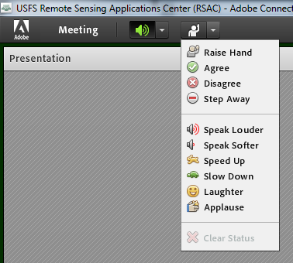
Housekeeping
Adobe Connect
  Quick orientation to interface
Please dial *6 to mute your phone
  Question or comment?
    Un-mute by dialing *6 again
    “Raise” your hand
    Send a chat
Notes:
Before we dive into things, I want to give a quick orientation to the Adobe Connect interface for those who aren’t used to it. The screen is made up of little windows called pods. You will always have an attendees pod (so you can send a message to me directly if you need to). In the chat pod, you can send messages to all participants, and you will see messages from me in pink so they’re easier to spot. When I’m sharing a PowerPoint, the links will be live – feel free to click them, and they will launch on your screen. There’s also an expand button in the upper right corner of this pod in case you want the slides to take up the whole screen. You can also use this to expand the screen when I’m sharing my desktop during demonstrations.
Random forests can be confusing, and these materials may be quite new for you. I expect and encourage questions – if you’re lost or need clarification, you’re probably not the only one. There are a few ways to participate: (1) you can send a message via the chat pod, and I will pause to address it when there’s a logical stopping point; (2) at the top of the screen, there’s a little person icon with a drop down menu – choose the option that best reflects what you need from me, whether it’s raising your hand or asking me to speak louder; (3) you can also speak up on the teleconference -- if you’re dialed in, please make sure you mute your phone by pressing *6 so we don’t get lots of background chatter, but feel free to press *6 again to unmute yourself and ask a question.

Slide 4
Software and course data
Required software
  RStudio 2.11.1 (or higher)
  ArcGIS 10.2 (or higher)
Optional software
  ArcGIS Pro 2.0
Course materials
  Available via link below
    https://fsapps.nwcg.gov/gtac/CourseDownloads/RandomForests/
    Exercises, NAIP imagery, ancillary raster variables, R script
Notes:
There are only two exercises in today’s course, and they both use the same data and workflow – one uses R, a free and open source statistical software and programming language, and one uses Google Earth Engine, a powerful cloud-based computing environment. For working in Google Earth Engine, we strongly suggest using Google Chrome as your web browser (if not possible Firefox usually works well, too, but there are a ton of problems that pop up when you try to use GEE in Internet Explorer). ArcGIS is not strictly necessary – we use it to view and explore data. If you don’t have access to ArcGIS, QGIS, a free and open source GIS software, works equally well.
If you haven’t downloaded the course materials yet, you can find them at the link on this slide. The folder contains the course exercises, some subset NAIP imagery and raster variables, and an R script.

Slide 5
Outline
AM
  Background and theory behind RF
  Execution of RF in RStudio
PM
  Google Earth Engine
  ArcGIS Pro
  Demonstrations in other software
  General Q & A
Notes:
This morning, we will cover the background and theory behind random forests, and then we’ll walk through how to run a random forests model in Rstudio. We’ll take a break for lunch and to work on exercises, and then we’ll reconvene and cover the Google Earth Engine workflow.
The morning session will be a bit denser than the afternoon session, so let’s dig in.

Slide 6
Random Forests
What: sophisticated ensemble machine learning algorithm
Who: developed by Leo Breiman and Adele Cutler
When: 2001
Why: need to correct for decision trees overfitting training data
How: …we’ll get to this in a bit
Notes:
Random forests is a sophisticated ensemble machine learning algorithm. To put that in layman’s terms: we’re taking a machine learning algorithm, which is a tool that adjusts itself based on the data that you feed it, and we’re creating many of them – this is the ensemble aspect.
Random forests is a proprietary algorithm developed by Leo Breiman and Adele Cutler, although there are slightly adapted versions of the algorithm found in different software packages. Because random forests is trademarked, you might see them called something else. The eCognition software package, which is used for Object-Based Image Analysis, calls them “random trees.” Here at GTAC, some of us jokingly call them “stochastic orchards”.
The algorithm has been around since 2001.
They created random forests because another popular type of machine learning algorithm, decision trees, had some problems. Decision trees tend to overfit data, which is a bad thing. We’ll talk about what this means and why it’s bad a little bit later.
We’ll also delve into how random forests work in a little while – first, we need to establish a bit more foundation and set the scene.

Slide 7
Image Classification
We have a finite number of classes, or categories (e.g., forest, water, built)
We sort our pixels into these classes
Pixels are sorted into the same group if they have similar characteristics
  Spectral response
  Climatic variables (ancillary)
  Topographic variable (ancillary)
Can be very simple or very complex!
Notes:
If you’re unfamiliar with image classification, it’s pretty simple in theory (but can get very complex in practice):
We have a finite number of classes. For example, we may want to divide our image into three classes: forest, water, and built.
Every pixel in our image should belong to a group, but how do we know which group to place it in? Pixels that are sorted into the same group will have similar characteristics – spectral response (or spectral signature) and climatic/topographic variables.

Slide 8
Image Classification
Depends on spectral separability
  How similar are the spectral responses of two or more features?
  Can those features be differentiated?
Focus on three main land cover types:
  Forest
  Water
  Built
Notes:
We’re going to focus on the spectral component of image classification here, because that tends to be what drives our models the most. Simple or complex, image classification is all based in the idea of spectral separability – that is, are these features/classes distinct in each of the bands that our imagery contains?
We’re going to walk through some classification examples using three classes: water, forest, and built.

Slide 9

Image Classification
Healthy Vegetation
Built
Reflectance
Clear Water
0.4
2.6
Near Infrared
Short-wave Infrared
Wavelength (µm)
Notes:
If you’re not accustomed to reading spectral signatures, the X axis is wavelength, with shorter wavelengths closer to the origin (visible bands) and longer wavelengths further away (shortwave bands). The Y axis is reflectance, where the origin represents zero reflectance (or total absorption of light), and as you move further away, you are reflecting an increasing amount of light.
In this graphic, you can see the three basic features that we’re focusing on – water, healthy green vegetation (forests), and built features. You can see that in each key part of the spectrum, these features have noticeable differences.

Slide 10
Image Classification
All classifications:
  Calculate spectral distances
  Create clusters (which will become classes) / define thresholds between clusters
Unsupervised
  Clusters pixels first
  Applies labels after clusters are made
Supervised
  Applies labels to training sites
  Clusters pixels according to training data
Notes:
Regardless of which classification method we’re using, all classification methods will calculate spectral distances in some way, and all classification methods will create clusters or define threshold between clusters.
Classification methods are generally divided into two groups: unsupervised and supervised methods. With unsupervised classification methods, the clusters are defined first, and after pixels are sorted into X clusters, the user applies labels to them.
In supervised methods, the user applies labels to a select number of pixels, which are called training sites. The algorithm will cluster the remaining pixels according to these training sites
They perform the same basic operations (labeling and clustering), but the order of operation is switched.

Slide 11
Unsupervised Classification
Near infrared
Red
Notes:
Our data is n-dimensional (for Landsat 5 and 7, we have 6 optical bands, or 6 predictor variables, to work with). Here you can see the red band plotted against the near infrared band. Points with low red and low near infrared values tend to be dark, either dark clear water bodies or shadows. Points with high red and high near infrared values tend to be bright, highly reflective features, like concrete or dry bare soil. Points that have low red values and high near infrared values tend to be healthy green vegetation, because it’s green rather than red and has a high near infrared reflectance because of the presence of the healthy cell wall.
On this slide, none of the pixels have been clustered/grouped/classified – we’re just interpreting what their placement on the scatterplot might mean.

Slide 12
Unsupervised Classification
Near infrared
Red
Notes:
In an unsupervised classification like ISODATA (iterative self-organizing data analysis technique), clusters/groups are formed based on distance. While simple Euclidean distance is the easiest way to measure the distance between samples, there are many other ways of doing so. Our examples will all use Euclidean distance to make things a little bit simpler.
With ISODATA, cluster centers are randomly placed, and pixels are assigned to groups based on a shortest-distance-to-center method.
---------------------------------------------------------------
Once each point has been assigned, standard deviation within each cluster is calculated, as well as distance between new cluster centers. If the standard deviation within a cluster is greater than a user defined threshold, the cluster is split. If the distance between clusters is less than the user defined threshold, the clusters are merged.
Using the new cluster-centroids, the process is run again. This continues until the average distance between cluster centers falls below the user-specified threshold, the average change in distance between cluster centers falls below a user-specified threshold, or the maximum number of iterations specified by the user is reached.

Slide 13
Unsupervised Classification
Near infrared
Classes
Class A
Class B
Class C
No Class
Red
Notes:
Clusters that have fewer than the user-specified number of pixels are eliminated. Lone pixels are either put back in the pool for reclassification or they are ignored as “unclassifiable”.

Slide 14
Unsupervised Classification
Near infrared
Classes
Class A
Class B
Class C
No Class
Red
Notes:
One classification is complete, the output is generated. Clusters have non-descript class names.

Slide 15
Unsupervised Classification
Near infrared
Classes
Forest
Class B
Class C
No Class
Red
Notes:
After clustering is complete, users have to manually apply categorical information to the cluster/categories. The user will probably swipe between the classification and the imagery to determine what each class represents.

Slide 16
Unsupervised Classification
Near infrared
Classes
Forest
Water
Class C
No Class
Red
Notes:
Label each category…

Slide 17
Unsupervised Classification
Near infrared
Classes
Forest
Water
Built
No Class
Red
Notes:
Until each is labeled

Slide 18
Unsupervised Classification
Saved Clusters
Cluster 3
Cluster 6
Output Classified Image
Next Pixel to be Classified
Cluster 5
Cluster 2
Cluster 1
Cluster 4
Unknown
Notes:
There are all different sorts of learners, so I want to present this in another way so we make sure everyone has a strong foundation.
In this example, clusters 1 + 4 represent water, clusters 3 + 6 represent built surfaces, and clusters 5 + 2 represent vegetation. The algorithm finds a number of classes (in this case, there are six), and then every pixel is compared against the clusters – the one that it is most similar to will be the one it is assigned to. In this case, the unknown pixel will probably be assigned to cluster 3 or 6, because it is appears most similar to the built class.

Slide 19
Unsupervised Classification
After the computer finishes processing, the analyst then attempts to assign these spectral classes into informational classes. It is a simple process to regroup (recode) the clusters into meaningful information classes (the legend).
The result is a land cover layer
Land Cover Map
Legend
Labels
Water
Water
Water
Tree
Tree
Tree
Built
Built
Built
Notes:
Once all of the pixels have been assigned to a cluster, it’s up to the user to make sense of what those clusters, or classes, mean. In this example, the interpreter found that the algorithm had a couple of different classes for each of the land cover categories they were interested in mapping. For example, it looks like the algorithm found that “shallow water” and “deep water” were spectrally distinct. This makes a lot of sense, but we only need one water class.
The user has defined what each of the clusters represent, and then they collapsed them into a simpler classification scheme.

Slide 20
Supervised Classification
Near infrared
Red
Notes:
Supervised classification works very similarly to unsupervised classification – distance operators are used to measure the differences between data points / pixels. However, instead of clustering and *then* labeling the groups, the labels are applied to individual data points / pixels, and clusters are built around them, such that the final clusters already have labels.

Slide 21
Supervised Classification
Near infrared
Classes
Forest
Water
Built
Red
Notes:
These three classified pixels represent our training data. We have an example of what the water class looks like, what the forest class looks like, and what the built class looks like.

Slide 22
Supervised Classification
Near infrared
Classes
Forest
Water
Built
Red
Notes:
Each pixels in our image is measured against each sample in our training dataset.

Slide 23
Supervised Classification
Near infrared
Classes
Forest
Water
Built
Red

Slide 24
Supervised Classification
Near infrared
Classes
Forest
Water
Built
Red
Notes:
Each point is then attributed with the class of the training data point closest to it (i.e., the point most spectrally similar to it)

Slide 25
Supervised Classification
Near infrared
Classes
Forest
Water
Built
Red
Notes:
In this case, the pixels we’re trying to classify is most similar to the water sample, so we’re going to call that pixel water, too.

Slide 26
Supervised Classification
Near infrared
Classes
Forest
Water
Built
Red
Notes:
Working through this process, thresholds between the classes are defined. Given our spectral space and the samples in our training dataset, any pixel that falls into the lower area will be classified as water.

Slide 27
Supervised Classification
Near infrared
Classes
Forest
Water
Built
Red
Notes:
In the send, we reach the same type of output that we got with the unsupervised classification, but the results are just slightly different (everything is classified), and we got there in a slightly different way.

Slide 28
Supervised Classification
Supervised classification requires the analyst to create training data, either in the field or from an image data source.
Mean Spectral Signatures
The computer then creates...
Tree
Known Tree Area
Water
Known Water Area
Built
Known Built Area
Digital Image
Notes:
Just to go through this example again for different types of learners, with supervised classifications, we tell the algorithm what the spectral signatures of our desired classes look like. In this example
In this example, we’re defining our training data with polygons – the spectral information across that area is averaged, which results in mean spectral signatures.

Slide 29
Supervised Classification
The computer compares each unknown pixel against the training data, and then it assigns the most similar class.
Mean Spectral Signatures
Output Classified Image
Tree
Next Pixel to be Classified
Built
Water
Unknown
Notes:
Once the mean spectral signatures have been calculated, we compared each unknown pixel location against the known signatures. The class of the most similar training data will become the class of the unknown sample.
You might be wondering why I didn’t just show you in this manner – it’s a lot easier to understand, right? But machine learning algorithms start to get pretty complex, so being able to understand even a very basic decision space will become very helpful in a few minutes.

Slide 30
Random Forests
What
  Sophisticated data mining tool
  Ensemble of decision trees
  Few parameters to set (easy to use for the layman)
  Underlying distribution of data irrelevant (parametric and non-parametric distributions are accepted)
  Not sensitive to bias or effects of high variance
Notes:
Now that we have a bit more of a foundation regarding classification, we can get into Random Forests knitty gritty.
-It’s a sophisticated data mining tool – this means that’s we’re using some fancy math/statistics to unveil patterns in our data so we can use them to our advantage.
-It’s an ensemble of decision trees – all this means is that we have multiple decision trees. If you’re not familiar with decision trees, we’ll get to that in a moment.
-There are very few parameters to set, so they’re easy for laypeople to run (but knowing what those parameters do mean that you’ll have more control!)
-Random forests is a non-parametric classifier, so the underlying distribution of data are irrelevant – this is important, because our data rarely follow a parametric distribution, but a lot of classification algorithm assume that’s the case).
-Random forests are not sensitive to bias or effect of high variance. This last point is very important, but understanding it probably isn’t intuitive. Don’t worry, we’re slowly piecing all of this together, and we’ll get there!

Slide 31
Classification and Regression Trees
RF is based in CART method
How CART works:
  CART seeks the most ideal splitting point and chooses the variable with the highest discriminating power
  Uses an impurity function to test splitting thresholds
  Recursive binary partitioning
    Recursive (over and over), binary (yes/no questions/criteria), partitioning (splitting the data)
Notes:
In order to understand how random forests work, it’s imperative that we understand the CART method, because that’s what random forests is built upon.
CART stands for Classification and Regression Trees. In this webinar, we’re really only talking about Classification Trees (i.e., each pixel will below to a thematic class). In regression trees, pixels will have a continuous value.
CART takes your data and considers every possible threshold you could use in order to split your data into two groups. For every threshold, it runs impurity function tests on the two new clusters of data – it’s basically testing to see how similar these two groups are. When it finds the threshold that creates the two most homogenous groups, it declares that the split point. Then it uses the same method to split each of the new groups. If a group is too pure to be split, it becomes a class.
This is called recursive binary partitioning – the algorithm repeatedly (this is recursion) splits your data into two groups (this is binary partitioning).

Slide 32
CART Feature Space
Near infrared
Classes
Unclassified
Built
Red
Notes:
A classification tree creates a set of binary rules, or splitting points, for our data. In a two dimensional feature space like you see here, that manifests as boxes.
In this example, the CART model has tested all of the possible thresholds, and it’s determined that the best splitting point is at ~.55 in the red band. All pixels on the right side of the threshold have a high enough purity to all belong to the same group, built.

Slide 33
CART Feature Space
Red Band
<.55>
Unclassified
Built
Near infrared
Classes
Unclassified
Built
Red

Slide 34
CART Feature Space
Red Band
<.55>
Near Infrared
<.40>
Built
Near infrared
Classes
Unclassified
Built
Red
Notes:
The CART model then seeks the best splitting point between the cluster of pixels on the left side of the red threshold. In this case, that is at .4 in the NIR band.

Slide 35
CART Feature Space
Red Band
<.55>
Near Infrared
<.40>
Built
Water
Forest
Near infrared
Classes
Forest
Water
Built
Red
Notes:
Once those point are split, the algorithm determines that each group is pure enough to be its own class. This is based on their similarities to the training data.

Slide 36
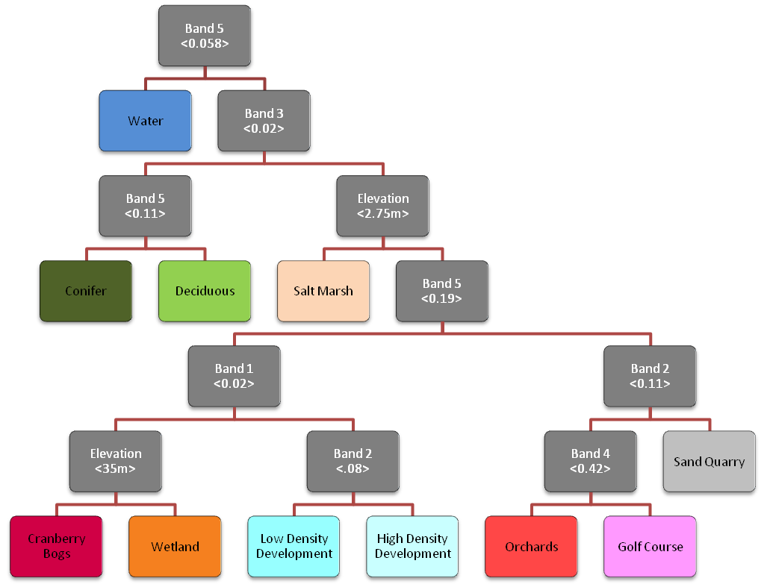
Classification tree example
More informative splits higher up in the tree
Easily interpretable
Prunable
Notes:
What we just went through is an overly simplistic model to help you learn, but here is another example. Here, we have 11 classes. It’s easy to see how the classification tree works and how it’s making its decisions. We have more informative splits higher up in the tree (i.e., the splits results in larger groups, so they’re more descriptive of patterns), and the tree is prunable. This means that if we don’t like a decision that was made, we can prune, or cut out, that branch from the tree.
The anatomy of the tree is also important – we’ve got deicision nodes, which is where we find the rules. The first node on this tree, the Band 5 split, is a decision node. WATER would be a terminal, or end, node.

Slide 37
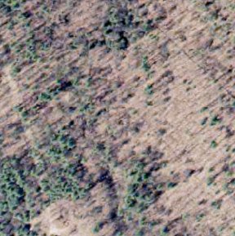
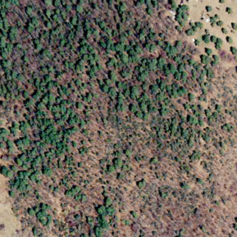


High within-class variability
Widely variable sub-pixel mixing effects associated with moderate resolution data
forest boundary
dec, dark
even mix, bright
dec, bright
con, dark
even mix, dark
con, bright
uneven mix, bright
uneven mix, dark
Notes:
Here’s one example that shows why decision trees can be so powerful AND why they can be so tricky to use. All of these are tree samples, but they’re all really different. We have some pixels with a ton of background effects (e.g., lots of dry bare soil peaking through and affecting the spectral signature), we have some deciduous samples (while others are mixed or just evergreen conifers), and we have varying canopy cover.
Unless we take tree samples across all of these different types of forests, the decision tree model will learn the specific characteristics of only one of these types of forest pixels. If we want to apply the model developed in the area on the left to the area on the right, the model may now perform as well. This is called overfitting – the model learns the EXACT characteristics of the training data we give it, and it can’t handle anything else well.

Slide 38
Cons of CART
Deterministic
  Slight changes in data could drastically change model output
Bias issue
  Some variables have more explanatory power, and they will be chosen over others (which still hold meaningful info)
Overfitting
  Splits form around the input data
  Model learns the input data too well
  Certain decisions may be based on illogical splitting rules (though these can be pruned)
Notes:
The cons of the CART method are why Breiman and Cutler decided to develop random forests.
CART is deterministic, meaning that the data informs the model, and those data will always produce the same result. This is nice, because there’s some predictability with how the model runs, but there is no randomization in the model., and this in turn leads to overfitting.
The CART method is also biased. Some variables might contain a lot of explanatory power, but they may only have a few groups (e.g., a soils layer). However, other variables that have more potential splitting points (e.g., Landsat’s green band would has 256 possible values) – CART often chooses these variables.
Overfitting happens when the splits form around the input data. The model learns the data too well, almost tracing the boundaries between classes. Not all of the splits chosen by the model are based on actual patterns, but rather things it may only see in the data once.
----------------------------------
“When potential predictor variables vary in their number of categories, and thus in their number of potential cutpoints, those variables that provide more potential cutpoints are more likely to be selected by chance.“ (Strobl and others, 1993) This bias can partially be explained by the fact that variables that are preferred in the biased individual trees acquire more influential positions close to the root node and have more effect on the prediction accuracy.

Slide 39
Bias of an estimator
Difference between estimated value and actual value
Say I want to predict a certain specific veg type, and I have two variables:
  Aspect (limited to N, NE, E, SE, S, SW, W, NW)
  Near Infrared (DN from 0-255)
Which variable is going to give me the most accurate estimate?
Notes:
Bias is a type of error, and it refers to the difference between estimated value and actual value. An unbiased predictor means that it accurately predicts what we want to model. That said, all predictors are going to have *some* bias.

Slide 40
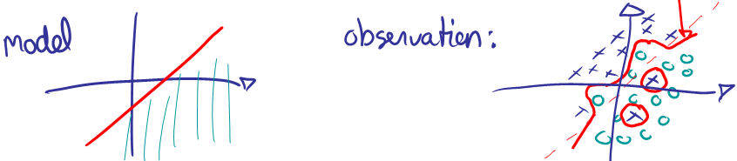
Overfitting
Overfitting – doesn’t generalize well (or as well as possible)
  Given a certain subset, the output model will be biased toward those data
  Some samples might be more accurate/explanatory than others
What does overfitting look like?
Notes:
When we’re modeling, we are trying to create a good generalization of something. We can’t get everything right all of the time, but we want to get things right a lot of the time.
When overfitting is present, the output appears to be incredibly accurate, but when applied that isn’t very similar to the training sites, it does not do well.

Slide 41
Improving on CART methods
Addressing overfitting
  May see a pattern in the training data that is not representative of the population
    some splitting rules may not be informative
    “correlation does not imply causation”
    Example:
      3 women, 2 men
      Women are wearing glasses; men are not
      Use glasses as a splitting rule for gender
  Incorporating randomization into model helps to minimize the creation of these spurious decision rules
Notes:
When data are overfit, we may see a pattern in the training data that are not representative of the population.
For example, if I’m differentiating between men and women in a small subset group of 5 people, a CART model may notice that all of the women happen to be wearing glasses. It decides that if GLASSES = YES, then WOMAN. What happens when we use the rules that we’ve defined here to differentiate gender in a larger group? A man who’s wearing glasses may be classified incorrectly as a woman. This is an easy to understand example of overfitting.
By incorporating randomization into our model, we can help to minimize these spurious or uninformative decision rules.

Slide 42
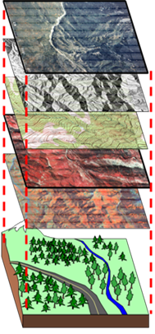
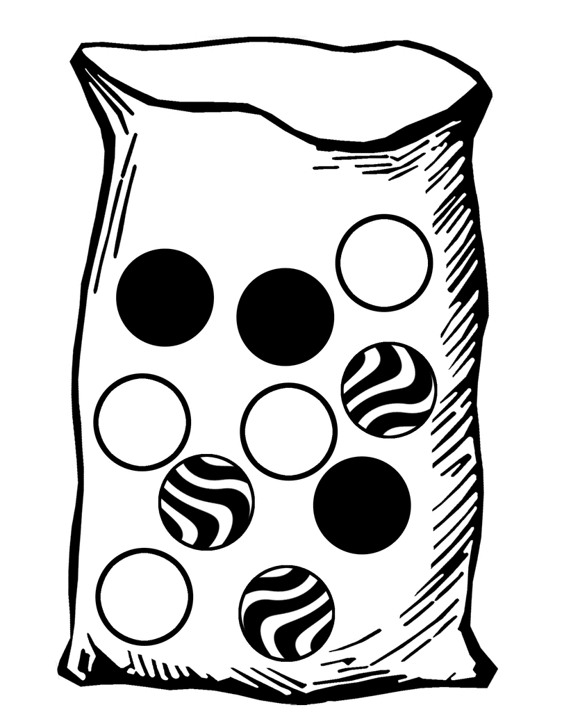
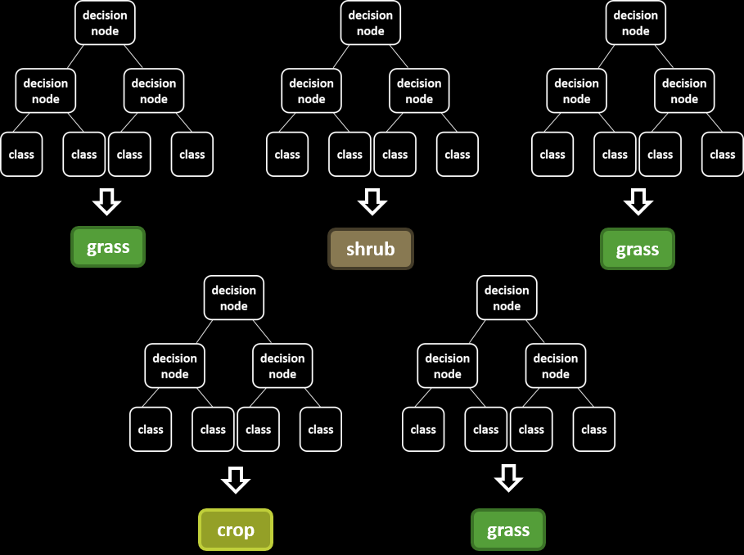
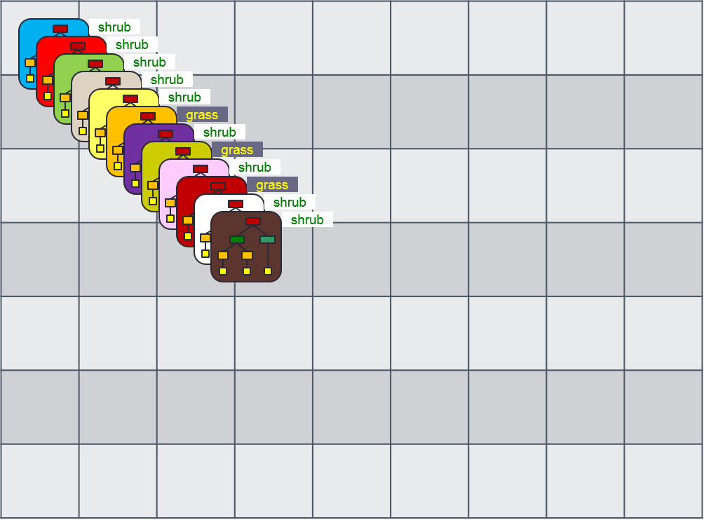
How RF works
Bootstrapping
  Each tree is created with a unique subsample of the training data, selected with replacement
  Each decision node uses a random selection of the predictor variables (instead of using all available variables)
Bagging
  Each tree = one vote; for each pixel, the majority rules in terms of the output classification
Each tree in the forest is based on a different subset of data, capturing different phenomena/irregularities
Notes:
Now we can talk about how random forests works and how it builds upon the CART method.
First, RF uses bootstrapping. Each tree is created with a unique subsample of the training data, and the samples are selected with replacement. So let’s say there are 10 marbles. Selecting with replacement means that if I select one of the black marbles (3/10), I replace it so that I have a 3/10 chance of selecting a black marble again. Without replacement, the odds of selecting a black marble would change from 3/10 (30%) to 2/9 (~22%). By selecting with replacement, we allow for an absurdly high number of possible computations, and this is important, because we’re running a large number of trees! So we’ve got 500 trees, and each one of those trees is using a unique subset of the training data – they’re all different.
Now let’s just consider one of the trees. In a CART model, each of our decision nodes has access to all of our input variables (spectral data, topographical data, climate data, etc). Remember that when we have a lot of variables, preference will be given to variables that have lots of possible splitting points. In random forests, when we come to a decision node, the model can only choose from a fraction of the variables we give it. Each node uses a different random assortment of variables. So the first decision node might have access to the SWIR band, but this variable may not be included in the next 7 decision nodes.
Because each of our trees are different, they may result in different classifications.
Each tree is used to predict the class of a given pixel. If there are 100 trees and in 70 of them, the pixel is classified as forest, the pixel will be forest in the output classification. It uses a simple one tree = one vote rule to determine what the output classification will be. This is called bagging.
SO! Each tree in your forest will contain different random subsets of the data – this helps us to eliminate overfitting and bias, and it helps us to caputure different phenomena/irregularities.
-

Slide 43
How RF works – summary
Lots of decision trees
Each tree has a unique subset of training data
Each decision node is based on a random selection of independent variables
Each tree = 1 vote
Notes:
So to summarize how random forests works:
-We have LOTS of decision trees. This is chosen by you! Usually this is set somewhere from 100-500.
-Each tree has a unique subset of the training data, chosen with replacement. This means that some samples can be chosen twice (or more!).
-Each decision node is based on a random selection of independent variables (this is a parameter).
-Each tree = 1 vote

Slide 44
Parameterization
# of trees
  How many? Eventually reach a saturation point where additional trees do not improve model
Variables per split
  Usually chosen as the square root of the number of available variables OR set at 2-4
Minimum leaf population
  The minimum number of pixels classified by a terminal node
Bag ratio/fraction
  How much of the data should be bagged per tree?
Notes:
We’ve got four main variable to set when running a Random Forests model:
Number of trees. How many? Eventually, we will reach saturation point where additional trees won’t improve the model, but it will lengthen the run time.
Variable per split. How many variables do we want the model to have access to? The default setting is usually the square root of the available variable, so if we have 16 variables, each decision node will randomly choose four variables. The other common option is to set this from 2-4.
Minimum leaf population. A node is also called a leaf. Sometimes, the terminal node is only classifying a few pixels, and this could be bad. If the model is making a rule for only a handful of pixels, it’s likely overfitting, or catering the decision ruleset specifically to the data that we’re feeding it. Setting a minimum leaf population will tell the model to prune these nodes.
Bag ratio/fraction. This refers to how much of the data is reserved for testing. Random forests give you a built in accuracy assessment!

Slide 45
Random Forests as a black box
Can’t see individual trees / choices
How do we assess which variables are being used? Whether they’re being used appropriately?
Variable importance plots
  Help us to determine the fit of a model
Notes:
Some people still refers to random forests as a black box, and to some extent, that’s fair. We can read out all of our trees the way we’d be able to if we were running a CART model.
So how do we assess how the model is doing and whether variables are being used appropriately? We can use variable importance plots to do this, and these plots help us to determine the fit of a model.

Slide 46
References
http://www.stat.berkeley.edu/~breiman/RandomForests/
Interesting Science Friday segment from 11/20/15
  “Why Machines Discriminate—and How to Fix Them” (27:50)
  http://bit.ly/1TgXfmu

Slide 47
What goes into models?
Training or reference data (point)
  Examples of each class (e.g., conifer, aspen, grass, shrub, road, sagebrush, shadow, water, soil, et cetera)
Predictor variables
  Multispectral imagery
  Panchromatic imagery
  Derived variables:
    NDVI
    Tasseled Cap transformations (brightness, greenness, and wetness)
  Topographic variables:
    Elevation
    Slope
    Aspect
  Bioclimatic variables:
    Temperature
    Precipitation
  Environmental variables:
    Soils
    Drainage
    Land-use
    Ecoregions

Slide 48
Questions?
Contact: Haans Fisk, Program Leader,
Remote Sensing Evaluation, Application, and Training (RSEAT)
hfisk@fs.fed.us

