Slide 1
Remote Sensing for Forest Cover Change Detection
Karis Tenneson & Brenna Schwert
Remote Sensing Specialists at USFS
Geospatial Technology and Applications Center (GTAC)

Slide 2
Outline
What is landscape change?
How is it mapped and measured?
Considerations for your own project
Workflow

Slide 3
Example of landscape change
32 years of shoreline changes in Incheon, South Korea
https://remotesensing.usgs.gov/gallery/gallery.php?cat=3#353

Slide 4
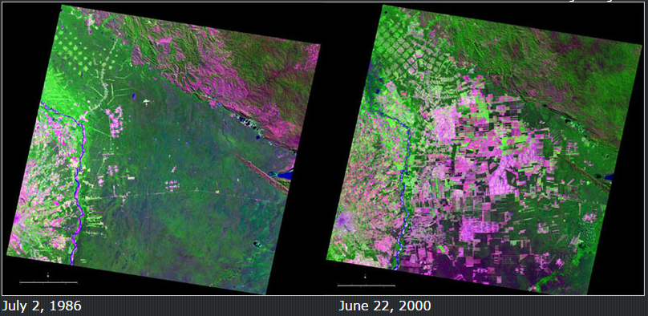
Example of landscape change
Forest cover changes in Bolivia, 1986-2000
https://remotesensing.usgs.gov/gallery/gallery.php?cat=3#137

Slide 5
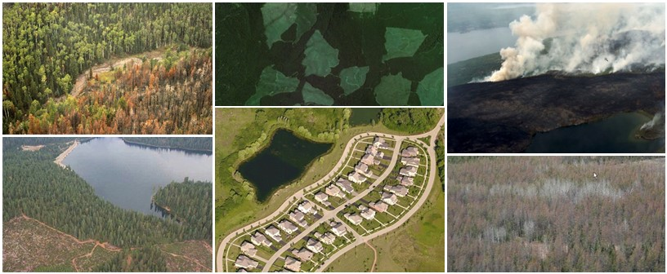
Change Agents
Change agents affecting forests
Natural disturbances: wildfire, insect outbreaks, drought or climate change, storms, invasive species, etc.
Growth cycle: regeneration, succession, etc.
Management: harvest, thinning, etc.
Land use change: urban development, agriculture, etc.

Slide 6
Dimensions of Change
Changes occur across variable spectral, spatial and temporal scales

Slide 7
How do we map these changes?
Identifying landscape change from remotely sensed images
Analyze images from different times to map/quantify
change
Assumption:
Landscape change -> Spectral change
Coconino NF – Schultz fire effects Landsat TM5 image – 1 year post fire

Slide 8
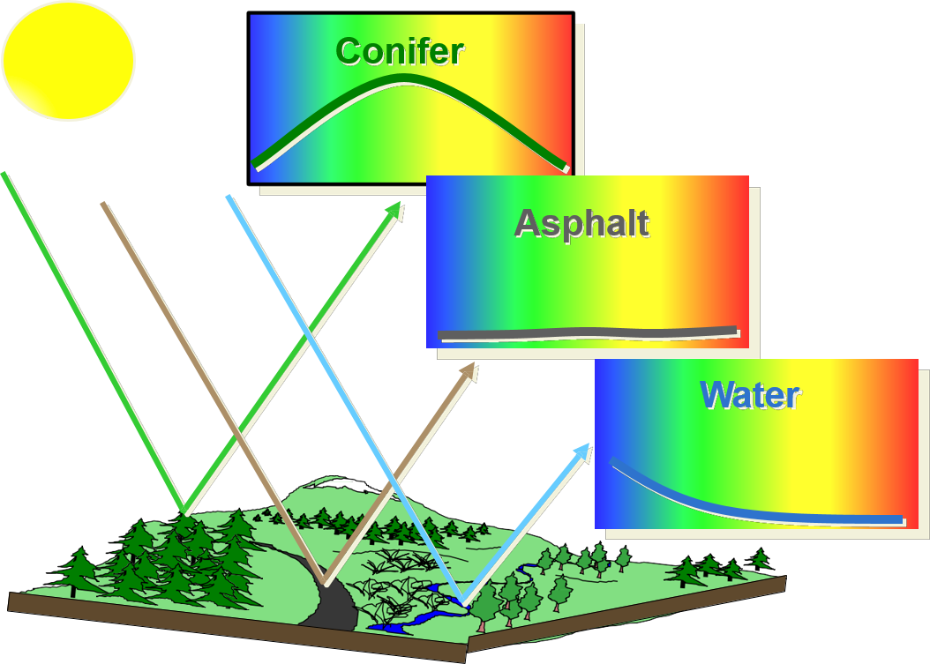
Review - Optical Remote Sensing Basics
Spectral Signatures
Remote sensing relies on the fact that different targets have unique responses to Electromagnetic (EM) energy
We can distinguish land-cover types spectrally and track them through time
electromagnetic spectrum

Slide 9
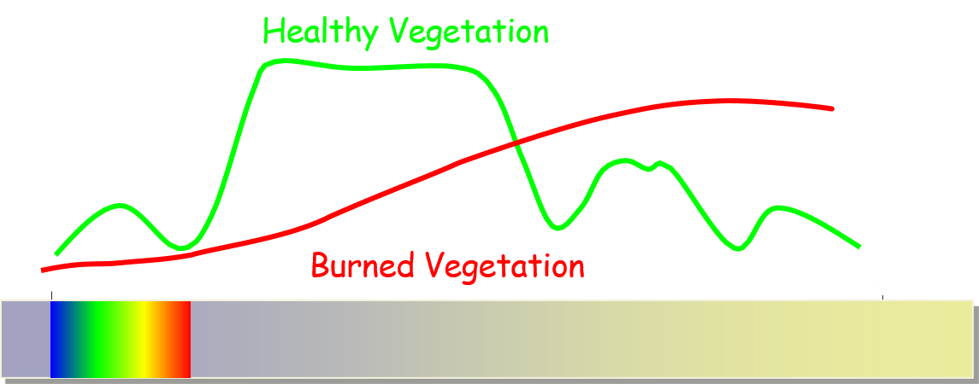
How do we detect change from imagery?
Changes on the landscape can be detected as changes in the ‘spectral space’ occupied by an image pixel
Pre-fire
Post-fire
electromagnetic spectrum

Slide 10
Benefits of monitoring change with remote sensing
Satellite and aerial sensors provide:
Consistent, repeatable measurements
An ever-growing archive of imagery
Several sensors/image programs available with different spatial scales, spectral resolutions and return intervals
Landsat
MODIS
SPOT

Slide 11
Analysis Prerequisites
Clearly define objectives
Identify the problem:
Change phenomena of interest (e.g., fire effects,
forest mortality, stream channel changes, etc.)
Define study area
Determine frequency for change analysis (e.g.,
seasonal, annual, biennial, etc.)
Consider limitations
These considerations determine appropriate methods and whether or not change can even be detected

Slide 12
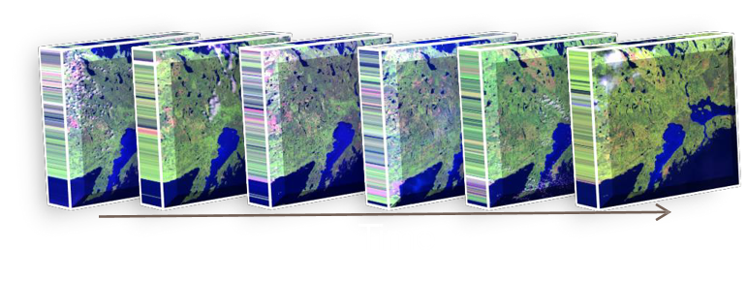
Approaches
Postfire
Manual
Image interpretation
Automated
Two-date change detection
Trend analysis
Multi-temporal image stacks
Prefire
Change

Slide 13
Workflow
Module 1: Project Planning and Documentation
Articulate project goals
Plan your remote sensing approach
Document methods
Module 2: Land Cover Mapping with SEPAL
Create Landsat mosaic
Reference Data Collection
Random forest Classification
Accuracy Assessment
Module 3: Mapping and Classifying Areas of Change with SEPAL
Create two Landsat mosaics (2010 and 2016)
Reference Data Collection
Classify Change
Accuracy Assessment

Slide 14
Remote Sensing Tools
Image processing and data download:
SEPAL
Image analysis:
SEPAL
Reference data collection:
CEO-SEPAL

Slide 15
Challenge
Separate real change from spectral change caused by:
Seasonal variation and phenology
Image misregistration
Clouds and shadows
Radiometric inconsistencies
Sensor
Variability in illumination (sun-angle, sensor position)
Atmospheric effects

Slide 16
Overall Goal: In a Nutshell
Minimize noise and map spectral change that represents significant landscape change

Slide 17
If you have questions please contact: Karis Tenneson, PhD Remote Sensing Specialist at USFS GTAC krtenneson@fs.fed.us, 801-975-3768 or Brenna Schwert Remote Sensing Specialist at USFS GTAC bmschwert@fs.fed.us, 801-975-3821

