Slide 1
Objectives and guiding principles for change detection using remote sensing
Developed by:
USFS Geospatial Technology
and Applications Center (GTAC)
Salt Lake City, Utah

Slide 2
Objectives
Build capacity and knowledge of remote sensing image processing
Specifically in regards to detecting and monitoring landscape change

Slide 3
Why use remote sensing?
We want to inventory and monitor our resources in the most cost effective and efficient manner (save money and time)
Our focus is on Forest Resources

Slide 4
How will this help you?
It will provide you with the knowledge and a set of associated tools to implement a processing workflow
You will be able to… “Produce reliable, consistent and comparable reports on change in forest cover and forest use and associated anthropogenic greenhouse gas emissions or removals”
GFOI (2013) Integrating remote-sensing and ground-based observations for estimation of emissions and removals of greenhouse gases in forests: Methods and Guidance from the Global Forest Observations Initiative: Pub: Group on Earth Observations, Geneva, Switzerland, 2014.

Slide 5
Remote Sensing for Forest Monitoring
Remote Sensing is a tool to help us make better Resource Management Decisions
It can inform us in 4 areas:
Inventory – how much is there (hectares)?
Mapping – where is it (map)?
Classification – what is it (stratum)?
Monitoring – has it changed (gain or loss of forest)?

Slide 6
Forest Emissions and Removal Workflow
Highlighted Sections will be covered in these PowerPoints and exercises
Has there been land use change from or to the Forest Class?
Develop carbon emission or removal estimates
Stratify Forest Area (primary, modified natural, planted)
Obtain average biomass carbon densities for identified stratum and/or land use classes
Estimate area of change within the forest between stratum and/or between forest and other land use classes
Create Baseline Forest Map
Can include other IPCC land use classes cropland, grassland, wetlands, settlements or other land
Develop carbon emission or removal estimates
Change due to degradation or sequestration
Change due to Deforestation, Afforestation or Reforestation?
Yes
No

Slide 7
Resulting Map Products
Map Products | Description
Forest/Non-Forest | Maps of forest cover through time
Forest/Non-Forest Change | Maps of change in the area of forest land
Forest Stratification | Forest/Non-Forest map, but with forest stratification according to primary forest, modified natural forest, and planted forest (or equivalent national stratification)
All Land Use Categories | Default is the UN-FAO Land cover Classification (forest, cropland, grassland, wetland, settlements and other land) or an equivalent national classification
Land Use Change | Map of conversions between the six IPCC land categories, can include forest stratification
Change within Forest Land | Map of conversions between forest stratum

Slide 8
Guiding Principles
Global Forest Observation Initiative (GFOI) – Guiding principles for remote sensing data sources and methods
These principles are suggested to help countries decide on the combination of data sources and methods used to support reporting on GHG emissions and removals
https://www.reddcompass.org

Slide 9
Guiding Principle 1
To find change, compare images, not maps
Images contain more information and are collected on a frequent basis

Slide 10
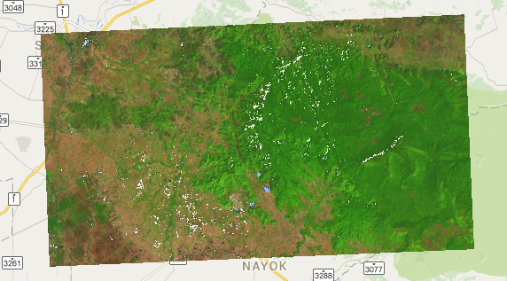
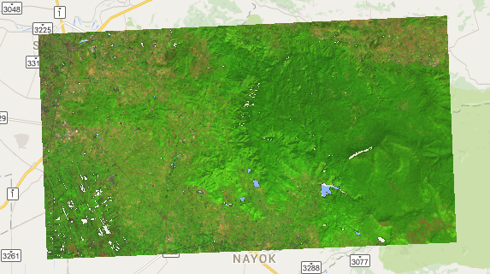
Guiding Principle 2
Time series Analysis and Consistency
When data are available from many time-steps, it is better to use the information from the entire time series of images rather than comparing only the end-dates.
//GEE provides access to the entire Landsat Archive
//Composite time period
var years = [2008, 2013];
var startJulian = 305;
var endJulian = 90;
var compositingPeriod = 2;
1986-1989 Landsat 5 Composite
2013-2015 Landsat 8 Composite

Slide 11
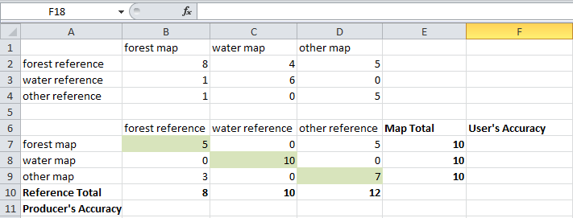
Guiding Principle 3
Always assess results from remote sensing
The goal of the remote sensing analysis is to estimate the areas of the classes in activity data or provide information that can be used to guide sampling strategies.
Collect Reference Data
Generate an Error Matrix

Slide 12
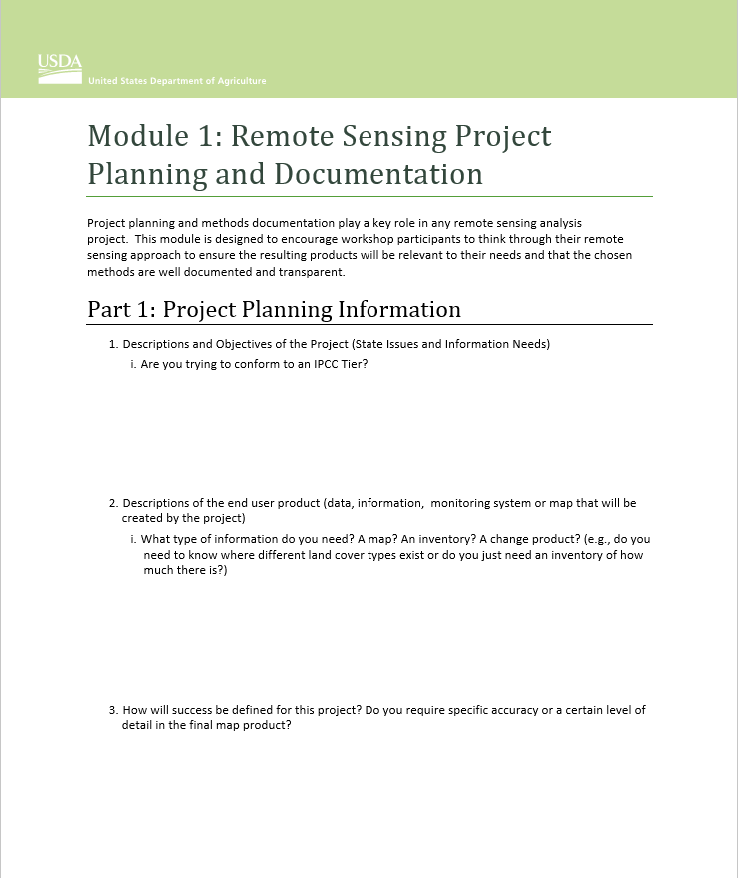
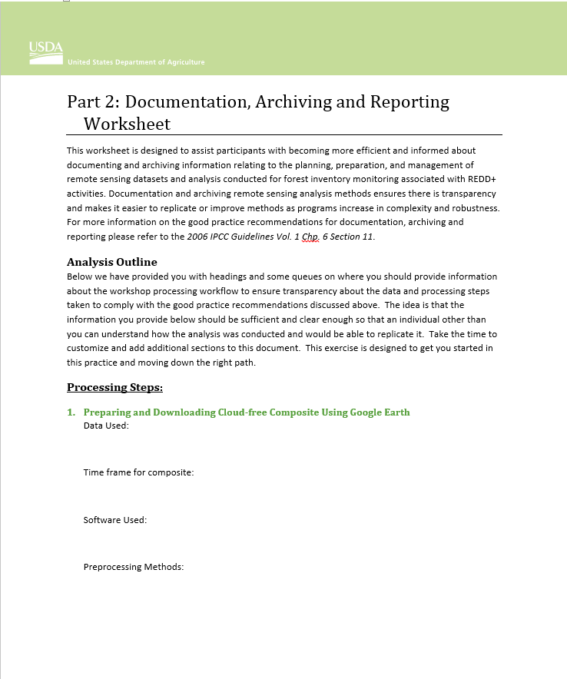
Guiding Principle 4
Document and archive steps taken
Project Planning Worksheet
Documentation Worksheet

Slide 13
Useful Remote Sensing Tips
Creating good remote sensing models is an iterative process.
“All models are wrong, but some are useful” - George Box

Slide 14
Project Planning

Slide 15
Objectives
Bridge the gap between training and project implementation.
Share appropriate remote sensing workflows and project development strategies (hands on materials)
Develop a preliminary workflow for participants (project planning document)
Provide assistance and project consultation (capstone project)

Slide 16
Remote Sensing Applicability
Clearly define project scope and objectives:
What are the information needs?
Communicate with end users (…ologists other ministries)
What will be a useable product
What are their expectations
Project area: size, shape, ruggedness, remoteness…?
Scale, resolution, and extent?
Is timing a concern?
When you have a new hammer, every problem looks like a nail…

Slide 17
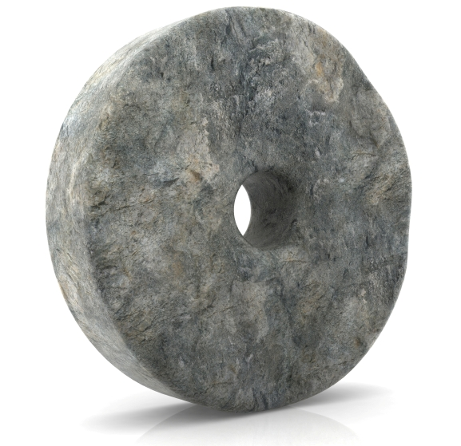
Remote Sensing Applicability
Identify similar work to yours:
Research results, explore end products, what did/not work
Contact key staff involved in similar work to yours
The wheel has been invented!

Slide 18
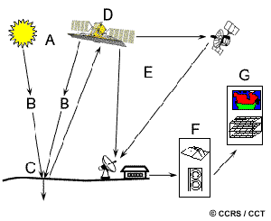
Remote Sensing Applicability
The human eye and brain is a very effective and complex remote sensing sensor. We derive information using the following image attributes
Size
Shape
Tone/color
Texture
Shadow
Association
Pattern
Remote Sensing technology attempts to duplicate that process, generally using only a couple of the attributes listed above.
Advantages of remote sensing technology
Virtually unlimited storage capacity
Computer Processing power
Automated processing
Large landscapes at multiple scales
Analyze full EM spectrum
Notes:
This is your typical display of a remote sensing system. Just to provide a visual of all the components it can be composed of.

Slide 19
If you have questions please contact: Karis Tenneson, PhD Remote Sensing Specialist at USFS GTAC krtenneson@fs.fed.us, 801-975-3768 or Brenna Schwert Remote Sensing Specialist at USFS GTAC bmschwert@fs.fed.us, 801-975-3821

