Slide 1
Quantitative accuracy assessment
Developed by remote sensing specialists at the USFS Geospatial Technology and Applications Center (GTAC), located in Salt Lake City, Utah

Slide 2
Accuracy Assessment
What is it and what is its role?
Accuracy Assessment…
is the process by which the accuracy or correctness of an image classification is evaluated
involves the comparison of the image classification to reference data that are assumed to be true
supports the spatial information used in the decision making process

Slide 3
Importance of Accuracy Assessments
Measure uncertainty (truth vs. agreement with reference data)
Accuracy assessments are required for decision-making
They allow us to compare approaches

Slide 4
Accuracy Assessment Process
Sample design
sampling methods
sample size

Slide 5
Sample Design
Objectives…
The major objective of the sample is to provide information that is representative of the population
It’s easy to calculate sample statistics
If the sample is representative of the population, then the sample statistics are good and valid estimates of the population parameters
However, sampling is very expensive. We must balance sampling validity with cost when considering:
Sample size
Site locations (remote sites are very expensive)
Field measurement requirements etc...

Slide 6
Sampling Methods
Several Major Types (slide 1 of 3):
Simple Random Sampling:
observations are randomly placed.
Stratified Random Sampling:
A minimum number of observations
Are randomly placed in each category.

Slide 7
Sampling Methods
Several Major Types (slide 2 of 3):
Systematic Sampling: observations are placed at equal intervals according to a strategy.
Systematic Non-Aligned Sampling: a grid provides even distribution of randomly placed observations.

Slide 8
Sampling Methods
Several Major Types (slide 3 of 3):
Cluster Sampling: Randomly placed “centroids” used as a base of several nearby observations. The nearby observations can be randomly selected, systematically selected, etc…

Slide 9
Accuracy Assessment Process
Sample design
Response design
Spatial assessment unit, sample frame
Sources of data (high res imagery, Landsat time series, field data)
Labeling protocol, schema
Defining agreement, map unit key
Reference classification uncertainty: geolocation and interpreter variability

Slide 10
Reference Data Collection
Reference data are assumed true!
Sources of reference data may be:
An existing map
Existing inventory data
Photo-interpreted
Collected on the ground (usually preferred although most expensive)

Slide 11
Reference Data Collection
Reference data are assumed true!
To avoid introducing errors because of poor reference data, the reference data must:
Be consistent (use standardized forms)
Use the same classification system as the map
Account for changes over time
Be precisely located
Have quality control

Slide 12
Assessing Accuracy
Budget Factors...
By far, the most expensive component of an accuracy assessment is the reference data collection:
Number of sample sites
Type of sites (e.g., field vs photo)
Distribution of sites and ease of access to sites
Amount of data collected at each site
Level of effort required for measurement on the site
Reference data quality control.

Slide 13
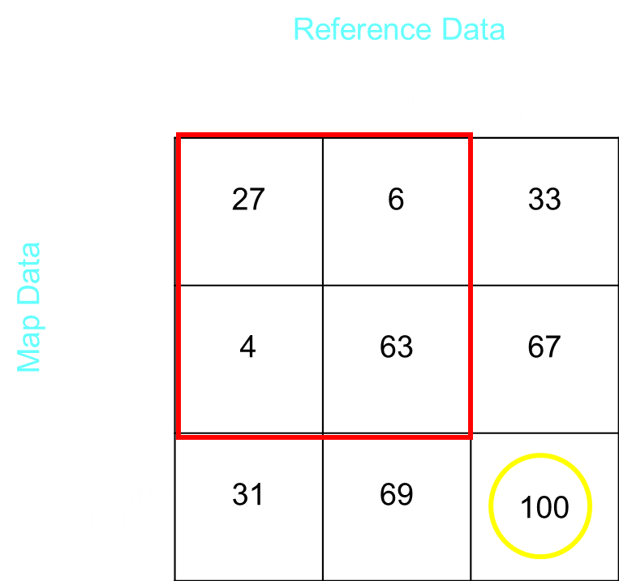
Accuracy Assessment Process
Sample design
Response design
Analysis: error matrix

Slide 14
The Error Matrix
Comparing the reference data
to the classified map...
An error matrix is the standard way of presenting an accuracy assessment
The error matrix is a square array in which accuracy assessment sites are tallied by both their classified category in the image and their actual category according to the reference data
For example, you classified an image into 3 categories: Hardwoods, Conifers and Other. You field collected reference data from 100 randomly selected sites and built this 3x3 error matrix…

Slide 15
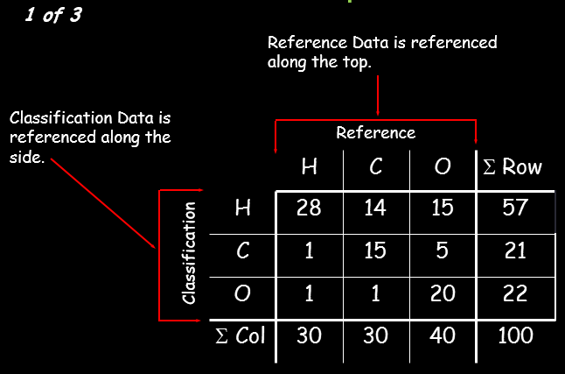
Error Matrix Components

Slide 16
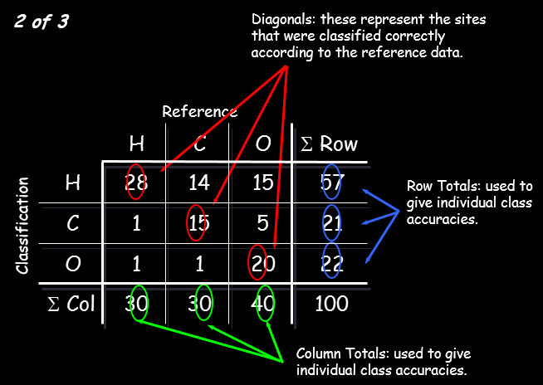
Error Matrix Components

Slide 17
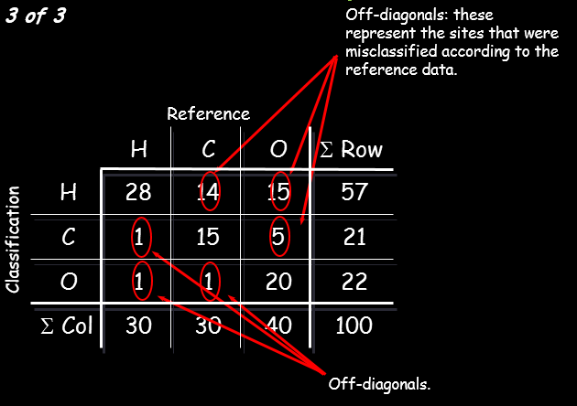
Error Matrix Components

Slide 18
Measures of Accuracy

Slide 19
Measures of Accuracy

Slide 20
Measures of Accuracy
Individual Class Accuracy...
How can there be two values and what do they mean...?
There are two types of errors: Omission and Commission
Any site that is omitted from the correct class is committed to an incorrect class
These two types of errors correspond to two types of class accuracies: User’s and Producer’s...

Slide 21
Measures of Accuracy
Producer’s Accuracy
The percentage of time a class identified on the ground is classified into the same category on the map.
(Forest) Omission – When forest is classified as other.
User’s Accuracy
The percentage of time a class identified on the map is classified into the same category on the ground.
(Forest) Commission – When other is classified as forest.
Notes:
Omission- omitted from the correct class
Commission – committed to the wrong class.

Slide 22
Measures of Accuracy

Slide 23
Measures of Accuracy

Slide 24
Measures of Accuracy

Slide 25
Error vs Difference Matrix
The error matrix really measures differences between reference
and classification labels and may not be classification error...
Some reasons for differences:
Classification errors
Registration differences between the reference and map data
Projections, datums, poor quality control
Lost--on the ground, image, or map
Changes in land cover between map and reference data (i.e., time)
Variation in interpretation of reference data
Mistakes in labeling the reference data
Data entry errors
Digitizing errors

Slide 26
Error vs Difference Matrix
Minimize reference label error by...
Imposing rigorous quality control
Locating accuracy assessment sites close to polygon centers:
Avoids sampling mixed classes near polygon boundaries and
Reduces errors due to mis-registration
Measure variance within sites

Slide 27
Error Matrix
Some Limits of Analysis...
Assumes each site can only be assigned to one map category
Doesn't consider the accuracy of polygon boundaries
Makes no distinction for magnitude of error:
Labeling a site as 30-40% crown closure (when its actually 45%) counts as a mistake just as much as labeling a Lake as a Mixed Deciduous Forest

Slide 28
Accuracy Assessment Conclusions
Accuracy Assessment:
Is expensive
Won’t improve the map accuracy
Must be well planned
Should be statistically valid
Should be reported as an error matrix
Is critical to any mapping project that may be used for decision making

Slide 29
Site Specific Accuracy - Summary
It’s more complicated than simply reporting overall accuracy…
Consider the relative costs of omission vs commission errors
These considerations should influence your choice of analysis methods, thresholds, post processing steps, etc.

Slide 30
If you choose to collect reference data via image interpretation…
Here are some slides to consider when labeling plots

Slide 31
Image interpretation
What will we cover?
Basics of image interpretation
Seven image characteristics
Scale and the varying importance of the seven
Land cover types (IPCC, NAMRIA’s, etc.) and their associated spectral signatures

Slide 32
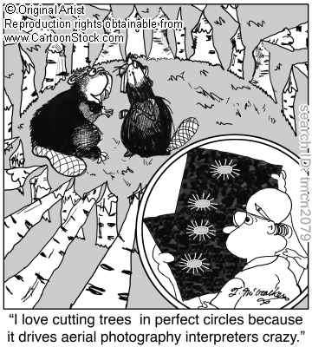
Basic image interpretation
Image interpretation is the “determination of the nature of objects in a photograph or image and the judgment of their significance.”
*This skill is developed through hours of practice with photos, coupled with ground visits to check accuracy of interpretations
Notes:
Solid background consists of local knowledge of the resources, topography, conditions in which the resources grow. If the interpreter doesn’t have this knowledge base, then it is important for them to lean on the knowledge of local experts and/or spend time building this background about the area of interest.

Slide 33
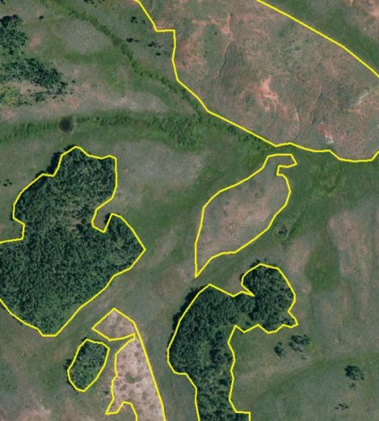
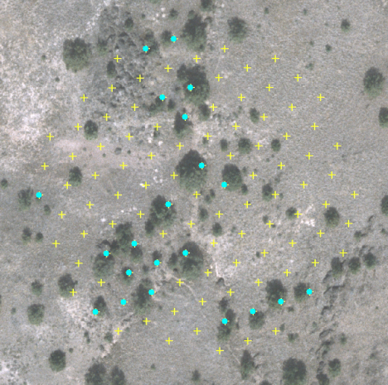
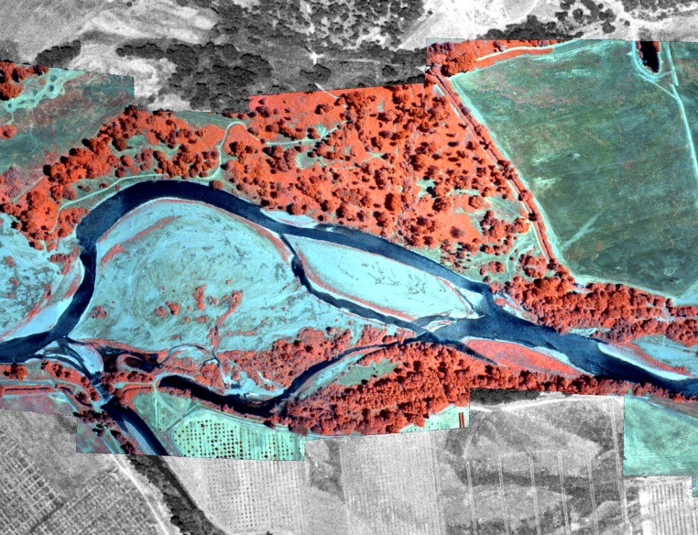
Basic image interpretation
Fundamental to any remote sensing project
Can reduce costs by up to 35% for mapping, inventorying, and planning for management of forests and rangelands
Estimated by the staff of DNR, State of Washington – Edwards, 1972
Can be used in a variety of applications:
Digitizing
Sampling
Training Data
Notes:
In many cases image interpretation and digitizing features is still a more cost efficient method than semi-automated methods of feature or information extraction. Humans’ ability to interpret and judge the significance of features in an image is unmatched by any software programs.

Slide 34
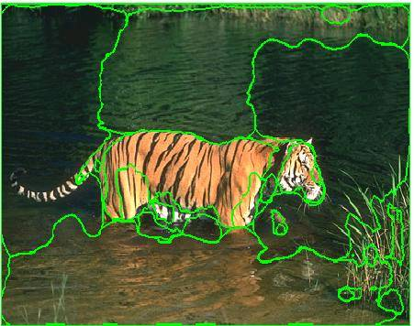
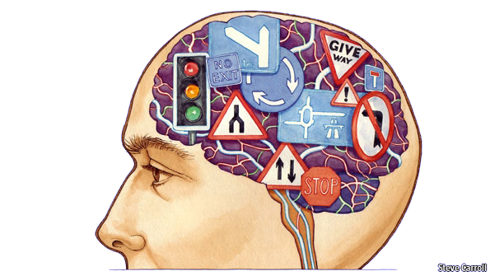
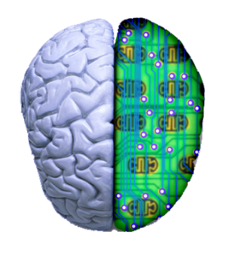
Image Interpretation v. Semi-Automated Classification
The human brain-eye system is unsurpassed at interpreting high-resolution imagery
Visual interpretation is the standard for evaluating any classification
If you don’t have the time or resources for a semi-automated method then image interpretation is a fit alternative.
Notes:
While it is possible to use computing power and ever-advancing technology to teach a computer what a tiger “looks like” it is still tough, and usually requires good quality imagery, training data and a robust machine learning algorithm.
If you don’t have the time or resources for this method, image interpretation is a fit alternative.

Slide 35
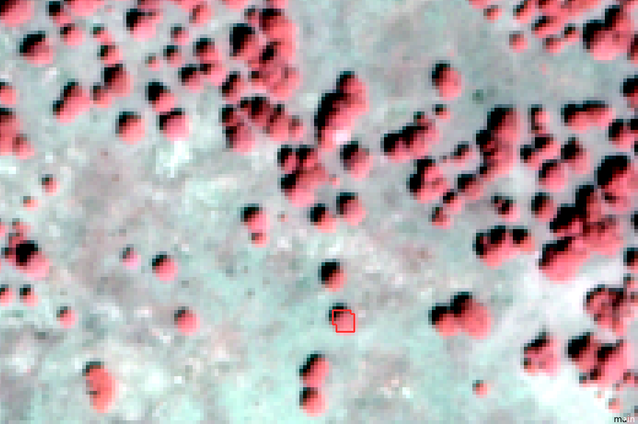
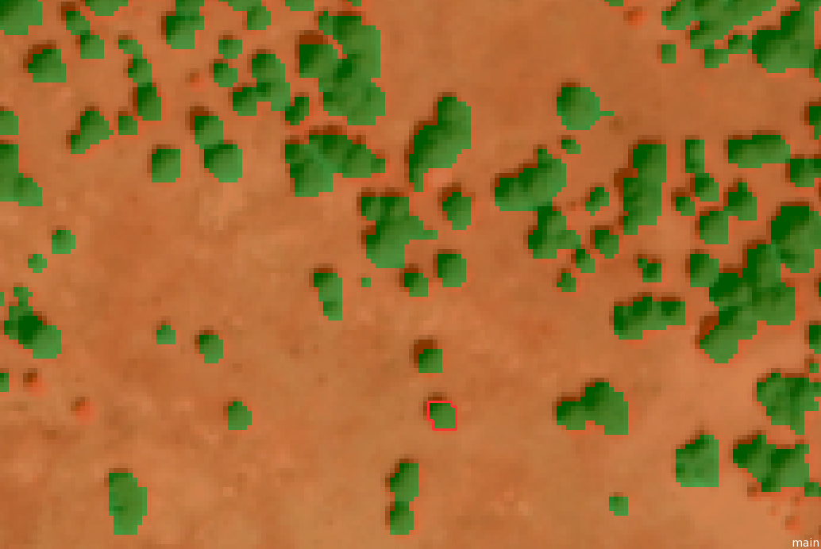
Image interpretation: 7 image cues
Humans use any combination of seven image characteristics (tone/color, shape, size, association, shadow, pattern, and texture) for visual interpretation
Spectral classifiers use only tone/color values
Object-oriented classifiers use tone/color plus other cues, such as shape and association
Notes:
Spectral classifiers (e.g. Supervised classification, Random Forest, etc), such as those classification algorithms found in image analysis software such as ERDAS Imagine, ENVI, eCognition and even ArcMap use just the spectral or color component of the image to classify. Using our suite of interpretation characteristics we can often interpret things a classifier cannot. An interpreter will use elements that are inherent to an image to recognize and make calls about objects of interest. We, as humans, though are subject to making mistakes and being inconsistent – computer programs that classify an image may have limits but they are very good at being consistent and results are very reproducible.
However, it can be tedious, slow and subject to inconsistent interpretations
- We’ll discuss some tools (Image Sampler and Cover Interpreter) that lend consistency...but first we must discuss the seven characteristics used in image interpretation.

Slide 36
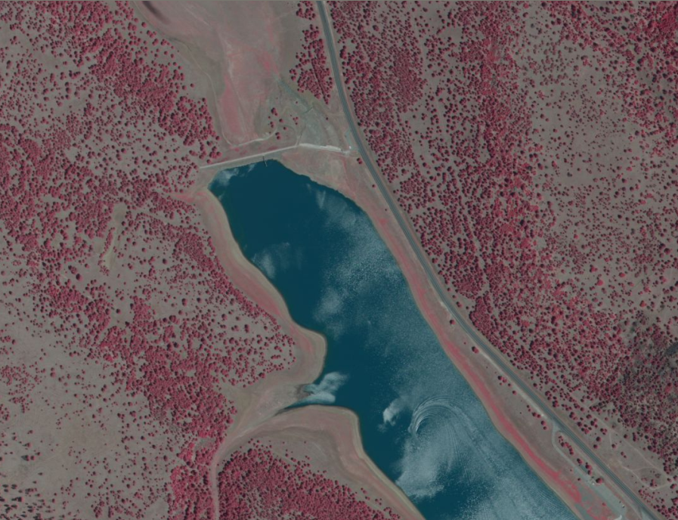
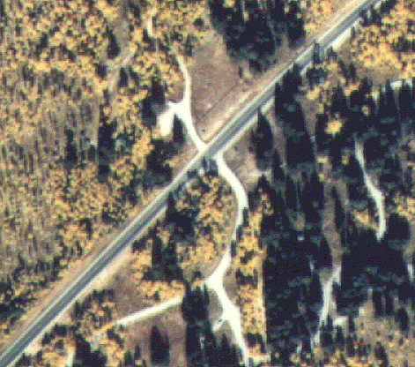
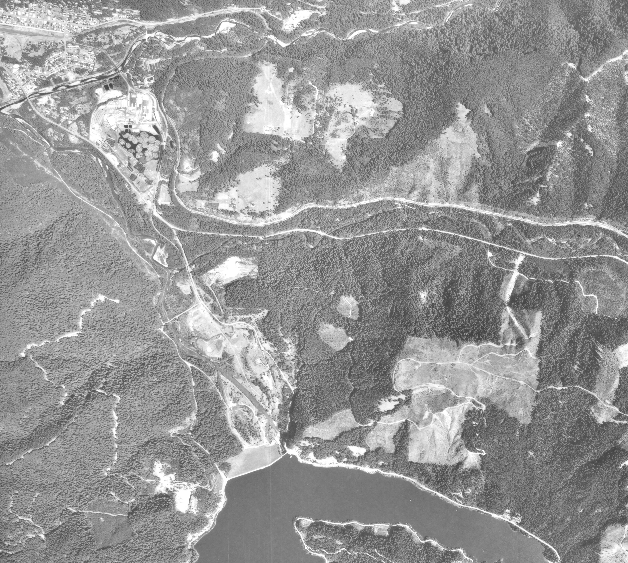
Seven characteristics: Tone/color
Tone (in the B&W image to the left) allows easy distinction between roads, forests, water and bare-ground. Color (in the upper image) allows easy distinction between coniferous trees, deciduous trees, senesced grasses and road surface types. Color (in the upper left image) in this Color Infrared image allows for added distinction between coniferous and deciduous forest, as well as between dead/dying and healthy forest. The brighter red vegetation is indicative of deciduous and the darker (finer textured too) red vegetation is indicative of conifers.

Slide 37
Seven characteristics: Shape
Shape is not necessarily diagnostic for interpretation: the same type of feature may have different shapes and different features may have the same shape.
The shape of the tree crowns in the left image is indicative of the type (deciduous/conifer) or even species of tree. The image key graphics indicated the importance of crown shape on large scale photos. In the image above, the shape of the road and the circular tree crowns help us interpret those two features.

Slide 38
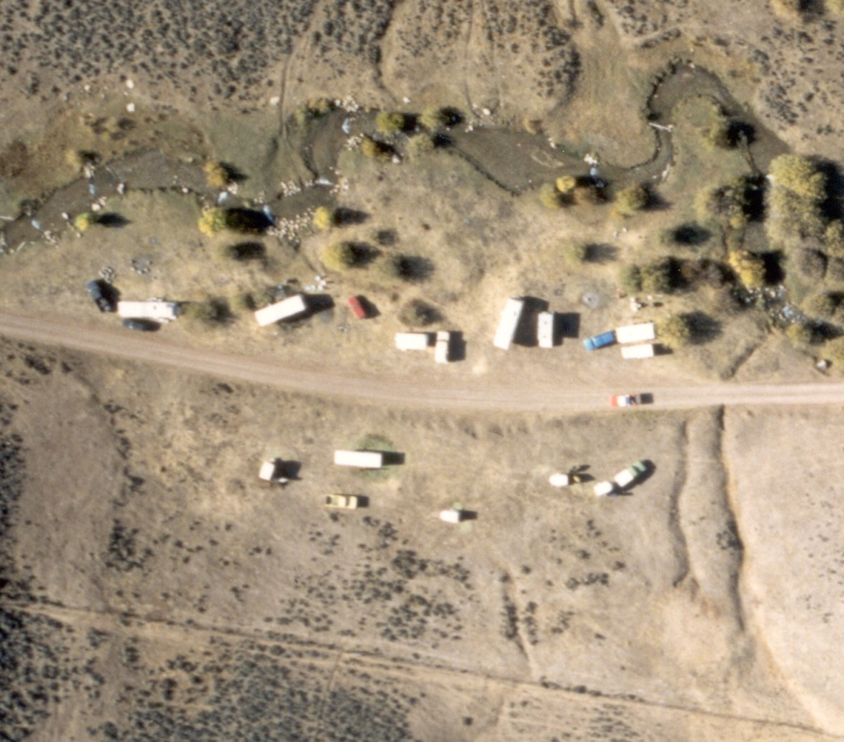
Seven characteristics: Size
Size is usually evaluated by looking at objects that the interpreter is familiar with and comparing the relative size to less familiar objects. At first glance the vegetation in the lower part of this image may look like trees, but in comparison to the size of the vehicles, the vegetation is likely shrubs (e.g. sagebrush).

Slide 39
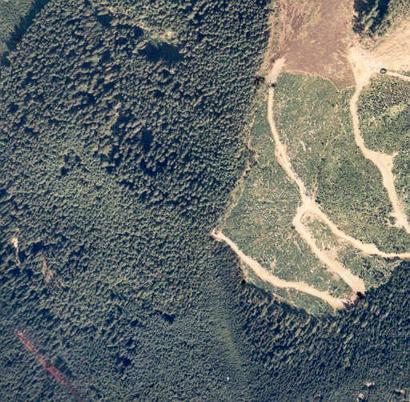
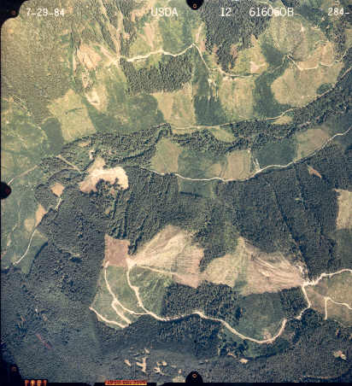
Seven characteristics: Texture
Texture is the apparent roughness or smoothness of an image region created by the tonal changes of the image.
Coarse
Medium
Fine
Texture can offer the interpreter clues about the density, age, and type of vegetation present. Note: texture becomes increasingly more important as the scale of the imagery becomes smaller.

Slide 40
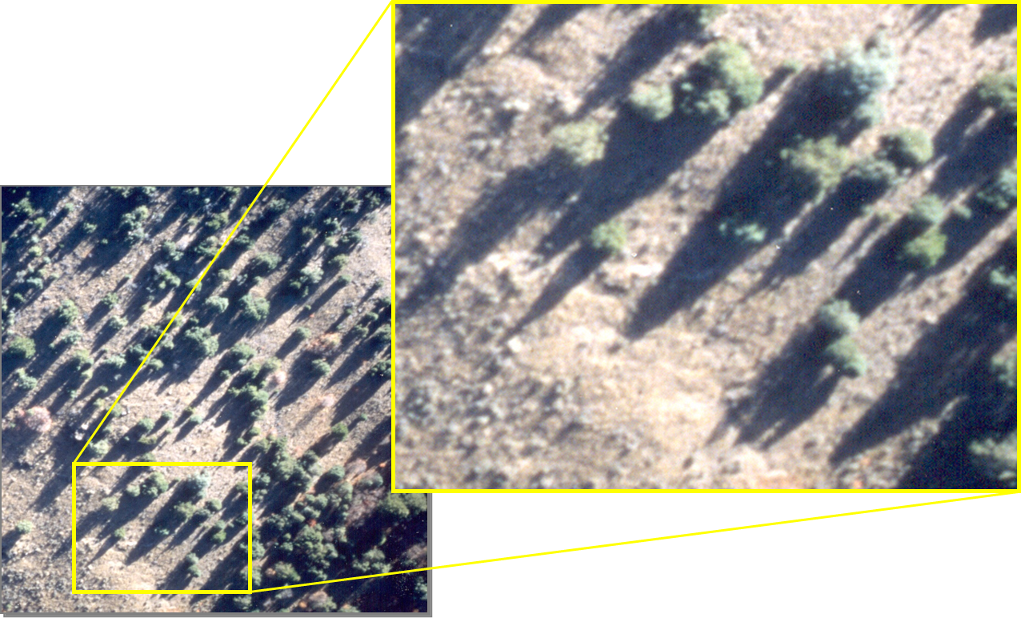
Seven Characteristics: Shadow
Shadows cast by objects in the image can give the interpreter information about the shape and size of certain features in the image.

Slide 41
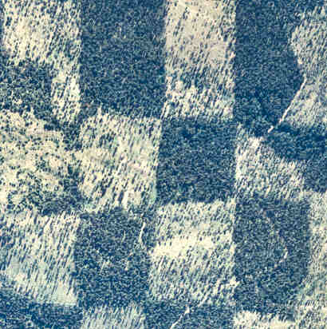
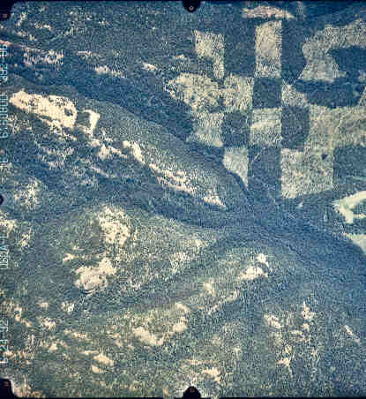
Seven Characteristics: Pattern
In general, man-made patterns can be easily distinguished. Natural patterns can also lead to information that will aid the interpreter’s decision.
??

Slide 42
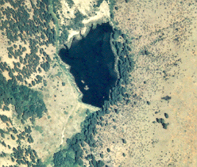
Seven Characteristics: Association
In forestry, biological association is particularly important in making vegetation-type maps.
?
?
By observing objects in the image and observing the objects in the surrounding area, the interpreter can make inferences about what the objects really are. In this case, the presence of a dam suggests that this water body is a reservoir. Without that association, the water body cannot be further classified as a reservoir.

Slide 43
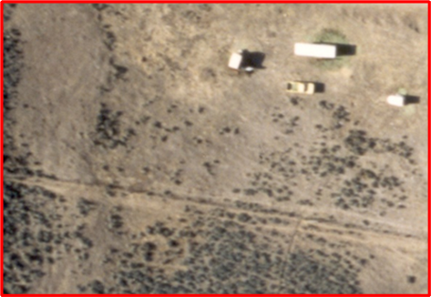
Convergence of evidence
Bringing together several types of information so that a conclusion may be drawn
Inference using multiple (or all) image elements
An interpreter might look at the discrete vegetation dots in this part of the image and interpret them as trees.

Slide 44
If you have questions please contact: Karis Tenneson, PhD Remote Sensing Specialist at USFS GTAC krtenneson@fs.fed.us, 801-975-3768 or Brenna Schwert Remote Sensing Specialist at USFS GTAC bmschwert@fs.fed.us, 801-975-3821

