Slide 1
Overview of detecting, mapping and quantifying change using remote sensing tools
Developed by remote sensing specialists at the USFS Geospatial Technology and Applications Center (GTAC), located in Salt Lake City, Utah

Slide 2
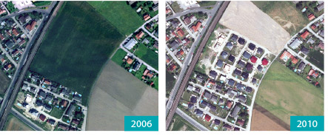
Land cover change: what is it?
The change of one land cover type to another type of land cover
Examples:
  Changes in tree cover
    Tree crop life cycle (e.g., palm oil and rubber)
    Fires
    Land clearing
  Development
  (urbanization)

Slide 3
Examples of Land Cover Change

Slide 4
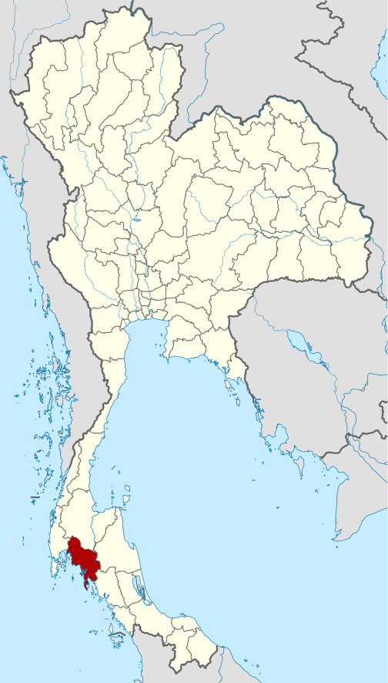
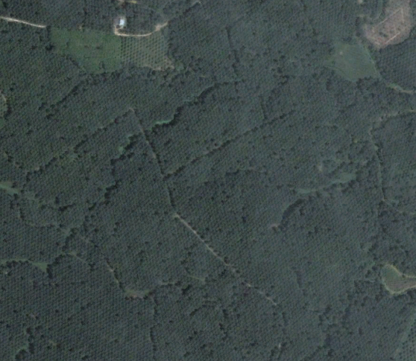
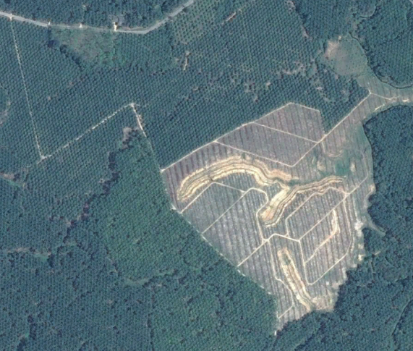
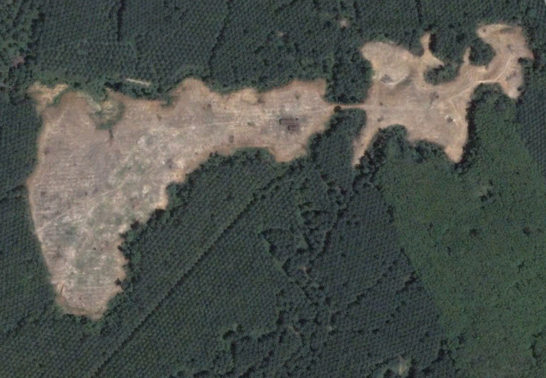
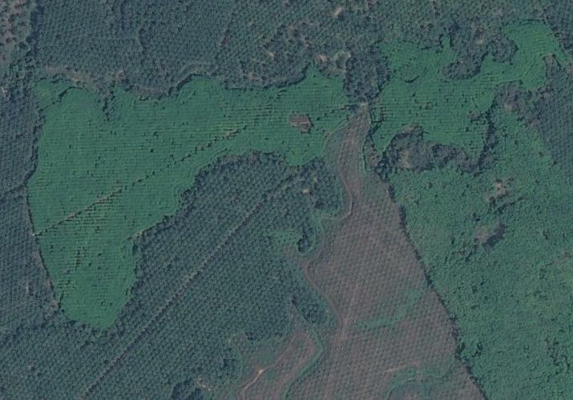
Krabi: ~20-30 year tree crop lifecycle
2007 2014

Slide 5
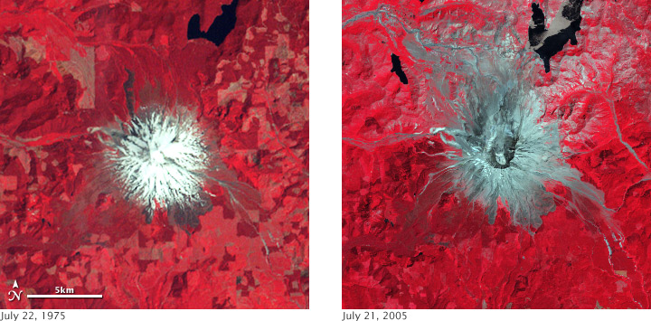
Volcanic Eruptions
Eruption of Mt St. Helens, USA http://earthobservatory.nasa.gov/Features/GlobalLandSurvey/page3.php

Slide 6
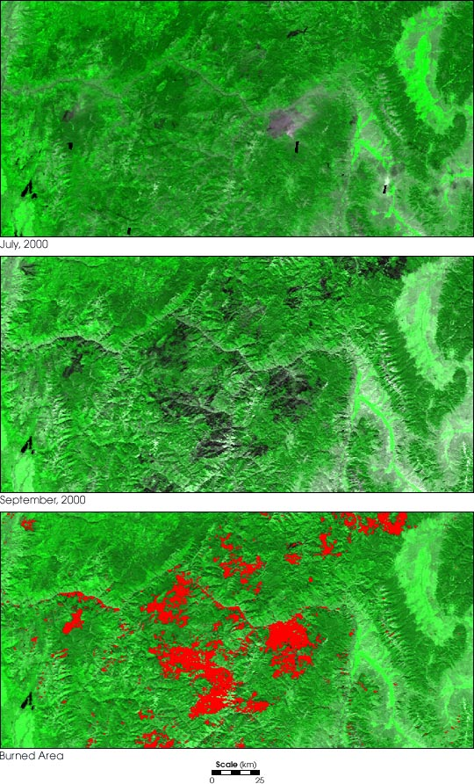
Fires
July 2000
September 2000
Burned area
Wildland fire in Montana and Idaho, USA http://earthobservatory.nasa.gov/IOTD/view.php?id=1309

Slide 7
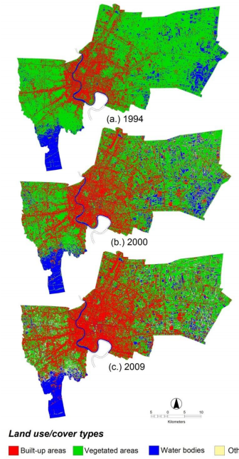
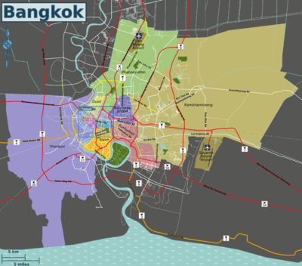
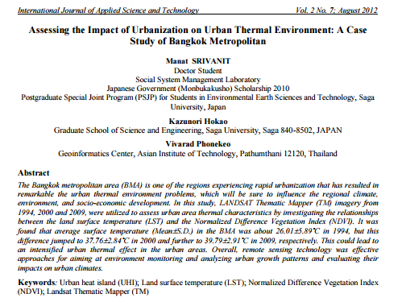
Urban Growth:
Bangkok, Thailand

Slide 8
Why monitor resources over time?
Land cover is linked to:
Economy (revenue from forestry, etc)
Carbon emissions
Urban heat island
Habitat
Water quality
Many more

Slide 9
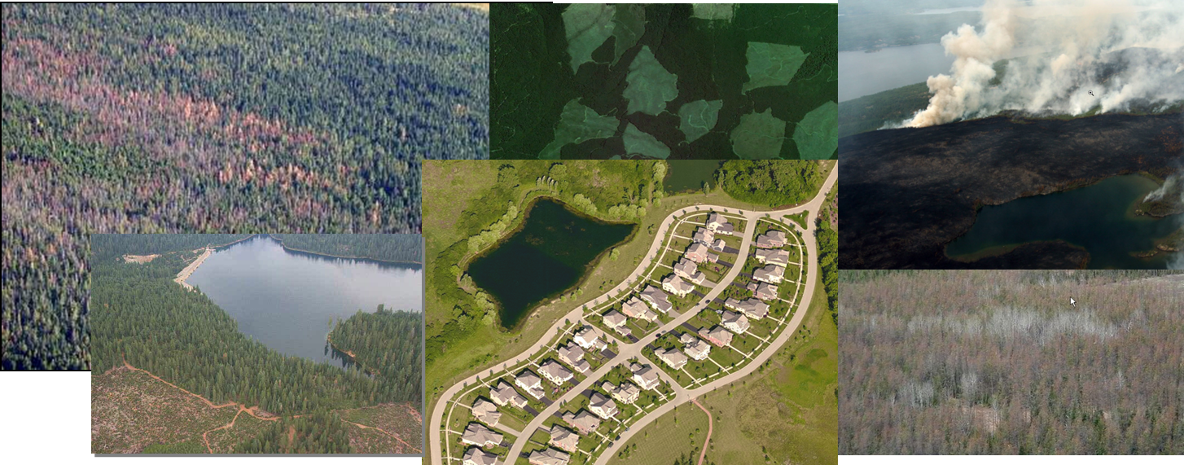
What are some change agents?
Natural or Human Caused
    Wildfire, insect outbreaks, succession, drought or climate change, regeneration, storms, etc.
    Harvest, management, agriculture, development, invasive species, etc.
Notes:
POTENTIAL DISCUSSION POINT: CHANGES IN LANDCOVER? DIFFERENCES BETWEEN LANDCOVER AND LANDUSE

Slide 10
Broad categories of change
Change in shape or size of patches of land cover types (urbanization)
Slow changes in cover type or species composition (succession) vs. abrupt land cover transitions (fire)
Slow changes in condition of a single cover type (forest degradation)
Changes in timing or extent of seasonal processes (lake coverage, drought monitoring)
Kennedy et al 2009

Slide 11
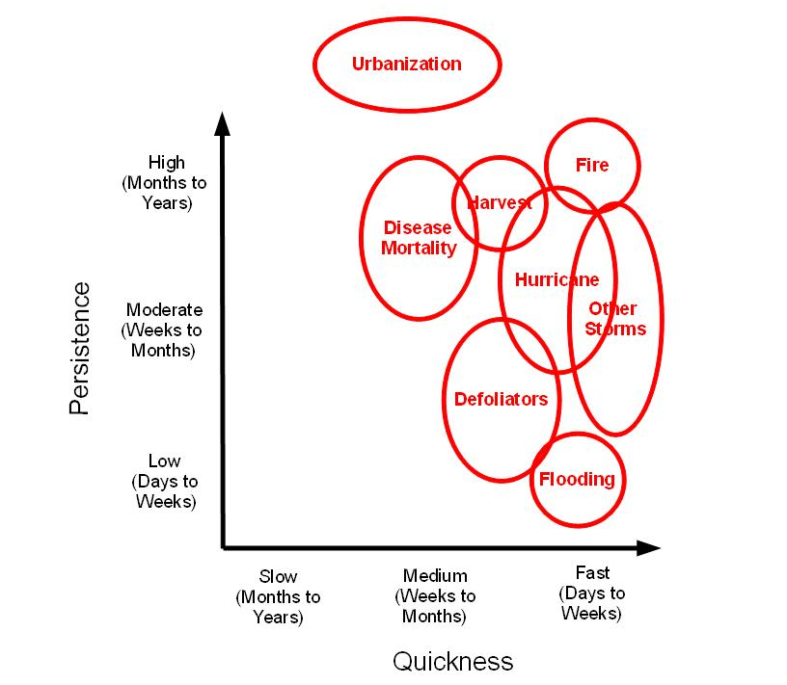
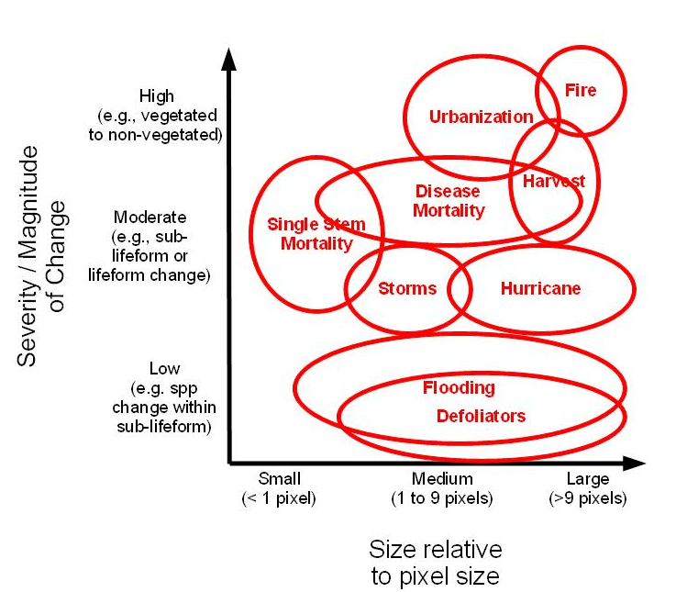
Dimensions of Change
Changes occur across variable spectral, spatial and temporal scales.
Temporal
Spatial

Slide 12
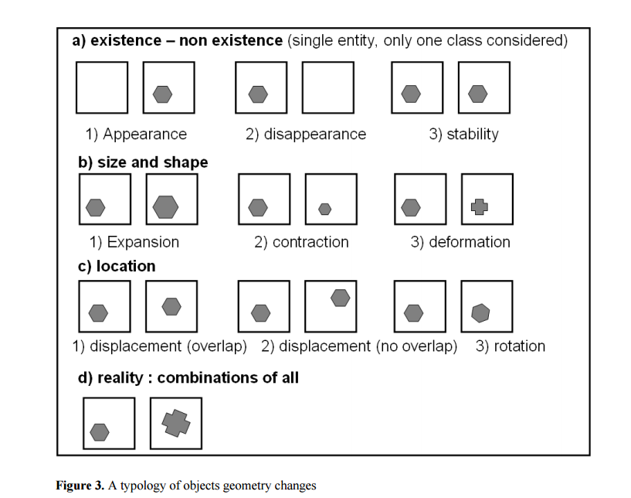
Potential change patterns

Slide 13
How do we assess land cover changes with remote sensing data and tools?

Slide 14
Review - Optical Remote Sensing Basics
Remote sensing relies on the fact that different targets have unique responses to Electromagnetic (EM) energy
We can distinguish landcover types spectrally and track them through time

Slide 15
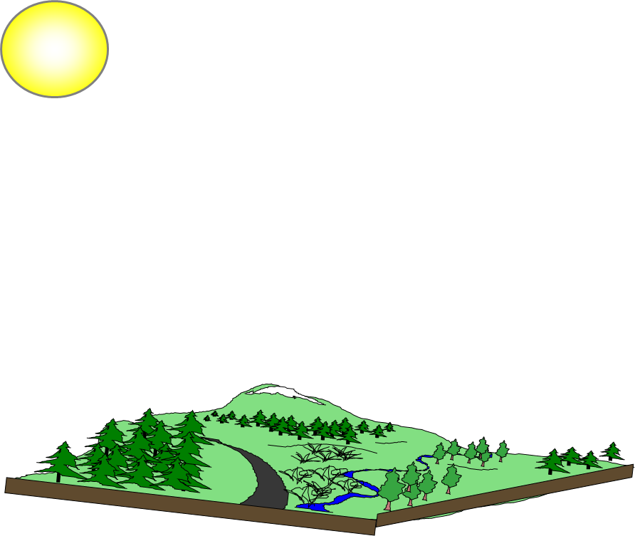
Review - Optical Remote Sensing Basics
Remote sensing relies on the fact that different targets have unique responses to Electromagnetic (EM) energy
We can distinguish landcover types spectrally and track them through time

Slide 16
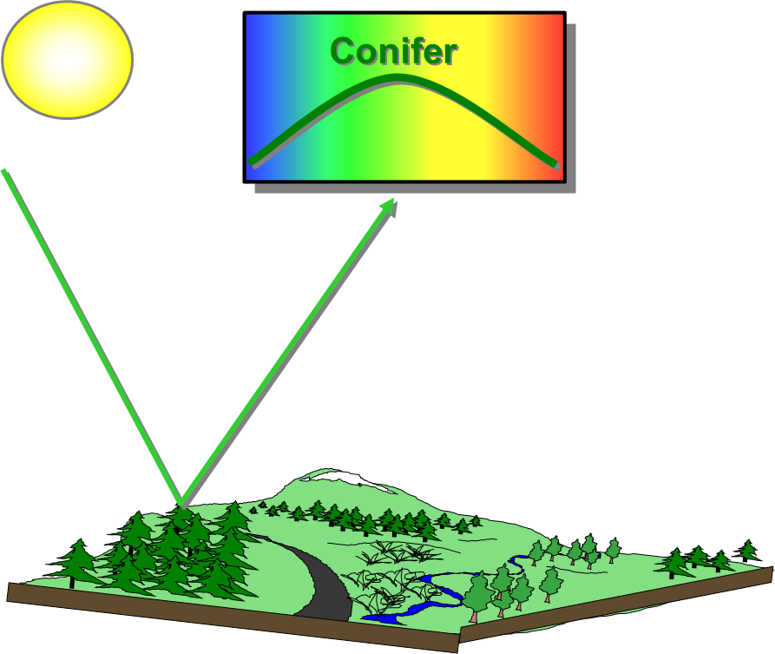
Review - Optical Remote Sensing Basics
Remote sensing relies on the fact that different targets have unique responses to Electromagnetic (EM) energy
We can distinguish landcover types spectrally and track them through time

Slide 17
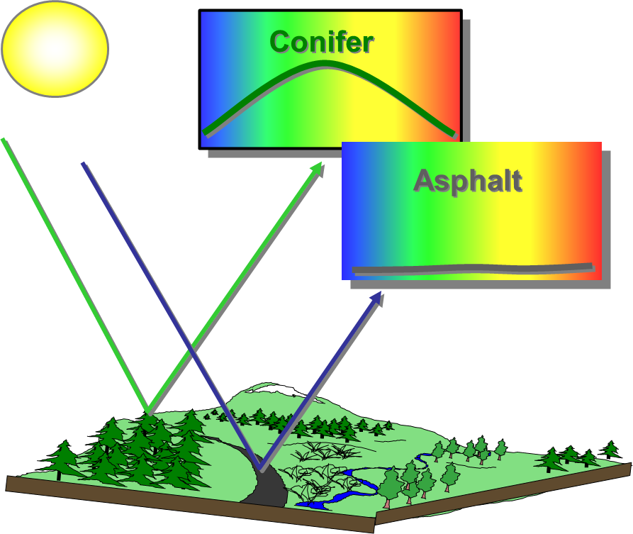
Review - Optical Remote Sensing Basics
Remote sensing relies on the fact that different targets have unique responses to Electromagnetic (EM) energy
We can distinguish landcover types spectrally and track them through time

Slide 18
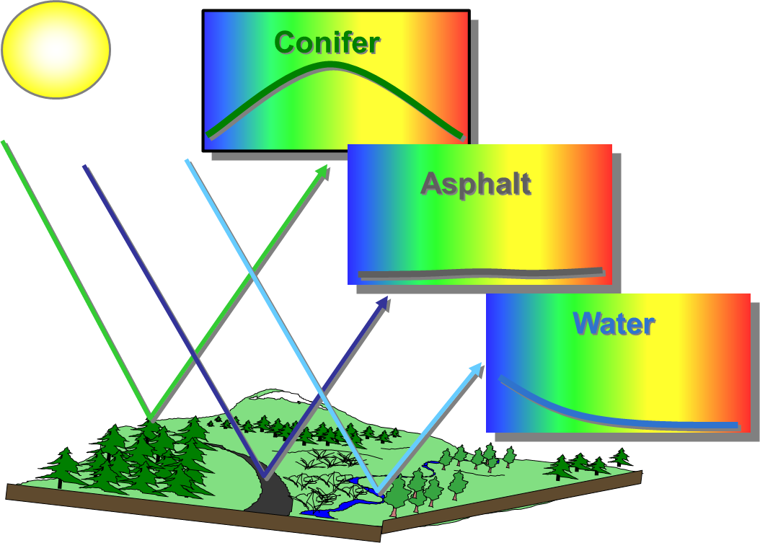
Review - Optical Remote Sensing Basics
Remote sensing relies on the fact that different targets have unique responses to Electromagnetic (EM) energy
We can distinguish landcover types spectrally and track them through time

Slide 19
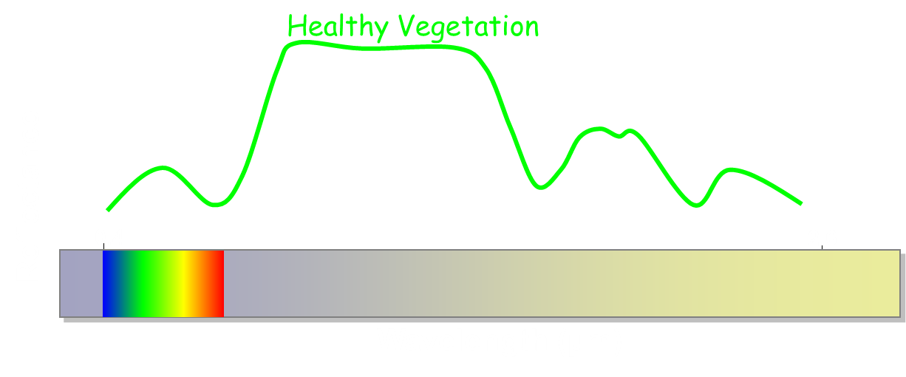
How do we detect change from imagery?
Changes on the landscape can be detected as changes in the ‘spectral space’ occupied by an image pixel

Slide 20
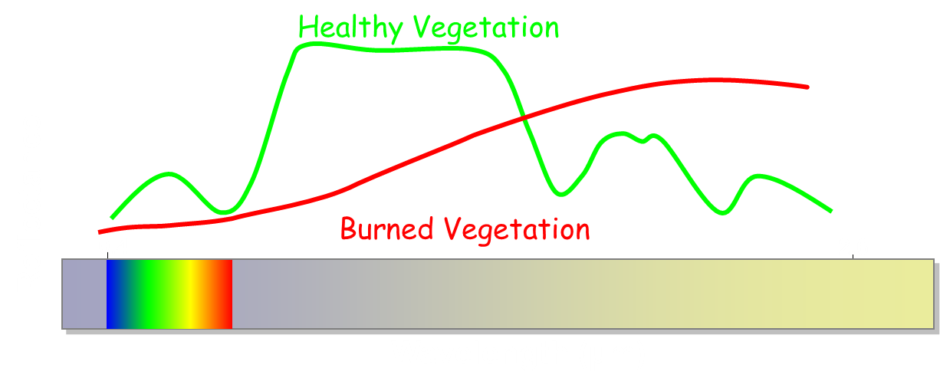
How do we detect change from imagery?
Changes on the landscape can be detected as changes in the ‘spectral space’ occupied by an image pixel

Slide 21
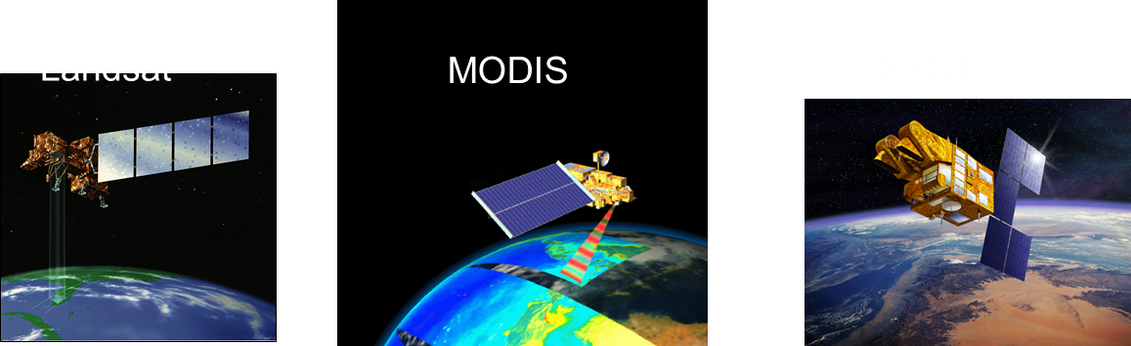
Detecting & Monitoring Change with Imagery
Satellite and aerial sensors provide:
  An ever-growing archive of imagery
  Consistent, repeatable measurements
  Several sensors/image programs available with different spatial scales, spectral resolutions and return intervals
Notes:
Develop this slide to make the point that more and more, there is a lot of data available at different spatial, temporal and spectral resolutions that make change detection possible. Sensors take images of the earth at varying spatial, spectral resolutions at different temporal resolutions and thus, there is an archive of data available to identify changes on the landscape by looking for spectral changes between images
Landsat archive has 4.5 million images and counting!

Slide 22
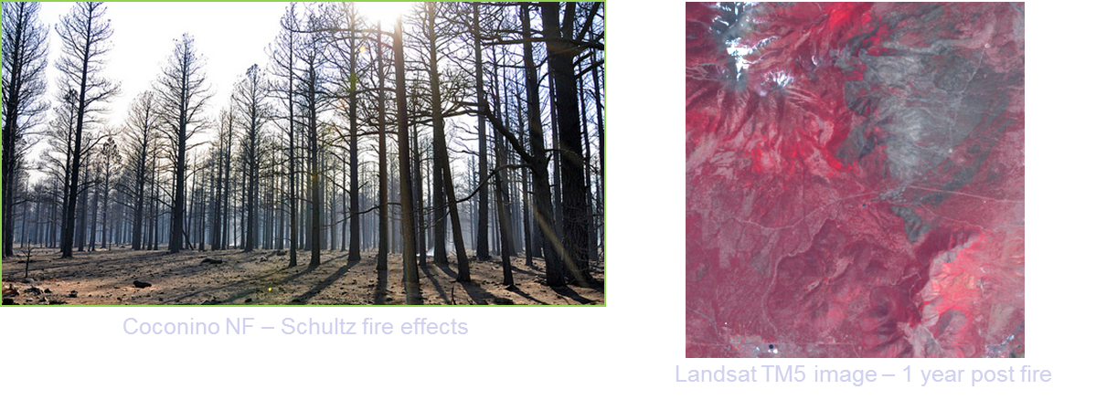
What is Change Detection with Remote Sensing?
Identifying landscape change from remotely sensed images
    Analyze images from different times to quantify and map change
    Assumption:
      Landscape change -> Spectral change
Notes:
Note: Important forest management task to which remote sensing is well suited
At regional and greater scales, the only feasible means of monitoring forest change on a regular and continuous basis may be through the use of remote sensing
This photo is an on-the-ground look at the effects of the Schultz fire in N Arizona in 2010… these effects are apparent in Landsat imgaery.

Slide 23
Approaches to Detecting Change
Estimation: sampling mode to get statistical estimates of change (e.g., CollectEarth)
  Method: change is estimated for a landscape (population) through image interpretation of a sample (number of plots)
  Appropriate for comparing regions (Countries, Provinces, Parks, etc.)
Mapping: wall-to-wall change map of study area
  Method(s): 2-date pixel-based change or multi-date change and trend analysis
  Appropriate when spatially explicit information required for management decision / action / map updates (fire fighting, modifying a land use map)
Notes:
There are temporal and technique approaches to detecting change. The estimation approach is essentially an inventory (sample) of the landscape at discrete times. The mapping approach uses a pixel-based approach between two or more snapshots in time.

Slide 24
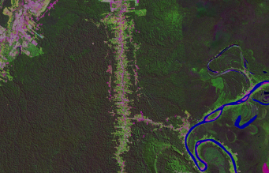
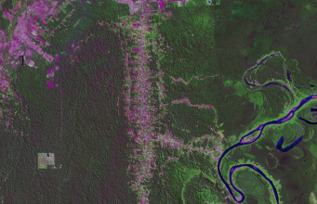
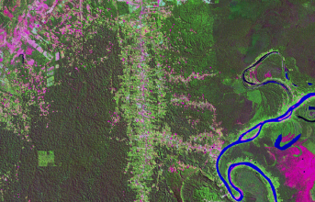
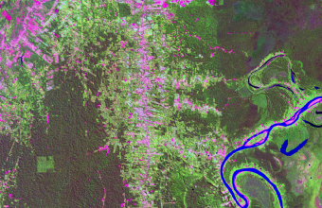
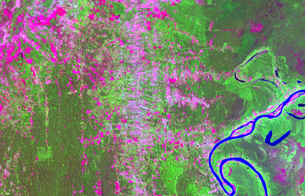
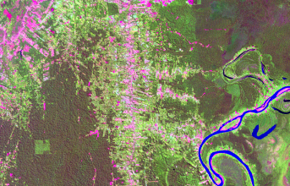
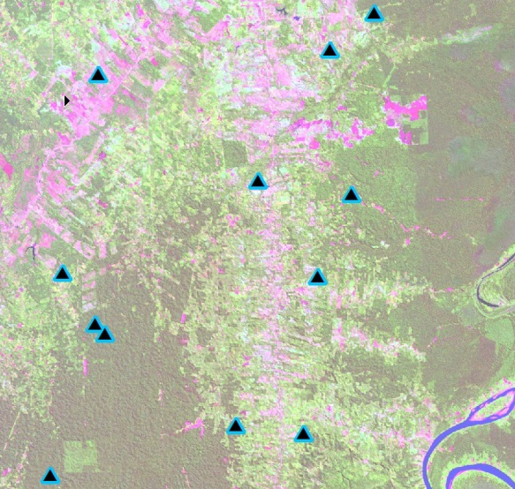
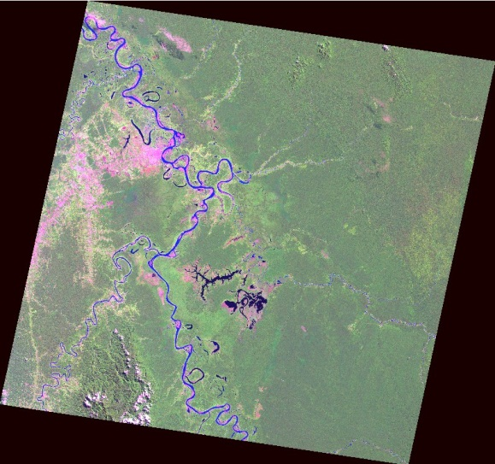
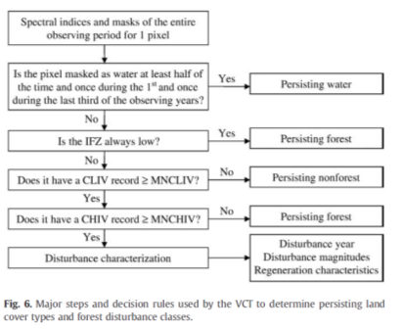

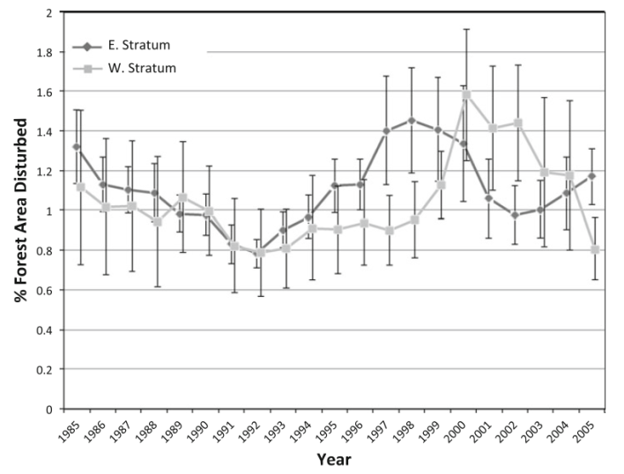
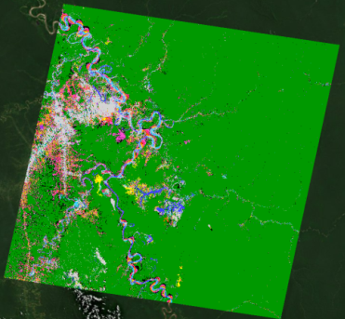
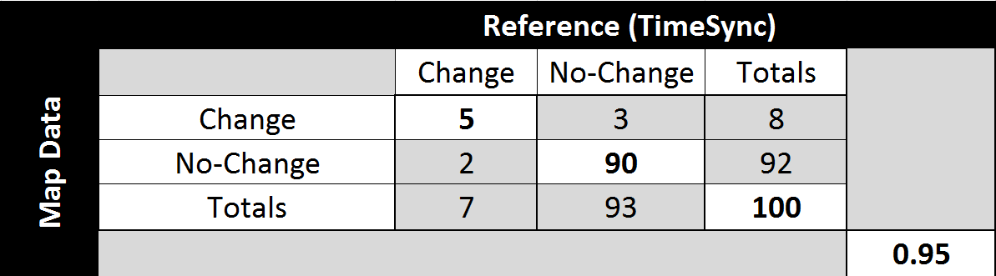
Estimation
Mapping
Input data
Image interpretation
at sample locations
Change detection algorithm applied to imagery
f(x)
Table output and summary statistics
Output change map
Map validation
Notes:
Estimation can generally depict change with a greater level of detail, but may introduce error due to a non-representative sample design
Estimation can be used with much higher resolution imagery than pixel-based change detection because the human eye can detect even subtle change and differences due to misregistration and/or shadows, while automated algorithms generally cannot.
Mapping can generally depict change with limited detail, but provides a spatially-explicit wall-to-wall map
Mapping is faster but does not generally detect subtle change (e.g., forest degradation).
Image Interpretation (and Sampling) is low-tech (a good thing for developing countries and agencies) and in many ways more capable and reliable than automated methods
Sampling is the most robust long-term monitoring method. Changes in image characteristics can be accommodated more readily than mapping methods.

Slide 25
Estimation Example
Estimation example:
Analyst compares an image pair from 2010 and 2014 to determine if there was a land cover change at the plot (following slide).
If there was no change, the analyst proceeds with some minor interpretation (arrow on the left, following slide).
If there was a change, the analyst proceeds with an interpretation of 45 more points to better characterize the change (arrow on the right, following slide).

Slide 26
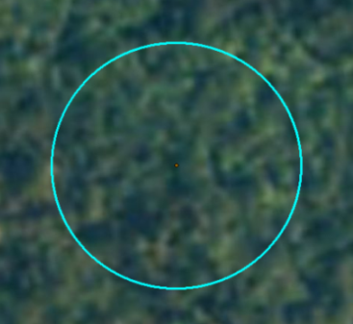
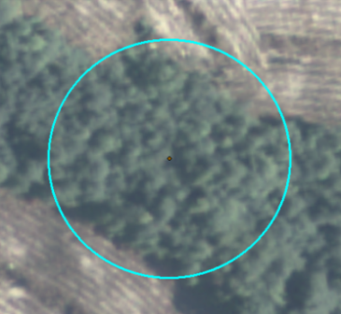
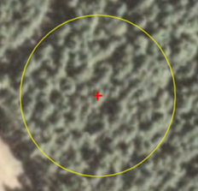
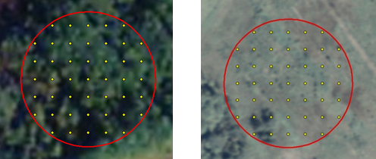
Estimation: ICE Example
NAIP 2010
NAIP 2014
Is there a land use or land cover change on the plot?
NO
YES
Including
seasonal change
Interpret 5 Points ~ 2min/plot
Interpret 45 Points ~ 8min/plot
NAIP 2010
NAIP 2014
NAIP 2010
NAIP 2014
1
1
2
2
3
3
4
5
4
5
Notes:
This is the workflow showing how an analyst would perform an interpretation on a plot.
When comparing the image pair from 2010 and 2014, the analyst will determine whether there was a land cover change at the plot. If No, the analyst follows the arrow on the left and proceeds with some minor interpretation. If Yes, the analyst follows the arrow on the right and proceeds with an interpretation of 45 more points to better characterize the change.

Slide 27
Mapping
Mapping is a different approach to detecting change and produces a map output at the end. There are two general ways to detect and map these changes: 2-date (time 1 versus time 2) or multi-date image stacks (more than 2 images in a stack showing the trend of change [or not] over the time period).
Inputs
  2-date image pairs
  or
  Multi-date image stack
Outputs
  GIS-ready change product
    Thematic map
    or
    Continuous raster layer
Notes:
Mapping is a different approach to detecting change and produces a map output at the end. There are two general ways to detect and map these changes: 2-date (time 1 versus time 2) or multi-date image stacks (more than 2 images in a stack showing the trend of change [or not] over the time period).

Slide 28
Tradeoffs between
Estimation and Mapping
Estimation can generally depict change with a greater level of detail, but may introduce error due to a non-representative sample design
Estimation can be used with much higher resolution imagery than pixel-based change detection because the human eye can detect even subtle change and differences due to misregistration and/or shadows, while automated algorithms generally cannot.
Mapping can generally depict change with limited detail, but provides a spatially-explicit wall-to-wall map
Mapping is faster but does not generally detect subtle change (e.g., forest degradation).
Image Interpretation (and Sampling) is low-tech and in many ways more capable and reliable than automated methods
Sampling is the most robust long-term monitoring method. Changes in image characteristics can be accommodated more readily than mapping methods.

Slide 29
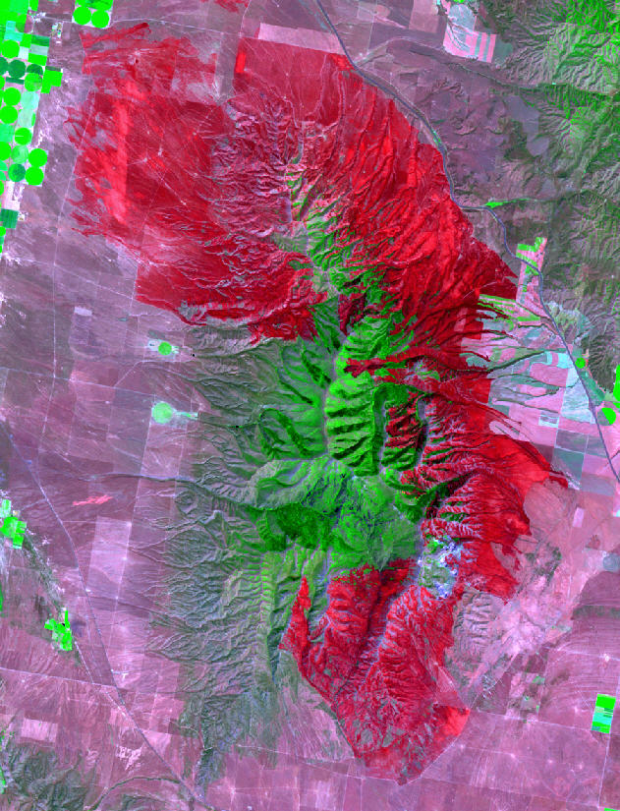
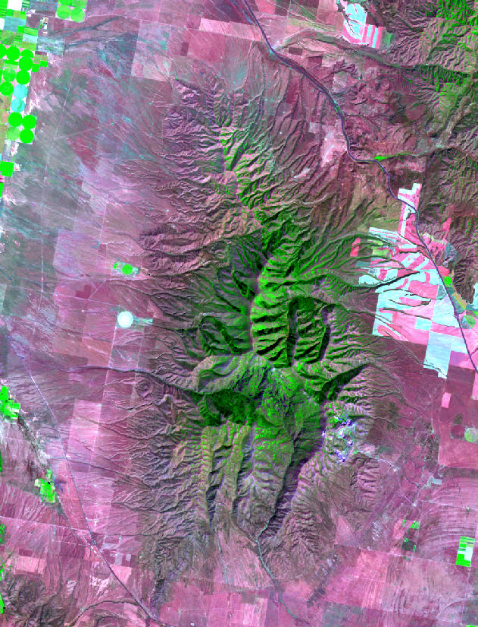
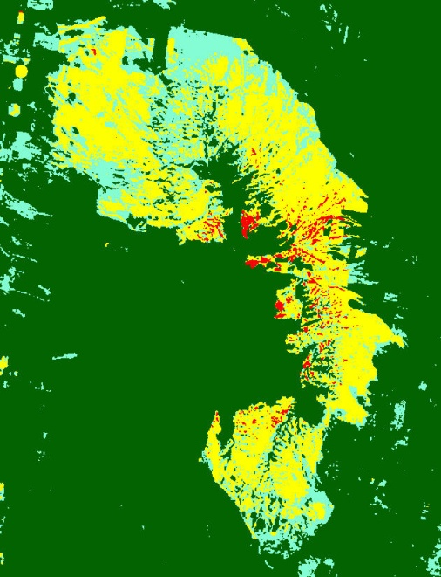
Mapping: Two-date Change Detection
Multiple approaches with common core concepts:
  Identify spectral characteristics of significant change and separate it from noise
Focus of this course:
  Two-date image differencing
  Moderate resolution satellite imagery
  Provides a foundation for other methods
  Can be accomplished using readily available tools
Postfire
Prefire
Change
Notes:
Examples of different approaches: Post classification, z-score analysis, simple image differencing, etc.
Different approaches are appropriate for different situations; however, all share some common core concepts.
“Kennedy et al 09, Despite the variety of methods, most change detection approaches contain a modeling phase or a functional algorithm and a subtraction phase”

Slide 30
Steps to map land cover change
Data selection and acquisition
    Imagery and reference data
Image processing and enhancement
    Correction, normalization and transformation
Analysis
    Quantify differences and create a change map
Evaluation
    Accuracy assessment

Slide 31
Management goals determine best remote sensing imagery and tools
Clearly define objectives
  Identify the problem:
    Change phenomena of interest
      What is measured?
      e.g., fire effects, forest mortality, stream channel changes, etc.
    Define study area
      Where?
    Determine frequency for change analysis
    When and how often?
      e.g., seasonal, annual, biennial, etc.
    Consider limitations
      What problems may occur?
These considerations determine appropriate methods and whether or not change can even be detected

Slide 32
1. Data Acquisition Considerations
Goals:
  Capture the change of interest
    Consider image and change phenomenon resolution (spatial, temporal and spectral)
  Minimize non-target change or ‘noise’
    Select near anniversary dates to minimize illumination and seasonal differences

Slide 33
1. Data Acquisition Considerations
Images:
Type
Timing
Quality
Cost
Reference data:
Type
Timing
Quality
Cost

Slide 34

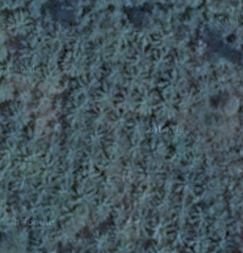

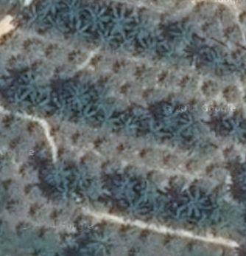
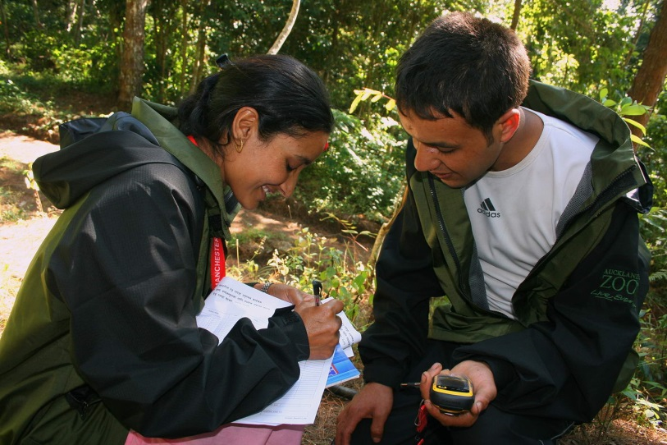
1. Data selection and acquisition
Images:
You should have wall-to-wall
coverage
Reference data:
You can collect reference data from imagery, preferably high resolution or with field visits

Slide 35
1. Type of imagery
Spatial character
  Spatial grain ~ pixel size
  Spatial extent ~ geographic scope
Temporal character
  Temporal grain ~ frequency of measurements
  Temporal extent ~ historical depth of imagery
Spectral attribute
  Spectral grain ~ width of bands
  Spectral extent ~ breadth of electromagnetic spectrum (red, blue, green, nir, etc)

Slide 36
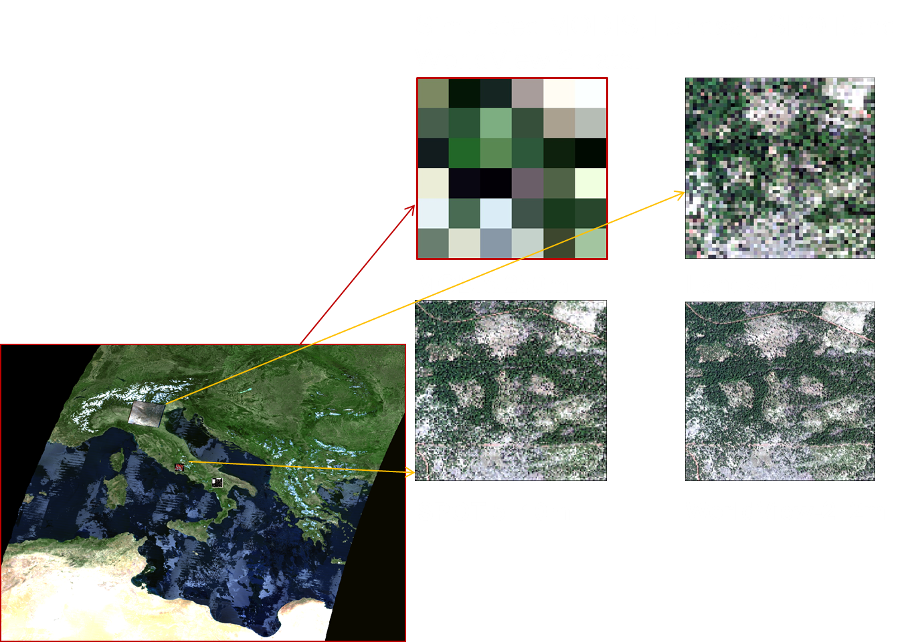
1. Imagery - Spatial Considerations
Spatial resolution (pixel size)
Extent
Trade-off between resolution and extent
Notes:
Consider the type of change that you want to map… Can’t see single trees in a Landsat pixel, can’t even really see ‘stands’ in a MODIS pixel… explain pixel mixing
Spatial grain is the area on the ground captured by a single sensor element, effectively the pixel size.
Extent is the geograhic scope of an image, the satellite footprint
Spatial grain of a sensor is the area on the ground captured within a single sensor element, effectively the pixel size.
The extent is the geographic scope of an image

Slide 37
1. Objectives determine temporal and spatial data needs
Changes occur across variable spectral, spatial and temporal scales.
Temporal
Spatial

Slide 38
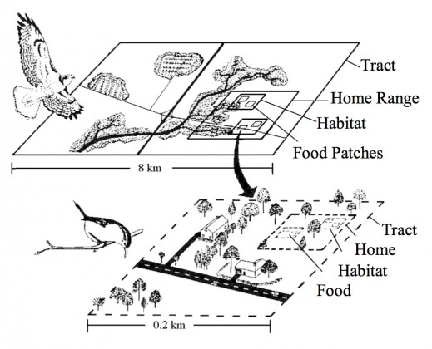
1. Spatial scale considerations
Depends on phenomenon of interest:
E.g. The habitat patterns for a red-tailed hawk are much different from that of a Carolina wren
267 x 267 = 71,000+ Landsat Pixels
7 x 7 = 49 Landsat Pixels
http://www.thenatureofcities.com/2014/01/15/a-matter-of-scale-connecting-human-decisions-with-decisions-made-by-wildlife/
Notes:
“Scale” essentially means the size of an area (e.g., 1 hectare, 5 hectare, 20 hectare, etc.). When a bird “responds to” an area, it is attracted to that area based on spatial objects within it. “Spatial objects” are the actual structures (such as trees, bushes, fields) within a given area that an animal uses to fulfill daily food, cover, and water needs. The scales at which wildlife respond to spatial objects are an important part of habitat selection.
Let’s take a theoretical representation of a Carolina Wren and a Red-tailed Hawk responding to spatial objects as they search for habitat (the drawing below)). The wren searches a tract of land to establish a home range. At the next scale, the wren searches its home range for suitable habitat patches for nesting or foraging for food. Then, within these habitat patches, the wren locates food patches where food items (e.g., insects) are abundant. This is the smallest scale in which the wren searches for food. The hawk has a similar set of decisions, but it selects much larger areas and objects at each comparable scale. Notice that the only overlap in scales is at the food patch level for the hawk and at the tract level for the wren.
Different wildlife species respond to different objects within a landscape. The type of object a species prefers is dependent on its natural history: what it eats, what it needs for nesting, etc. For example, one wildlife species could prefer tree patches. Another species prefers flowering plants. Others prefer woods along streams (riparian habitat). Some prefer natural, open fields. Some even prefer the actual homes (buildings) and others prefer lawns. In addition, the size of these spatial objects is important too. Different species may respond to different sizes of a particular object in the landscape. Let’s say two species like open areas (e.g., lawn). One species, such as a robin, may be attracted to a front yard. Another species, say a hawk, may prefer large expanses of lawn (e.g., golf courses). They both respond to lawn. However, the area of lawn is much bigger on a golf course than a front yard.
In addition, during different periods of an animal’s life, it may have different requirements for food, water, cover, and space. For example, birds may have vastly different requirements when breeding than when they are migrating or wintering in an area. Some bird species only nest in large expanses of wooded areas to keep their nests hidden from predators while primarily catching insects to feed their young. However, outside the breeding season, these same birds can be found in small patches of forest feeding on a variety of food items including fruits and seeds (e.g., Ovenbird, Seiurus aurocapillus).
After the breeding season, many young animals disperse from their natal site looking for new areas that provide food and shelter. For animals that are dispersing, many urban sites that may not be appropriate for breeding could serve as ‘dispersal sites’ where animals can feed and rest when searching for new habitat. These dispersal sites can serve as corridors that help animals move from one habitat to the next. In addition, urban sites can serve as “stopover sites” for birds that are looking for food and shelter along their migration route.Radars around cities have detected massive amounts of birds flying at night in and around cities. Urban areas can also serve as wintering sites for animals that normally breed outside of urban areas.
In summary, a particular patch can serve as habitat for animals during different times of the year. A patch of woods, for example, may be a breeding area for some animals while at other times of the year it may serve as a stopover site or wintering site. In many cases, the property may serve primarily as a ‘connector’ between natural areas — an important role to permit the movement of animals.

Slide 39
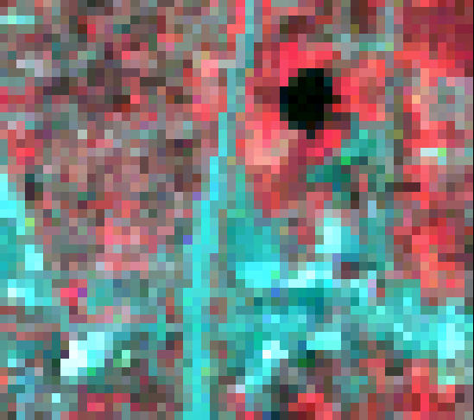
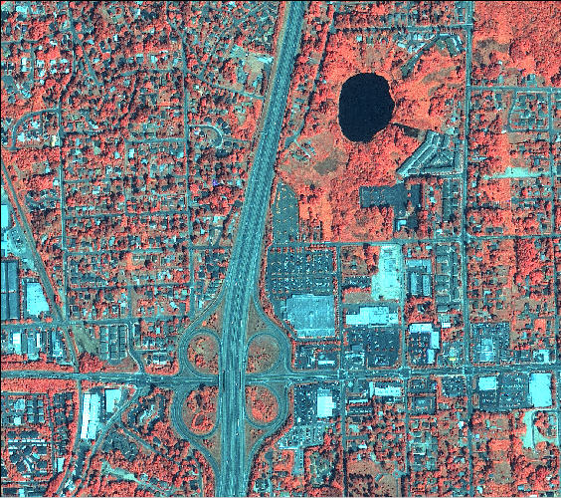
1. Spatial resolution
Landsat 7 (30m) Only broad patterns are visible on the landscape with this lower spatial resolution
Ikonos (4m)
Individual buildings are visible with this higher spatial resolution
Notes:
Although Landsat has a large geographic extent, it has a lower spatial resolution (grain, cell size) than some other modern satellites. These high resolution images have their own disadvantages which is a talk in and of itself.

Slide 40
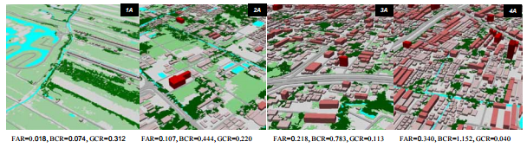

1. Spatial scale considerations
(human) land use is heterogeneous, many scales of impact/change

Slide 41

1. Temporal Scales
Is this a land cover change? Or stable land cover?
Having only two points of time to reference may not show us a clear picture of how things are changing

Slide 42
1. Temporal Scales
In the example below, greenness (tree cover) is fairly stable over time and doesn’t fluctuate much

Slide 43
1. Temporal Scales
In the example below greenness (tree cover) has a large change because of a fire, but then starts to recover. Multiple images would be required to track this change.

Slide 44
1. Temporal Scales
In the example below greenness (tree cover) has a gradual change because of a pest outbreak. Multiple images would be required to track this change as well.

Slide 45


1. Imagery - Temporal Considerations
Image timing must be chosen to minimize the influence of unwanted effects on spectral space, since such effects obscure real change or produce the false appearance of change
Seasonal and environmental effects (e.g., soil moisture, phenology)
Persistence of change phenomena
  (i.e., consider recovery and succession)
Notes:
Image timing must be chosen to minimize the influence of unwanted effects on spectral space,since such effects obscure real change or produce the false appearance of change. Key issues to consider are phenological state of the landscape, sun angle
Temporal grain is the frequency at which images of a given point on the earth are acquired (Kennedy et al 2009)

Slide 46

1. Spectral extent
What are you mapping?
What spectral bands are sensitive to the change in land cover(s) of interest?
Vegetation ~ NDVI
(red and NIR bands)
Hokao, Kazunori, Vivarad Phonekeo, and M. Srivanit. "Assessing the impact of urbanization on urban thermal environment: a case study of Bangkok Metropolitan." International Journal of Applied 2.7 (2012).

Slide 47


1. Spectral extent
Vegetation ~ NDVI
(red and NIR)
Make sure to have the right spectral extent for what you are wanting to measure/detect

Slide 48

1. Spectral extent
Urbanization ~ can represent with the radiative skin temperature of the land surface (thermal band)
Hokao, Kazunori, Vivarad Phonekeo, and M. Srivanit. "Assessing the impact of urbanization on urban thermal environment: a case study of Bangkok Metropolitan." International Journal of Applied 2.7 (2012).

Slide 49

1. Spectral Response of Common Materials

Slide 50
2. Challenge
Separate real change from spectral change caused by:
  Seasonal variation and phenology
  Image misregistation
  Clouds and shadows
  Radiometric inconsistencies
      Sensor
      Variability in illumination (sun-angle, sensor position)
      Atmospheric effects
Notes:
Detecting landcover change by mapping spectral change presents the challenge of separating ‘significant’ change from ‘noise’

Slide 51
2. Image pre-processing
Goal: ensure that each pixel records the same type of measurement at the same location over time
  Pre-processing steps are becoming automated and often are done before you receive an image

Slide 52
2. Image Enhancement or Transformation
Derive and compare attributes highlighting scene features of interest
  E.g., NDVI, NDMI, Tasseled Cap Greenness layers
Advantages:
  Reduce data and noise
  Simplify comparisons
Notes:
You should select those that help to hone in on your change phenomenon of interest

Slide 53

2. Normalized Difference Vegetation Index (NDVI)
4band image NAIP image
Single band NDVI image
NDVI = (NIR – Red) / (NIR + Red)
Vegetation appears bright (high values)
Non-vegetation appears dark (low values)
Notes:
Take this slide and adapt for band ratio talk? Add the actual NDVI values for non-veg, veg, etc.

Slide 54

2. Band Ratios
NIR
- Red
We can make use of the spectral response of vegetation to obtain more information about the vegetation…
NDVI =
NIR
+ Red
134
- 50
NDVI =
134
+ 50
NDVI =
0.45
134
Unhealthy Vegetation
50
Reflectance
0.4
2.6
Near Infrared
Short-wave Infrared
Wavelength (µm)

Slide 55

2. Variety of Image Transformations
These are examples of some other commonly used Image Transformations. This is not an exhaustive list, but it does show more widely used transformations

Slide 56


2. Image Transformations
Tasseled Cap
  Linear spectral transformation (each tasseled-cap band is created by the sum of image band 1 times a constant plus image band 2 times a constant, etc…)
  Extracts components related to geophysical properties
  First 3 bands of new image:
    Brightness
    Greenness
    Wetness
  Uses coefficients specific to the sensor

Slide 57





2. Image Transformations
7-band Landsat TM5 image
Brightness
Greenness
Wetness
3-band Tasseled Cap image

Slide 58
3. How do we detect change from imagery?
Changes on the landscape can be detected as changes in the ‘spectral space’ occupied by an image pixel
Time 1. Healthy Vegetation
Reflectance
Time 2. Burned Vegetation
0.4
2.6
Wavelength (µm)

Slide 59

Analysis includes two steps
(can be done in either order)
Subtraction (difference of time 1 and 2)
Modeling (subtract and then model)

Slide 60



Model land cover, then subtract
Land Cover Land Cover
Time 1 Time 2 Change

Slide 61






First Subtract, then Model
NDVI Time 1 NDVI Time 2 NDVI Change

Slide 62

3. Image Differencing (multi-temporal transform)
Normalized Burn Ratio (NBR)
NBR from two different 3 year periods is analyzed to see differences

Slide 63






3. Change Analysis with Image Differencing
(multi-temporal transform)
Example:
  Normalized Burn Ratio (NBR) = NBR = (NIR – SWIR) / (NIR + SWIR)
  Difference NBR = dNBR = Pre NBR – Post NBR
  Burn Severity = Thresholds applied to dNBR
Landsat
NBR
Threshold applied -
Burn Severity
Pre-fire
dNBR
6/8/2005
Difference
Post-fire
6/14/2007

Slide 64

3. Principle Components Analysis (PCA)
Same multi-temporal transform can be done with PCA
PCA transforms the spectral bands into new variables that are uncorrelated with one another.
multi-date image stack.
  Since areas of change will have low correlation between all the variables (spectral bands) when compared to stable pixels, these changes will be accentuated in the Principal Components.

Slide 65


3. Multi-temporal PCA “Bands”

Slide 66

3. Multi-temporal PCA “Bands”

Slide 67
4. Evaluation
Compare map (results) to reference data
  Evaluation of agreement vs. accuracy assessment
  Not same data that was used to train classification process
  Note: reference data assumed to be true, but reference data collection is also prone to error
Can use reference data to update area estimates of land undergoing change

Slide 68
Change Detection - Summary
Articulate goals
Evaluate data and options for image processing
Refine or eliminate unrealistic paths
Assess cost and utility of different options

Slide 69
Change Detection - Summary
Many considerations and approaches
    Manual, automated, two-date and trend analysis methods
A multistep process
    Image selection/acquisition, preprocessing, enhancement/transformation, mapping change, validation
Notes:
Additional relevant training
Available through RSAC, ask us for recommendations!

Slide 70
If you have questions please contact:
Karis Tenneson, PhD
Remote Sensing Specialist at USFS GTAC krtenneson@fs.fed.us, 801-975-3768 or
Brenna Schwert
Remote Sensing Specialist at USFS GTAC bmschwert@fs.fed.us, 801-975-3821

