Slide 1
Introduction to Google Earth Engine
Developed by remote sensing specialists at the USFS Geospatial Technology and Applications Center (GTAC), located in Salt Lake City, Utah

Slide 2
Agenda
Introduction to Earth Engine
Explore the Code Editor Platform
Show case available resources
Register for Earth Engine account

Slide 3
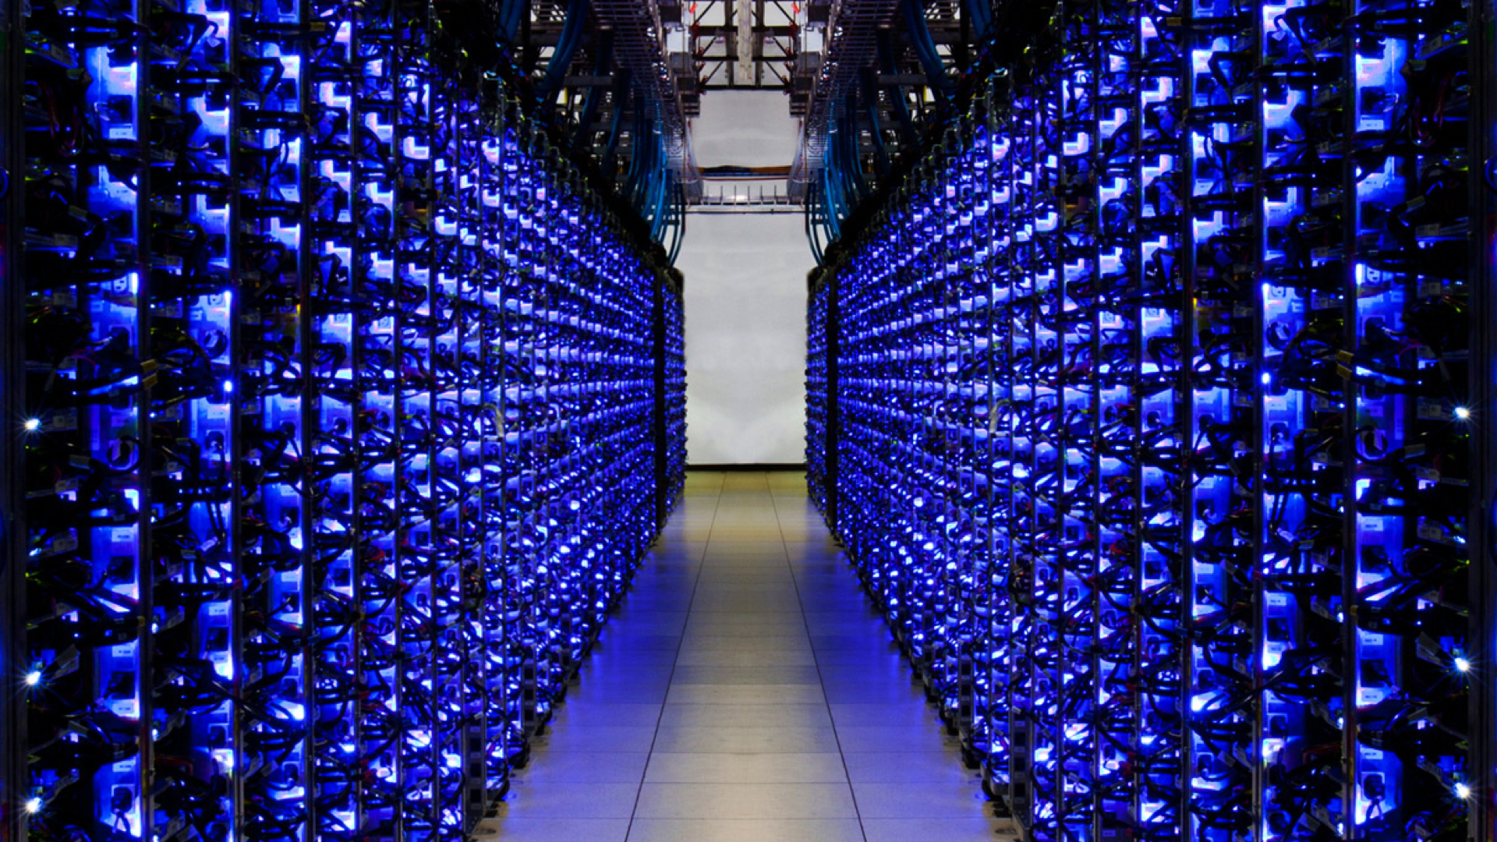
What is Earth Engine?
Remote Sensing Archive with petabytes of data in one location
A cloud-based geospatial processing platform for executing large-scale data analysis.
Photo courtesy of Google Earth Outreach
Source: Google Earth Engine Slide
Notes:
It is a cloud-based geospatial processing platform for executing large-scale environmental data analysis. Applications of environmental analyses in Earth Engine include detecting deforestation, classifying land cover, and urban mapping.

Slide 4
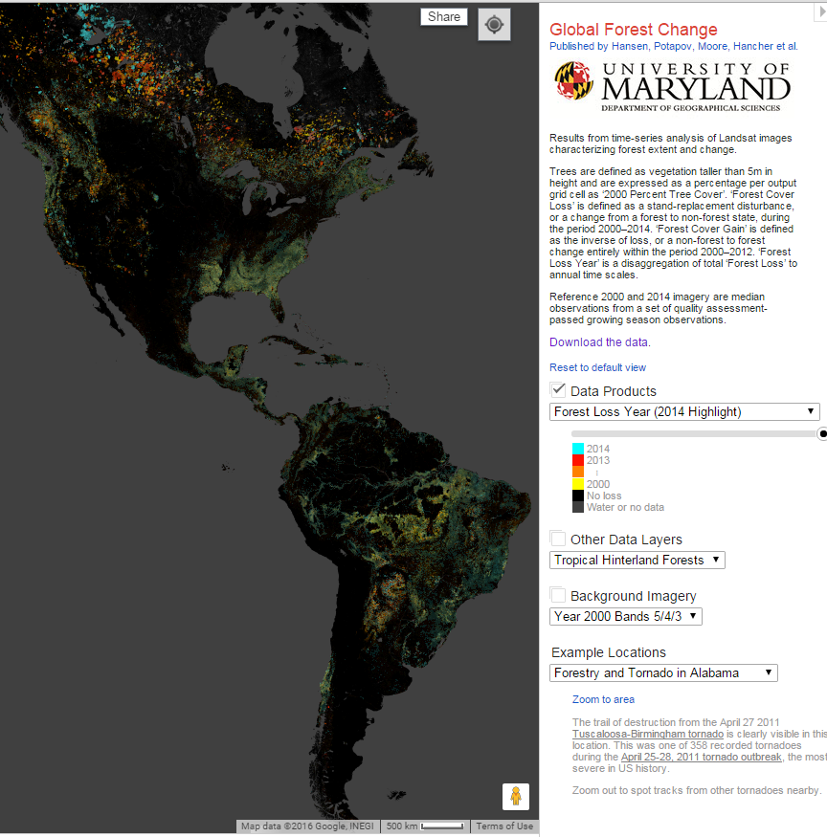
Example Applications:
Classifying land cover conditions and change detection:
Video of deforestation in Brazil https://earthengine.google.com/timelapse/?location=rondonia
Global Forest Change Map, Hansen et al http://earthenginepartners.appspot.com/science-2013-global-forest
Notes:
It is a cloud-based geospatial processing platform for executing large-scale environmental data analysis. Applications of environmental analyses in Earth Engine include detecting deforestation, classifying land cover, and urban mapping.

Slide 5
Why is it such a powerful image analysis software?
Public data catalog: vast amounts of publicly available data (you don’t need to store data)
Processing power (computation engine)
Interactive development platforms
Save and share work routines
Notes:
Three aspects of Earth Engine make it quite powerful as a geospatial processing tool. The first is its extensive public data catalog, the second is the processing power of the computation engine, and the third is its interactive development platforms.

Slide 6
Data Catalog
MODIS
250m daily
Landsat & Sentinel
10-30m, 14-day
Terra Bella
<1m daily–weekly
Terrain &
Land Cover
Weather & Climate
NOAA NCEP, OMI, ...
... and many more, updating daily!
> 200 public datasets
> 4000 new images every day
> 5 million images
> 5 petabytes of data
Source: Google Earth Engine Slide

Slide 7
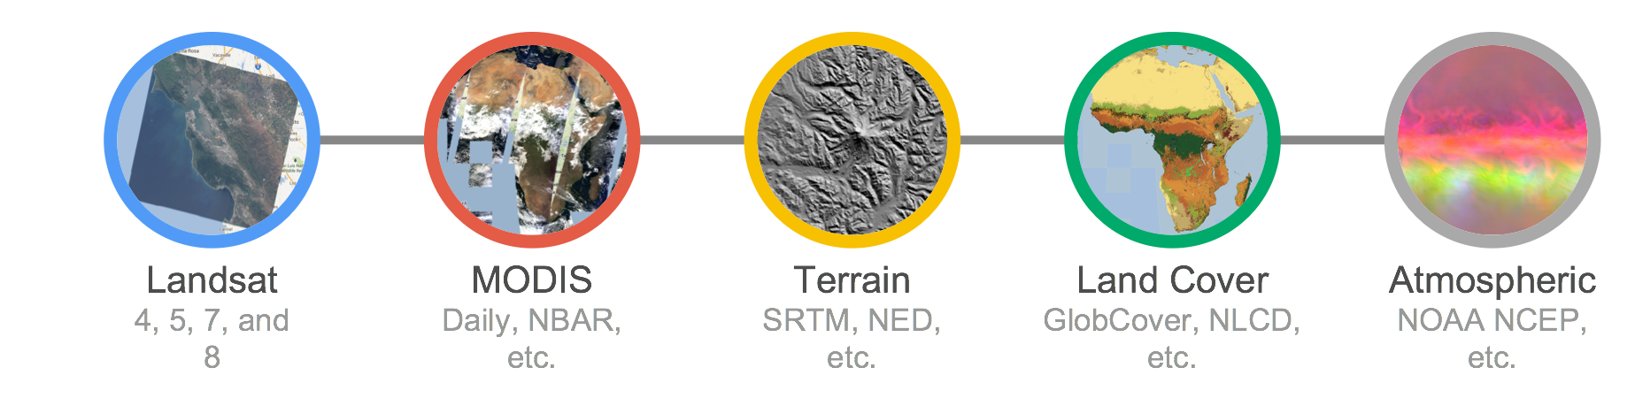
1. Earth Engine Public Data Catalog
Imagery
Geophysical
Climate & Weather
Demographic
Vector Data (Fusion Tables)
Image: Dave Thau
Notes:
In the data catalog, there is over 40 years of current and historical imagery and data in the Earth Engine data library. Available data sets include
Imagery – these imagery sets include both raw and pre-processed, georeferenced data products that are ready for use. Examples include NAIP, comprehensive Landsat archive, and MODIS data and ancillary products such as global composites and max NDVI.
Geophysical data – such as digital elevation models, surface temperature, and land cover
Climate and weather – NASA’s TOMS atmospheric data and – forecast weather and climate model data
Demographic data – such as population density estimates
Users are also able to load in their own data – both imagery and vector files to use for analysis.

Slide 8
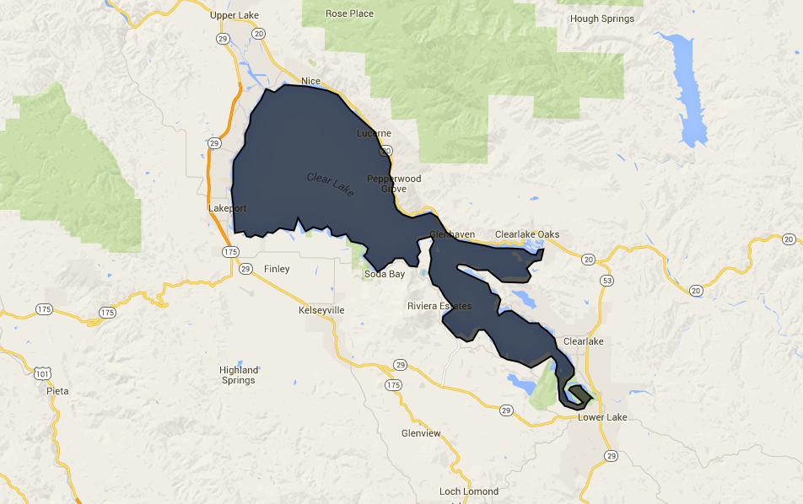
1. Load your own data
Fusion Tables
Polygons in GEE come in Fusion Tables. These are in a spreadsheet format but can contain geospatial information that can be viewed in GEE

Slide 9
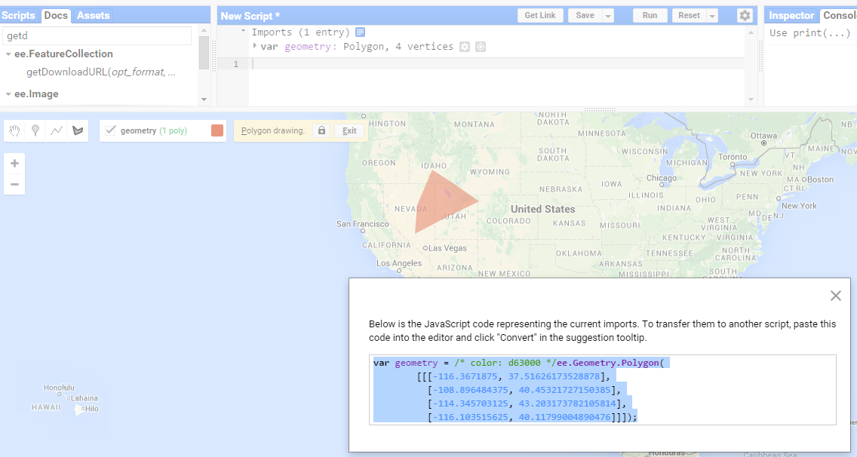
1. Make your own data in the map
You can also digitize vector data sets (e.g., polygons) in the map window.
These records can then be converted to code to use in your Javascript script

Slide 10
Why is it such a powerful image analysis software?
Public data catalog: vast amounts of publicly available data (you don’t need to store data)
Processing power (computation engine)
Interactive development platforms
Save and share work routines
Notes:
Three aspects of Earth Engine make it quite powerful as a geospatial processing tool. The first is its extensive public data catalog, the second is the processing power of the computation engine, and the third is its interactive development platforms.

Slide 11
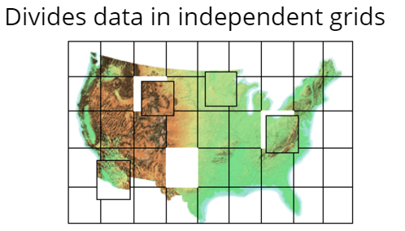
2. Computation Engine
“The computation engine is a just in time distributed computation model, ...”
Notes:
This means that the analysis requests are sent out to many different computers; each computer runs the calculations on a small area (small number of pixels) and returns the results. Requests are also efficient – it only computes for the input data of your requested values or to the extent of your screen. Results are then cached so that multiple requests for the same image or values do not result in re-computation. This results in:
– unprecedented speed: reduce processing times by orders of magnitude by using the cloud-based computing power
– Ease of use and lower costs. Online platform with easy access to data, scientific algorithms, computational power.

Slide 12
2. Computation Engine
“The computation engine is a just in time distributed computation model, a cloud-based processing infrastructure that automatically parallelizes analyses on many CPUs across many computers in Google’s data centers.”
Storage Clusters (petabytes of data)
Computing clusters (1,000’s of CPUs
Notes:
This means that the analysis requests are sent out to many different computers; each computer runs the calculations on a small area (small number of pixels) and returns the results. Requests are also efficient – it only computes for the input data of your requested values or to the extent of your screen. Results are then cached so that multiple requests for the same image or values do not result in re-computation. This results in:
– unprecedented speed: reduce processing times by orders of magnitude by using the cloud-based computing power
– Ease of use and lower costs. Online platform with easy access to data, scientific algorithms, computational power.

Slide 13
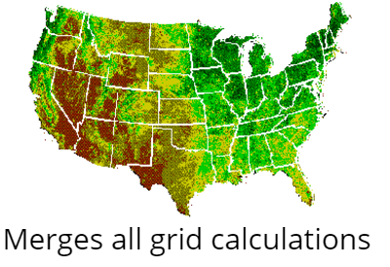
2. Computation Engine
Storage Clusters (petabytes of data)
Computing clusters (1,000’s of CPUs
Notes:
This means that the analysis requests are sent out to many different computers; each computer runs the calculations on a small area (small number of pixels) and returns the results. Requests are also efficient – it only computes for the input data of your requested values or to the extent of your screen. Results are then cached so that multiple requests for the same image or values do not result in re-computation. This results in:
– unprecedented speed: reduce processing times by orders of magnitude by using the cloud-based computing power
– Ease of use and lower costs. Online platform with easy access to data, scientific algorithms, computational power.

Slide 14
2. Computation Engine
Unprecedented speed: reduce processing times by orders of magnitude by using the distributed, cloud-based computing power
Ease of use and lower costs: online platform with easy access to data, scientific algorithms, computational power.
Notes:
This means that the analysis requests are sent out to many different computers; each computer runs the calculations on a small area (small number of pixels) and returns the results. Requests are also efficient – it only computes for the input data of your requested values or to the extent of your screen. Results are then cached so that multiple requests for the same image or values do not result in re-computation. This results in:
– unprecedented speed: reduce processing times by orders of magnitude by using the cloud-based computing power
– Ease of use and lower costs. Online platform with easy access to data, scientific algorithms, computational power.

Slide 15
Why is it such a powerful image analysis software?
Public data catalog: vast amounts of publicly available data (you don’t need to store data)
Processing power (computation engine)
Interactive development platforms
Save and share work routines
Notes:
Three aspects of Earth Engine make it quite powerful as a geospatial processing tool. The first is its extensive public data catalog, the second is the processing power of the computation engine, and the third is its interactive development platforms.

Slide 16
3. Two Platforms
Graphical User Interface (Explorer)
https://explorer.earthengine.google.com/#workspace
User friendly way to begin exploring and analyzing data
Application Program Interface (Code Editor)
https://code.earthengine.google.com/
Powerful geospatial tool to create complex custom analysis
Requires some programming knowledge
Supports both JavaScript and Python
Notes:
Earth Engine’s geospatial processing algorithms and API interface enables interactive algorithm development. These include basic spatial analysis operations (overlay, map algebra, vector based extraction of image statistics, etc.) and more advanced algorithms such as image classification, terrain modeling, and time series analysis.
Results can be reported as charts, maps, tables, or image exports. Google Earth Engine algorithms and user-submitted sample scripts – are constantly being added, enhanced, and updated – enabled by an open source environment.
Highly interactive algorithm development – a web based IDE for rapid proto-typing and visualization of complex spatial analyses across the world. Read more here: https://earthengine.google.com/platform/
Two Platforms
Explorer - a light-weight web app with point and click processing.
Code Editor - an IDE where users can program analysis scripts in either JavaScript or python. This allows the user to take advantage of a larger suite of Earth Engine processing algorithms and methods and create more complicated workflows.
Both platforms include a mapping window for instant visualization of results and data export capabilities. You have to register to access computational power in either platform; although you can visualize data in the Explorer without having an account.

Slide 17
Explorer Platform
A point and click platform:
Audience: non-programmers
Basic analysis functionality
Per pixel math (~ESRI’s raster calculator),
Neighborhood algorithms,
Terrain algorithms, etc
Save and share workspace
Explore and export data

Slide 18
Explorer Platform
Cons:
Limited analysis power:
subset of tools

Slide 19
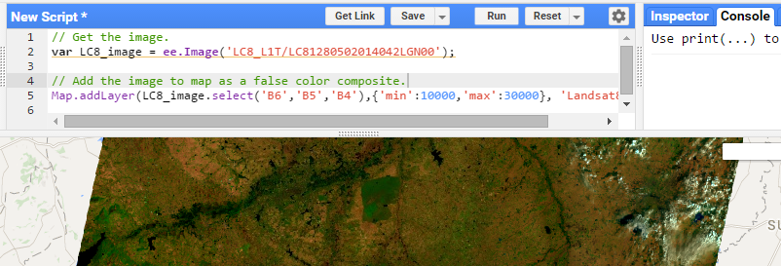
Code Editor
What is it?
Web based IDE for the Earth Engine API
Access many pre-made geospatial tools

Slide 20
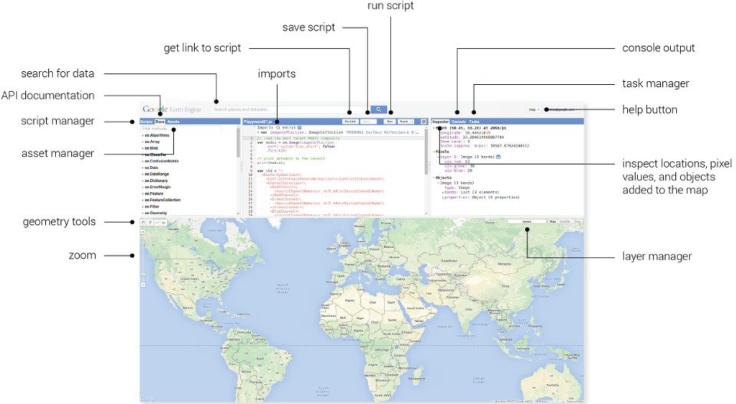
Code Editor Interface
Notes:
Point out the
Data search bar – this is similar to the one we saw in Explorer
Scripts and docs –
Scripts Manager - a wide variety of preloaded example scripts to provide simple examples of API usage;
Shared and your scripts can also be saved here – in the private scripts area;
Documentation List – a searchable list of documentation for the predefined GEE object types and methods (functions).
Text editor – write and edit code here. Click run to execute script.
Map output area – visualize the results of your query or analysis
Information panel - inspector, console, and tasks.
Inspector - locate information about the layers in your map,
Console - return messages as the scripts run and record any errors,
Manage the exporting of data and results to your google drive.
The Help dropdown menu in the upper right hand corner of the screen has many nice documents. The Feature Tour is a nice introduction that points out the different panels and features of the Code Editor.

Slide 21
Why is it such a powerful image analysis software?
Public data catalog: vast amounts of publicly available data (you don’t need to store data)
Processing power (computation engine)
Interactive development platforms
Save and share work routines (see demo)
Notes:
Three aspects of Earth Engine make it quite powerful as a geospatial processing tool. The first is its extensive public data catalog, the second is the processing power of the computation engine, and the third is its interactive development platforms.

Slide 22
When to use Earth Engine
EE Benefits:
Good for projects that requires:
Data coverage for a large region
Extensive data library
High speed, intensive processing capacity
Advanced raster processing tools
EE Limitations:
Better suited to image analyses than vector-based analyses
Analysis based on pixel spatial relations are harder to complete (because of the processing on multiple CPUS). Image segmentation and hydrologic modeling options are limited or in testing phases.

Slide 23
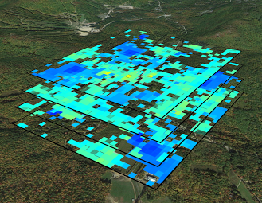
Spatial Data in GEE .
Images (raster) objects
ee.Image
An image refers to a single image (usually with multiple bands. e.g., one Landsat scene)
ee.ImageCollection
An image collection refers to a set of Earth Engine images (multiple rasters)
Vector objects (points, lines, polygons or tables)
ee.Geometry or ee.Feature
ee.FeatureCollection (multiple features)
Image: Global Snow Observatory

Slide 24
Methods and Algorithms
Functions: are actions that can be applied to data
E.g., exporting image objects stored as variables
Methods: are functions that are tailored to specific objects
E.g., adding numbers
Algorithms: provide some commonly used (higher) level functions
E.g., Landsat specific processing

Slide 25
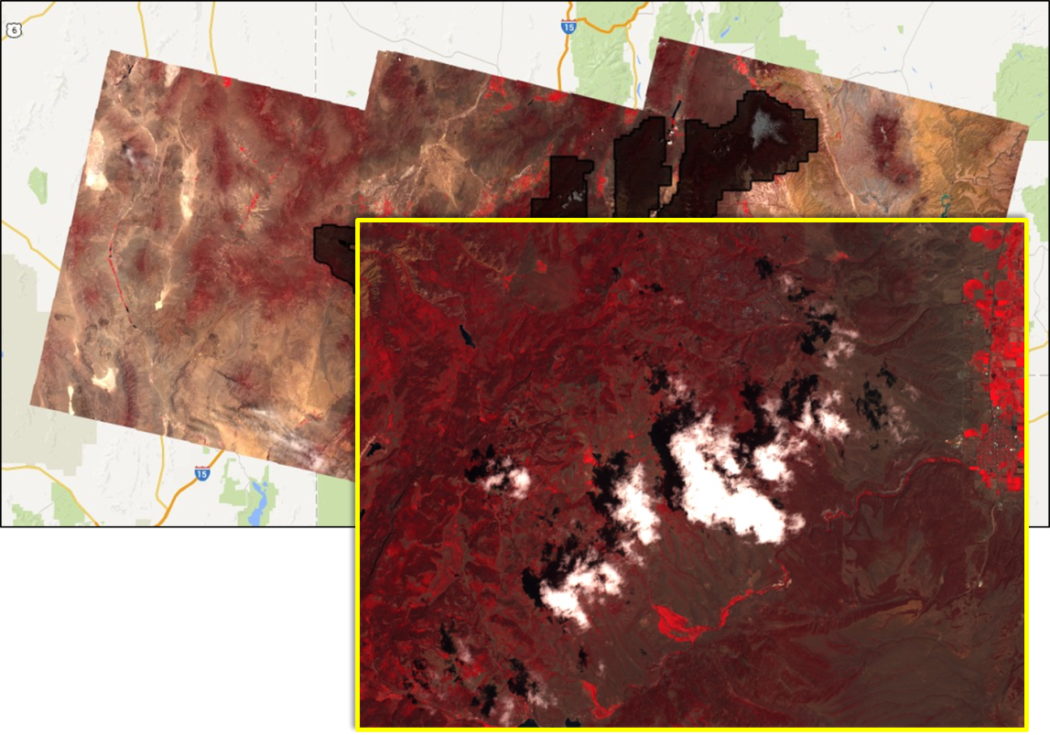
Processing & Analysis in Code Editor
Custom functions
Multiple Earth Engine and JavaScript functions can be combined to create custom algorithms
Example: use spectral and thermal values to identify and remove pixels that are likely to represent clouds and/or shadows.

Slide 26
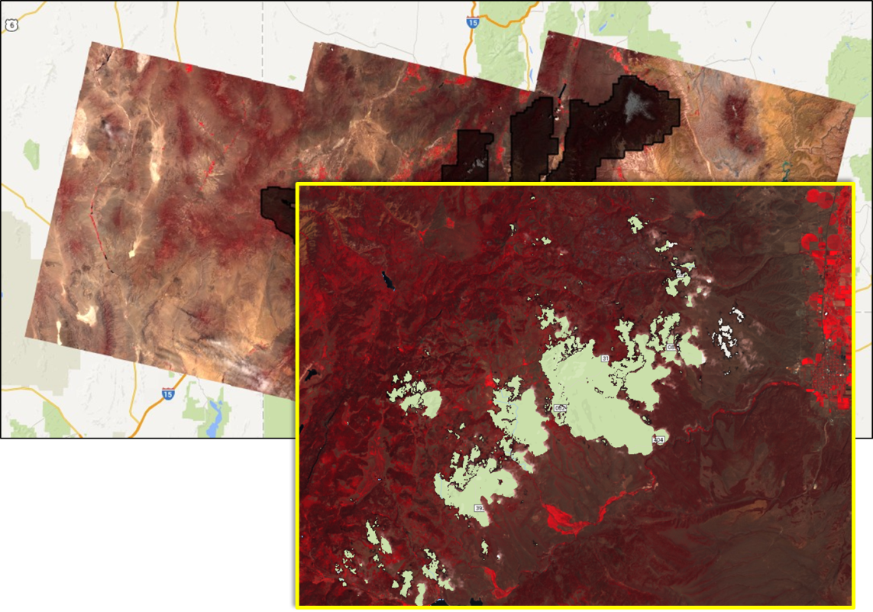
Processing & Analysis with GEE
Custom functions
Multiple Playground and JavaScript functions can be combined to create custom algorithms
Example: use spectral and thermal values to identify and remove pixels that are likely to represent clouds and/or shadows.

Slide 27
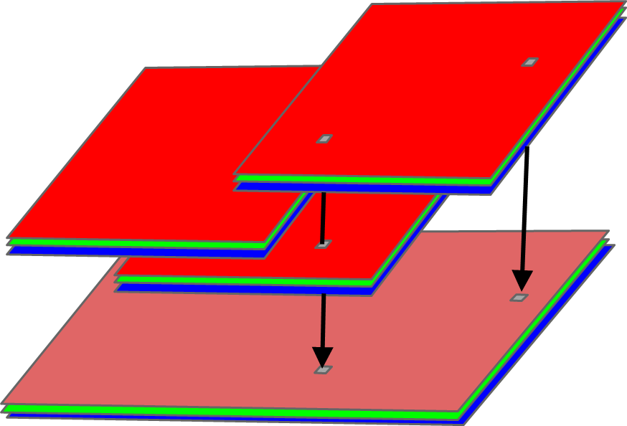
Processing & Analysis with GEE
Reducing collections
applies a reducer to all of the bands of an image.
the reducer must have a single input and will be called at each pixel to reduce the stack of band values.
the output image will have one band for each reducer output.
Median Image
AOI
AOI mean = X
Images: Tyler Erickson

Slide 28
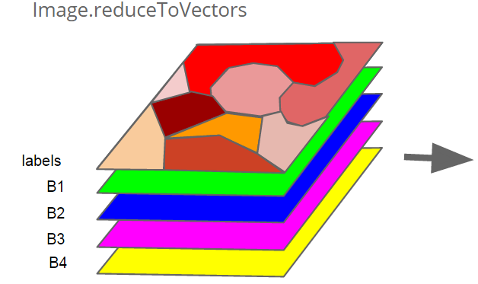
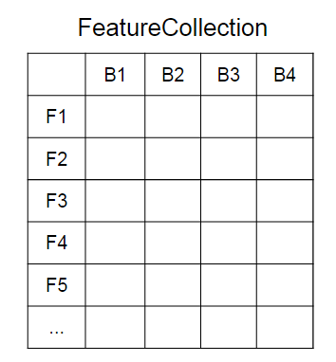
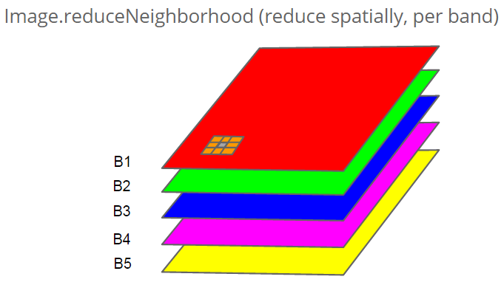
Processing & Analysis with GEE
Reducing areas (e.g., region, neighborhood)
Images: Tyler Erickson

Slide 29
Registration Process
Sign up for an Evaluator account:
Register here: https://earthengine.google.com/signup/
It may take up to one week to be granted access
Notes:
Earth Engine’s geospatial processing algorithms and API interface enables interactive algorithm development. These include basic spatial analysis operations (overlay, map algebra, vector based extraction of image statistics, etc.) and more advanced algorithms such as image classification, terrain modeling, and time series analysis.
Results can be reported as charts, maps, tables, or image exports. Google Earth Engine algorithms and user-submitted sample scripts – are constantly being added, enhanced, and updated – enabled by an open source environment.
Highly interactive algorithm development – a web based IDE for rapid proto-typing and visualization of complex spatial analyses across the world. Read more here: https://earthengine.google.com/platform/
Two Platforms
Explorer - a light-weight web app with point and click processing.
Code Editor - an IDE where users can program analysis scripts in either JavaScript or python. This allows the user to take advantage of a larger suite of Earth Engine processing algorithms and methods and create more complicated workflows.
Both platforms include a mapping window for instant visualization of results and data export capabilities. You have to register to access computational power in either platform; although you can visualize data in the Explorer without having an account.

Slide 30
Additional Learning Materials
https://developers.google.com/earth-engine/getstarted
https://developers.google.com/earth-engine/playground

Slide 31
If you have questions please contact: Karis Tenneson, PhD Remote Sensing Specialist at USFS GTAC krtenneson@fs.fed.us, 801-975-3768 or Brenna Schwert Remote Sensing Specialist at USFS GTAC bmschwert@fs.fed.us, 801-975-3821

