Slide 1
Land Cover Classification Techniques
supervised classification and random forests
Developed by remote sensing specialists at the USFS Geospatial Technology and Applications Center (GTAC), located in Salt Lake City, Utah

Slide 2
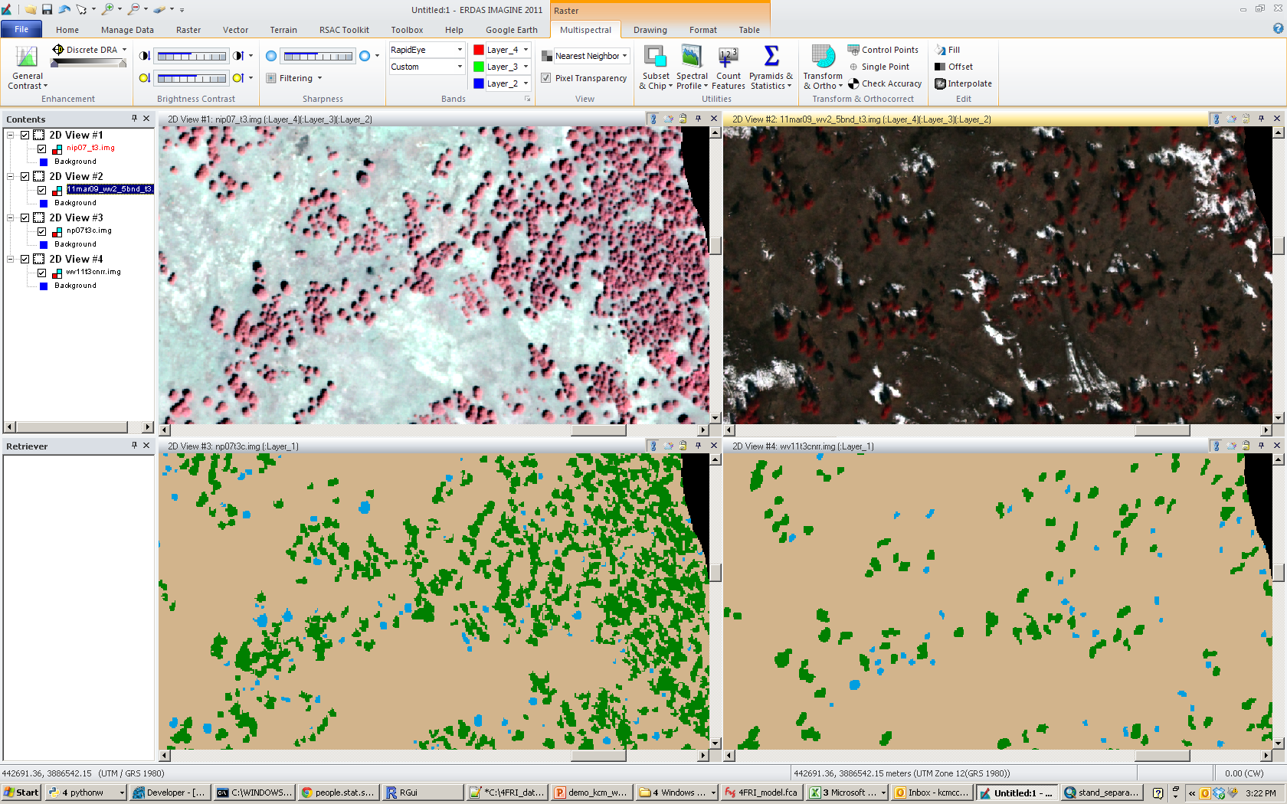
Image Classification
The automated process of categorizing pixels or image objects into a thematic classes (e.g., conifer, deciduous, herbaceous)

Slide 3
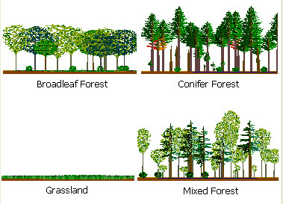
Classification Scheme
Decide on the scheme
  The schema categorizes and labels the land cover theme (e.g. vegetation cover)
  A well-designed classification scheme is critical to deriving acceptable and useful information
  The complexity will affect project accuracy and cost
  It’s not easy—but time spent creating a well designed classification scheme is always well spent!
Notes:
First you choose your “theme”
Formally defined as a central topic, subject or concept the user is trying to capture.
Note: a theme could be Urban, Transportation, etc. In our case, most of the time our theme will be vegetation cover. And the scheme will be designed around this central theme.
Categorizes and labels the variation in land cover that you wish to capture:
Based on measurable land cover (not land use) characteristics,
Based on what the photography can detect
Avoid interpretive classes such as “Old Growth” or “Suitable Habitat”; these should be derived by definitions based on measurable characteristics,

Slide 4
IPCC greenhouse gas inventory
Estimate changes in 5 carbon pools for six categories of land use.
The six land use categories include:
Forest land
Cropland
Grassland
Wetland
Settlements
Other land

Slide 5
The Classification Scheme – 5 rules
Requirements (for continuous cover classifications)
Must:
  Be exhaustive:
    All land cover must be accounted for in the legend
    An “Other” category ensures this condition!!
  Be mutually exclusive:
    Each land cover can be assigned to exactly one class
    A land cover feature is considered mutually exclusive if it cannot occur in two classes.
  Be composed of Labels and Rules for labeling
  Meet the user’s needs
  Must be based on what can be interpreted from the imagery (note: this may conflict with the previous requirement in some cases).

Slide 6
The Classification Scheme – Suggestions
In addition, the scheme should be:
  Hierarchical
    To be more flexible and better support multiple users.
  Based on measurable land cover characteristics
    Size class, % canopy cover, dominance, etc.
  Avoid subjective, interpretive classes, such as “old growth”.

Slide 7
Classification Scheme -- Bad Example
Yes! The data can be collapsed or expanded.
Water
Rock and Soil
Shrub
Forest
  Hardwood
    Sparse
    Medium density
    Dense
  Softwood
    Sparse
    Medium density
    Dense
Regeneration
No, there is no place for grasslands, mixed forests, etc… an “other” class would satisfy this.
Hierarchical?
Exhaustive?
None! How much tree cover does it take to separate shrub and forest? No definition for density labels.
Labeling Rules?
Mutually Exclusive?
No! What is “Regeneration”? That could include grasses, shrubs or forest…

Slide 8
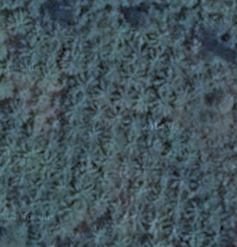
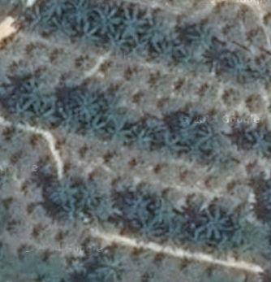
Classification Scheme -- Good Example?
Water
Non-Vegetated (< 20% vegetated)
Rangeland (< 10% tree crown closure)
Forest (> 10% tree crown closure)
  Hardwood (65% of trees are hardwood)
    sparse ( 10% and < 30% CC)
    medium density (30% and < 66% CC)
    dense (66% CC)
  Softwood (65% of trees are softwood)
    sparse (10% and < 30% CC)
    medium density (30% and < 66% CC)
    dense (66% CC)
  Other Forest (includes Mixed)
Other
Notes:
This is a better example…
Other ‘Forest’ options-> dense evergreen forests, degraded evergreen forests, dry deciduous forests, mangrove and swamp forest

Slide 9


Classification Scheme -- Good Example?
Water
Non-Vegetated (< 20% vegetated)
Rangeland (< 10% tree crown closure)
Forest (> 10% tree crown closure)
  Hardwood (65% of trees are hardwood)
    sparse ( 10% and < 30% CC)
    medium density (30% and < 66% CC)
    dense (66% CC)
  Softwood (65% of trees are softwood)
    sparse (10% and < 30% CC)
    medium density (30% and < 66% CC)
    dense (66% CC)
  Other Forest (includes Mixed)
Other
Notes:
This is a better example…
Other ‘Forest’ options-> dense evergreen forests, degraded evergreen forests, dry deciduous forests, mangrove and swamp forest

Slide 10
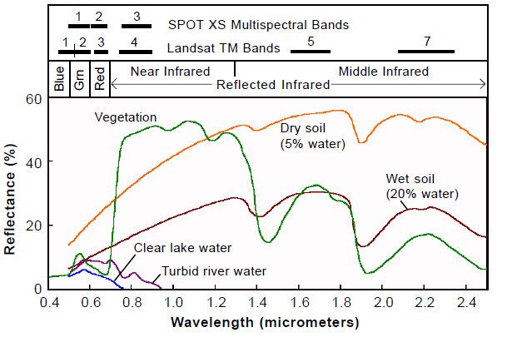
This is a graph of a spectral response curves for several different types of material.
It represents the visible to NIR portion of the electromagnetic spectrum
As you can see materials (e.g., dry soil, wet soil) can be identified and differentiated from each other as long as their signatures are unique from one another.
purple red infrared
Notes:
This is a graph of a spectral response curves for several different types of material.
It represents the visible to NIR portion of the electromagnetic spectrum
As you can see materials can identified and differentiated from each other as long as their signatures are unique from one another.

Slide 11
Spatial Models
Linking goals (land cover categories)
with
Land cover characteristics (spectral signatures)

Slide 12
Spatial Modeling Process
Theory
Candidate variables
Sample Design
Lidar metrics
Reference Data
Lidar metrics
Predictor Variables: (e.g., image enhancements)
Fitting/Training
Validation
Model
Applying Model
Map of predicted values
Adapted from Guisan and Zimmerman (2000) & Franklin (2009)

Slide 13
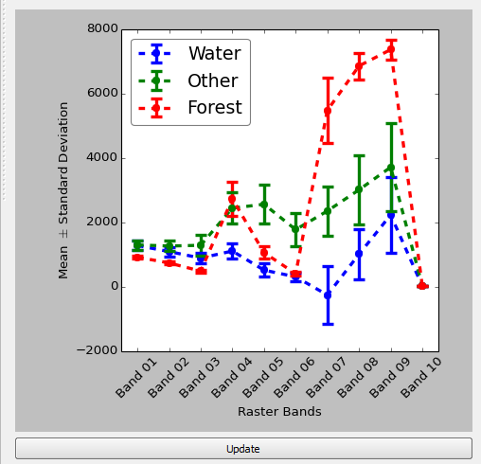
Spatial Modeling Process
Theory
Candidate variables
Sample Design
Lidar metrics
Reference Data
Lidar metrics
Predictor Variables: (e.g., image enhancements)
Fitting/Training
Validation
Model
Applying Model
Map of predicted values
Adapted from Guisan and Zimmerman (2000) & Franklin (2009)

Slide 14
Components of the Spatial Modeling Process
Theory
Candidate Variables
Sample design
Lidar metrics
Reference Data
Lidar metrics
Predictor Variables: (e.g., image enhancements)
Fitting/Training
Validation
Model
Applying Model
Map of predicted values
Adapted from Guisan and Zimmerman (2000) & Franklin (2009)

Slide 15
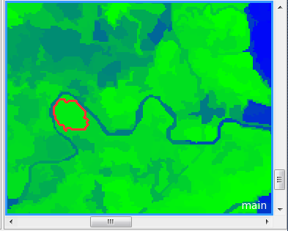
Predictor Variables
What does water look like?
What does land look like?
What information do you think will help differentiate water
from land?

Slide 16
Predictor Variable Examples
  Impervious surface metric
  Modified normalized difference water index
  Normalized difference vegetation index
  Elevation
  Aspect

Slide 17
Predictor Variables
Theory/Knowledge to get predictor variables:
Tone/color:
Shape:
Size:
Association:
Shadow:
Pattern:
Texture:

Slide 18
Spatial Modeling Process
Sample Design
Theory
Candidate variables
Lidar metrics
Reference Data (ROI)
Lidar metrics
Predictor Variables: (e.g., image enhancements)
Fitting/Training
Validation
Model
Applying Model
Map of predicted values
Adapted from Guisan and Zimmerman (2000) & Franklin (2009)

Slide 19
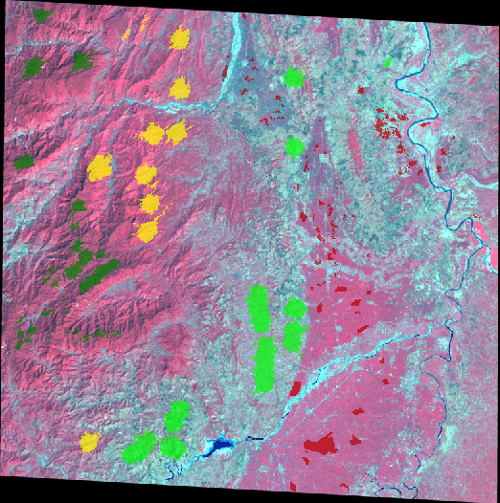
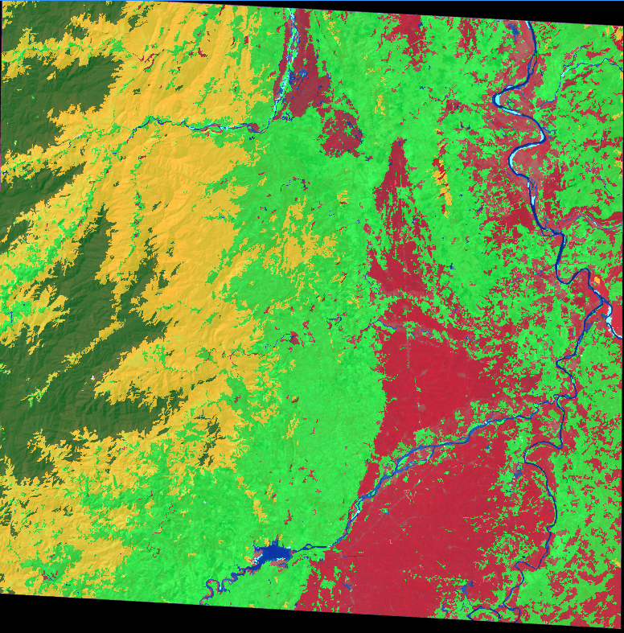
Training Data
Required for the advanced classifiers
  Interpreted manually
  Imported from a point or polygon shapefile
    Polygons can end up overlapping multiple segments
    Points are more precise and have less potential for error
Image with samples collected
Classified image

Slide 20
Required Elements: training data
Sample (training) data considerations:
  Collected in field or digitized from high resolution imagery
  Covers full region
  Full range
  Random, or stratified random is best, often an opportunistic sample is all that is available

Slide 21
Spatial Modeling Process
Theory
Sample design
Candidate Variables
Lidar metrics
Reference Data
Lidar metrics
Predictor Variables: (e.g., image enhancements)
Fitting/
Training
Validation
Model
Applying Model
Map of predicted values
Adapted from Guisan and Zimmerman (2000) & Franklin (2009)

Slide 22
Unsupervised Classification
After the computer finishes processing, the analyst then attempts to assign these spectral classes into informational classes. It is a simple process to regroup (recode) the clusters into meaningful information classes (the legend).
The result is a Land Cover Map
Land Cover Map
Legend
Labels
Water
Water
Water
Conif.
Conifer
Conifer
Hardw.
Hardwood
Hardwood

Slide 23
Supervised Classification
Supervised classification requires the analyst to create training data, either in the field or from an image data source.
Mean Spectral Signatures
The computer then creates...
Conifer
Known Conifer Area
Water
Known Water Area
Deciduous
Known Deciduous Area
Digital Image

Slide 24
Supervised Classification
Using the statistical information provided by the training regions, the computer attempts to determine all remaining pixels in the image falling into these defined classes.
Mean Spectral Signatures
Output Classified Image
Conifer
Next Pixel to be Classified
Deciduous
Water
Unknown

Slide 25
Supervised Classification
Supervised classification requires the analyst to create training data, either in the field or from an image data source.
Mean Spectral Signatures
The computer then creates...
Conifer
Known Conifer Area
Water
Known Water Area
Deciduous
Known Deciduous Area
Digital Image

Slide 26
Supervised Classifiers
  Nearest neighbor
  Bayes
  Decision Tree
  K-nearest neighbors
  Support Vector Machines
  Random forests

Slide 27
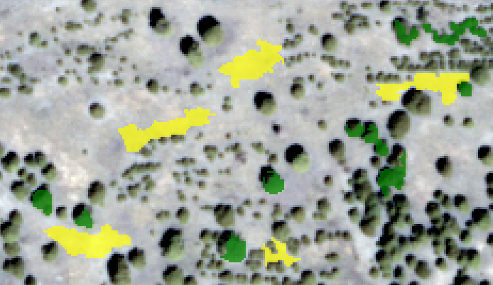
Classification Process
Classifies based on descriptors applied to the classes
Nearest neighbor
  Select the features the classification will be based on (e.g., red band, NDVI, ancillary data, etc)
  Select training data
Training samples selected for classification

Slide 28
Decision Trees
Also known as CART (Classification and Regression Tree) when they refer to both:
  Classification tree = predicted outcome is the class to which the data belongs.
  Regression tree = predicted outcome can be considered a real number (e.g. NDVI value)
Data mining technique
Uses training data to develop a tree-like set of rules to determine the class for certain combinations of input data
Simple to use and can produce good results

Slide 29
Example of a Decision Trees
For example - separating shrub from grassland
Landsat Band 4 >120
Landsat NDVI > 350
Landsat NDVI < 350
Aspect > 180
Aspect < 180
shrub
grassland
grassland

Slide 30
Spatial Modeling Process
Theory
Candidate variables
Sample Design
Lidar metrics
Reference Data
Lidar metrics
Predictor Variables: (e.g., image enhancements)
Fitting/Training
Validation
Model
Applying Model
Map of predicted values
Adapted from Guisan and Zimmerman (2000) & Franklin (2009)

Slide 31
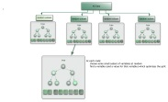
Random Forest
Ensemble-based machine learning technique
  Ensemble = “many of”
  Machine learning technique = Classification and Regression Trees (CART)
  The “Random” in Random Forest describes that the selection of predictor variables is random for any given CART model (“tree”).
= shrub prediction? Yes or No.
Notes:
Developed by Adele and Richard Cutler, Dept. of Mathematics, Utah State

Slide 32
What is input into Random Forest?
Training or reference data (point data)
  Examples of each class (e.g., Conifer, Aspen, Grass, Shrub, Road, Sagebrush, Shadow, Water, Soils)
Predictor variables such as:
  Multispectral imagery
  Panchromatic imagery
  Topographic variables: Elevation, Slope, & Aspect.
  Bioclimatic variables: Temperature, Precipitation, Moisture Index, Potential Global Radiation, Vapor Pressure, Humidity, Degree Days.
Derived Predictor variables such as:
    NDVI
    Tasseled Cap transformations (soil brightness, greenness, wetness)

Slide 33
CART
Random input variables are selected and used on your training data to make trees.
Landsat Band 4 >120
Landsat NDVI > 350
Landsat NDVI < 350
Aspect > 180
Aspect < 180
shrub
grassland
grassland
This is an example of 1 Classification tree – hundreds are created randomly using your reference/training data and built for your various Classes.
Notes:
Each “tree” is the result of the random selection of input variables (multispectral bands, elevation data, etc.) from the reference data (e.g., image segments or pixels).
Random Forest makes hundreds to thousands of these Classification trees or decision trees.

Slide 34
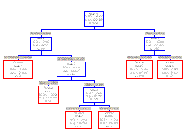
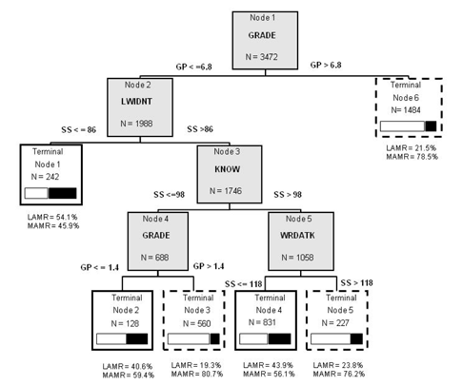
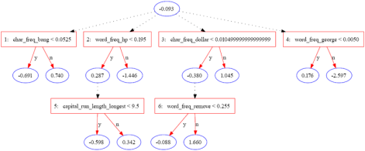
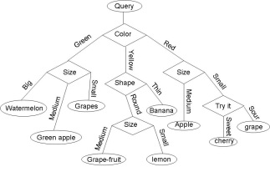
A single CART model created during the Random Forest process.
A single pixel
= shrub prediction? Yes or No.
The CART models make a class prediction for each pixel using the predictor variables that were used as inputs to that particular CART model.
= shrub prediction? Yes or No.

Slide 35
Spatial Modeling Process
Theory
Sample design
Candidate Variables
Lidar metrics
Reference Data
Lidar metrics
Predictor Variables: (e.g., image enhancements)
Fitting/
Training
Validation
Model
Applying Model
Map of predicted values
Adapted from Guisan and Zimmerman (2000) & Franklin (2009)

Slide 36
A single CART model created during the Random Forest process.
A single pixel
shrub
shrub
shrub
In this example, the most frequently occurring class modeled from the CART models for this pixel is Shrub.
So the final class for that pixel is Shrub.
shrub
shrub
grass
shrub
grass
shrub
grass
shrub
shrub
Notes:
To make predictions:
Each CART model gets the input data that corresponds to the variables in it’s model to make a predication about which class each segment/pixel should be (e.g., shrub).
Which ever class gets the most votes, “wins”!
**Disclaimer: Garbage in = Garbage out

Slide 37
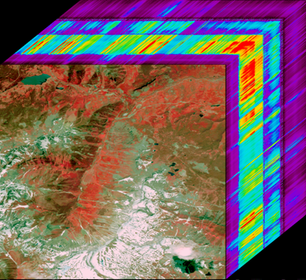
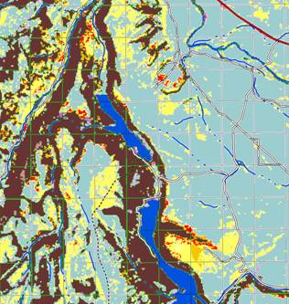
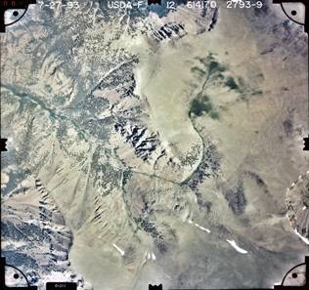
What comes out of Random Forest?
Inputs
Outputs
Random Forest models are created & applied
Classification & labeled segments
Input image-cube
(58 layers)
Field & PI training samples

Slide 38
Qualitative assessment of land cover map output

Slide 39
Ways to improve classification
Improving ROI
Select better predictor variables
Modify land cover class categories
Sieve
Try an object based approach

Slide 40
Unit of Analysis
Pixel Based Classification
  Uses spectral signatures
  Ancillary data (elevation, etc)
Object Based Classification
  We can use more than spectral information!
  Texture
  Contextual relationships
  Etc.

Slide 41
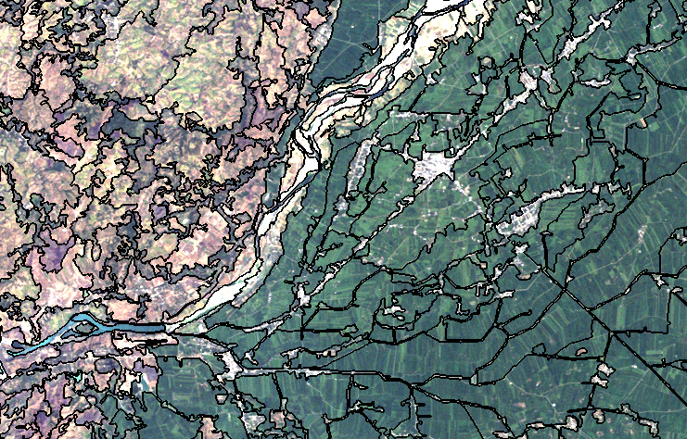
Object-based Image Analysis
What is object-based image analysis (OBIA)?
  Image processing technique that uses image “objects” or “segments” as the basic unit instead of pixels

Slide 42
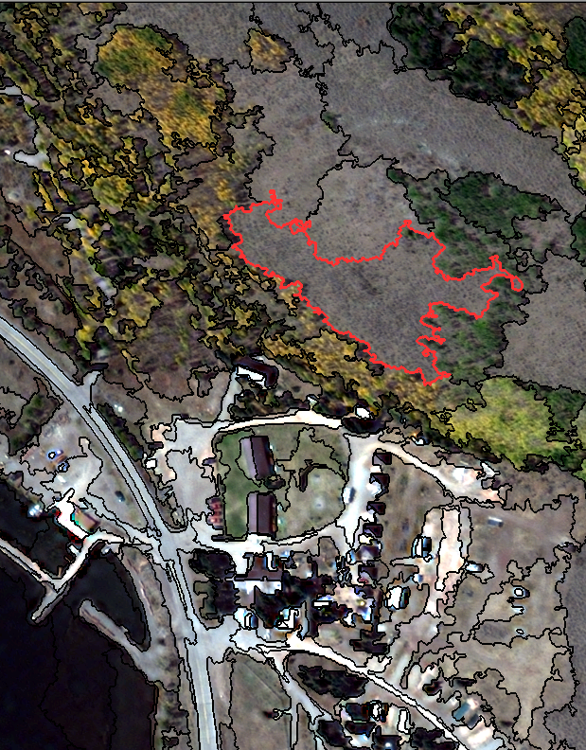
Object-based Image Analysis
Division of imagery into homogeneous areas
  Image segmentation
Analysis performed on object or segments, not pixels
Especially useful for high-resolution imagery, but beneficial for coarse resolution as well

Slide 43
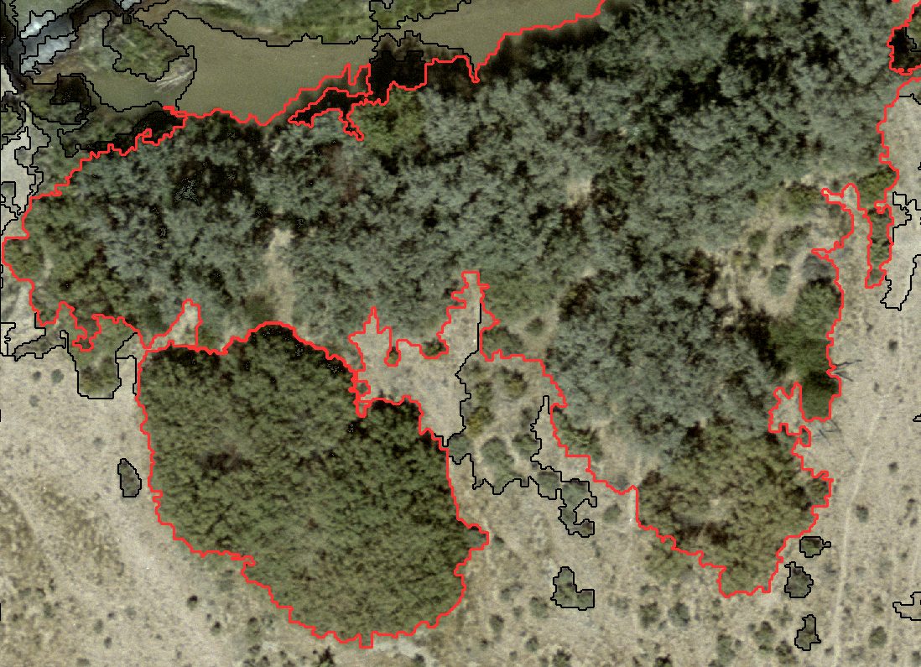
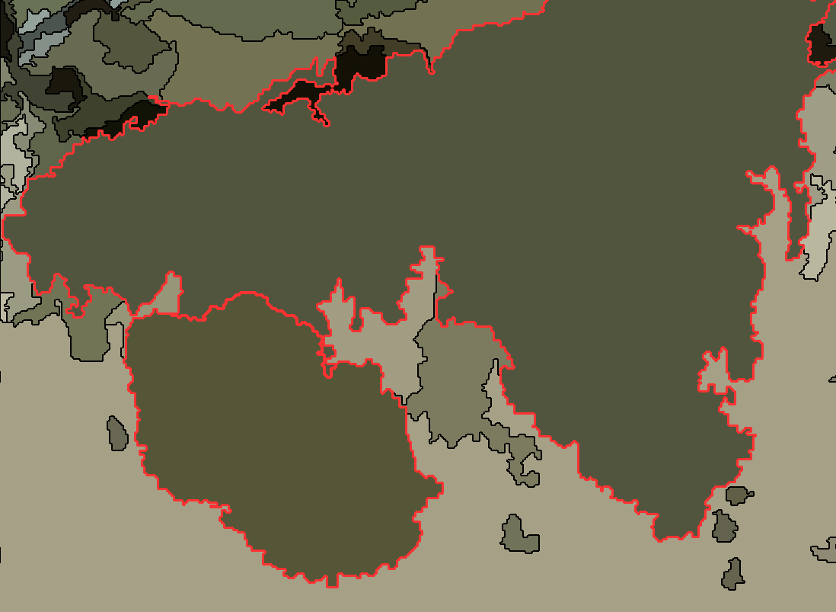
Why object-based classification?
Spectral data is averaged for each segment
  Useful when dealing with features that have a range of spectral values (high texture)
Segments filter out “noise” or meaningless information present in individual pixels and groups
  Helps to reveal recognizable features
Increase signal-to-noise ratio
Can improve classification accuracy over pixel-based classification

Slide 44
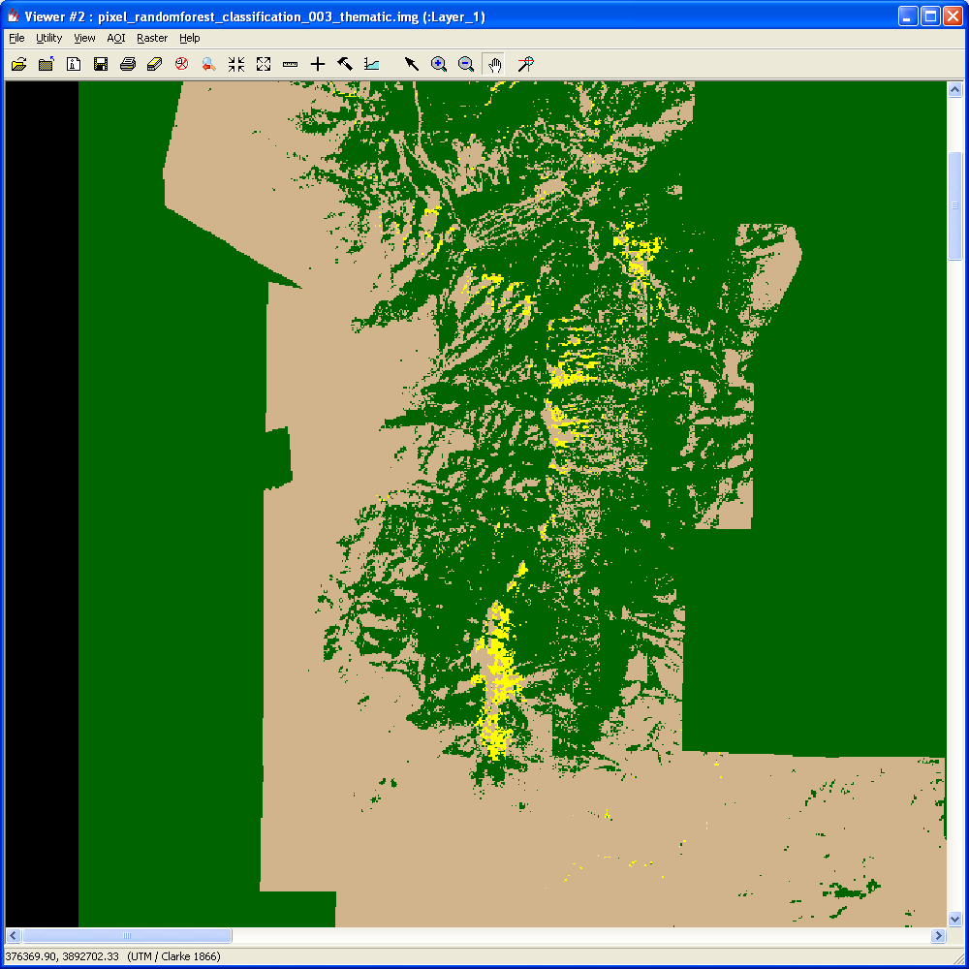
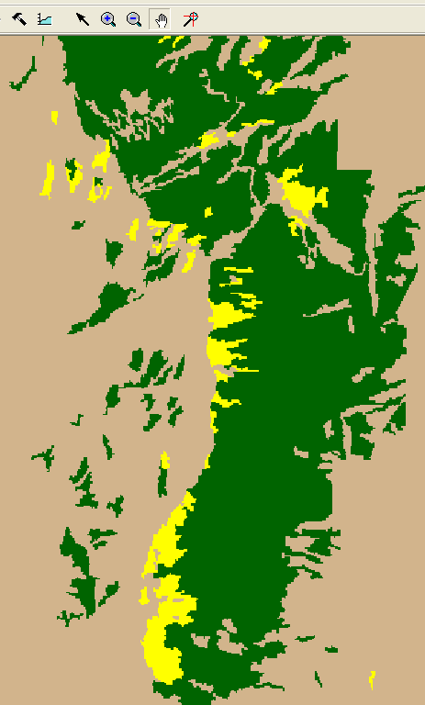
Why object-based classification?
Object-based image analysis
  Can use spectral AND other information (size, shape, context, texture, et cetera) for classification
  Eliminates the pixel-based speckling or “salt and pepper” that we sometimes see

Slide 45
Segmentation
Mean shift
  Most commonly used
  Robust algorithm
  Delineates homogeneous areas
  Memory and processor intensive

Slide 46
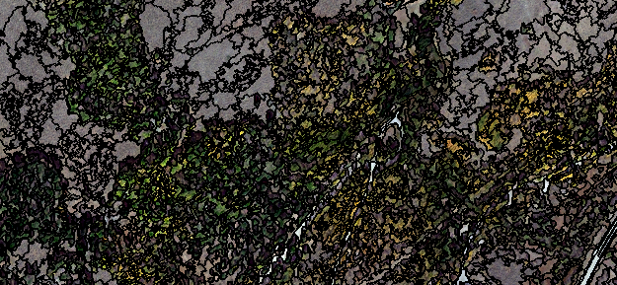
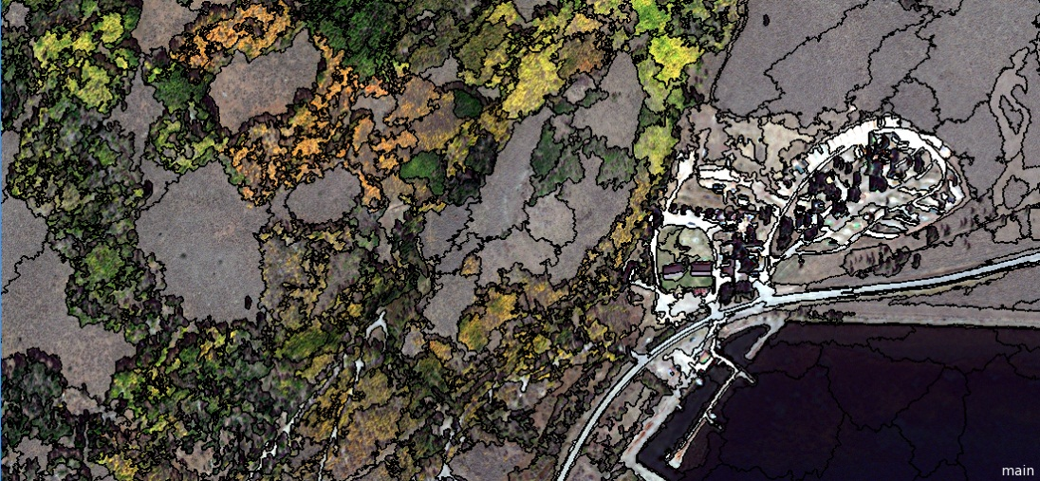
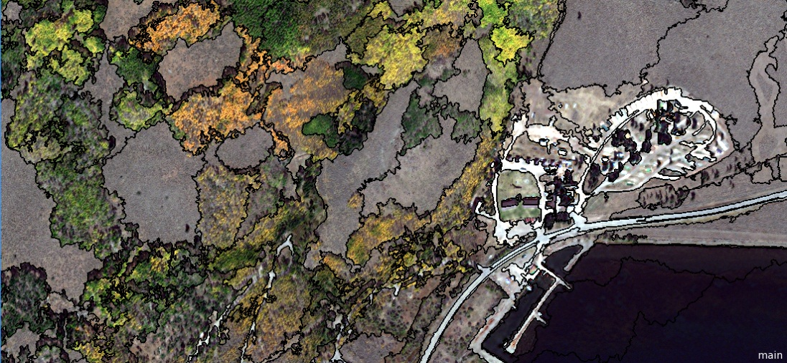
Segmentation
Minimum region size controls the size of the segments
Min region = 50
Min region = 150
Min region = 300

Slide 47
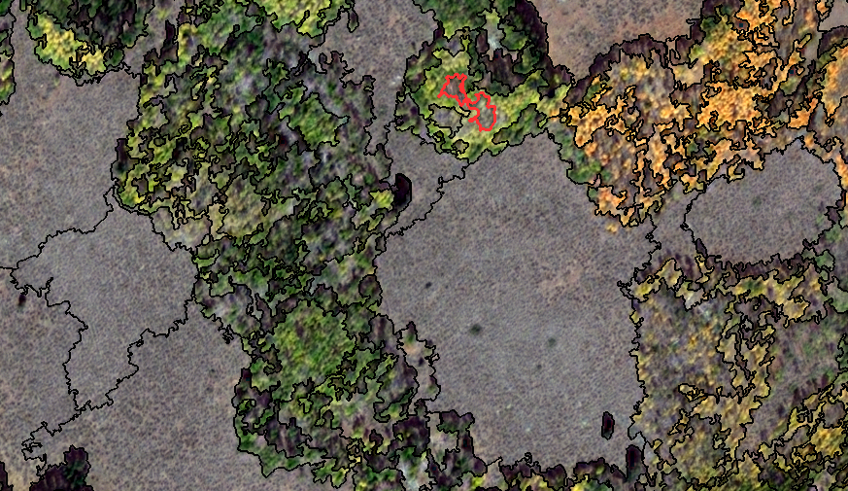
Segmentation
High variance = small segments
Low variance = large segments

Slide 48
If you have questions please contact:
Karis Tenneson, PhD
Remote Sensing Specialist at USFS GTAC krtenneson@fs.fed.us, 801-975-3768 or
Brenna Schwert
Remote Sensing Specialist at USFS GTAC bmschwert@fs.fed.us, 801-975-3821

