Slide 1
Framework Overview
Brenna Schwert
Remote Sensing Specialist
brenna.schwert@usda.gov
Geospatial Technology and Applications Center | GTAC
USDA Forest Service

Slide 2
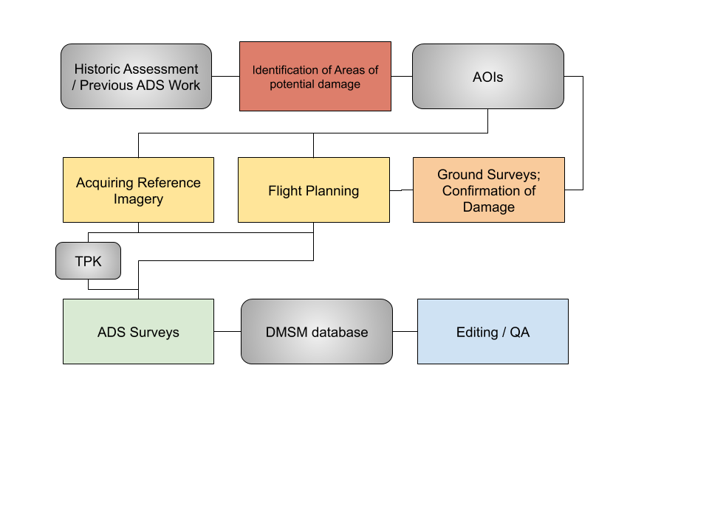
Framework Overview

Slide 3
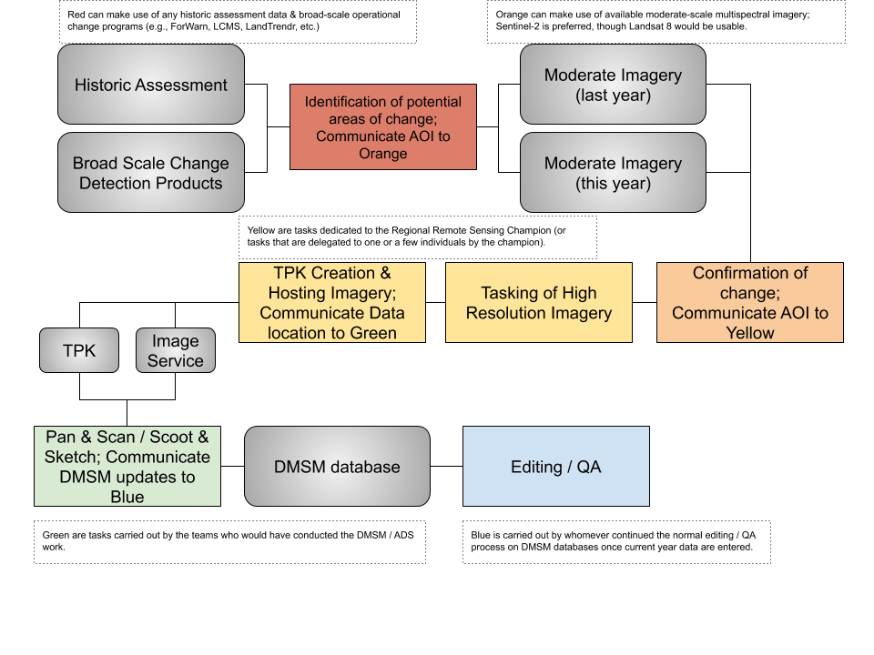
Framework Overview

