Slide 1
Detecting & Monitoring Change
Brenna Schwert
Remote Sensing Specialist
brenna.schwert@usda.gov
Geospatial Technology and Applications Center | GTAC
USDA Forest Service

Slide 2
Framework Overview
LCMS, ForWarn II, and other remote sensing tools
Ground surveys
Is it different than it was before?

Slide 3
Framework Overview

Slide 4
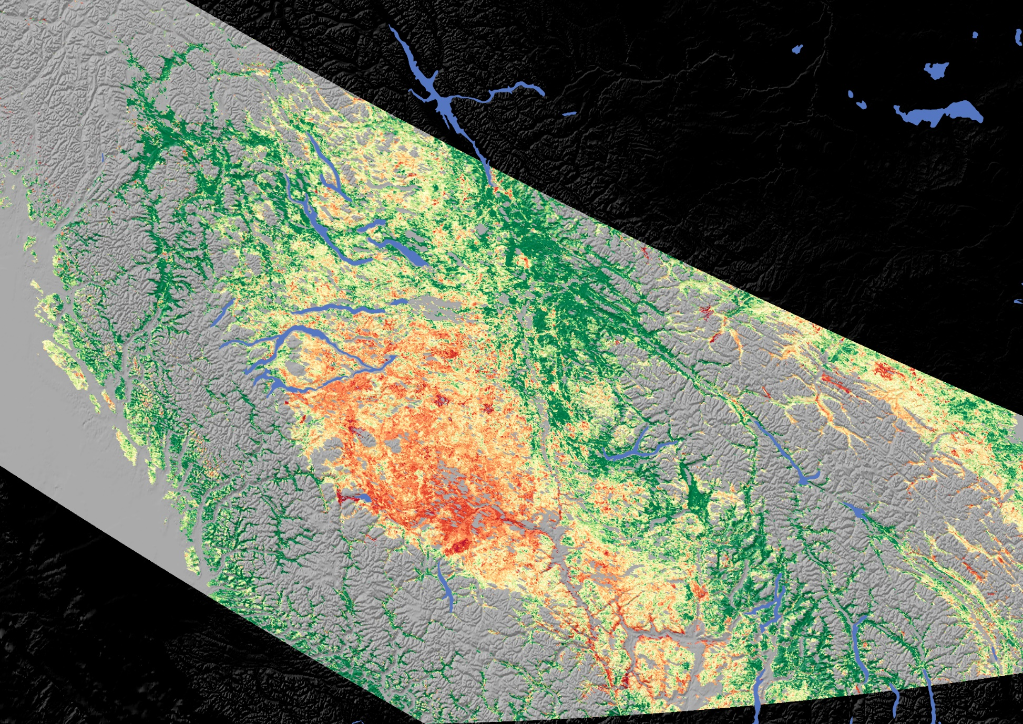
MODIS image (250 m)
Red shows more severe pine beetle damage, green represents healthy forests

Slide 5
ASTER image
15 m spatial resolution
60 km swath width
SWIR composite
Healthy vegetation looks green
Water looks blue
Dry bare soil looks anywhere from grey/tan to pink to purple.

Slide 6
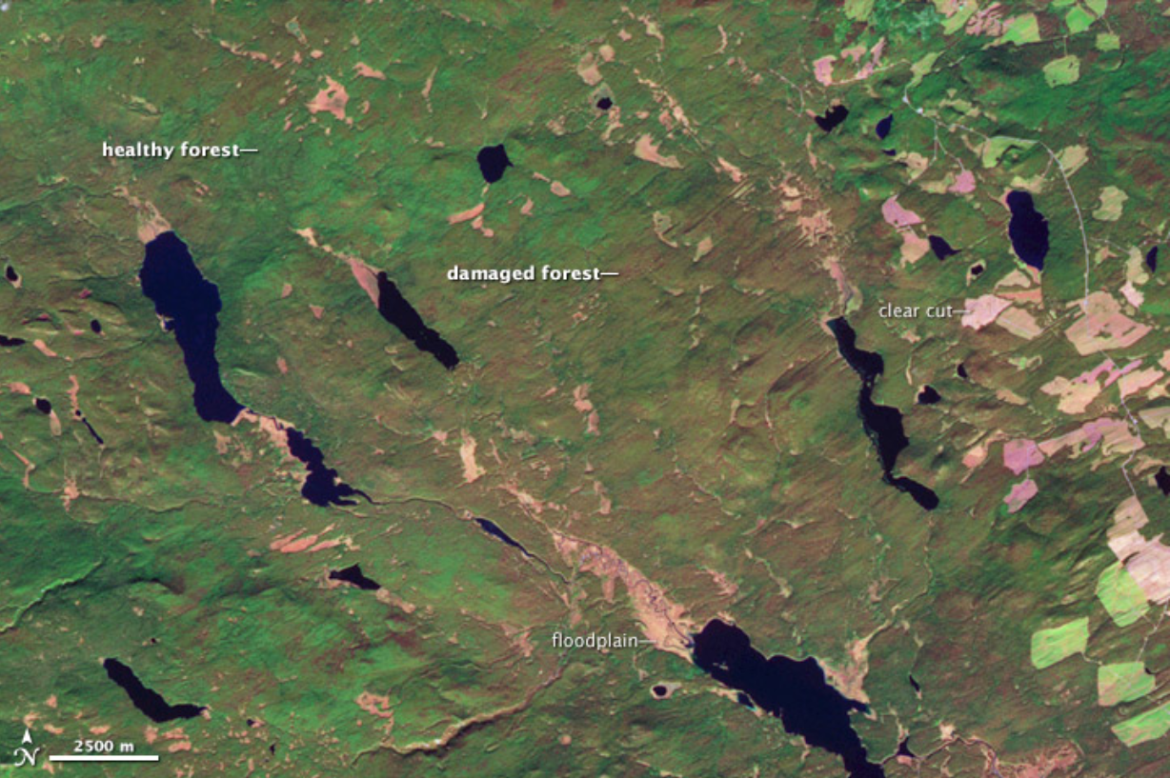
https://earthobservatory.nasa.gov/images/36202/pine-beetle-infestation-in-british-columbia
Full image: https://eoimages.gsfc.nasa.gov/images/imagerecords/36000/36202/bc_ast_2006281_lrg.jpg
ASTER imagery – 15 m spatial resolution
Shortwave Infrared Composite – combination of light humans can and cannot see, presented in an intuitive way

Slide 7
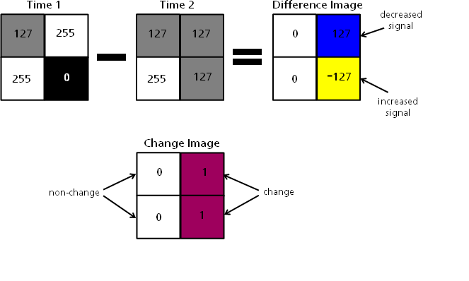
Image Differencing

Slide 8
Time Series Analysis
Figure 1. Red dot corresponds to a change point identified by CCDC for a single Landsat pixel time series. Here, CCDC identifies two time segments, one beginning in 2004 and ending 2012 (when a change is detected), and the second extending from 2012 to the end of the time series. (Global Land Cover mapping and Estimation (GLanCE), a NASA MEaSURES project designed by Boston University)

Slide 9
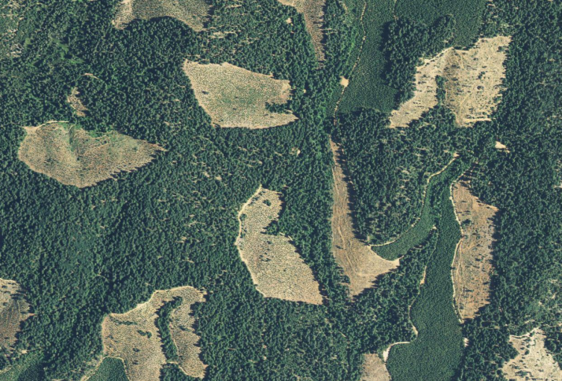
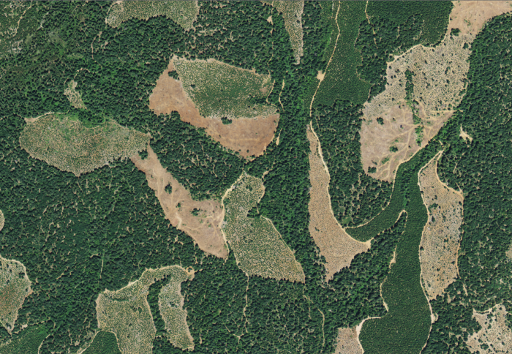
Confirming Change
Landsat Derived Change Map
Higher Resolution Reference Imagery (Pre and Post)

Slide 10
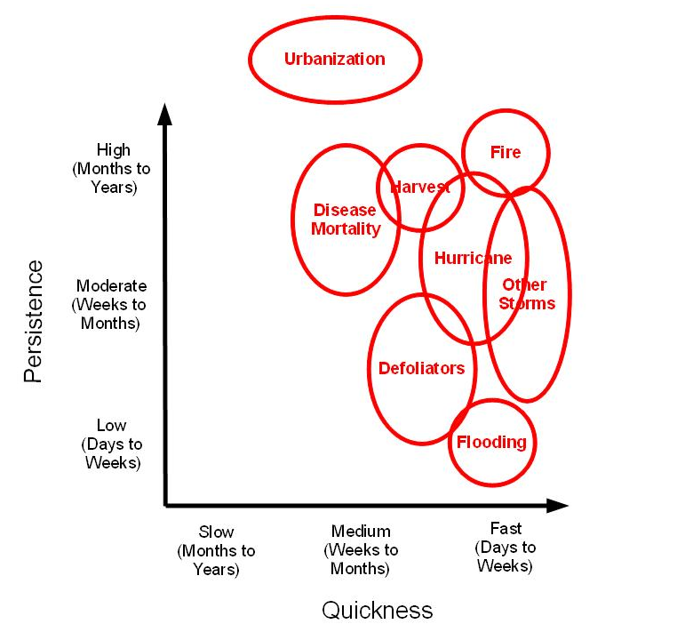
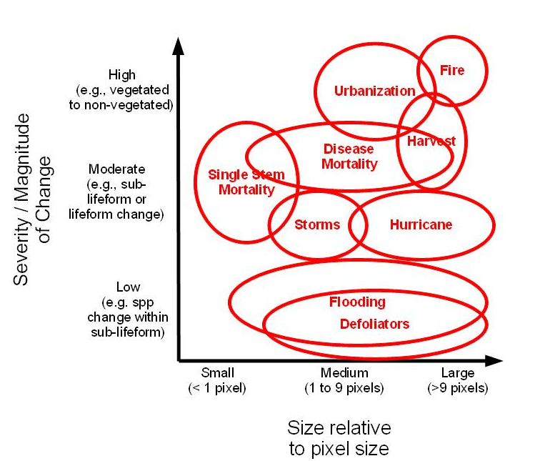
Resolutions
Temporal
Spatial

Slide 11
Resolutions
Bigger pixels = bigger images
Smaller pixels = smaller images

Slide 12
Resolutions
Bigger pixels = bigger images
Smaller pixels = smaller images
Bigger pixels = more images in a temporal window
Smaller pixels = fewer images in a temporal window

Slide 13
Resolutions
Bigger pixels = bigger images
Smaller pixels = smaller images
Bigger pixels = more images in a temporal window
Smaller pixels = fewer images in a temporal window
Bigger pixels = increased availability
Smaller pixels = increased cost

