Slide 1
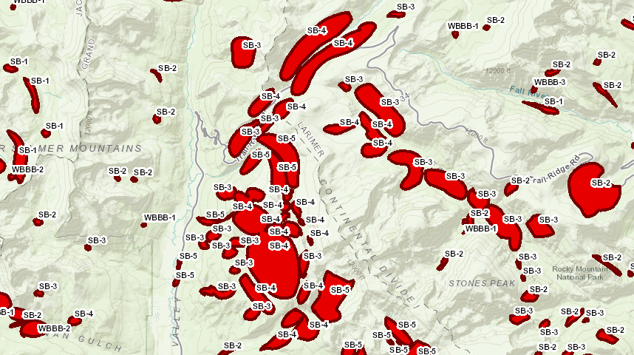
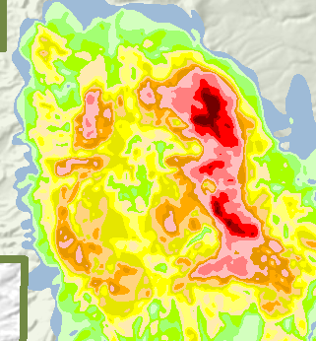
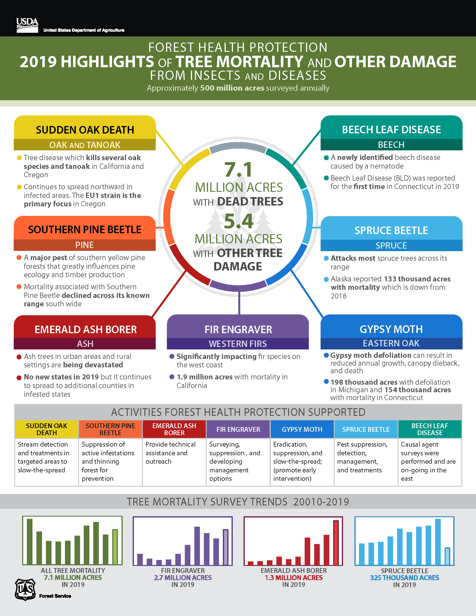
Historic Perspective - ADS
United States Department of Agriculture
Dan Ryerson
Forest Service May 2020 Geospatial Solutions for Supporting ADS FY20 Field Season
Notes:
Historic Perspective Presentation for May 2020 FHM / ADS Geospatial Solutions for Supporting ADS FY20 Field Season. Dan Ryerson, R3 FHP, New Mexico Zone Office, daniel.ryerson@usda.gov, 505-842-3285.

Slide 2
Historic Perspective
Identifying areas of concern for 2020
Datasets to organize and prioritize survey or remote sensing needs within your region
Notes:
Goals of historic perspective

Slide 3
Notes:
National ADS dataset

Slide 4
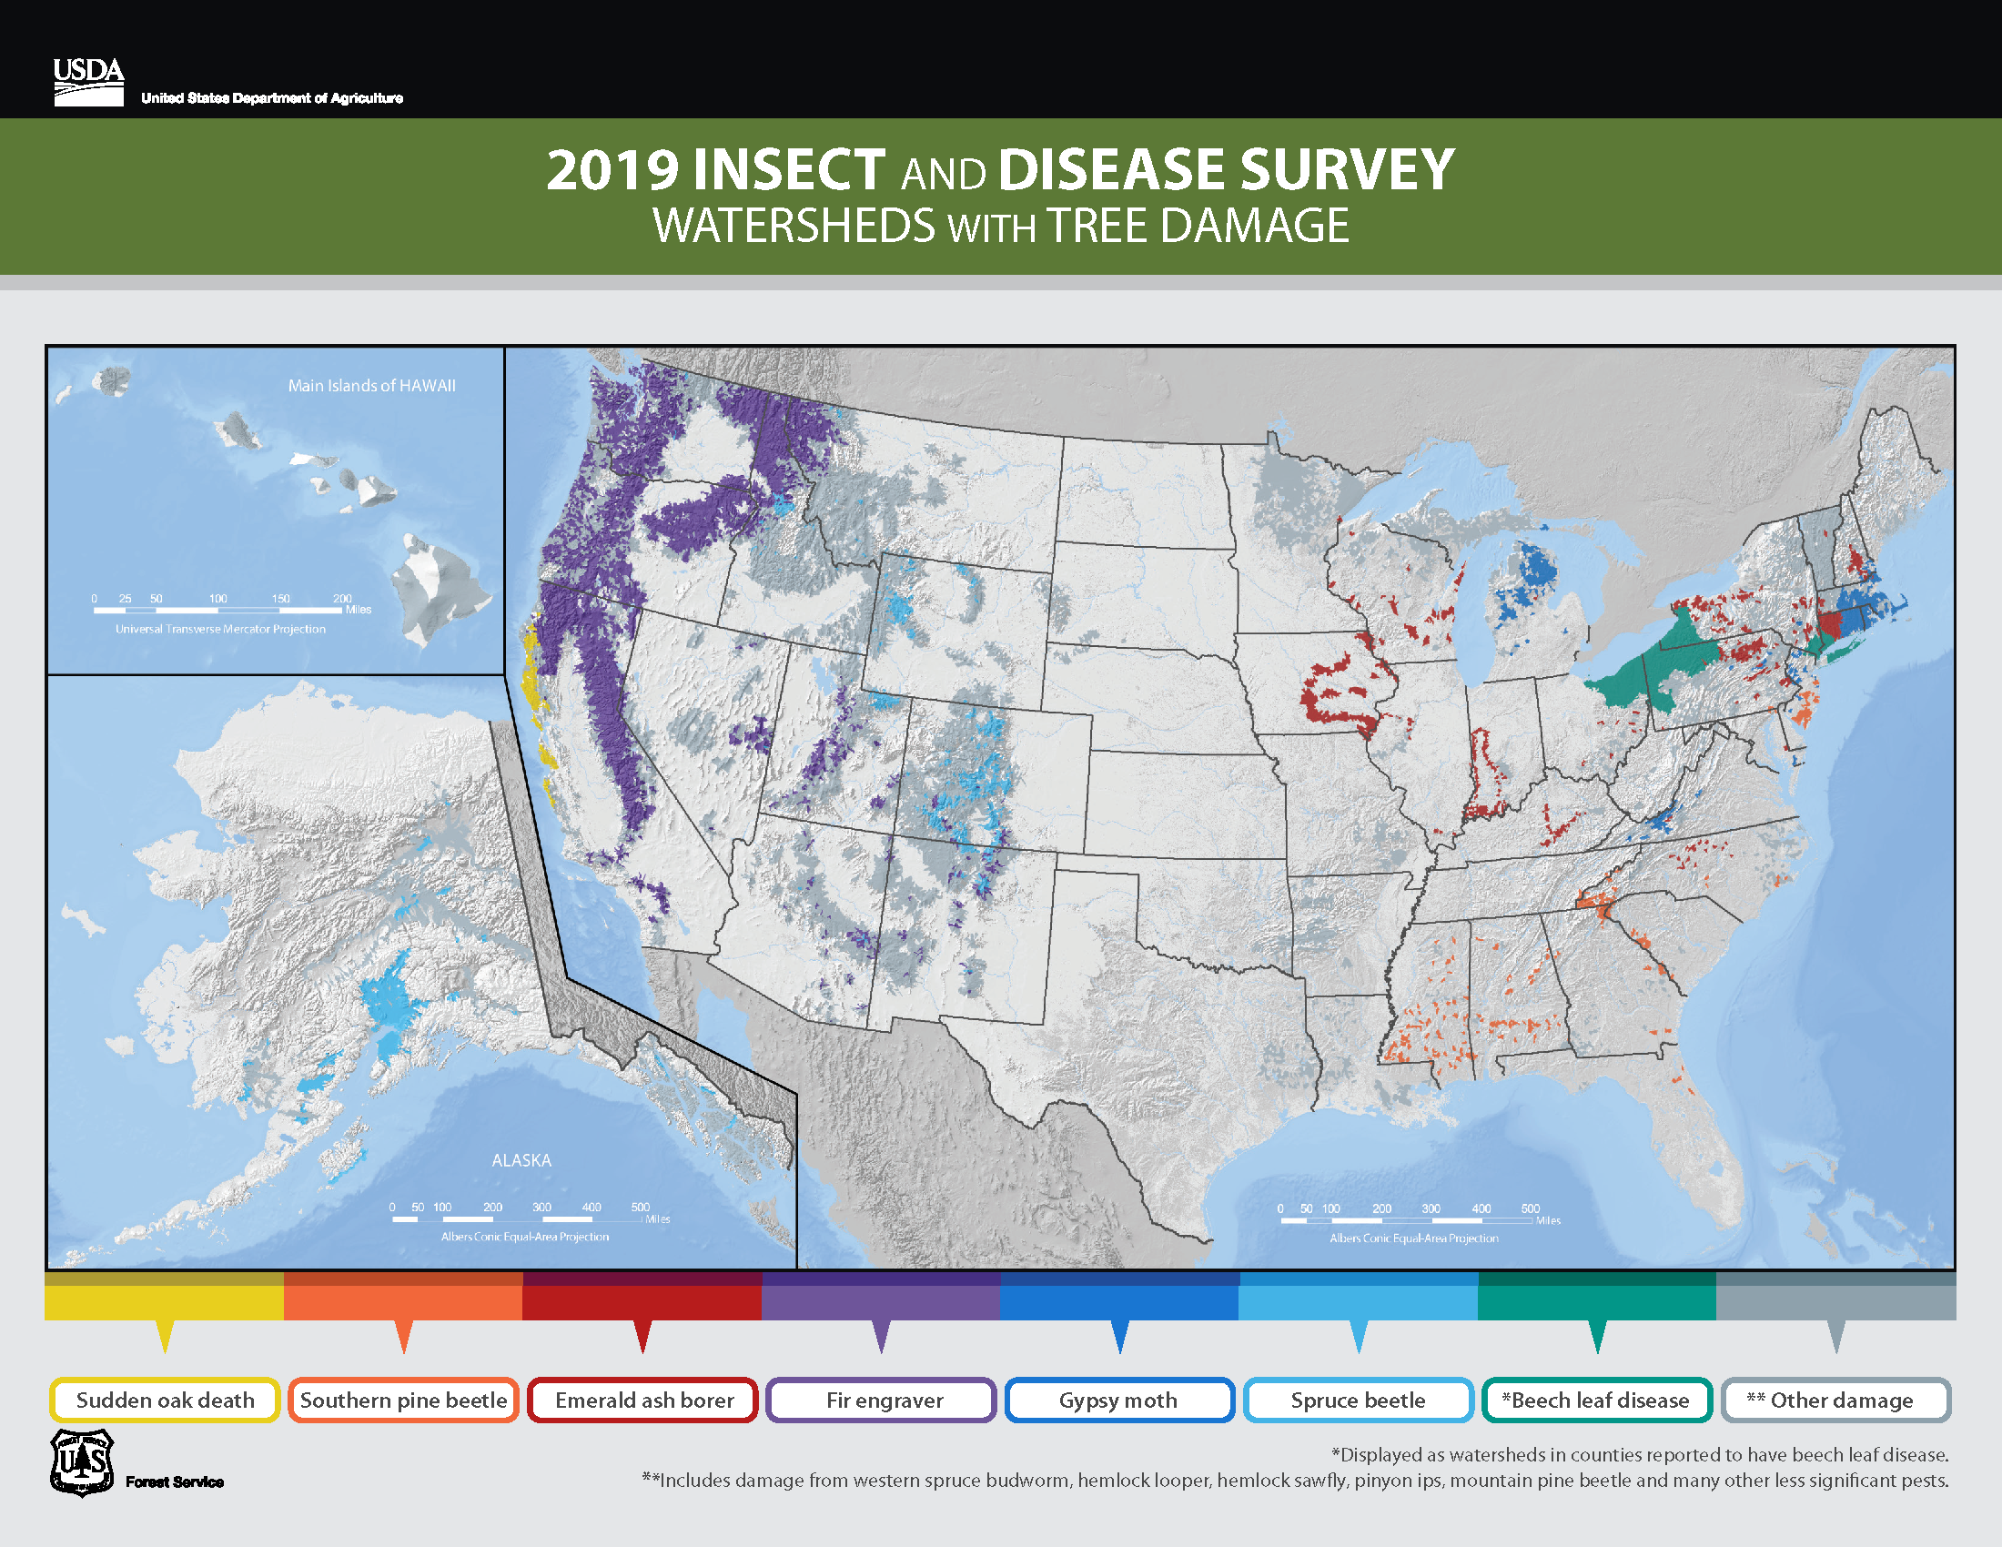
Notes:
National ADS dataset

Slide 5
Historic Perspective – Using ADS
  Qualitative Assessment
Up to Current Known Activity
Persistent Activity
High Concern Activity
  Cumulative Activity
  Queried/
  Filtered Data
Query by
Agent
Host
Severity
Notes:
Example methods of evaluating ADS for a historic perspective

Slide 6
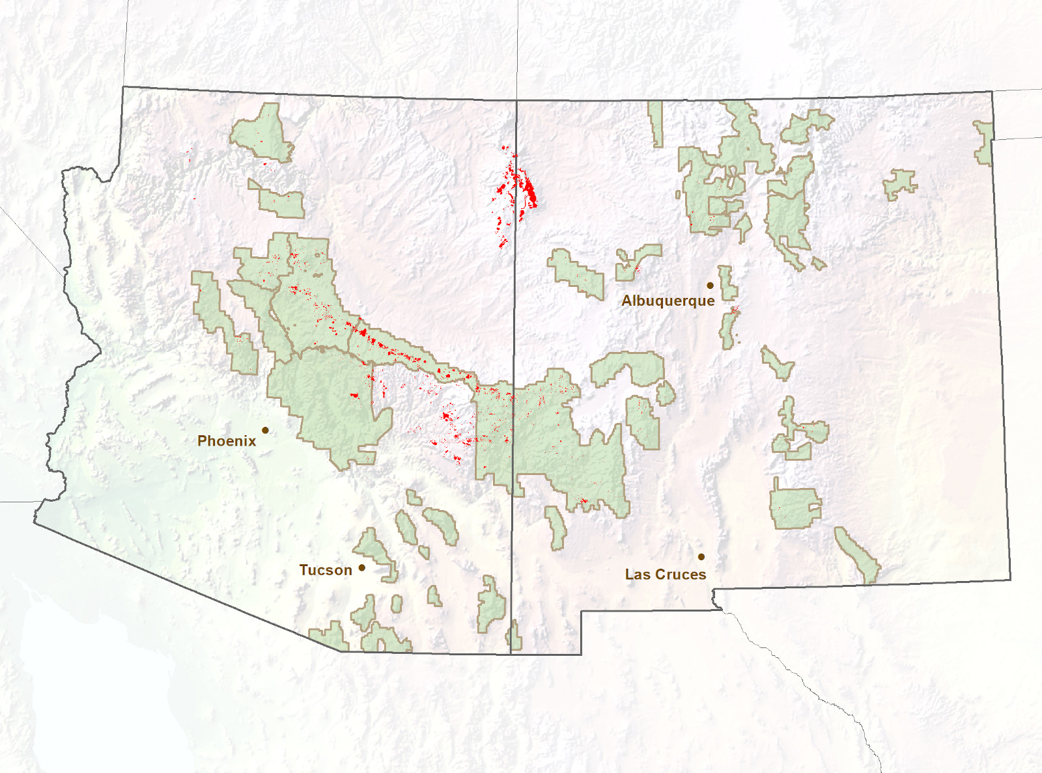
Ponderosa Pine Mortality
2017 - 2019
Notes:
Recent activity

Slide 7
Palmer Drought Severity Index for NM
With ADS Summaries (Statewide)
1,000,000
800,000
600,000
Acres with Defoliation
400,000
200,000
PDSI
0
200,000
400,000
Acres with Mortality
600,000
800,000
1,000,000
Year
PDSI Data from National Climate Data Center record, accessed through NOAA Earth System Research Laboratory - http://www.esrl.noaa.gov/psd/data/timeseries/
Notes:
Plot of PDSI for NM (statewide average) from 1985-2020 (through March) along with ADS data to show moisture patterns in relation to mortality and defoliation. Revised 4/22/20.

Slide 8
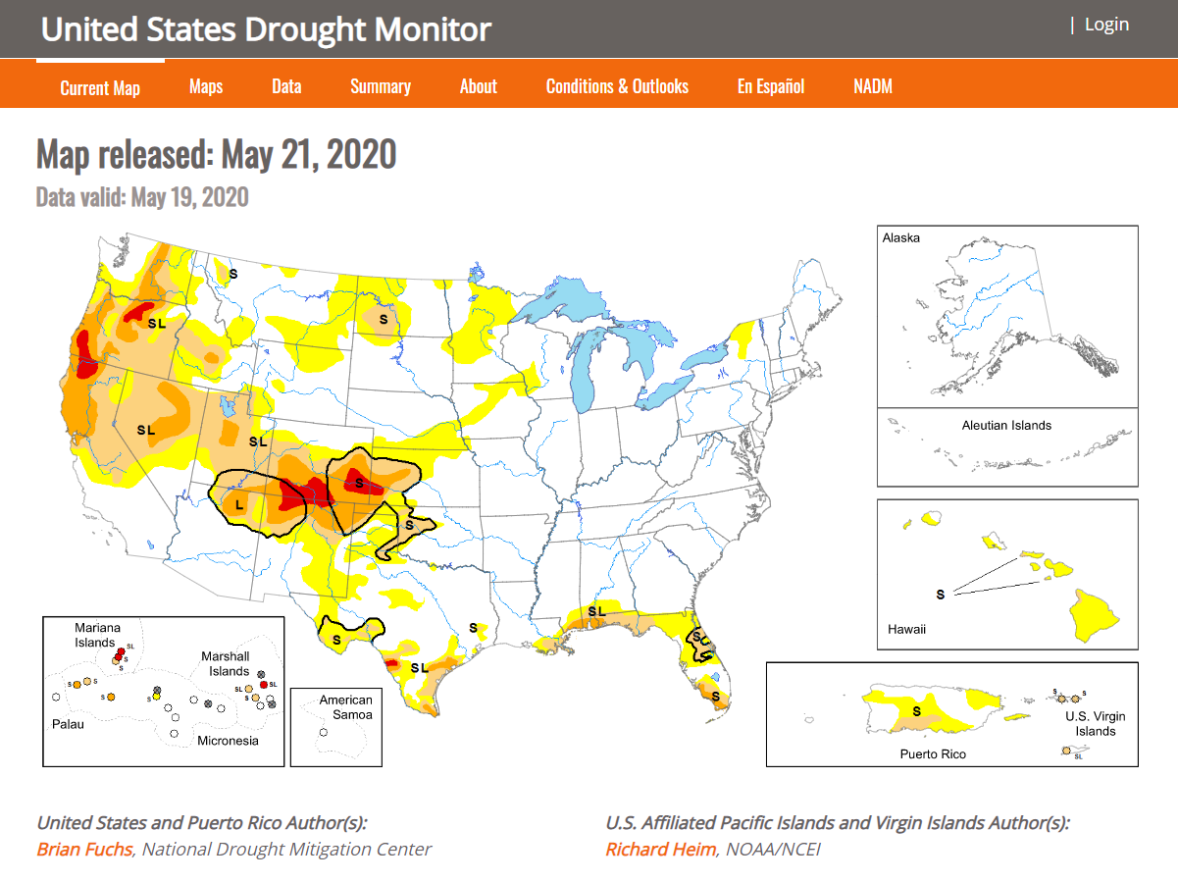
https://droughtmonitor.unl.edu/
Notes:
Leveraging other datasets - US Drought Monitor

Slide 9
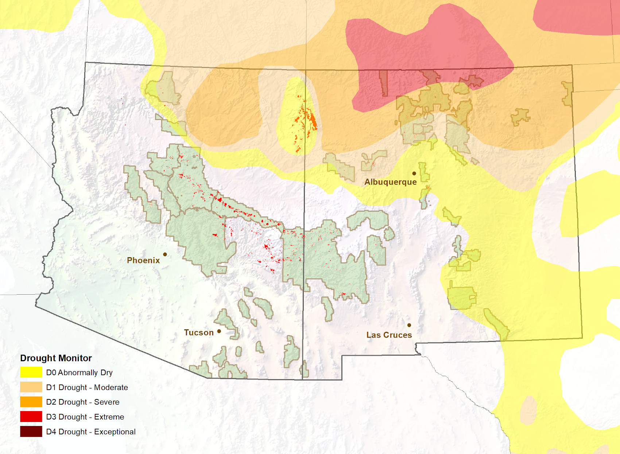
Ponderosa Pine Mortality
2017 - 2019
U.S Drought Monitor - National Drought Mitigation Center (NDMC), the U.S. Department of Agriculture (USDA) and the National Oceanic and Atmospheric Administration (NOAA).
Notes:
Looking at recent activity along with Drought Monitor

Slide 10
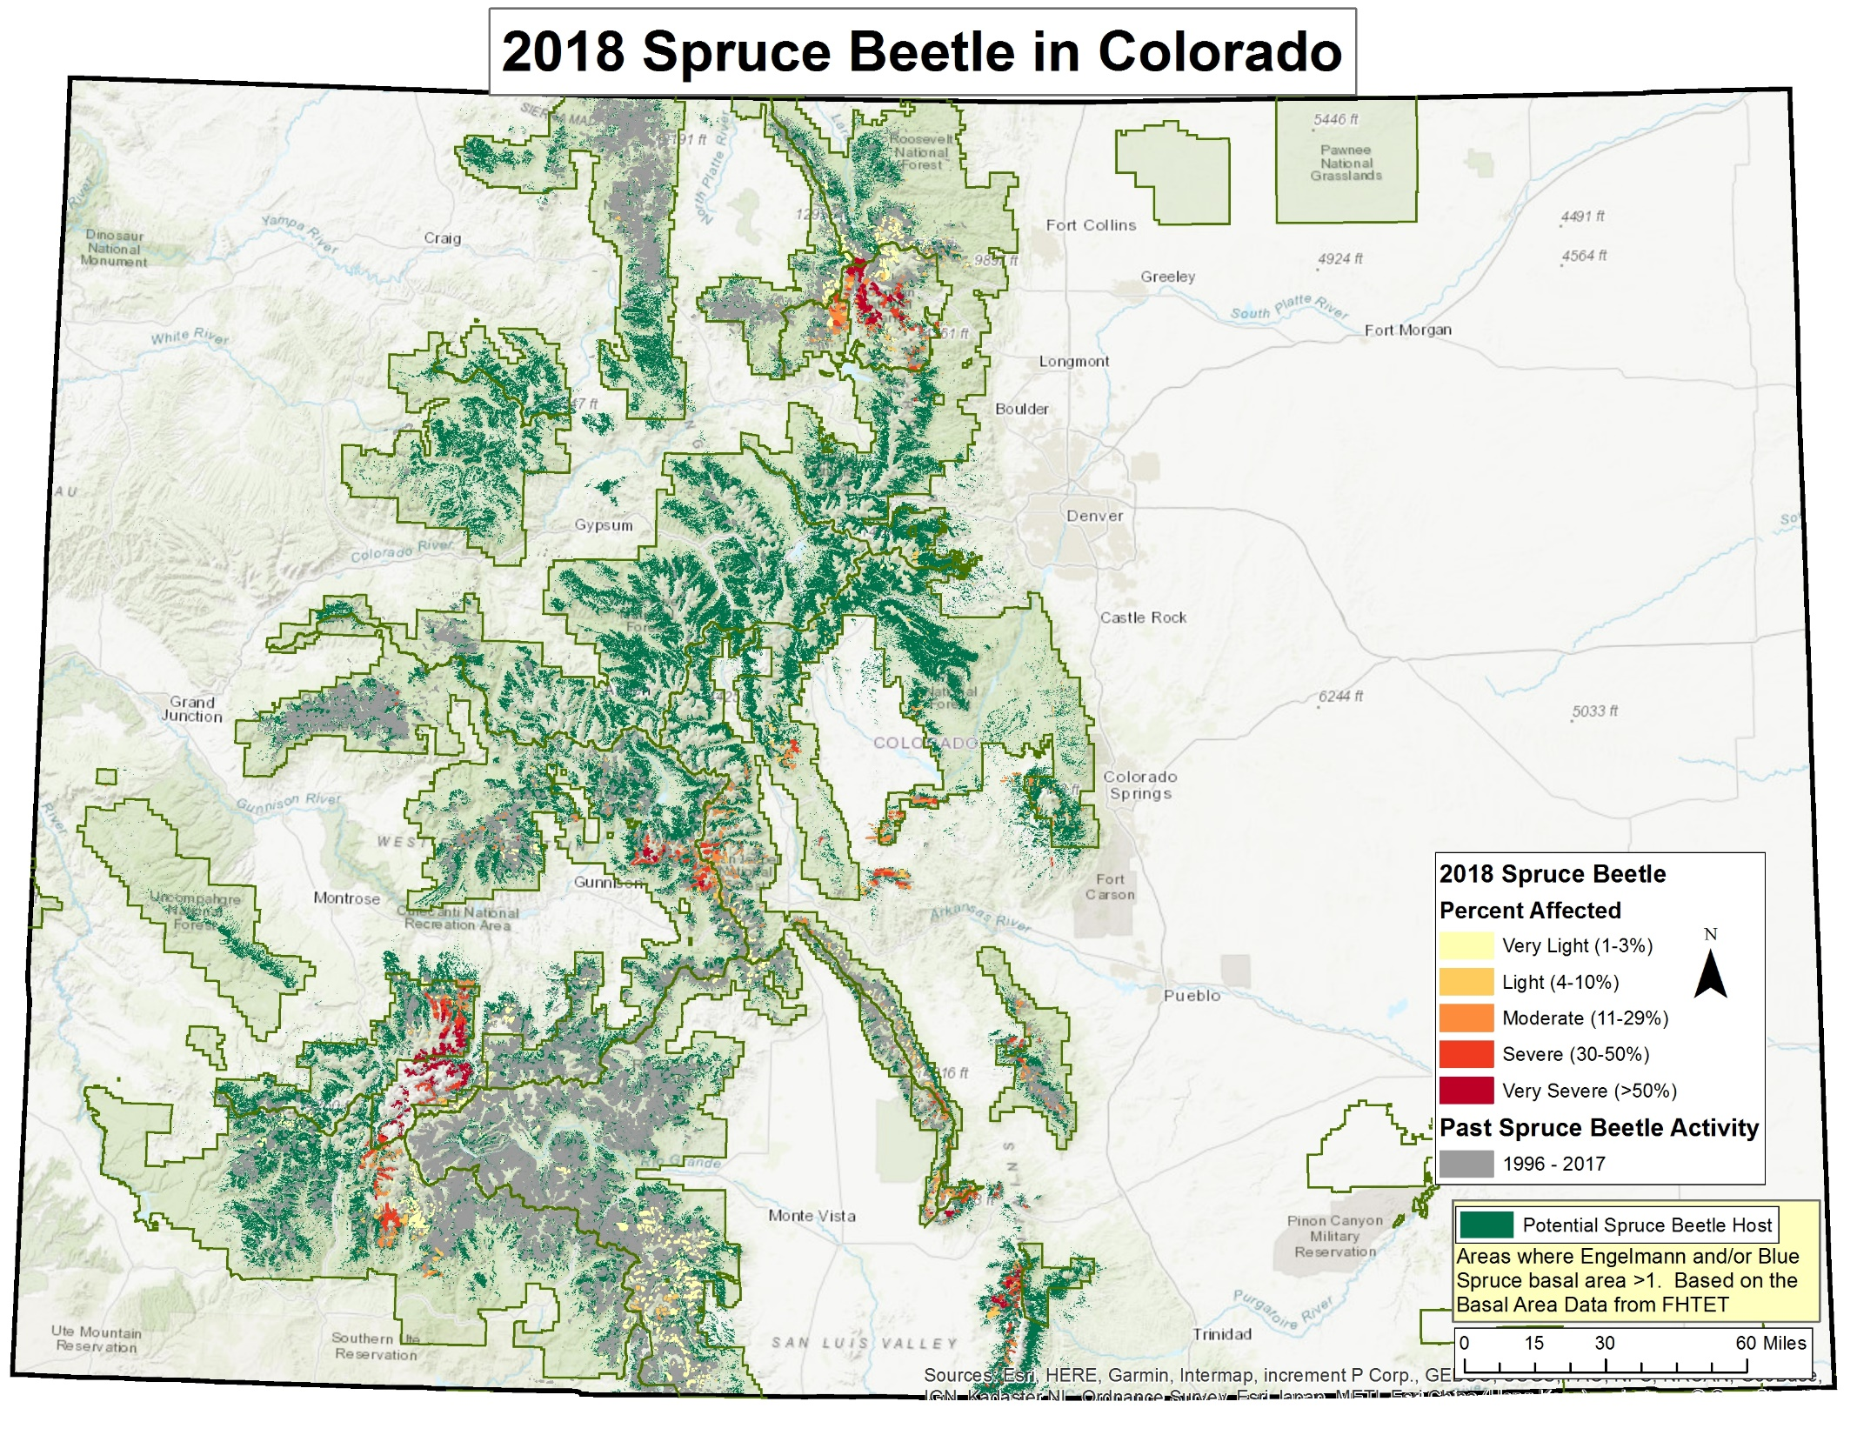
Map courtesy of Jen Ross, R2
Notes:
Spruce beetle activity in Colorado for 2018 with cumulative past activity shown. Map courtesy of Jen Ross, Region 2 Forest Service, FHP.

Slide 11
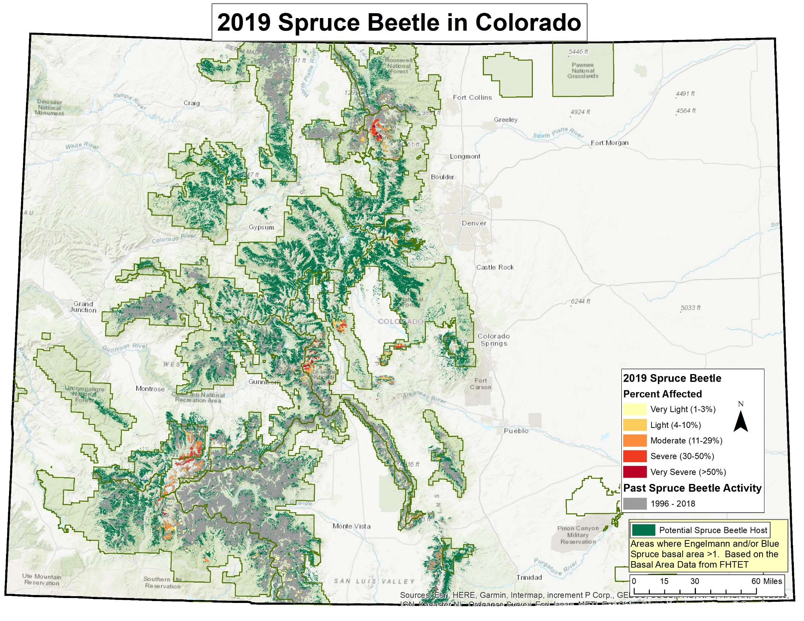
Map courtesy of Jen Ross, R2
Notes:
Spruce beetle activity in Colorado for 2019 with cumulative past activity shown. Map courtesy of Jen Ross, Region 2 Forest Service, FHP.

Slide 12
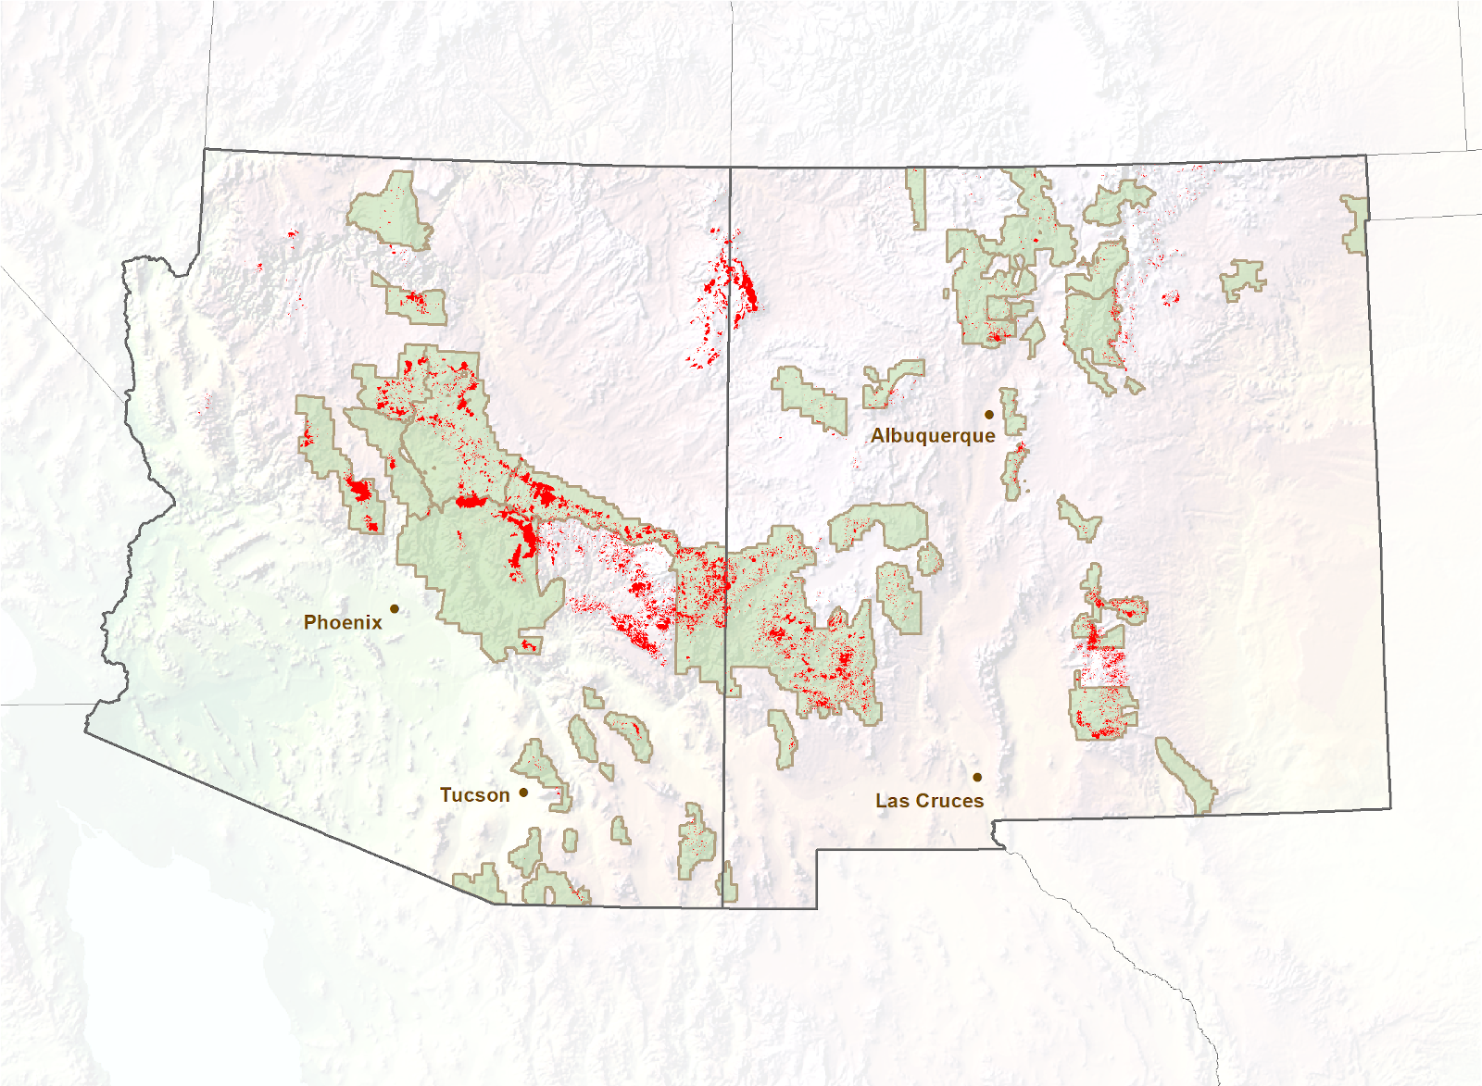
Ponderosa Pine Mortality
1999 - 2019
Notes:
Composite map of ponderosa pine mortality in Southwestern US 1999 – 2019.

Slide 13
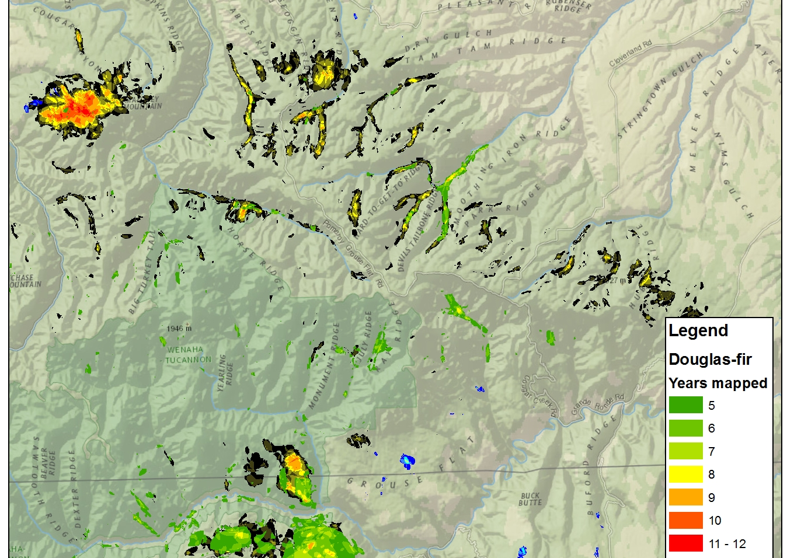
Map courtesy of Zack Heath, R6
Notes:
Cumulative Douglas-fir mortality mapped. Map courtesy of Zack Heath, Region 6 Forest Service, FHP.

Slide 14
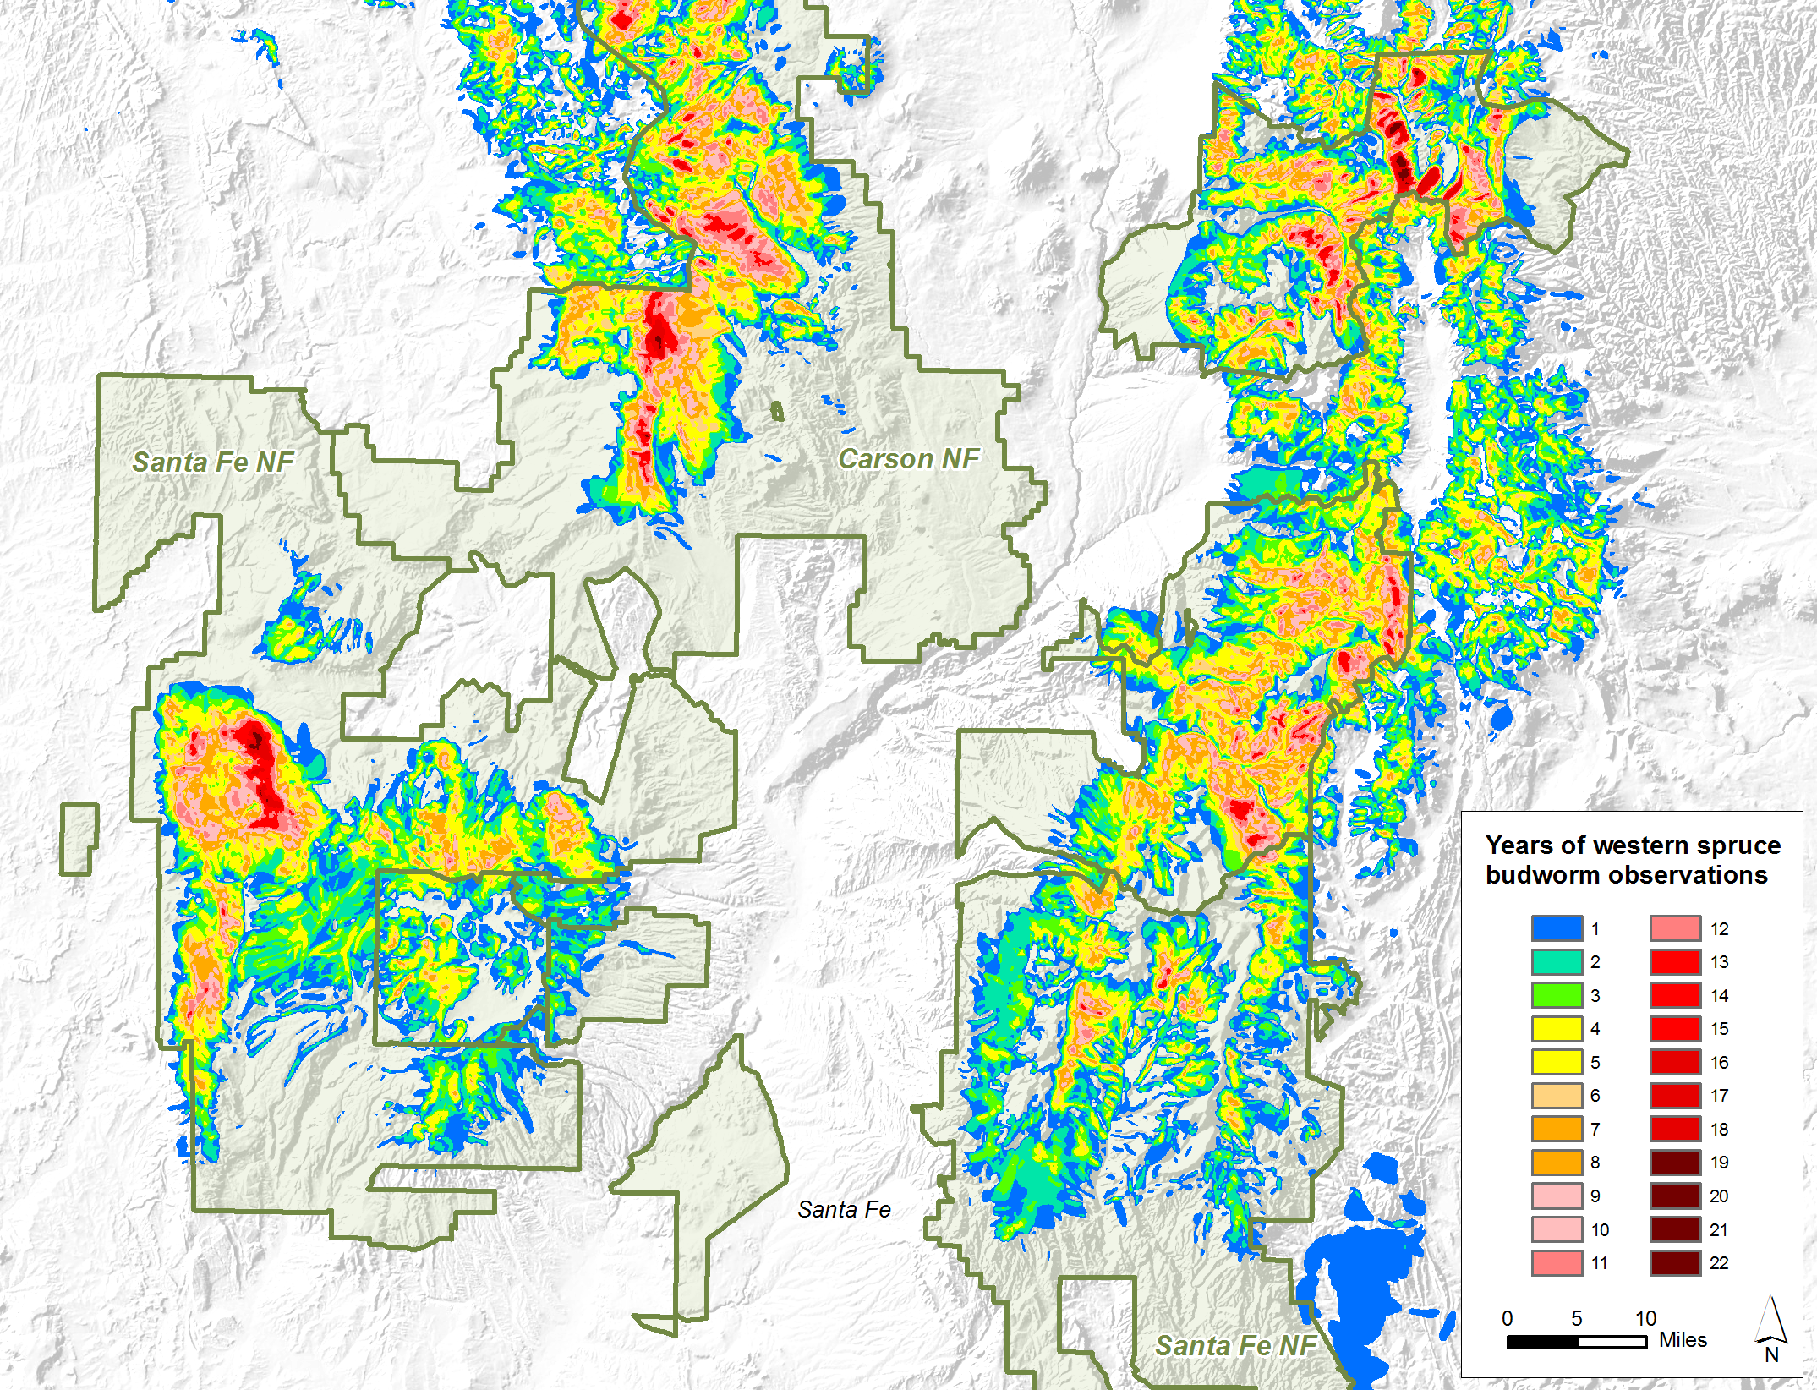
Notes:
Cumulative WSBW defoliation mapped in northern NM

Slide 15
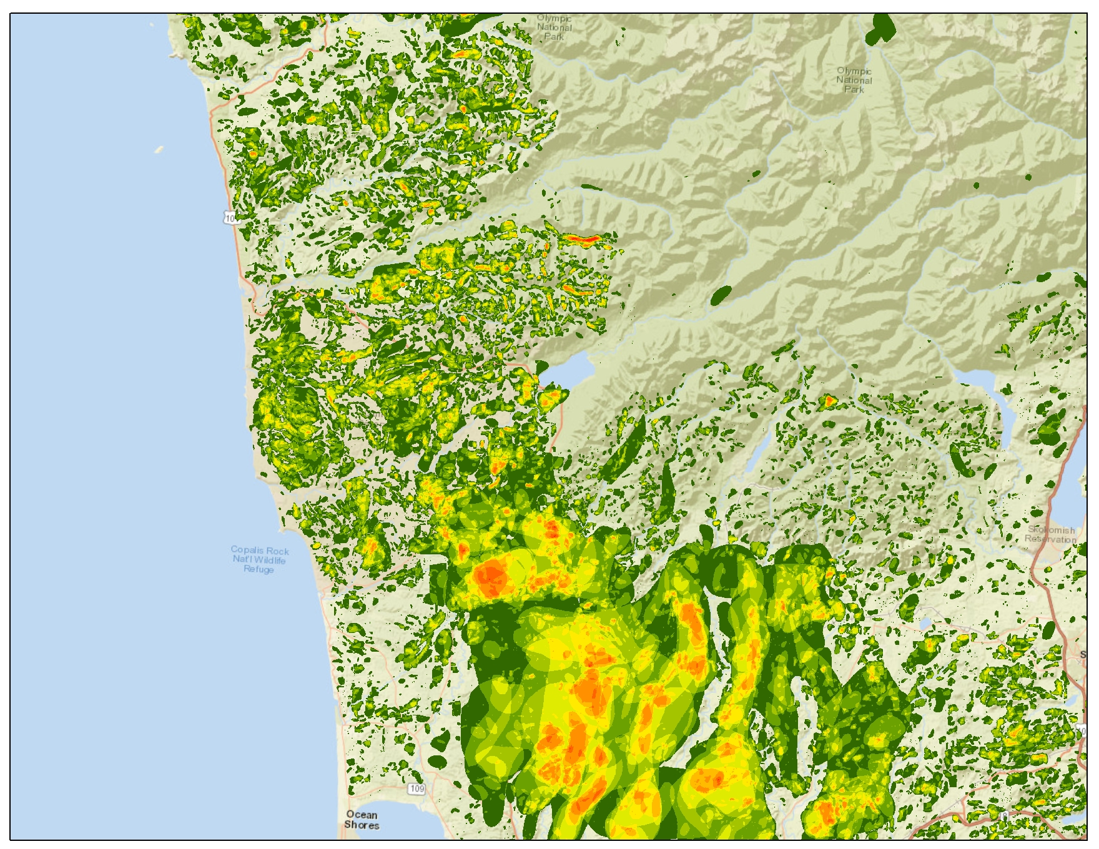
Map courtesy of Zack Heath, R6
Notes:
Cumulative bear damage mapped. Map courtesy of Zack Heath, Region 6 Forest Service, FHP.

Slide 16
ADS Evaluation Process
  Qualitative Assessment
Recent Known Activity
Persistent
Activity
High Concern Activity
  Cumulative Activity
  AOIs
Query by
Agent
Host
Severity
  Filtered
  Data
Notes:
Example methods of evaluating ADS for a historic perspective to determine areas of interest (AOI)

Slide 17
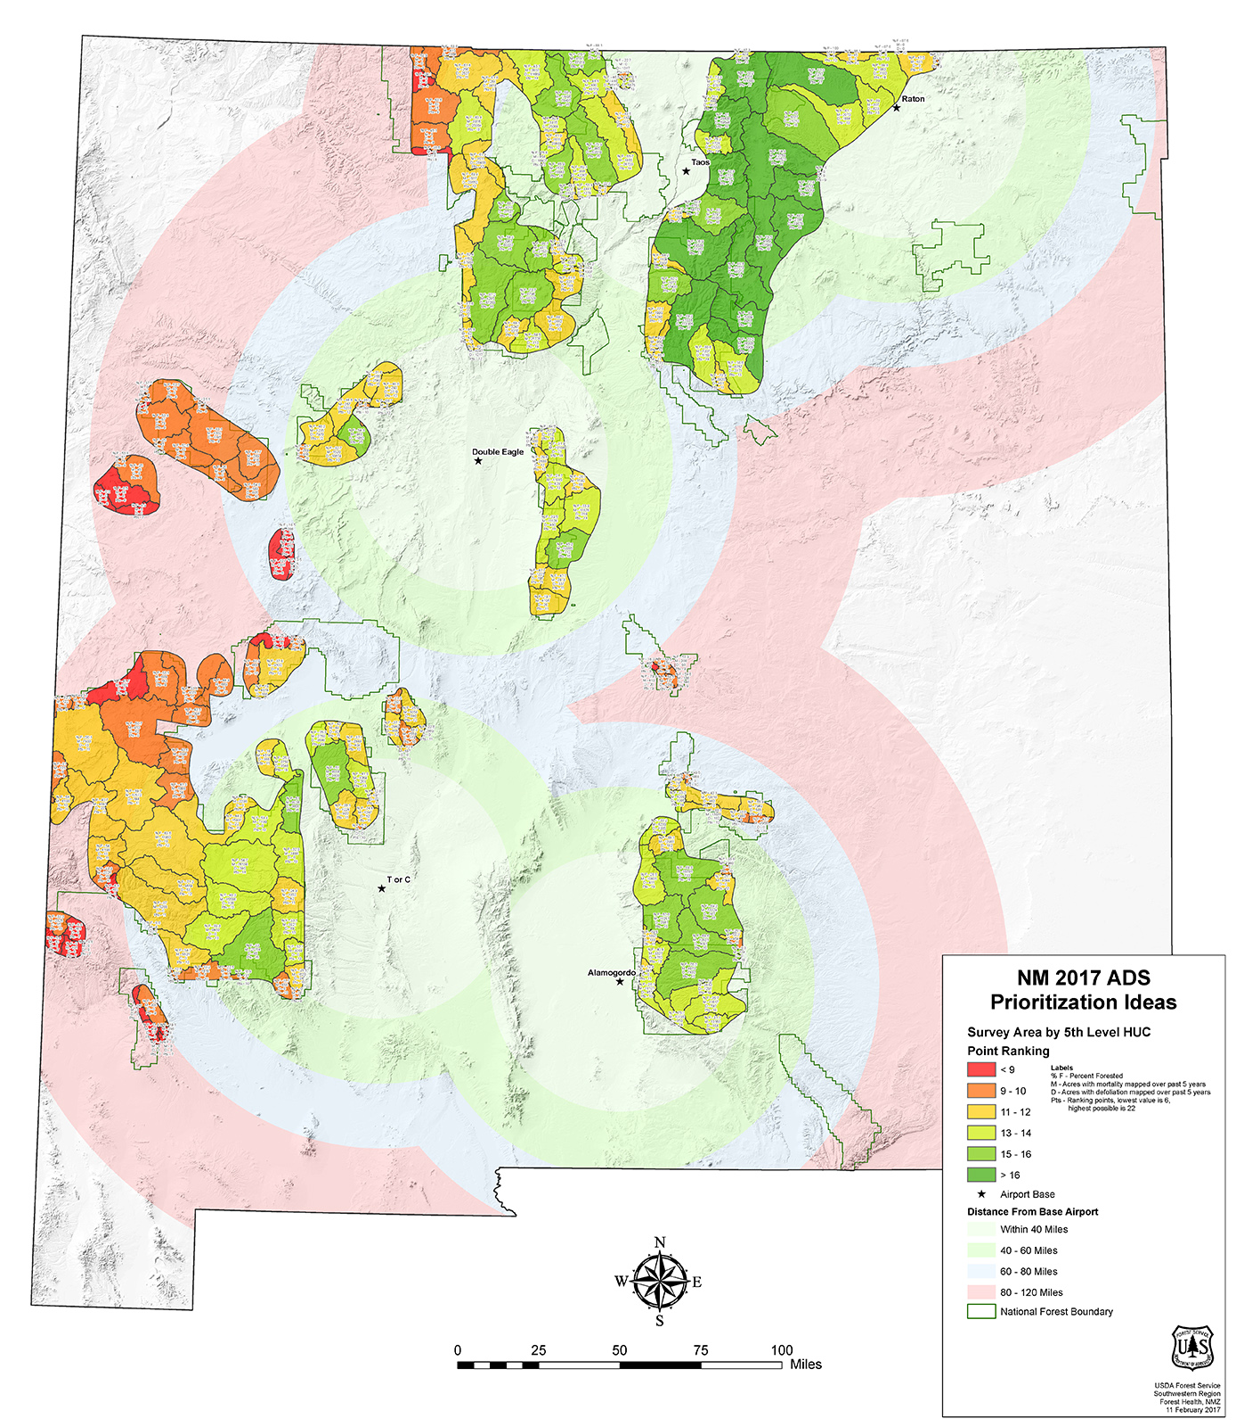
Using 5th level HUCs and survey areas intersected
Six criteria:
% Forested
% Woodland
Past 5 years of defoliation
Past 5 years of mortality
Past 5 years of damage types
Distance from base airport
Notes:
Prioritization processes can be quantitative and involve a number of factors such as this example we did for NM during budget constraint considerations.

Slide 18
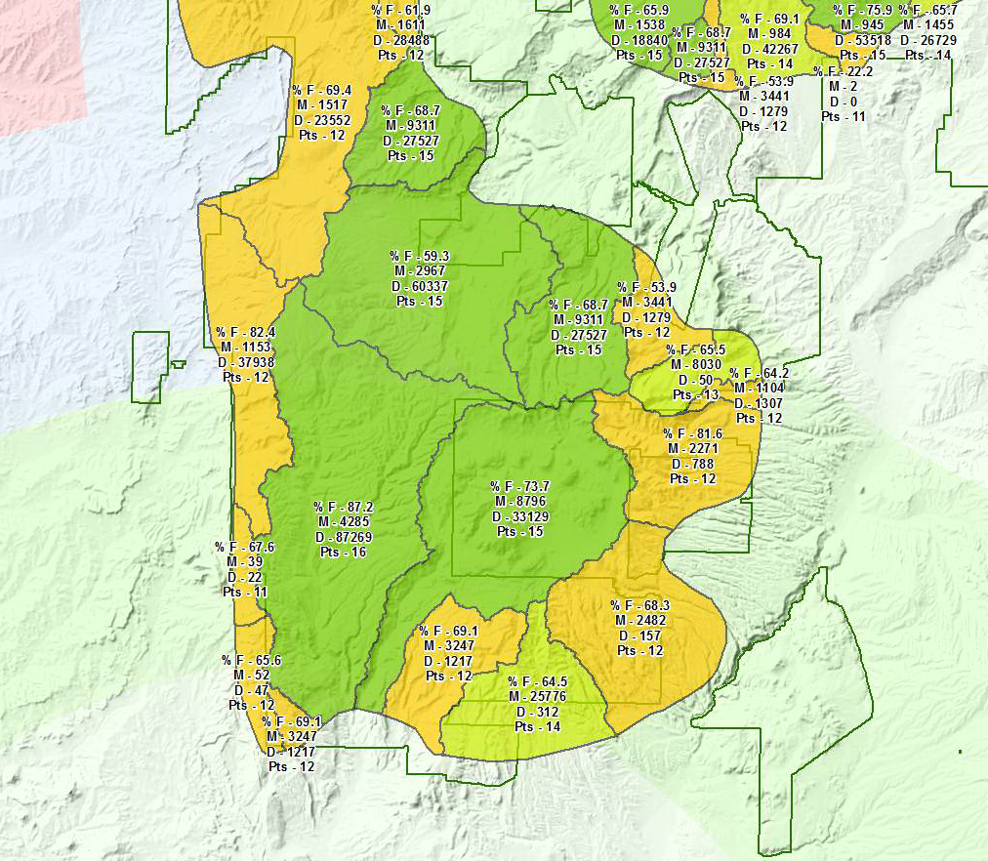
Notes:
Prioritization processes can be quantitative and involve a number of factors such as this example we did for NM during budget constraint considerations.

Slide 19
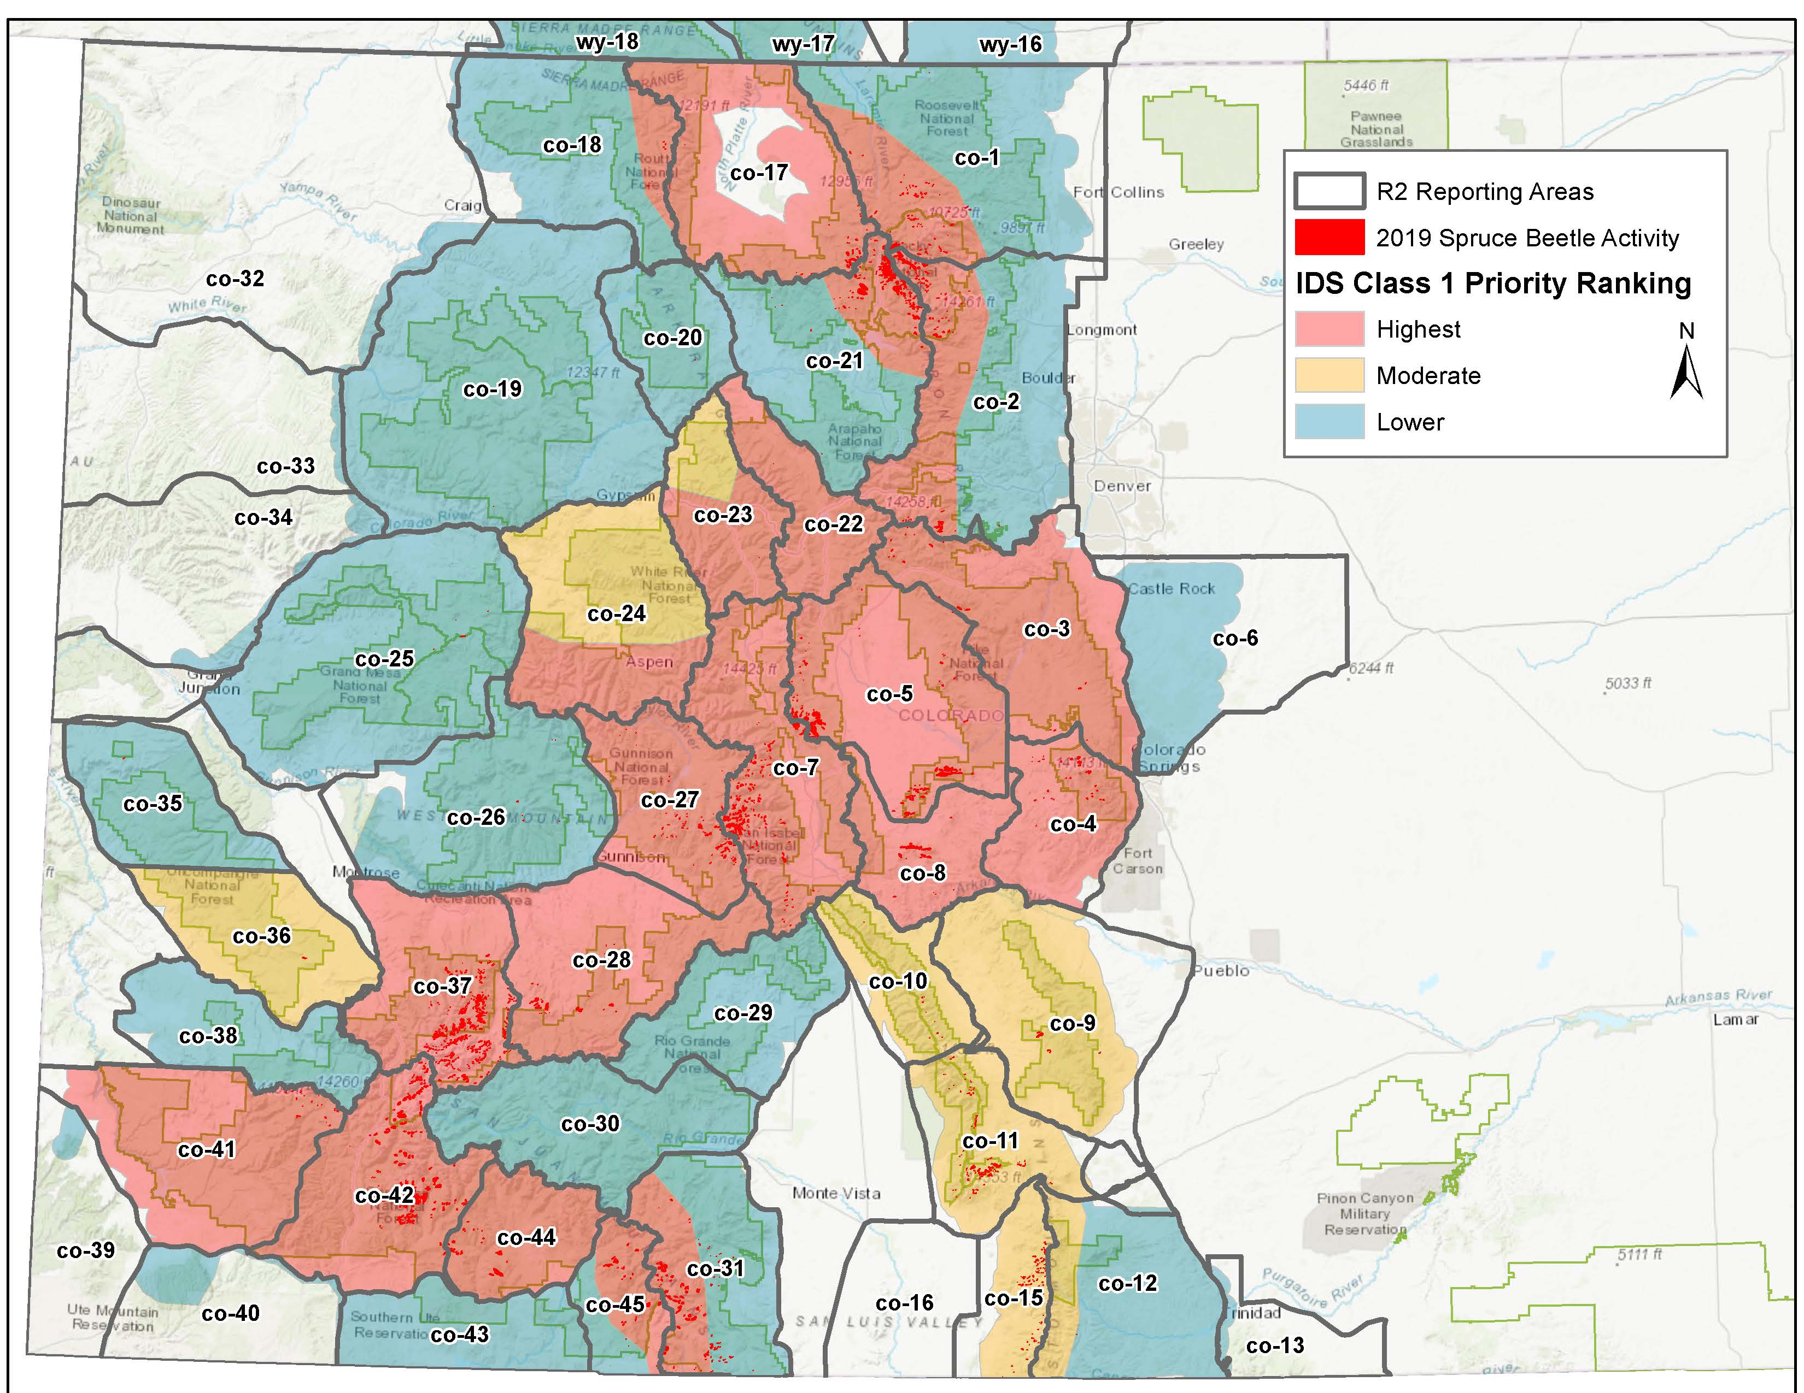
Map courtesy of Jen Ross, R2
Notes:
Example prioritization map from Jen Ross, Region 2, for their flight areas in 2020 rating survey class 1 areas into three priority levels.

Slide 20
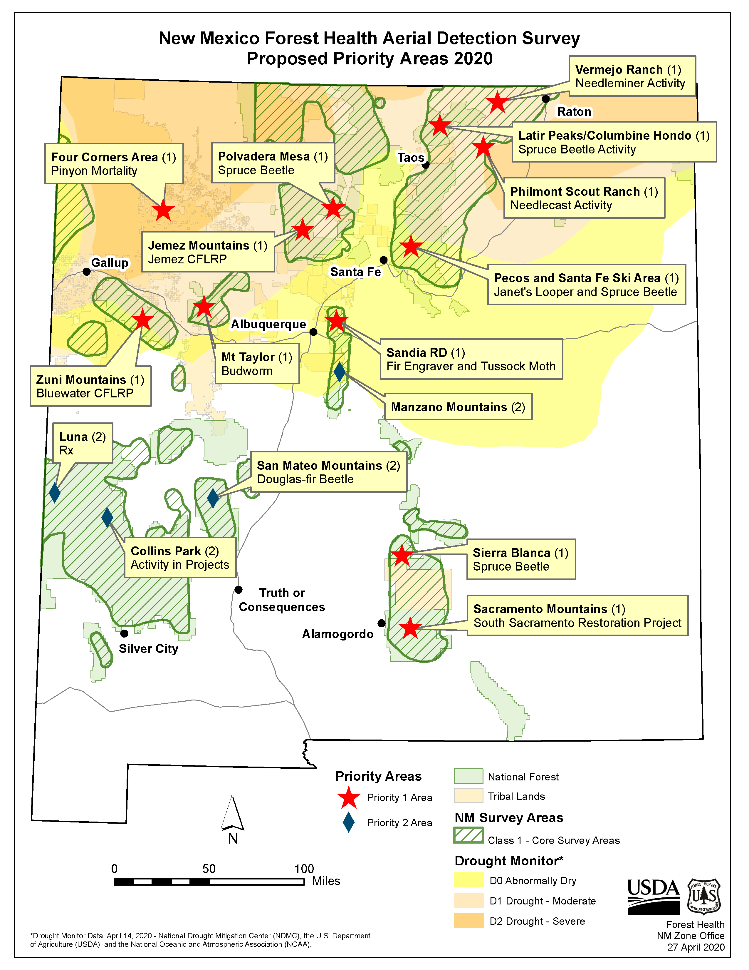
Notes:
Or prioritization maps can be more simple such this example for our leadership showing areas of priority and activity/reason.

Slide 21
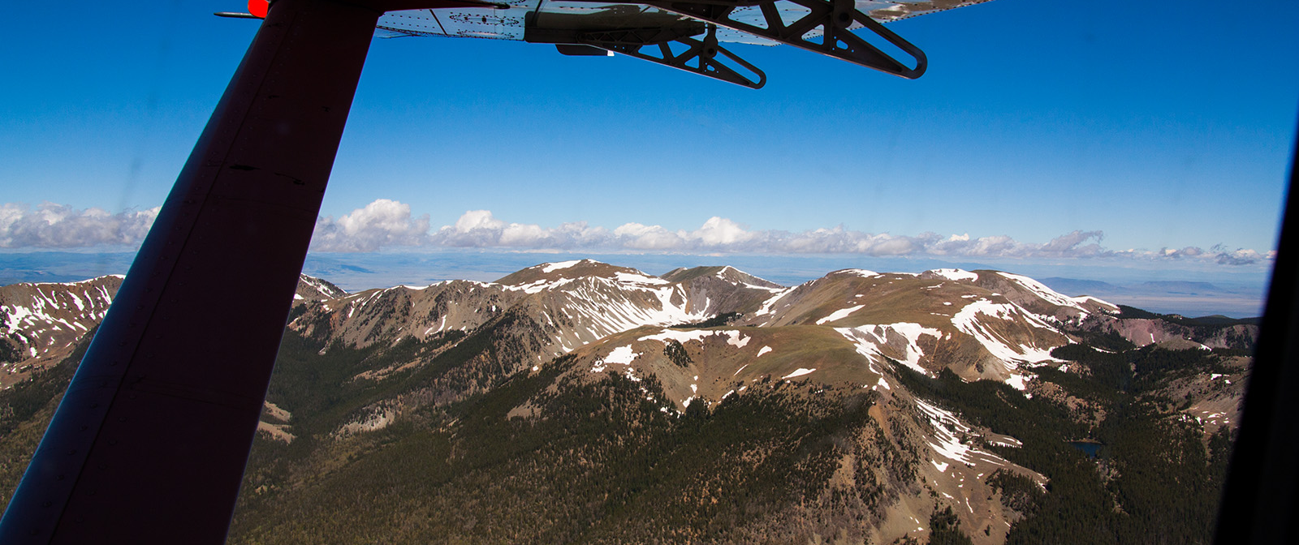
Dan Ryerson
Forest Health/GIS Specialist
R3 FHP
505-842-3285
daniel.ryerson@usda.gov
Forest Service May 2020 Geospatial Solutions for Supporting ADS FY20 Field Season

