Slide 1
Landscape Change Monitoring System (LCMS)
FHP ADS Webinar
May 2020
Leah Campbell
leah.campbell@usda.gov
RedCastle Resources, contractor to
USDA Forest Service
Geospatial Technology & Applications Center
Resource Mapping, Inventory & Monitoring Program

Slide 2
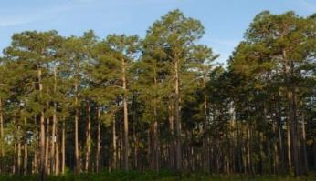
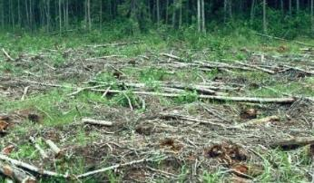
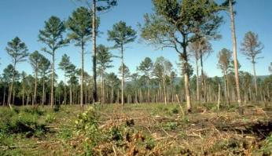
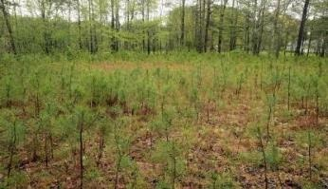
LCMS: The Story of a Place
Ensemble-based change detection system
Landsat TM & OLI Series data record (1985-present)
Pixel-based maps of Vegetation Loss, Gain, & Land Cover
2001
2011
1999
2007
Landscape Change Monitoring System
Notes:
LCMS is an ensemble-based change detection system that leverages the Landsat data record to produce pixel-based maps of vegetative loss & gain as well as land cover and land use for every year since 1985.
We can think of this as the story of a place.

Slide 3
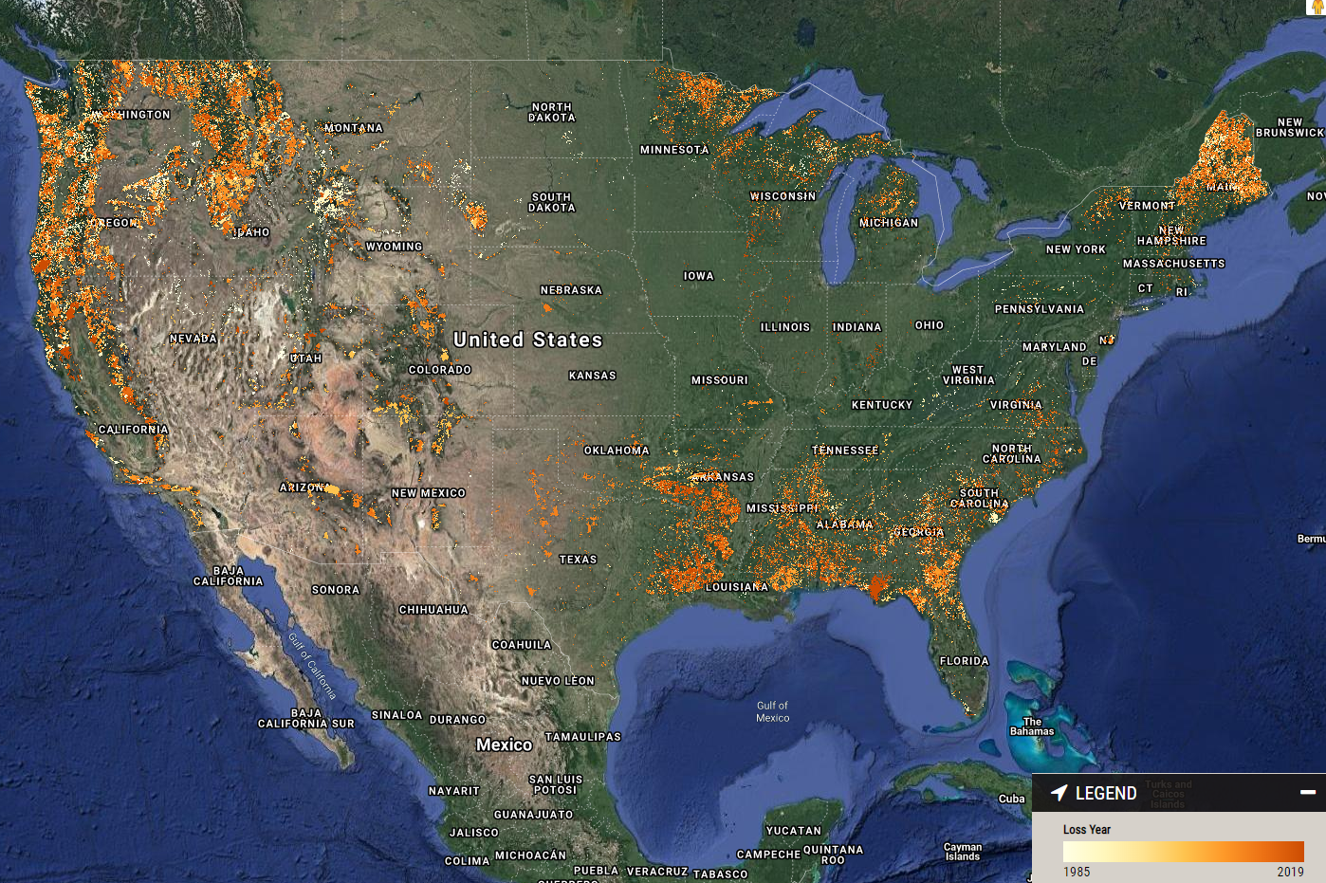
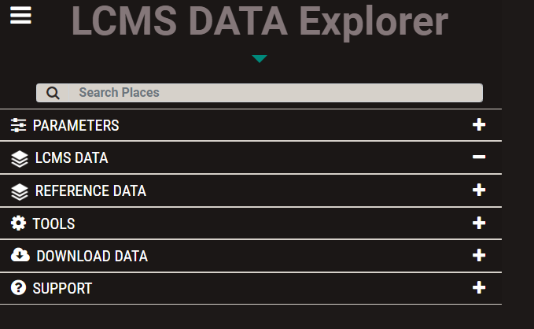
Where is LCMS available?
CONUS - *Loss only*
Will be expanded to include other layers Jan. 2021
Region 4 – Loss, Gain, Land Cover, and Land Use
Forests - Loss, Gain, Land Cover, and Land Use
Region 1 – Flathead NF
Region 10 – Chugach NF & Kenai Peninsula

Slide 4
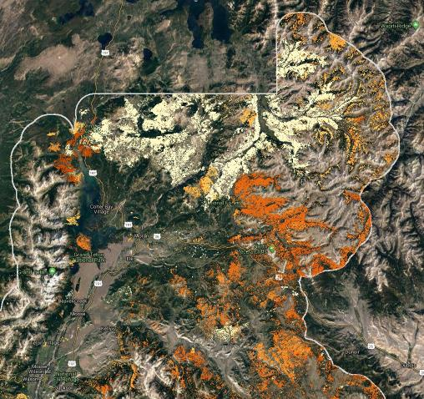
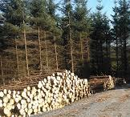
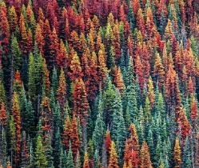
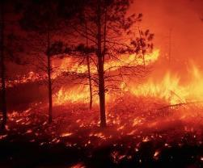
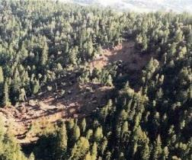
Schedule
CONUS – January 2021
(Full Suite of Layers)
Coastal Alaska Product – January 2021
Non-CONUS – est. December 2021
Loss, Gain, and Land Cover
Annual Updates

Slide 5
LCMS Products Loss
One map for each year: 1985-2019
A loss in vegetation cover due to change processes such as harvest, fire, insects & disease, etc.

Slide 6
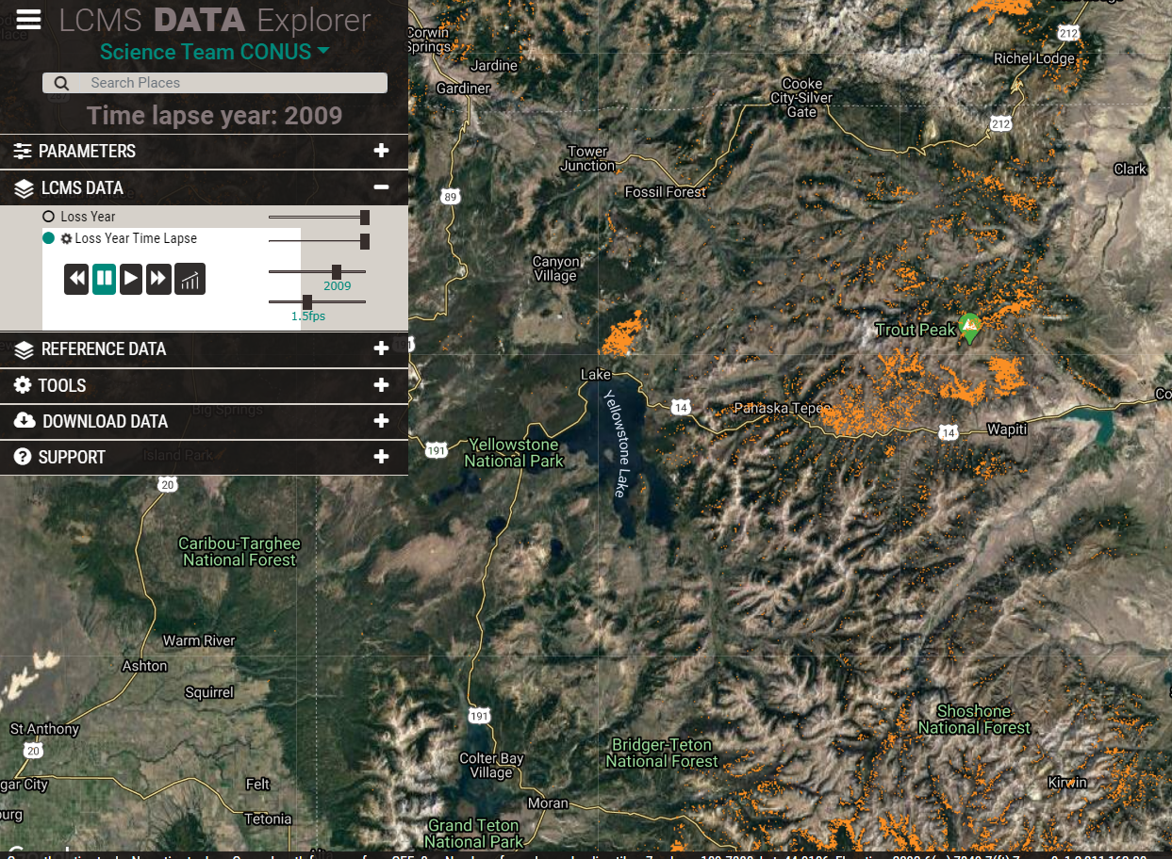
LCMS Products Loss – Time Lapse

Slide 7
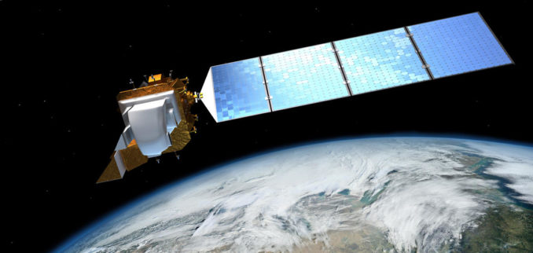
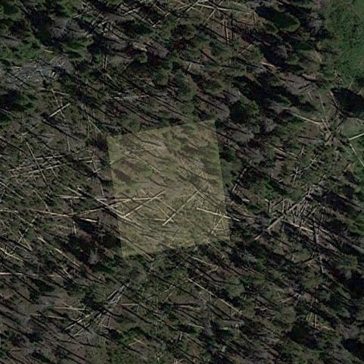
LCMS vs. LandTrendr & TimeSync
All three use a Time Series approach with the Landsat data archive
Landsat 4 TM
Landsat 5 TM
Landsat 7 ETM+
Landsat 8 OLI
1 Data point per
Landsat Pixel (~1/5 acre)
Landsat recurrence: ~1 image every 16 days
30m
30m

Slide 8
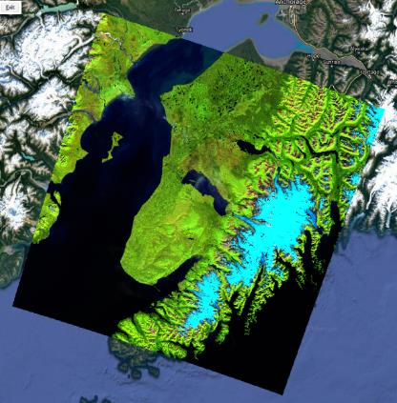
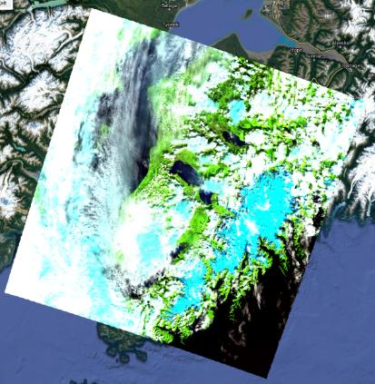
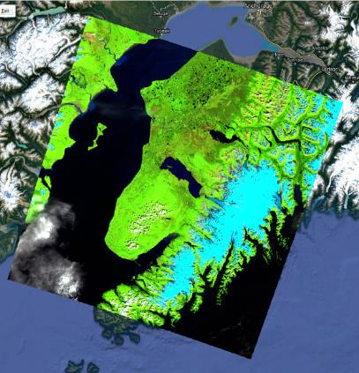
Landsat Composites
* Similar process used for LCMS & LandTrendr*
Aggregate all appropriate scenes (LCMS: early July to early September)
Mask clouds and cloud shadows
Take middle-most value at each pixel
Produces one representative composite image for each year

Slide 9
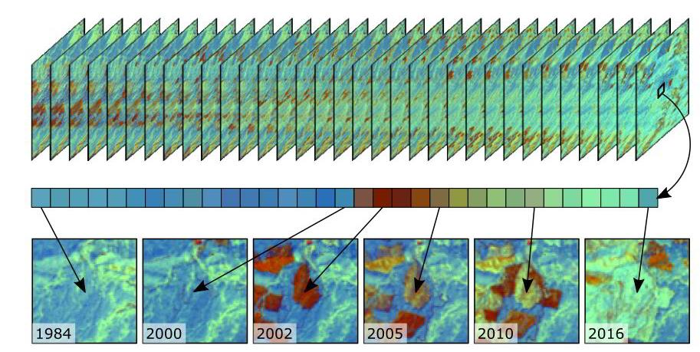
The Time-Series Approach
Figure from Braaten & Kennedy’s eMapR Lab LT-GEE Guide
(https://emapr.github.io/LT-GEE/landtrendr.html)
Notes:
If you look at how spectral indices from one pixel change throughout the 35 years of composites, you can get an idea for what has happened on the landscape.

Slide 10
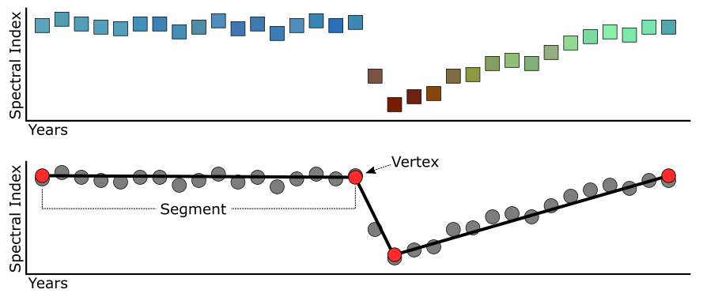
The Time-Series Approach
Stable
Loss
Gain
Figure from Braaten & Kennedy’s eMapR Lab LT-GEE Guide
(https://emapr.github.io/LT-GEE/landtrendr.html)
Notes:
Here is that pixel’s spectral values in graph form. The change algorithms LandTrendr and Verdet basically fit segments to the raw values from the satellite (lower figure), that can then be interpreted as segments of “Stable”, “Loss”, or “Gain.”

Slide 11
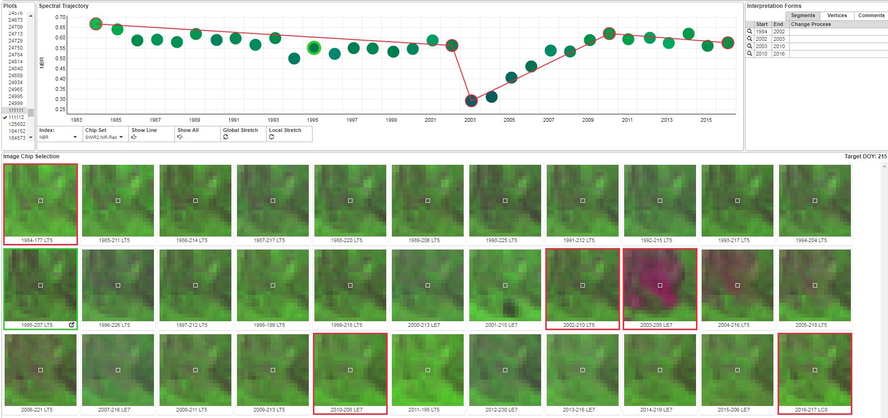
LCMS vs. LandTrendr & TimeSync
TimeSync:
Software package to manually, and systematically, analyze the Landsat time series at specific points.
Used to generate objective data for training and assessing the accuracy of the LCMS model.
Stable
Stable
Loss
Gain

Slide 12
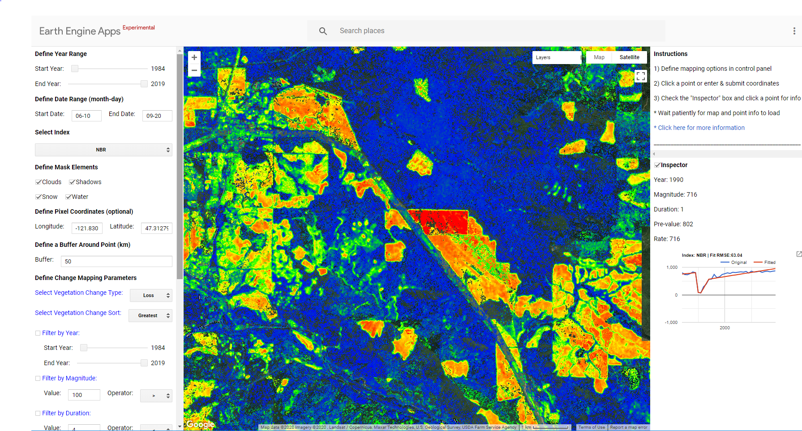
LCMS vs. LandTrendr & TimeSync
LandTrendr:
Algorithm that automatically creates segments and vertices using the Landsat composites, produces maps of loss and gain.
Can use to characterize magnitude, slope, and duration of segments – in units of the spectral index you’re using.

Slide 13
LCMS
LCMS uses an ensemble-based approach to model vegetation loss, gain, and land cover.
Landsat Composites
(Multiple bands/indices)
LandTrendr
(Multiple bands/indices)
LCMS
Ensemble
Verdet
(Multiple bands/indices)
TimeSync Plots

Slide 14
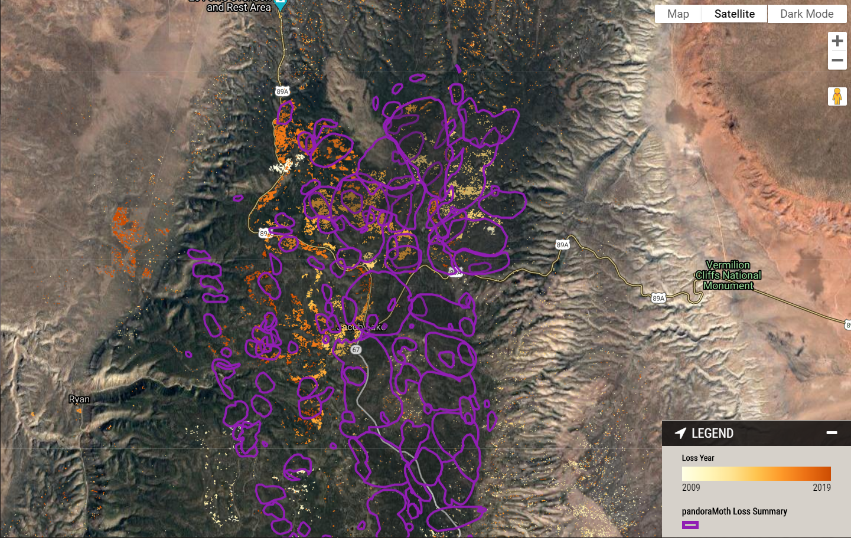
Pandora Moth Case Study

Slide 15
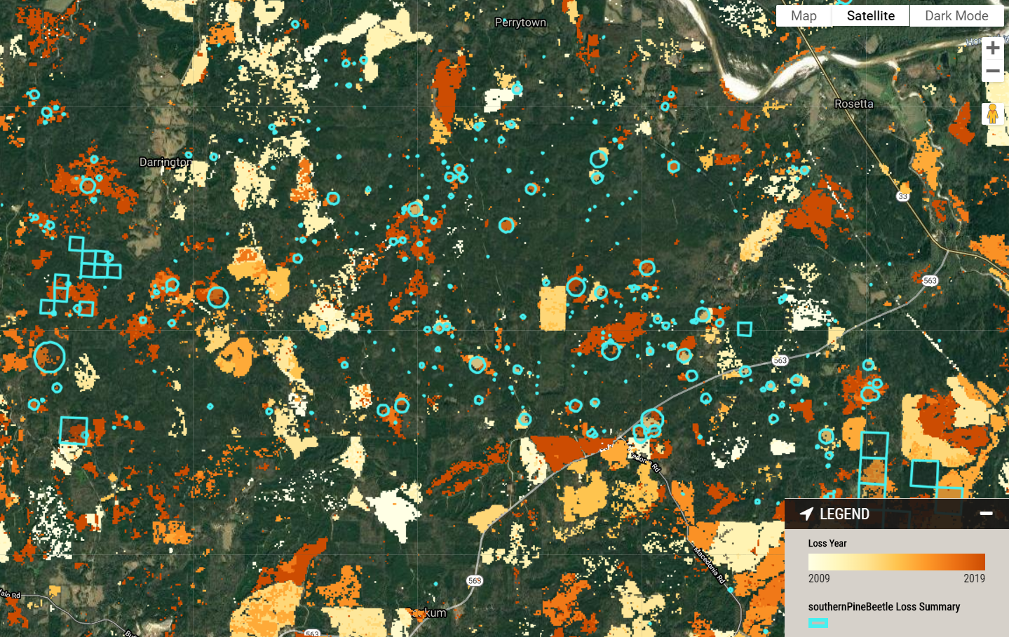
Southern Pine Beetle Case Study

Slide 16
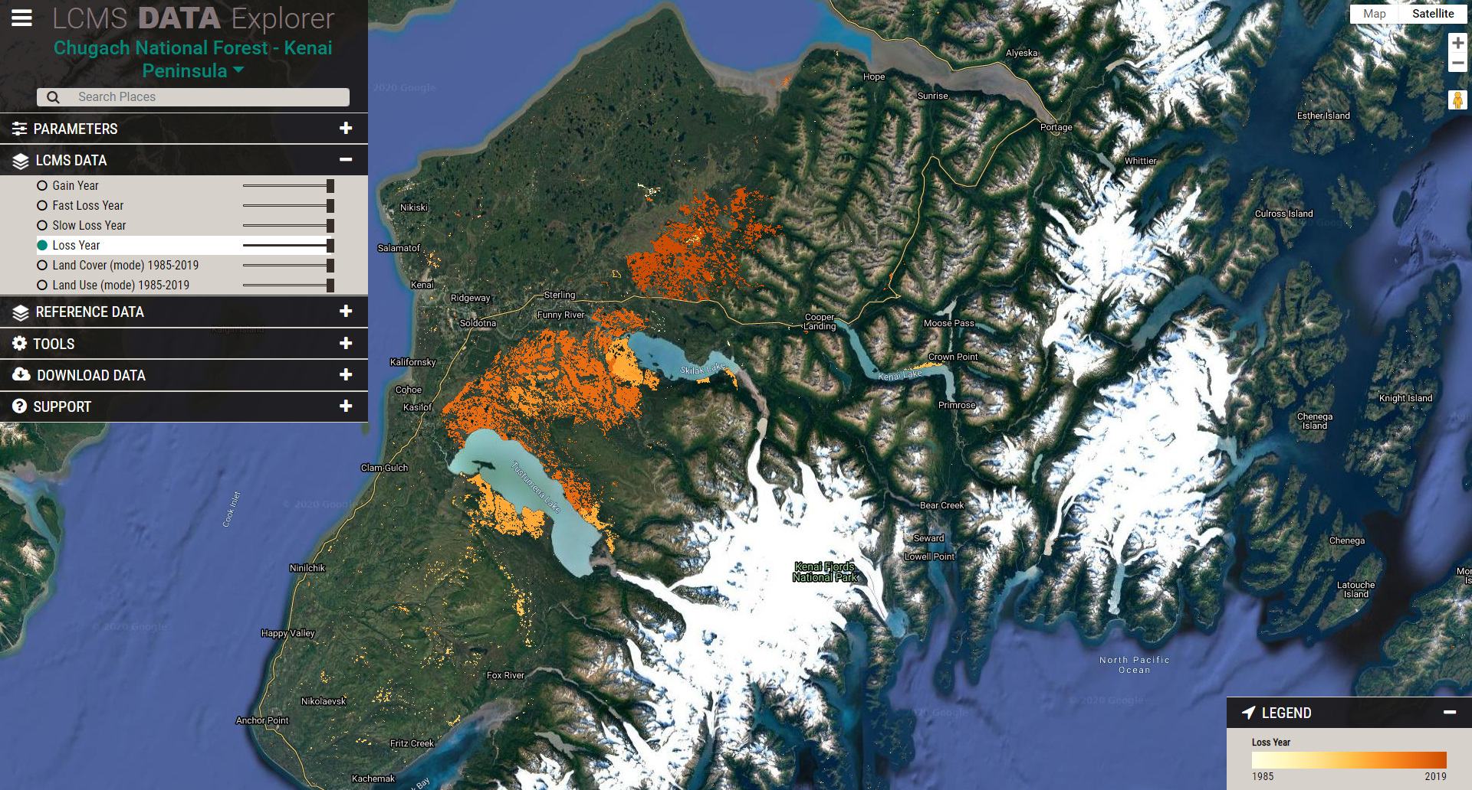
Data Explorer Demo
https://lcms.forestry.oregonstate.edu
Works best in Chrome!

Slide 17
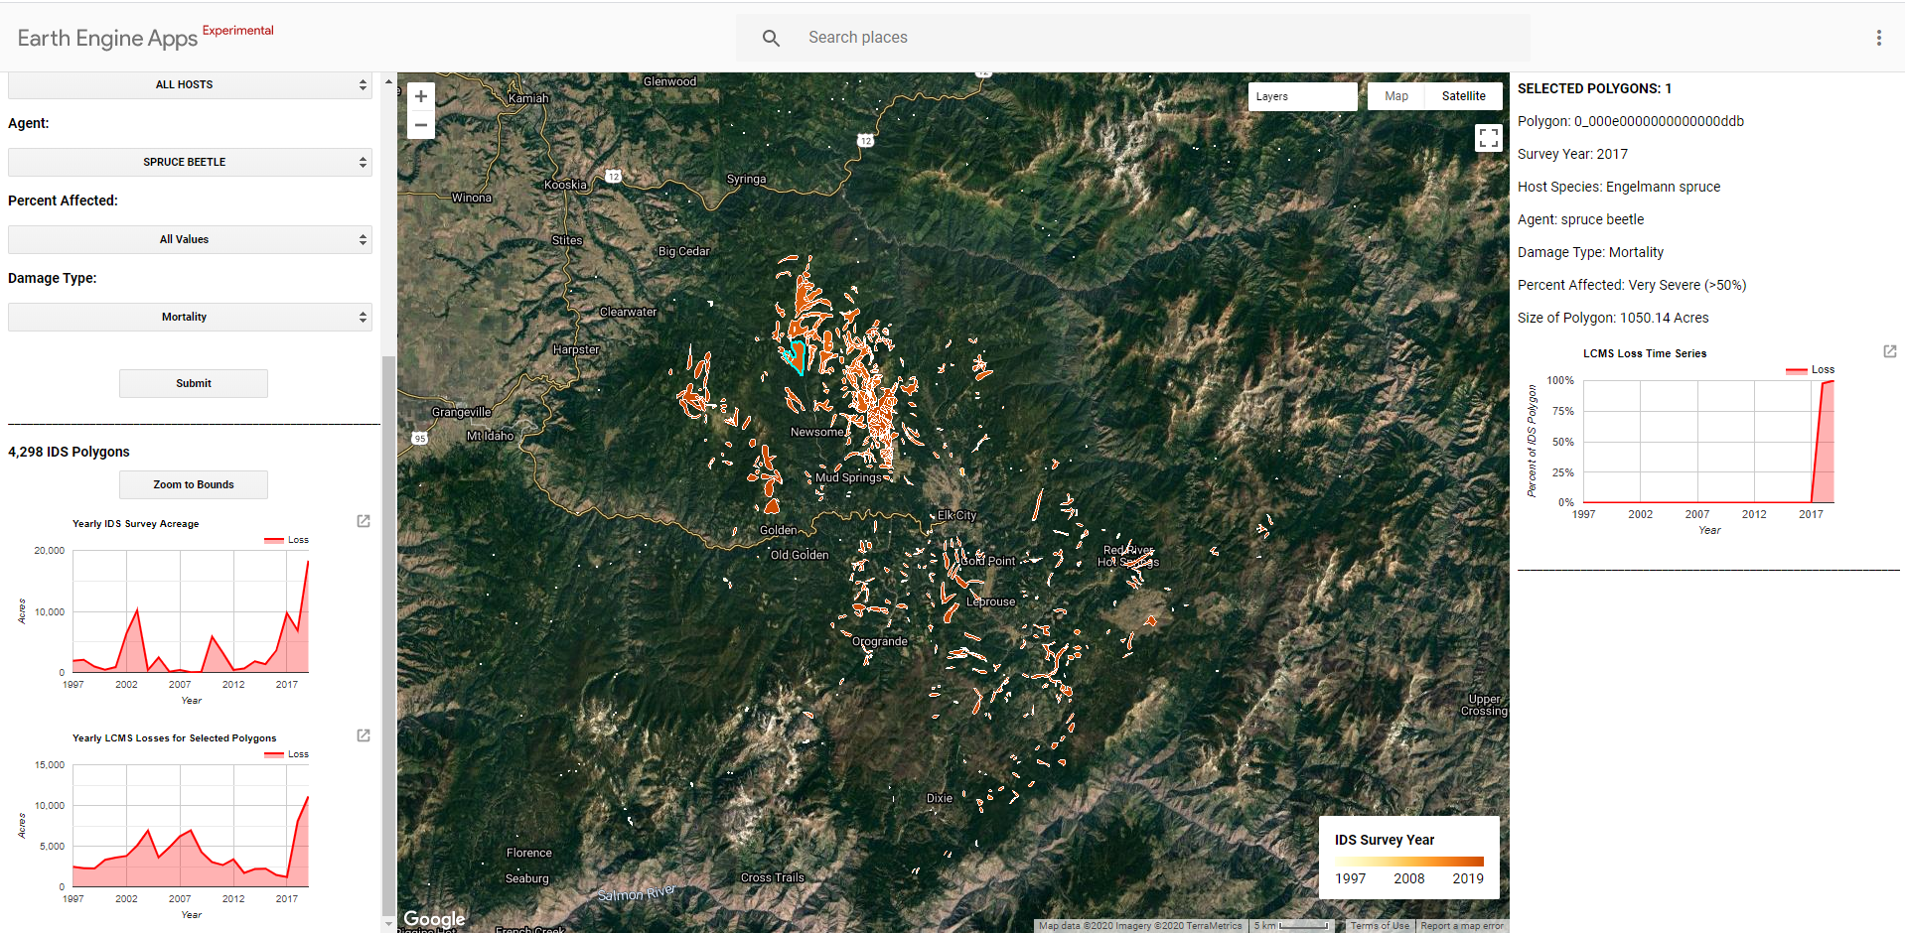
Other Resources
LCMS IDS Viewer:
https://usfs.earthengine.app/view/lcms-ids-viewer

Slide 18
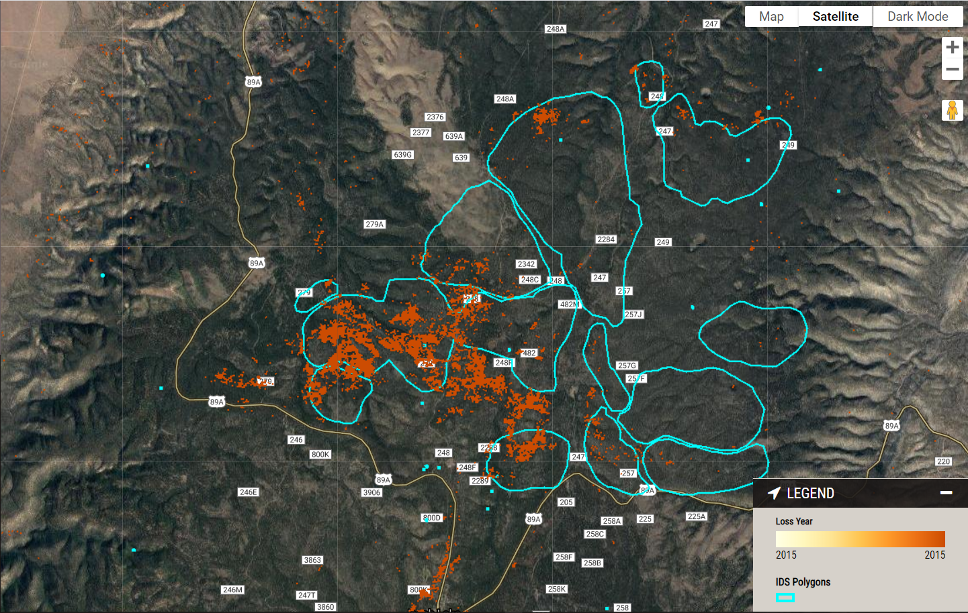
Some Final Thoughts
LCMS Data should be used in combination with other layers like IDS. It requires some additional sleuthing.
LCMS can add depth and nuance to our understanding of the history of an area / agent. It can identify spatial and temporal patterns that may not have been captured in IDS (and visa versa)

Slide 19
Some Final Thoughts
LCMS can be used to inform decisions about where to focus monitoring efforts
2017
2018
2019
Words of Wisdom from Karen Hutten
Use Clues:
Known agents and ADS
Damage patterns
Host distribution
Topography
Be suspicious of what doesn’t make sense

Slide 20
Limitations
Only one data point for the entire year
If your agent of interest produces the most damage in the fall, or for a brief period of time, LCMS may not be the best product to use
30 m resolution
It generally will work best for events that produce widespread mortality. If most of a 30 m pixel is not impacted, that loss may not be sensed.
Every agent and host will manifest differently
This will require some sleuthing. Use clues!
Best for historical analyses
The full LCMS suite for CONUS, including summer 2020, will be available in January.
It will be updated annually thereafter in the fall.

Slide 21
Where can I get LCMS data?
LCMS Data Explorer:
http://lcms.forestry.oregonstate.edu
LCMS FHP Explorer:
http://lcms.forestry.oregonstate.edu/FHP
LCMS IDS Viewer:
https://usfs.earthengine.app/view/lcms-ids-viewer
FSGeodata Clearinghouse:
https://data.fs.usda.gov/geodata/rastergateway/LCMS/index.php
T-Drive:
T:\FS\NFS\WOEngineering\GMO-GTAC\Program\RMIM\LCMS
Email us:
leah.campbell@usda.gov
sm.fs.lcms@usda.gov

