Slide 1
LandTrendr: Working with RGB Fitting
For Interpretation of Change
Robert Kennedy, Peter Clary - Oregon State University
emapr.ceoas.oregonstate.edu
With prior contributions from Justin Braaten (former OSU)

Slide 2
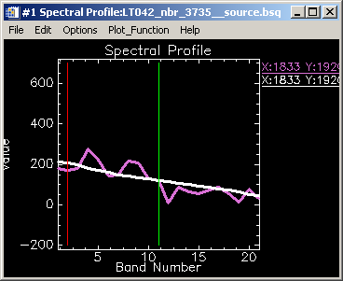
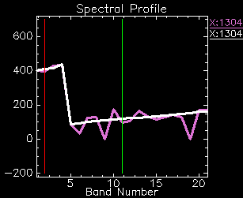
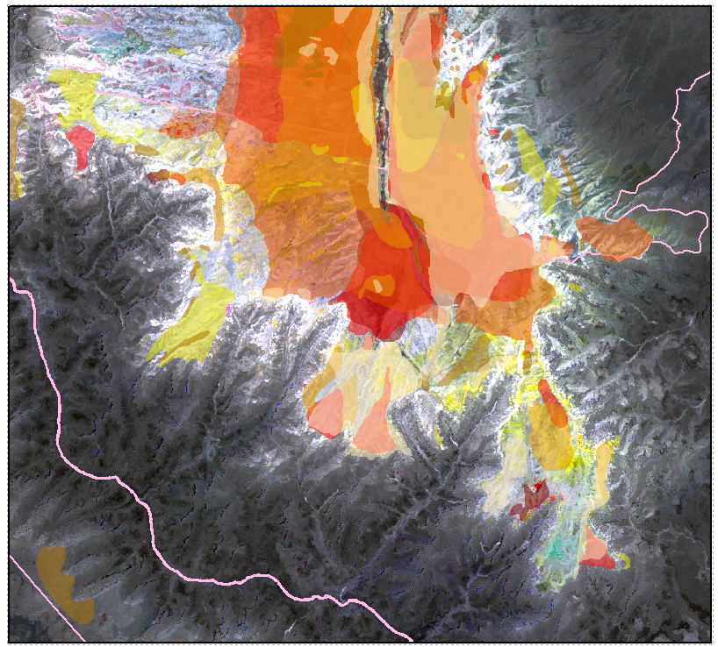
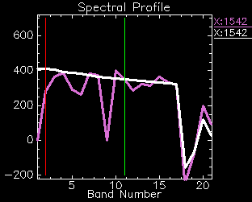
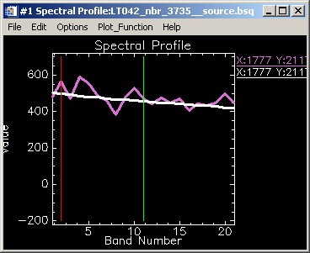
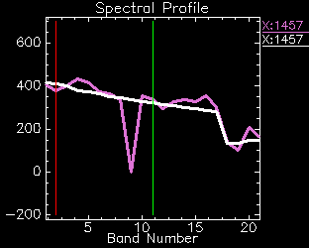
A slide from 2012
A
D
Colors correspond to detections in different years from 1997 to 2005
D
B
A
One pixel’s NBR trajectory
E
C
Colors represent ADS overflight data
B
C
E
Map area: North Rim of the Grand Canyon

Slide 3
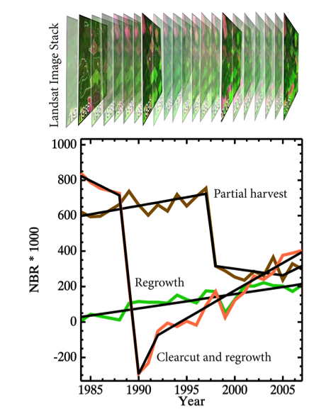
Temporal Segmentation
LandTrendr* strategy
  Look for TRENDS and EVENTS in the same algorithm
Segmentation
  Simplify temporal trajectory into periods of consistent process: SEGMENTS
  Separated by VERTICES
Distill large dataset to key information
Leverage temporal domain to improve detection
Consistently capture range of fast and slow processes

Slide 4
Two ways to visualize LandTrendr change
Across all years
Across limited years
OR
One pixel
Across all space

Slide 5
Two ways to visualize LandTrendr change
Across all years
Across limited years
One pixel
Across all space

Slide 6
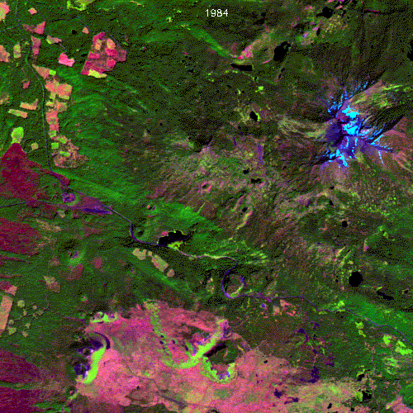
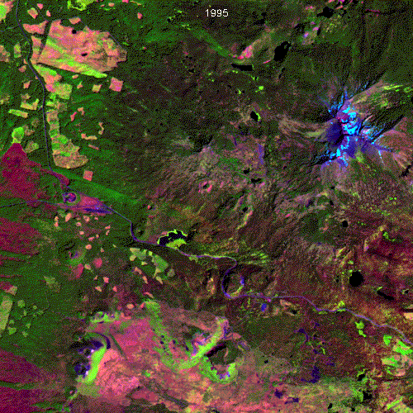
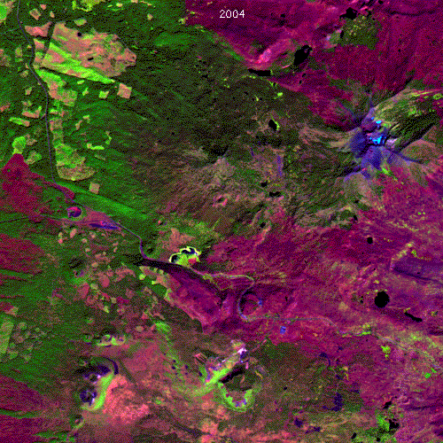
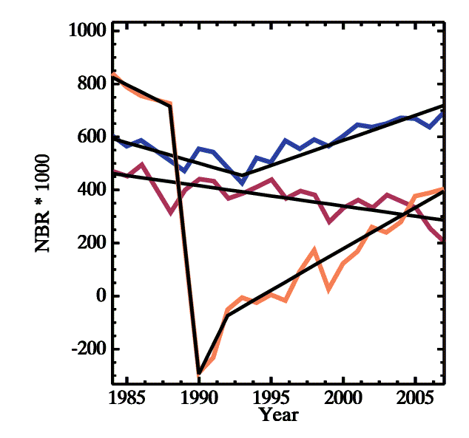
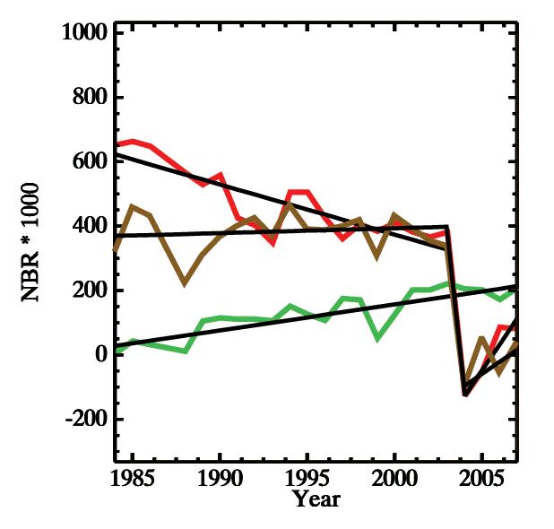
Pixel by pixel: Diagnostic shapes
1
2
3
4
5
1: Insect, then
regrowth
6
1984
1995
2004
4: Insect, then
fire
1
4
3
5
5: Growth,
then fire
3: Insect-related
mortality
2
6
2: Harvest, then
regrowth
From Kennedy et al. 2010
6: Growth

Slide 7
LandTrendr: Tell each pixel’s story
Fast, high magnitude disturbance
Stable forest
Forest recovery
Stable forest
Slow, low
magnitude disturbance
Minor forest recovery
Segmentation allows us to summarize …
Change years
Magnitude
Duration
Start/end values

Slide 8
Two ways to visualize LandTrendr change
Across all years
Across limited years
One pixel
Across all space

Slide 9
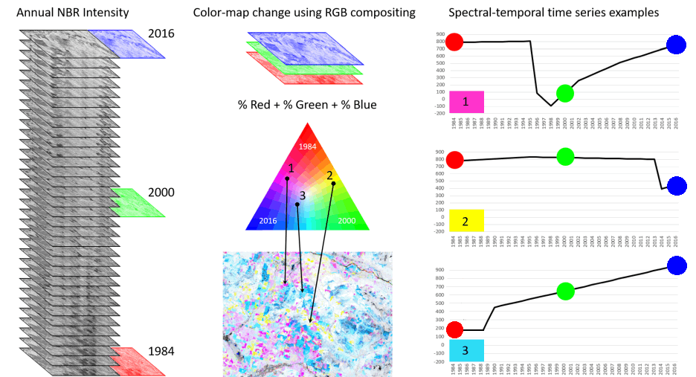
RGB Color Composites: Visualize change

Slide 10
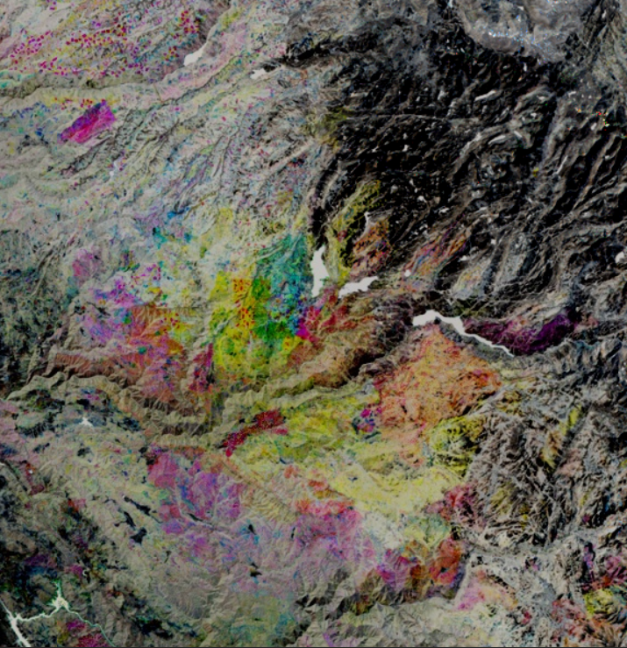
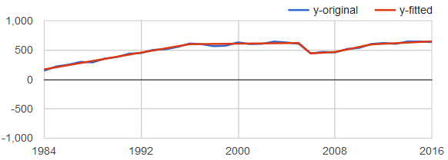
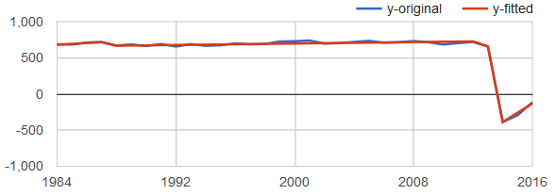
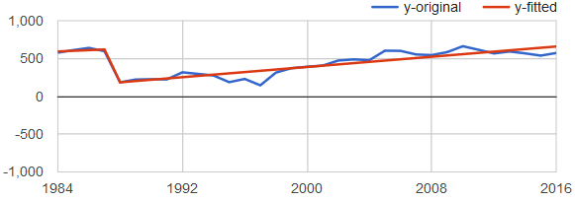
Combine
Red layer
Green layer
Blue layer
If it has color, then something changed.
If it is only on the grayscale, it was relatively stable

Slide 11
ASIDE: A further way of mapping
Segmentation outputs
Map onset, duration, delta of target segments
Target segments identified by direction of change in known index, or by a sequence of changes.
Raw map
Threshold by magnitude of change
Optional. If done, in units of original spectral index or a transformed index, such as % veg or tree cover
Thresholded map
Filter by minimum mapping unit
Requires rules to define which adjacent pixels are from same change process. Currently, based on coincidence of onset, plus or minus buffer years.
Final cleaned map

Slide 12
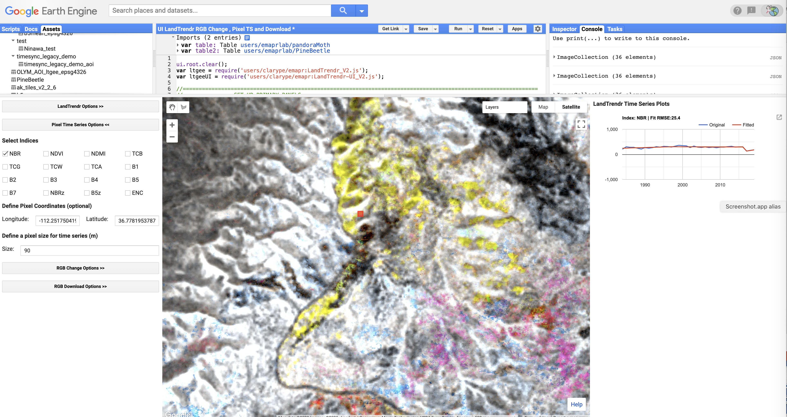
So how do we do it?
Google Earth Engine User Interface (UI)
Both pixel and RGB visualizer

Slide 13
LandTrendr: Underlying logic
One observation per year in a defined date window
You can adjust these!
One spectral index

Slide 14
LandTrendr: Strategies
Target must have spectral manifestation
Signal must be greater than background noise
Explore different spectral indices and different date windows
Change “tuning knobs” on the algorithm

Slide 15
Pixel level approach
Go to area of known change
For example, use your knowledge of ADS polygons or MTBS fire polygons, etc. Use pixel fitter to chart the time series
Experiment with broad and narrow ranges of dates, use different seasons, try different spectral indices to see the expected progression of change in the chart of the source imagery
Find date and spectral windows
Find best fit
Change the parameters to make the fitted trajectory match the source imagery time series

Slide 16
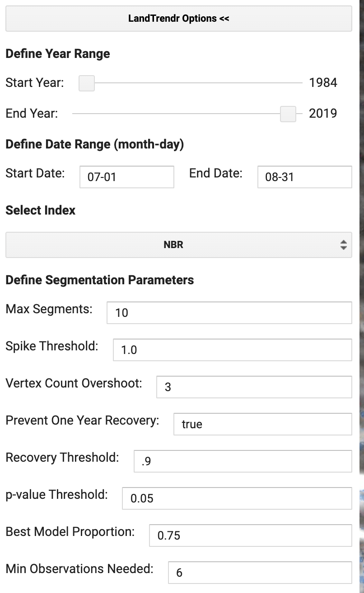
Find date and spectral windows
Find best fit

Slide 17
Segmentation Approach
Despike
Find Best Path
“Over-find” vertices
Pick Best Model
Cull vertices
From: Kennedy et al. 2010 “Detecting trends in forest disturbance and recovery using yearly Landsat time series: 1. LandTrendr - Temporal segmentation algorithms. Remote Sensing of Environment, 114, 2897-2910

Slide 18
Best LT Parameters to tweak
Max: roughly 1/3 the number of observation years
Keep between 0.75 and 1.0. At 1.0, de-spiking is turned off
0.25 is conservative – tweak this knob closer to 1.0 to allow more complex fits
Making this 0.15 allows sloppier fits, but can be useful in noisy signals

Slide 19
So how do we do it?
Google Earth Engine User Interface (UI)
Both pixel and RGB visualizer

Slide 20
Warning!
We are a team of two.
Our interface reflects that….
You’ll need your own Google Earth Engine account!
Send us your email and we can share this tool with you.

