Slide 1
Track 2: Confirming Change, Tasking Satellites, and Sharing Imagery
Brenna Schwert
Remote Sensing Specialist
brenna.schwert@usda.gov
Geospatial Technology and Applications Center | GTAC
USDA Forest Service

Slide 2
Housekeeping
Brenna Schwert
Remote Sensing Specialist & Senior Trainer
On-site contractor
USDA Forest Service, Geospatial Technology and Applications Center (GTAC)

Slide 3
Housekeeping
Adobe Connect
Quick orientation to interface
Different layouts
Please dial *6 to mute your phone
Question or comment?
Un-mute by dialing *6 again
“Raise” your hand
Send a chat

Slide 4
Framework Overview

Slide 5
Framework Overview
Track 1
Track 2
Track 3

Slide 6
Track 2 Overview
Confirming Change
Sentinel-2 visual change detection / confirmation demonstration (Eric Rounds)
Tasking Satellites (Brenna Schwert)
NextView license overview
Limitations of NextView & purchase considerations
CIDR tool demonstration
EarthExplorer demonstration
DigitalGlobe portals demonstration
Sharing Imagery
Image Services
TPK generation (Bill Frament)
Q & A

Slide 7
Confirming Change
Assumption is that we have some data regarding probable locations of change
These polygons / AOIs could come from:
Analysis of previous years’ ADS work / local knowledge and expertise
Broadscale change detection tools / applications
Some combination of the two

Slide 8
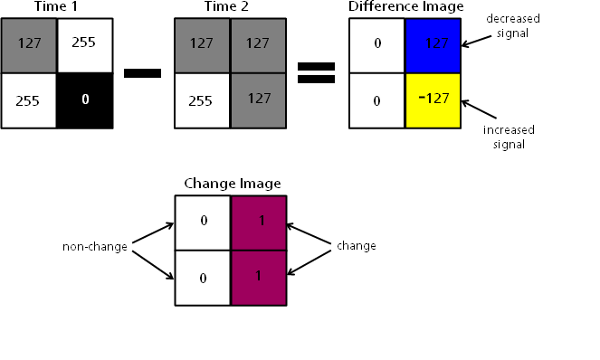
Image Differencing

Slide 9
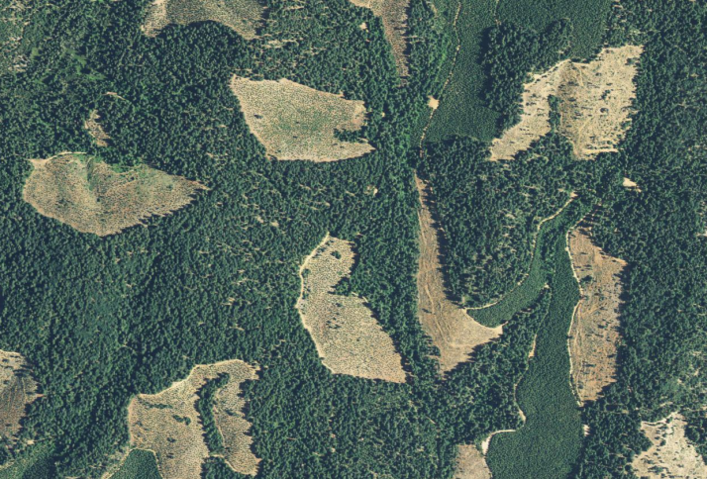
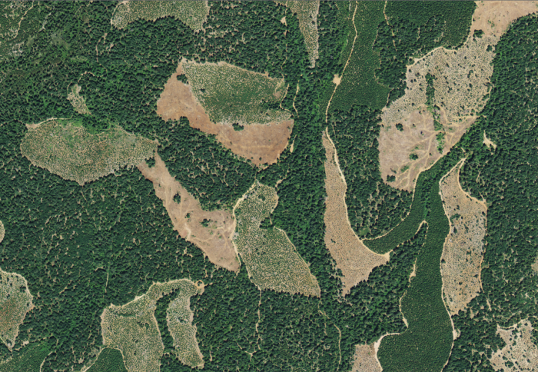
Confirming Change
Landsat Derived Change Map
Higher Resolution Reference Imagery (Pre and Post)

Slide 10
Confirming Change
The goal is to use higher (not necessarily the highest) resolution imagery to confirm that change does or does not exist
There are tradeoffs in regards to resolution
Time & Cost
Sentinel-2 is a moderate scale sensor, giving us a reasonable look at the landscape

Slide 11
Demonstration
Confirming change using Sentinel-2 imagery

Slide 12
Higher Resolution Imagery
Confirming the change narrows our scope and tells us where to go to get even higher resolution imagery
When interpreting mortality and defoliation, we want the highest resolution possible
Pansharpening Sentinel-2
NAIP
Commercial Satellites

Slide 13
Pansharpening
Panchromatic band
Finer resolution than other multispectral bands
Records all visible light, not just blue, green, or red
Usually ~1/2 spatial resolution of other bands
Landsat
Pan = 15 m
Multi = 30 m
WorldView-2
Pan = ~0.5 m
Multi = ~2 m

Slide 14
Higher Resolution Imagery
60 cm
Four band
R, G, B (true color)
NIR helpful for vegetation and stress

Slide 15
Commercial Satellites
IKONOS-2 (switched off Jan 2015)
GeoEye-1
QuickBird-2 (switched off Jan 2015)
WorldView-1
WorldView-2
WorldView-3

Slide 16
Tasking
Sensors like Landsat and Sentinel are constantly collecting imagery and sending it back to Earth
Commercial satellites are constantly orbiting, but they are not always collecting
We need to ‘task’ commercial satellites and request that they be turned on to acquire images

Slide 17
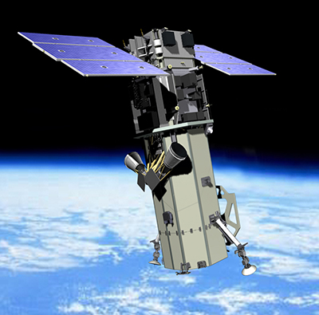
Tasking
Two approaches:
Request through NextView contract, which gives us license to use imagery (but not own)
Purchase imagery

Slide 18
NextView License
NGA does not own the imagery, they are licensed users
Members of the US Federal Government (all branches) are licensed users
Imagery may be shared with:
USG Contractors & University Researchers supporting USG contracts
State & Local Governments
Foreign Governments & Intergovernmental Agencies
Non-Governmental Organizations (NGOs) & Non-profit Organizations

Slide 19
NextView License
Before sharing:
Ensure proper USG use
Communicate sharing limitations
May generate and share freely any derived products
A USG employee must authorize all non-USG users
More information at nga.mil:
https://www.nga.mil/ProductsServices/NextView%20Public%20Release%20Documents/NextView_License_Information_Paper_20170503.pdf

Slide 20
NextView License
“the USG shall use its reasonable best efforts to minimize the effects on commercial sales”
What does that mean?
Commercial requests (direct purchases) are placed before our requests in queue
We’re not sure how they manage the queue
We’re not sure what a reasonable request entails

Slide 21
Purchasing
Minimum order is 25 sq km with 2 km order width
Speculative
Work with Maxar (DigitalGlobe) to see if your AOI qualifies
Feasibility study, looking retroactively at study area
$1/sq km
For reference, no AOIs in R5 qualify
Purchased
Base of $27.50/sq km
~$2.7 million for all of R5’s needs
~$50k would cover Tahoe National Forest

Slide 22
Timing Requests
Place orders / requests ASAP!
Lots of things out of our control:
Commercial queue
Clouds
Wildfire smoke
Etc.
The sooner you make a request, the more likely you will get high quality images

Slide 23
Timing Requests
Data Acquisition Requests (DARs)
Example timeline:
Submitted a request on 6/3/2019
Worked with contractor to clarify details 6/4-5/2019
Request approved on 6/5/209
Request submitted to vendor 6/12/2019

Slide 24
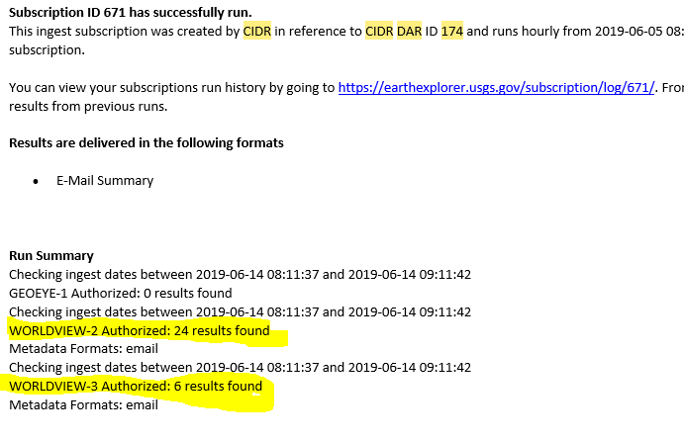
Timing Requests
USGS/EROS updates on 6/14/2019 and 6/21/2019

Slide 25
Portals
Obtaining Remotely Sensed Imagery
Requesting imagery:
CIDR: https://cidr.cr.usgs.gov/
Ordered by availability of WV imagery:
Earth Explorer: https://earthexplorer.usgs.gov/
EVWHS G-EGD: https://evwhs.digitalglobe.com/myDigitalGlobe/login
Discover: https://discover.digitalglobe.com/

Slide 26
Demonstration
Tasking with the CIDR tool & obtaining imagery

Slide 27
How do I share this imagery?
You can use it as is in ArcGIS
Formatted as a GeoTIFF
You can create image services, so that other people in your organization can ingest the data
You can create TPKs, or tile packages, which are essentially subsets of much larger datasets that you can load into mobile devices (e.g., DMSM)

Slide 28
Storage
Those WoldView images from the DAR I talked about earlier?
Imagery to support 2 days of field work
>50 GB
Storage needs will depend on data products ordered
The smaller the pixels, the more storage you’ll need
The more bands you have, the more storage you’ll need

Slide 29
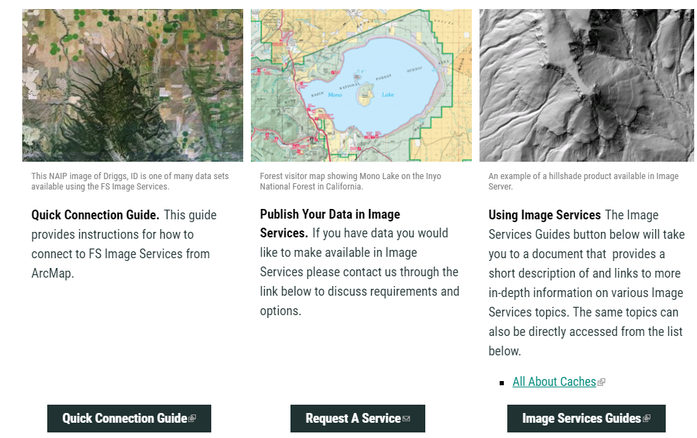
Image Services
https://apps.fs.usda.gov/gtac/products#imageservices

Slide 30
Creating TPKs

