Slide 1
Sentinel-2
Mosaic Creation & Change Detection in GEE
Eric Rounds, eric.rounds@usda.gov
5/28/2020

Slide 2
Outline
Overview of Sentinel-2
Google Earth Engine (GEE)
Mosaic creation
Data download
Data visualization and comparison

Slide 3
Copernicus and Sentinel
European Space Agency’s (ESA) program for earth observation
Copernicus is the overarching program that is managing the Sentinel satellites
Sentinel Satellites
7 individual Satellite programs (or constellations) each with two satellites and a specific purpose related to earth monitoring

Slide 4
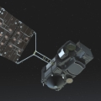
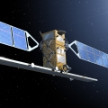
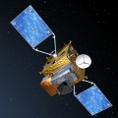
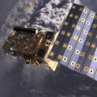
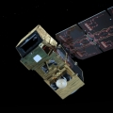
Sentinel Satellites
Sentinel-1 (April 2014, 2016)
Land and Ocean monitoring
2 polar-orbiting satellites
Radar Imaging
Operate day and night
All Weather
Sentinel-3 (February 2016, April 2018)
Marine Observation (sea surface topography, sea and land temperature, ocean and land color)
2 polar-orbiting satellites–
2 Optical Imaging
1 Altimeter – Radar Imaging
Sentinel- 4 & 5
Air quality, Ozone, Solar radiation, Climate monitoring in Europe (4);
UVN Spectrometer instrument aboard
Sentinel-2 (June 2015, March 2017)
Land monitoring (Vegetation, Soil, Coastal area)
2 polar-orbiting satellites
Optical Imaging
Dependent on solar radiation
Impacted by clouds
Sentinel- 5p (October 2017)
Cover data gaps, Data Continuity
Atmospheric monitoring
Notes:
Sentinel 2b, which will cut the time it takes to obtain imagery for the whole globe in half to 5 days, will launch on March 7
Sentinel 3’s land-based applications are intended to compliment what is already provided by Sentinel-2—referred to as its sister satellite. It will provide a bigger picture by monitoring wildfires, mapping land use, provide indices of vegetation state and measure the height of rivers and lakes (lower resolution. Sentinel-3A was launched on 16 February 2016. Sentinel-3B will follow in 2017..
Sentinel 3 also measures the temperature, color and height of the sea surface as well as the thickness of sea ice.
It has 4 different instruments on board each satellite (3a and 3b), with 300-500 m resolution. It has a revisit time of less than two days.
There is also a SENTINEL 6 that carries a radar altimeter to measure global sea-surface height, primarily for operational oceanographe and for climate studies

Slide 5
Sentinel 2
Sentinel 2 is a Landsat clone/upgrade
Uses: Forest monitoring, change detection, land use/land cover
Coverage: Currently every 5 days- Collection began June 23, 2015 (every 10 days prior to 2017)
Spatial resolution: 10, 20 and 60 meters (wavelength dependent)
More spectral bands than Landsat 7 and 8
Sentinel 2 has 13 bands, Landsat 8 has 11 bands, Landsat 7 has 7 bands

Slide 6
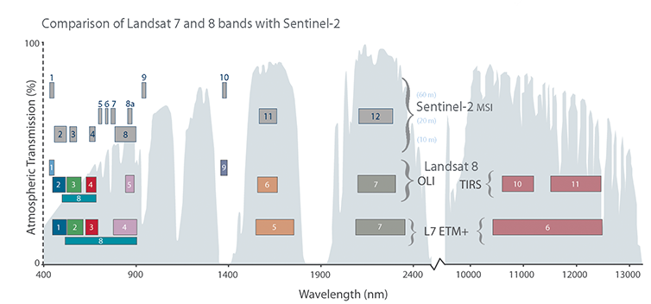
Sentinel 2 vs Landsat
60 m
20 m
10 m
Sentinel 2 has three different spatial resolutions
Visible and IR – 10 meter
SWIR (red edge) and Longwave IR – 20 meter
Aerosols, Water Vapor, and Cirrus bands – 60 meter
Landsat 7 is 30m, Landsat 8 is 30m except for a few 100 m TIRS bands & the Panchromatic Band

Slide 7
Sentinel 2 vs Landsat
Sentinel 2
Landsat 8

Slide 8
Data Access
Sentinel Scientific Data Hub (https://scihub.copernicus.eu/dhus/)
Most up to date data access here
Includes processed and unprocessed data
USGS Earth Explorer & GLOVIS
Data is now on Earth Explorer, and GLOVIS
Only a selected amount of data
Google Earth Engine (draft script)
https://code.earthengine.google.com/a15acc547affb1fb30409413c69af3f7

