Slide 1
Raster Data in the RDW and FS Image Services
Mark Hammond
Remote Sensing Specialist / Trainer
RedCastle Resources Inc., working onsite at
Geospatial Technology and Applications Center (GTAC)
(801) 975-3497
markhammond@fs.fed.us

Slide 2
Overview
Comparison of Image Services (IS) and the Raster Data Warehouse (RDW)
IS specifics
RDW specifics
Demonstration: how to access, use, and add data to the servers
Notes:
In this presentation I’ll explain how Image Services and the Raster Data Warehouse can be valuable sources of geospatial data for you. I’ll clarify some of the similarities and differences between these two services because it can be easy to mix them up. Then I will cover all of the data that is available from each service as well as how you can get your geospatial data hosted on these services. Finally, I will demonstrate how to access the services within ArcGIS and outside of it and also some ways to process and use the data.

Slide 3
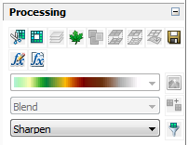
IS and RDW Similarities
Both use ArcGIS for Server 10.X to serve data (image services or map services)
REST endpoints available to developers
You can request data be added to both servers
Image processing functionality
Raster function templates
Pixel based processing functionality
Analysis for discrete (categorical) and continuous raster datasets.
Notes:
One of the main similarities of Image Services and the Raster Data Warehouse is they both use ArcGIS for Server serve data in both image service and map service formats. Both services can be accessed on REST pages which are particularly helpful to developers. I’ll also explain what REST pages are later on. If you have geospatial data that you would like to share with others or just easily access yourself on the servers then you can request it to be added. Finally, accessing data from the servers in ArcGIS gives you the option of performing some basic image processes and analysis on it.

Slide 4
Image Services and RDW Differences
IS accepts wide range of products; RDW only authoritative rasters
IS takes lidar derived raster products; not yet at RDW
RDW faces both external and internal; IS only faces internal
Adding data to RDW is more complicated than for IS
Notes:
So what are some key differences between IS and RDW? IS provides both imagery and raster products while the RDW only provides authoritative Forest Service produced raster products. However, RDW has the options sharing your data with the public on an external server or reserving it for Forest Service use on an internal server. IS only has an internal server. The request process for adding your data to the RDW is more complicated than for IS

Slide 5
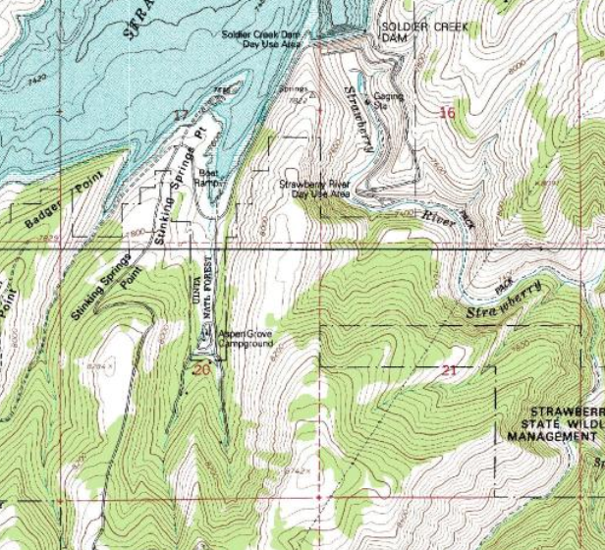
FS Image Services
Largely used for viewing and backdrop analysis
Accepts all imagery products (airborne, satellite, scanned georeferenced, etc.)
Includes eTopo and FSTopo
Submittal requests
Internal facing only
Notes:
Forest Service Image Services serves imagery data to Forest Service and BLM. All imagery products are acceptable for submission to FS Image Services.
FS Topo, an authoritative product, has been served on FS Image Server from the start.
Data accepted as part of FS Image Services:
• All imagery data (high resolution imagery primarily – 1 meter data or less)
• Forest and district Lidar derived raster products (bare earth, Canopy Height, etc.)
• Scanned georeferenced map raster products
• FSTopo and ETopo have and will continue to be served.

Slide 6
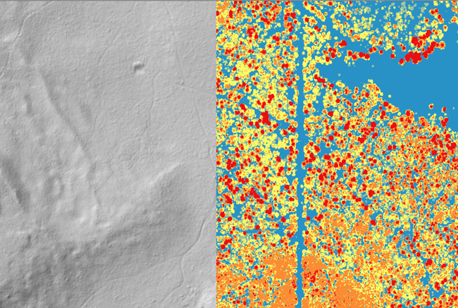
FS Image Services
Image Services are a GIS Service
Current high-resolution datasets
Quick, easy access without storing your own data
Widely available to Forest Service
Preprocessed data
NOT for advanced processing
NOT for spectral analysis
Notes:
Image services are GIS Service that allows users to efficiently access and display large volumes of raster data from a central server. You can enjoy easy access to current high resolution imagery such as NAIP without the hassle of storing so much data. The data is preprocessed which is convenient in some ways but the drawback is that the original spectral information has been modified and likely does not represent the true reflectance characteristics of features on the ground. So this means it shouldn’t be used for advanced image processing or spectral analysis. If you want to do advanced processing or analysis it’s best to acquire the original imagery from sources such as APFO or the Geospatial Data Gateway which I’ll explain more about later.

Slide 7
FS Image Services – Folder Setup
Forest Visitor Maps
Maps
NAIP
NAPP
NWSelect
Resource Photography
Terrain

Slide 8
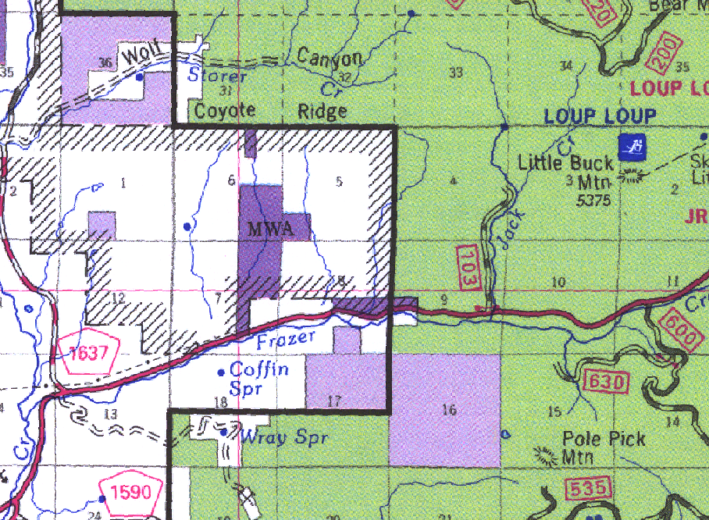
Forest Visitor Maps
Check if your region’s visitor map is up to date.
Work with your Regional GIS Coordinator to update
Notes:
You can check the Forest Visitor Maps folder to see if your region’s visitor map is up to date or even existing. Currently the server doesn’t have visitor maps for region 10. You can work with your regional GIS coordinator to get your region’s map updated and then request for it to be added to the server.

Slide 9
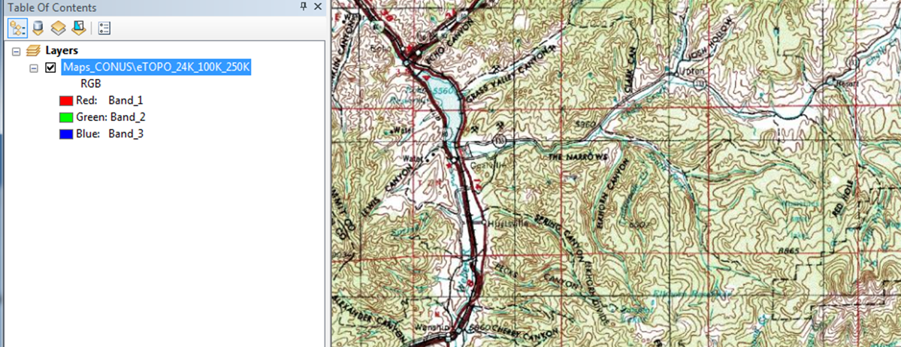
Maps CONUS - eTOPO
USGS DRGs (digital raster graphics)
Green tint = forest
1:24,000; 1:100,000; 1:250,000
Notes:
eTOPO uses USGS DRGs (digital raster graphics) which are available across the entire lower 48 states.
The data has green tint which highlights forested communities.
It’s made of 3 datasets which are for different scales as you zoom in and out.

Slide 10
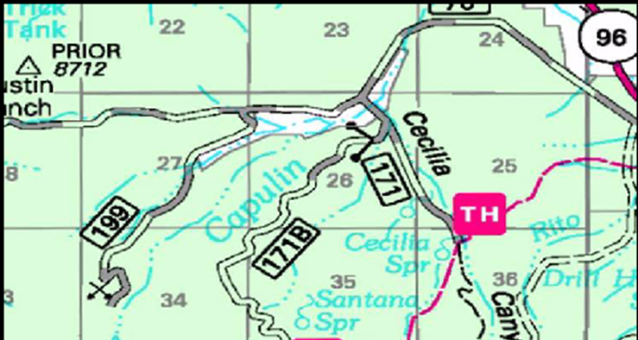
Maps CONUS - PBS_GeoTiff
Softcopy PBS (Primary Base Series)
A.k.a- FSTopo
Similar to USGS DRGs, but made by Forest Service
Higher resolution than DRGs
No green tint
Only for quads with Forest Service lands
Notes:
Softcopy PBS (Primary Base Series) are similar to USGS DRGs (eTOPO), but are developed by the Forest Service.
They have higher resolution than eTOPO which of course makes identifying boundary systems and other features easier.
Unfortunately they are only available for quads with Forest Service lands

Slide 11
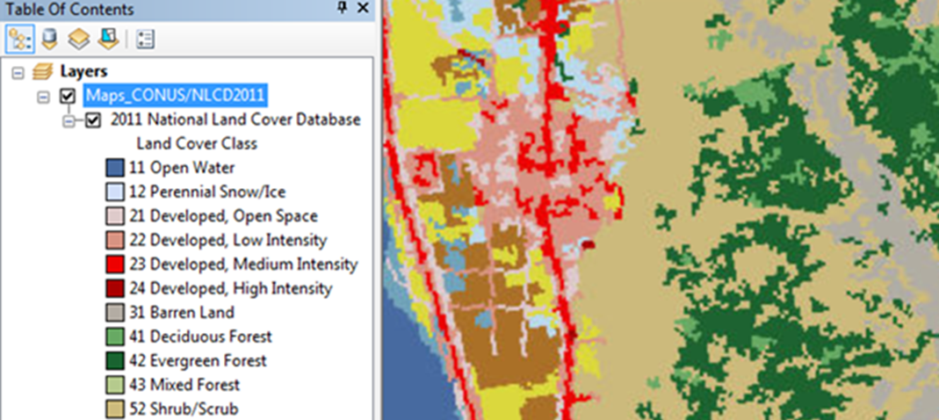
Maps CONUS - NLCD
NLCD (National Land Cover Database)
16 class land cover classification scheme
30 m resolution
Assess land cover changes from 2001 to 2011 to 2016
Notes:
National Land Cover Database 2016 is the most recent national land cover product we have
It has a 16-class land cover classification scheme that has been applied consistently across the United States
The resolution is 30 meters because the classification is based on 30 meter Landsat data
There’s also a 2001 and a 2011 NLCD dataset so by comparing the three NLCD datasets we can assess national land cover changes and trends during that 15 year period.

Slide 12
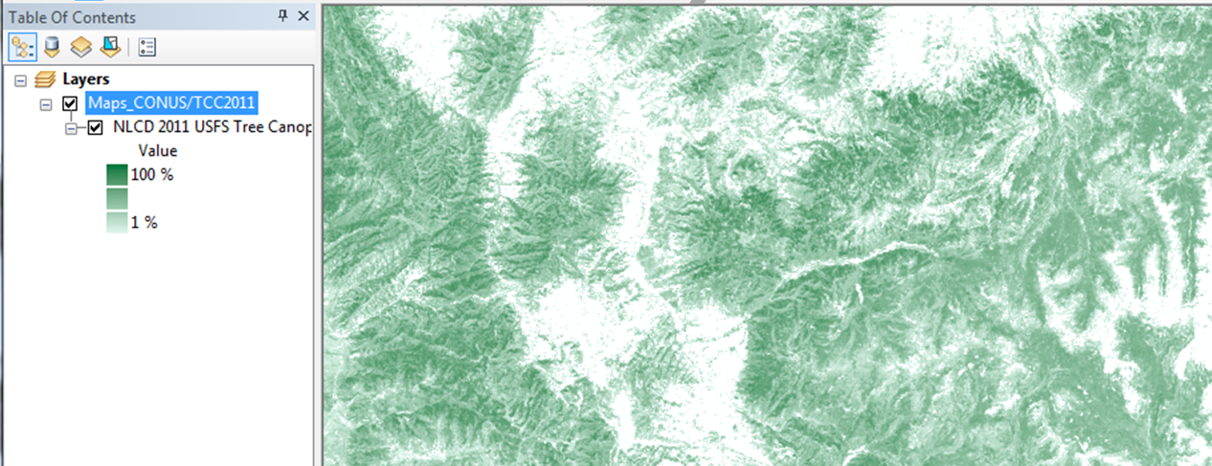
Maps CONUS - TCC
TCC (Tree Canopy Cover)
NLCD tree canopy cover dataset for CONUS
30 m resolution
Single layer, percent tree canopy cover
Notes:
And finally the Tree Canopy Cover layer is produced from the NLCD dataset.
So of course it also has 30 meter resolution
It’s just one layer displaying percentage values

Slide 13
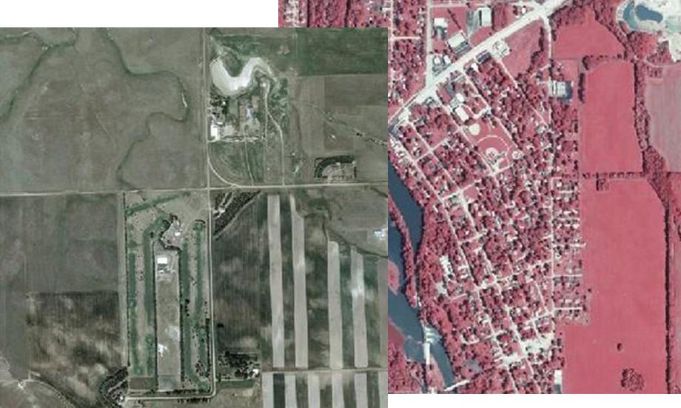
NAIP
National Agricultural Imagery Program
High resolution
Free!
Has infrared band
Easily accessible and preprocessed!
Notes:
NAIP is relatively new and is currently the primary national aerial photo acquisition program. It’s designed to acquire leaf-on imagery of the lower 48 states over a 3 year period. NAIP Imagery has several advantageous characteristics for many resource applications in the Forest Service.
First, it’s high resolution. High resolution imagery is usually too expensive for many forest managers to afford but thankfully NAIP imagery is FREE!
The imagery includes an infrared band so you can view it in a color infrared composite which is very useful for applications such as interpreting vegetation.
Many resource specialists are not trained to process raw imagery so the fact that NAIP imagery is preprocessed makes it even more practical for to use for many people.

Slide 14
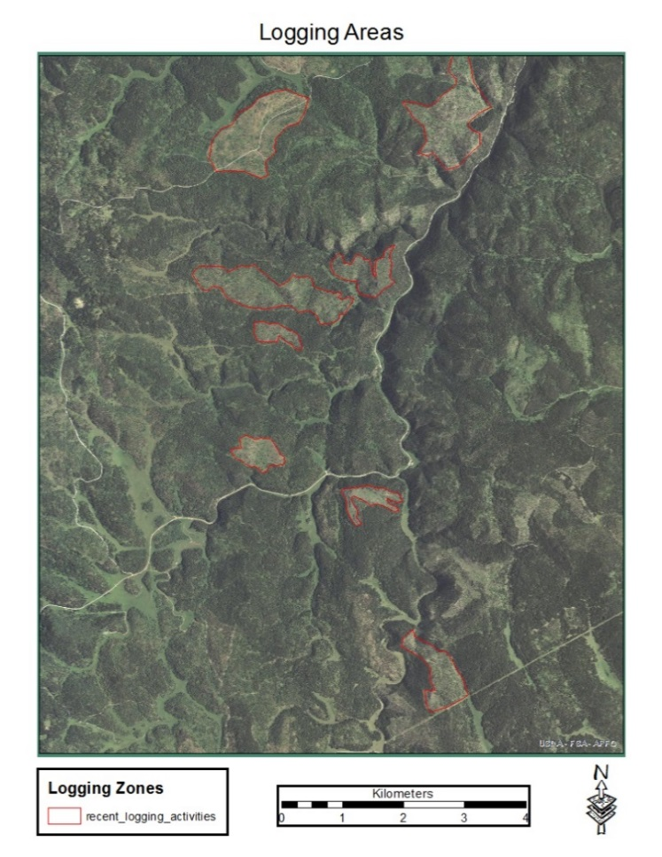
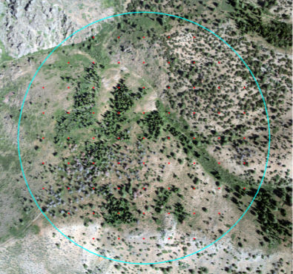
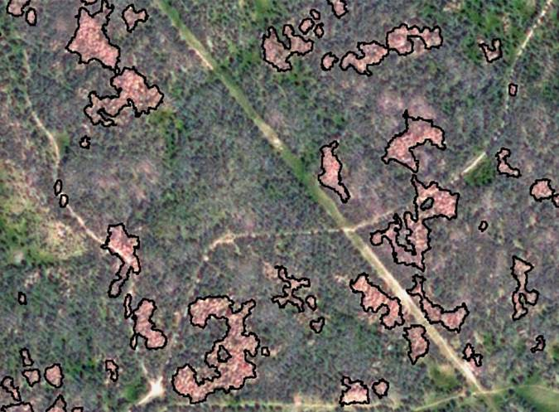
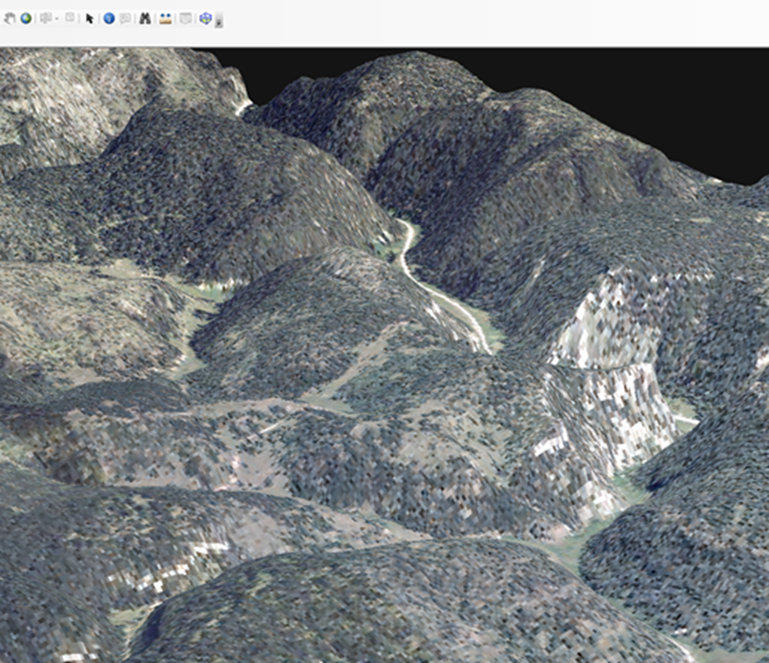
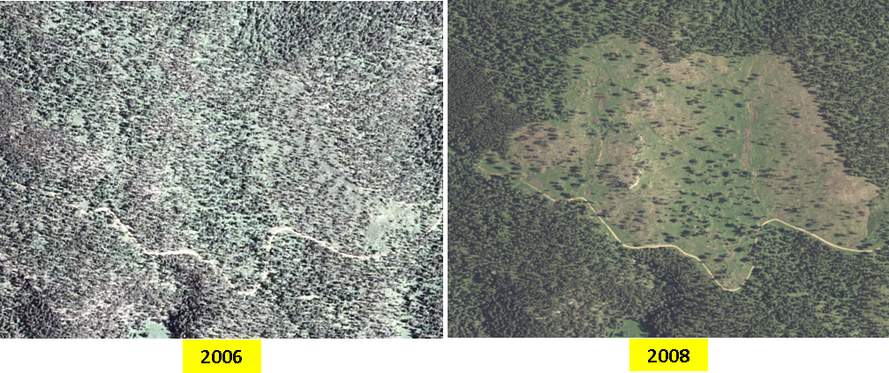
How can NAIP be useful to you?
Monitoring change / updating GIS
Forest health assessment
Map backdrop
Image drape (3D)
Image sampling
Notes:
Monitor change or update GIS by manually digitizing features
It is used for Forest Health assessments like tracking the extent of pine beetle infestations
Its great for map backdrops
and you can drape it over a DEM to create a 3D scene for more effective image analysis
Attribute dot grid plots with classification information

Slide 15
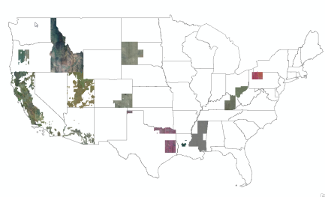
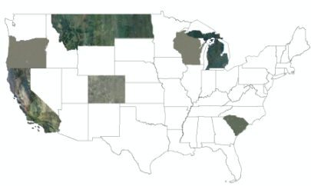
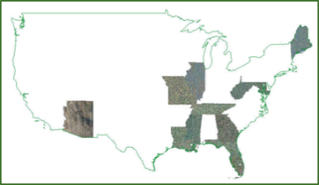
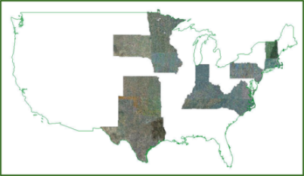
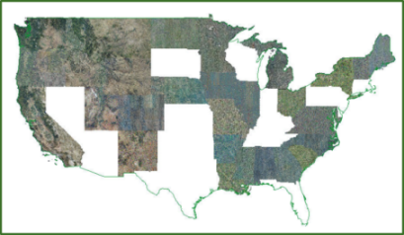
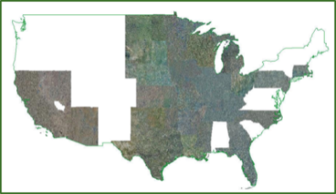
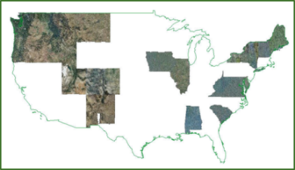
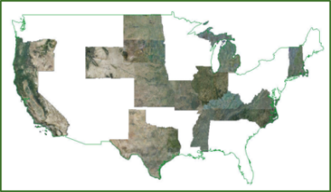
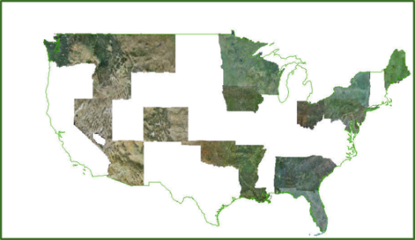
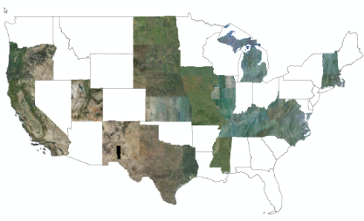
NAIP Acquisitions
CONUS for each year of NAIP 2004- 2014
2004
2005
2007
2008
2009
2010
2011
2012
2015….
2013
2014
Notes:
Acquisition amount changes: The amount of NAIP imagery collected each year fluctuates based on available funding and is not collected at a constant annual rate. You can see here how it changes within a 10 year span.

Slide 16
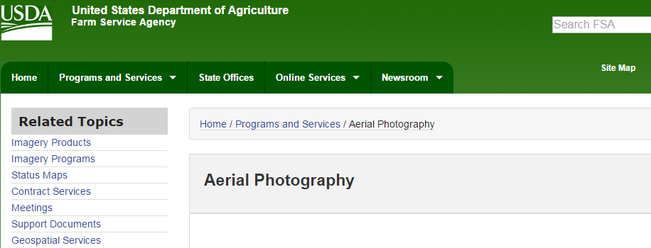
Other NAIP Sources
Aerial Photography Field Office is one of the nation’s largest aerial film libraries
APFO website
Email: apfo.sales@slc.usda.gov
Notes:
For very large project areas spanning up to millions of acres it's best to contact the APFO and request imagery which can be mailed as digital or hard copies. Use the email address listed here.
APFO is home to one of the country's largest aerial film libraries with more than 10 million images covering the entire country dating from 1955 to the present. Historic aerial images play a more vital role today than ever before with environmental assessments, change detection, and property boundary disputes.

Slide 17
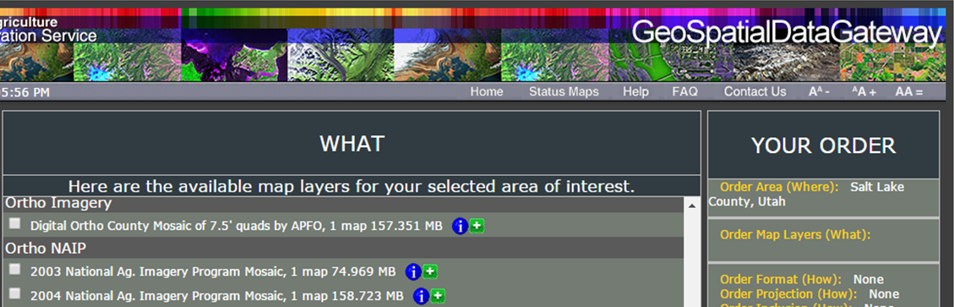
Other NAIP Sources
GeoSpatial Data Gateway website
Map library of high resolution vector and raster layers including NAIP
Search by county, state, place, or custom AOI
Download or shipped on media
Notes:
The Geospatial Data Gateway (GDG) provides access to a map library of over 100 high resolution vector and raster layers in the Geospatial Data Warehouse. It’s a great source for environmental and natural resources. It allows you to choose your area of interest, browse and select data, customize the format, then download or have it shipped on media.

Slide 18
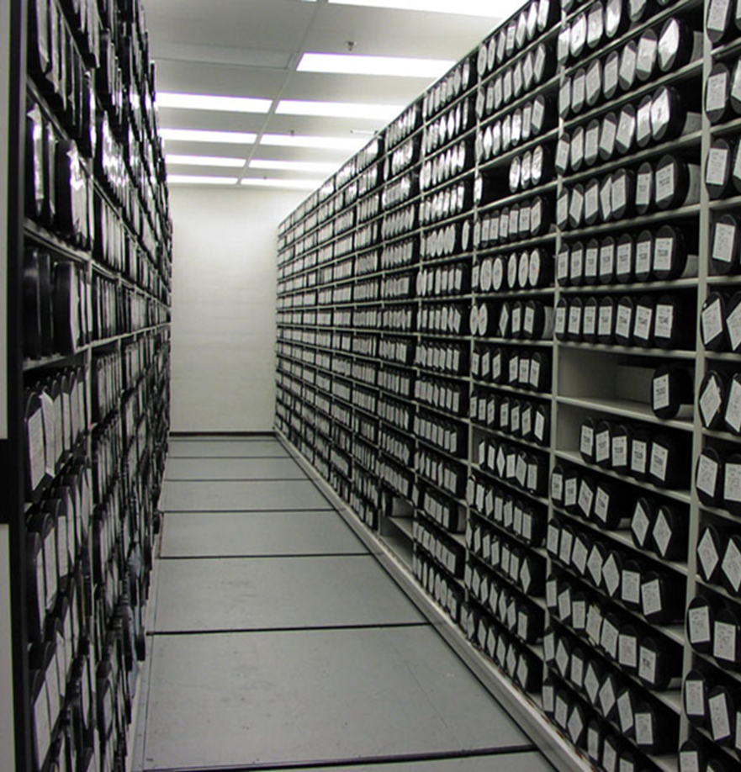
NAPP
A little history…
NARA (National Archives and Records Administration) for pre 1955 imagery
Pre 1980: B&W images
NHAP (National High Altitude Photography)
NAPP (National Aerial Photography Program)
Notes:
Any imagery dated earlier than 1955 can likely be acquired from a Regional Office or from NARA which stands for the National Archives and Records Administration. APFO is currently in the process of scanning all of their film, and the canisters will be heading to NARA over the next couple of years. Before 1980, most national aerial photo programs were collecting mainly black and white imagery in 5 year cycles.
NHAP: Starting in 1980 there was NHAP which stands for National High Altitude Photography. This program collected both color infrared and black and white images over a span of 7 years.
NAPP: In 1987 the National Aerial Photography Program (NAPP) began and it was essentially just an extension of the NHAP program. The main difference was the imagery was collected at a finer resolution.

Slide 19
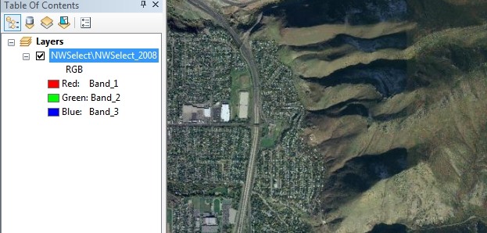
NWSelect
Nationwide Select
NAIP at largest scale
Landsat and MODIS at smaller scales
Notes:
This service uses a mosaic made mostly from NAIP and also uses Landsat and MODIS for viewing at smaller scales.

Slide 20
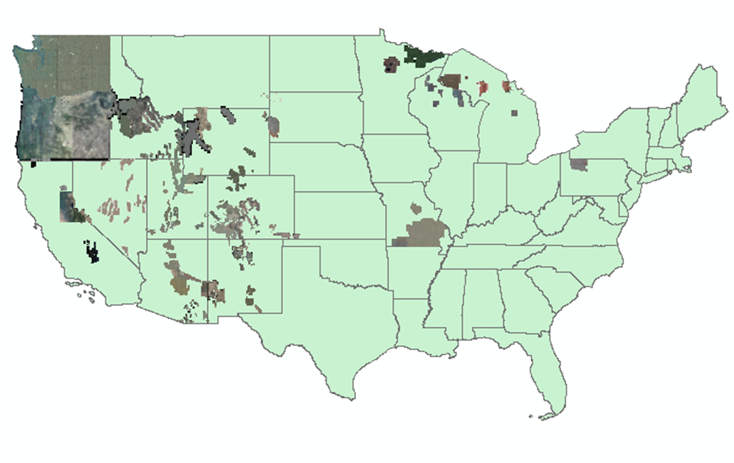
Resource Photography
Resource and high resolution satellite –
individual services by project
Notes:
This Resource Photography folder contains imagery from various projects around the country. Much of it is very high resolution, around 1 ft to 6 inch.

Slide 21
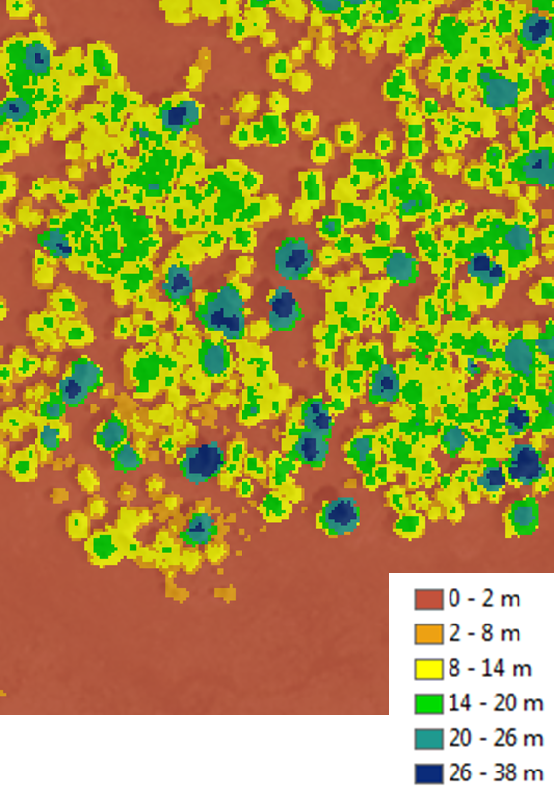
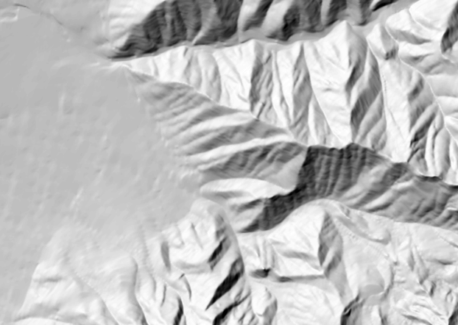
Terrain
Lidar Derivatives:
Bare earth
Highest hit hillshade
Bare earth hillshade
Canopy height
Others….
Notes:
The Terrain folder contains mostly lidar derivatives such as Bare Earth, Canopy Height, and Canopy Cover models which are very useful for analyzing terrain and forest metrics for management decisions.

Slide 22
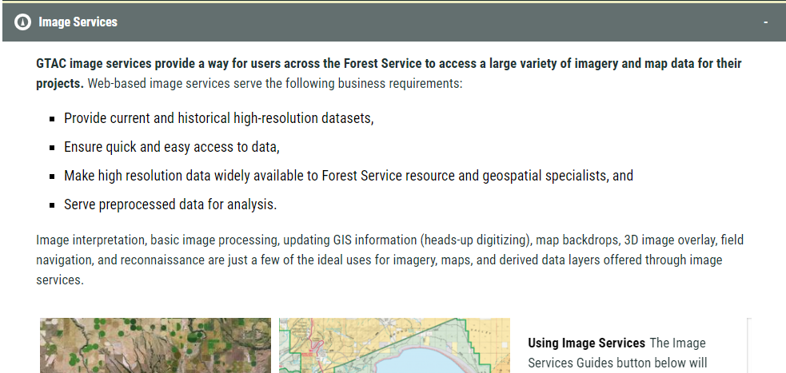
Image Services Overview Page
Image Services website
Important information regarding updates
Links to articles about using the services
Notes:
On the GTAC website there is a page for IS. This page explains recent updates and essential information about the service, and also has links to articles with more helpful information.

Slide 23
Getting Your Data Hosted on Image Services
Before submitting a request, consider the following:
Make sure the service isn’t already published
Not all file formats, bit depths, or imagery types will be accepted
Single mosaic or tiled
Should already be fully processed
Color balanced
Orthocorrected
Other processing
Submit request to: SM.FS.GTAC@usda.gov
Notes:
If you have data you would like hosted on Image Services, you can submit a request to GTAC. Before doing that you should make sure the data isn’t already on the server. Not all file formats, bit depths, and imagery types are acceptable. The data can be single mosaic or tiled and it should already be fully processed meaning it has already been color balanced, orthorectified, and so on… GTAC simply doesn’t have the funding to do those processing steps for you.
Your request will be reviewed for appropriateness. If it’s approved, copy the data to an external hard drive or a thumb drive and mail it to GTAC (an address and point of contact will be provided if approved). Drives will be returned after the service has been published.

Slide 24
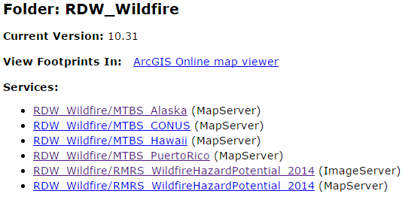
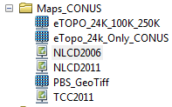
Image Services vs. Map Services
= Image Service
= Map Service
Notes:
Map Services
Required to maintain a legend
Processing capabilities limited with Map Services
Dual Function Image Services
Cached and Dynamic Services

Slide 25
What are Caches?
Similar to image pyramids for improving speed of image display
a.k.a Static map service
Preprocessed tiles stored on your hard drive
Meant for zooming and panning
NOT for processing or detailed analysis (must switch to Dynamic mode to access raw data)
Notes:
A major improvement of the new Image Services over the old Image Server is the ability to create image service caches. Caches are reduced resolution JPG images, and were not designed by ESRI to be used for anything other than improving drawing speeds when navigating the imagery. This is also known as a static map service. Caches are pre-generated at GTAC, similar to how you would create image pyramids on your own imagery. As you pan and zoom around the image, the cache tiles are delivered to your computer faster than the raw imagery would be drawn. Be aware that in order to perform processing on the served imagery, you will need to turn the caching off and work in the dynamic mode.

Slide 26
Questions?

Slide 27
Raster Data Warehouse Overview
Part of the Enterprise Data Warehouse at the FS Kansas City Data Center
Intended for authoritative FS produced products (not raw data or imagery)
External (public) facing and internal (FS only) options
All data submitted reviewed by Content Governance board (same as EDW)
More information on GTAC’s website
Notes:
The Raster Data Warehouse (RDW) is a part of the Enterprise Data Warehouse (EDW) program. The purpose of these programs is to integrate data from different sources so that they can be used for viewing, reporting and analysis. Additionally, the data are meant to be shared across the Forest Service as well as with the public. Currently for capacity reasons, the RDW is only accepting data layers covering the continental US or multi-regional data. Only authoritative Forest Service produced products are acceptable for submission, so that means no imagery, raw data, or scanned georeferenced products will be accepted by the Content Governance Board. All services for RDW and EDW are discoverable through data.gov and the FS Geodata Clearinghouse. Also, GTAC’s public facing website contains information about it.

Slide 28
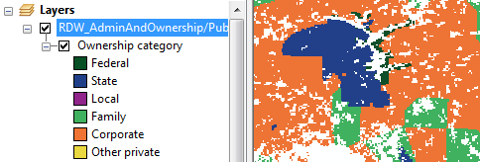
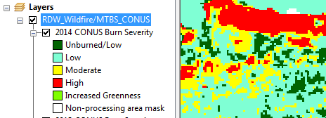
RDW – Folder Setup
Folders contain continuous and thematic raster datasets
Administration and Ownership
Climate
Engineering and Earth Science
FHP Tree Species Metrics
Forest Ecology
Forest Health
Inventory and Products
Landscape and Wildlife
Watershed
Recreation
Wildfire
Notes:
Here is how the RDW data is organized. Most of the datasets in these folders contain a single layer of information that is represented continuously (such as a phenomena that ranges from values of 0 to 100) or thematically with labeled (e.g. low, medium, and high) or binned (such as 1 to 10, 10 to 20.) categories. Several of these folders don’t yet contain any data

Slide 29
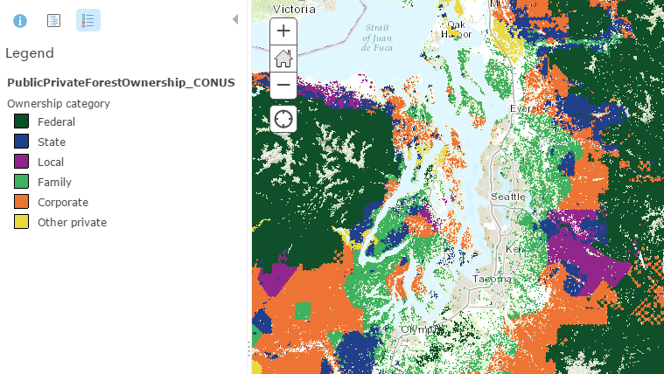
RDW_AdminAndOwnership
Public/Private forest ownership data designed for national or regional scale analysis
Notes:
This Admin and Ownership layer is designed for strategic analyses at a national or regional scale but not for informing local management decisions because the map accuracy varies considerably

Slide 30
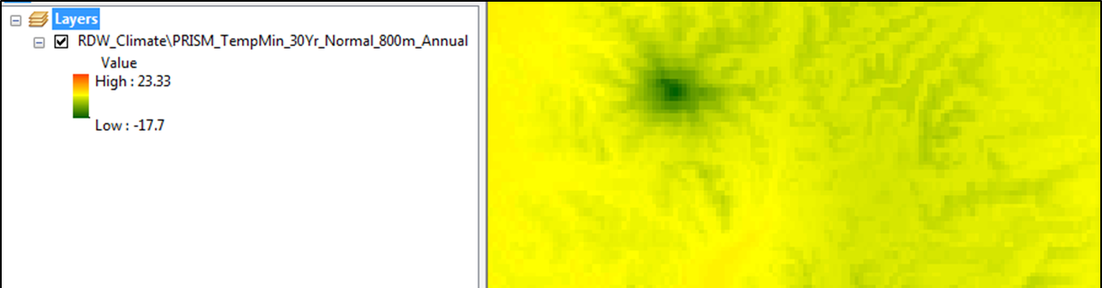
RDW_Climate
Precipitation 30 year normal
Minimum Temperature 30 year normal
Notes:
Here are some examples of layers in the climate folder. These two show 30 year average precipitation and minimum temperature at a 800 m grid cell resolution.

Slide 31
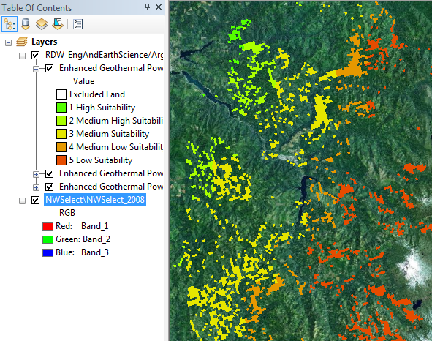
RDW_EngAndEarthScience
Data from the Argonne National Laboratory
Power potential layers
Biomass
Geothermal
Solar
Photovoltaic
Wind
Notes:
The Engineering and Earth Science folder contains data from the Argonne science and engineering laboratory. The layers show the various methods of potential power production in our forests.

Slide 32
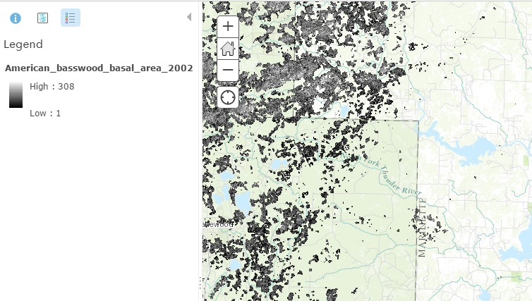
RDW_FHP_TreeSpeciesMetrics
Over 300 species
Notes:
The Tree species metrics folder has layers showing nationwide basal area for over 300 species

Slide 33
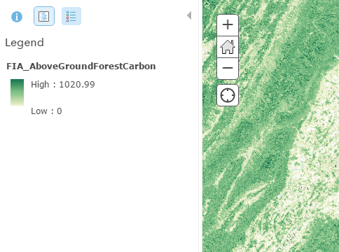
RDW_ForestEcology
Forest carbon layers:
Above Ground
Below Ground
Dead Down
Forest Litter
Forest Soil
Standing Dead
Total Forest
Understory
Notes:
The Forest Ecology folder has 8 raster maps showing estimates of forest carbon density as estimated from the annual Forest Service Inventory and Analysis Program.

Slide 34
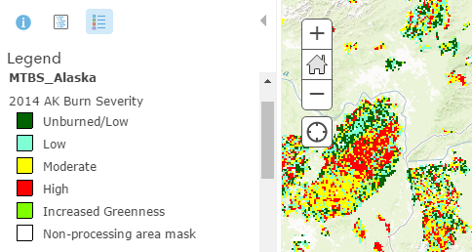
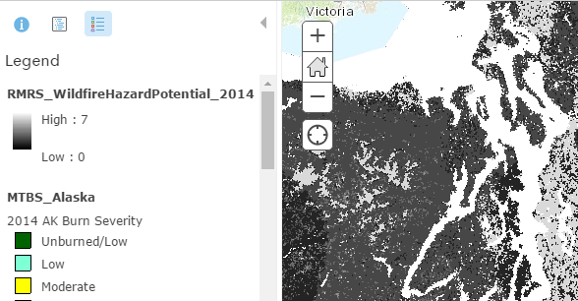
RDW_Wildfire
Data from the Monitoring Trends in Burn Severity (MTBS) project
Wildfire Hazard Potential
Notes:
In the Wildfire folder there are layers which classify burn severity. The wildfire hazard potential layer can help inform evaluations of fuels management needs across millions of acres.

Slide 35
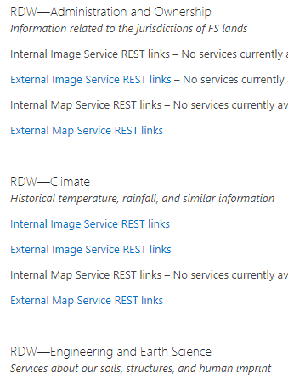
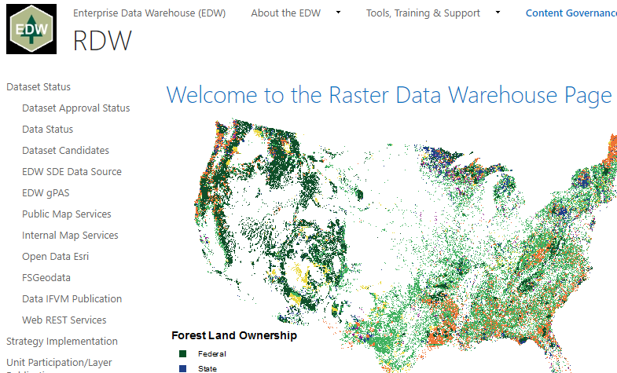
RDW SharePoint
RDW Sharepoint website
Basic info about RDW
Links to all published RDW services
Notes:
The RDW has a sharepoint website that I’ve linked here. It provides essential information about the Server as well as links to each of the internal and external services.

Slide 36
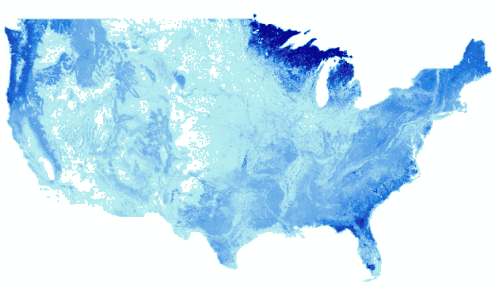
Getting Your Data Hosted on the RDW
Data qualifications for RDW:
• Supports the Forest Service mission
• Authoritative for the subject
• Has a multi-regional or national scope
• Well documented with metadata
Process to keep data current
Notes:
If you have raster data which you would like hosted on the RDW, make sure it meets these qualifications. It should support the Forest Service mission which is to “sustain the health, diversity, and productivity of the Nation's forests and grasslands to meet the needs of present and future generations”. It should be authoritative and have a national or multi-regional scope. Make sure it has sufficient metadata. Finally, do you have a process to keep the data current?

Slide 37
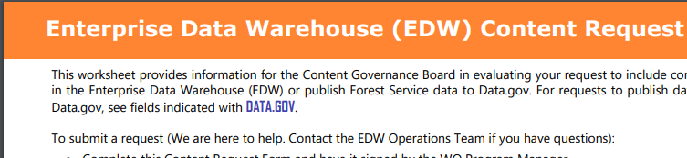
RDW Data Hosting Process
Download and Complete the Content Request Form
Submit to SM.FS.data@usda.gov
Meet with Content Governance Board
Transfer Data to RDW
NAS
FTP
Portable Hard Drive
Follow-up call with RDW staff
Notes:
Before the data can be included, it will need to go through a review and vetting process, and then be prepared for publication. On the RDW page you can download the Content Request Form (or just use the link here). On the form you can indicate if you want the data to also be posted to data.gov and geoplatform.gov. Once you have filled in all relevant information, email the form to an appropriate member of the Content Governance Board as listed on the sharepoint site. The Content Governance Board will then evaluate your proposal you will be notified if your request is acceptable. If it is, a meeting will be set up to review your data. After the data is approved, you can provide the data to the RDW staff and have a follow-up call with them to discuss the details of how the data will be shared, including whether it is placed on the internal or external server.

Slide 38
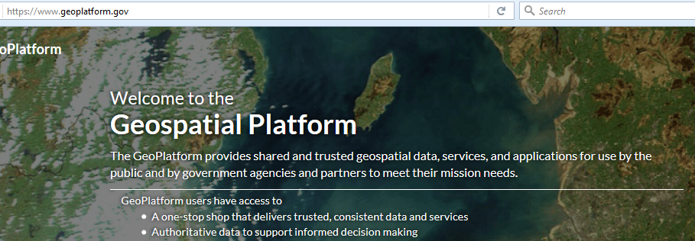
data.gov & geoplatform.gov
Other public facing outlets for RDW data
Notes:
All data posted to the RDW will eventually be posted on data.gov unless the person who submitted the data requests otherwise. Geoplatform.gov is another site where you can find RDW data. These are sites where the public can access the data.

Slide 39
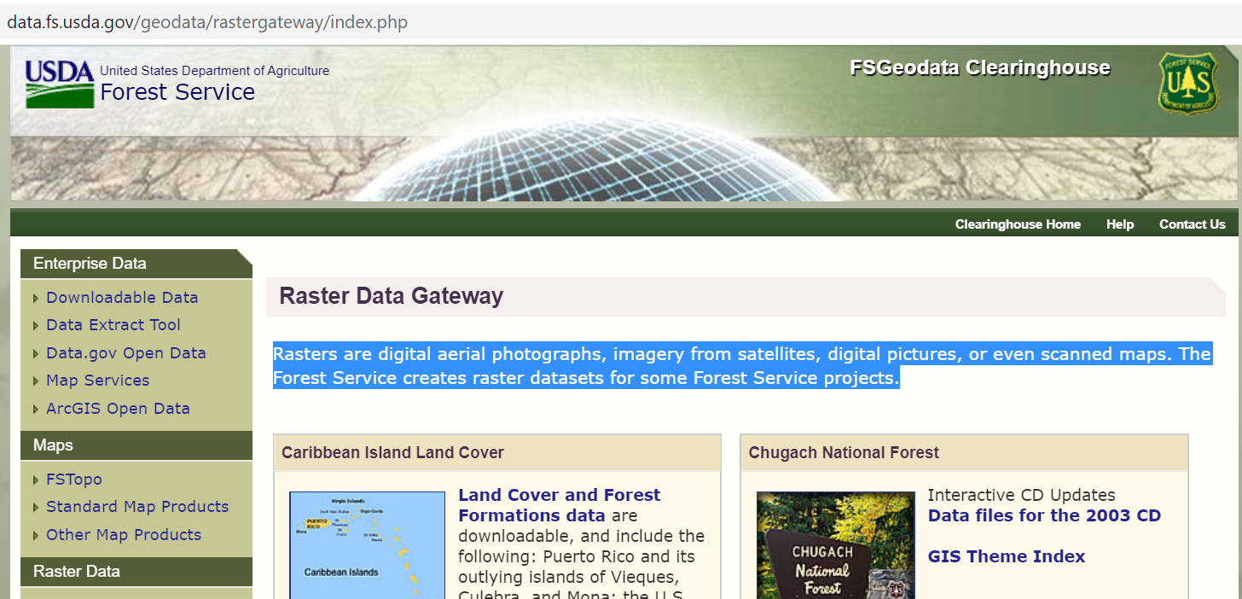
FSGeodata Clearinghouse
Download datasets including national forest type, biomass, and post-fire vegetation conditions

Slide 40
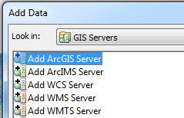
Access IS and RDW Server in Arc
Go to “Add Data”, click on the ”Look in” drop down, and select “GIS Servers”
Double click on “Add ArcGIS Server” and press “Add”
Ensure “Use GIS services” is selected and click on Next.
In the Server URL field, type in one of the following addresses:
Image Services: https://image-services-gtac.fs.usda.gov/arcgis
Internal RDW Map: https://apps.fs.usda.gov/arcn/services
Internal RDW Raster: https://apps.fs.usda.gov/fsgisn01/services
External RDW Map: https://apps.fs.usda.gov/arcx/services
External RDW Raster: https://apps.fs.usda.gov/fsgisx01/services
Notes:
Here are the steps for adding the IS and RDW Servers to ArcCatalog. Notice the different URLs for the internal and external RDW Servers.

Slide 41
Access IS & RDW Outside of ArcGIS
Server REST pages
REST: REpresentational State Transfer (type of web service)
Most basic way to access the server data
Pages include service descriptions and metadata
Various way to view data including Google Earth and AGOL
Notes:
You can access the IS and RDW Server data on their REST pages. REST is an acronym for Representational State Transfer which is a method of transferring information to your web browser. On the server REST pages you will find descriptions and metadata for each of the services. You will also find several ways to view the service data, including a link to download a KML file to view the data in Google Earth. You’ll notice that the internal and external RDW servers have partly different data. This is just a matter of if the data owner needed it available for external and internal users, or only internal. However, anything on either location has gone through the governance process and is authoritative.

Slide 42
Access IS and RDW in AGOL
ArcGIS Online (AGOL)
Cloud based WebGIS
Share maps, apps, data, etc…
Doesn’t work well with Chrome
Must setup account:
Notes:
ArcGIS Online (AGOL) is a cloud based Web GIS content management platform for collaboration and sharing of maps, applications, data and other geospatial information. The Forest Service is implementing AGOL enterprise wide to provide a method for publishing and communicating both standard and non-standard, unit-level spatial information to the public, agency cooperators, and other government entities. Please note, I’ve had issues with AGOL when using it in Chrome so you may have better luck with Internet Explorer or Firefox. To access the Forest Service AGOL you must first submit an account application which I’ve linked here.
As a federal agency we are under mandate with OMB-M15-13 which states all government websites must be accessed via HTTPS only, including ArcGIS Online. What this means for you in ArcGIS Online is that any content added to maps or applications (e.g. map, image or data services, pictures, logos, etc.) must come from HTTPS sources. Content that reference a non-https source (http) could potentially create mixed content error messages and\or broken source data errors within ArcGIS Online web maps and other web map viewers.

Slide 43
Access IS and RDW in AGOL
AGOL already has small collection of NAIP
Can’t change band combo
Add servers in AGOL
In the Map menu, click Add | Search for Layers
In: A GIS server
Notes:
You may notice that AGOL has a small collection of NAIP imagery. Some have asked why GTAC provides NAIP imagery on Image Services when AGOL has NAIP in its collection. Here’s 4 reasons 1) Image Services offers many more years of NAIP than AGOL. 2) ESRI could eliminate NAIP imagery from AGOL at any time. 3) NAIP is posted to Image Services much sooner than ESRI posts it to AGOL. And 4), you can’t change the band combo and utilize the infrared band of NAIP in AGOL.
You can access the IS and RDW servers in AGOL by following these instructions. I’ll demonstrate this later on.

Slide 44
USGS Elevation Data
Image Services no longer has CONUS elevation
Instead use USGS 3DEP service: https://elevation.nationalmap.gov/arcgis/rest/services

Slide 45
Summary of Links
RDW sharepoint: https://usdagcc.sharepoint.com/sites/fs-cio-edwts/SitePages/RDW.aspx
Internal RDW Map: https://apps.fs.usda.gov/arcn/rest/services
Internal RDW Raster: https://apps.fs.usda.gov/fsgisn01/rest/services
External RDW Map: https://apps.fs.usda.gov/arcx/rest/services
External RDW Raster: https://apps.fs.usda.gov/fsgisx01/rest/services
FSGeodata Clearinghouse: https://data.fs.usda.gov/geodata/rastergateway/index.php
Image Services: https://image-services-gtac.fs.usda.gov/arcgis
Image Services website: https://apps.fs.usda.gov/gtac/products#imageservices
Image Services data addition requests: SM.FS.GTAC@usda.gov
Image Services REST page: https://image-services-gtac.fs.usda.gov/arcgis/rest/services
AGOL: usfs.maps.arcgis.com
AGOL account setup: https://apps.fs.usda.gov/gtac-tools/AGOL/request_access.php
APFO: https://www.fsa.usda.gov/programs-and-services/aerial-photography/
GeoSpatial Data Gateway: https://gdg.sc.egov.usda.gov/
USGS CONUS elevation data: https://elevation.nationalmap.gov/arcgis/rest/services

