Slide 1
TEUI Geospatial Toolkit
Mark Hammond
Remote Sensing Specialist / Trainer
RedCastle Resources Inc., working onsite at
Geospatial Technology and Applications Center (GTAC)
(801) 975-3497
mark.hammond@usda.gov

Slide 2
Introduction
This workshop is provided by:
USDA Forest Service-Geospatial Technology and Applications Center (GTAC)
Introductory workshop
No previous experience with TEUI Toolkit required
Experience with ArcGIS will be helpful but not required

Slide 3
Workshop Overview
Mixed Format
10 am
Overview
Presentation about the toolkit history and functionality
Exercises 1-3 demo
Work on exercises
Instructor available to provide assistance until 12:30 pm
1:30 pm
Short presentation about case studies
Exercises 4-6 demo
Work on exercises
Instructor available until 4 pm

Slide 4
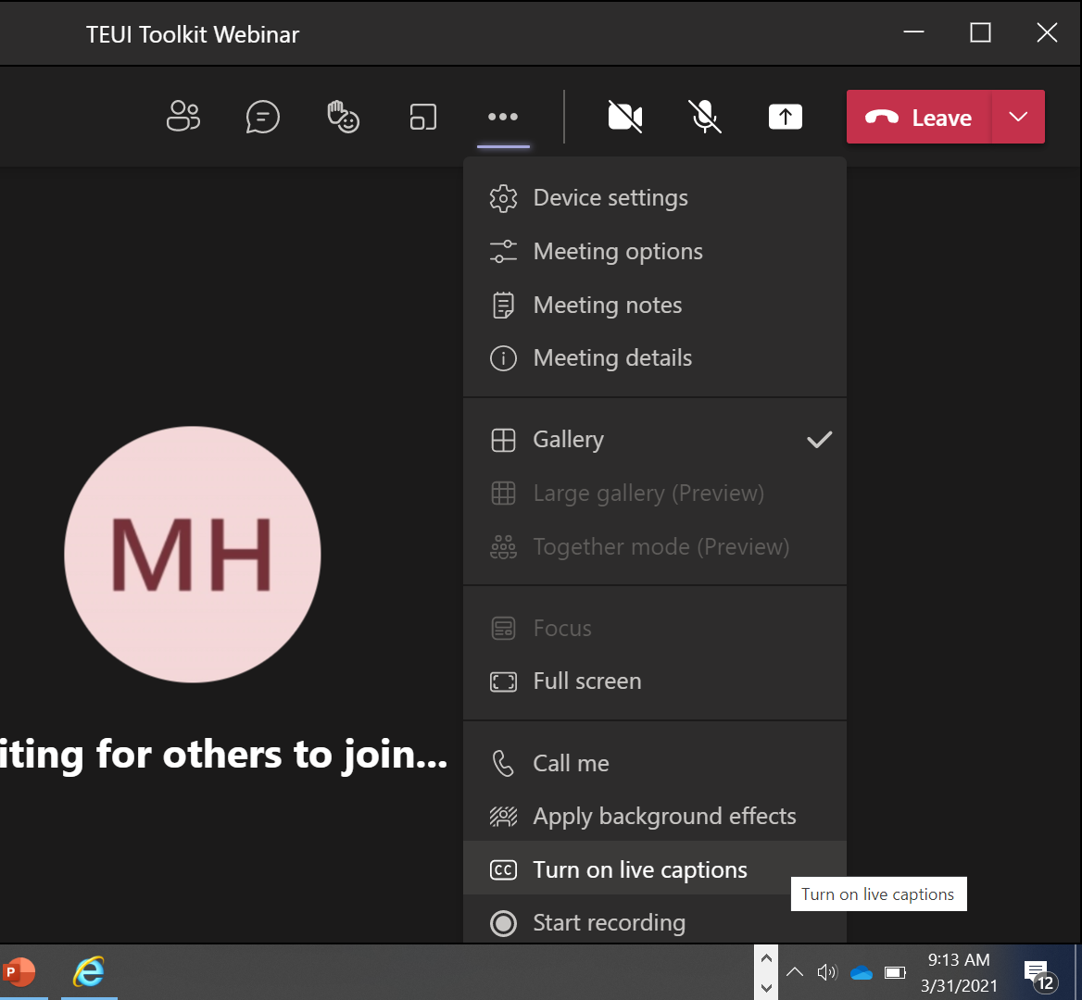
Housekeeping
Question or comment?
Type it in chat
Closed Captioning available in the More Options menu

Slide 5
Course Format & Learning Styles
Many different learning styles: visual, auditory, kinesthetic, etc.
Webinar format seeks to address a variety of learning styles
PPTs, live demonstrations, step-by-step exercises
Content may be repetitive for some people
Feel free skip formats that don’t serve your learning style

Slide 6
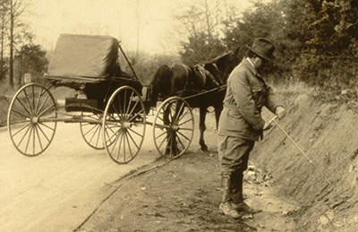
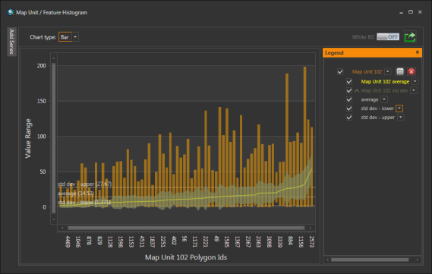
Today’s Topics
MT634
Kootenai NF
TEUI and Toolkit history
TEUI Toolkit 5.8 software
Toolkit Case Studies
Part 1
Part 2

Slide 7
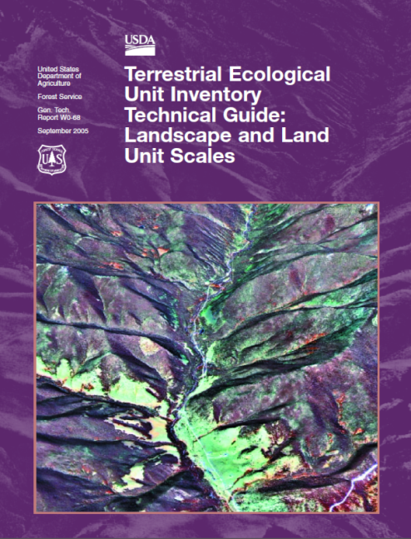
Terrestrial Ecological Unit Inventory
The purpose of TEUI is to classify ecosystem types and map land areas with similar capabilities and potentials for management (Cleland et al. 1997)
Winthers, E., et al. 2005

Slide 8
TEUI Geospatial Toolkit
“An ArcGIS Add-In designed to facilitate and streamline the landscape mapping process.”

Slide 9
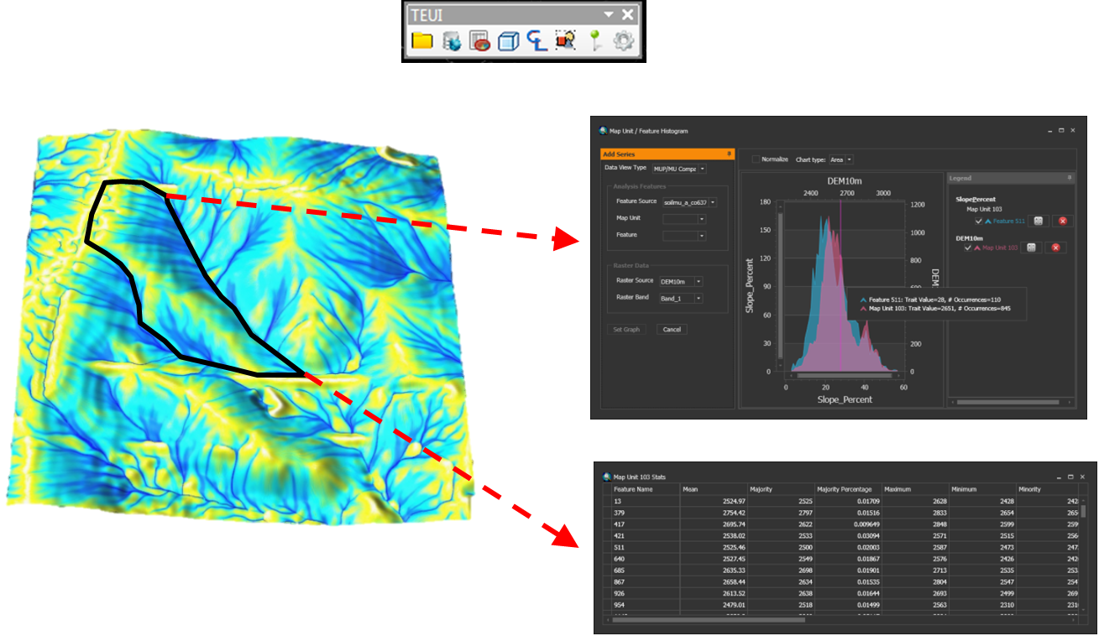
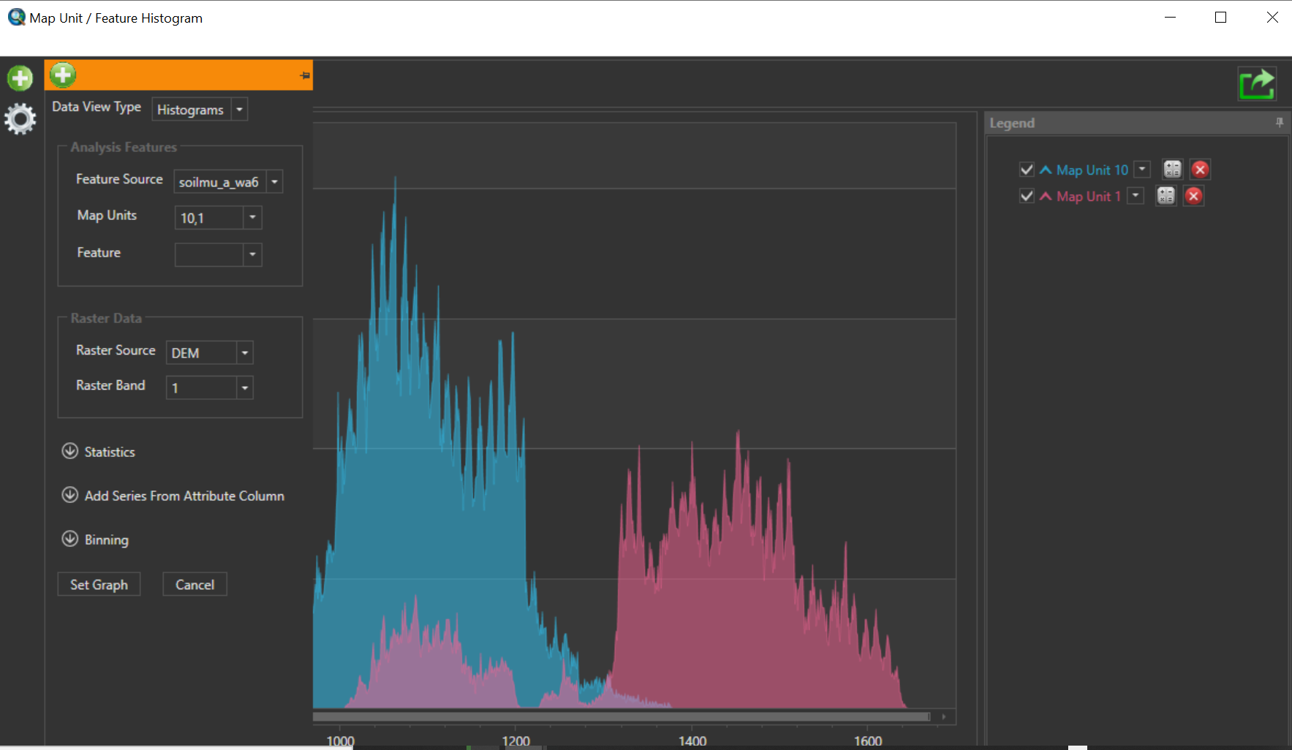
What does the Toolkit do?

Slide 10
What does the Toolkit NOT do?
Not a true digital soil mapping (DSM) tool*
The toolkit does not….
predict soil properties or classes on the landscape
provide estimates of uncertainty

Slide 11
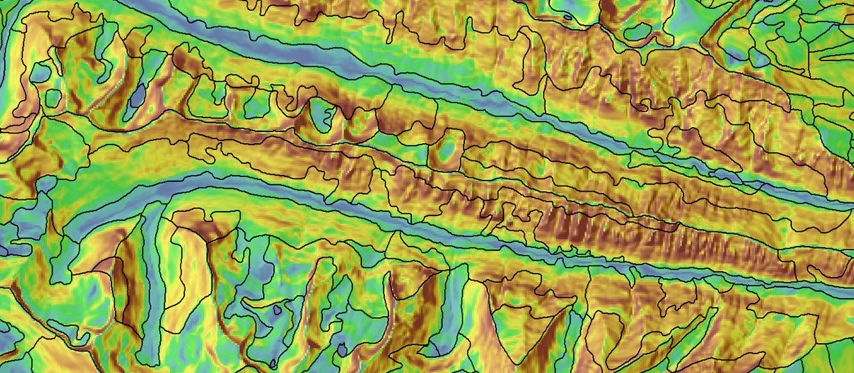
The Toolkit does not develop pre-maps!

Slide 12
But GTAC can do that for you!

Slide 13
TEUI Toolkit History
2001 - 2003
Developed as a set of Erdas models
2004
Migrated to ArcGIS
2004 - 2007
I-Cubed era
2008
TEUI 3.2
2010
TEUI 4.1
2013
TEUI 5.0

Slide 14
GTAC TEUI Program
Software development
and maintenance
Geospatial data provisioning
Help desk
Tech support
Project support
Outreach

Slide 15
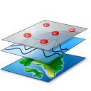
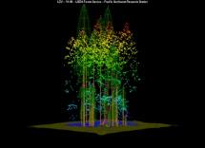
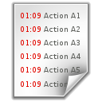
Vision for Toolkit
Lidar product tools
TEUI Module
Data Mining Module
Data
Statistics
Toolkit Engine
Data prep
Utilities
Statistics Reports
ESD
ESD Module
Soil Survey Module

Slide 16
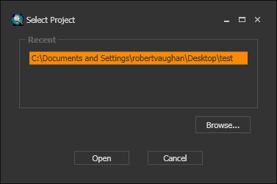
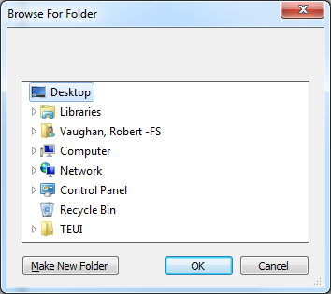
Simple project setup
Select a new project location or an existing project

Slide 17
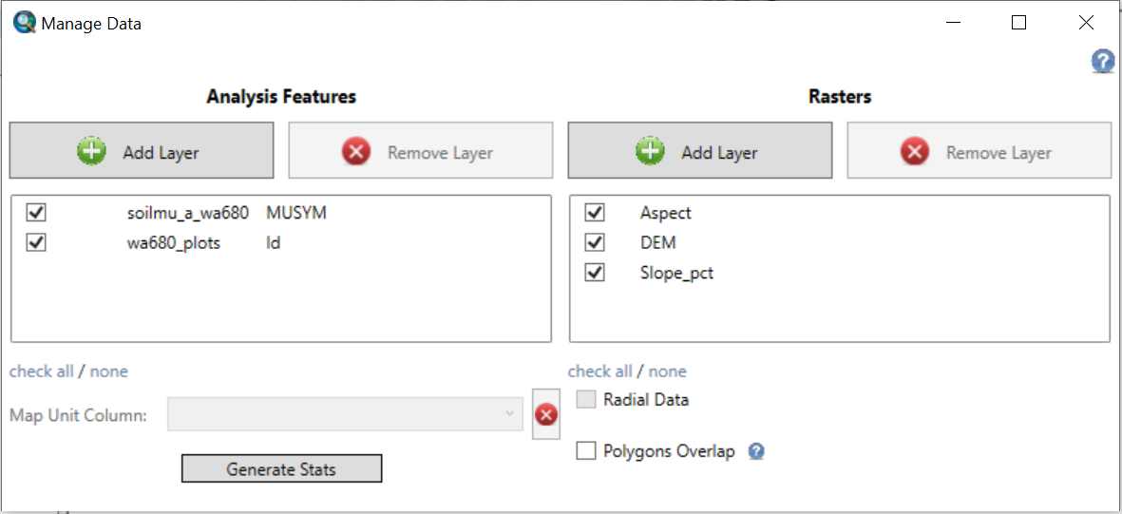
Simple data management interface
“Zones”
“Rasters”
Polygons
Lines
Points
Raster

Slide 18
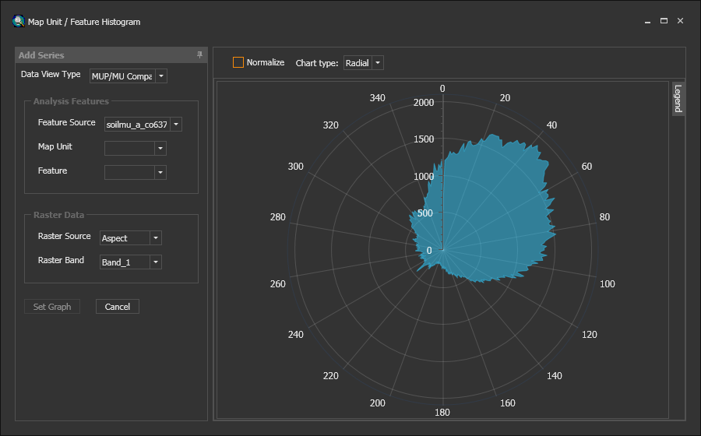
Flexible graph interfaces

Slide 19
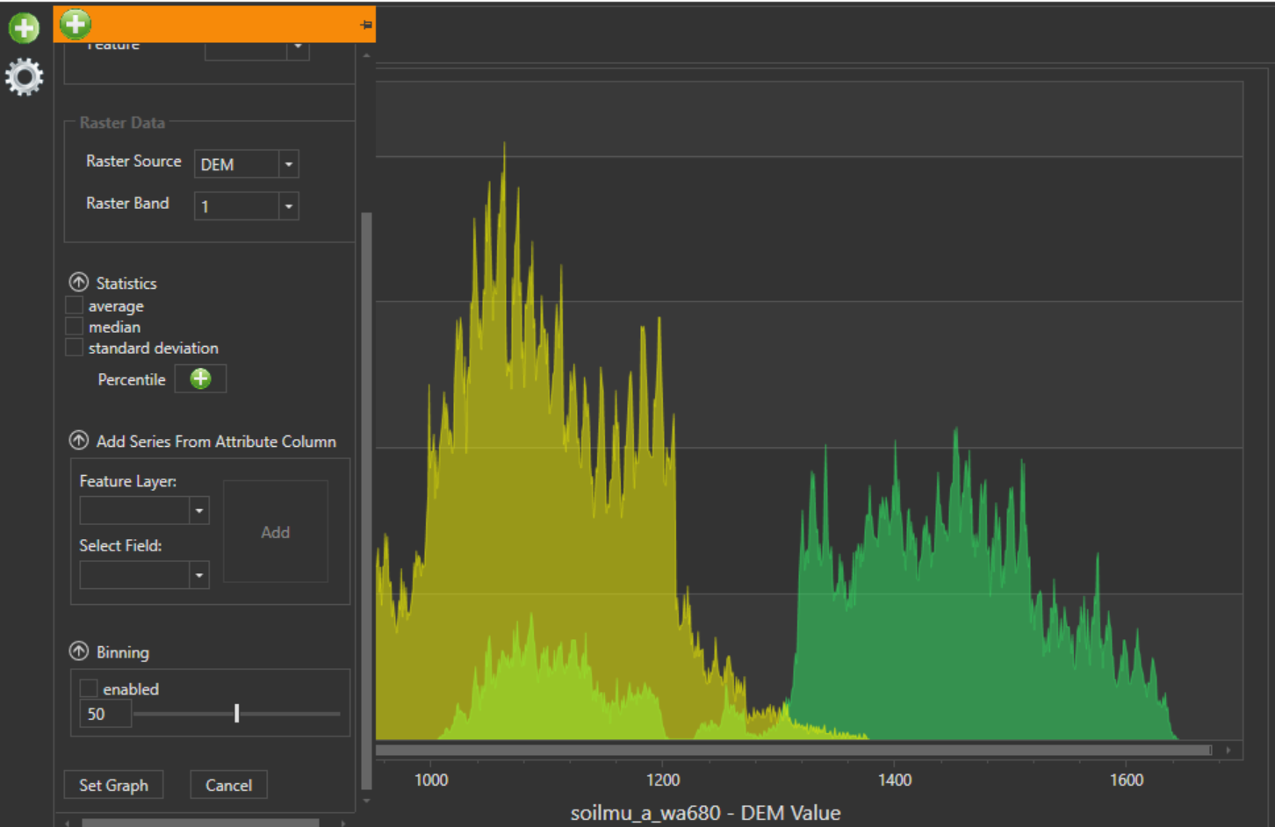
New graphing features

Slide 20
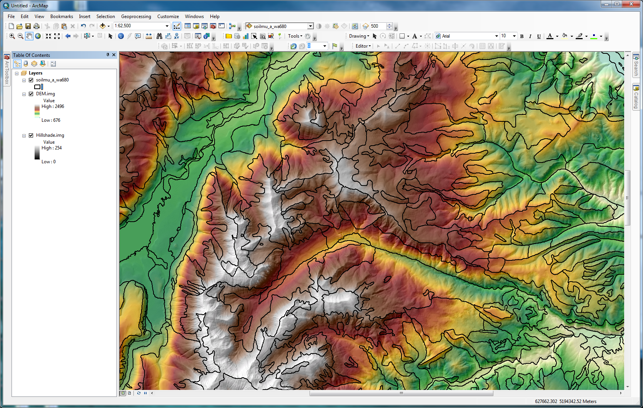
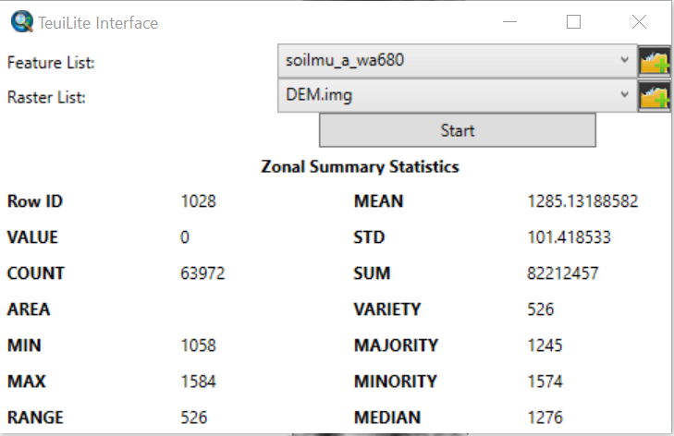
TEUI Lite

Slide 21
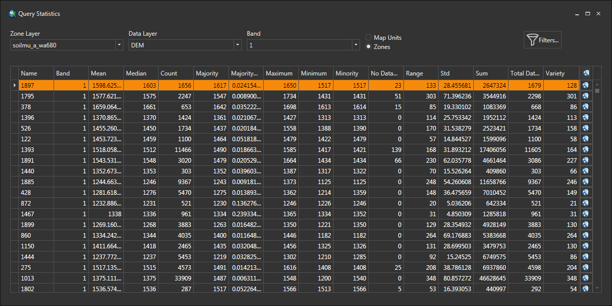
Query Statistics Tool

Slide 22
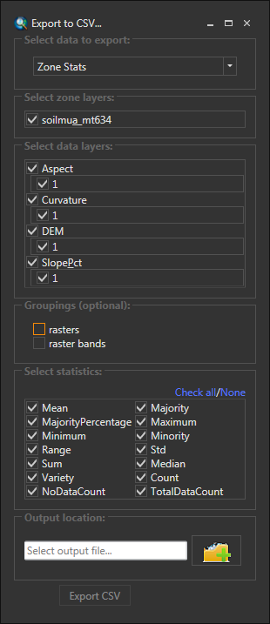
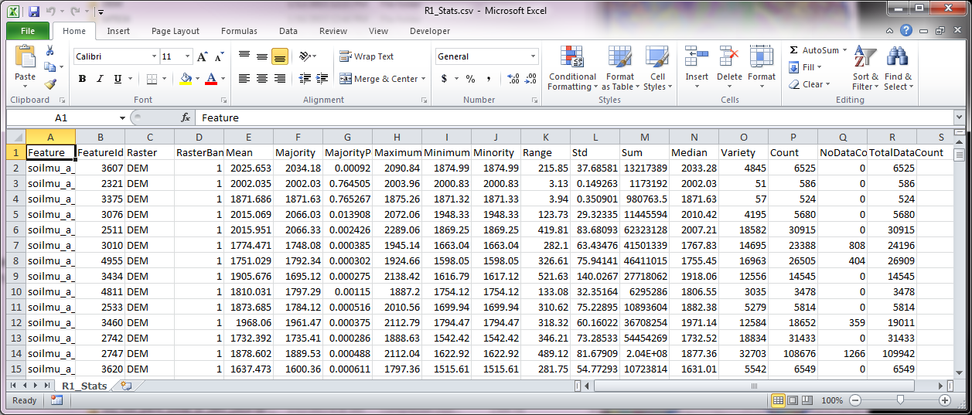
Export statistics
Select…
polygon or map unit statistics
histograms?
raster layers and bands
type of statistic

Slide 23
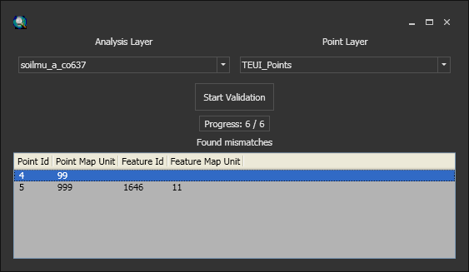
Point-polygon map unit validation
625
620

Slide 24
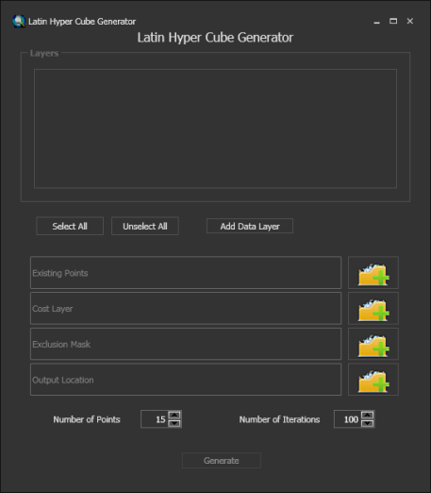
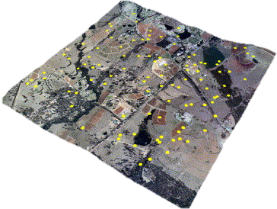
Conditioned latin hypercube sampling (cLHS)
“Stratified random sampling without replacement”
Minasny, Budiman, and Alex B. McBratney. "A conditioned Latin hypercube method for sampling in the presence of ancillary information." Computers & Geosciences 32.9 (2006): 1378-1388.

Slide 25
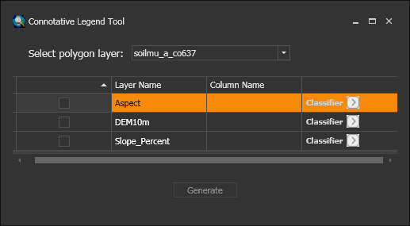
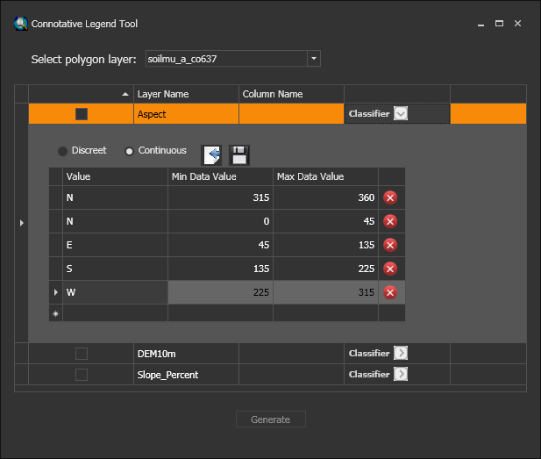
Connotative Legend Tool
Develop a connotative legend
Evaluate existing map units

Slide 26
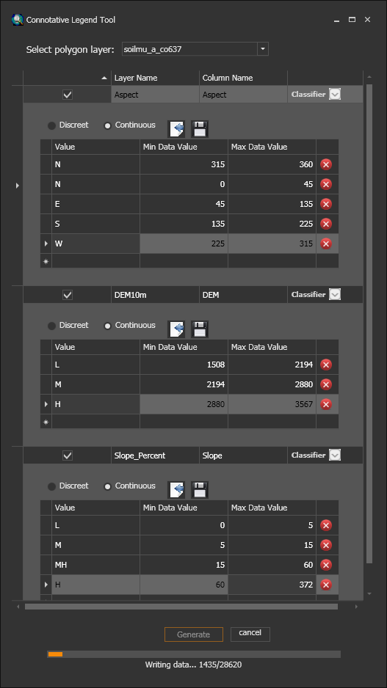
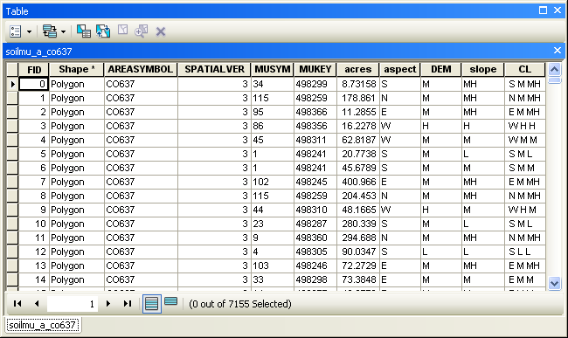
Connotative Legend Tool

Slide 27
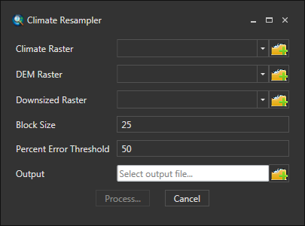
Climate Resampling Tools
Helpful when modelling
Be aware of limitations
Data is altered
Scale may not be appropriate
Method based on Zimmerman et al. 2001

Slide 28
How Climate Downscaling Works
Two new rasters produced
Form linear regression between 1km Temp and 1km DEM layers
1km temperature
or precipitation
Lapse Rate/Slope= B₀
1km DEM
Intercept= B₁

Slide 29
New Climate Raster
Slope/Lapse Rate = B₁
Intercept= B₀
30m DEM= X
Y (temp or precip) = B₀ + B₁ * X
New 30m climate raster!

Slide 30
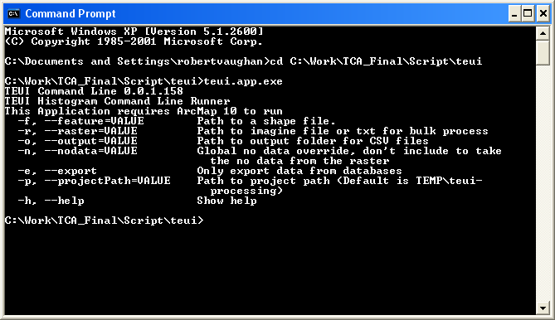
Stand-alone version
TEUI.Commandline.exe
Command line
Python, others…

Slide 31
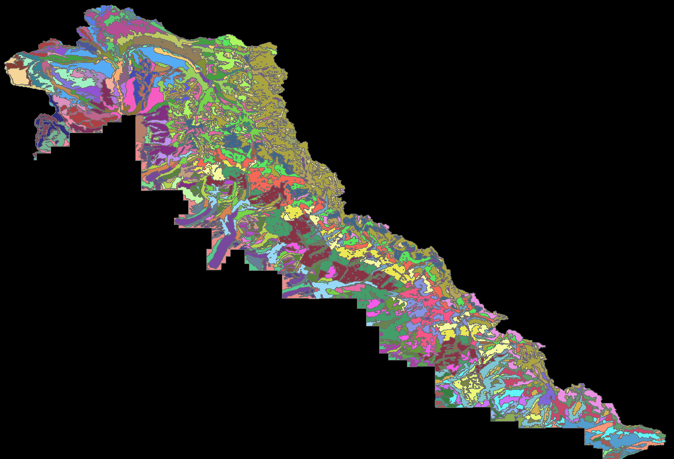
Toolkit applications
TEUI and Soil Survey
Initial mapping
Updates
Map unit
design
validation
QA\QC
Documentation
Bridger Teton NF TEUI (WY622)

Slide 32
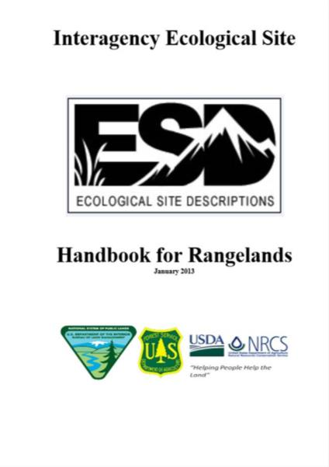
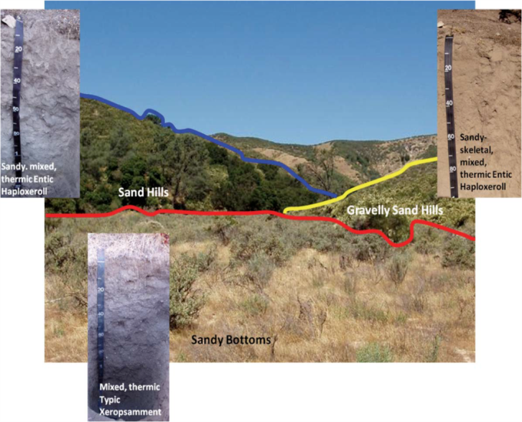
Ecological Site Descriptions

Slide 33
Free self-paced online training
https://usfs-public.box.com/s/5qe7p8eyawyowezcreo2zyb1q10ov9e3

Slide 34
Toolkit information and download
https://www.fs.usda.gov/about-agency/gtac/teui

Slide 35
TEUI Program Leaders
For more information, contact:
Robert Vaughan
Soil Scientist
Remote Sensing/GIS Analyst
RedCastle Resources, Inc.
Working remotely for:
USDA Forest Service
Geospatial Technology and Applications Center (GTAC)
Office\Mobile: (805) 440-2549
Email: robertvaughan@fs.fed.us
Kevin Megown
Resource Mapping, Inventory,
and Monitoring (RMIM) Program Leader
USDA Forest Service
Geospatial Technology and Applications Center(GTAC)
Office: (801) 975-3826
Email: kamegown@fs.fed.us

Slide 36
Soil Survey Example
Notes:
This is a brief example of one way the TEUI Toolkit could be used to validate existing mapping. It could be an update to an existing survey or part of the progressive correlation of an initial survey. For this example, we will look at survey area MT634, Kootenai National Forest in Montana. This is just one way to use the tool, you can find your own methods as well.

Slide 37
Soil Survey Example
Notes:
Survey Area MT634 is located in USFS Region 1

Slide 38
Kootenai National Forest survey area mt634
Notes:
Right up against the Canadian border

Slide 39
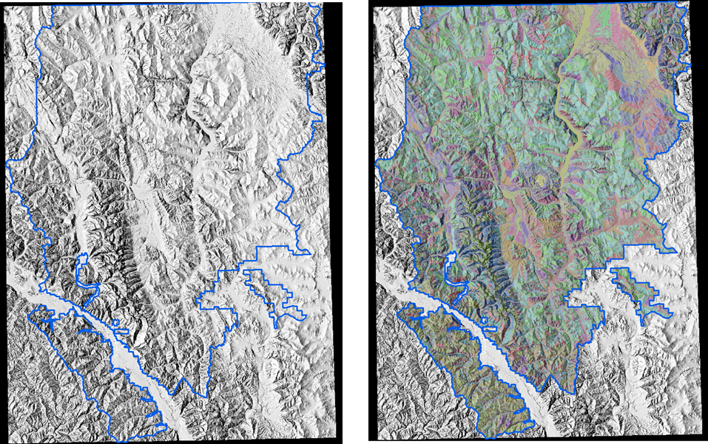
Kootenai National Forest
2,785,803 acres
5,221 polygons
91 map units
Notes:
Some brief descriptions of the survey

Slide 40
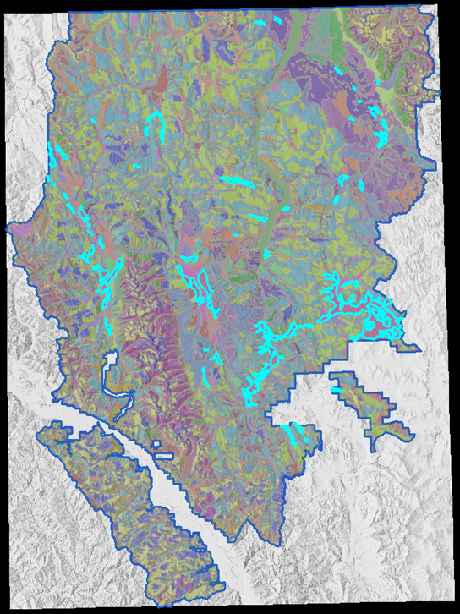
Map Unit Symbol 102
Slope_l = 0% | slope_r = 8% | slope_h = 15%
Elev_l = 610 ft | elev_r = 869 ft | elev_h = 1128 ft
Acres = 62,043 in SA mt643
Notes:
Ok, this example is just a random map unit in the list. Here is some background information, these data represent the range in terrain properties for the map unit. So we percent slope and elevation: _l is the low value, _r is the representative (close to average) value, and _h is the high value.

Slide 41
Map unit 102 Map unit percent slope by feature
Roughly 1/3 of mu polygons slope > 15%
Notes:
So lets look at the map unit chart types. Here we can graph the data ranges for each polygon within map unit 102 for percent slope. There is a little mark where 15% slope (the high range cutoff) occurs. So 1/3 the map unit polygons for this particular map unit have a mean higher than the high range cutoff.

Slide 42
mu 102 feature 2569
Notes:
Lets take a look at polygon feature ID 2569. It has an average of 54 % slopes within the polygon, that is way off our max value of 15% slopes.

Slide 43
mu 102 feature 3330
Notes:
Lets take a look at map unit 102, feature 3330. Here, the average percent slopes appears to be a little more reasonable. But lets take a closer look.

Slide 44
Let’s take a closer look
Notes:
Here are the two polygons with a percent slope layer under them. You can see feature 3330 looks as expected, but feature 2569 has very high slopes.

Slide 45
Feature 3330
Notes:
Here are the tabular stats for feature 3330

Slide 46
Feature 2569
Notes:
Here are the tabular stats for feature 2569

Slide 47
mu 102 feature 2569 vs mu 102! mu 102 | feature 2569 | bar graph
Notes:
Now lets compare a bar graph of map unit 102 (pink) to feature 2569 (blue). I have also normalized the data because the cell count for the overall map unit is much higher than the cell count for just one polygon. These two shapes don’t match at all. There may be a mistake

Slide 48
MU 102 feature 2569 needs review! mu 102 | feature 2569 | feature 3330 | line graph
Notes:
Ok, now lets compare map unit 102 (pink) with feature 2569 (blue) and feature 3330 (green) with a normalized line graph. I think it is easy to conclude that polygon 2569 in map unit 102 will need further inspection. Most likely this polygon was simply attributed with the incorrect map unit symbol and could be quickly changed to a more appropriate map unit symbol.

Slide 49
MU 102 elevation
Notes:
Lets take a quick peek at elevation in map unit 102. Only 4% of polygons > than the high value of 1128 ft. This isn’t too bad and they are relatively close to the cutoff so they are ok.

Slide 50
Take home message
Toolkit can be useful for finding outliers in both initial and existing surveys
Toolkit won’t tell you what is bad, it leaves it up to you, the expert.

Slide 51
Soil Monitoring Unit analysis for NEPA disturbance assessments
Case study provided by Samuel Prentice- CFLRP Soil Scientist on the Payette NF
Notes:
Ok I have one more quick case study to show you. This one is about a soil monitoring unit analysis for a NEPA disturbance assessment.

Slide 52
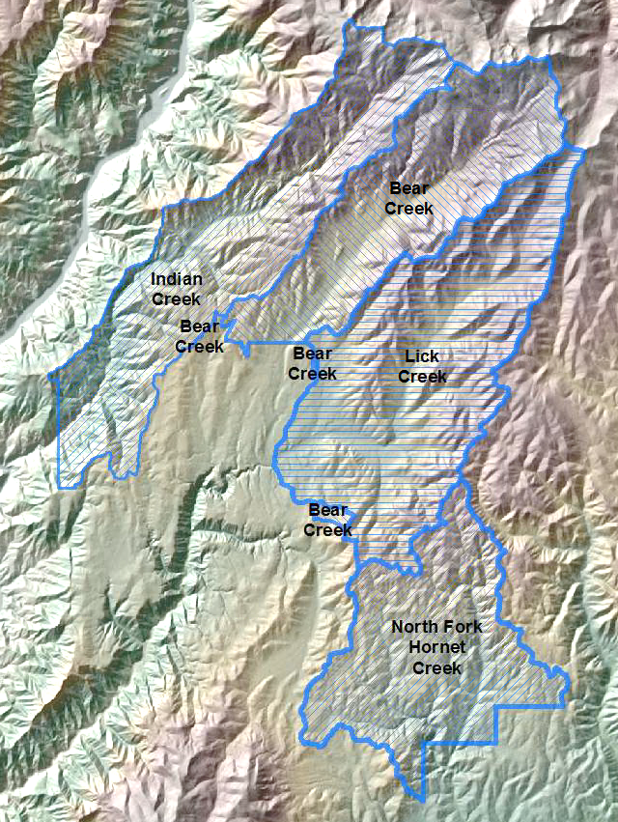
Huckleberry Project Area- Payette NF
NHD Subwatersheds
Notes:
The toolkit’s radial graph makes it easy to compare the aspect distributions of several subwatersheds. We can quickly identify the unique and similar aspect values of these areas. For example, the Indian subwatershed has almost twice as much south and southwest facing terrain as the Lick subwatershed. Consequently, Indian likely has more sun and wind exposed terrain than Lick and that can have significant implications for fire risk, vegetation composition, and calculating spring run-off.

Slide 53
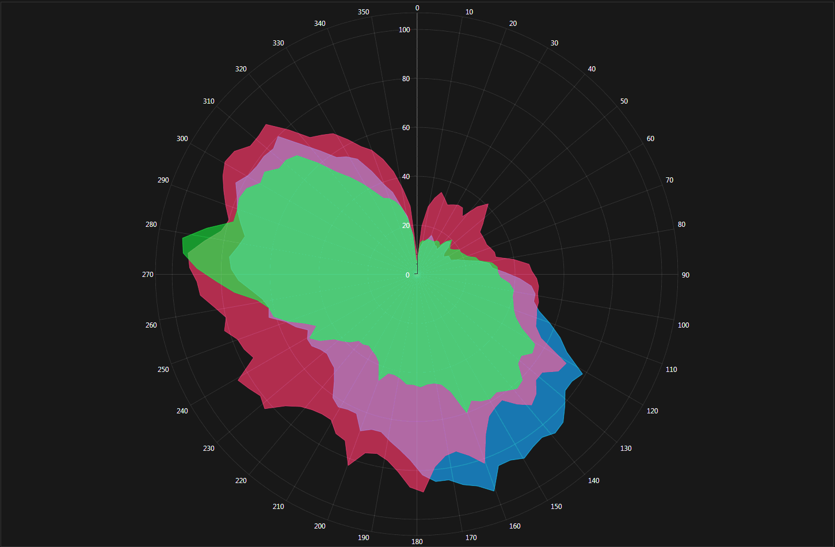
Aspect Distribution by Watershed
Lick
Indian
Bear
Notes:
The toolkit’s radial graph makes it easy to compare the aspect distributions of several subwatersheds. We can quickly identify the unique and similar aspect values of these areas. For example, the Indian subwatershed has almost twice as much south and southwest facing terrain as the Lick subwatershed. Consequently, Indian likely has more sun and wind exposed terrain than Lick and that can have significant implications for fire risk, vegetation composition, and calculating spring run-off.

Slide 54
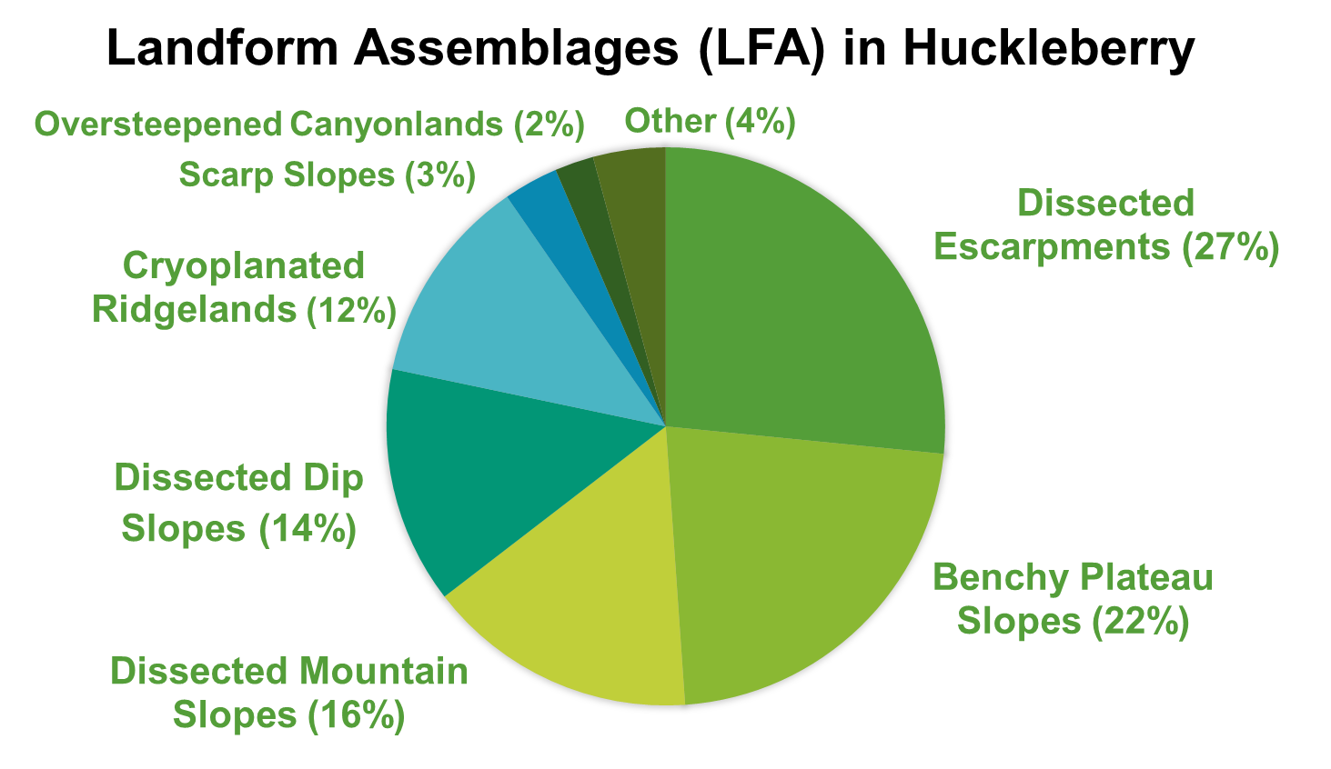
Notes:
Here is how all the landform assemblages are classified in the project area. Dissected Escarpments and Benchy Plateau Slopes make up nearly half of the area. Knowing the size, distribution, and characteristics of these landforms is critical for understanding the distribution of soil types in the area.

Slide 55
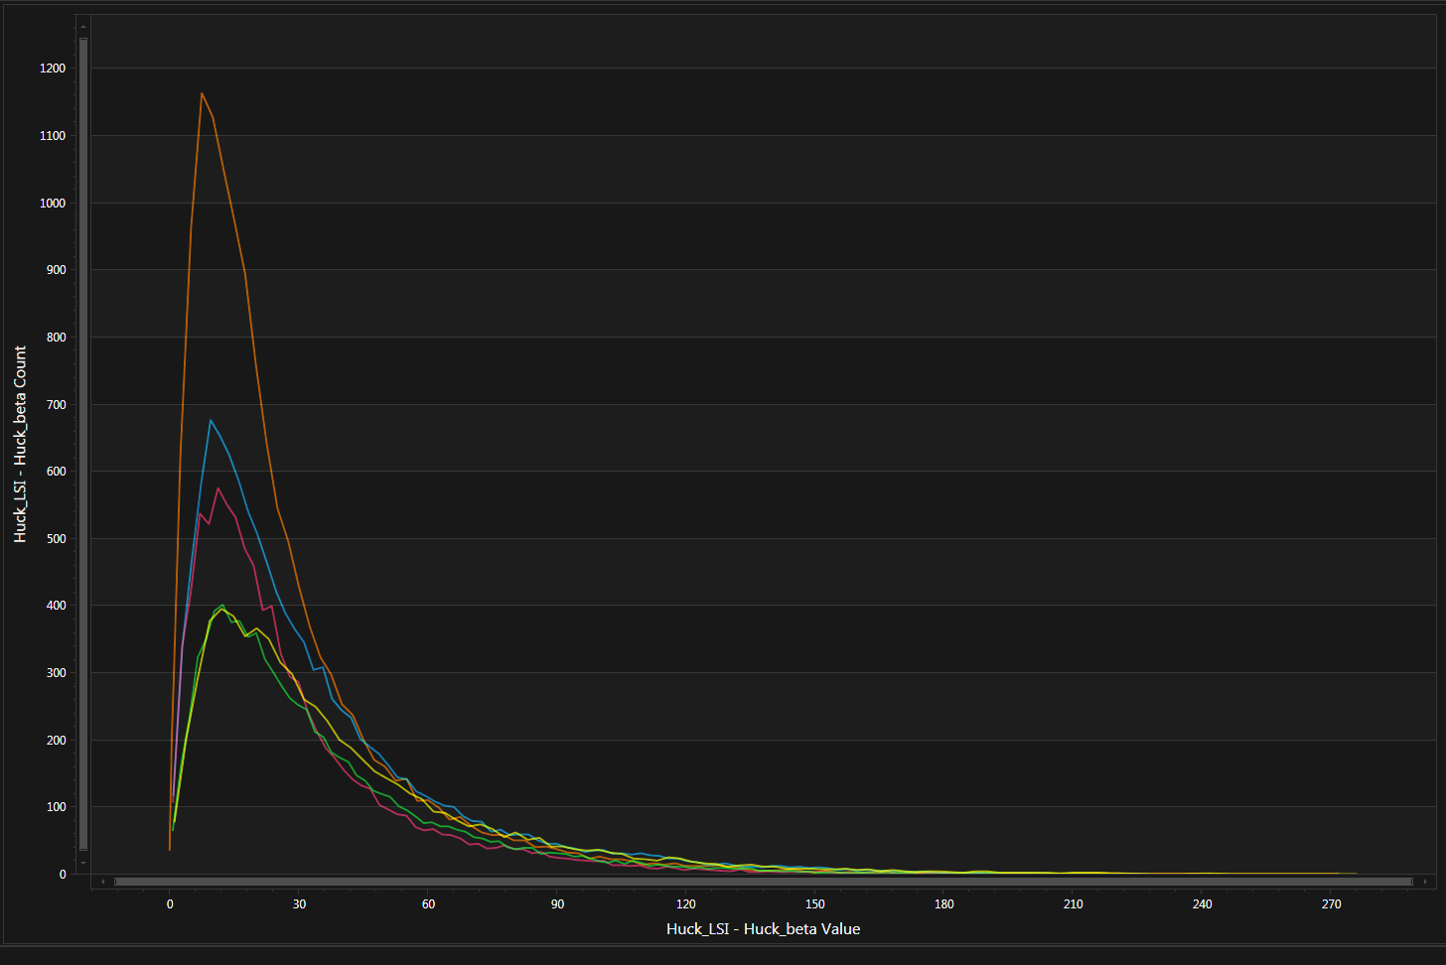
Huckleberry Landform Assemblages (LFA)
Slope gradient distribution
Dissected Escarpments (MU 132)
Benchy Plateau Slopes (MU 134) – least steep
Dissected Mountain Slope Land (MU 120) - steepest
Dissected Dip Slope Land (MU 131)
Cryoplanated Ridgeland (MU 109)
Slope %
Notes:
The toolkit was used to analyze the slope gradient distribution of these landforms. It is readily apparent that the Benchy Plateau Slopes landform contributes the most dominant slope gradient of about 10-15 percent.

Slide 56
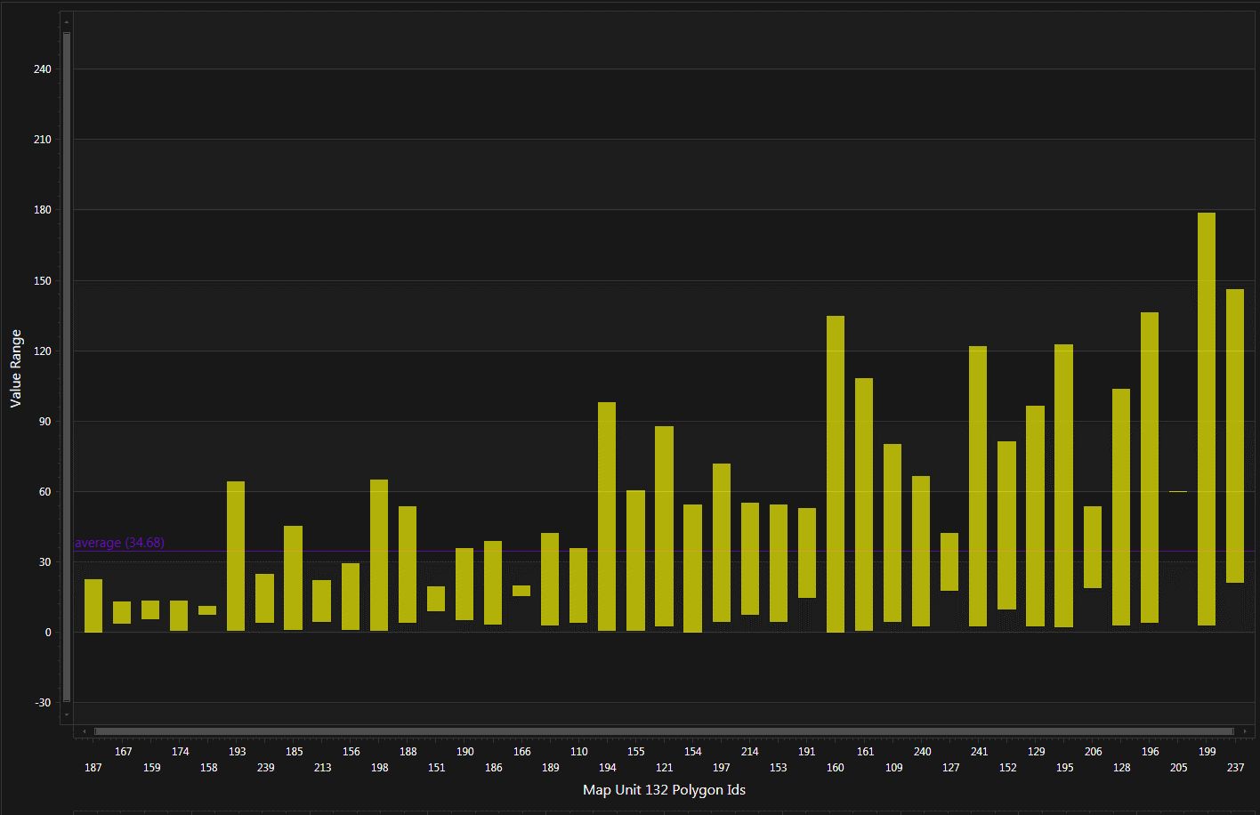
Monitoring Units - Dissected Escarpments (MU 132)
SAMPLED
Slope %
Notes:
The Map Unit Analysis mode was used for a more detailed analysis of each polygon’s slope values within the unit. Some of the polygons have a drastically large range of slope values than the majority. Those outlier polygons might need to be reclassified with a different unit to achieve better accuracy in the analysis.

Slide 57
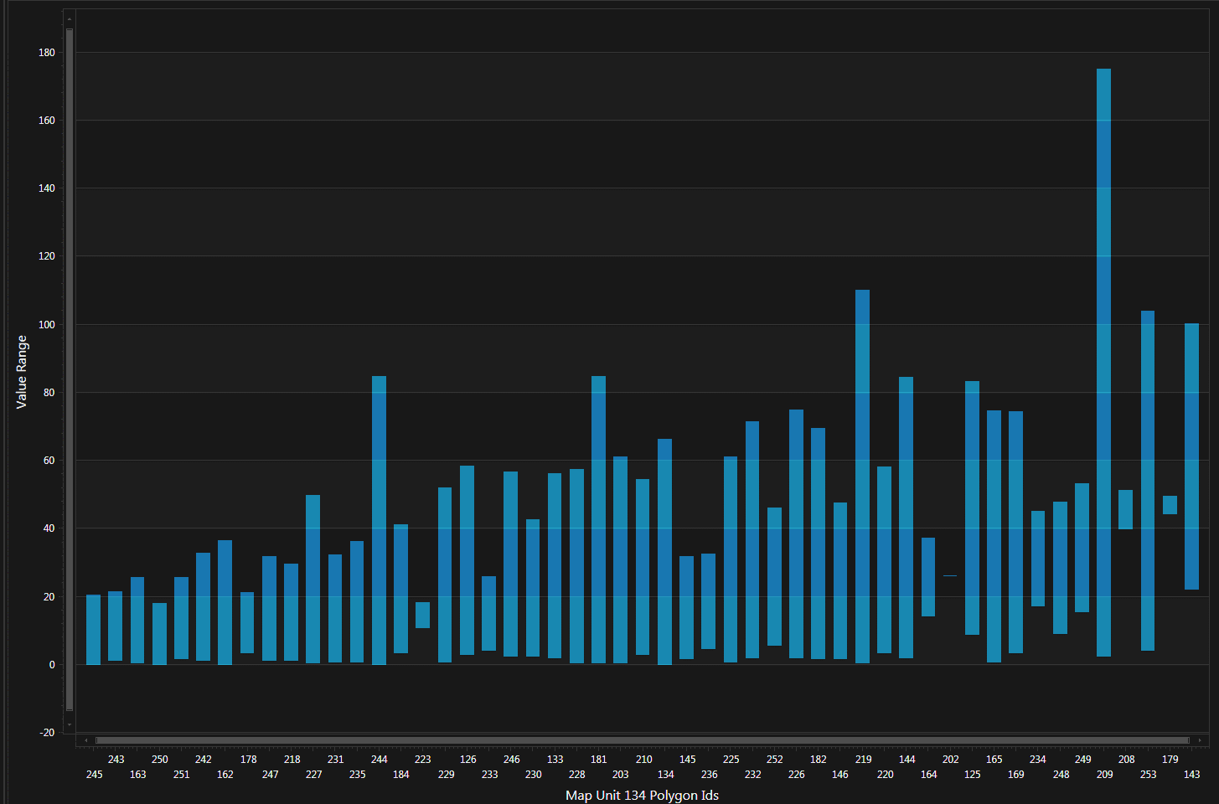
Monitoring Units - Benchy Plateau Slopes (MU 134)
SAMPLED
Slope %
Notes:
In the Benchy Plateau landform unit we see there is a polygon on the right side here that is an obvious outlier. Maybe it doesn’t belong with this unit?

Slide 58
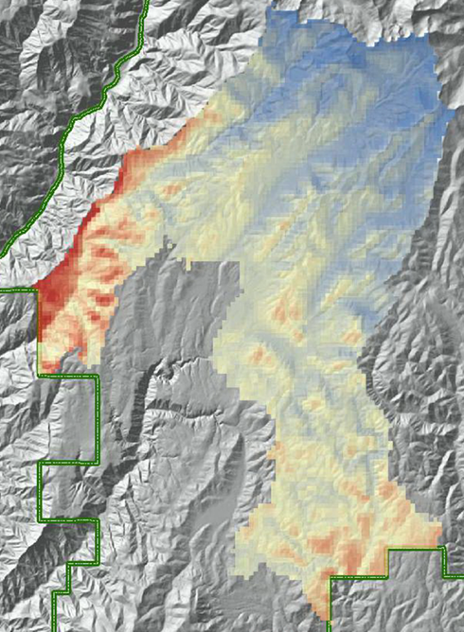
Annual Soil-Water Deficit (mm) analysis for NFMA
Notes:
Now let’s see how the toolkit was used for a soil water deficit analysis of the same project area. This analysis was done for the National Forest Management Act.

Slide 59
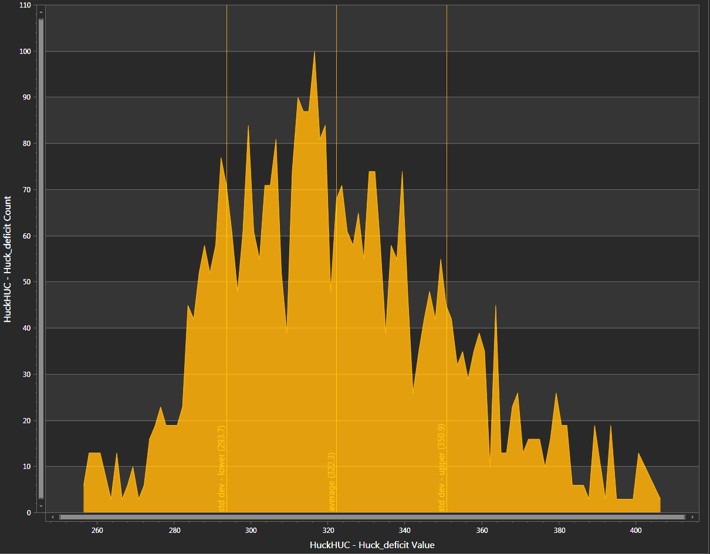
North Fork Hornet Creek
(upper ~2/3)
21% of project area
INCREASING ECOSYSTEM ARIDITY
Notes:
Looking at the North Fork of Hornet Creek graph we see that the distribution of deficit values is skewed towards more arid.

Slide 60
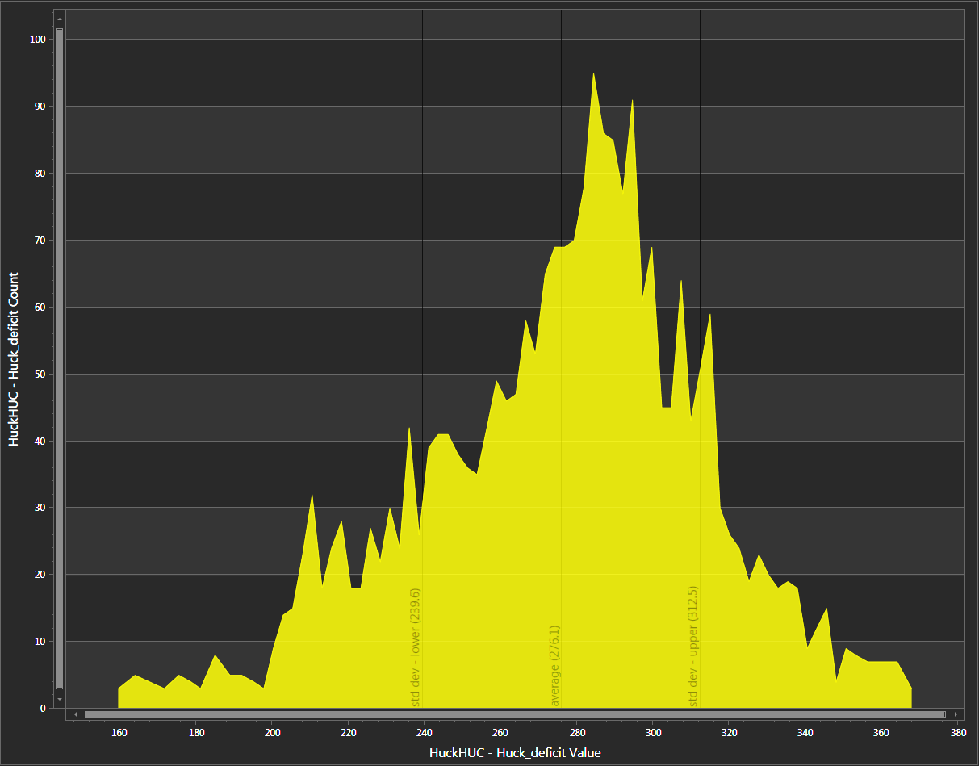
Lick Creek
31% of project area
Notes:
But in Lick Creek, which contains 31% percent of the project area, the values are skewed towards less arid.

Slide 61
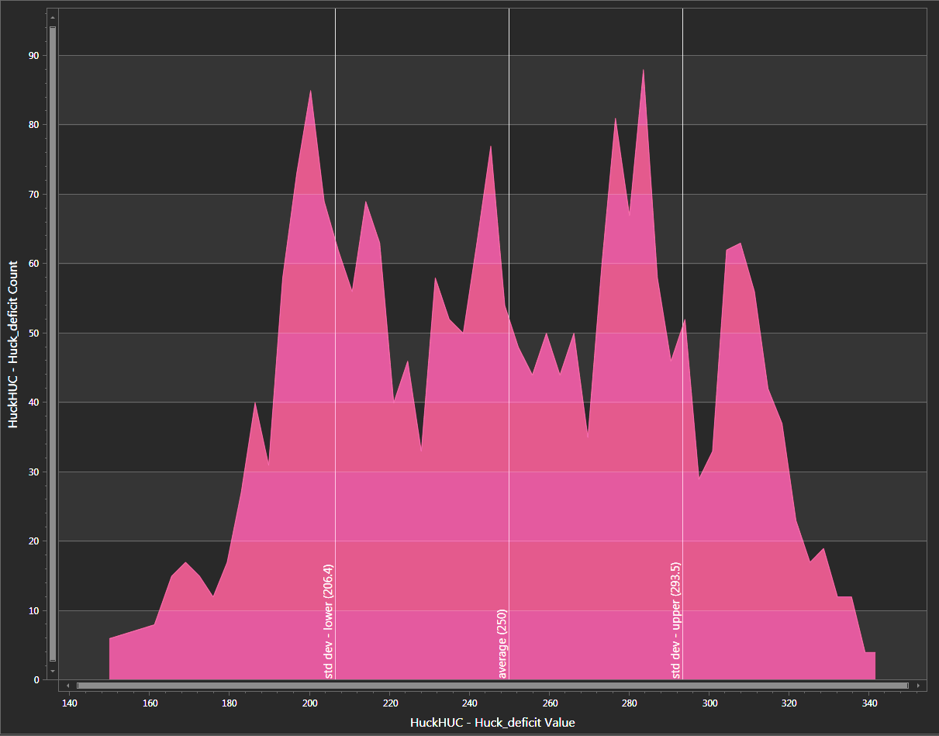
Multiple distinct
soil-water-climate
habitats
Bear Creek
(upper ~2/3)
21% of project area
Notes:
The toolkit graph allowed quick identification of multiple distinct soil-water-climate habitats. So in Bear Creek we see there are 4 of these distinct habitats.

Slide 62
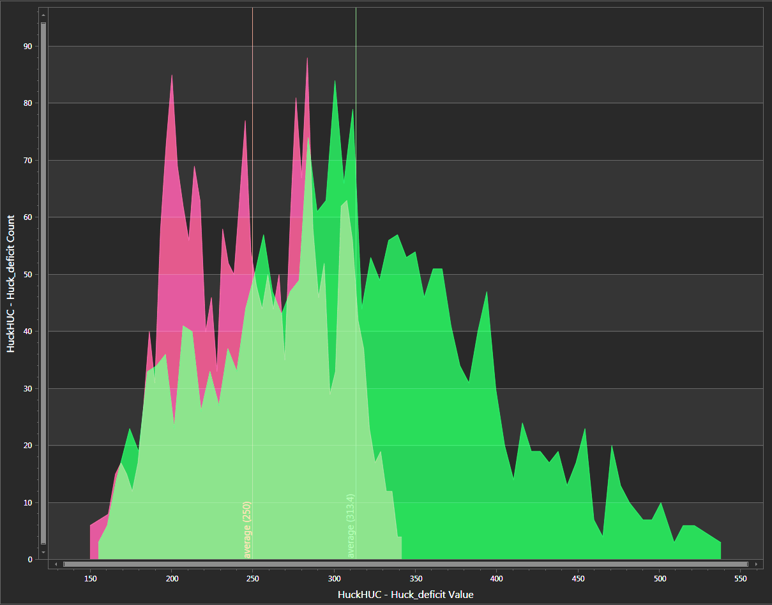
Overlap of Bear Creek
and Indian Creek
in soil-water-climate space
Bear Creek
Indian Creek
Notes:
By comparing two units on the same graph we see how much of these two subwatersheds had the same soil-water-climate habitat characteristics.

Slide 63
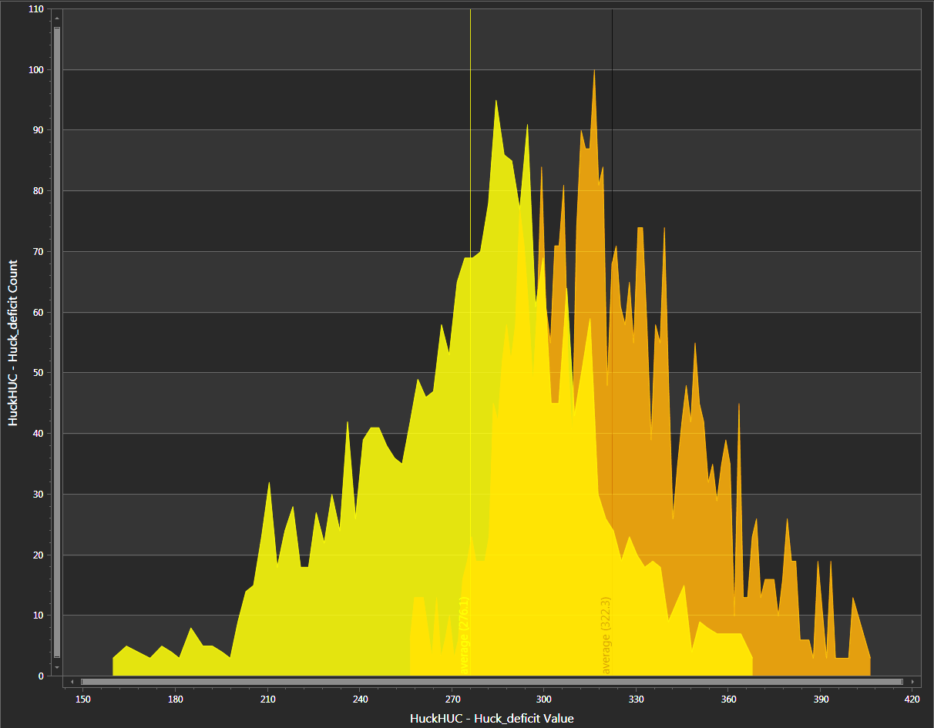
North Fork Hornet Creek
(upper ~2/3)
Lick Creek
= relatively dry headwaters?
Notes:
Lick Creek and North Fork of Hornet Creek shared less common deficit values than Bear and Indian. Understanding how the soil water deficits compared across the project was important for making forest management decisions.

Slide 64
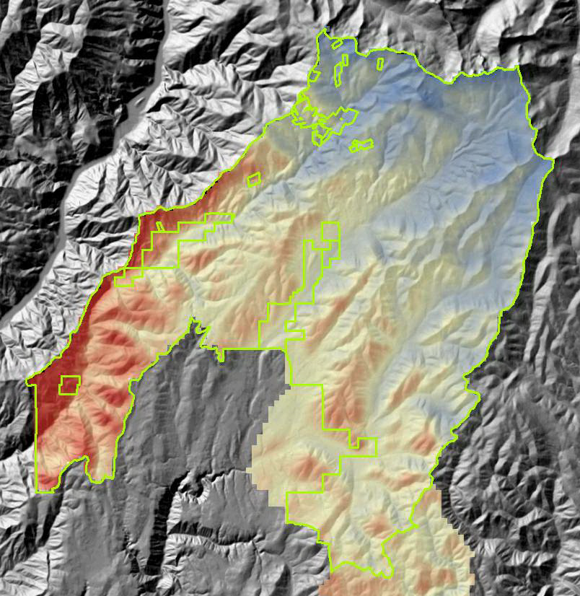
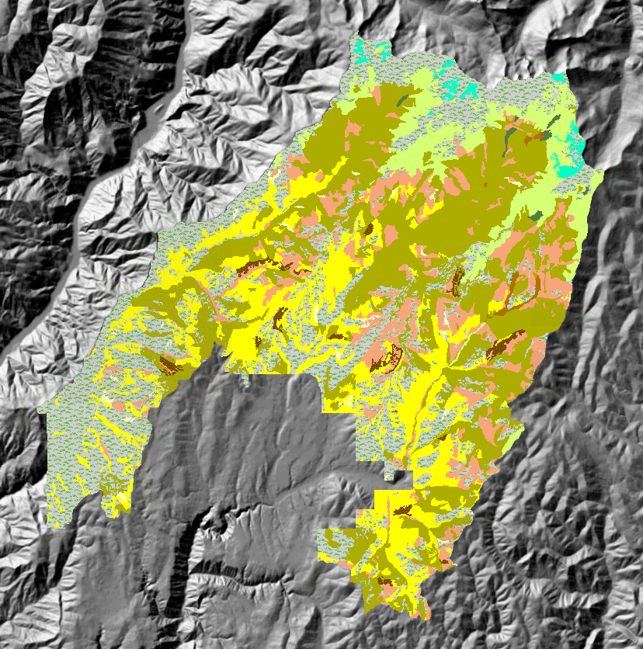
PVG Polygon Validation based on Soil-Water Deficit Outliers
20 yr mean Evapotranspiration (ET) Deficit*
Z. Holden, USFS/UMT
Potential Vegetation Groups (PVG)
* ET deficit = actual - potential ET. Influenced by soil thickness and water holding capacity.
Notes:
And finally, let’s see how the toolkit was used for Potential Vegetation Group polygon validation based on soil water deficit outliers. This analysis is based on the 20 year mean evapotranspiration deficit. This deficit index is calculated as the difference between actual and potential evapotranspiration and is directly controlled by soil thickness and water holding capacity.

Slide 65
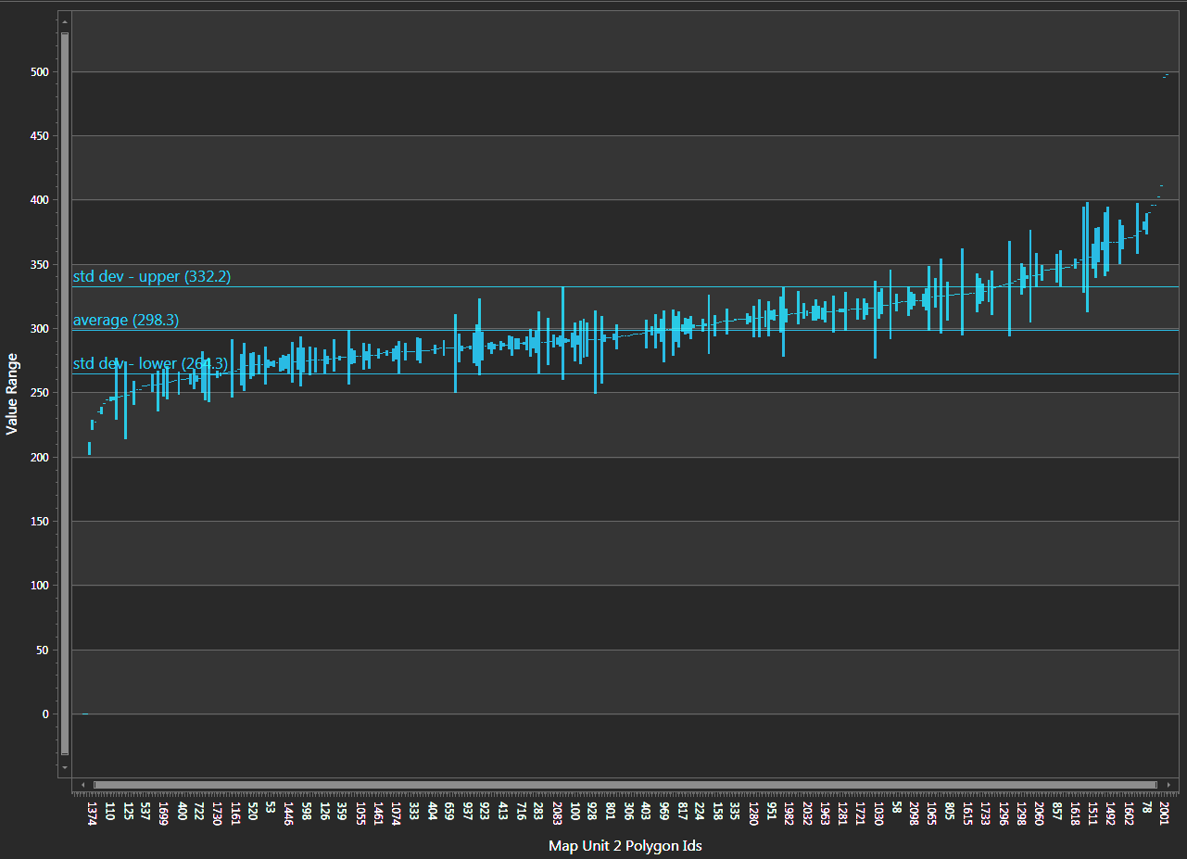
PVG 2
Polygon FID
Lower ET deficit range | Upper ET deficit range
1374 1193 399 847 931 317 2170 110 1290 | 1330 421 1220 1304 1614 1304 78 961 1911 1491 1602 446 57 1597 1419 1930 1492
Graph can aid timber inventory and planning by sorting PVGs and locating polygons that occur outside the range (±~2 SD) of the mean 20 year ET deficit.
Notes:
This summary is intended to aid timber inventory and planning by sorting PVG groups along the Huckleberry ET gradient, and locating PVG polygons that occur outside the range (±~2 SD) of the mean 20 year ET deficit. Accordingly, PVG polygons identified here may be in significant disagreement with the soil-driven biotic potential that dominates that site. These polygons may be prioritized for NFMA field validation, and as a tool for evaluating the PVG model. The first polygon on each list is the most severe outlier, followed by the 2nd most severe, 3rd, etc.

Slide 66
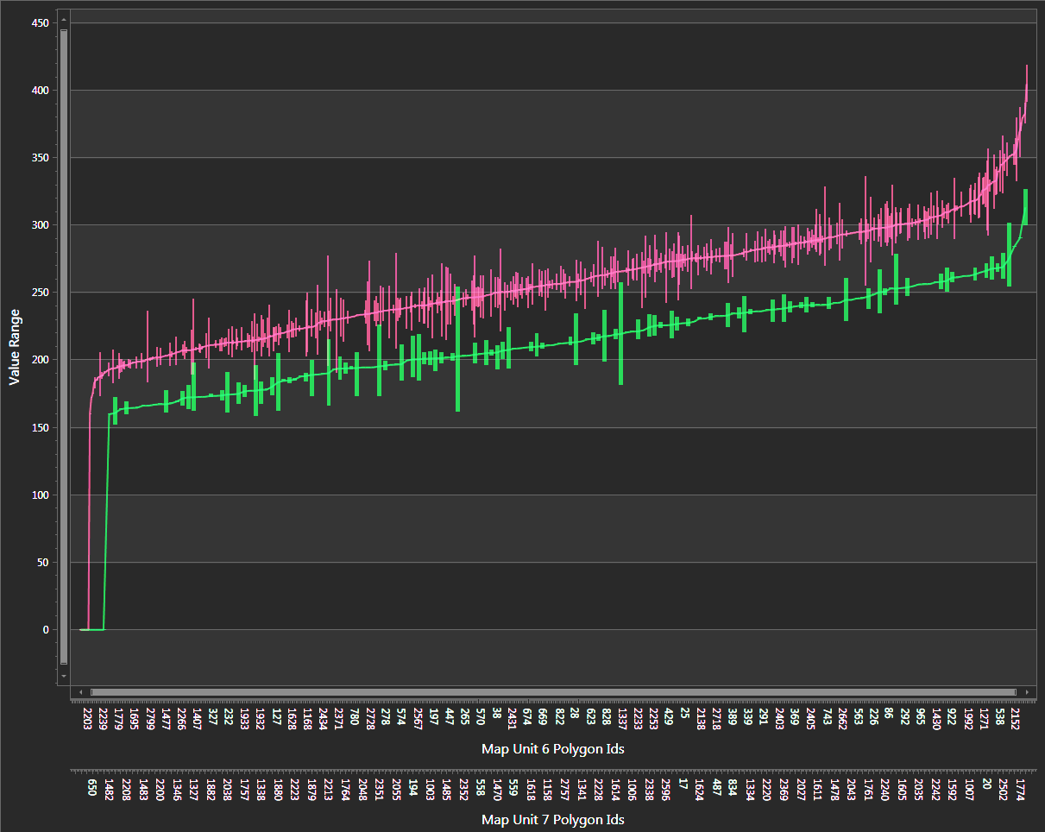
Cool, Moist Grand Fir
PVG 6
25% of project area
HOW SEPARATE/NEAR SHOULD THESE POLYGONS BE IN FEATURE SPACE?
Deficit (mm)
Warm, Dry Subalpine Fir
PVG 7
6% of project area
Notes:
Comparing potential vegetation groups in feature space can help us decide if the groups should be combined or divided into more groups. By looking at this graph, we might decide PVGs 6 and 7 have similar enough soil-water deficit values that they can be combined into one PVG. Or if a PVG has a wide enough range of deficit values it might be best to divide it into two or more PVGs.

Slide 67
Geospatial Help Desk
Did you know that GTAC offers geospatial support through the Customer Help Desk?
Tickets first go to a Tier 1 Help Desk Agent
Tickets are then routed to a Tier 2 Agent who specializes in the area of your issue
Geospatial Tier 2 Agents work directly at GTAC
Bypass long wait times and contact us directly: sm.fs.geotraining@usda.gov

Slide 68
GIS Help Desk
3x Tier 2 Agents at GTAC
Submit a CHD request directly to the GIS Help Desk queue
Local GIS issues (desktop version of ArcMap, ArcGIS Pro, etc.)
Mobile GIS issues (GPS, Collector, Survey123, Avenza, etc.)
Data Center (Citrix users of ArcMap)
Topics: appropriate standards, recommended agency workflows, best practices, field data collection and management, standard and custom data dictionaries, data transfer, tile package creation and use, mobile GIS equipment recommendations based on use, etc.
Available 7 am to 6 pm Mountain Time

Slide 69
Remote Sensing Help Desk
4x official Tier 2 Agents at GTAC, myriad Subject Matter Experts (SMEs)!
This is a funded service that we provide – you are not inconveniencing anyone by asking for help.
Contact SMEs directly, we’ll take care of the CHD ticket.
We have a whole office of SMEs at our disposal to help you resolve whatever issue you’re facing.
Topics: troubleshooting remote sensing software, lidar, radar, Google Earth Engine, modeling, geospatial scripting, photogrammetry, stereo viewing, change detection, segment generation / object-based image analysis (OBIA), raster geoprocessing, and more.

Slide 70
Geospatial Training and Awareness
Sign-up for live webinars
Desktop GIS
Web GIS
Mobile GIS
Remote Sensing
Find self-paced training materials
Access to recorded webinars

