Slide 1
Advanced Change Detection -1
Change Detection Principles and Intro to Earth Engine

Slide 2
Housekeeping
Keep video off and stay on mute
When you have questions:
  Raise hand in Teams
  Respond in chat box
  Q + A at the end
Closed captions are available
Take care of your body!
Lila, remember to record!

Slide 3

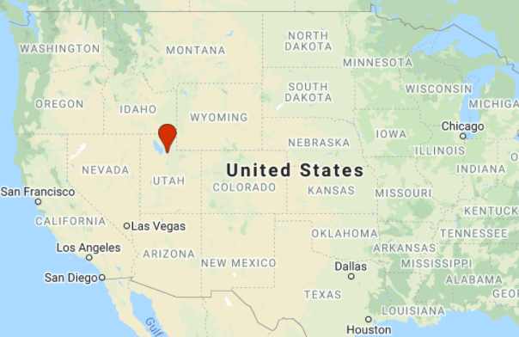
Personal intro
Lila Leatherman (they/them)
Remote Sensing Specialist
Oberlin College, Oregon State Univ.
Forest health, DeltaViewer change detection method, Google Earth Engine
Trail running, mountain biking, skiing
Notes:
Personal intro—
Invite people to introduce themselves with name, pronouns if they want, location, one thing they’re excited to learn more about

Slide 4

Course Format & Learning Styles
Many different learning styles: visual, auditory, kinesthetic, etc.
Webinar format seeks to address a variety of learning styles
  PPTs, live demonstrations, step-by-step exercises
  Content may be repetitive for some people
  Feel free skip formats that don’t serve your learning style

Slide 5
Community Guidelines
  Asking questions encouraged!
  Go at your own pace; take what works
  Anticipate non-closure—
    This is an intro to skills that you’ll be able to adapt. This is where the learning begins, not where it ends!
  What else helps you feel welcome in a learning environment?

Slide 6
Prerequisites
Courses or knowledge equivalent:
  Introduction to change detection
  Geospatial scripting in JavaScript and Google Earth Engine
Google Chrome browser
Google Earth Engine account
Notes:
Mention that everyone should have completed the prerequisites and ensure that everyone has an Earth Engine account: https://signup.earthengine.google.com/#!/

Slide 7
Learning Objectives
  Deeper understanding of remote sensing change detection
  Skills and tools for image processing in EE
  Awareness and understanding of state-of-the-art remote sensing change monitoring programs and data products
  Experience implementing an advanced change detection algorithm in EE

Slide 8
Technical Topics Covered
Image processing in Earth Engine
    Review image processing in EE and generate composite image time-series and indices.
Time-series based change algorithms
    Explore time-series based change mapping methods
Use LandTrendr in EE to map change
    Implement the LandTrendr algorithm, fit parameters, and explore results in multiple ways

Slide 9
Exercises for today
Exercise 1: Process and explore Landsat time series
  Optional – review image processing in GEE
Exercise 2: Basic trend analysis
Exercise 3: LandTrendr in GEE: Model fitting
Exercise 4: LandTrendr in GEE: Disturbance mapping

Slide 10
Course Agenda
All times MDT
Start Time | Content
10:00 am | Lecture 1: Concepts and Image Processing
10:45 am | Break + Exercise 1: Process + Explore Landsat time series
11:00 am | Lecture 2: Adv Change Detection Methods and Products
11:45 am | Lunch + Exercise 2: Basic trend analysis in EE
12:45 pm | Lecture 3: LandTrendr
1:15 pm | Do Exercise 3 – LandTrendr in EE - Fitting & finding parameters
2:15 pm | Lecture 4: LandTrendr, Change Mapping, and Scripting
2:30 pm | Do Exercise 4 –Run LT-GEE toMap Disturbance

Slide 11
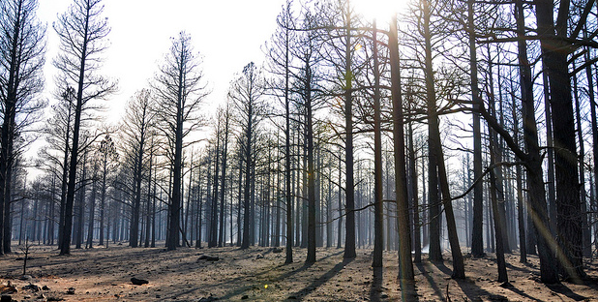
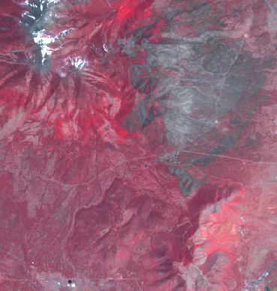
What is change detection?
Identifying landscape change from remotely sensed images
    Analyze images from different times to map and/or quantify change
    Assumption:
      Landscape change -> Spectral change
Coconino NF – Schultz fire effects
Landsat TM5 image – 1 year post fire

Slide 12
What is change detection?
  Landscape changes can be detected and measured using the spectral values of pixels in multispectral satellite imagery
Coconino NF – Schultz fire effects
Landsat TM5 image – 1 year post fire
Notes:
Break down each point –
Landscape changes – due to fire, bark beetle, drought, storm, development, etc –
Can be Detected, i.e., we can identify that they are there
And can also be measured – e.g., spatially, temporally, and in terms of severity. So we can map the size of change, track the duration of change, and assess the magnitude / severity of change– all using spectral data from these images

Slide 13
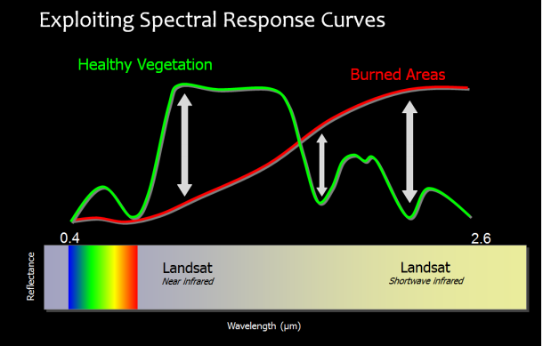
What is change detection?
  Landscape changes can be detected and measured using the spectral values of pixels in multispectral satellite imagery
Notes:
We’ll review the electromagnetic spectrum in more detail a little bit later, but for now the important thing to note is that the spectral response of healthy vegetation is different from that of burned areas.
We know that this is true in visible light, it’s also true across the non-visible areas of the EM spectrum.

Slide 14
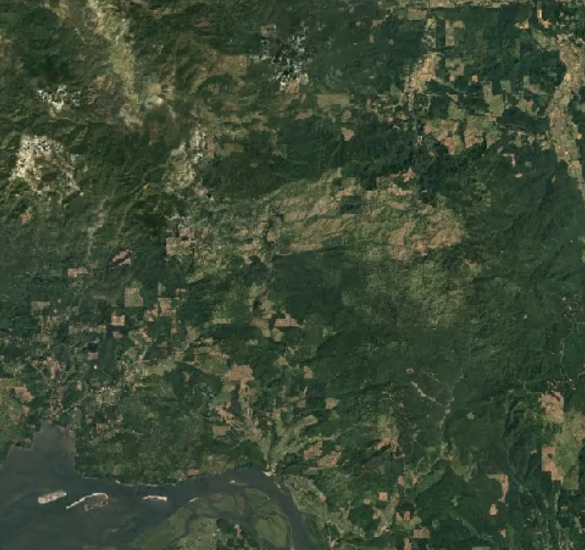
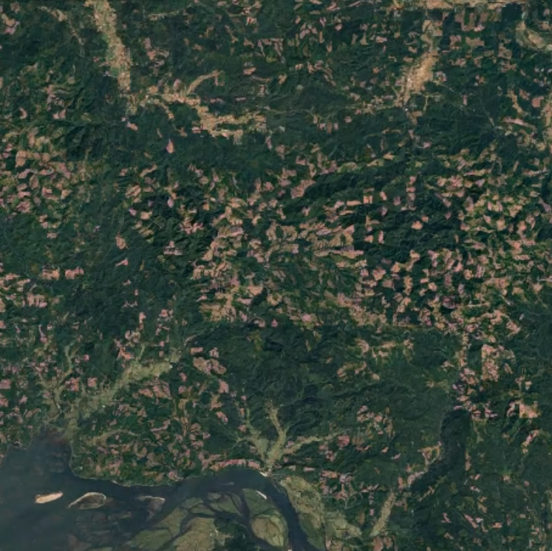
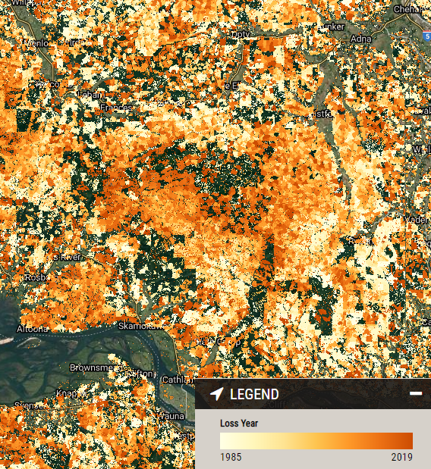
Change Detection Goals
Map the location of change
Report timing of change
Quantify change
Assess accuracy
Notes:
Note that we’re not necessarily attributing change to a specific agent here– sometimes we have prior knowledge of what the agent is in in area, like when we’re looking at a specific fire event, or a timber harvest, or an area that’s been really hard-hit by bark beetle.
Algorithms are in development and have broader applications for attributing the change to a specific cause, based on the spectral values, as well as the spectral trajectory, or values of the spectra over time. Which is what we’re talking about today!

Slide 15
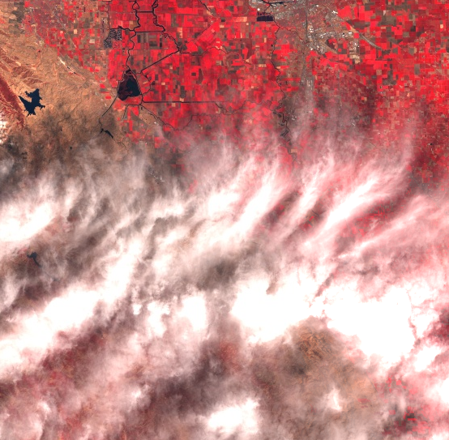
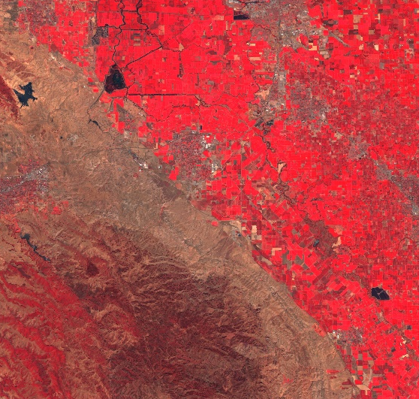
Change Detection Challenges
Separating the signal from the noise!
  Noise from clouds, image effects, seasonal variation, etc.
  ‘Real’ change?

Slide 16
Change Detection Methods
Image interpretation (visual)
Two-date (image differencing)
Modeling (classify change)
Multidate time series
  Analysis of spectral/temporal trajectories
  Includes methods covered in this course
Notes:
While discussing/presenting, hint at some limitations and historical context explaining how methods have become increasingly sophisticated as more and more data and analysis tools become available.
Emphasize that this course focuses on multidate time series change detection

Slide 17
Change Detection Methods
Image interpretation (visual)
Two-date (image differencing)
Modeling (classify change)
Multidate time series
  Analysis of spectral/temporal trajectories
  Includes methods covered in this course
Notes:
While discussing/presenting, hint at some limitations and historical context explaining how methods have become increasingly sophisticated as more and more data and analysis tools become available.
Emphasize that this course focuses on multidate time series change detection

Slide 18
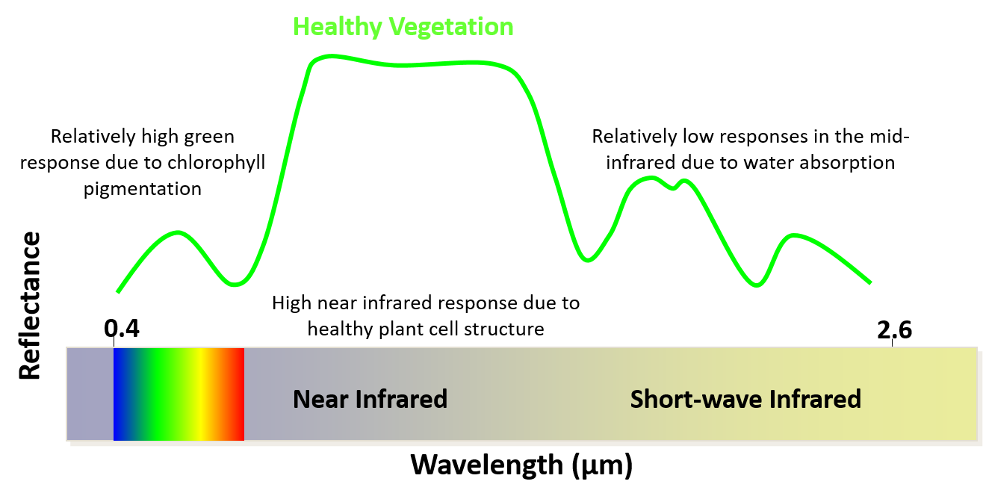
Review of Spectral Signatures

Slide 19
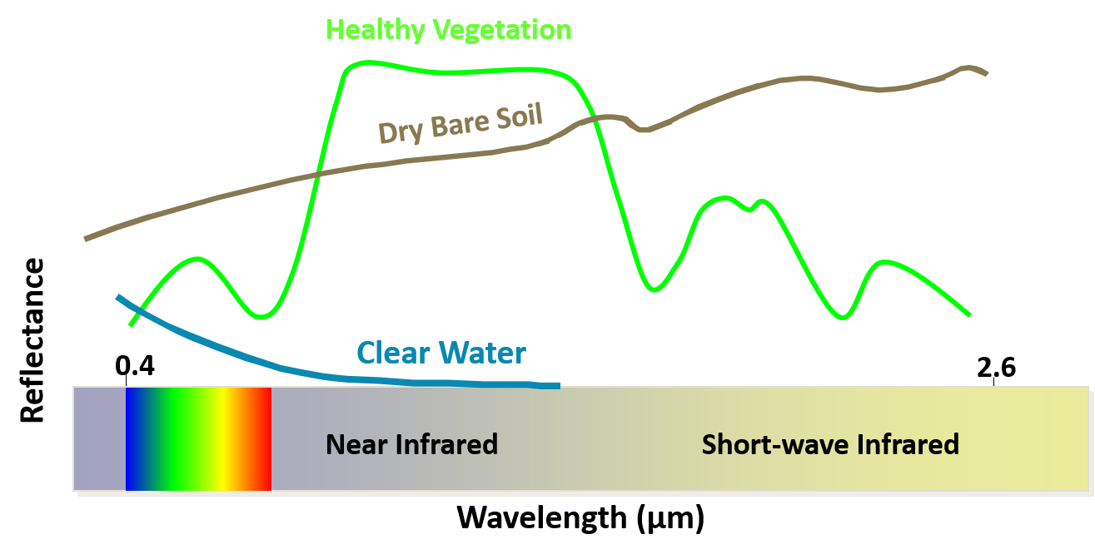
Review of Spectral Signatures

Slide 20
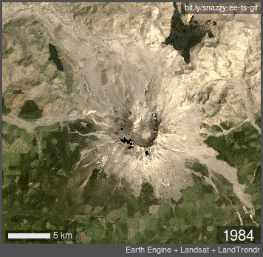
Change mapping is complicated
Change is usually a continual process operating on multiple timescales
  Time series imagery can help us capture these dynamics provided we can analyze them
Animation showing succession and vegetation recovery on Mt St Helens from 1984-2019, following the 1980 eruption
Landsat imagery

Slide 21
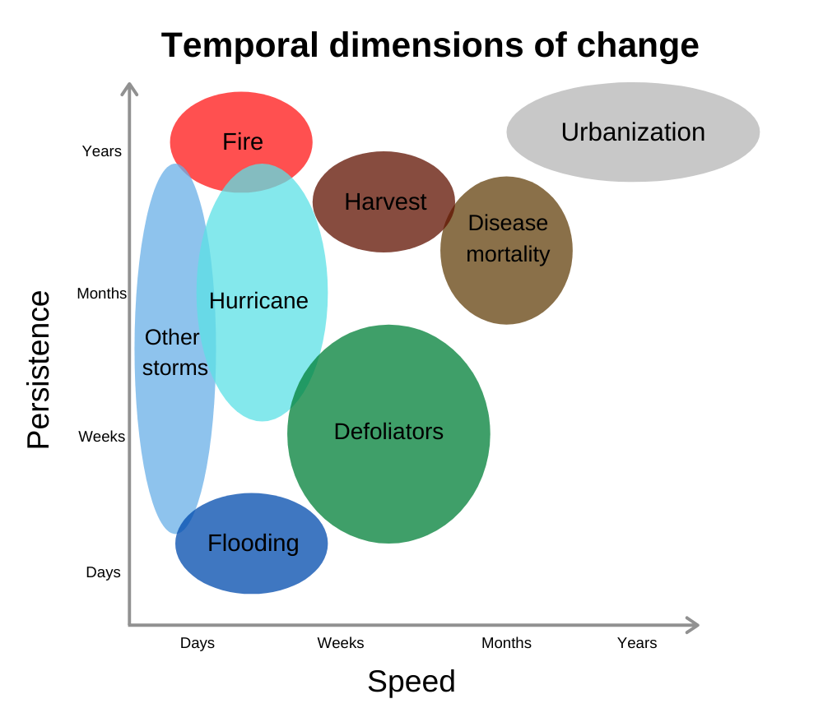
Temporal characteristics
  What does change look like from an Earth observation perspective?
Notes:
We are often interested in annual trends or changes that occur over long time periods. Whereas seasonal trends are usually driven by annual temperature or precipitation and not always of interest to managers wanting to understand how the landscape is changing.
Walk through the temporal characteristics of these different types of change and also SUCCESSION… Disturbance and recovery, sometimes things don’t return to the way they were…

Slide 22
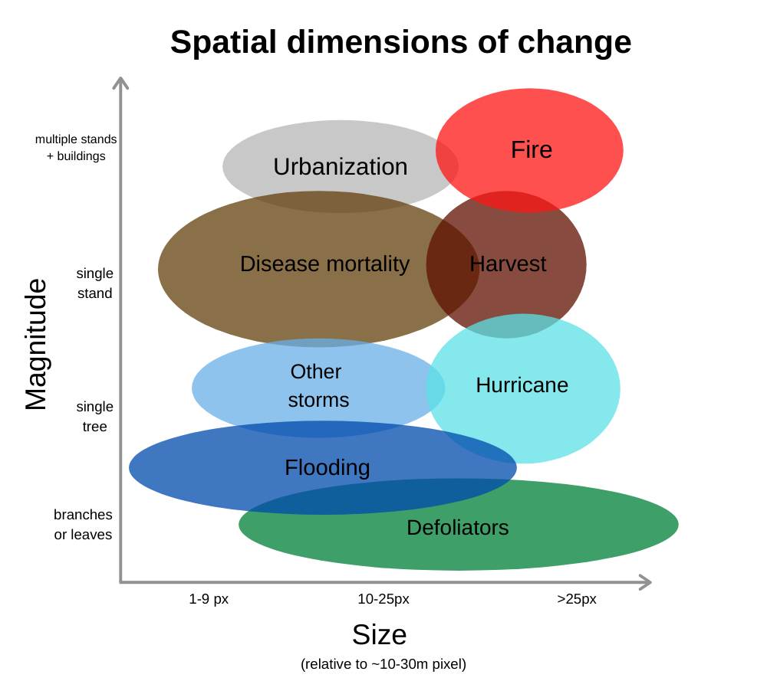
Spatial & spectral characteristics
  What does change look like from an Earth observation perspective?
Notes:
Explain the graph but focus on the spectral magnitude of change, i.e. the departure from the previous values and also the severity in the environment

Slide 23
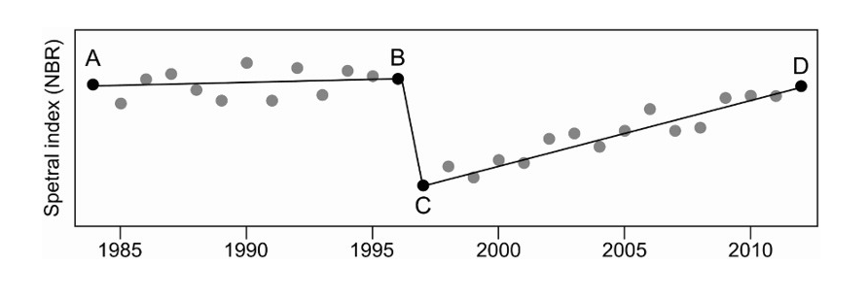
Change & ecology are complex
“Conventional single date (PI) and multi-date approaches have been missing the full picture”
Hermosilla et al 2016 https://doi.org/10.1080/17538947.2016.1187673
Notes:
Key point here to discuss is that methods have been evolving. Use this figure and the points to discuss two date vs. trend vs segmentation.

Slide 24
Change & ecology are complex
“Conventional single date (PI) and multi-date approaches have been missing the full picture”
Hermosilla et al 2016 https://doi.org/10.1080/17538947.2016.1187673
Notes:
Methods have been evolving!
Discuss differences between:
Two-date
Trend
Segmentation

Slide 25
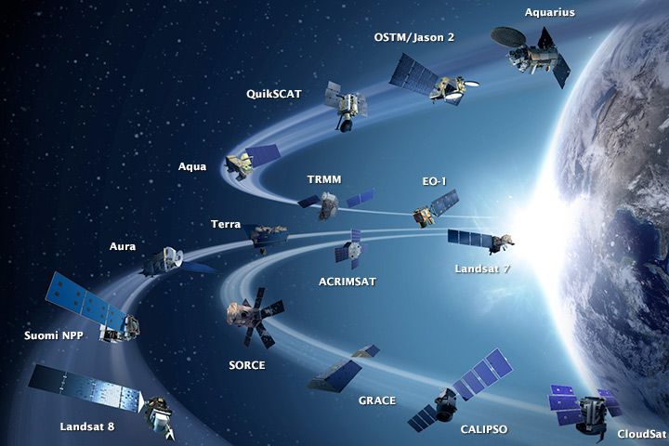
Modern methods
Methods evolve to leverage more data
  In the past, computing power and data storage were largely limiting factors but no more…
earthobservatory.nasa.gov
Notes:
Lots of satellites, collecting lots of data!
Trade-offs between spatial and temporal resolution , and storage space, depending on goals of project
Computing power means we can leverage powerful change detection algorithms, but they might not always be necessary
Sometimes a little detail is enough

Slide 26
Satellite time series
Modern methods can capture the bigger and more complex ecological picture thanks to:
  Data availability
    Landsat (30+ years)
    MODIS (18+ years)
  Computing power and cloud-based platforms like Google Earth Engine
Notes:
Sentinel-2 is also now out for 5 years, we’re going to begin to be able to leverage the time series from that as well, at higher temporal resolution and higher spatial resolution

Slide 27
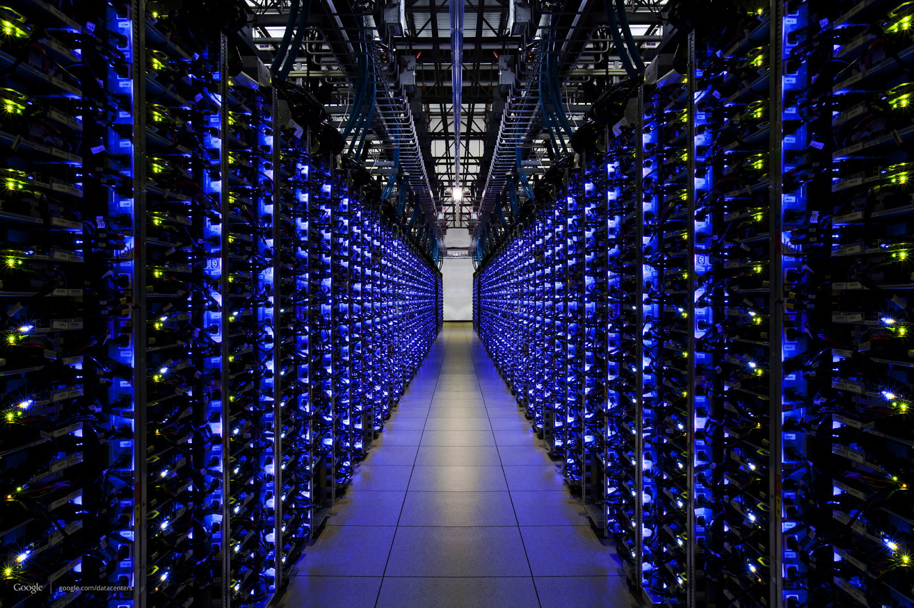
Earth Engine
Massive computation
Scientific algorithms
Customized for geospatial data
APIs for developers
Slide and photo credit: Google Earth Engine

Slide 28
What is Earth Engine?
  Google's platform for scientific analysis of large-scale Earth observation data
  Two major components:
    A collection of scientific data
    The computational power to work with data at large scales
  API provides an interface through which you express operations for Earth Engine to perform
Slide adapted from Google Earth Engine

Slide 29



Earth Engine Components
Data
An exhaustive catalog of remote sensing datasets, including multispectral, radar, aerial, climate, land cover, and vector.
Computation
Co-located data storage and computation
API & Code Editor
Rich JavaScript API, and support for Python, hosted on GitHub.
No software to download or keep up to date. All you need is a modest internet connection.
Slide adapted from Google Earth Engine with icons from Flaticon.com

Slide 30





How does Earth Engine work?
Client
Server
Request
filter
add
distance
{ }
JS
join
Response
reduce
mosaic
addBands
select
simpleCloudScore
convolve
Slide adapted from Google Earth Engine with icons from Flaticon.com
Notes:
You write code on the client which in this case is the Earth Engine code editor. This code gets translated to JSON and sent as a request for processing on the server. Google Earth Engine distributes the processing across several servers and sends the response back to the client as a JSON object.

Slide 31
How does Earth Engine work?
  The Earth Engine API allows us to write scripts defining our analysis on the client (the browser) and run our analysis on the server and Google has awesome servers!
Request
filter
add
distance
{ }
JS
join
Response
reduce
mosaic
addBands
select
simpleCloudScore
convolve
Slide adapted from Google Earth Engine with icons from Flaticon.com
Notes:
Make the point that processing on the Google servers is distributed and processed in parallel and ‘as needed’ or lazy. This means that some of the behavior is quite different from a normal GIS.
“How does it work? The code you write in the Code Editor gets turned into an object representing the set of instructions which is then sent to Google for processing. The analysis you requested is then run in parallel on many computers. What you get back in your browser is only what you request, for example a statistic or chart printed to the console or small RGB tiles to display on the Map. This is low bandwidth, but it's as if you have access to a supercomputer for geospatial analysis.”

Slide 32
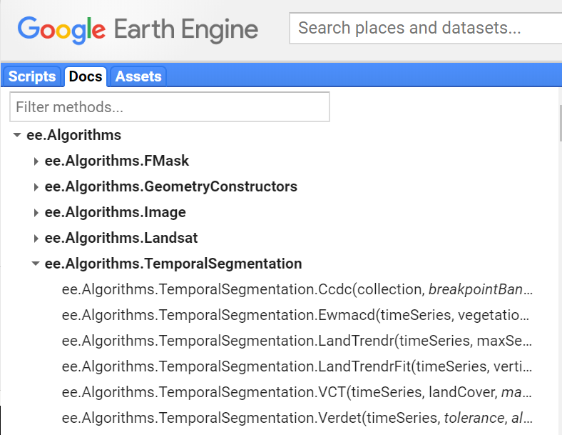
Earth Engine API & Code Editor
  Environment for developing and managing code
    Git enabled repositories for version control & sharing
  JavaScript methods for remote sensing data

Slide 33
Earth Engine is not your typical GIS
Key points
  Cloud-based
  ‘Lazy’ or deferred execution
  Image resolution (scale) and map projections are handled differently in EE – to make these more user-friendly
Notes:
You don’t need to know the details but you need to know that EE is different and having the basic understanding of the relationship between the client and the server is helpful
Deferred execution – means that your code is translated into JSON objects representing instructions to get a particular output. The EE client library sends these to the server (Google) and handles/waits for the response. No processing is done on the server until that result is explicitly requested
Scale of analysis is determined from the output, rather than the input. You choose the scale of the output; be mindful of scales of the input! Scale is also determined by zoom level.
Earth Engine is designed so that you rarely have to worry about map projections when doing computations. Images displayed are requested in web Mercator. Similar to scale, you specific the projection of the output.

Slide 34
Client vs. Server Objects
    ‘Normal’ JavaScript objects and primitives AND server objects that you manipulate via client-side ‘proxy’ objects.
    “Proxy” or server objects start with ee. and any methods on that are server functions.
ee.Image("LANDSAT/LC8_L1T_TOA/LC80450322014244LGN00");
    Loops, conditionals don’t work on server objects
    More info: https://developers.google.com/earth-engine/client_server
Notes:
If you are familiar with writing JavaScript for web development or building server-side applications with Node, you will want to be aware that things are a bit different in GEE.
The client doesn’t know what’s on the server, so the for loops don’t work. There are other EE-specific functions like MAP that iterate over lists of objects.

Slide 35
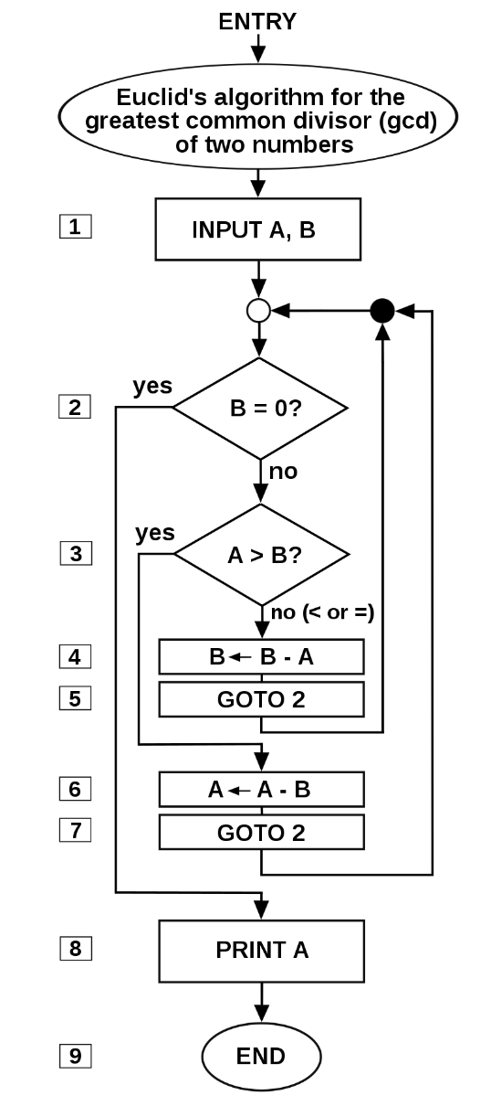
Earth Engine algorithms
What is an algorithm?
    Like a recipe most of the time…
    Input + parameters → output
Relevant examples in EE
    Radiometric calibration
    Cloud masking
    Compositing
    Temporal segmentation
      i.e., time series change analysis
https://en.wikipedia.org/wiki/Algorithm

Slide 36
Algorithms & methods today
Image processing & preparation
  Landsat algorithms
Time series analysis methods
  Linear trend analysis
  LandTrendr
All in Earth Engine!
Notes:
All of these are multi date methods using lots of image data (timeseries) and require a lot of processing power

Slide 37

Preparation & Image Processing
    Cloud masking, compositing
Slide and photo credit: Google Earth Engine
Notes:
Basically, taking a stack of available images, removing the clouds, and then using an equation, like an average, median, or percentile, to turn all of the images into a single composite image

Slide 38




Image Processing Parameters
Seasonal dates | Radiometric correct | Cloud masking | Compositing
    There is often a tradeoff with seasonal date selection. The more tightly you define your season, the less ‘noise’ you will have from phenology; however, you will likely get fewer cloud free observations!

Slide 39
Course Example – Dixie National Forest
Was there a relationship between burn severity and spruce beetle kill patterns in Utah’s Dixie NF? (link to SL Tribune article)
  Spruce beetle outbreak began in the 1990’s
  Fire occurred in 2017
  Though we can’t answer that question exactly, we can do a change detection analysis to provide insight.

Slide 40
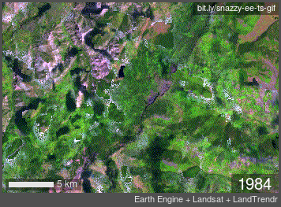
Dixie National Forest change
Time-lapse animation from 1984-2019 shows slow decline due to spruce beetle and drought and then a stand replacing wildfire.
Notes:
Slow decline due to spruce beetle and drought and then a stand replacing wildfire

Slide 41
Exercises for today
Exercise 1: Process and explore Landsat time series
  Optional – review image processing in GEE
Exercise 2: Basic trend analysis
Exercise 3: LandTrendr in GEE: Model fitting
Exercise 4: LandTrendr in GEE: Disturbance mapping

Slide 42
Demo + Ex 1
Process + Explore Landsat time series
  1.1:
    Load image time series
    Create function for cloud-masking
    Create a single image composite
  1.2:
    Load a module
    Create a Landsat time series
    Explore the Landsat time series

