Slide 1
Advanced Change Detection -4
LandTrendr, Change Mapping, and Scripting

Slide 2
Housekeeping
Keep video off and stay on mute
If you have questions:
  Raise hand in Teams
  Respond in chat box
  Q + A at the end
Closed captions are available
Take care of your body!

Slide 3
Course Agenda
All times MDT
Start Time | Content
10:00 am | Lecture 1: Concepts and Image Processing
10:45 am | Break + Exercise 1: Process + Explore Landsat time series
11:00 am | Lecture 2: Adv Change Detection Methods and Products
11:45 am | Lunch + Exercise 2: Basic trend analysis in EE
12:45 pm | Lecture 3: LandTrendr
1:15 pm | Do Exercise 3 – LandTrendr in EE - Fitting & finding parameters
2:30 pm | Lecture 4: LandTrendr, Change Mapping, and Scripting
2:45 pm | Do Exercise 4 –Run LT-GEE to Map Disturbance
Notes:
Mention that everyone should have completed the prerequisites and ensure that everyone has an Earth Engine account: https://signup.earthengine.google.com/#!/

Slide 4

Lecture objectives
Introduction to change detection platforms
Understand uses and applications of the skills developed in previous courses
Introduction to best practices + resources for coding
Photo by Jan Huber on Unsplash

Slide 5
Building LTS Tools
Algorithms are methods/instructions to solve a problem
  Can be implemented in different venues if the necessary tools are available
  You have been learning EE tools & algorithms
  Someday you may write your own!
Let’s look at a few programs and projects using LTS algorithms and Earth Engine
Notes:
The most important part is defining/understanding the problem.
Originally LandTrendr was written in IDL and then moved over to Google Earth Engine.
All the UI tools you explored in the last exercise are just GUI’s built on EE.
You could write your own algorithms, use and customize existing published algorithms and ultimately, if you wanted to, create your own web applications that use or serve the data products derived
That is difficult and takes a lot of knowledge, resources and time and has been done by others…

Slide 6
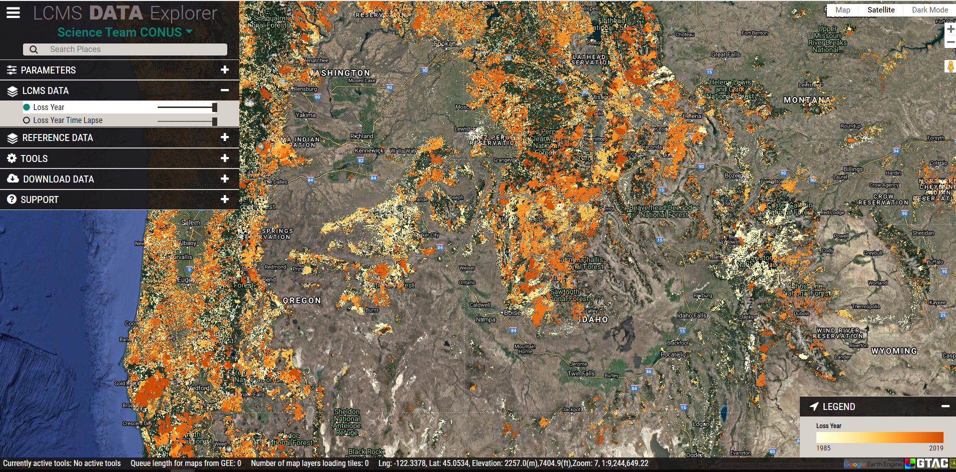
Time series methods used to support management & conservation
Landscape Change Monitoring System (LCMS)
    Ensemble model integrating multiple methods
http://lcms.forestry.oregonstate.edu/

Slide 7
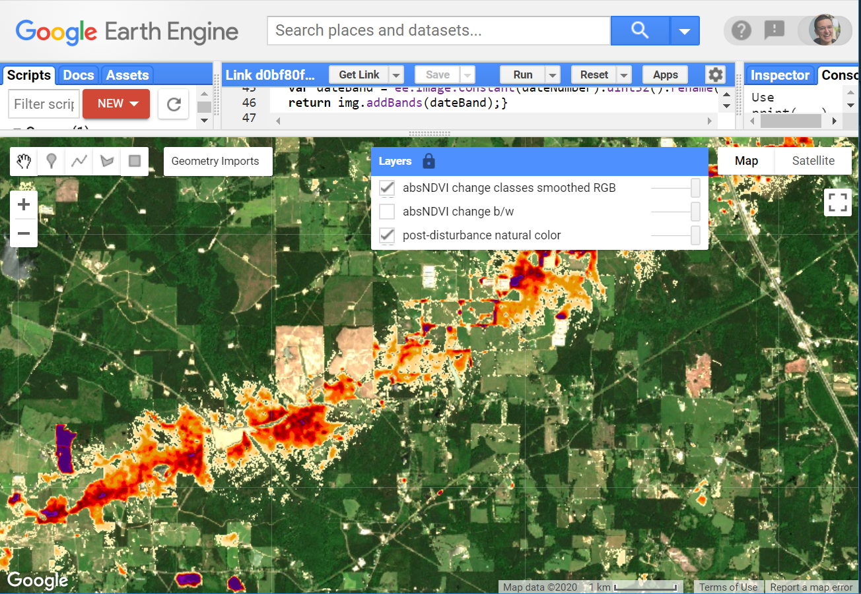
Time series methods used to support management & conservation
HiForm https://hiform.org
  High-resolution imagery
  Within-year change + near real time change detection

Slide 8
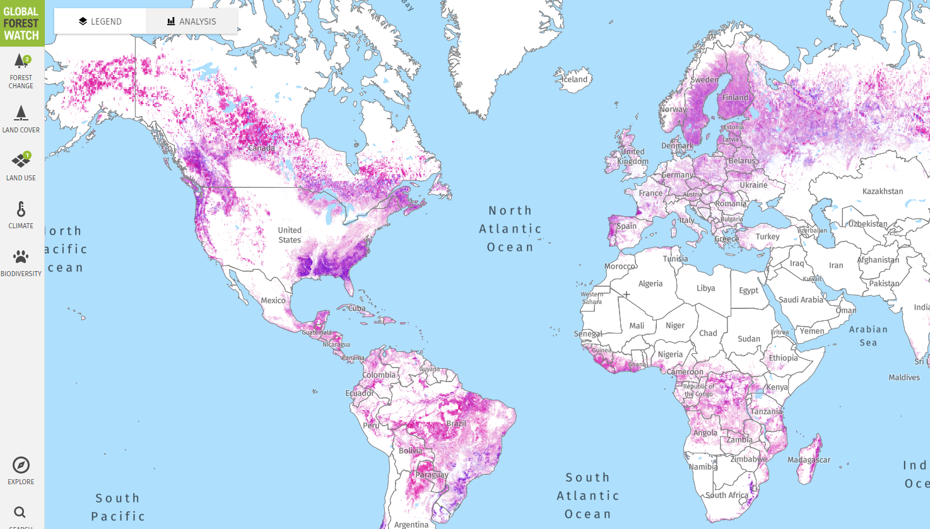
Time series methods used to support management & conservation
Global Forest Watch
    Image interpretation and machine learning methods to classify change from Landsat time series.
https://www.globalforestwatch.org/
Notes:
This analysis was done in and Earth Engine and relied on the supermassive computing capabilities of this platform. Machine learning approaches are quite powerful but some interpretability is lost as the ‘learning algorithm’ can be kind of a black box and you can’t get exactly the same result with the same parameters each time. These data are available in Earth Engine https://developers.google.com/earth-engine/datasets/catalog/UMD_hansen_global_forest_change_2018_v1_6

Slide 9
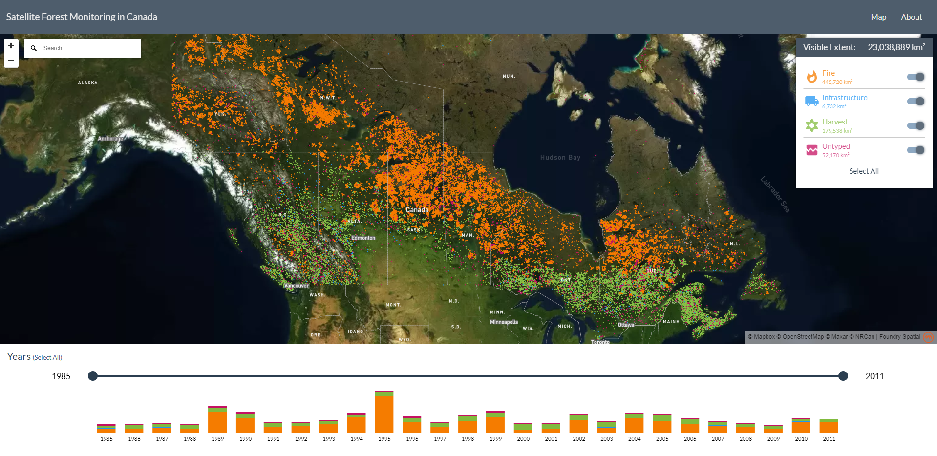
Time series methods used to support management & conservation
Satellite Forest Information for Canada
    Composite2Change (C2C) algorithm used to map forest disturbance across Canada
https://forests.foundryspatial.com/
Notes:
These data are available: https://opendata.nfis.org/mapserver/nfis-change_eng.html

Slide 10
Time series methods used to support management & conservations
Other data products & tools
  ForWarn II https://forwarn.forestthreats.org/
  AppEEARS, LCMS, FHAAST, Composite2Change in Canada OTHERS???? ForWarn
  TRY TO COME UP WITH A GOOD LIST OF PROGRAMS AND APPLICATIONS
  Let’s try to get a few more or leave this for the future?
Notes:
L

Slide 11


Learning to Develop in Earth Engine
If you want to master Earth Engine development, learning JavaScript will help to a point…
EE !== JS

Slide 12





Learning to Develop in Earth Engine
Remote sensing, GIS, JavaScript knowledge required but mostly learn EE!
EE !== JS

Slide 13
Learning to code – Whiteboard Sessions
You can’t code what you don’t understand
Identify & draw
  The goal, constraints, tools (data, methods, etc.), assumptions and sketch out general solution/approach
Outline code
  Pseudocode
  Modularize

Slide 14
Whiteboard Canvas Layout
1. Goal (objectives, outputs, validation)
2. Users
5. Solution Space
3. Problem Space (constraints, available tools, etc.)
4. Assumptions
Adapted from: Practical whiteboarding for designers
Notes:
Top of the whiteboard is where you write down the ultimate goal or objective you are trying to achieve. What do you need to produce and how will you know if you were successful?
Who is going to use our tool or script and how do we facilitate them or meet their needs?
What data, tools are available and what constraints exist for getting things done?
Insight on assumptions will often come from identifying/outlining the previous 3.
This is where you start sketching

Slide 15
Learning to code - Adapting
“If you want to get better at programming, there are two things you need to do: Write code and read everything!”
      -freeCodeCamp article
  Start with official docs & tutorials
  Articles
  Papers
  Other people’s code

Slide 16
Learning to code - Adapting
  Start with official docs & tutorial
      GEE Documentation
  Articles
      on Medium, and elsewhere!
  Academic papers
      Focus on methods presented in literature (e.g., LandTrendr described in detail in Kennedy et al 2020)
  Other people’s code
      Earth Engine Google Groups Forum
      GEE Community on GitHub

Slide 17
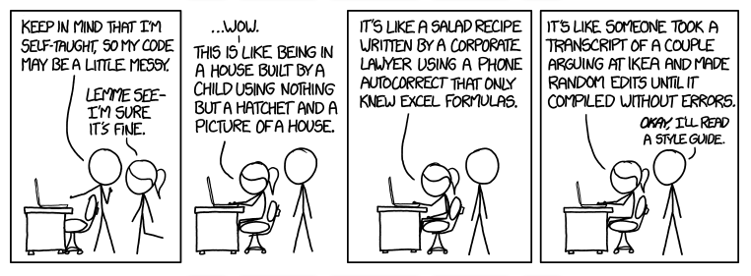
Learning to code
Invest in learning conventions & patterns
Source: xkcd
Notes:
Learn the style and patterns of EE. Look to the docs and prolific EE developers for inspiration and examples.

Slide 18
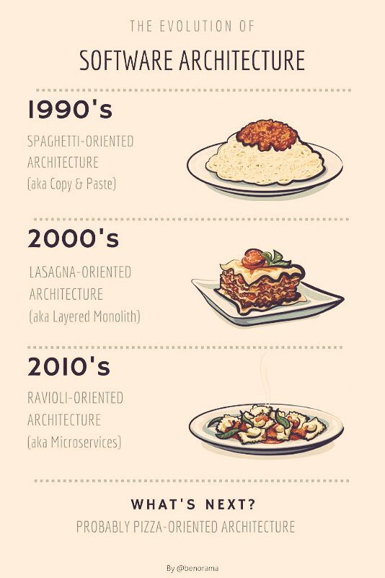
Learning to code
https://medium.com/@benorama/the-evolution-of-software-architecture-bd6ea674c477
Notes:
This comic may also describe the evolution of your code as you learn!

Slide 19
Learning to code - Practice
Programming languages are languages
  Therefore, practice like you would practice your Spanish, Japanese or Swahili!
Practice coding with tutorials & challenges:
    https://www.w3schools.com/js/
    https://www.codecademy.com/learn/introduction-to-javascript
    https://edabit.com/challenges/javascript
    https://www.codewars.com/
  There are many resources!
Notes:
Just like you would ‘train’ for a sporting event, train with coding. Start with small challenges, progress.

Slide 20
Additional Resources
Change detection
      Introduction to Change Detection
JavaScript and Earth Engine
      Geospatial Scripting in JavaScript and Earth Engine
      Earth Engine lecture: Code editor & JavaScript
Advanced topics in Earth Engine time series analysis
      Slides from LandTrendr & CCDC in Earth Engine lecture
      Time Series Analysis in Earth Engine lecture
      Time series visualization analysis with Earth Engine, Pandas, Altair and Colab

Slide 21
Back to change analysis with LT-GEE!
Let’s run LandTrendr in the code editor with code this time!
Putting the pieces together:
  Reviewed/practiced with simple EE algorithms
  Found analysis parameters with UI tools
  Now we will write the JavaScript code run LandTrendr and get data

Slide 22
Exercises for today
Exercise 1: Process and explore Landsat time series
  Optional – review image processing in GEE
Exercise 2: Basic trend analysis
Exercise 3: LandTrendr in GEE: Model fitting
Exercise 4: LandTrendr in GEE: Disturbance mapping

Slide 23
Demo and exercise steps
Review API documentation
Understand and adapt an example analysis script
Setup and run a full LandTrendr analysis script in the EE Code Editor
Download a disturbance map

Slide 24
GTAC Remote Sensing SME Contacts
Point of Contact | Specialization | Email
Indigo Catton | Image interpretation, data portals, ArcGIS Pro, segmentation | indigo.catton@usda.gov
Lila Leatherman | Change Detection, Image Classification, R & Earth Engine scripting, modeling | Lila.Leatherman@usda.gov
Jeremy Webb | Aerial Photography, Photogrammetry, UAS | jeremy.webb@usda.gov
Mark Hammond | ERDAS and Data Services, Photogrammetry | mark.hammond@usda.gov
Shiona Howard | Lidar Acquisition, Analysis, and Support, Python scripting | Shiona.Howard@usda.gov
Jamie Chaitman | Google Earth Engine Scripting, change detection | Jamieson.Chaitman@usda.gov
Juliette Bateman | Image Classification, Google Earth Engine Scripting | Juliette.Bateman@usda.gov
Rowan Moody | Change detection, modeling, vegetation classification | Rowan.Moody@usda.gov
Geospatial Training and Awareness page

Slide 25
Geospatial Help Desk
Did you know that GTAC offers geospatial support through the Customer Help Desk?
  Tickets first go to a Tier 1 Help Desk Agent
  Tickets are then routed to a Tier 2 Agent who specializes in the area of your issue
Geospatial Tier 2 Agents work directly at GTAC
  Bypass long wait times and come directly to us!

Slide 26
Remote Sensing Help Desk
4x official Tier 2 Agents at GTAC and myriad Subject Matter Experts (SMEs)!
  Tier 2 agents answer questions + formally handle tickets; SMEs answer questions + let the Tier 2 agents handle the tickets
  This is a funded service that we provide – you are not inconveniencing anyone by asking for help.
  Contact SMEs directly, we’ll take care of the CHD ticket.
  We have a whole office of SMEs at our disposal to help you resolve whatever issue you’re facing.

Slide 27
Remote Sensing Help Desk
Topics: troubleshooting remote sensing software, lidar, radar, Google Earth Engine, modeling, geospatial scripting, photogrammetry, stereo viewing, change detection, segment generation / object-based image analysis (OBIA), raster geoprocessing, and more.

