Slide 1
Introduction to Change Detection Lecture 1: Overview and Image Selection
Instructor: Lila Leatherman (they/them)
November 17-18, 2021

Slide 2
Housekeeping
Keep video off and stay on mute
If you have questions:
Raise hand in Teams
Respond in chat box
Q + A at the end
Closed captions are available
Take care of your body!
* this webinar will be recorded*

Slide 3
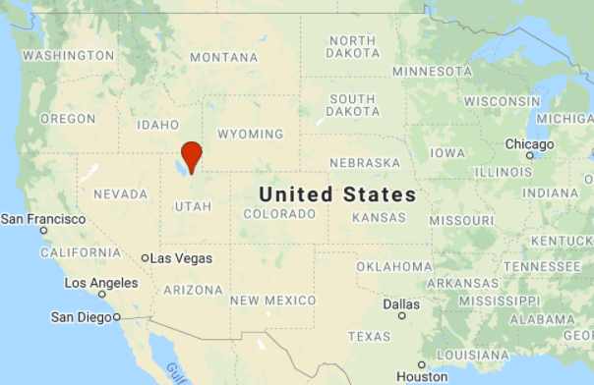
Personal intro
Lila Leatherman (they/them)
Remote Sensing Specialist
Oberlin College, Oregon State University
Spatiotemporal stats, ecophysiology, biogeography, Google Earth Engine
Trail runner, rock climber, newbie mountain biker
Notes:
Personal intro—
Invite people to introduce themselves with name, pronouns if they want, location, one thing they’re excited to learn more about

Slide 4
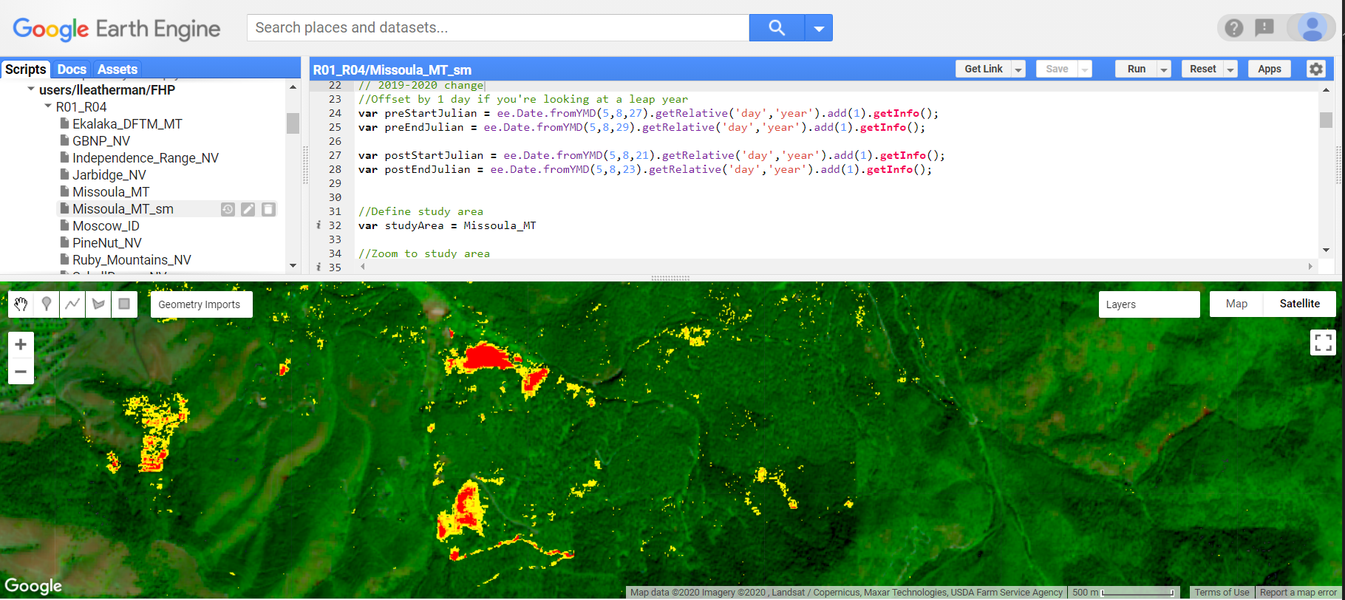
DeltaViewer Overview
Basic two-date change detection
Implemented in Google Earth Engine (GEE)
Used in FHP to supplement aerial surveys grounded by COVID
Delta Viewer Hub Site on AGOL

Slide 5
Software and course data
Required Software:
ArcGIS 10.x
Suggested Software
Google Earth Engine account
Course data
Available via the tutorial or agenda (unnecessary with GEE account)
Data.zip (542 MB)
Contents:
Landsat imagery

Slide 6
Introduction to Change Detection
Course objectives
Establish a conceptual foundation for change detection
Increase awareness of applications and capabilities
Acquire a conceptual and technical toolset enabling you to conduct/evaluate change analyses

Slide 7
Outline and Course Agenda
Day 1:
Concepts and overview
Scene selection and image pre-processing
Identifying change: Spectral characteristics of change
Day 2:
Measuring and mapping spectral change
Classifying and validating change
Notes:
Flesh out this outline slide

Slide 8
Course Agenda
Day 1 – Morning
10:00-10:45 – Presentation: Course overview and image selection and preparation
10:30-10:45 – Demonstration: Overview of GEE
11:00-11:10 – Break
11:10-11:30 – Presentation: Image correction
11:30-12:00 – Demonstration: Creating cloud-free composites in EE
Tasks to complete before the next session: Exercise 1 + 2
Day 1 – Afternoon
2:00-2:30 – Presentation: Band ratios and image transformations
2:30-3:00 – Demonstration: Identifying significant landscape change
3:00-4:00 – Q&A and Exercise Help
Tasks to complete before next session: Exercise 3

Slide 9
Course Agenda
Day 1 – Morning
10:00-10:45 – Presentation: Course overview and image selection and preparation
10:30-10:45 – Demonstration: Overview of GEE
11:00-11:10 – Break
11:10-11:30 – Presentation: Image correction
11:30-12:00 – Demonstration: Creating cloud-free composites in EE
Tasks to complete before the next session: Exercise 1 + 2
Day 1 – Afternoon
2:00-2:30 – Presentation: Band ratios and image transformations
2:30-3:00 – Demonstration: Identifying significant landscape change
3:00-4:00 – Q&A and Exercise Help
Tasks to complete before next session: Exercise 3

Slide 10
Course Agenda
Day 2 – Morning
10:00-10:45 – Presentation: Image standardizations and image differencing
10:30-11:00 – Demonstration: Calculating z-scores
11:00-11:10 – Break
11:10-11:30 – Presentation: Change thresholding and discussion of accuracy assessment
11:30-12:00 – Demonstration: Exploring histograms and creating change maps
Tasks to complete before the next session: Exercise 4 + 5
Day 2 – Afternoon
2:00-2:30 – Q + A and Exercise Help
2:30-3:00 – Presentation: Change detection applications within USFS
3:00-4:00 – Final Q + A; help with course-related projects/ideas

Slide 11
Lecture outline:
What is change detection?
Review of remote sensing principles
Principles of change detection
Analysis considerations
Analysis methods
Two-date change detection
Methods
Image selection
Image processing
Image enhancement
Analysis
Evaluation

Slide 12
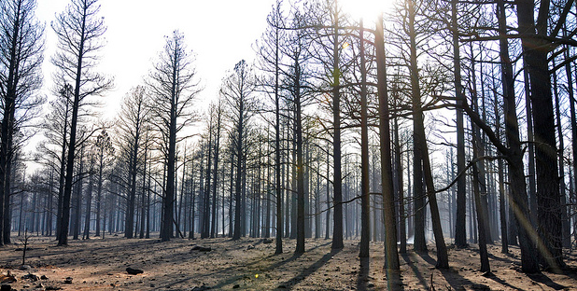
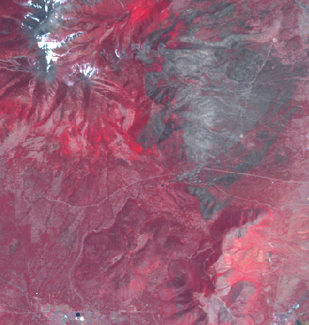
What is Change Detection?
Identifying landscape change from remotely sensed images
Analyze images from different times to map/quantify change
Assumption:
Landscape change -> Spectral change
Coconino NF – Schultz fire effects
Landsat TM5 image – 1 year post fire

Slide 13
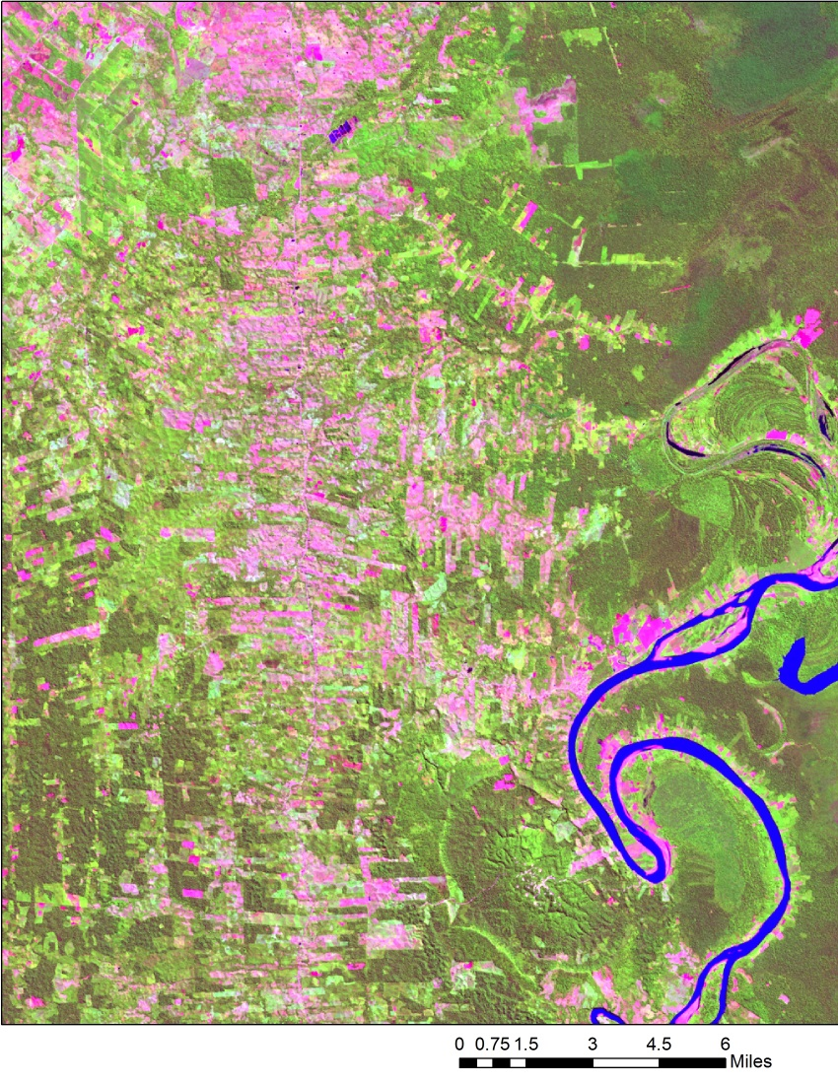
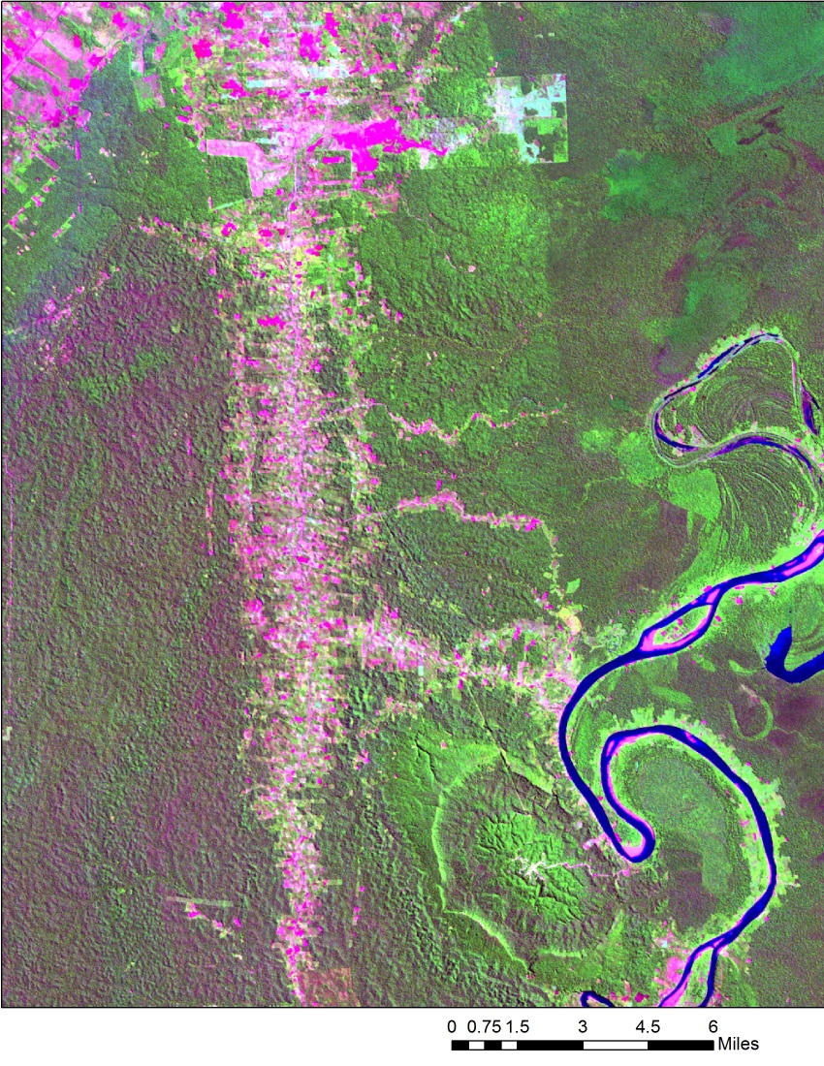
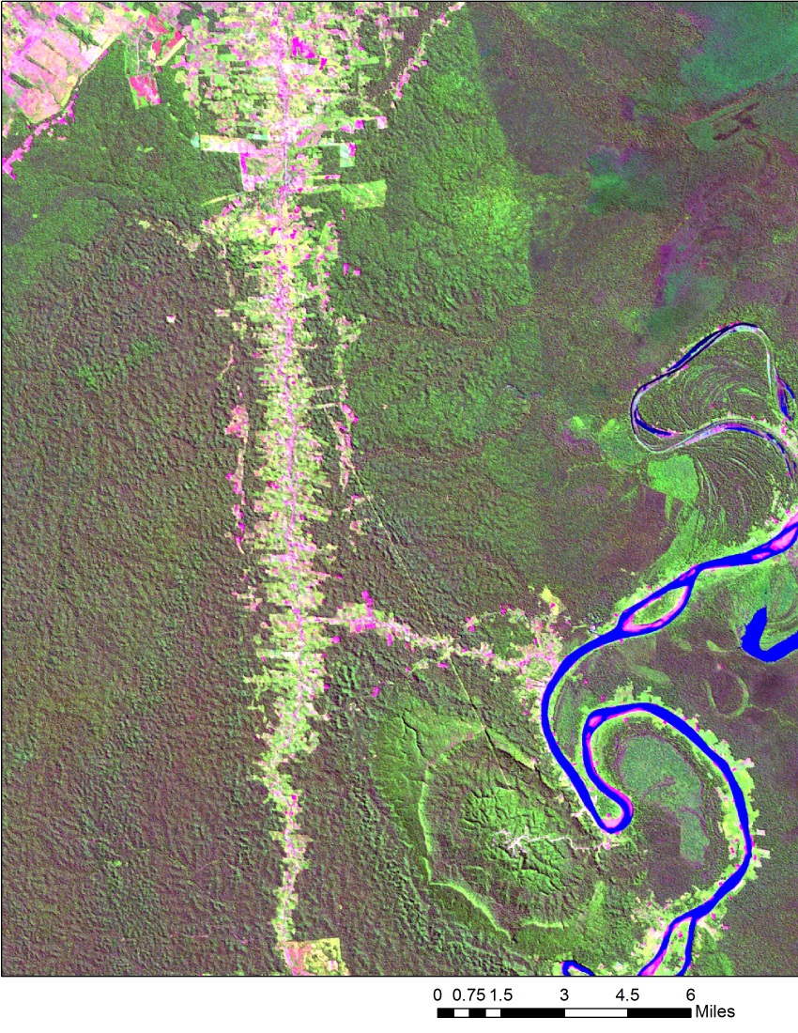
What is Change Detection?

Slide 14
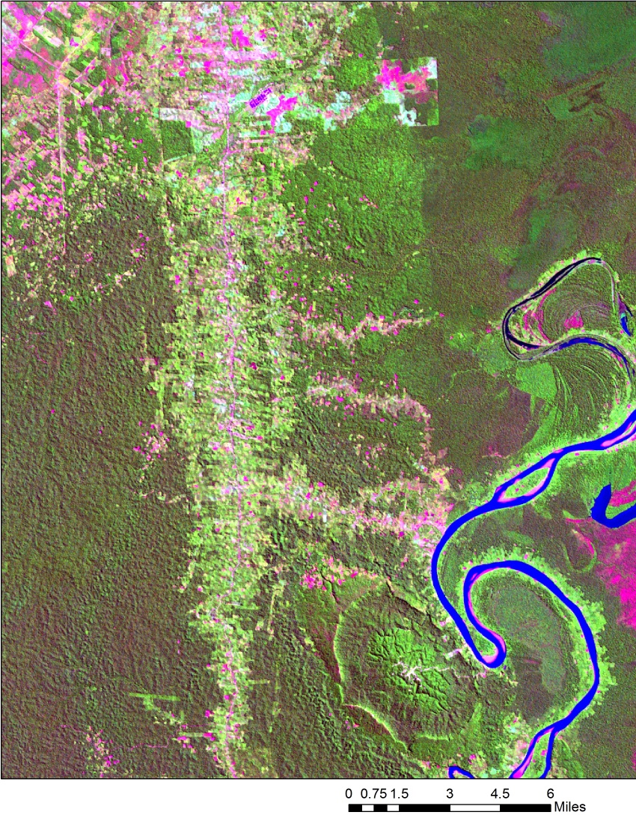
What is Change Detection?

Slide 15
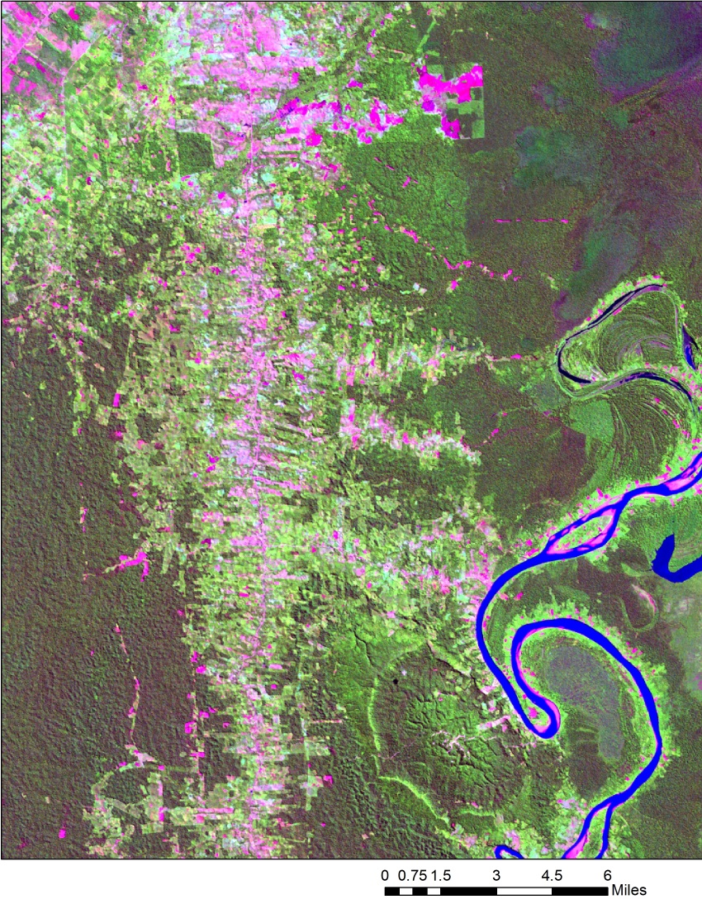
What is Change Detection?

Slide 16
What is Change Detection?

Slide 17
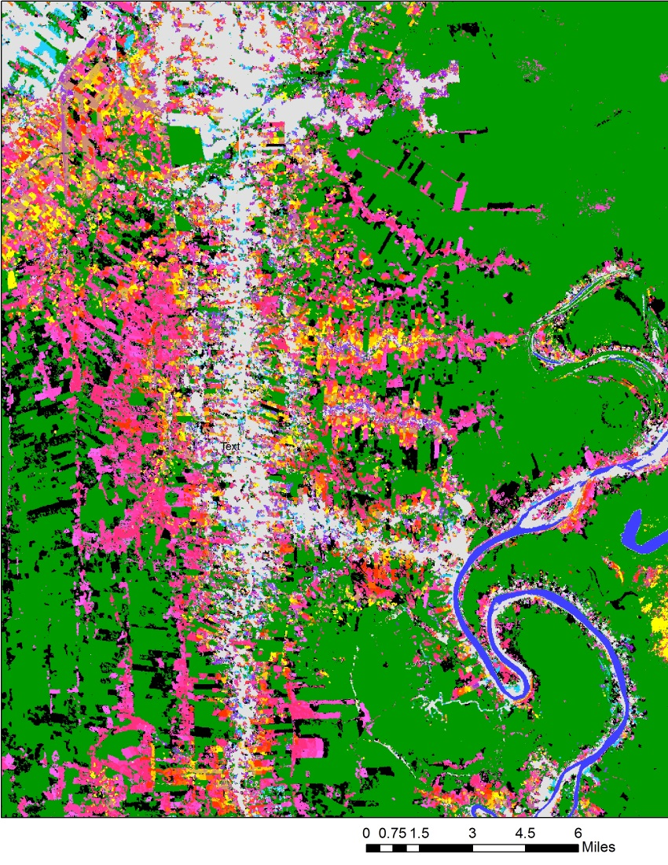
What is Change Detection?

Slide 18
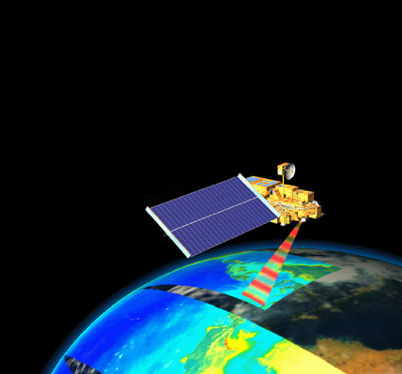
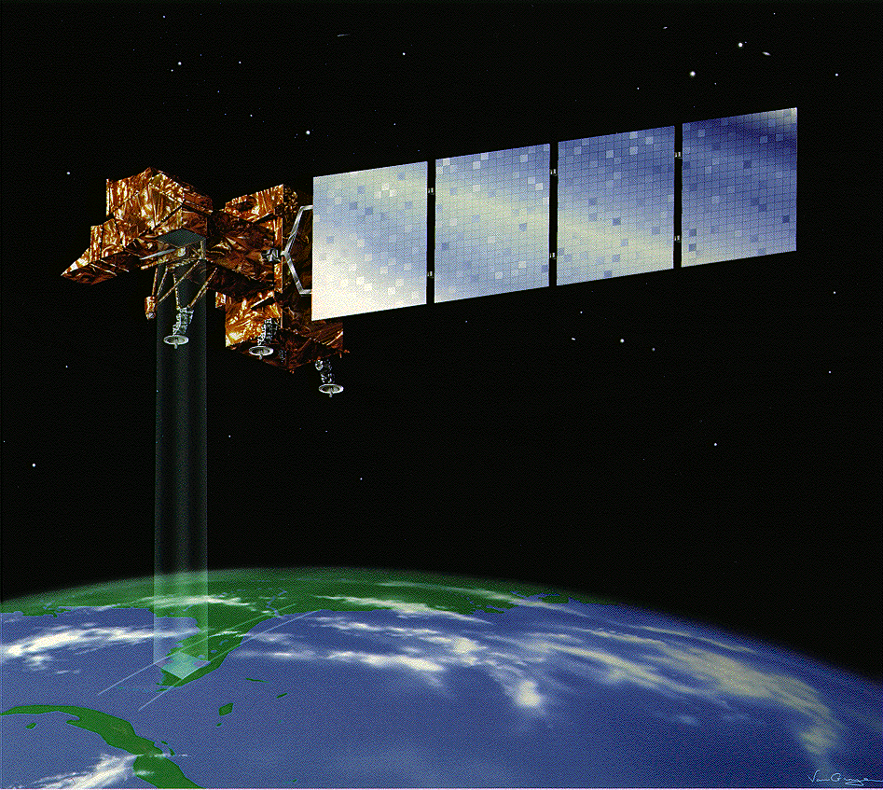
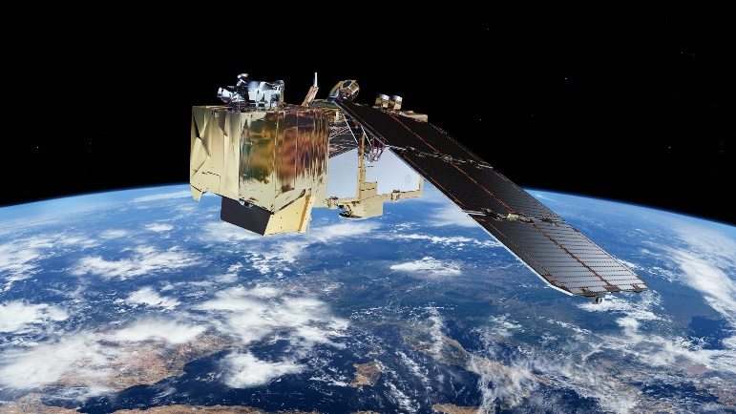
Monitoring Change with Remote Sensing
Satellite and aerial sensors provide:
Consistent, repeatable measurements
An ever-growing archive of imagery
Several sensors/image programs available with different spatial scales, spectral resolutions and return intervals
SPOT
Landsat
MODIS

Slide 19
Review - Optical Remote Sensing Basics
Remote sensing relies on the fact that different targets have unique responses to Electromagnetic (EM) energy
We can distinguish land-cover types spectrally and track them through time
Conifer
Asphalt
Water

Slide 20
How do we detect change from imagery?
Changes on the landscape can be detected as changes in the ‘spectral space’ occupied by an image pixel
Healthy Vegetation
Reflectance
Burned Vegetation
0.4
2.6
Wavelength (µm)

Slide 21
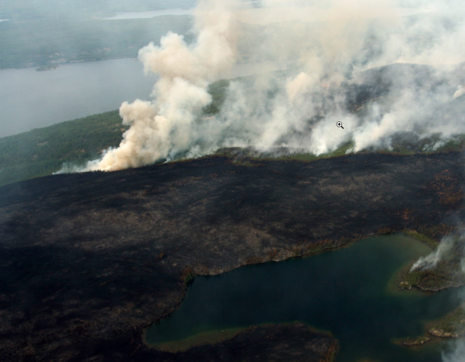
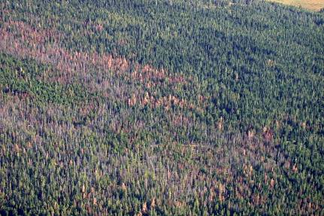
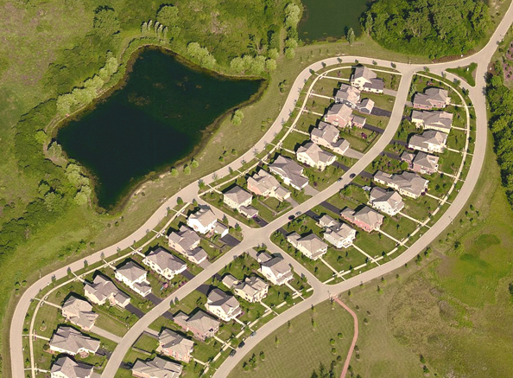
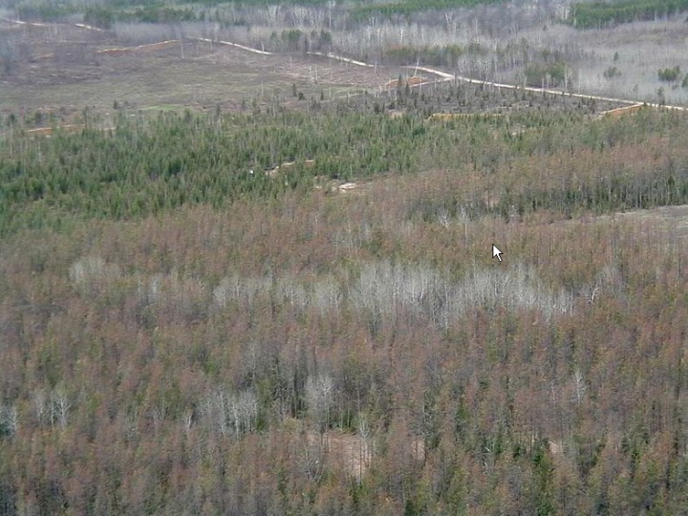
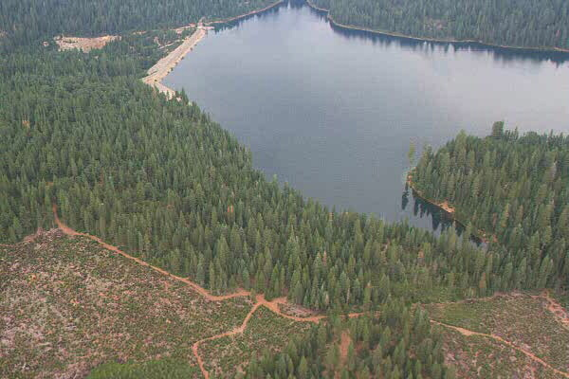
Change Agents
Natural or anthropogenic
Change agents affecting forests:
Wildfire, insect outbreaks, succession, drought or climate change, regeneration, storms, etc.
Harvest, management, agriculture, development, invasive species, etc.

Slide 22
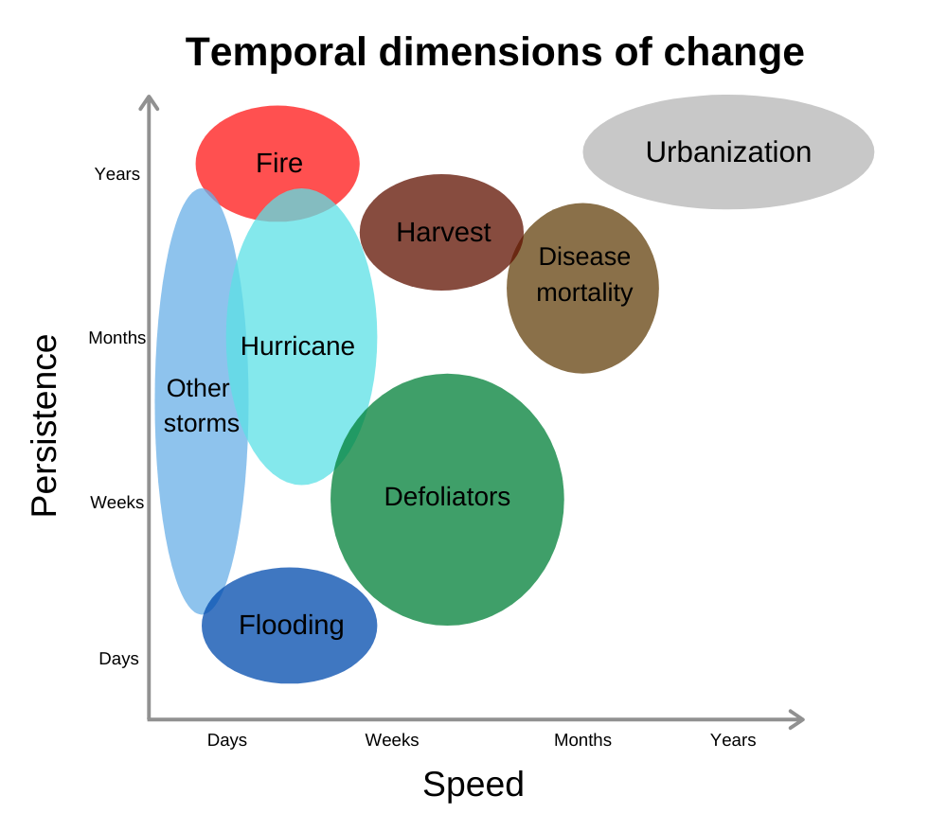
Dimensions of Change

Slide 23
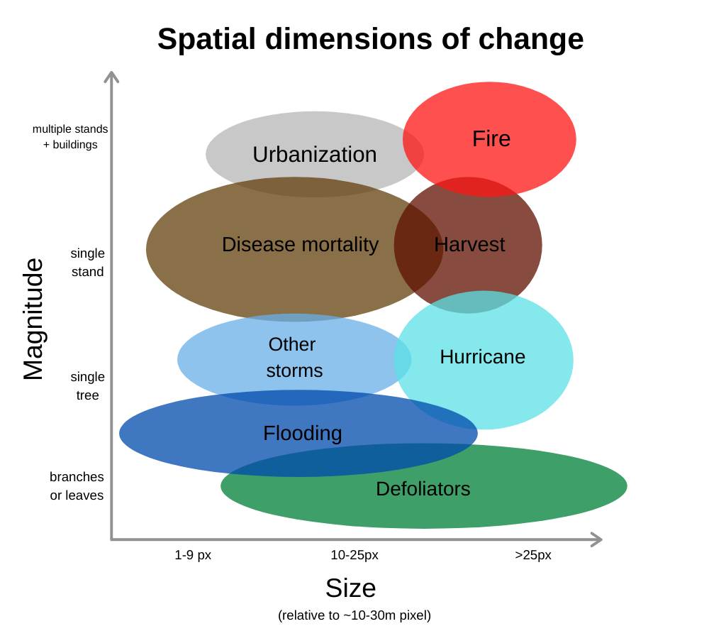
Dimensions of Change

Slide 24
Sensor Characteristics
Sensor | Number of Bands | Spatial Resolution | Temporal Resolution | Radiometric Resolution | Swath width/Footprint
MODIS | 36 | 250 m, 500 m, 1000 m | *1 day | 4096 | 2330 km swath width
Sentinel-2 | 13/1 | 10 m, 20 m, 60 m | *5 days | 4096 | 290 km swath width
Landsat 5 & 7/Pan | 7/1 | 30 m/15 m | *8 days | 256 | 34,225 km² footprint
Landsat 8/Pan | 10/1 | 30 m/15 m | 16 days | 4096 | 34,225 km² footprint
SPOT 5/Pan | 3/1 | 20 m/10 m | *2-3 days | 256/256 | 3600 km² footprint
IKONOS/Pan | 4/1 | 4 m/1 m | ~3 days | 2048/2048 | 11.3 km swath width
QuickBird/Pan | 4/1 | 2.4 m/0.6 m | 2-11 days | 2048/2048 | 16.4 km swath width

Slide 25
Analysis Prerequisites
Clearly define objectives
Identify the problem:
Change phenomena of interest (e.g., fire effects, forest mortality, stream channel changes, etc.)
Define study area
Determine frequency for change analysis (e.g., seasonal, annual, biennial, etc.)
Consider limitations
These considerations determine appropriate methods and whether change can even be detected
Notes:
Analysis prerequisites
Identify the problem
Are there multiple types of change? Do those multiple types of change interact or intersect with each other? We have to be able to tease them apart
Define study area
E.g., rocky mountain might be v different from white mountains
Determine frequency for change analysis
Post-fire: one-time event
Vs. sequential or long-term change--- looking at trajectories, slower decline, interacting multiple disturbances – might want annual images
Vs. recovery from hurricane impacts, might want weekly imagery
This will also effect the sensor you choose
Consider limitations
Can’t get all the information we need from one kind of imagery or source of imagery

Slide 26
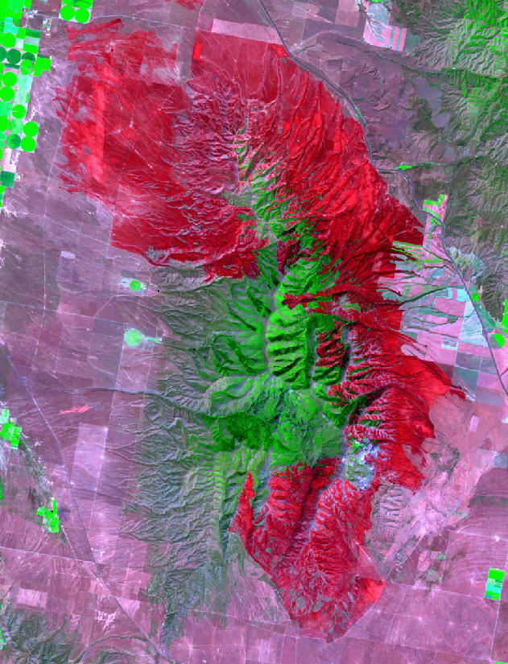
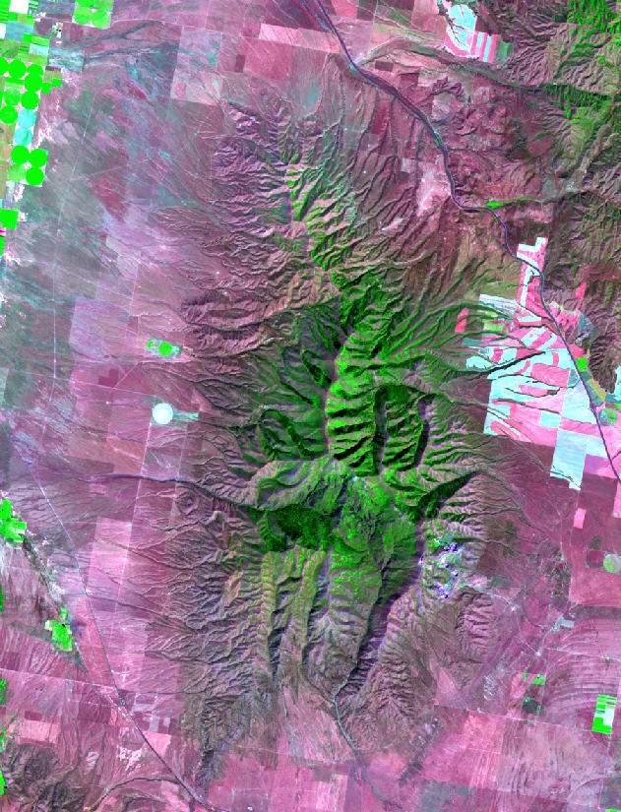
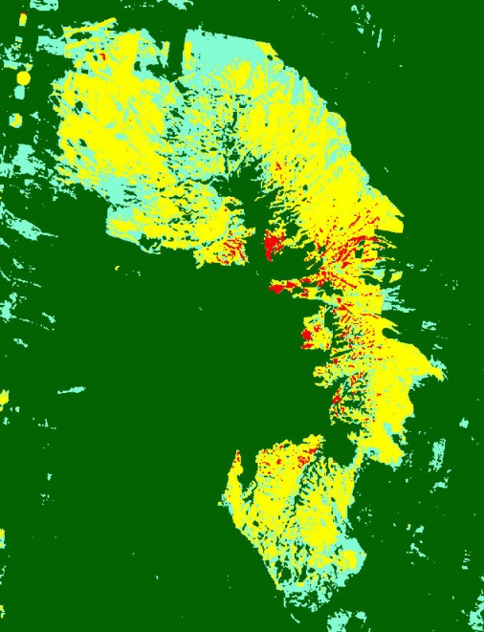
Approaches
Manual
Image interpretation
Automated
Two-date change detection
pre- and post-imagery
Trend analysis
Multi-temporal image stacks
Postfire
Prefire
Change
Time
Notes:
Approaches
Manual
Image interpretation methods of detecting change
ICE – Image Based Change Estimation has circular plots, plotted on imagery, where people interpret change in the different points in circles on the landscape, and can use that to estimate how much change is occurring
Might be creating a tabular output, rather than a map product
Can manually identify and delineate where change has occurred
Image of a forest harvest, boundary has been delineated in yellow
Takes a lot of time and clicking
Automated / semi-automated methods
Today we’re doing an automated two-date change detection
Means that there’s not clicking, there’s an algorithm that identifies areas of change
Lots of research has been done into automated thresholds, but these tend to be very specific to particular agents and areas—not super generalizable
Usually we do semi-automated methods, with some input from the user. We’re using a basic method, basically subtracting one image from another
Trend analysis can give us a lot more nuanced information—easily all the way back to 1984 in the Landsat archive
LandTrendr
LCMS
Harmonic curve fitting
Multiple approaches with common core concepts

Slide 27
Two-date Change Detection
Postfire
Multiple approaches with common core concepts:
Identify spectral characteristics of significant change and separate it from noise
Focus of this course:
Two-date image differencing
Moderate resolution satellite imagery
Provides a foundation for other methods
Can be accomplished using readily available tools
Prefire
Change
Notes:
Examples of different approaches: Post classification, z-score analysis, simple image differencing, etc.
Different approaches are appropriate for different situations; however, all share some common core concepts.
“Kennedy et al 09, Despite the variety of methods, most change detection approaches contain a modeling phase or a functional algorithm and a subtraction phase”
Multiple approaches with common core concepts
Assume that changes on the landscape are reflected by spectral change
And we have to separate that from noise, or artifacts that aren’t informative
Focus of this course:
Two-date image differencing
Moderate resolution satellite imagery
Provides a foundation for other methods
Readily available tools
Used to be much more complex to access and process images, needed all kinds of data storage space and proprietary software.
For this course we’ll be working in a combination of GEE and Arc; future interactions of the class will be exclusively in GEE

Slide 28
Challenge
Separate real change from spectral change caused by:
Seasonal variation and phenology
Image misregistration
Clouds and shadows
Radiometric inconsistencies
Sensor
Variability in illumination (sun-angle, sensor position)
Atmospheric effects
Notes:
Detecting landcover change by mapping spectral change presents the challenge of separating ‘significant’ change from ‘noise’
Challenge:
Separate “real” change or change of interest, from change caused by:
Seasonal variation and phenology
May v December, year to year variation in greenness even on same dates
Image misregistration
Basically, misalignment
If your images aren’t perfectly matched up, the landscape features might be mapped as change.
E.g., road is shifted 10m to the west, will be registered as change
Not something we have to worry about as much with GEE
Clouds, shadows, and cloud shadows
Radiometric inconsistencies
Sensors have inconsistencies that we account for in image pre-processing (but this is mostly handled in GEE)
Variability in illumination (sun-angle, sensor position)
Atmospheric effects
Less about haze, more about pollution
Smoke cover
Affect and attenuate the reflectance in the image
h images showing examples of these kinds of change

Slide 29
Two-Date Methods Overview
Image selection and acquisition
Imagery and reference data
Image processing
Correction
Image enhancement
Normalization and transformation
Analysis
Quantify differences and create a change map
Evaluation
Accuracy assessment
Notes:
Two Date Methods Overview
Data selection and acquisition
Image processing
1 and 2 are linked in GEE
Image enhancement
But, enhancement refers to highlighting specific features that we’re interested in—can be calculating specific vegetation indices or other band math, which can help us piece out specific kinds of change we’re interested in
E.g., NDVI – works super well for forests
NDMI – looks at moisture content, derived from swir bands
Analysis
Relatively short comparatively—most of the work goes in to the pre- and post-analysis pieces for this process
Evaluation
Look at classified layers, qualitatively and quantitatively

Slide 30
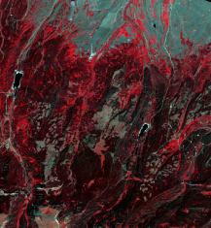
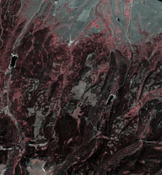
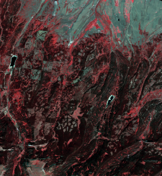
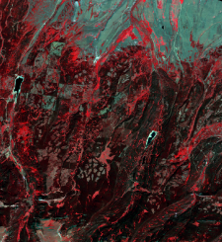
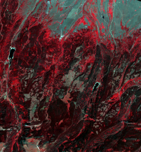
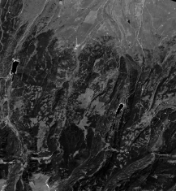
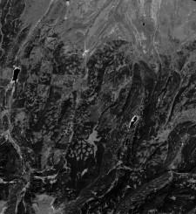
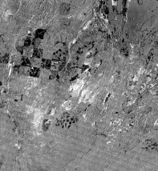
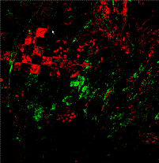
Select imagery
Correct and normalize Images
Co-register images
Transform images
Compute Difference Image
Threshold change and Filter results
Evaluate results
Time 1 - Image
Time 2 - Image
Transformation Time 1
Transformation Time 2
Difference Image
Final Change Image
Notes:
Copy to work on

Slide 31
Image Selection - Overview
Four primary considerations
Type, timing, quality, cost/availability
Notes:
Minimize extraneous factors to isolate changes of interest
Add pictures to this slide, esp in re the primary considerations
Image Selection – Overview
Type of imagery
What’s the spatial resolution, spectral resolution, temporal resolution—which sensor are we choosing
Timing
When was the imagery acquired? Does it capture our change? Often choose images at peak greenness
Quality of the image
If there is a lot of haze or clouds in the image, maybe you select a different date
Cost / availability
Often, things are free! Landsat, MODIS, Sentinel-2. Now, we even have high-quality imagery available for free, esp if you’re USFS, you can download, for example, worldview 2m imagery for free for a site of interest. Or, you can task or request for other high-res satellites to view your area. I have never paid for satellite images, but—am sometimes limited in the types of images that are available for my area of interest.

Slide 32
Image Selection - Overview
Four primary considerations
Type, timing, quality, cost/availability
Goals:
Capture the change of interest
Consider image and change phenomenon resolution (spatial, temporal and spectral)
Minimize non-target change or ‘noise’
Select near anniversary dates to minimize illumination and seasonal differences
Notes:
Minimize extraneous factors to isolate changes of interest
Goals
Capture the change of interest while minimizing the non-target change or ‘noise’
A fine line—sometimes more art than science as we adjust the kinds of noise or error that we tolerate

Slide 33
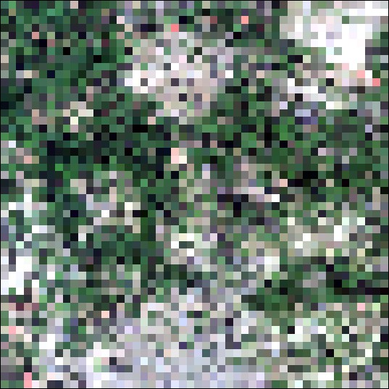
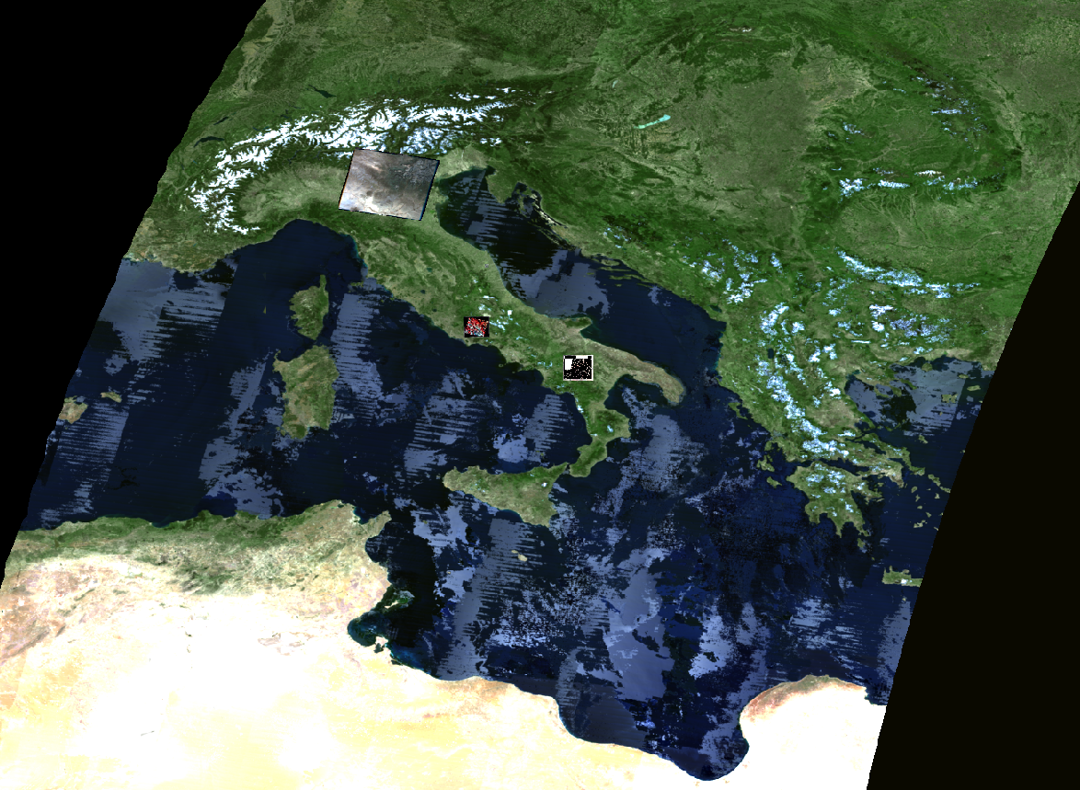
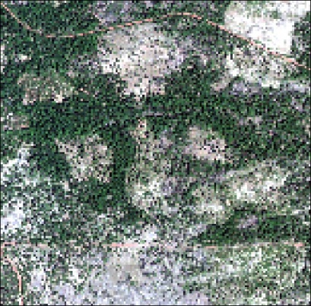
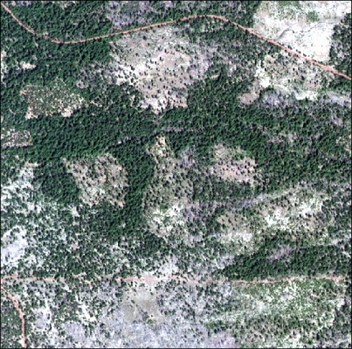
Image Selection - Spatial Considerations
Simulated imagery data
Spatial resolution
(pixel size)
Extent
Trade-off between resolution and extent
MODIS (250m)
Landsat (30m)
MODIS 250m
Landsat 7 30m
Sentinel-2 (10m)
WorldView (2m)
SPOT 5 10m
WorldView-2 2m
Notes:
Consider the type of change that you want to map… Can’t see single trees in a Landsat pixel, can’t even really see ‘stands’ in a MODIS pixel… explain pixel mixing
Spatial grain is the area on the ground captured by a single sensor element, effectively the pixel size.
Extent is the geographic scope of an image, the satellite footprint
Spatial grain of a sensor is the area on the ground captured within a single sensor element, effectively the pixel size.
The extent is the geographic scope of an image
[This image does not adequately depict the trade-offs between resolution and extent]

Slide 34
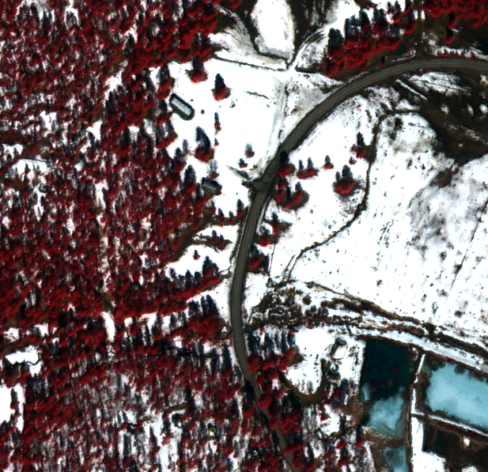
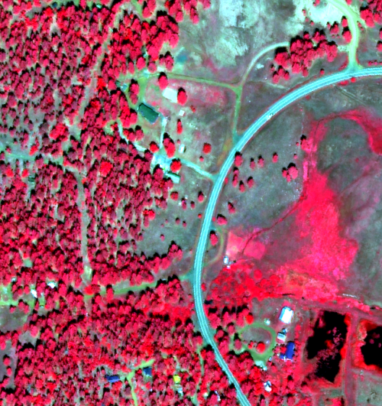
Image Selection - Temporal Considerations
Seasonal mismatch - World View2
March 2011
September 2011
Seasonal and environmental effects (e.g., soil moisture, phenology)
Persistence of change phenomena
(i.e., consider recovery and succession)
Figure adapted from Kennedy et al 2007
Notes:
Image timing must be chosen to minimize the influence of unwanted effects on spectral space, since such effects obscure real change or produce the false appearance of change. Key issues to consider are phenological state of the landscape, sun angle
Temporal grain is the frequency at which images of a given point on the earth are acquired (Kennedy et al 2009)

Slide 35
Image Processing - Overview
This is now automated in Google Earth Engine!
Geometric
Co-registration
Pixel-to-pixel alignment is especially important for image differencing
Image Correction
Correct or normalize the spectral values in the image pair
Notes:
Careful preprocessing of image pairs is required
Minimize spurious changes facilitating the identification of ‘true’ change
Image pre-processing
Now all done in GEE; removes potential for a lot of user-based error
The following slides all cover things that now are mostly done in GEE – we’ll make you aware of the fact that they happen, but they’re no longer considerations for analysts in the same way as they once were

Slide 36
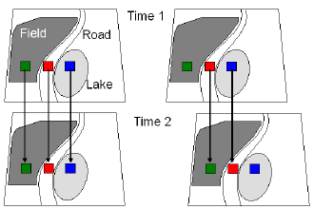
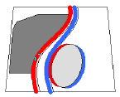
Image Processing - Registration Errors
Co-registered
Not co-registered
Notes:
Notes: One study (Dai and Khorram 1998), found that to achieve 10% or less errors, co-registration of 0.2 pixels or better was required. DeltaCue requires (or recommends) better than ½ pixel co-registration.
Accurate and consistent georeferencing is especially important for automatic land cover change algorithms because change detection is performed by overlaying images from different dates. If shifted even slightly, the overlay will show many false changes that are artifacts of the georeferencing error and not due to actual changes in the landscape.

Slide 37
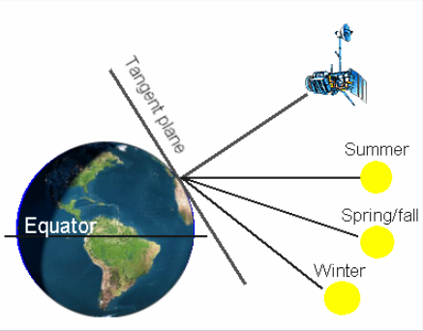
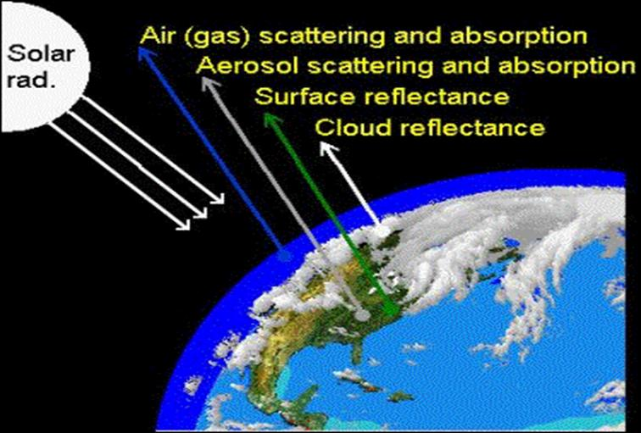
Image Processing - Image Correction
Radiometric
Sensor calibration, illumination and view angle
Atmospheric
Selective scattering and absorption of light alters reflectance
Notes:
It’s really important to convert digital numbers (DNs) or brightness values recorded by the sensor to meaningful physical units such as reflectance. Depending on the project objectives, it may be desirable to also try to correct for atmospheric effects but this is more difficult and not always done.
Talk about DNs:
DN- Brightness value-initial value that gets recorded by the sensor (analogous to zeros and ones, it’s a record, it’s a marker… makes ); however, in order to interpret the data, we have to convert it to brightness
Brightness is also affected by:
Haze
Sun angle
Water vapor
Talk about atmospheric gases and aerosols –

Slide 38
Image Enhancement or Transformation
Derive and compare attributes highlighting scene features of interest
E.g., NDVI, NDMI, Tasseled Cap Greenness layers
Advantages:
Reduce data and noise
Simplify comparisons
Notes:
You should select those that help to hone in on your change phenomenon of interest

Slide 39
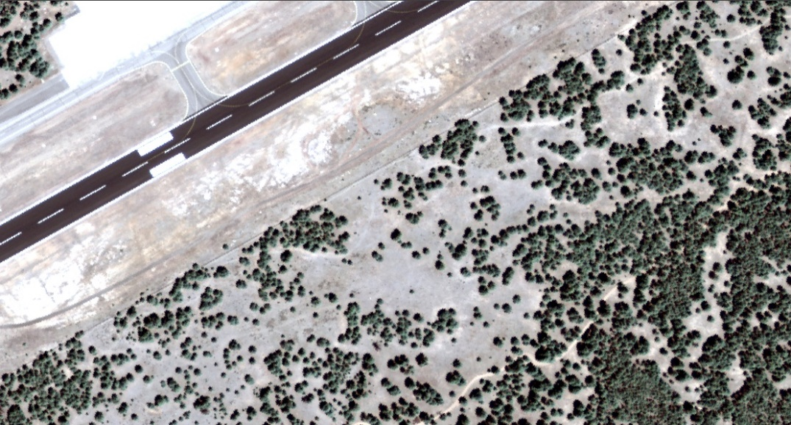
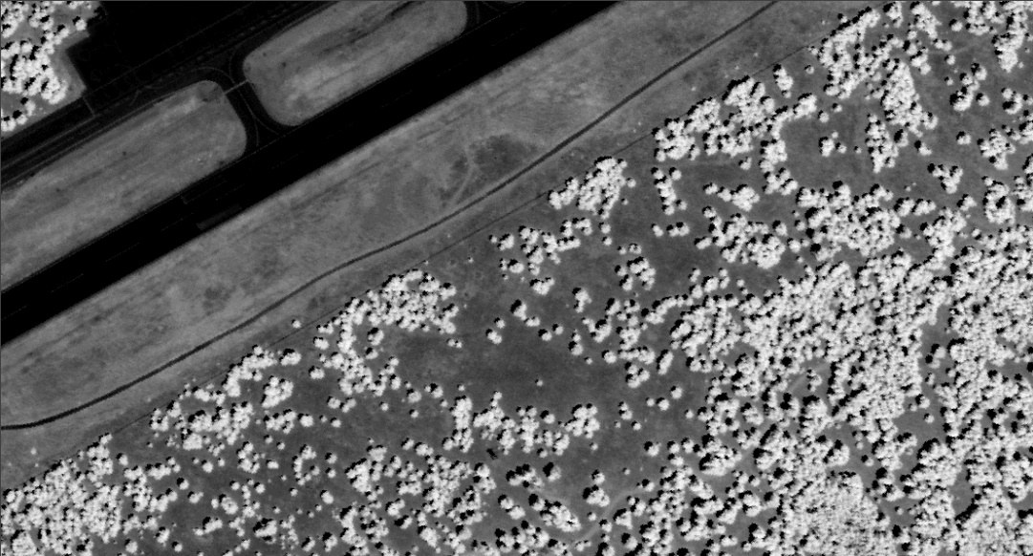
Normalized Difference Vegetation Index (NDVI)
Image Enhancement or Transformation
1m NAIP imagery – 4band (blue, green, red, NIR)
4- band image NAIP image
Single band NDVI image
NDVI = (NIR – Red) / (NIR + Red)
1m NAIP NDVI – 1band (NDVI)

Slide 40
Normalized Difference Vegetation Index (NDVI)
Image Enhancement or Transformation
1m NAIP imagery – 4band (blue, green, red, NIR)
4- band image NAIP image
Single band NDVI image
NDVI = (NIR – Red) / (NIR + Red)
Vegetation appears bright (high values)
Non-vegetation appears dark (low values)
1m NAIP NDVI – 1band (NDVI)

Slide 41
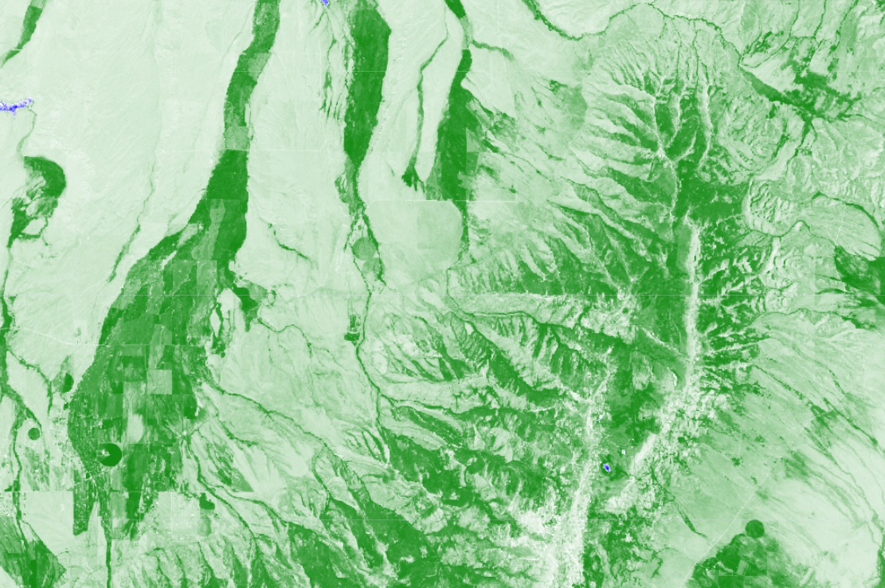
Image Enhancement or Transformation
Single band NDVI image
Notes:
Another way to visualize NDVI – areas that are water are blue, -1; areas that are veg are green, to positive 1

Slide 42
Analysis- Image Differencing
Use raster math to calculate a difference image
Pixel values in change image represent spectral change (positive/negative)
Notes:
In the difference image, positive and negative values represent increases or decreases in brightness…

Slide 43
Analysis- Image Differencing
Use raster math to calculate a difference image
Pixel values in change image represent spectral change (positive/negative)
Difference image, thresholded to represent change
Pre-change image composite
Post-change image composite
Notes:
In the difference image, positive and negative values represent increases or decreases in brightness…

Slide 44
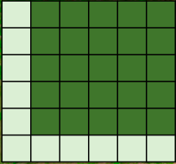
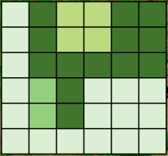
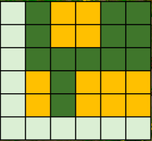
Analysis- Image Differencing
Use raster math to calculate a difference image
Pixel values in change image represent spectral change (positive/negative)
Difference image, thresholded to represent change
Pre-change image composite
Post-change image composite
Notes:
In the difference image, positive and negative values represent increases or decreases in brightness…

Slide 45
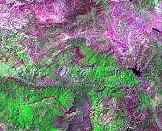
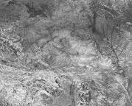
Analysis - Image Differencing
Example:
Normalized Burn Ratio (NBR) = NBR = (NIR – SWIR) / (NIR + SWIR)
Difference NBR = dNBR = Pre NBR – Post NBR
Burn Severity = Thresholds applied to dNBR
Landsat
NBR
Threshold applied -
Burn Severity
Pre-fire
dNBR
6/8/2005
Difference
Post-fire
6/14/2007
Notes:
Taken from MTBS workflow

Slide 46
Analysis – Thresholding
Partition change image (change/no change)
Example – Landsat NDVI difference image and a threshold of 2 standard deviations (+/-)
Vegetation Decrease
Vegetation Increase
Notes:
NDVI image difference of forest north of the uintas. Forest harvests show up clearly as decreases in NDVI

Slide 47
Analysis – Thresholding
Aerial photos Aug. 2020
Missoula, MT
Douglas Fir Tussock Moth
DeltaViewer output Aug 2019-Aug 2020
Sentinel-2 Imagery, false color visualization
Yellow-orange-red: thresholds representing severity of change

Slide 48
Evaluation– Accuracy Assessment
Evaluate change maps using reference data
Landsat Derived Change Map
High Resolution Reference Imagery (Pre and Post)
Notes:
Multiple assessment options depending on project goals and resources
Quantitative
Qualitative
“Does this pass a sniff test?”

Slide 49
Change Detection - Summary
Many considerations and approaches
Manual and automated methods
Two-date and trend analysis methods
A multistep process
Image selection/acquisition
Preprocessing
Enhancement/transformation
Analysis - mapping change
Evaluation
Notes:
Additional relevant training
Available through RSAC, ask us for recommendations!

Slide 50
Overall Goal
Minimize noise and map spectral change that represents significant landscape change
Ruby Mountains, NV Mtn Pine Beetle, Fir Engraver, Aspen mortality
Post-event Sentinel-2 Imagery
False color + change product 2020-08-01

Slide 51
Demonstration
Exercise 1: Overview of GEE

