Slide 1
Introduction to Change Detection Lecture 5: Data access + applications
Instructor: Lila Leatherman (they/them)
November 17-18, 2021

Slide 2
High Resolution Data Resources
FS EDW and Image Services
NAIP Imagery
Google Earth Engine
NAIP Imagery (and others)
Digital Globe
WorldView-2 and WorldView-3 image search + view capabilities
USGS Earth Explorer
Limited WorldView-2 and WorldView-3 imagery
Planet
Basemaps available for select states, imagery starting April 2021
USGS CIDR request portal (use in moderation)
Request archived high-resolution imagery
Request future acquisitions of high-resolution imagery
GTAC High Resolution Imagery access tutorial
For identifying WorldView Imagery and requesting through Earth Explorer + CIDR

Slide 3
Moderate Resolution Imagery Resources (10-30m resolution)
USGS Earth Explorer
Landsat - Analysis Ready Data (ARD)
Level-2 Data Products
Copernicus
Sentinel-2 data
Sentinel Hub EO Browser
Google Earth Engine (GEE)
Sentinel-2, Landsat, and many more
Tutorial to get started, from GEE
GTAC GEE Training Repository with example code
GTAC Sentinel-2 Imagery Acquisition tutorial
For downloading via the Copernicus portal

Slide 4
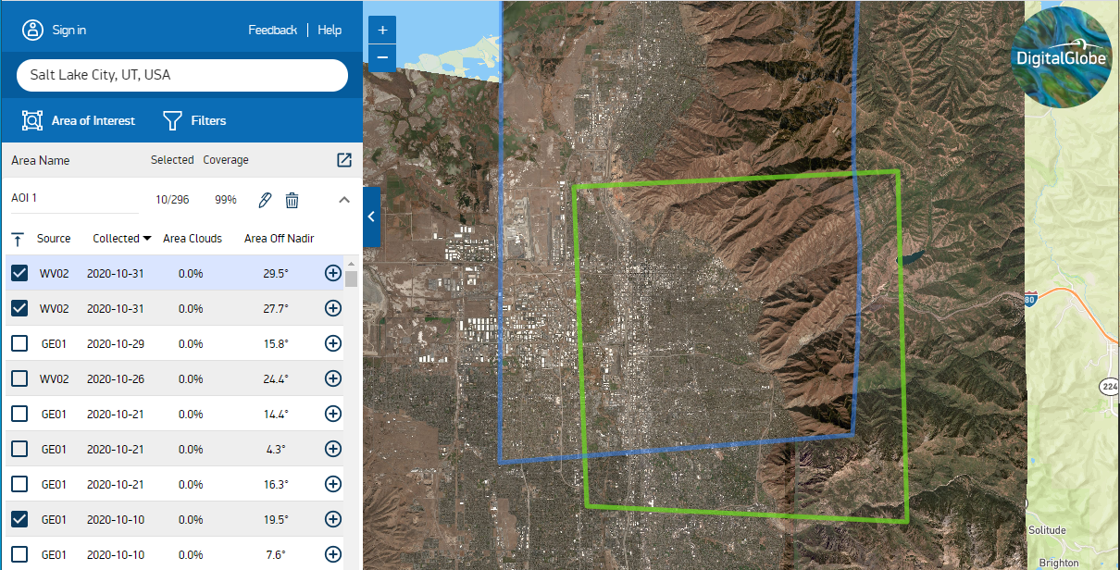
More data resources
WorldView data
Digital Globe – Discover to browse , G-EGD to download
Requires authorization to create an account
Submit CIDR request for specific new imagery acquisitions
Notes:
Need a federal sponsor for an account

Slide 5
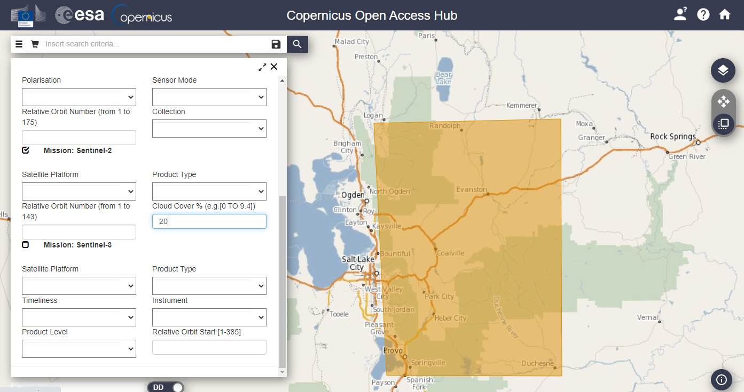
More data resources
Sentinel-2 Data
Copernicus via the European Space Agency
Notes:
Free to make an account!

Slide 6
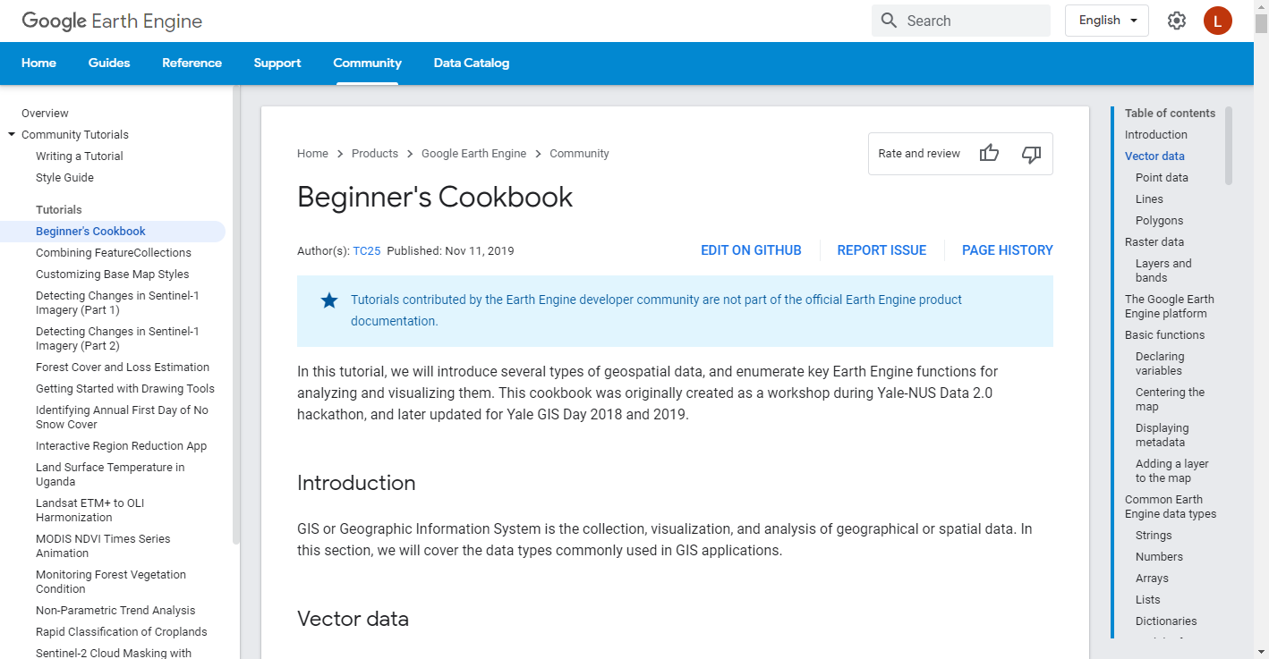
More data resources
Google Earth Engine tutorials
From GEE
From GTAC

Slide 7
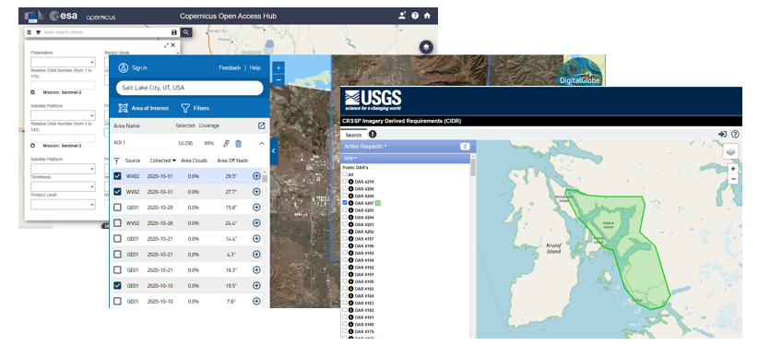
More data resources
Tutorials on image access developed for FHP
Obtaining Remotely Sensed Imagery webinar + self-paced tutorial

Slide 8
Data Resources - Disturbance Mapping Projects
USFS/partner programs
Fire Mapping
BAER (Burned Area Emergency Response), RAVG (Rapid Assessment of Vegetation after wildfire), MTBS (Monitoring Trends in Burn Severity) and more…
Forest Health and Disturbance Monitoring
FHAAST (Forest Health Assessment and Applied Sciences Team)
More programs and partnerships
USGS/NASA, research institutions, Google Earth Engine, etc.

Slide 9
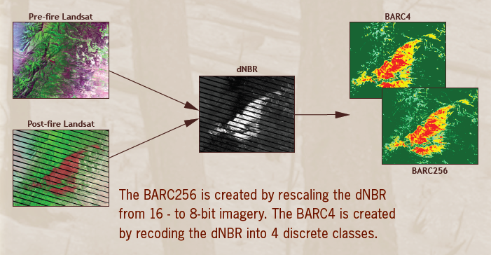
Fire Effects Data Products - BAER
Burned Area Reflectance Classification (BARC)
1-7 days post containment
Notes:
Delivered to BAER teams upon request. First approximation of burn severity which can be used to identify hazards from flooding, landslides, etc. BARC is classified dNBR difference image.

Slide 10
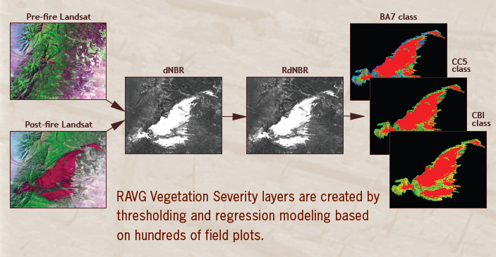
Fire Effects Data Products - RAVG
RAVG Severity layers and tables
30-45 days post containment
All fires >1000 acres on USFS land
Notes:
Primary audience for RAVG data are regional silviculturists who need to communicate yearly reforestation and restoration needs.
Uses established regression models that relate calibrated NBR difference layers to field plot data in order to estimate changes in forest inventory parameters such as canopy cover and basal area.
Data is available via the RAVG website which you can get to via RSAC websites.

Slide 11
Fire Effects Data Products - MTBS
Burn Severity layers from MTBS
Assessed 12-18 months post containment
All fires >1000 acres on USFS land
Notes:
Long term monitoring of fire severity effects. Thresholds applied to the calibrated NBR difference image to create fire severity maps with low, medium and high severity burns

Slide 12
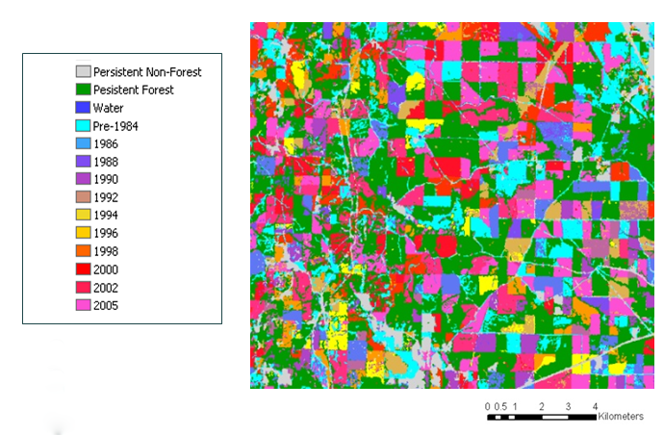
North American Forest Dynamics (NAFD)
Forest Disturbance and Regrowth Data
Products from analyses of Landsat time series
Vegetation Change Tracker (VCT) Algorithm
Data available for 55 areas in the US
NAFD project summary and data access
Notes:
The NAFD project uses the Vegetation Change Tracker (VCT), an automated forest change analysis algorithm, on temporally dense (annual or biennial) Landsat Time Series Stack (LTSS) of images and produces forest disturbance data products (Huang et al. 2010). The VCT algorithm was designed specifically for mapping forest change using LTSS. The algorithm consists of two major steps: 1) individual image analysis and 2) time series analysis. VCT produces a disturbance product where each pixel is labeled as either a static land class (persistent non-forest, persistent forest, or persistent water) or with the year of change for disturbed forest pixels.

Slide 13
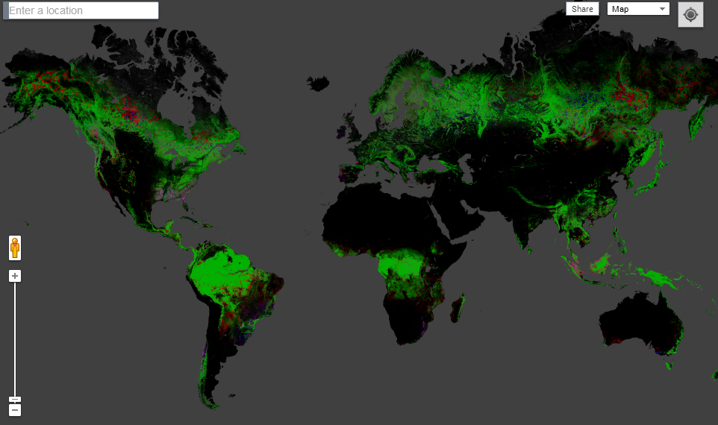
Hansen’s Map of Global Forest Change

Slide 14
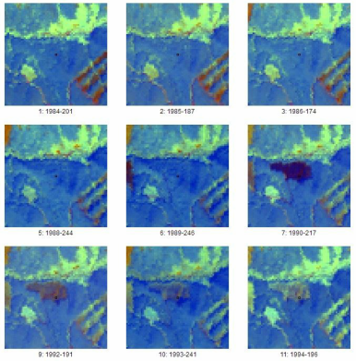
Tools for validation – TimeSync
Online tool facilitating human interpretation of Landsat time series
Useful for:
Validating change detection output
Estimating change from samples
Users get to interpret both images and plots

Slide 15
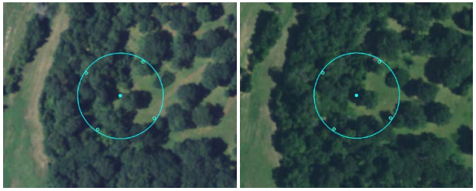
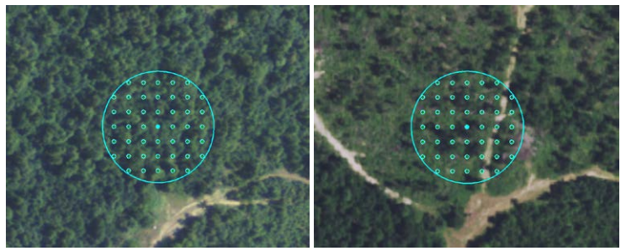
Image-Based Change Estimation (ICE)
No change
What is it?
Sampling approach using image-based interpretations to quickly estimate land cover and land use change
When no change present, 5 points
When change present, 45 points
All points attributed with LULC
Completed for all lower 48 states
Interpretation cycle follows NAIP’s schedule
Change

Slide 16
Change Detection Products Guide
Overview of operationally ready change detection methods for rapid, accurate, and repeatable estimates of tree mortality and defoliation events across large spatial extents
Link to the Change Detection Products Guide

Slide 17
Products and Links
Delta Viewer
High-Resolution Forest Mapping System (HiForm)
ForWarn II
Landscape Automated Monitoring and Detection Algorithm (LAMDA)
LandTrendr
LCMS

Slide 18
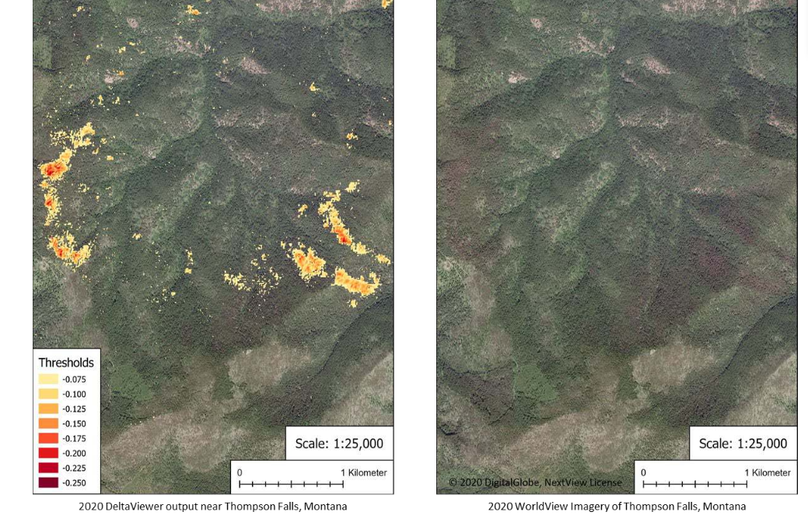
Delta Viewer
Delta Viewer Hub Site
Near real-time, every 5 days
Spatial Resolution: 20m
Imagery: Sentinel 2
Method: Two-date change
Detection, uses multiple spectral
Indices

Slide 19
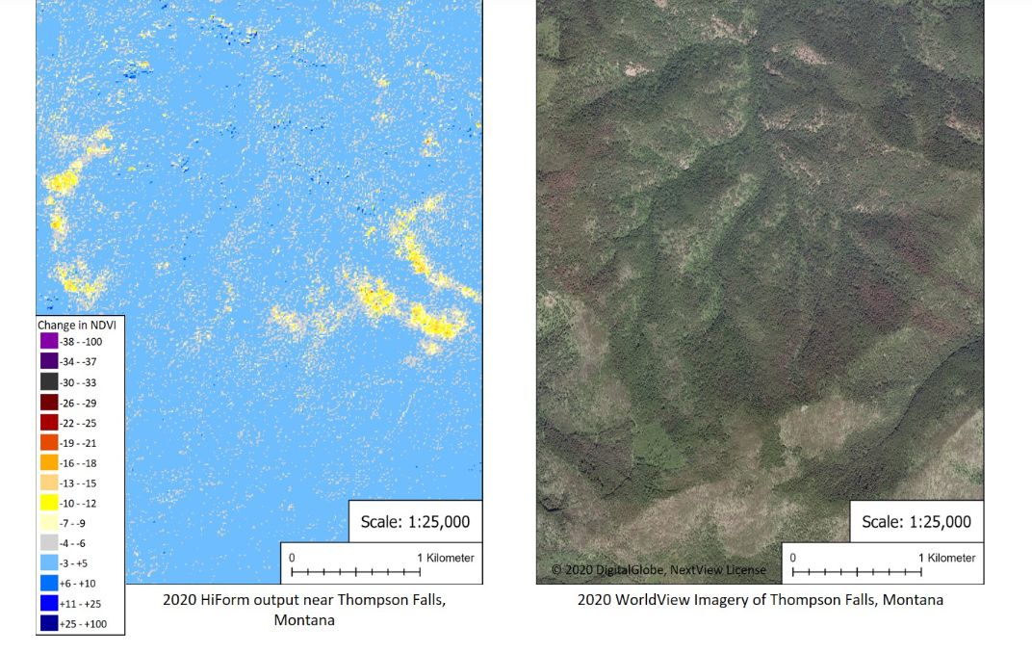
High Resolution Forest Mapping System (HiForm)
HiForm
Near real-time, every 5 days
Spatial Resolution: 20m
Imagery: Sentinel 2 and Landsat
Method: Two-date change
Detection of NDVI
Easy-to use GEE script

Slide 20
High Resolution Forest Mapping System (HiForm)

Slide 21
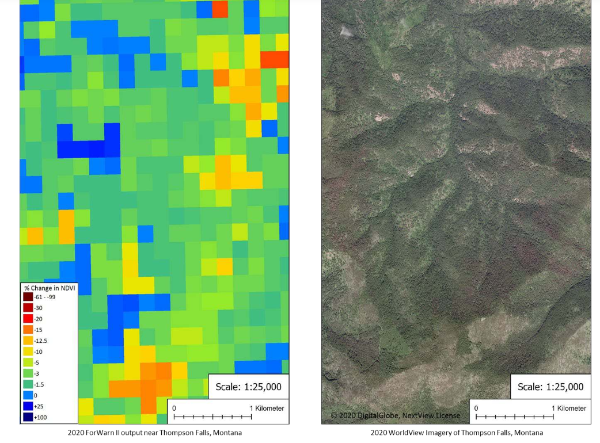
ForWarn II
ForWarn II
Near real time – every 8 days
Spatial Resolution: 250m
Imagery: MODIS
Method: multi-date differencing of NDVI
Can filter by landcover type

Slide 22
ForWarn II

Slide 23
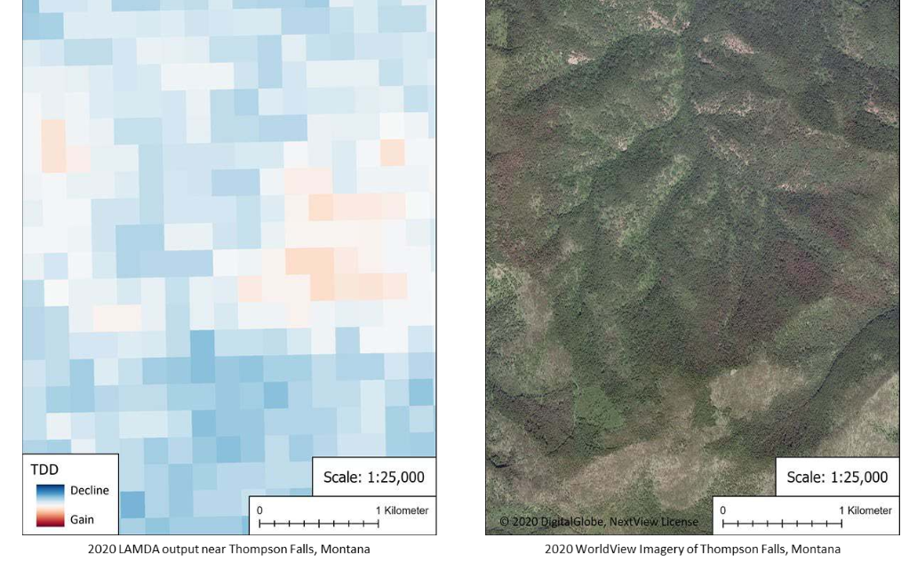
Landscape Automated Monitoring and Detection Algorithm (LAMDA)
LAMDA
Near real time
Spatial Resolution: 250m
Imagery: MODIS
Method: Trend analysis
Download Rasters

Slide 24
Landscape Automated Monitoring and Detection Algorithm (LAMDA)

Slide 25
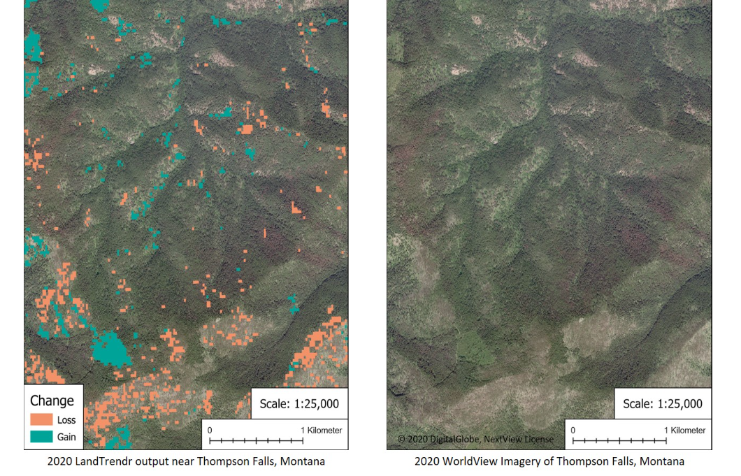
LandTrendr
LandTrendr
Annual
Spatial Resolution: 30m
Imagery: Landsat
Method: Trend analysis
Extensive documentation
Requires at least 5 years of data input

Slide 26
LandTrendr

Slide 27
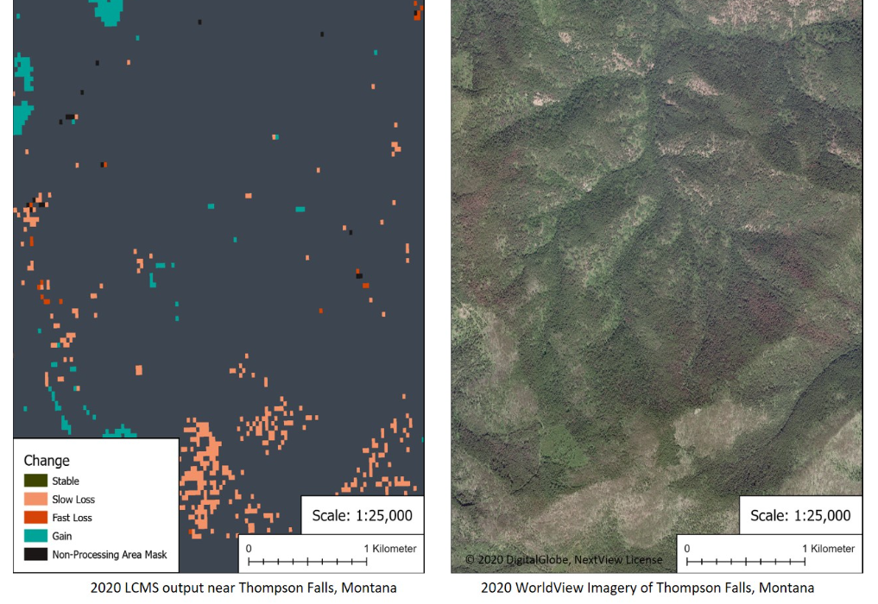
Landscape Change Monitoring System (LCMS)
LCMS
Annual
Spatial Resolution: 30m
Imagery: Landsat and Sentinel 2
Method: Trend analysis
Dates from 1985-Present

Slide 28
Landscape Change Monitoring System (LCMS)

Slide 29
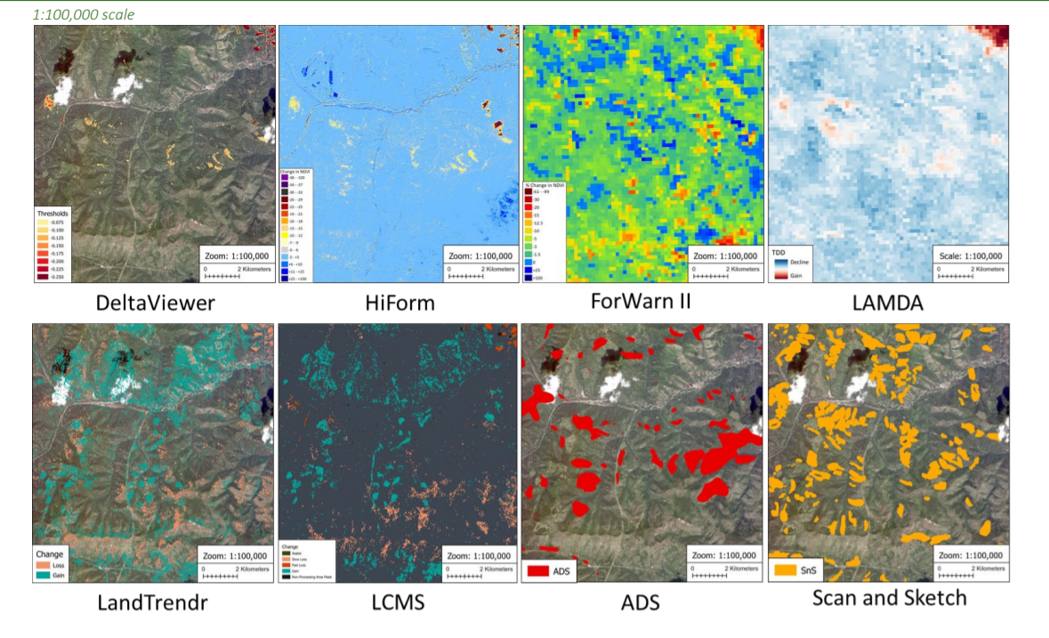

Slide 30
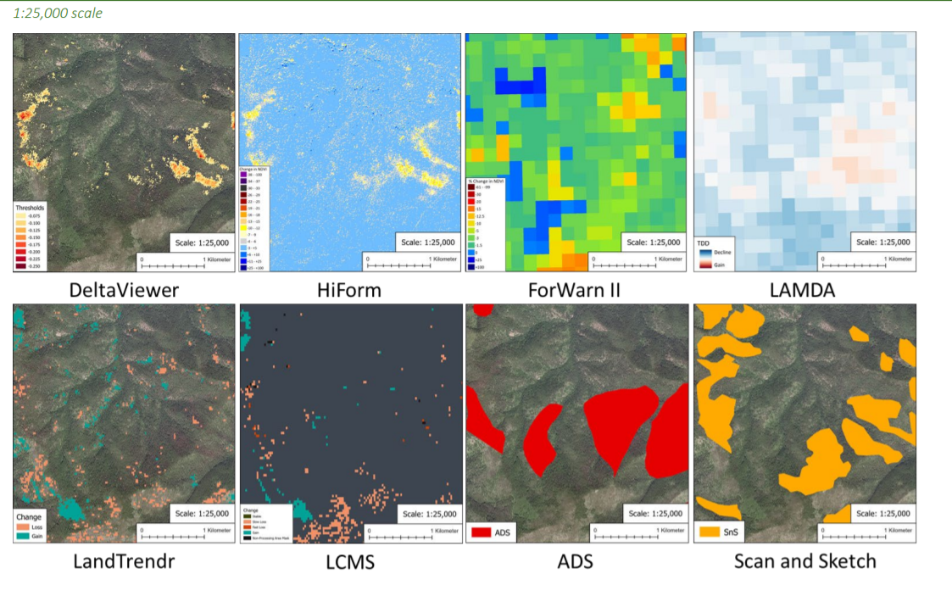

Slide 31
GTAC Remote Sensing Contacts
Point of Contact | Specialization | Email
Indigo Catton | Image interpretation, data portals, ArcGIS Pro, segmentation | indigo.catton@usda.gov
Kain Kutz | Object-based Image Analysis, Raster Geoprocessing, UAS | kain.kutz@usda.gov
Lila Leatherman | Change detection, Image classification, R & Earth Engine scripting, modeling | Lila.Leatherman@usda.gov
Jeremy Webb | Aerial Photography, Photogrammetry, UAS | jeremy.webb@usda.gov
Mark Hammond | ERDAS and Data Services, Photogrammetry | mark.hammond@usda.gov
Shiona Howard | Lidar Acquisition, Analysis, and Support, Python scripting | Shiona.Howard@usda.gov
Geospatial Training and Awareness page

Slide 32
GTAC Remote Sensing Contacts
Areas of expertise | Name | Contact
Land cover classification, geospatial scripting in R and Google Earth Engine | Juliette Bateman | Juliette.bateman@usda.gov
Image interpretation, data portals, ArcGIS Pro, segmentation | Indigo Catton | Indigo.catton@usda.gov
Change detection, scripting in R and Google Earth Engine, machine learning, forest health | Jamie Chaitman | Jamieson.chaitman@usda.gov
Lidar data acquisition and analysis, python scripting | Shiona Howard | Shiona.howard@usda.gov
Change detection, scripting in R and Google Earth Engine, machine learning, forest health | Lila Leatherman | Lila.leatherman@usda.gov
eCognition, image segmentation, image classification | Wyatt McCurdy | Wyatt.mccurdy@usda.gov
Habitat suitability modeling, scripting in R and python, ArcGIS desktop | Marie Schleicher | Marie.schleicher@usda.gov
Aerial photography, photogrammetry, UAS | Jeremy Webb | Jeremy.webb@usda.gov
Geospatial Training and Awareness page

Slide 33
Questions?
Lila.Leatherman@usda.gov

