Slide 1
Lidar Point Cloud Processing
Eric Rounds
Remote Sensing Specialist & Trainer
Geospatial Technology and Applications Center
October 17, 2018

Slide 2
Housekeeping
Workflow and Software developed by Pacific Northwest Research Station (PNW)
    Research Forester: Bob McGaughey
Technical webinar
Experience with FUSION and DOS recommended, but not required
Experience with ArcGIS will be helpful, but not required

Slide 3
GTAC Lidar Courses
Overview of Lidar and FUSION Software
FUSION—Software for Lidar Data Analysis and Visualization
Lidar Derivatives: Raster Geoprocessing and Analysis
Lidar Point Cloud Processing
Lidar Forest Inventory Modeling
Technical Webinars with Exercises

Slide 4
Lidar Geospatial Workflows
Point cloud processing workflows (this class)
  extract canopy structure information at specific scales and vertical thresholds
GIS workflows with the lidar derivatives
  BareEarth Surface (DEM, hillshade etc…)
  Canopy Height Layer (CSM – BE)
  1st order derivatives created during point cloud processing
Notes:
Ways of processing lidar data: processing point cloud vs processing derivatives

Slide 5
Course Objective
Gain the knowledge to implement the processing workflow and obtain the necessary tools for implementation
Computer Setup
Directory Structure
FUSION’s information extraction capabilities
  Become familiar with running executable tools from command prompt
Using the AreaProcessor Interface
Understanding and Integrating the outputs into your GIS workflow

Slide 6
Course Outline
Morning
  Brief overview of Lidar
  Exercises
    Install FUSION, prepare work environment
Afternoon
  Canopy Metrics Overview
  Getting Acquainted with Command Line
  Exercises
    QA/QC
    Area Processor

Slide 7

Lidar System Overview
LiDAR – Light Detection and Ranging
Active Sensor
Measures distances through laser pulses that strike and reflect off of features on the surface of the earth.
  Distance = (speed of light * round-trip time)* ½
Converts scanning angle and distance-from-sensor information into georeferenced data points
Collects 100 thousand – 1 million positions/second (creates a point clouds)

Slide 8
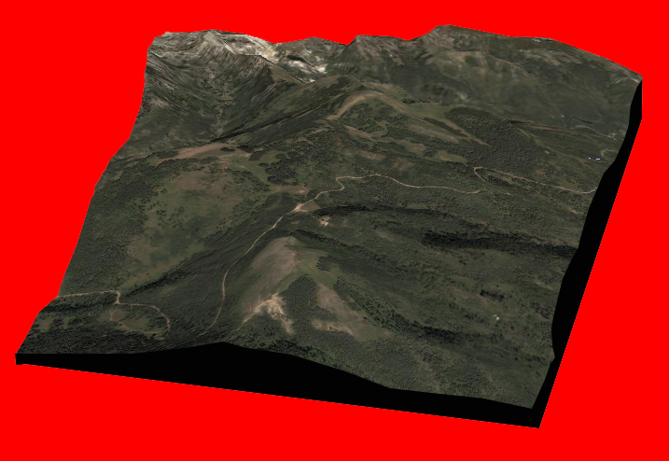
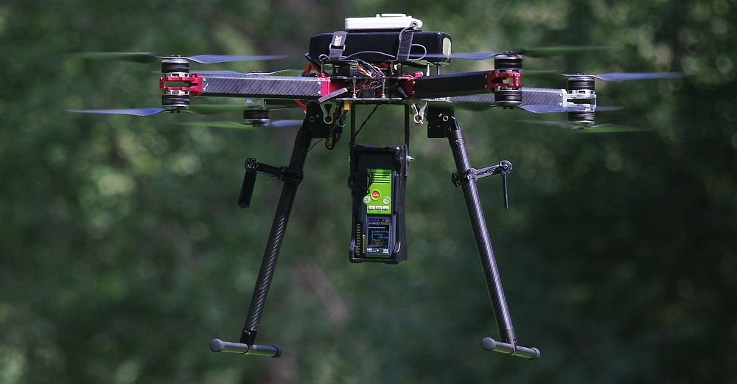
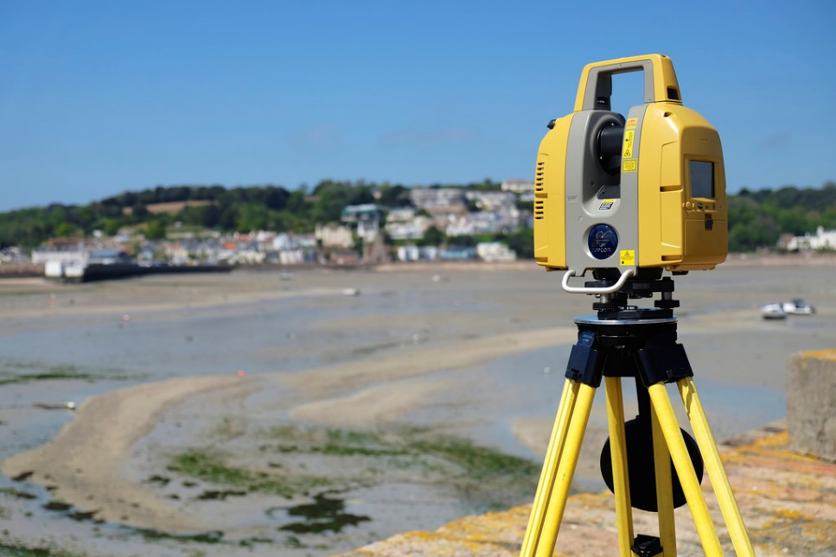
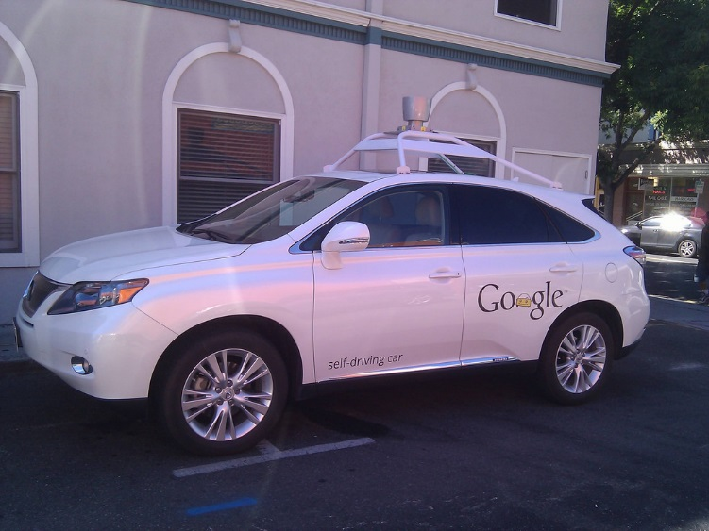
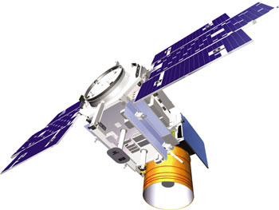
Collection Mechanisms

Slide 9
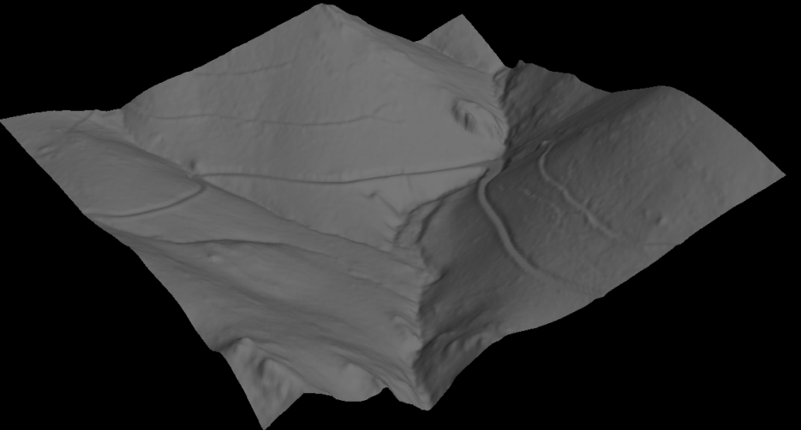
Airborne Lidar System Components
GPS
IMU
Scanning laser emitter-receiver unit (the sensor)
Differentially-corrected GPS on the ground and in the plane
Inertial measurement unit (IMU)
Computer to control the system and store data
z
y
pitch
X
roll
yaw
z
GPS
y
X

Slide 10
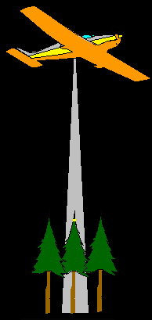
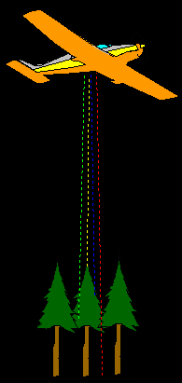
Lidar Data Characteristics
A lidar “pulse” is a laser beam emitted from the Lidar sensor (NIR --1064nm).
  Scan rate ~ up to 500 kHZ (500,000 pulses per second)
A single pulse may strike several features
Portions of the pulse are reflected back to the sensor, these portions are called “returns”
Up to 5 returns per pulse
  *Typically only 2-3 returns
1st Return (Canopy Height)
Intermediate Return
Intermediate Return
Last Return (Ground)

Slide 11
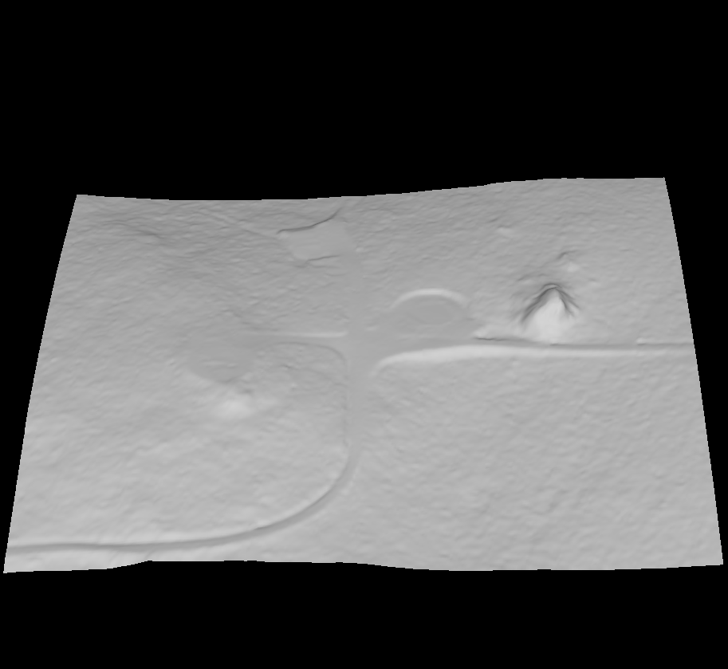
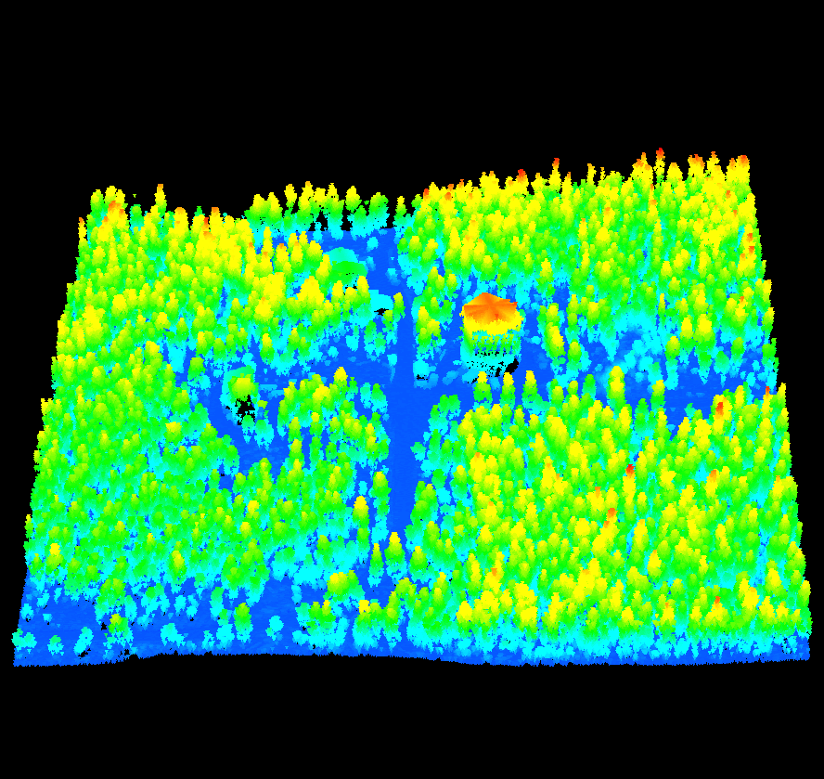
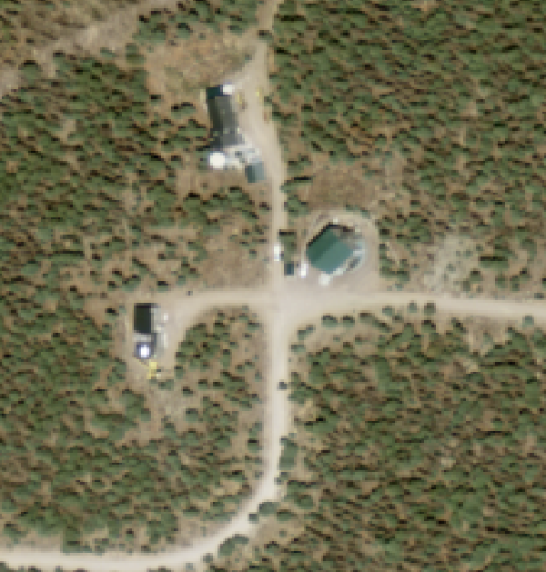
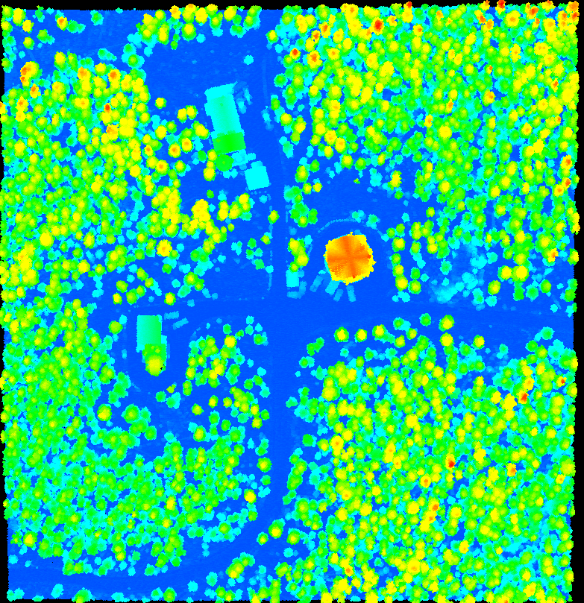
Lidar Data Characteristics
What does the raw data look like?
Discrete-return Lidar data consists of precisely referenced points in time and space.
A collection of these points are referred to as a “point cloud”. From point clouds we can extract information about:
  Ground
  Roads and other surface features
  Vegetation
  Structures
Notes:
Here is what the raw data product looks like. This example simply shows you the benefit of having 3-dimensional data over the standard 2-dimensional aerial imagery.
so lets look at how we capture this information..Then we will start building towards a discussion of interpreting this info.

Slide 12

Lidar Data Characteristics
Raw Lidar Data Resolution (Full Point Cloud)
  The only consistent measure of lidar data resolution (when considering the full point cloud) is Pulse Density (pulses/m²).
  Return density can vary depending on the target being scanned.
1st Return (Canopy Height)
Intermediate Return
Intermediate Return
Last Return (Ground)
Notes:
For example, if we hold the specifications of a lidar system constant, the return density generated by the system over a forest stand will be much higher than the density generated over a nearby pasture. This is due to the fact that virtually all of the energy returned to the sensor in the case of the “pasture target” falls within a single distance class.

Slide 13
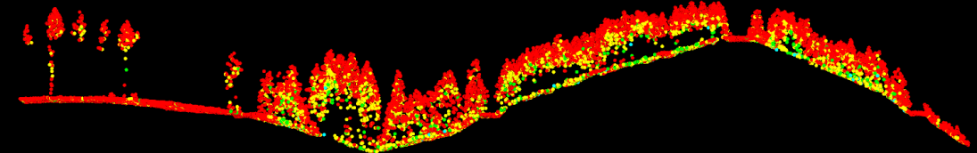
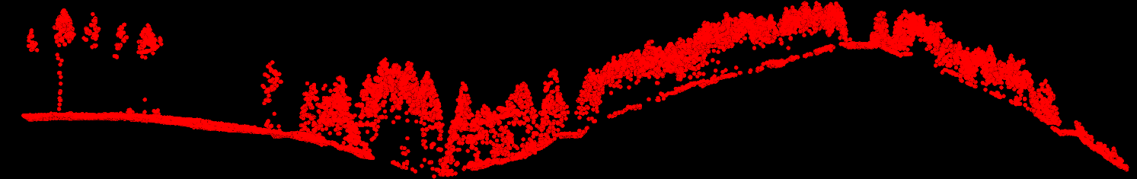
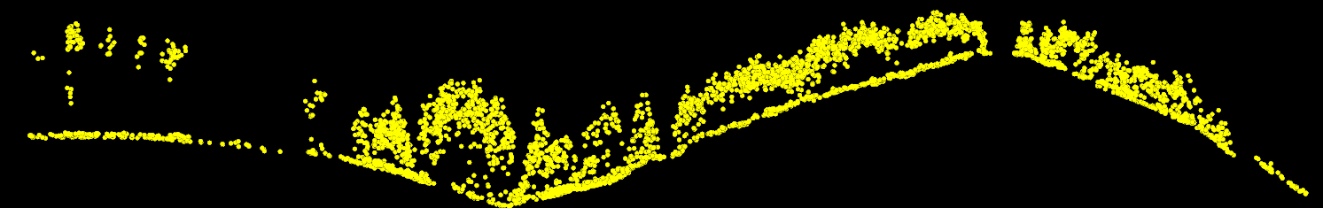
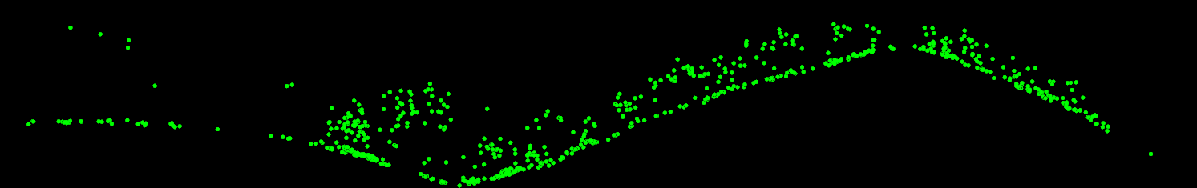

Lidar Data Characteristics
All returns (100%)
1st returns (69%)
2nd returns (26%)
3rd returns (4%)
4th returns (<0.1%)
Notes:
You can see in the 4th returns that some points are above ground. This exemplifies something we have already talked about: that the last return is not always reflecting off of the ground. In denser canopies, a pulse may not reach the ground and will, instead, reflect off of parts of the understory/midcanopy.

Slide 14
Lidar Data Characteristics
Lidar Data Quality Levels
Quality Level | Aggregate Nominal Pulse Density (pulses/m²) | Non-vegetated vertical accuracy in cm (RMSE_{z})
QL0 | ≥ 8 | 5.0 cm
QL1 | ≥ 8 | 10.0 cm
QL2 | ≥ 2 | 10.0 cm
QL3 | ≥ 0.5 | 20.0 cm
Reference: “National Geospatial Program Lidar Base Specification—V 1.3” -USGS

Slide 15
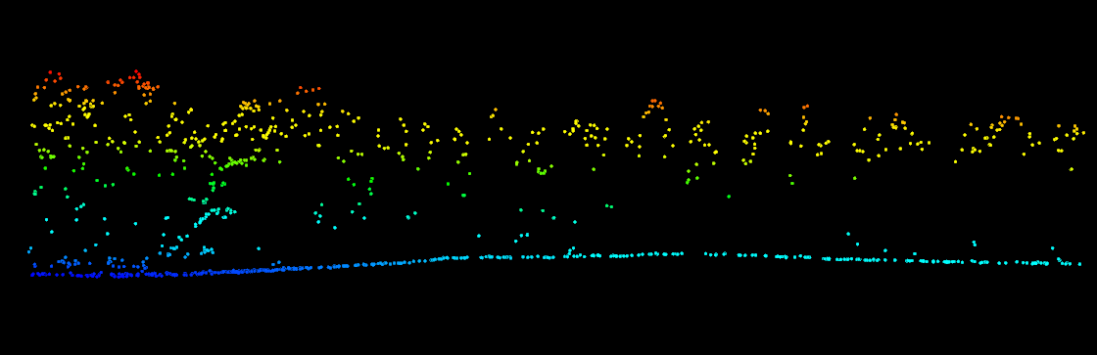
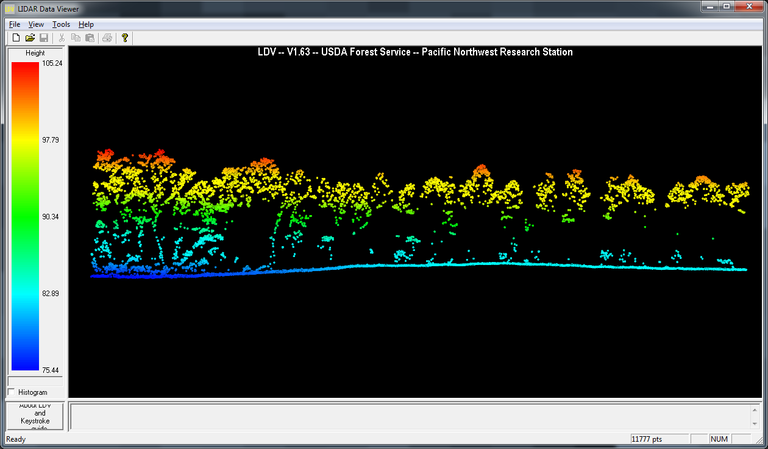
Lidar Pulse Density
1 pulse/meter
8 pulses/meter
Forestry spec

Slide 16
Why process the point cloud…
Vegetation Cover and Density
Canopy Height Statistics
  Max, mean, mode
Height Strata (Density Slices)
Flexibility
  Scale (pixel size)
  Cover and density thresholds can be customized based on forest type

Slide 17
Lidar Derived – 1st order vs. 2nd order
1st Order (Measured)
  Metrics that can be measured directly from raw lidar data
  2 dimensional products with values created from point clouds
2nd Order (Modeled)
  Not directly measured from raw data
  Uses lidar in conjunction with field plots
  Models outputs based on relationships between data
Notes:
We have other courses that introduce modeled applications. Today is only focusing on the 1st order, measured derivatievs

Slide 18
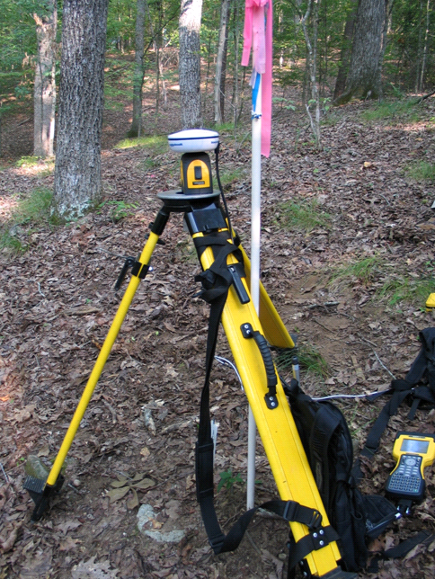
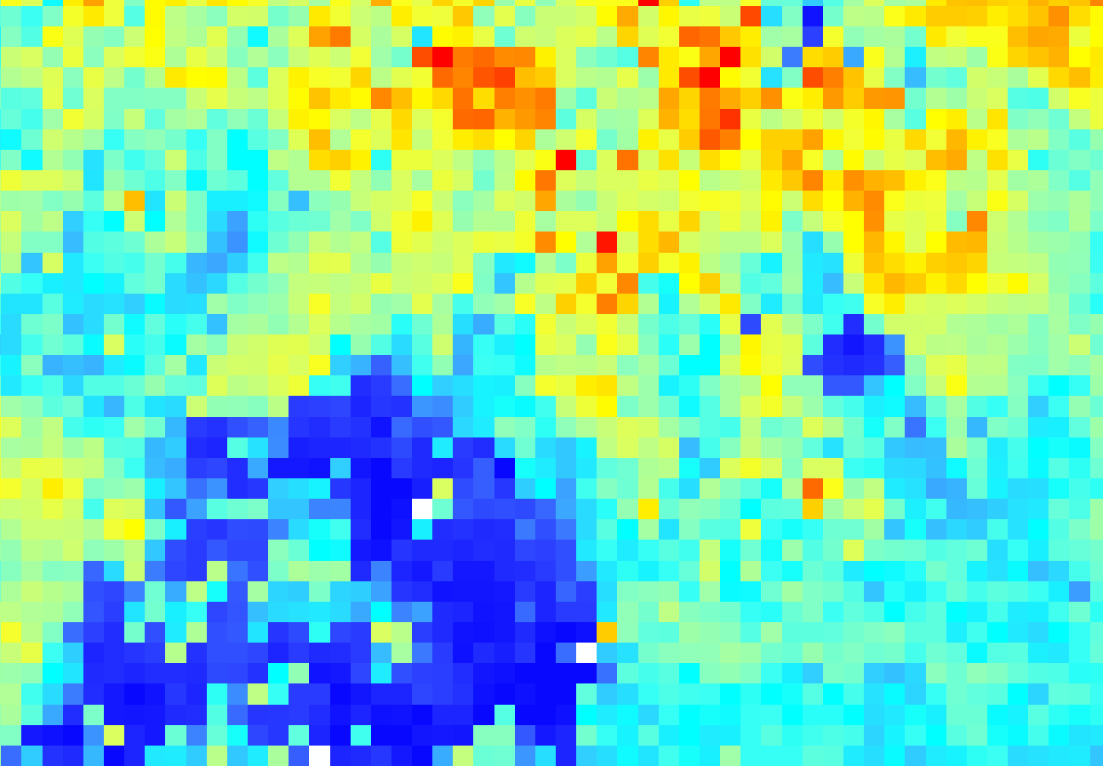
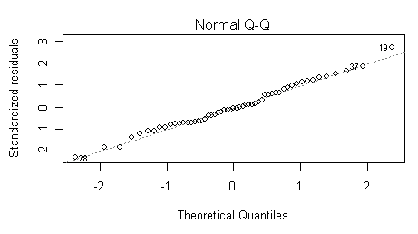
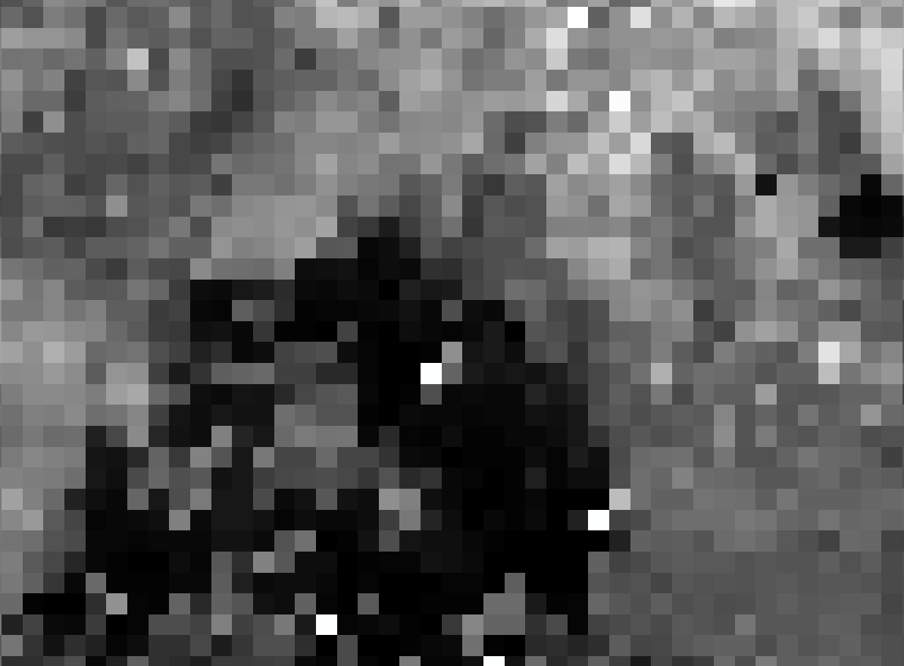
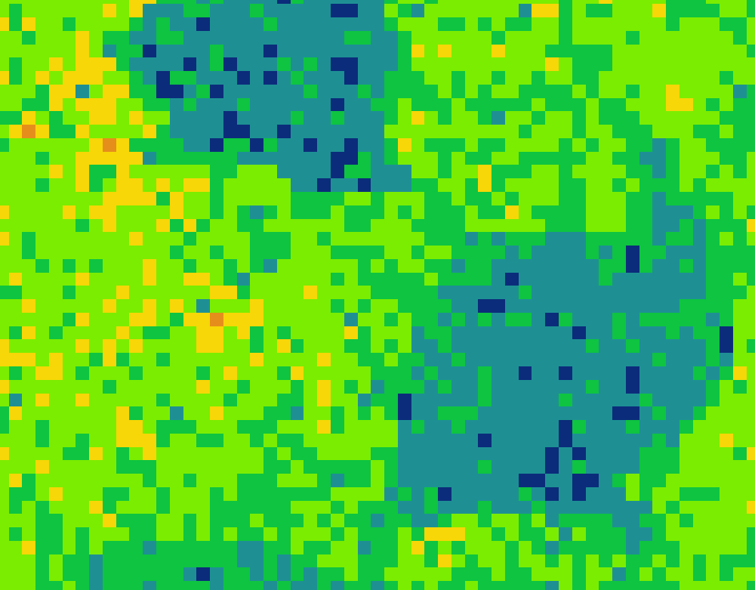
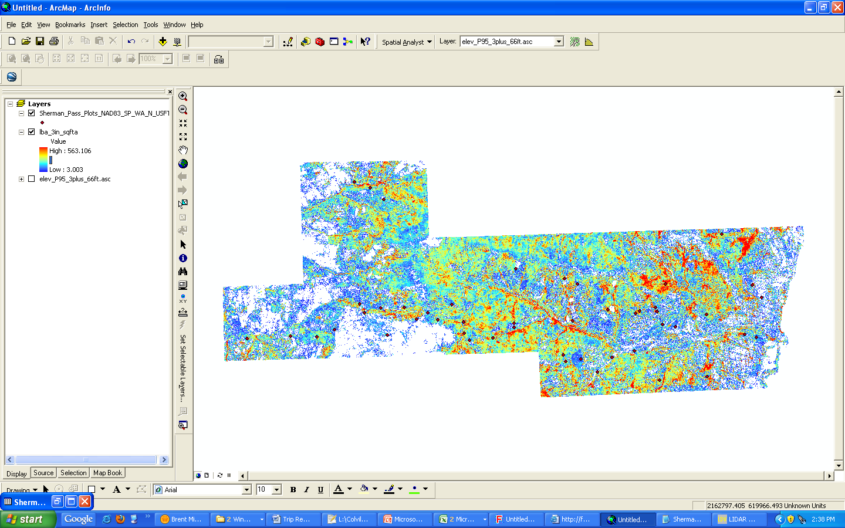
Lidar Derived – 1st order vs. 2nd Order
1st Order (Measured)
2nd Order (Modeled)
1st Order Metrics
Field Data
Build Statistical Relationships
Build Inventory Models

Slide 19
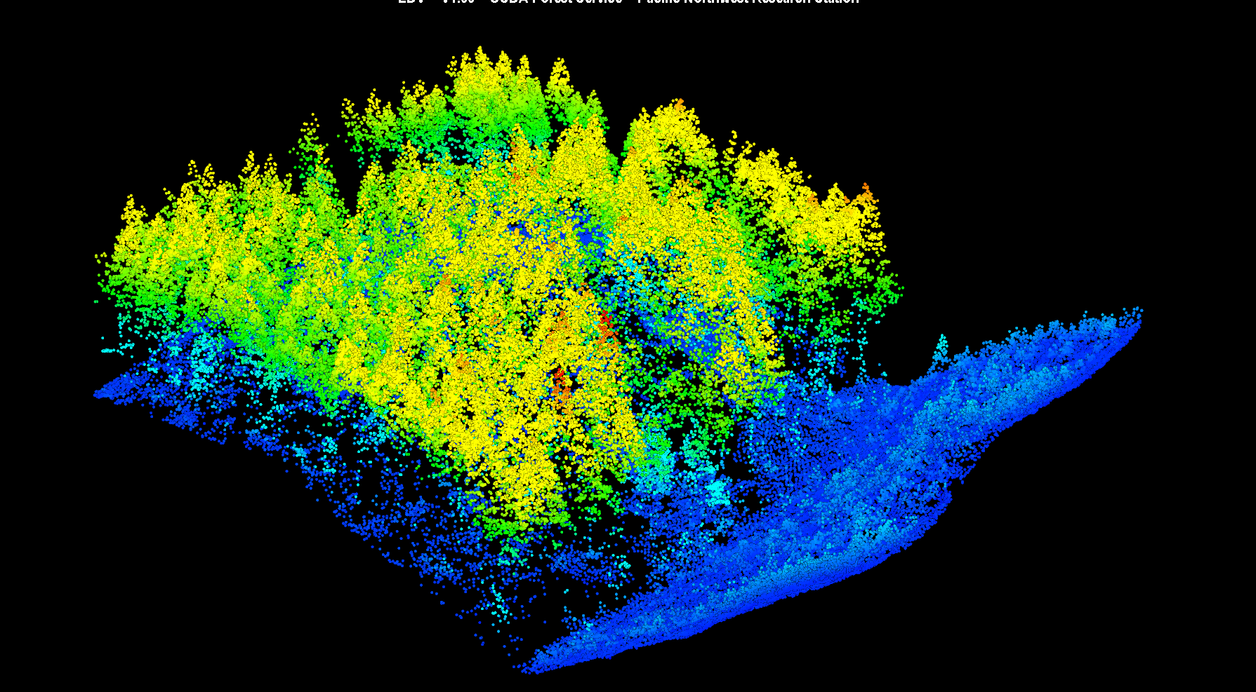
Bare Earth Surface

Slide 20
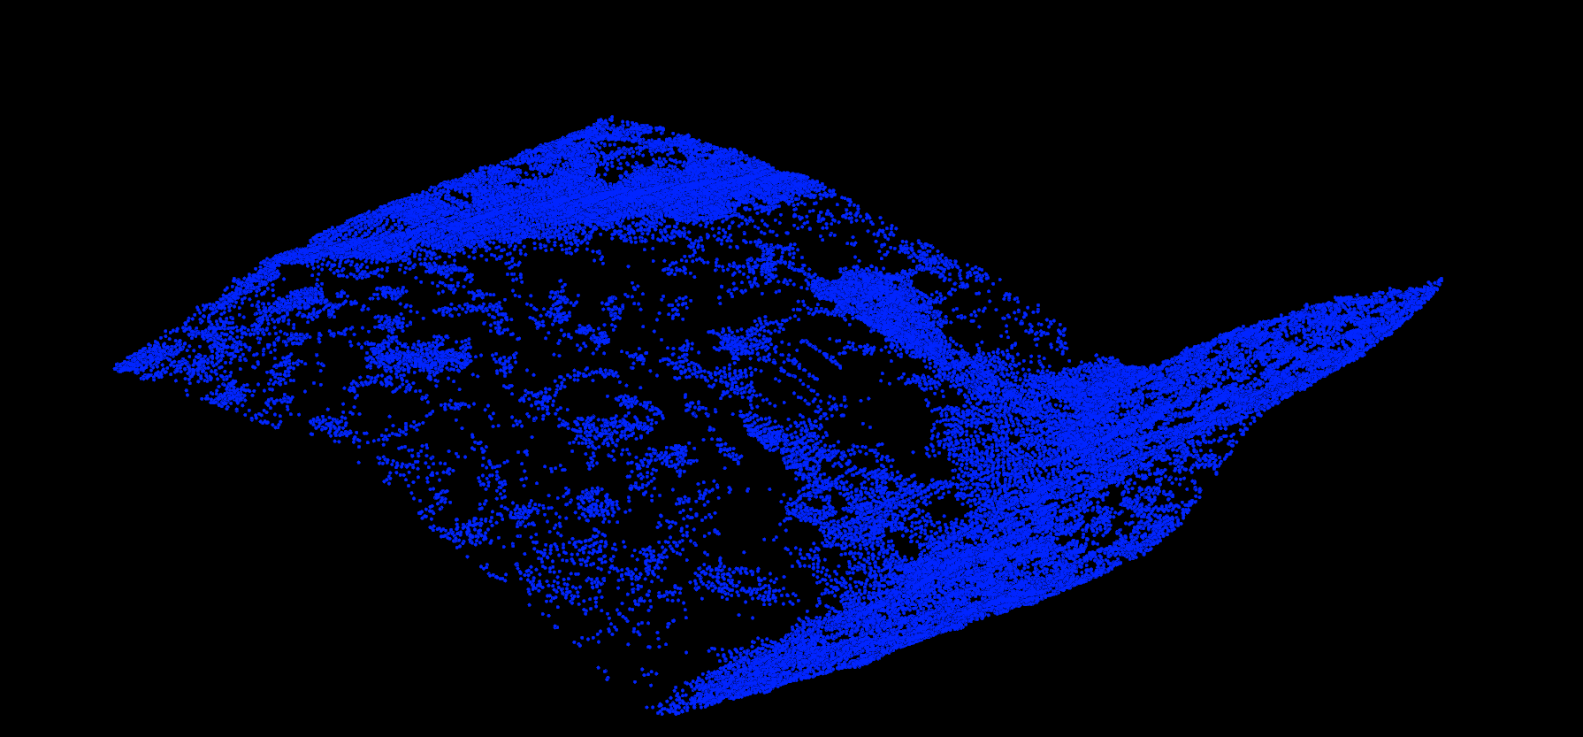
Bare Earth Surface

Slide 21
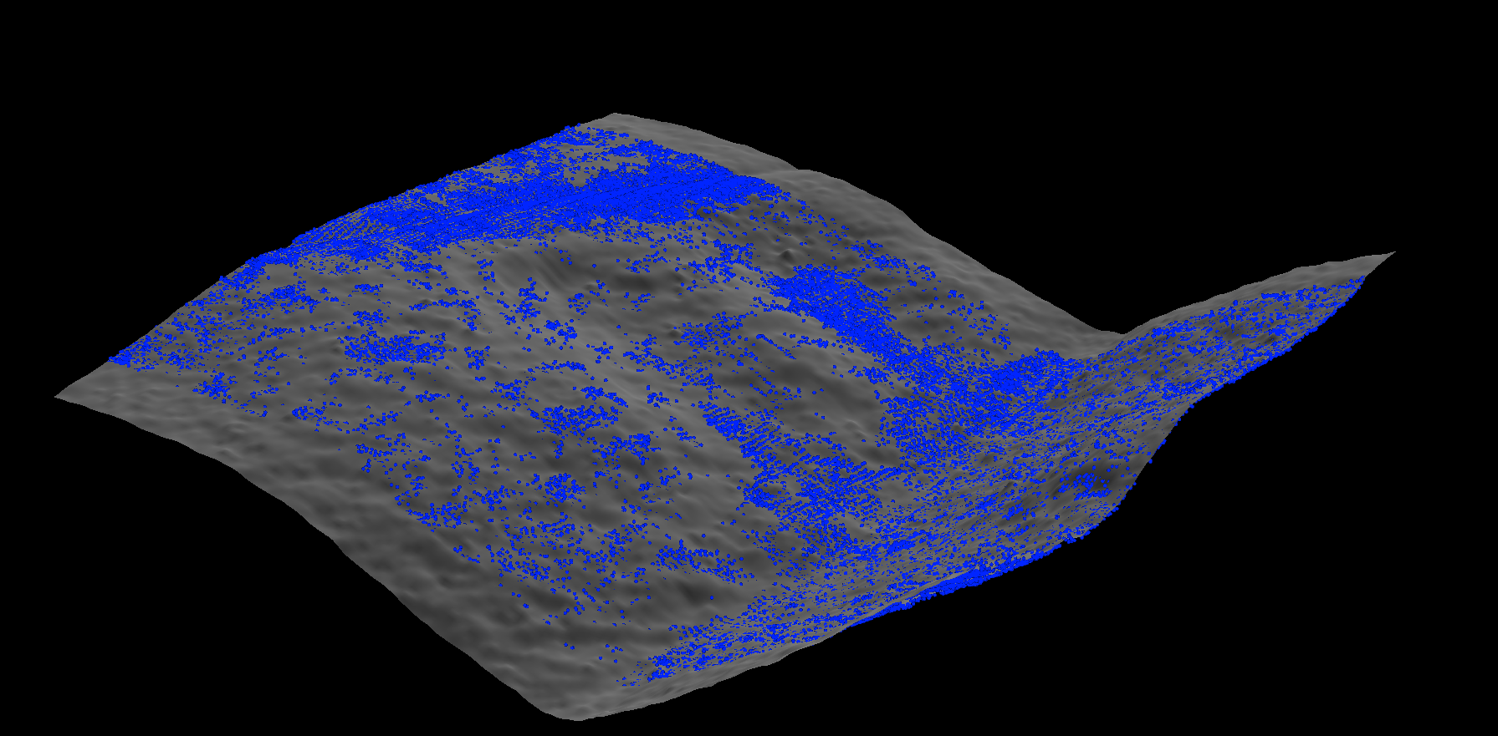
Bare Earth Surface

Slide 22
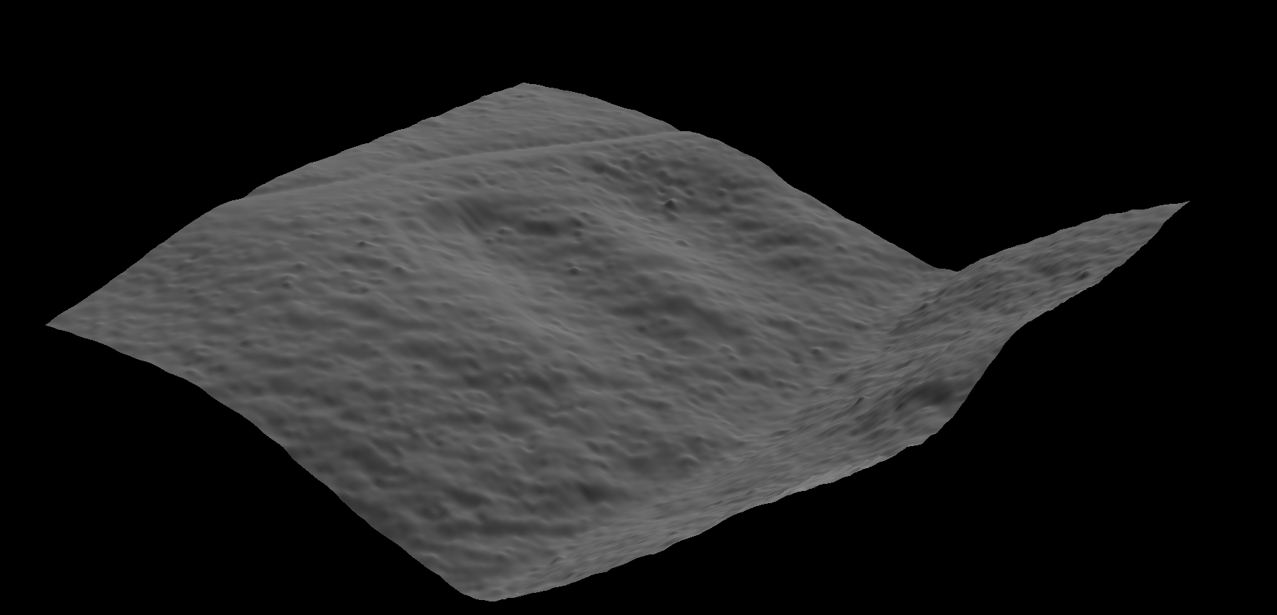
Bare Earth Surface

Slide 23
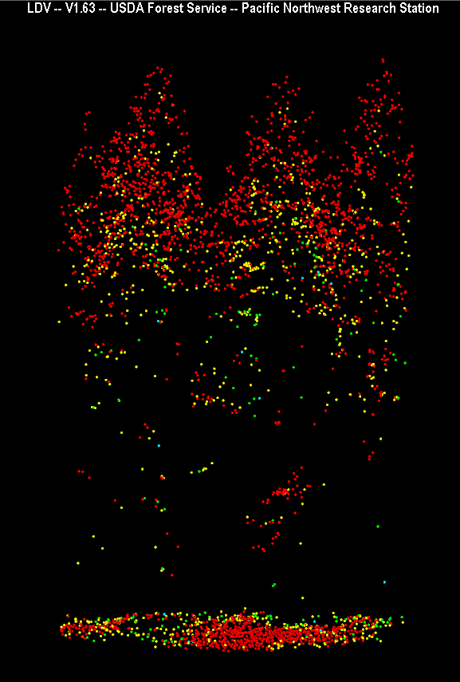
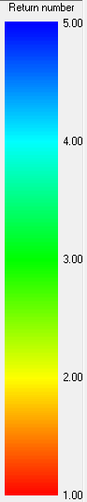
Lidar Cover Metrics
1st Returns
1st Returns
CoverCUTOFF (3m)
1st Returns > 3m
X 100
1st Returns > 0m

Slide 24
Lidar Density Metrics
All Returns
All Returns
CoverCUTOFF (3m)
All Returns > 3m
X 100
All Returns > 0m

Slide 25
Lidar Mid-story Density Metrics
Strata: 3 – 6 meters
Strata Proportion =
All Returns > 3m and < 6m
“Relative” Strata Proportion =
All Returns > 3m and < 6m
All Returns > 0
All Returns < 6

Slide 26
Lidar Height Metrics
Maximum Canopy Height
95th percentile
(Dominant Canopy Height)
Mean Canopy Height
Height Cutoff (2m)
Notes:
Height cutoff excludes points that would skew our metrics such as mean canopy height.

Slide 27
Changing Cutoff Parameters

Slide 28
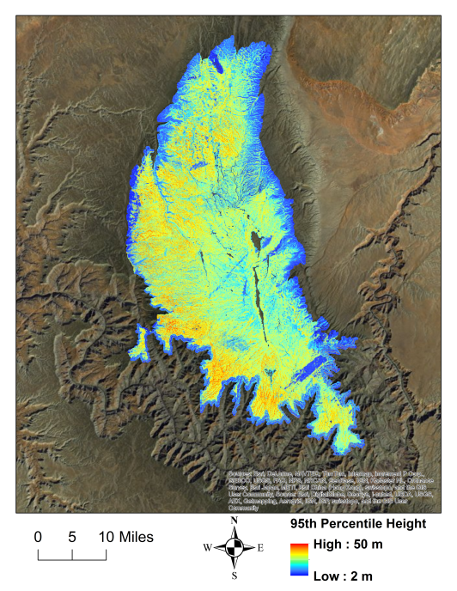
95% Percentile Height

Slide 29
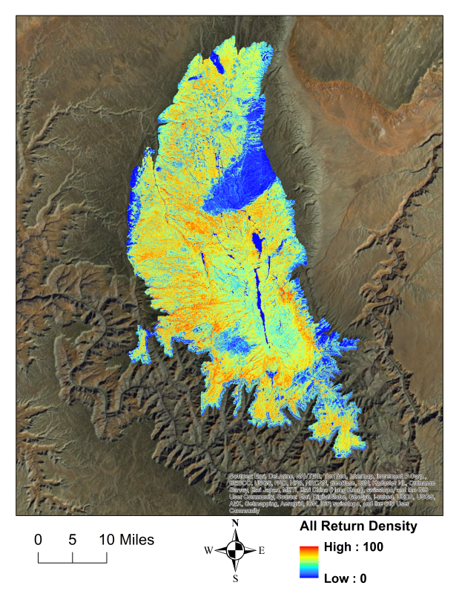
Vegetation Density Landscape Metric

Slide 30
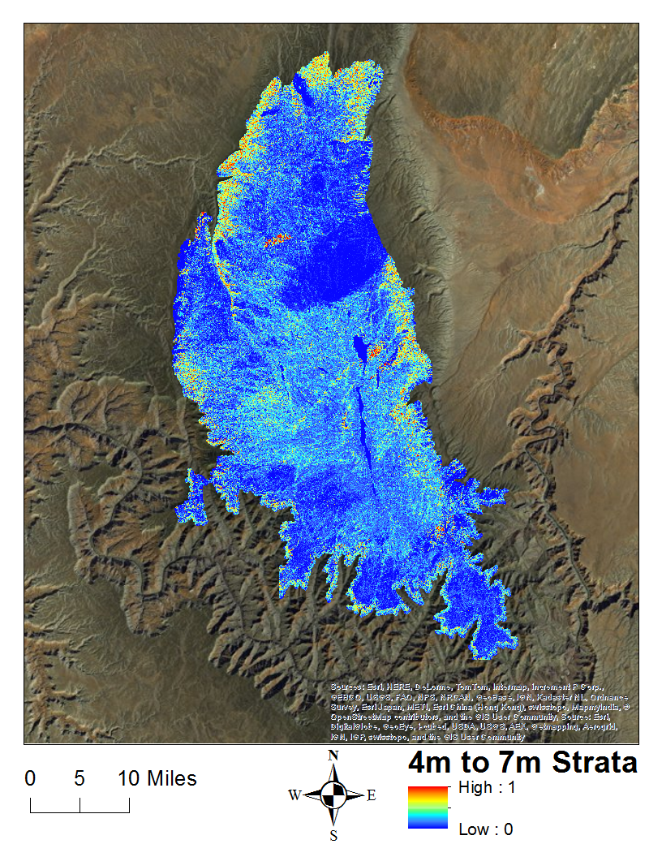
4-7 m St Density Landscape Metric

Slide 31
Exercises
1-Prepare workspace
2-Convert BE grid file to .dtm
3-Use Catalog.exe for QA of lidar data
4-Setup and run the AreaProcessor.exe
5-Tree Segmentation

Slide 32
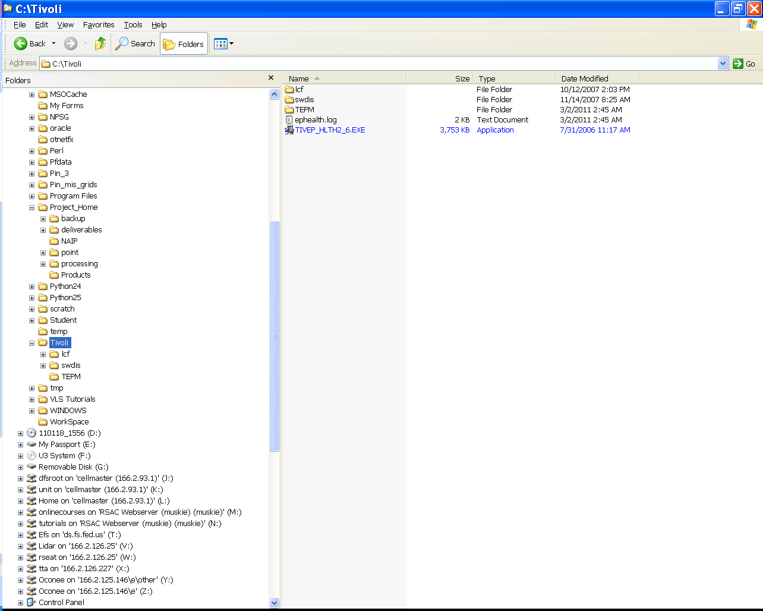
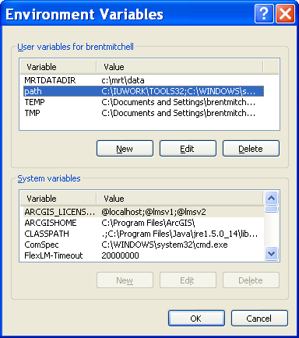
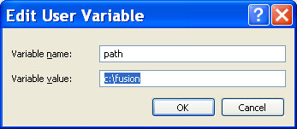
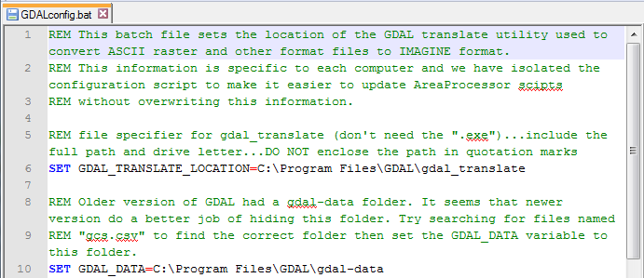
Processing Setup
Create the appropriate directory structure for processing
Add the FUSION directory to the environment variables
Install GDAL and Connect it with FUSION

Slide 33
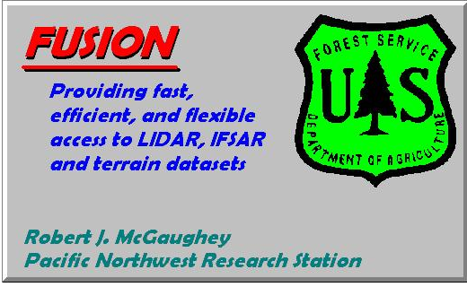
FUSION Software
Supports a variety of data types
      Shapefiles, images, digital terrain models (dtm), canopy surface models, and Lidar Return data (.las)
Provides a 3D visualization environment for examination and visualization
Provide specific analysis and data processing capabilities designed to make FUSION suitable for processing large LIDAR acquisitions.
      Provides independent Quality Assurance
      Creates detailed Canopy Structure Metrics across large areas

Slide 34
Questions/Comments?
Time for a Demo!

Slide 35
How do we get there?
Point cloud →Pixels

Slide 36
Lidar Processing Road Map
What product do I want from my lidar?
  Cell size
  Structural component
  Height thresholds
  Is the lidar Quality level appropriate
Processing Set Up
  Computer settings
  Directory Structure
  Necessary Skills
Incorporate the Bare Earth Surface
  Convert to DTM format
Perform lidar Quality Assessment
  Validate or Assess quality level
  Create point density raster for FUSION to use in processing
    Used to run AreaProcessor
Setup and Run the AreaProcessor
  Basic_Setup.bat(master batch file)
  AreaProcessor Interface
Integrate lidar 1st Order structural derivatives into your GIS

Slide 37
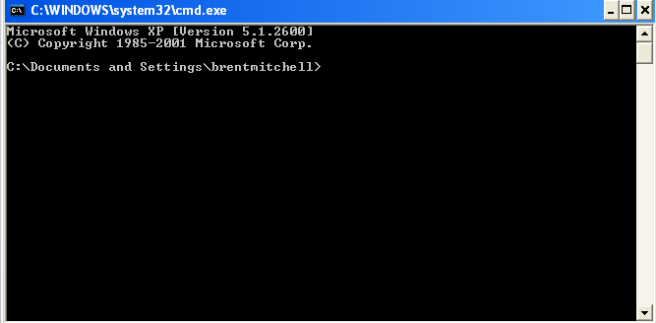
Fusion-Lidar Tool Kit (LTK) Programs
The FUSION-LTK programs (or information extraction tools) are designed to run from a command prompt using Batch(.bat) files
No graphical user interface (GUI) available

Slide 38
Using Tools in FUSION
What information do I want to extract from the lidar?
What tool do I use, which command line function?
    Browse manual and tutorial
How do I run the command line function?
    Create a batch file and call it from the command prompt
Notes:
For instance, do I use PolyClipData or ClipData?

Slide 39
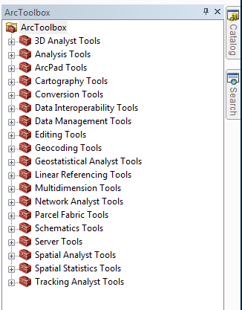
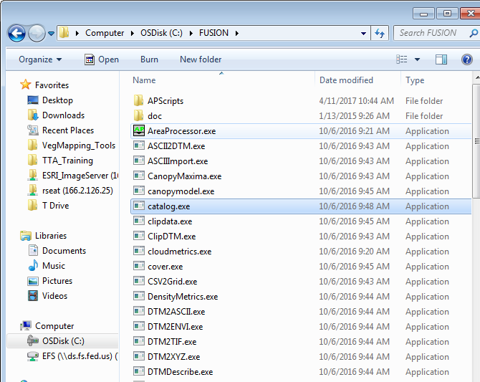
ArcMap vs. FUSION
Toolbars
Notes:
Now we’ll use a comparison with ArcMap tools to understand how our interaction with FUSION may be different, but the underlying theory remains the same.

Slide 40
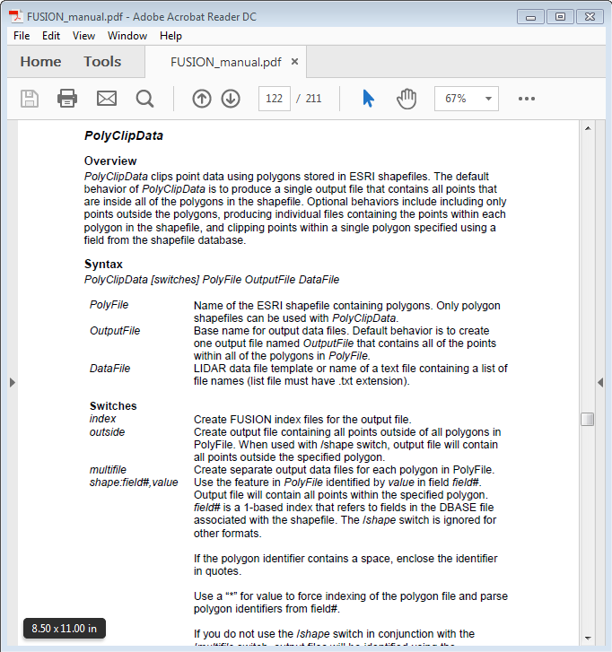
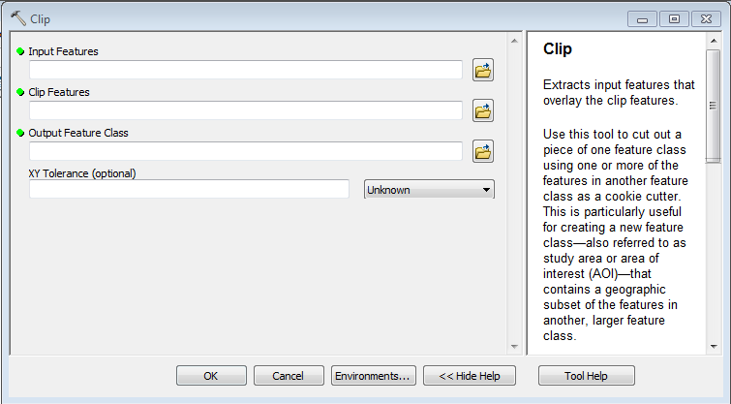
ArcMap vs. FUSION
Help Information

Slide 41
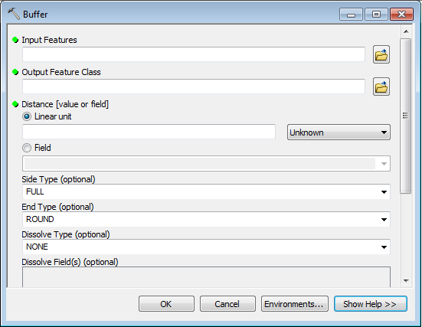
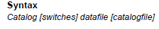
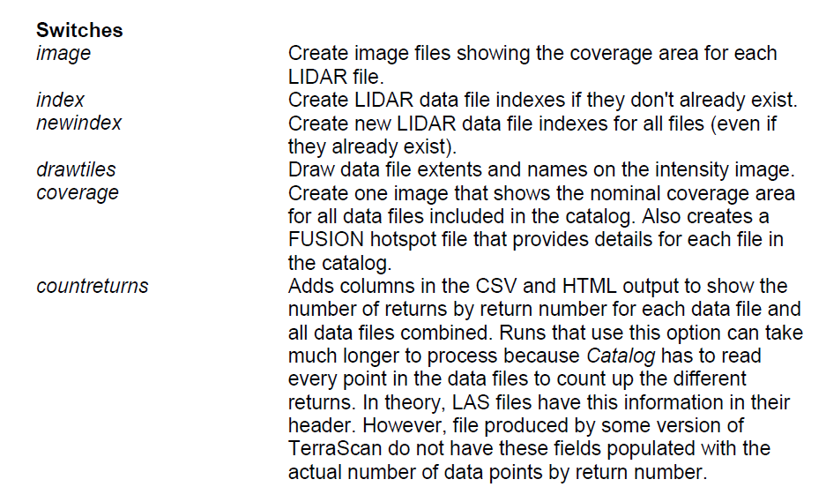
ArcMap vs. FUSION
Setting Parameters

Slide 42
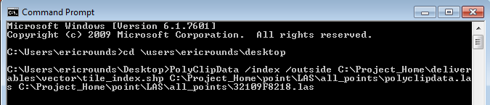
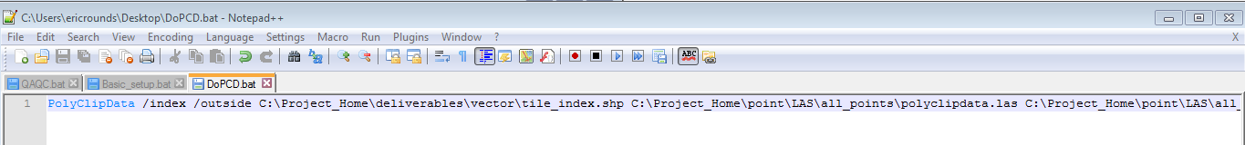
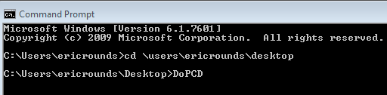
ArcMap vs. FUSION
Running Tools/Commands

Slide 43
FUSION Command Line Utilities
The FUSION-LTK programs generally have required and optional parameters as well as switches to control program options.
  ***You need to understand each command line utility enough to customize it for your data!!
Notes:
These parameters/switches are particularly important to understand when you are working with your own data.

Slide 44
Catalog.exe
The Catalog command line utility produces a set of descriptive reports describing several important characteristics of LIDAR datasets.
Syntax
  Catalog [switches] datafile [catalogfile]
Example
  catalog /image /index /coverage /density:2,1,3 /intensity:2,0,255 /outlier c:\lidar_data\lub_tiles.txt c:\lidar_data\lub_cat
Optional Switches, all preceded by a / slash.
Fusion Command Line Executable
Output datafile, in this case a html catalog file
Input datafile, in this case multiple files are listed in a text file

Slide 45
Exercises
1-Prepare workspace
2-Convert Bare Earth grid file to .dtm
3-Use Catalog.exe for QA of lidar data
4-Setup and run the AreaProcessor.exe
5-Tree Segmentation

Slide 46
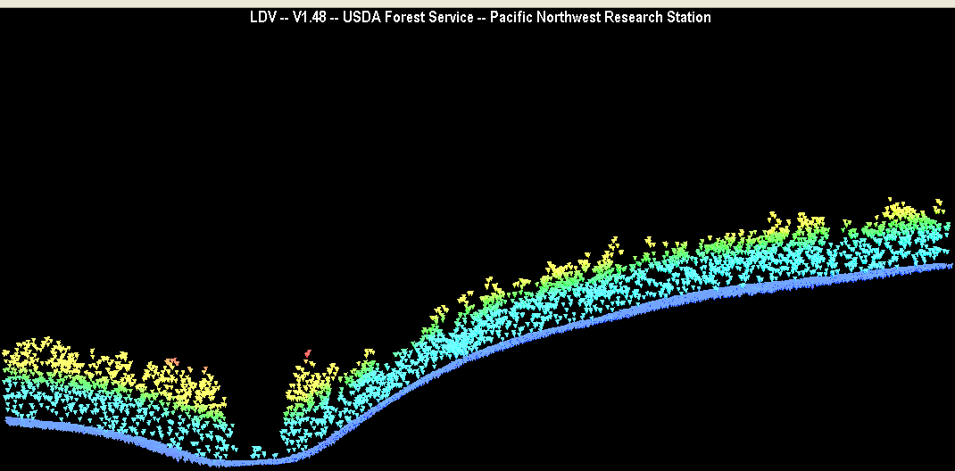

Bare Earth Conversion
Converting BareEarth vendor deliverables into a format FUSION can utilize
  Convert Grid to ASCII (ArcMap)
  Convert ASCII to DTM (ascii2dtm FUSION command)
Enables us to normalize the topography “remove it from the data”, so we can make measurements that pertain to canopy structure based on height above ground

Slide 47
Exercises
1-Prepare workspace
2-Convert BE grid file to .dtm
3-Use Catalog.exe for QA of lidar data
4-Setup and run the AreaProcessor.exe
5-Tree Segmentation

Slide 48


Quality Assessment
FUSION’s Catalog command line utility produces a set of descriptive reports describing several important characteristics of LIDAR data sets.
First Return (Pulse) and Point Densities
Creates image files
Produce Index files (.ldi and .ldx files for each tile)
Point cloud (.las) classifications
Tile Layout

Slide 49
Exercises
1-Prepare workspace
2-Convert BE grid file to .dtm
3-Use Catalog.exe for QA of lidar data
4-Setup and run the AreaProcessor.exe
5- Tree Segmentation

Slide 50


Review Basic_Setup.bat
Three Rings for the Elven-kings under the sky,
Seven for the Dwarf-lords in their halls of stone,
Nine for Mortal Men doomed to die,
One for the Dark Lord on his dark throne
In the Land of Mordor where the Shadows lie.
One Ring to rule them all, One Ring to find them,
One Ring to bring them all and
in the darkness bind them
In the Land of Mordor where the Shadows lie.
He paused, and then said in a deep voice,
"This is the Master-Ring, the One Ring to rule them all”.
(Gandalf, the Grey - Third Age of Middle Earth)
"This is the Master-Batch File, the One Batch file to rule them all”.

Slide 51

AreaProcessor
Draws on .bat files in APScripts folder, including basic_setup.bat
Allows you to break up processing of point cloud into multiple “streams”
Creates a complex batch file that will generate canopy metrics

Slide 52




Generate Canopy Metrics
Extract seamless canopy related statistical information (canopy metrics) from the lidar point cloud
Workflow appropriate for large acquisition area
Utilize Gridmetrics FUSION Command line utility to characterize canopy
Utilize AreaProcessor to mitigate tile edge artifacts
Notes:
1st image is CH, 2nd CC, 3rd 8 to 16m density slice

Slide 53





Integrate Outputs into your GIS
  Stand Level Vegetation Metrics
Legend
Mature Loblolly Stand
85 years old
Area = 65 acres
Young Loblolly Stand
19 years old
Area = 62 acres
Canopy Height (m)
% Canopy Cover
High:40m
High:100%
Low: 0m
Low:0%
Canopy height model created from the Sabine NF lidar data.
% Canopy cover model created from the Sabine NF lidar data.
High: 73 m
Low: 0 m
Background image represents a subset (1150 acres) of the Sabine National Forest, TX. (NAIP 08, 1 meter resolution)
Notes:
The figure depicts a canopy height model and % canopy cover model over a relatively large area. You can start to pick out stand boundaries for plantations versus more complex natural stands.

Slide 54
Exercises
1-Prepare workspace
2-Convert BE grid file to .dtm
3-Use Catalog.exe for QA of lidar data
4-Setup and run the AreaProcessor.exe
5- Tree Segmentation

Slide 55




Tree Segmentation

Slide 56
Questions/Comments?

