Slide 1
Information Extraction from 3D Digital Imagery
Mark Hammond
Remote Sensing Specialist / Trainer
RedCastle Resources Inc., working onsite at
Geospatial Technology and Applications Center (GTAC)
(801) 975-3497
markhammond@fs.fed.us

Slide 2
Our Data is Geospatial
The appropriate repository for storing and analyzing geospatial information is our GIS…
Forest Service GIS and Image Analysis
Notes:
A basic function for those of us who work with remotely sensed data is extracting useful information that can be used in products.

Slide 3
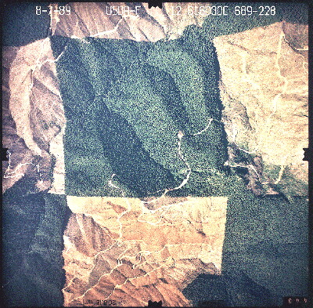
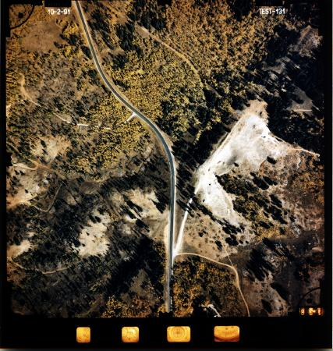
Photography Contains a Wealth of Information
However, the geometry of photos makes direct transfer of photo information to our GIS highly inaccurate…
Notes:
This is strictly for uncorrected hardcopy aerial photography, since this is our source of stereo imagery. Each of the images shown here are prints from negatives, and are not geocorrected.
We can transfer some information directly from these; for example (next slide)

Slide 4
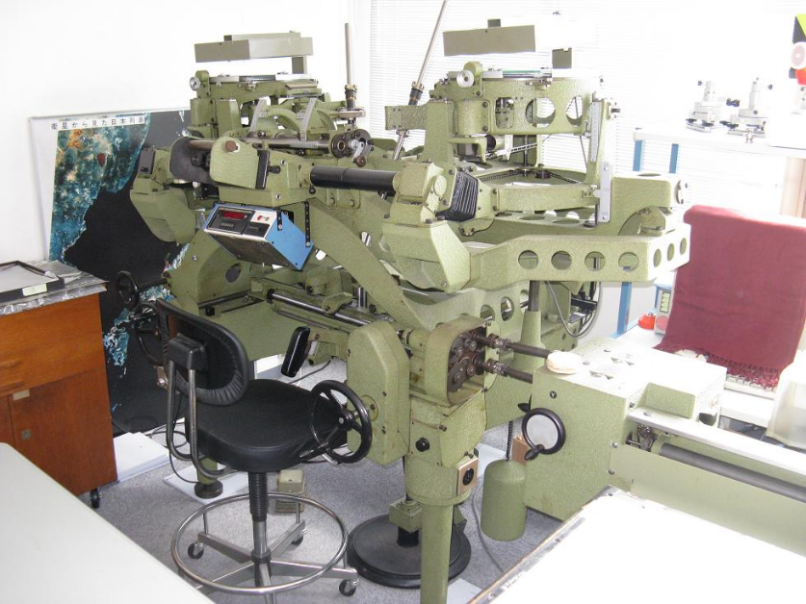
Transfer Options
There are many options that have been developed.
Options vary in:
Accuracy
Ease
Cost
Technology has, of course, greatly improved the access to information transfer.
Notes:
In the analog days, we could use two consecutive images in a nice expensive machine like this, and transfer information directly to a map or other type of document.
If you have never had the chance to use one of these, don’t pass it up if you get a chance.
A little cheaper method; [next slide]

Slide 5
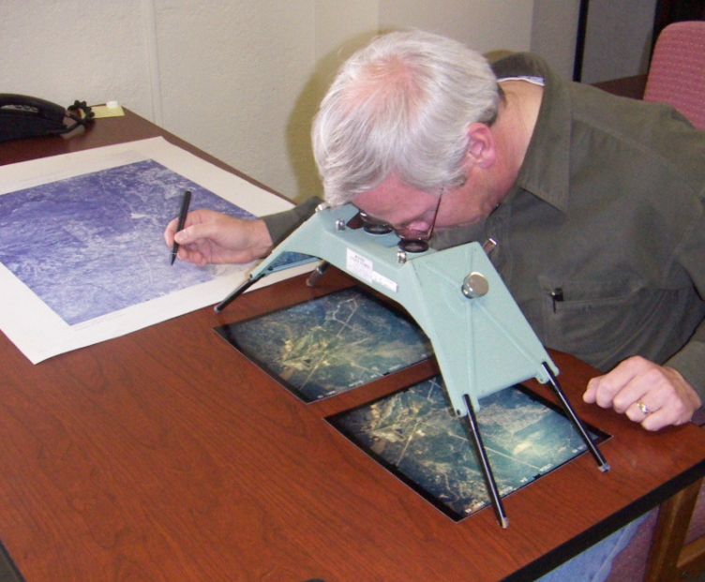
Ocular Transfer to OrthoPhoto Quads
Delineations are completed on photos
Transferred by eye to the orthos
Hardcopy orthos can be scanned into GIS
and then polygons digitized on-screen
Or lines can be digitized from hardcopy orthos using a digitizing tablet.
Notes:
Is using a simple stereo scope like the one shown here. However, it may not be as accurate since the images are the map are not used directly together.
But in a pinch, these steps can be used to get data from image pairs into vector form.

Slide 6
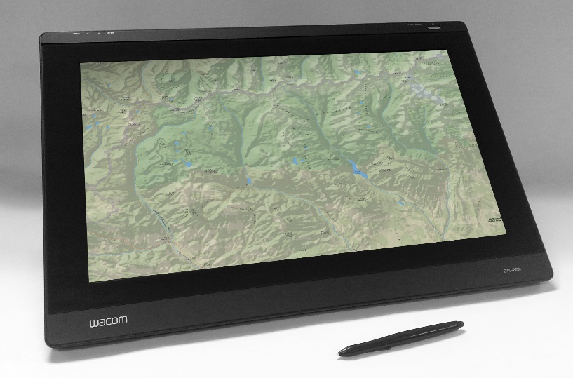
Digitizing
Use orthocorrected photos
Reduces time needed to go from image to vector
Heads-up digitizing remains
Can use a Wacom or similar monitor (if you have the budget) to reduce the time needed even more
Still working in a 2-D world
Notes:
Another alternative, if we have a softcopy orthomosaic and GIS software, is heads up digitizing. This is still the easiest method, and works for most projects.
A touchscreen tablet makes the process go even quicker, but can be costly
Stereo can offer improved interpretation, and allow us to get elevation.

Slide 7
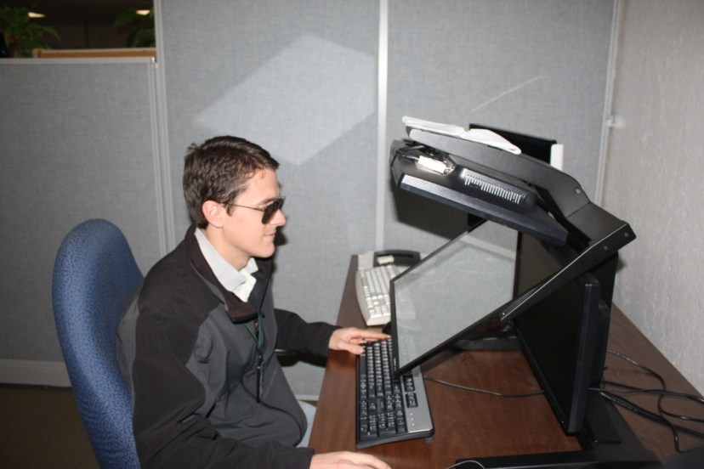
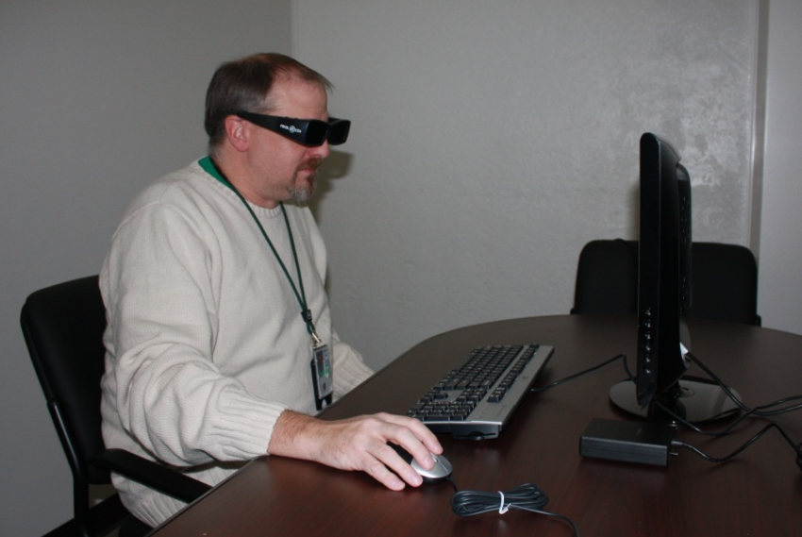
Computer Stereo Systems
Greatly reduces the barriers between photos and GIS.
Allows stereo viewing and digital GIS data collection via a single interface.
Passive Glasses with a StereoMirror
Shutter Glasses with 120Hz Monitor
Notes:
As we saw this morning, there are two main types of stereo hardware beyond using red/blue or red/cyan glasses;
[recap the advantages and disadvantages of each, and mention the passive systems are becoming available again.]
While the two points on this slide are the same for heads up digitizing, we also have the stereo advantage now

Slide 8
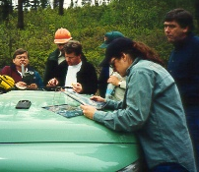
Photo Interpretation
An often overlooked element of digitizing is interpretation. Stereo viewing can be a great aid in (understanding? Interpreting?) what is occurring on the ground.
Image interpretation skills you might use for a single photo are still important for digitizing in stereo:
Ground knowledge of the area
Interpretation skills
A sound scheme for your vector data
The GTAC Fundamentals of Image Interpretation tutorial can be a good refresher for those who need it.

Slide 9
Photo Interpretation Topics
Your Ground Knowledge — the most important tool!
Classification Scheme
Seven Image Characteristics for Interpretation
Convergence of Evidence
Photo Keys and Ancillary information

Slide 10
Ground Knowledge and Experience
The most important tool in photo interpretation
Must be able to discriminate features and their attributes (e.g. species and size class) on the ground
Then relate that ground knowledge to photos—lots of time on the ground with photos in hand!
“The best method of training is to conduct at least two field visits for photo interpreters--and even more if field site proximity permits. The first trip should be made in the initial training phase before photointerpretation is begun. The second should be made after photointerpretation is begun, but before a significant amount of PI data has been produced. After this field trip, each interpreter will have a substantial number of personally identified features he or she can discuss with co-workers to determine how easily and consistently a feature can be identified on an aerial photograph.”

Slide 11
The Classification Scheme (Legend)
Categorizes and labels the variation in land cover that you wish to capture:
Based on measurable land cover (not land use) characteristics,
Based on what the photography can detect
Avoid interpretive classes such as “Old Growth” or “Suitable Habitat”; these should be derived by definitions based on measurable characteristics,
A well-designed classification scheme is critical to deriving acceptable and useful information,
The complexity of a classification scheme will affect project accuracy and cost,
Time spent designing a workable classification scheme is always well spent!

Slide 12
Classification Themes
Vegetation cover
Varying levels of species detail, Size class, Canopy closure, etc…
Forest Health
Mortality due to:
Insect damage (and type), weather, etc…
Transportation Features
Roads, trails etc…
Water Features
Stream networks, lakes, wetlands etc…
Cultural Surveys
Possibly including historic photos?
And many more…

Slide 13
The Classification Scheme
Requirements (for continuous cover classifications)
Must:
Be exhaustive:
All land cover must be accounted for in the legend,
An “Other” category ensures this condition,
Be mutually exclusive:
Each land cover can be assigned to exactly one class,
Be composed of Labels and Rules for labeling,
Meet the user’s needs,
In addition the scheme should be:
Hierarchical:
To be more flexible and better support multiple users.

Slide 14
Classification Scheme -- Bad Example
Water
Rock and Soil
Shrub
Forest
Hardwood
Sparse
Medium density
Dense
Softwood
Sparse
Medium density
Dense
Regeneration
Yes! The data can be
collapsed or expanded
No! There is no place for
Hierarchical?
pavement, grasslands,
mixed forests etc...
Exhaustive?
None! How much tree cover
does it take to separate
Labeling Rules?
shrub and forest? No
definition for density labels
Mutually Exclusive?
No! What is regeneration?
It could be non-vegetated,
grasses, shrubs or forest...

Slide 15
Classification Scheme
A Better Example
Water
Non-Vegetated (< 20% vegetated)
Rangeland (< 10% tree crown closure)
Forest (> 10% tree crown closure)
Hardwood (65% of trees are hardwood)
sparse ( 10% and < 30% CC)
medium density (30% and < 66% CC)
dense (66% CC)
Softwood (65% of trees are softwood)
sparse (10% and < 30% CC)
medium density (30% and < 66% CC)
dense (66% CC)
Other Forest (includes Mixed)
Other
Notes:
The main point here is that if we set up a solid classification scheme first, we can use this to develop our classes for our feature classes, or the attribute table if we decide to set up a single layer.

Slide 16
Image Interpretation
Seven Characteristics for Interpretation:
Size
Shape
Tone/Color
Texture
Shadow
Association
Pattern
We use each of these image attributes, often subconsciously, to derive information about features in an image.
More information on each of these characteristics can be found in the Image Interpretation tutorial on the Geotraining Website.

Slide 17
Convergence of Evidence
Seven Characteristics for Interpretation:
Size
Shape
Tone/Color
Texture
Shadow
Association
Pattern
If we consider all of the image attributes that are present for a feature, and all attributes lead to the same interpretation, we have confidence in the interpretation.
Misinterpretation increases when we don’t consider all of the available image attributes or when the image attributes conflict.

Slide 18
Photo Interpretation Keys
PI keys – guidelines designed to:
aid the photo interpreter in applying the classification system correctly and
maintain consistency
PI keys have different formats
Example interpreted photos—carefully ground checked for accuracy
Simple, uses same photography and classification scheme
Written descriptions
Helpful but less intuitive
Drawings of tree crowns
Most useful for large scale (small area) photos

Slide 19
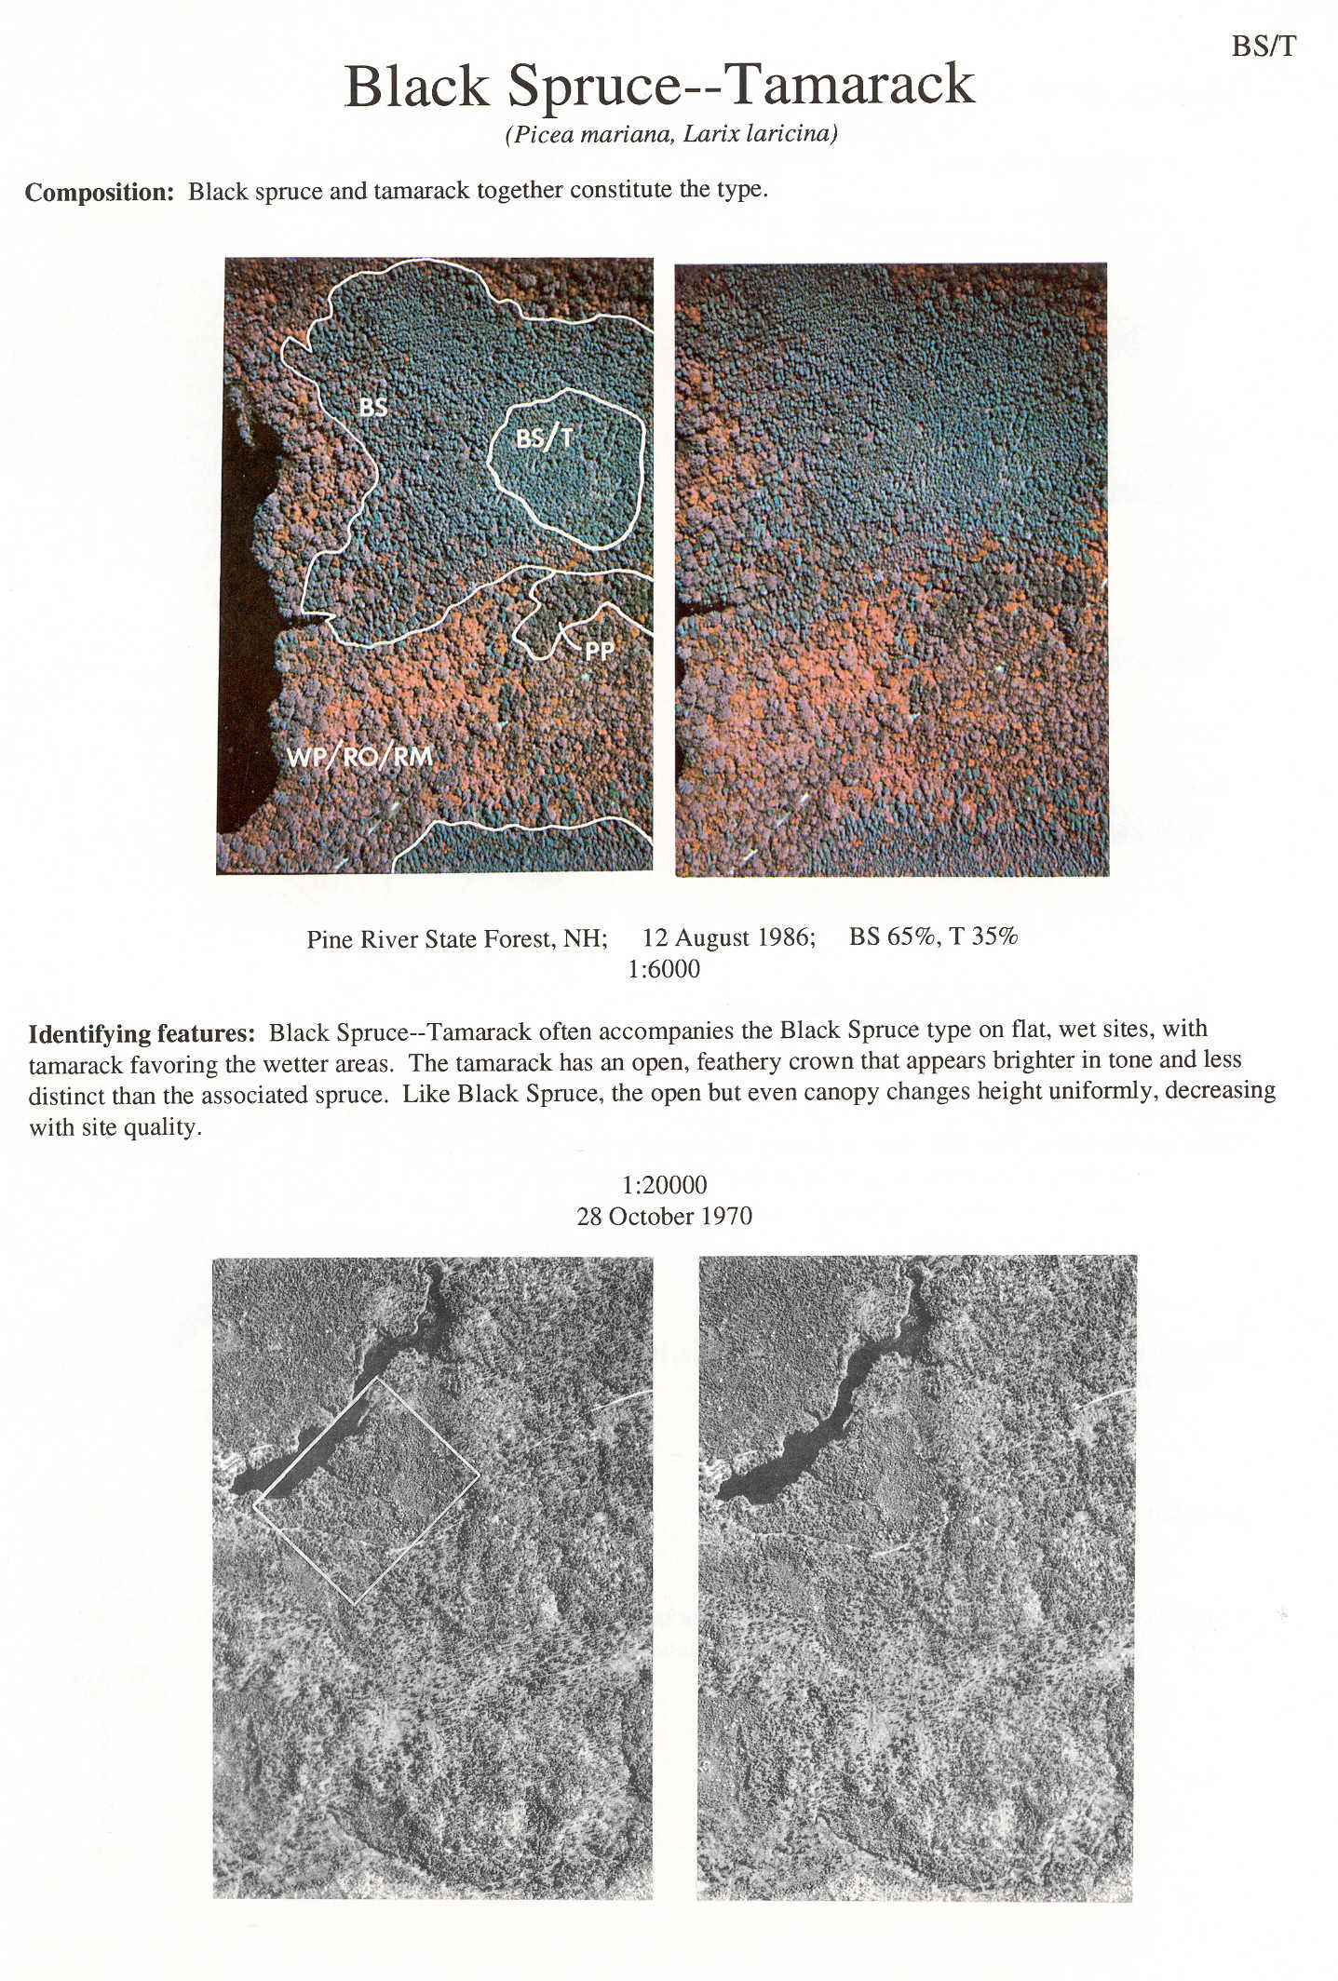
PI Keys…

Slide 20
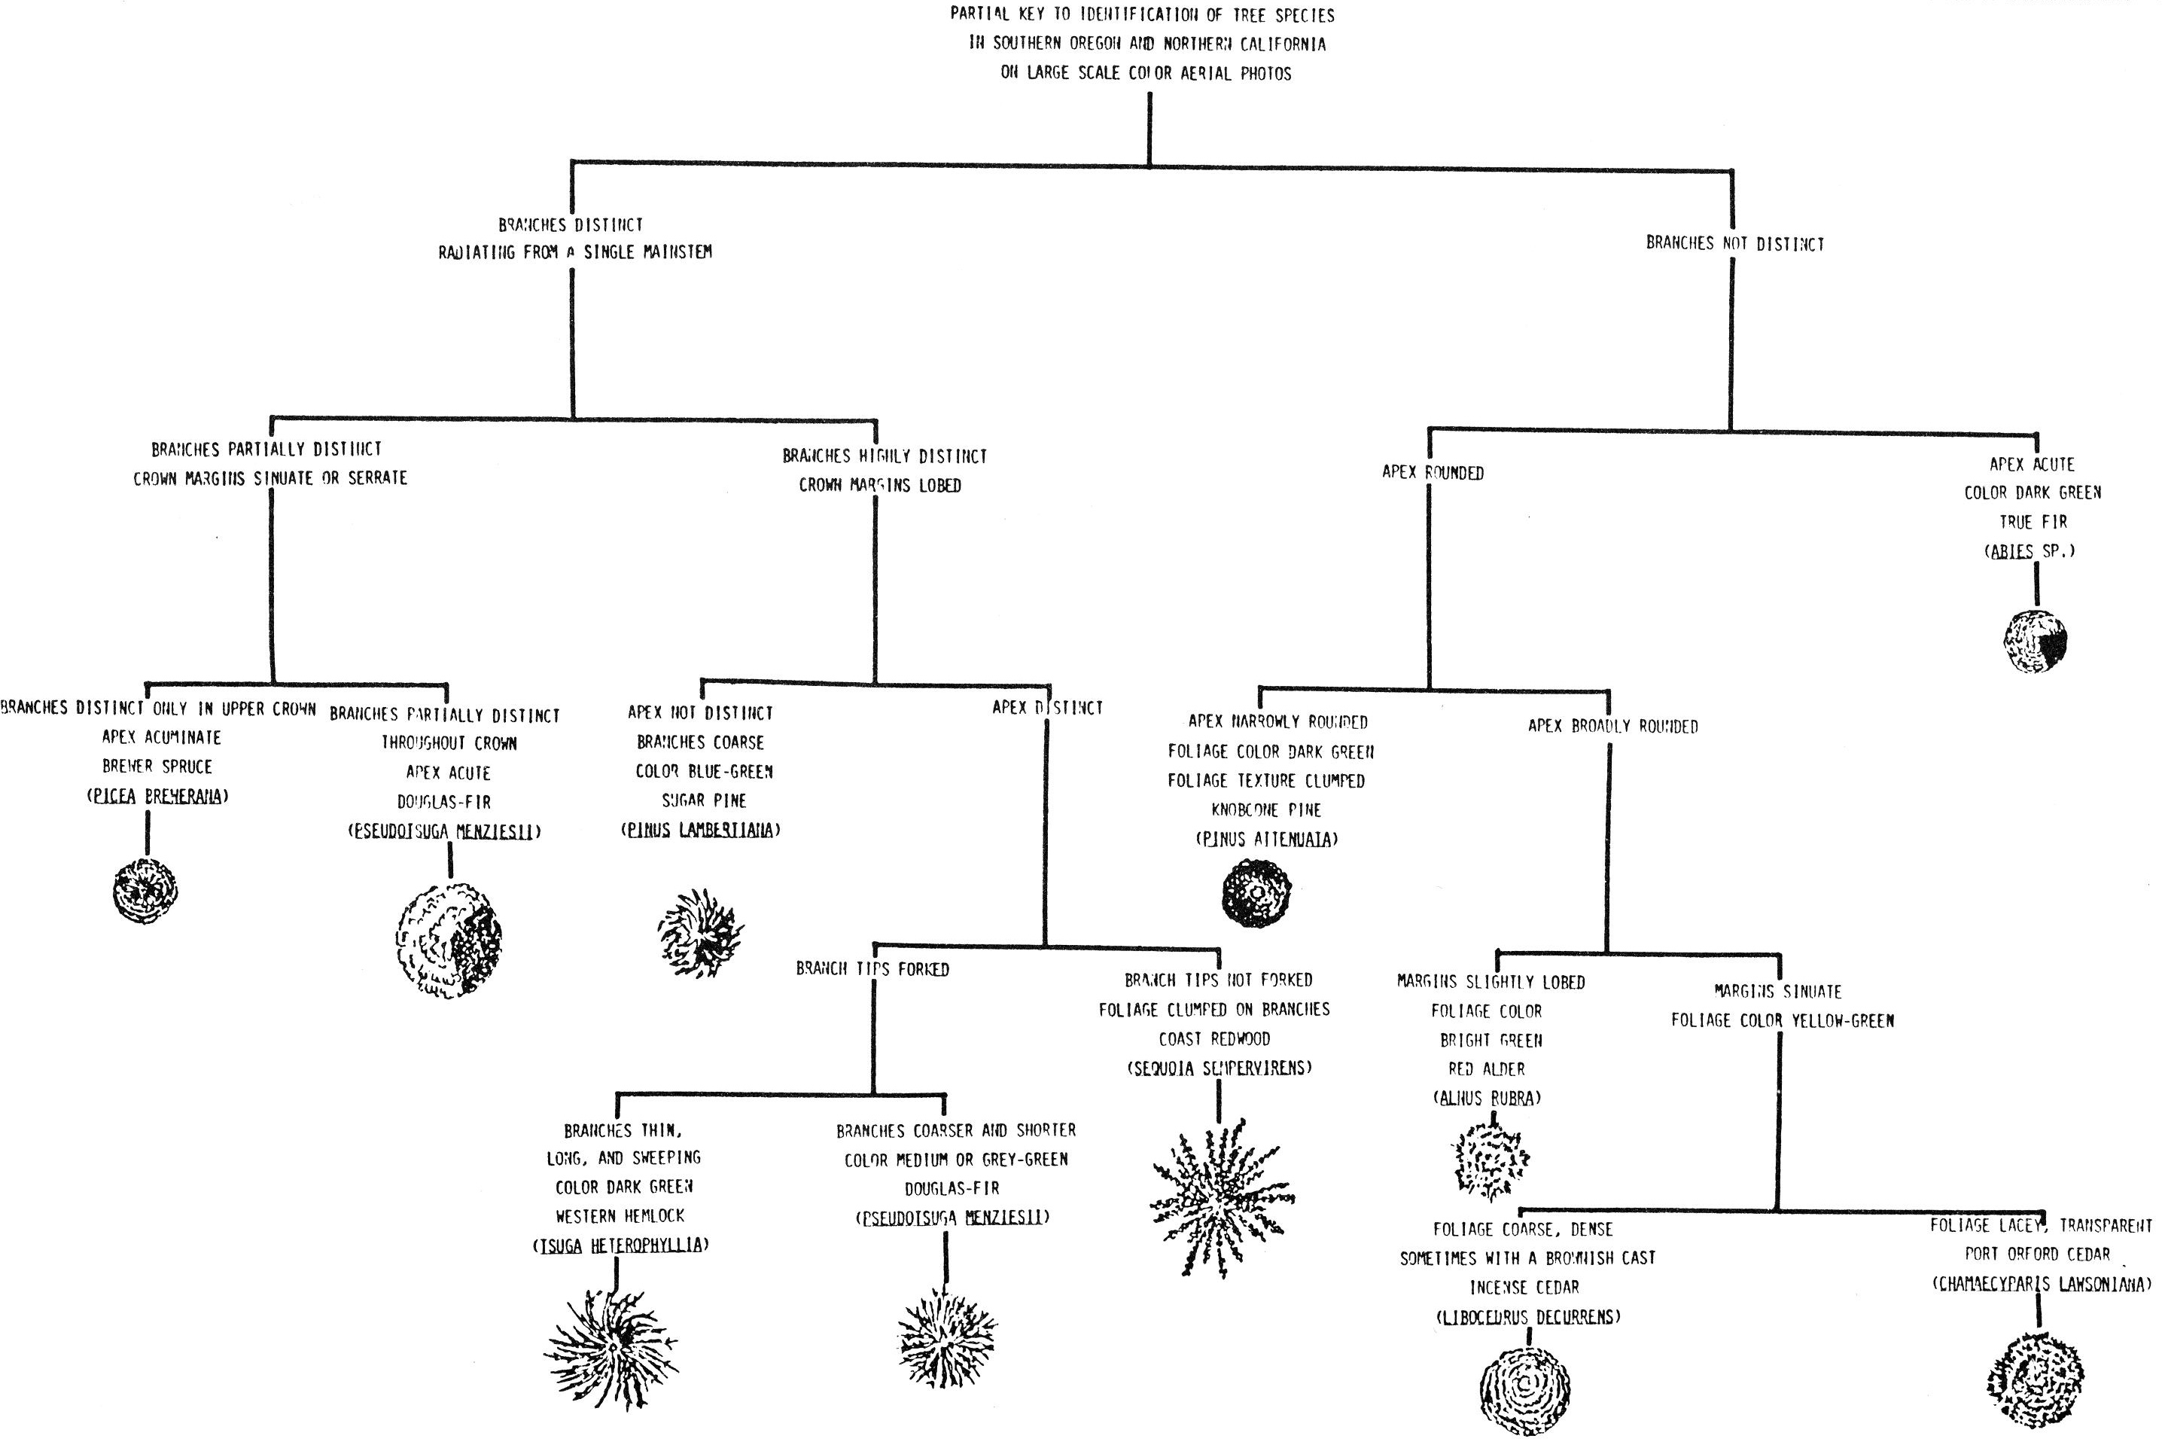
PI Keys…

Slide 21
Ancillary Information
The more you know about the resource, the better your interpretation of resource photos:
Elevation, aspect range, etc…
Associated vegetation
Life and seasonal cycles
This ancillary information can be built into your photo keys…

Slide 22
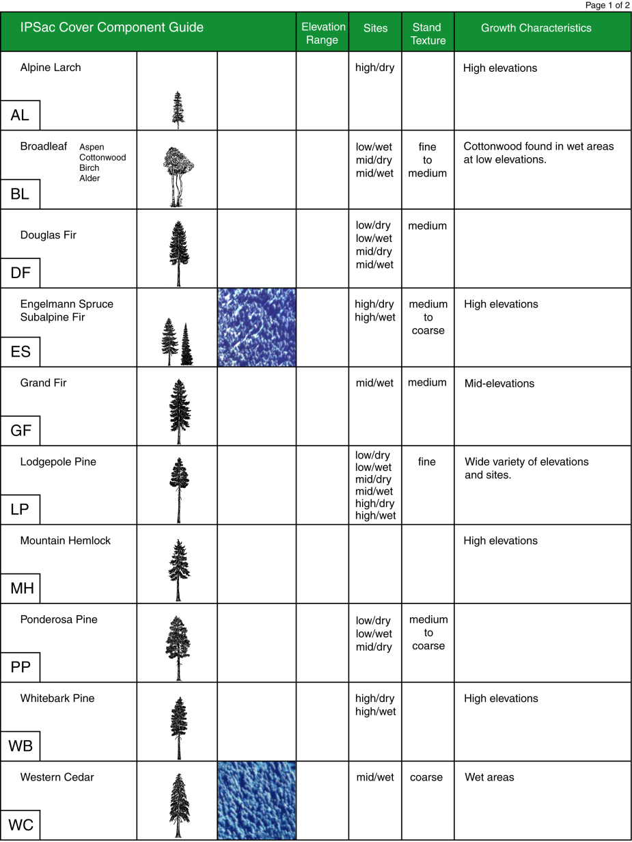
Photo Key with Ancillary Information
Brief description of growth characteristics
Example of Type on the project photography
Tree profiles useful for shadow interp.

Slide 23
Digitizing in Summit Evolution
The main event!

Slide 24
Why the new software
Request for Proposals held in 2015
Thorough review process completed
Main advantages of Evolution:
Simpler install
ArcMap version agnostic
Loads imagery much quicker
Major improvements with large blocks of imagery
Notes:
For those who are used to using Stereo Analyst

Slide 25
Heads-Up Digitizing in Summit Evolution
Uses the common ArcMap digitizing tools in conjunction with Evolution
The target file must be 3D (has to have the Z value included)
Can add a background image/map in ArcMap to assist in review
By default, the orientation of the ArcMap window will rotate to match Evolution
Notes:
Last bullet: can be a bit of a nuisance, but not bad once you are used to it; can always go into the Layer properties and re-orient north to the top.

Slide 26
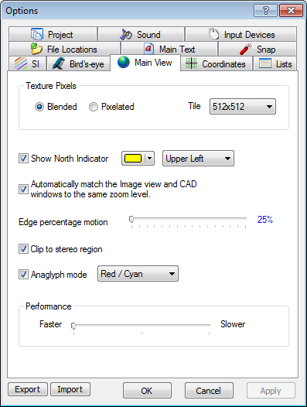
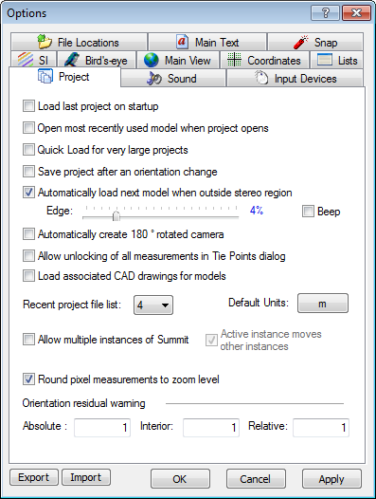
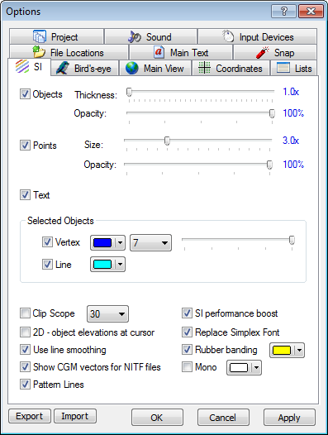
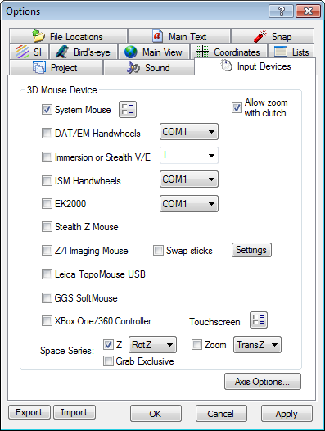
Summit Options for Digitizing
Notes:
“Why we found Summit Evolution attractive”
Discuss the myriad of options, and that these are covered in both the demo and exercises

Slide 27
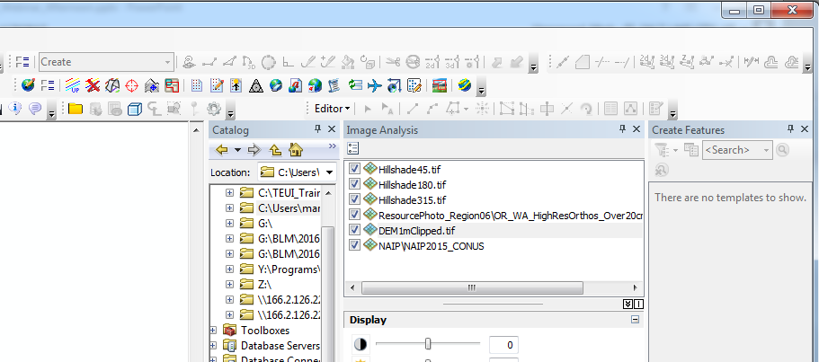
Summit Digitizing Toolbars in ArcMap
Notes:
Discuss the myriad of options, and that these are covered in both the demo and exercises

Slide 28
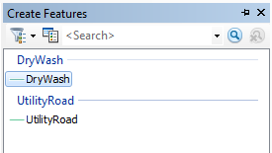
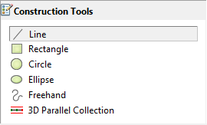
Digitizing Basics
In ArcMap, start an editing session.
Click on the Capture Coordinates button to get the two programs communicating
Make sure the Create option is chosen in the DAT/EM Capture Drawing toolbar
Open the Create Features pane, choose your feature, and then choose your Construction Tool
Notes:
I am starting with the actual digitizing process; presuming at this point that we have already created a vector file in Arc that includes the ability to capture elevation information if we need it.

Slide 29
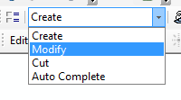
Digitizing Basics
Move to Summit Evolution, and activate the Stereo View window by right clicking in it.
Add an elevation file if desired
A single left mouse click starts the polygon and adds vertices…
…use Ctrl+Z to remove the last vertex…
… After you place the last vertex, press F2 to end the line or to close the polygon.
Change the setting in the DAT/EM Capture Drawing toolbar to Modify to edit a vertex in the Stereo View
Notes:
For the edit in the bottom half, emphasize that while we are using many settings in ArcMap, all of your editing should be done in the Stereo view in Evolution

Slide 30
Digitizing in Summit Evolution
Demo - Exercise 4

Slide 31
Geospatial Help Desk Resources
Brenna Schwert, brenna.schwert@usda.gov
November 21, 2019

Slide 32
Geospatial Help Desk
Did you know that GTAC offers geospatial support through the Customer Help Desk?
Tickets first go to a Tier 1 Help Desk Agent
Tickets are then routed to a Tier 2 Agent who specializes in the area of your issue
Geospatial Tier 2 Agents work directly at GTAC
Bypass long wait times and come directly to us!

Slide 33
GIS Help Desk
3x Tier 2 Agents at GTAC
Submit a CHD request directly to the GIS Help Desk queue
Local GIS issues (desktop version of ArcMap, ArcGIS Pro, etc.)
Mobile GIS issues (GPS, Collector, Survey123, Avenza, etc.)
Data Center (Citrix users of ArcMap)
Topics: appropriate standards, recommended agency workflows, best practices, field data collection and management, standard and custom data dictionaries, data transfer, tile package creation and use, mobile GIS equipment recommendations based on use, etc.
Available 7 am to 6 pm Mountain Time

Slide 34
Remote Sensing Help Desk
4x official Tier 2 Agents at GTAC, myriad Subject Matter Experts (SMEs)!
This is a funded service that we provide – you are not inconveniencing anyone by asking for help.
Contact SMEs directly, we’ll take care of the CHD ticket.
We have a whole office of SMEs at our disposal to help you resolve whatever issue you’re facing.
Topics: troubleshooting remote sensing software, lidar, radar, Google Earth Engine, modeling, geospatial scripting, photogrammetry, stereo viewing, change detection, segment generation / object-based image analysis (OBIA), raster geoprocessing, and more.

Slide 35
GTAC Remote Sensing SME Contacts
Point of Contact | Specialization | Email | Phone
Nolan Cate | Scripting, machine learning, spatial modeling | nolan.cate@usda.gov | (801) 975-3426
Kain Kutz | Object-based Image Analysis, Raster Geoprocessing, UAS | kain.kutz@usda.gov | (801) 975-3371
Brenna Schwert | Change Detection, Image Classification, Accuracy Assessment | brenna.schwert@usda.gov | (801) 975-3821
Jeremy Webb | Aerial Photography, Photogrammetry, UAS | jeremy.webb@usda.gov | (801) 975-3450
Mark Hammond | ERDAS and Data Services, Photogrammetry | mark.hammond@usda.gov | (801) 975-3750
Eric Rounds | Lidar Acquisition, Analysis, and Support | eric.rounds@usda.gov | (801) 975-3711
Geospatial Training and Awareness page

Slide 36
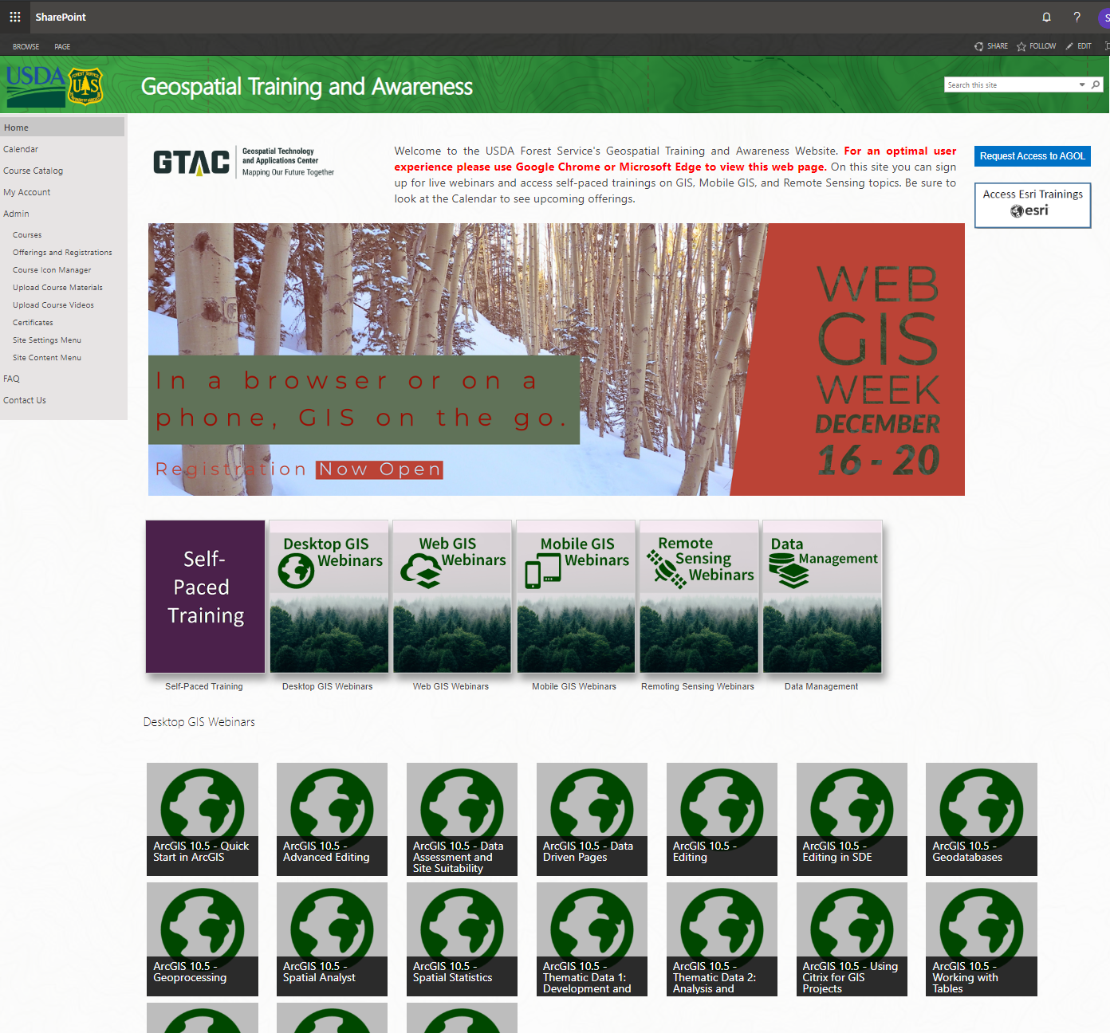
Geospatial Training and Awareness
Sign-up for live webinars
Desktop GIS
Web GIS
Mobile GIS
Remote Sensing
Find self-paced training materials
Access to recorded webinars

Slide 37
Questions/Comments? brenna.schwert@usda.gov
Send them all to me - seriously!

