Slide 1
Integrating Digital 3D Imagery in Geospatial Workflows
Mark Hammond
Remote Sensing Specialist / Trainer
RedCastle Resources Inc., working onsite at
Geospatial Technology and Applications Center (GTAC)
(801) 975-3497
markhammond@fs.fed.us

Slide 2
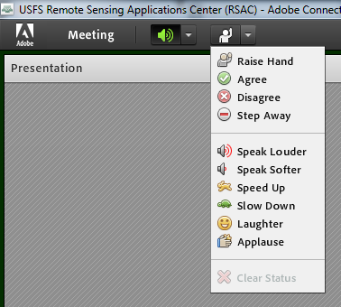
Housekeeping
Adobe Connect
  Quick orientation to interface
Question or comment?
    Un-mute by dialing *6 again
    “Raise” your hand
    Send a chat

Slide 3
Webinar Overview
Mixed Format
  10:00am
    Presentation
    Demonstration
    Work on exercises 1-3: setting up Summit, importing block files, measuring heights
  1:30 pm
    Presentation
    Demonstration
    Work on exercise 4: digitizing
Instructor standing by to provide assistance as you work on exercises
This webinar is being recorded
Course Duration: 10 am MDT to ~ 4:00 pm Mountain Time.

Slide 4
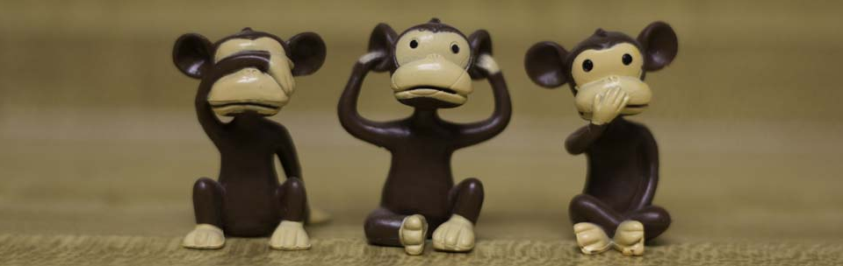
Course Format & Learning Styles
Many different learning styles: visual, auditory, kinesthetic, etc.
Webinar format seeks to address a variety of learning styles
  PPTs, live demonstrations, step-by-step exercises
  Content may be repetitive for some people
  Feel free skip formats that don’t serve your learning style

Slide 5
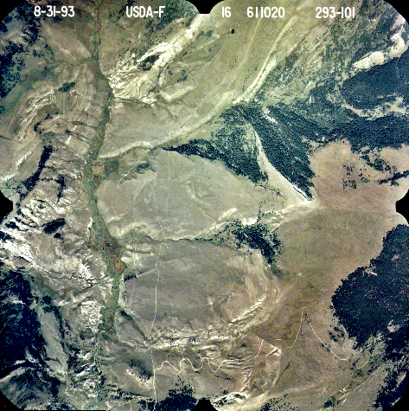
What this course will cover
Introduce how we can see stereo from imagery
Notes:
Will discuss some of the properties that will aid in understanding how we can view two ‘flat’ photographs in stereo
[click to bring up single point image]

Slide 6
What this course will cover
Using stereo parallax to measure heights from photos.
Film Plane
Camera Station 1
Camera Station 2
lens
lens
Notes:
We will cover a minimum amount of technical detail so that you can understand what Summit Evolution is doing, without needing the full technical knowledge.

Slide 7
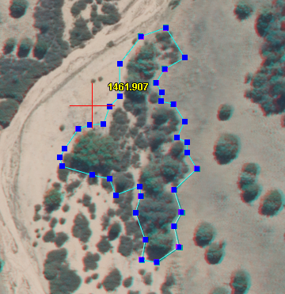
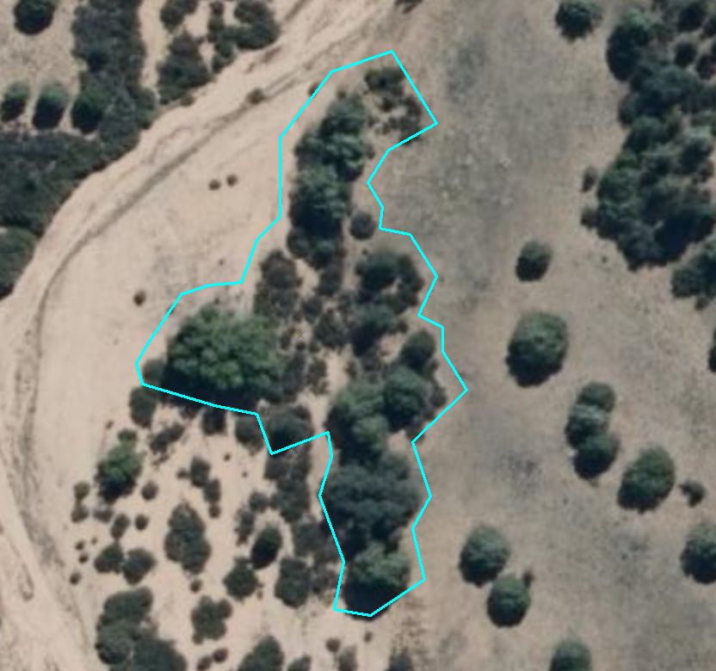
What this course will cover
How to digitize in stereo
Notes:
How to take the information we are seeing in stereo into actionable data
[graphics appear automatically]

Slide 8
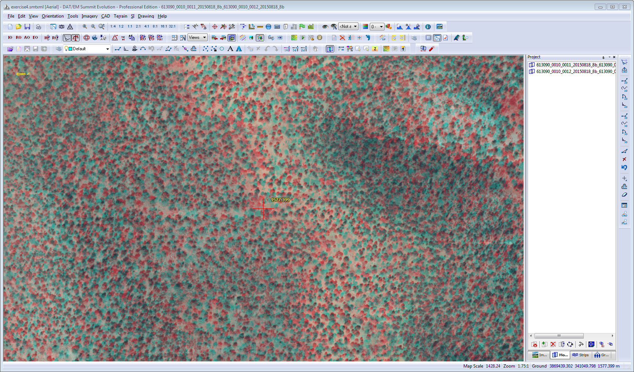
What this course will cover
The FS digital 3D viewing software: Summit Evolution
Notes:
Most importantly, we will make use of demonstrations and exercises to learn how to use Summit Evolution with ArcMap

Slide 9
Selected Characteristics of Aerial Photos
… a VERY brief introduction …

Slide 10
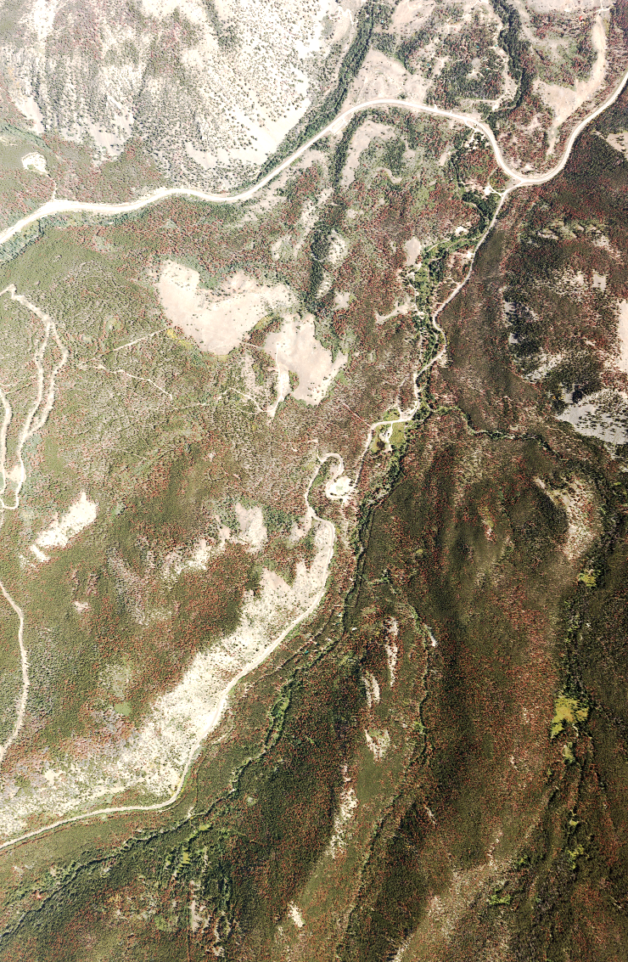
Aerial “photos”
Notes:
I will use the terms aerial photos and aerial images interchangeably for this class. While there are some important differences, once they get to the point of using them in stereo, the properties that are important are the same whether they are collected using film or a digital frame camera.

Slide 11
Requirements for Stereo
60% Overlap
Date Agency Scale Roll-Frame
Date Agency Scale Roll-Frame
Date Agency Scale Roll-Frame
Date Agency Scale Roll-Frame
Notes:
There are a couple of basic requirements of imagery that allow us to see in stereo.
First, the imagery must have a minimum amount of overlap. The minimum is 50%, but typically it is collected with 60% or more. The reason we need this much overlap is so there is enough common area of successive images for viewing. Also, if only the edges of an image pair, say 10%, were overlapping, an object would be very difficult to see due to its displacement.
Newer sensors (pushbroom) attempt to replicate this with forward and backward viewing sensors, but some have difficulty seeing in stereo with data from these sensors.

Slide 12
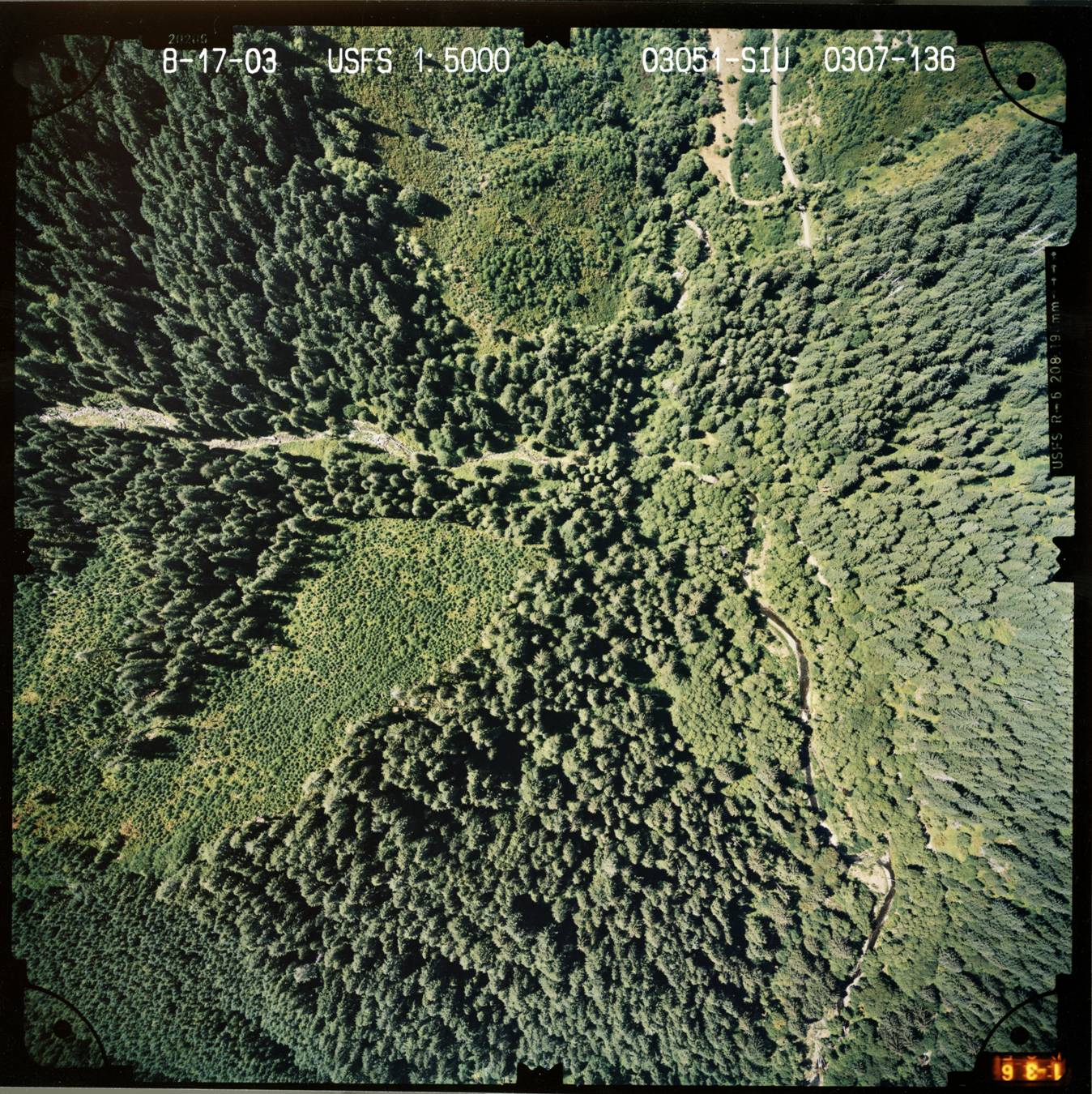
Requirements for Stereo
Notes:
What is displacement, then?? Mention how the trees at the center are properly placed and looking upright, but as you move away from the center (also called the principle point), the trees ‘lean’ away, and they are also DISPLACED. Higher elevations are also displaced more as you move away from the center.

Slide 13
Photo Geometry--Single Point Perspective
Distortion: noise due to lens imperfections, poor camera vacuum, paper shrinkage etc… Always a nuisance factor
Displacement: the result of projecting a 3-D world (with varying heights) on a 2-D surface from a single point perspective. Almost always a good thing
  Allows for stereo viewing
  Measurement of heights, volumes
  Very predictable: f(relief, camera height, proximity to PP)
Notes:
Displacement: comes from taking items on the surface of the earth and placing them on a flat surface WITHOUT the typical process we use to make a map. The displacement in imagery is replicated on the computer screen, and mimics our natural depth perception to allow us to see in stereo.

Slide 14
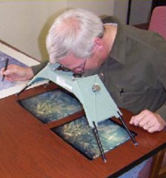
Relationship to viewing
Parallax: the apparent shift of something we are viewing when we move position. This gives us depth perception.
Date Agency Scale Roll-Frame
Date Agency Scale Roll-Frame
We can equate two adjacent photo center locations to our pair of eyes.
Notes:
Parallax is the apparent shift of something we are viewing when we move position, and it is this property, along with displacement, that makes it appear as if we can see the objects in three dimensions.
To put it all together, when we take two consecutively capture images and view them simultaneously, we are looking at one capture with our left eye, and the other with our right, simulating how we can see depth perception in our everyday world.
We will put together parallax, displacement, and how we make use of these, here in a few minutes.

Slide 15
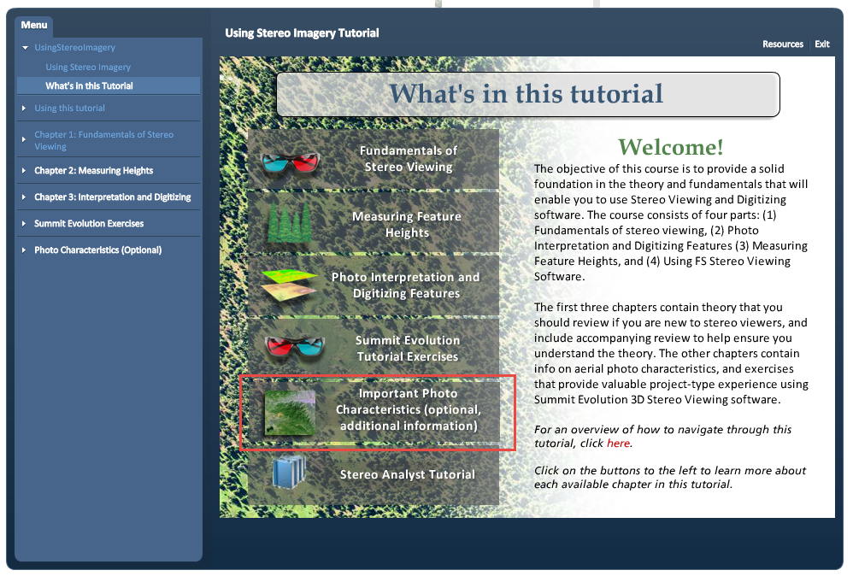
For more information…
The tutorial has more information on photo characteristics, as well as a supporting exercise

Slide 16
Summit Evolution
Introduction and Overview

Slide 17

Stereo Viewing Overview Topics
Capabilities—what is stereo imagery good for?
Major Components (hardware/software)
System Requirements
Importing ‘block files’
Navigation/Interaction
Notes:
These last two topics will be covered in the demo rather than in slides.

Slide 18
Summit Evolution Capabilities
Digital 3D Imagery software provides the following primary functions:
  The ability to view and navigate in stereo
  Photo interpretation
  The capability to measure and collect geographic information in 3D including:
    Measuring heights, and
    Heads-up digitizing (with elevations!)
Notes:
[go through the points]
For the last point: in order to record an elevation in the shapefile or feature class, you must set up them up to include Z values.

Slide 19
Summit Evolution System Requirements
System (moving target):
  Computer req. (class 2 desktop minimum recommended)
  Video/graphics requirement
  ArcGIS: version agnostic
    Recommend 10.2 or later
    Have not tested in 10.4(.1) yet
Data:
  Oriented Stereo Imagery—specifically…
    Block files from Imagine’s Leica Photogrammetry Suite (LPS), or
    Project files from SocetSet, or similar photogrammetric software
    Can now also import from PhotoScan
  This is not a trivial requirement!
Notes:
The reason system is a moving target is the continued improvement in 3D technology and software
Unlike our experience with Stereo Analyst, Evolution has a more stable set of requirements, and is not as dependent on your version of ArcMap.

Slide 20

How stereo-ready imagery is created
Block File
Image list
Sensor info
Orientation info
Elevation file info
Datum and coordinate info
Notes:
Do not need to know LPS to use Summit Evolution, but it helps if the block file experiences any errors, or if you need to create smaller (subset) blocks from the full dataset.
Once you have the data, you need something to view it with…

Slide 21
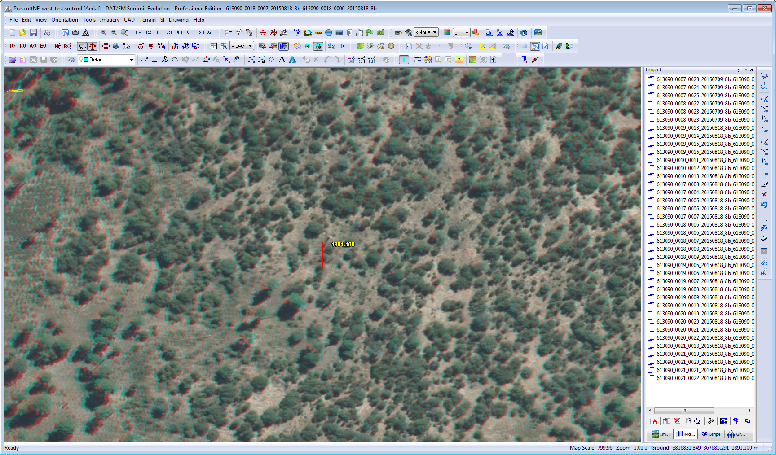

Stereo Viewing—Red/Blue Anaglyph
Notes:
Looking at hardware, let’s start with the simplest. Can be used with any computer monitor system; the glasses cost less than a dollar or using plastic glasses for a few bucks
Not always easy to see (depending on the imagery); darkens the colors;

Slide 22
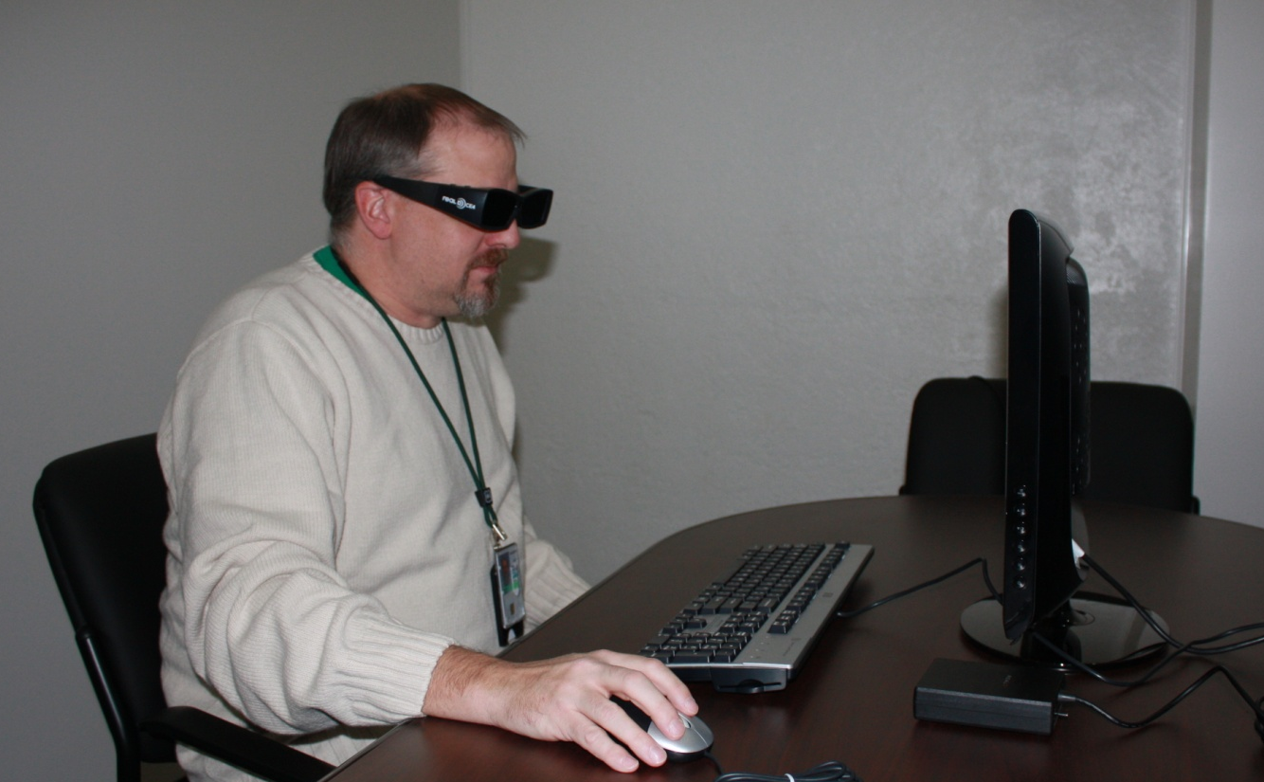
Stereo Viewing—Active Systems
Stylish 3-D Glasses
IR emitter
Stereo Images rapidly flicker to produce 3D image effect.
Notes:
The active stereo system is the most commonly used due to its affordability. The monitor, emitter, and glasses can be had for around $500. For those who have not used one before, [describe how it works]
The only downside is that, due to the flicker in the glasses, it can cause eye fatigue for many users.

Slide 23
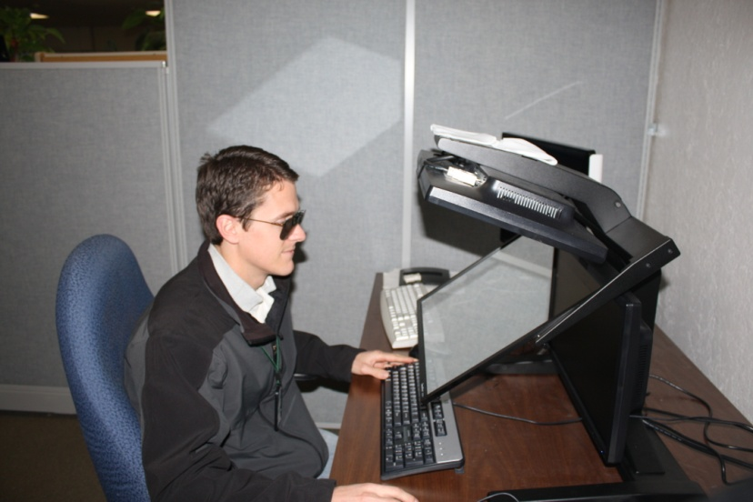
Stereo Viewing—Passive Systems
3-D Glasses
Stereo Mirror Monitor
Computer needs higher-end graphics card.
Notes:
A ‘passive’ system, such as shown here, works by using different polarizations for each eye; e.g. horizontal for the left eye, and vertical for the right. [explain how the mirror then works]
The main benefit is that there is less eye fatigue, so this system is good for production work. On the negative side: cost; more difficult to use as a day to day monitor, and now becoming harder to find, although the company that makes the stereo software is not importing them from a company in Germany.
However, while either of these systems are nice to have, can use the system sitting on your desktop right now. Anaglyph isn’t the best, but it works.

Slide 24
Setup Options—Stereo Display
Red/Blue anaglyph glasses.
Cheap
Works with any graphics card
Relatively poor performance (dark, poor colors, etc.)
Shutter Glasses and Emitter.
Price ranges from $400 to $800
Newer models work with LCD monitors
Great quality
Big heavy glasses
Recommended for occasional but not full-time production use
Planar Stereo Mirror with Polarized Glasses.
Price ranges from $2,000 to $8,000
Excellent quality
Improved glasses
Recommended for full-time production use
Notes:
Active stereo system: Should work with current class 3 desktops; class 2 may need a different graphics card; check the computer graphics card against the manufacture system requirements.
Planar stereo mirror: Have been out of production for a little while and might be found in secondary market. A German company recently began manufacturing these, and we are in contact with their reseller for the US to get price information.
BIG RECAP: the software and hardware work together to give us digital 3D viewing; need to do a little homework in selecting a monitor system, and ensuring that you have a graphics card that will work.

Slide 25
Measuring Heights
How we can use parallax to our advantage

Slide 26

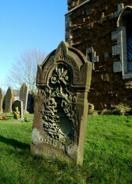
A bit of theory
Parallax: the apparent shift in the appearance of an object due to the change in position of the observer
Notes:
Describe parallax using the near and distant tree or items on the desk example

Slide 27
Fundamentals of Digital 3D
Left Image
Right Image
T
B
In the stereo model, distance T is less than distance B and T appears (and is) higher than B. The quantity B – T is directly related to the height of the feature.
Notes:
In stereo viewing, we have two successive images captured along a flight line. The tree of course has not moved, but due to the shift in position of the observer, the camera in this case, the tree now appears to lean in different directions. We will refer to them as the left and right images based on how they are displayed.
This is a type of displacement, and since we know the details of how these images were capture (such as the altitude of the plane, information about the camera, etc.) we can use this to estimate the height of an object.

Slide 28
Fundamentals of Digital 3D
The X parallax is adjusted for the tree
Top.
Bottom.
Left Image
Right Image
T
B
In the digital stereo view, the user must make X parallax (Z) adjustments to clearly see features at different elevations. The Z adjustments determine the elevation…
Notes:
In the stereo viewer, we move the objects along the X axis of the screen, so this is usually referred to as the X Parallax [FIND THE PROPER TERM!]
This is a basic generalization, but it holds true whether we are measuring heights, or looking to get ground elevations to either measure slopes or include them in our shapefiles.

Slide 29
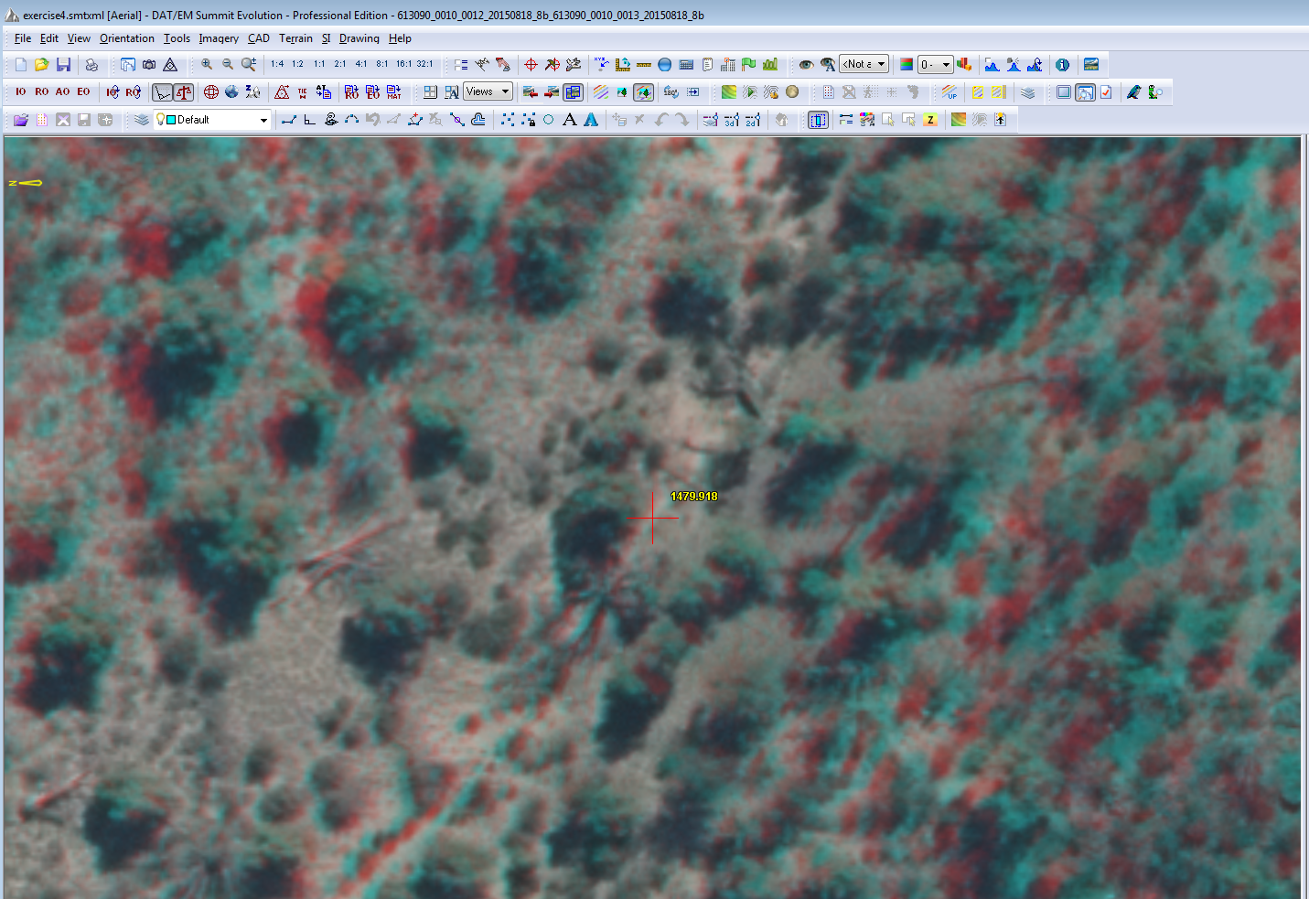
“Seeing” in stereo
(This is viewable with your anaglyph glasses)
Notes:
Point out that we can use the scroll wheel to adjust the parallax and move the stereo cursor up and down to ‘place it on the ground’.
If we look a little closer to where the cursor is at… [advance to next slide]

Slide 30
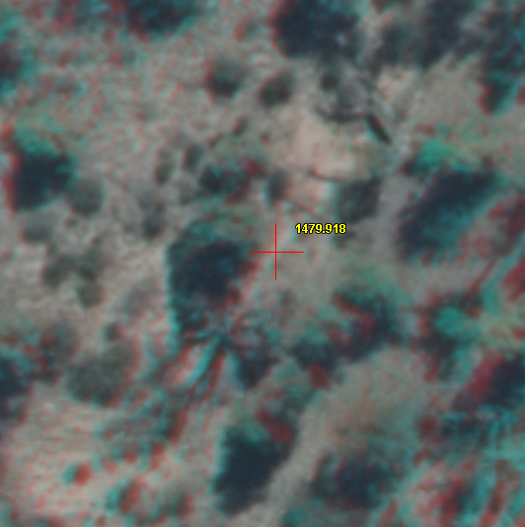
“Seeing” in stereo
(This is viewable with your anaglyph glasses)
Notes:
If you are new to stereo, it does take a while to get used to seeing the height of the cursor.
If you have anaglyph glasses, you should notice a red cursor and a yellow cursor in the image. The challenge for new users is to be able to note when the cursor is ‘on the ground”, or when the two cursors are lined up.
One key is to relax your eyes, and let them focus on the ground. A similar situation that might help is when you are looking out of your car windshield when it could be cleaned. Your eyes can focus alternately on your windshield, or on the road in front of you like they should be!! This is similar; let your eyes focus on the terrain, and then as the two cursors approach each other, you will be able to see them more easily.

Slide 31


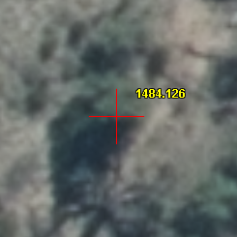
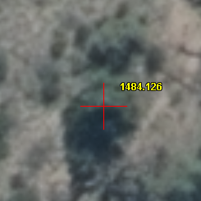
“Seeing” in stereo
Left Image
Right Image
Notes:
To check how close you are, you can use the view modes in the Image View toolbar. This allows you to view only the left or right image at a time, and is a good check to see how well you have done getting the cursor on your object.
For those transitioning from Stereo Analyst, there is no mode where all three windows are displayed simultaneously, but this is a useful compromise.
There are two different ways we can adjust the parallax; manually with the scroll wheel on the mouse, or we can let the software do it, either on its own or by using an elevation file

Slide 32
X Parallax Adjustment Modes
There are three X Parallax Adjustment Modes:
Manual — you make the adjustments
Automatic — using an external DEM
Automatic — using image autocorrelation
 | Measuring Heights | Heads-Up Digitizing
Manual | Best | Too tedious
Auto w/DEM | No - won’t work | Best (if DEM is good)
Auto w/Img auto corr. | Possible, do not recommend | OK (esp. if no or bad DEM)
Notes:
-- explain autocorrelation

Slide 33
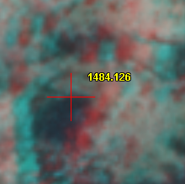
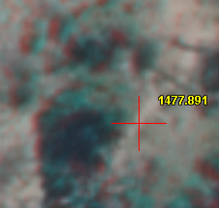
X Parallax Adjustment Modes
Manual Parallax Adjustment
  Best for measuring heights of features (e.g. trees)
X Parallax is adjusted to view the tree top and a point on the ground near the tree—provides a tree height of approximately 6.3 m (~20.6 ft)
Notes:
This really only works if you have bare ground near the tree. If you want the height of a tree in an area with closed canopy, it can be a bit trickier
Using manual adjustment is not best when digitizing, particularly when you are capturing Z values.

Slide 34

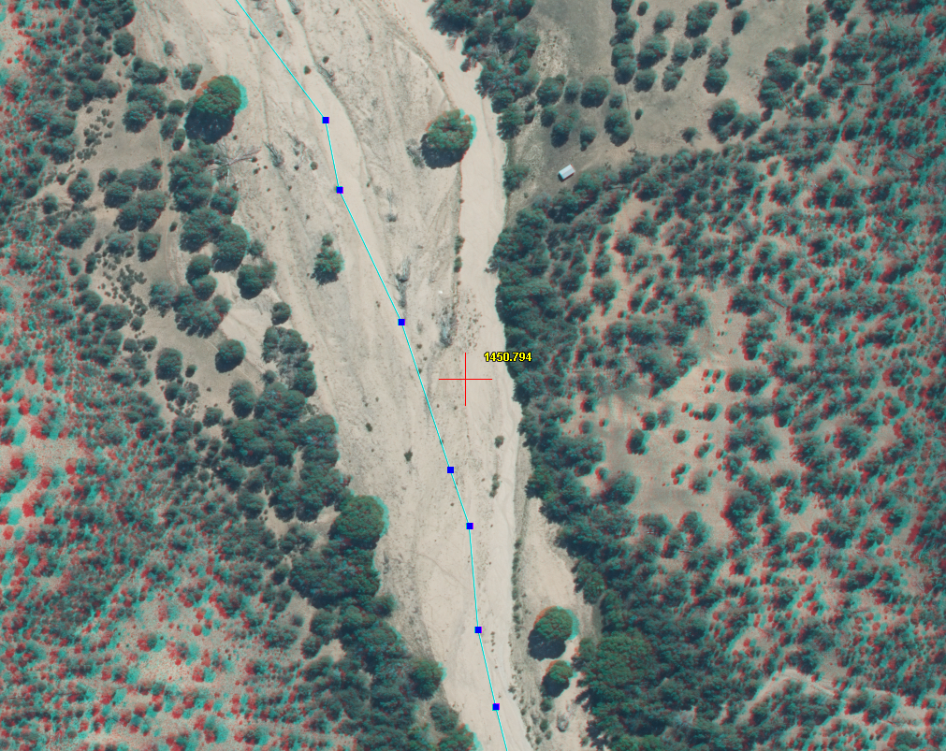
X Parallax Adjustment Modes
Automatic Parallax Adjustment using DEM
  Best for heads-up digitizing
The X Parallax is adjusted as you roam through the imagery based on the elevation provided by the DEM—quite fast.
The the X Parallax is adjusted to match the ground, and not features within the imagery.
Notes:
Note the icon in the upper right; we will use this button to add a DEM in Evolution

Slide 35

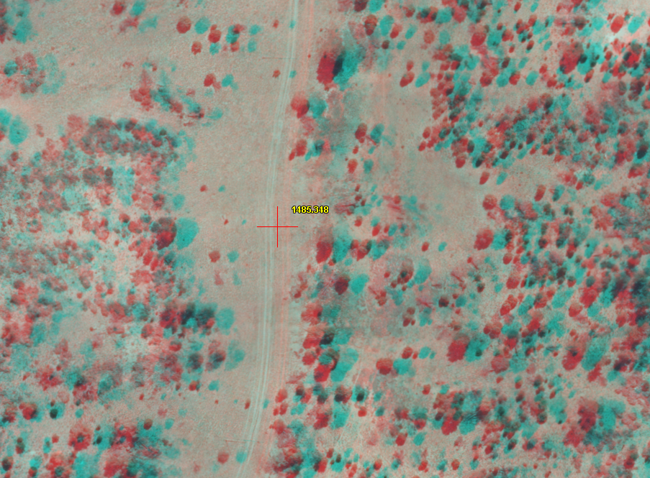
X Parallax Adjustment Modes
Automatic Parallax Adjustment using image autocorrelation
  Use for heads-up digitization if DEM is bad or missing.
The X Parallax is adjusted to match features as you roam through the imagery. This happens based on the software’s ability to locate the same feature on both images—can be slow and jumpy.
Also depends on having contrasting objects in the imagery to work well.
Notes:
Image Correlation is an option when digitizing where a DEM is not an option. It is called ‘Snap Toggle’ in evolution, and should not be confused with snapping when digitizing in ArcMap. This mode compares the two scenes, and uses a correlation routine between the two to compare locations and try to match the locations in the pair.
Typically this works well, but if you have any area such as around this two-track where there is little contrast, it can have a difficult time with the correlation, as can sort of be seen here; you will be able to see it better in the demonstration.
Now that we have an idea of how stereo works, let’s look more at the interface

Slide 36
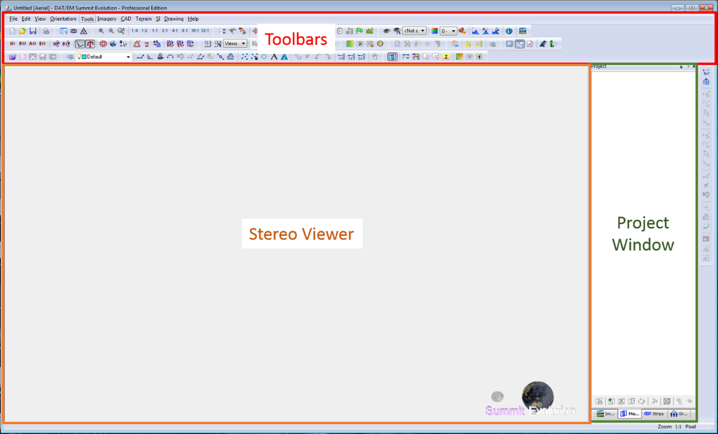
Evolution Major Software Components (1)
Notes:
When you first open Evolution, the tool bar can be rather intimidating at first glance. However, there are only a few of the toolbars that you will regularly use, and we can easily customize the toolbar to remove the one’s we do not need.

Slide 37



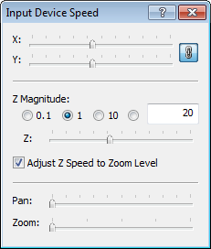
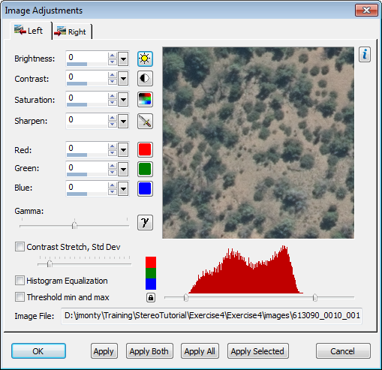

Evolution Major Software Components (2)
Options
Elevation
Image adjustment
Scroll speed
Zoom levels
Notes:
For now, we will look only at Summit Evolution; there are toolbars that are available in ArcMap as well, and we will look at these in the second session.
When I opened Evo initially, the first thought was that this had a lot of options, but it could be intimidating for a first time user. Found that we can easily remove and add toolbars to simplify the interface; also found that I really used a few tools regularly.
Options button (also in menu option);

Slide 38

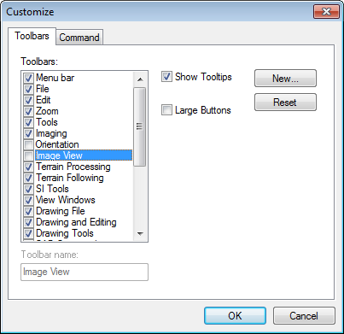
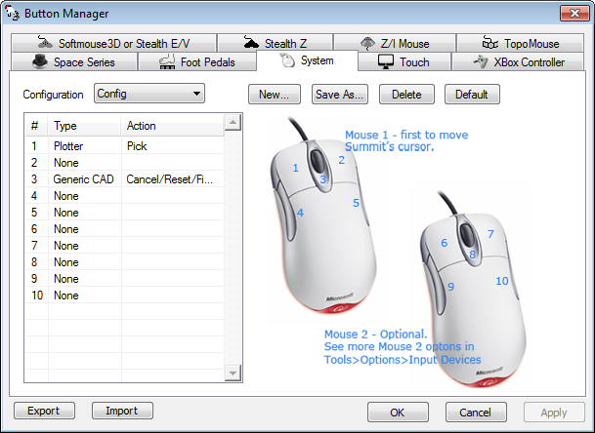
Customization
Notes:
As I mentioned, you can customize which toolbars appear, and the first exercise will take you through reducing the number that appear.
Another advantage of Evolution is the number of input devices you can use, and the ease in customizing the buttons. Good if you have something other than a system mouse; but even the system mouse buttons can be reconfigured. Notice a coupel of things; you can use two mice at once with this; X-box controller too!!
[Point out that you can Export and Import settings in case you need to move to a different computer, or you have multiple users.]

Slide 39
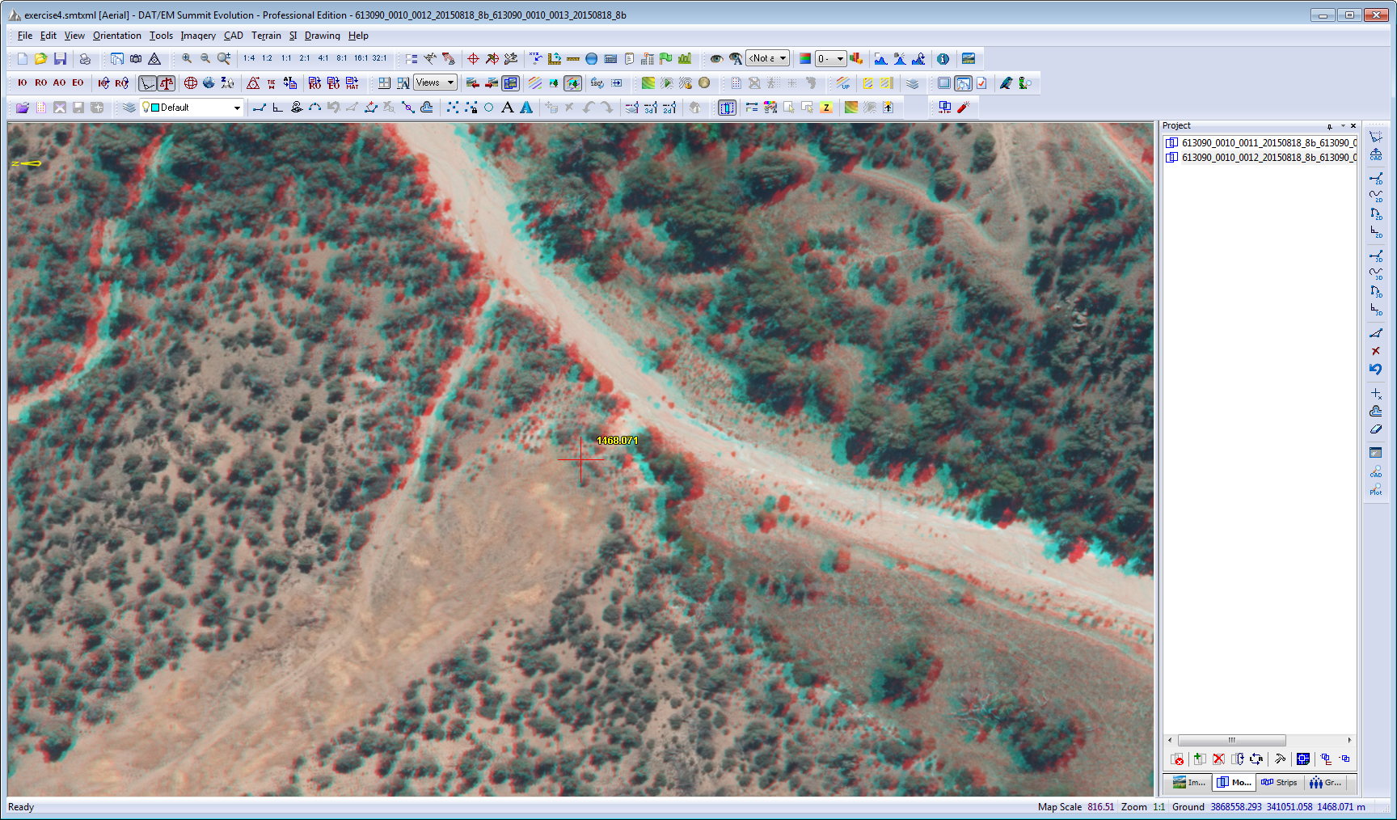
Navigation Tips
In the main Stereo Window:
To activate the 3D cursor, ensure the stereo window is active click the right mouse button.
To exit the stereo window, either
  Double click the right mouse button, or
  Press the “Esc” key
While in the stereo window, use the F5-F12 keys to set zoom level. Also:
  Page Up will zoom out
  Page Down will zoom in
Notes:
So last, here are the basics for using the stereo window. By the time you complete the exercises, these will hopefully become second nature to you.
[go thru the first two main bullets, and the zoom function keys]
One set of keys we do not stress in the exercises, but are good to keep in mind, are the final pair. The page up/page down buttons allow finer control of the zoom level in Summit

Slide 40
NAIP Statewide Stereo Imagery
Collected using the ADS100 pushbroom camera, but loads into Summit Evolution very efficiently.
State Vendor Stereo DSM
Connecticut Quantum Spatial FS FS
Delaware Quantum Spatial FS FS
Maine Surdex Corporation NRCS NRCS
Maryland Quantum Spatial FS FS
Massachusetts Quantum Spatial FS FS
New Hampshire Quantum Spatial FS FS
North Carolina Quantum Spatial NRCS
Rhode Island Quantum Spatial FS FS
Tennessee Surdex Corporatio FS
Vermont Quantum Spatial FS FS
Virginia Quantum Spatial FS
West Virginia Quantum Spatial FS FS
Notes:
These are the states where we’ll be getting NAIP stereo.

Slide 41
Summit Evolution
Demo - Exercises 1 - 3

