Slide 1
Forest Service Update
Everett Hinkley
USDA GIO (acting)
Fall TFRSAC Meeting
December 14, 2017

Slide 2
Talking Points
Washington Office
Everett on detail to USDA OCIO (120 days)
Significant Push to Educate Directors on capabilities and the “art of the possible”
How to do more with less

Slide 3
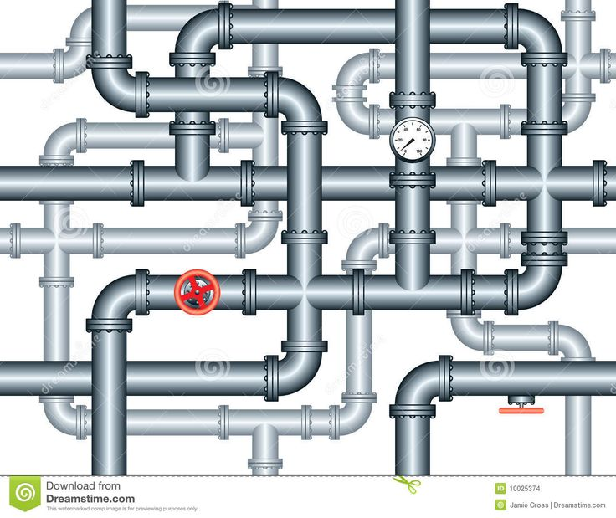
National Remote Sensing Program
Talking Points
Geospatial Technology Applications Center (GTAC)
APFO Film Scanning & Archiving Effort
UAS Activities
Wildland Fire Support – Fire Detection / Active Fire Monitoring
LiDAR / USGS 3DEP Support

Slide 4
Geospatial Technology Applications Center
Open for business! RSAC has become part of GTAC.
New leadership in place
Working on marketing, awareness and relevance
Continue to promote the role of remote sensing in the new center
Moving to new location in late 2018

Slide 5
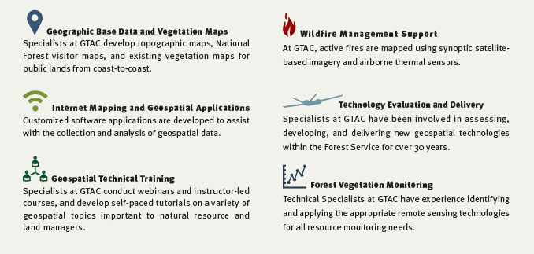
Geospatial Technology Applications Center

Slide 6
Aerial Film Conversion / Archiving
The Forest Service has a significant amount of film stored at the APFO facility. The film spans a 60 year time frame and amounts to ~18,000 cannisters (~3.1 million frames). This is approximately 10 semi truck trailer loads of film.
APFO is relocating from the West Valley location to downtown Salt Lake City beginning in July 2018. The new location does not have space for archival film.
Some film is already degrading due to age and less than ideal storage conditions (vinegar syndrome).
Building awareness and understanding of the value of this film, both in the regions and the Washington Office. Intent: get as much scanned as possible over the next 5 to 10 years.

Slide 7
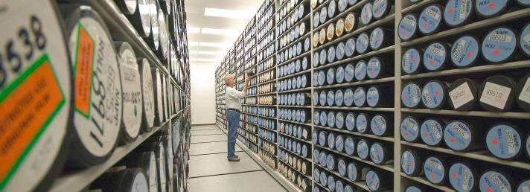
The Film
The vault is typically at 70ºF and 35-40% RH

Slide 8
Current Capabilities – National Systems
Hawkeye Fire Detection and Reporting System
The Hawkeye Fire Detection and Reporting System uses airborne and space borne remote sensing assets to rapidly detect and report new fire starts within the continental United States.
Detected fire starts are relayed to the Ignition Point Database (IgPoint) operated and managed by the Forest Service.
Firehawk Fire Mapping Capability (Aircraft 3)
The Firehawk capability provides large scale fire detection/mapping support to incident command operations. The Firehawk unclassified product is intended to have the same “look and feel” as products from NIROPS.

Slide 9
Remote Sensing Working Groups
Tactical Fire Remote Sensing Advisory Committee (TFRSAC) The TFRSAC is co-hosted by NASA and the Forest Service and is a broad collaborative forum for advancing and enabling the development and delivery of remote sensing platforms, sensors and decision support tools to the wildland fire community. Focus: largely unclassified.
Thermal Working Group (TWG) - has authority and responsibilities as a standing sub-working group under the Overhead Persistent Infrared (OPIR) Working Group (OWG) and Civil Applications Committee (CAC). The TWG is the coordinating body for advancing and enabling the development and delivery of data, information or products derived from classified thermal remote sensing platforms to civil users. Focus: largely classified.
The TWG met yesterday (12/13) at Gowan Field to strategize on forward progress.
The TWG hosted the second Thermal Summit in early February 2017. The meeting was a gathering between Civil and DoD/Intelligence Community members that have a common interest and mission in thermal detection and reporting.
Notes:
Key Findings
Defined Requirements - In order to support the mission(s) of the civil agencies, carefully defined remote sensing requirements are needed for each business area. Requirements documents need to carefully describe the information need(s), current capabilities, desired future capabilities, and information gaps as well as formatting standards. Following the completion of a requirements document, the real work begins, looking for ways to fill the information gaps. Well integrated solutions can come from National Systems, unclassified government systems, and commercial systems. The TWG is tasked with developing requirements and having those validated by the CAC before sharing with other agencies for action/support.
Untapped Resources and Process Engineering / Re-engineering - There are a lot of untapped resources, and the methods/timelines we have worked on for the past 30 years are no longer fully valid. Both the resources delivering the product as well as the teams/land managers using the products need to update and change their processes to get closer to real time, at least for tactical decision making. The current processes work okay for strategic decision-making, but we need to support both strategic and tactical, and the means are available, or close to being available, to do both.
Education – with any remote sensing tool in the toolbox, end users need to be aware of what is available, and how to use it. So there is an awareness piece and a training piece.
End User Community Participation – End user participation throughout the process of discovery (new processes and new data sources) and integration is key to providing the most operationally useful remote sensing information to the incident command structure in a reliable way.

Slide 10
Remote Sensing Working Groups

Slide 11
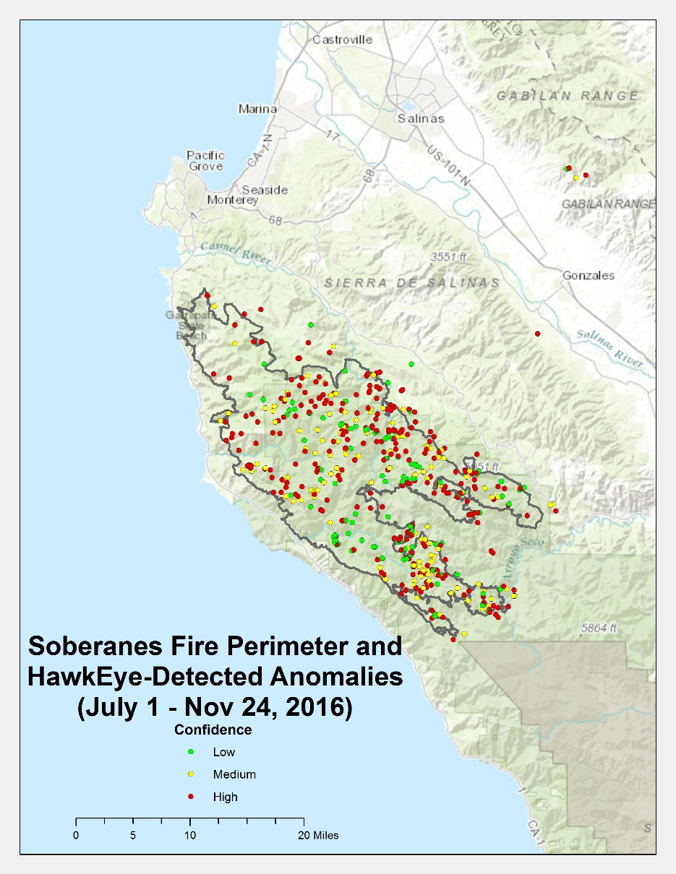
Hawkeye Fire Detection
2016 Statistics
Quarter | Anomaly Count
FY16Q1 | 14,630
FY16Q2 | 8,691
FY16Q3 | 17,281
FY16Q4 | 18,063
FY17Q1* | 5,309
 | 63,974

Slide 12
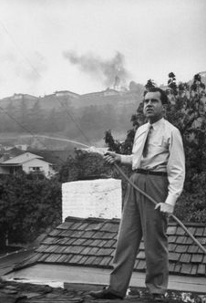
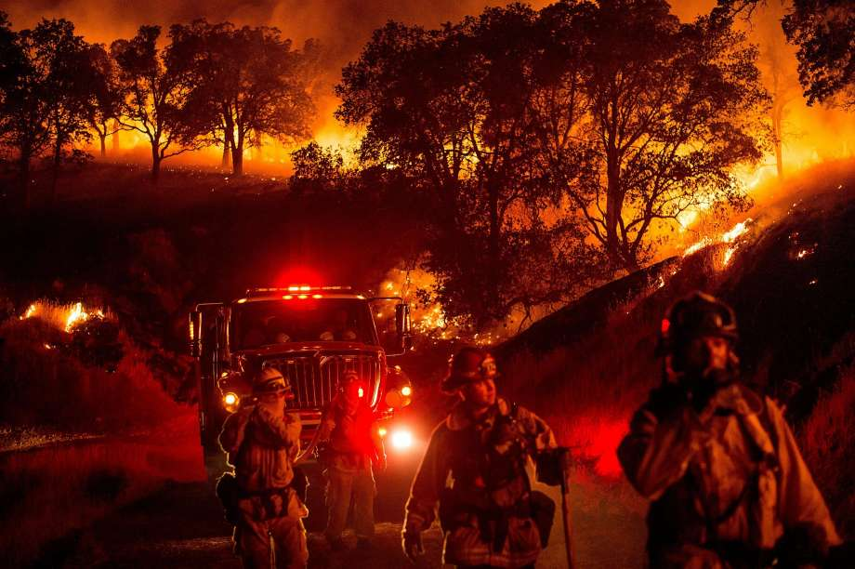
Comments / Questions?

