Slide 1
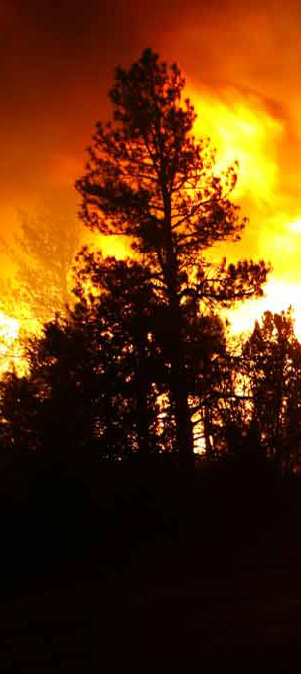
Remote Sensing Support Unified Fire CONOPs Tactical Fire Remote Sensing Advisory Committee
June 2017
Everett Hinkley
National Remote Sensing Program Manager
USDA Forest Service

Slide 2
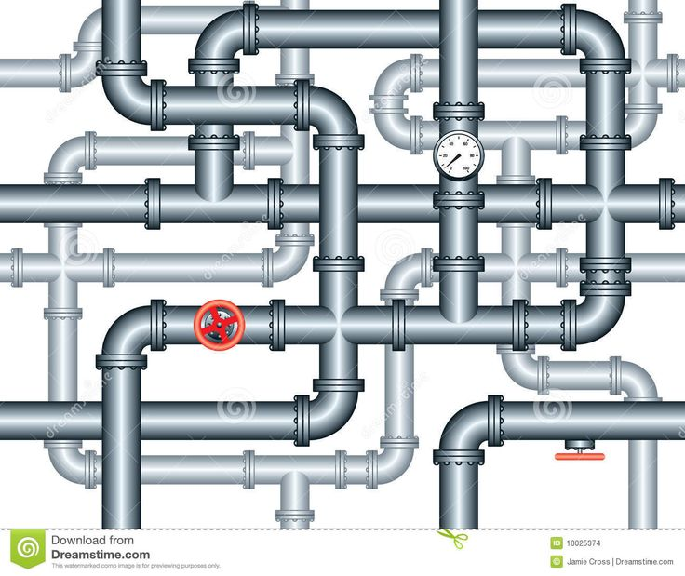
Talking Points
Remote Sensing Working Groups
Unified Fire CONOPs
Current capabilities
Looking ahead
Notes:
Remote Sensing people are basically plumbers in that they are trying to figure out the most efficient “plumbing” to get need information through the pipeline from acquisition to data processing to produce desired end products and finally to deliver end products to the end user (incident command teams for fire).

Slide 3
Remote Sensing Working Groups
Tactical Fire Remote Sensing Advisory Committee (TFRSAC) The TFRSAC is co-hosted by NASA and the Forest Service and is a broad collaborative forum for advancing and enabling the development and delivery of remote sensing platforms, sensors and decision support tools to the wildland fire community. Focus: largely unclassified.
The TFRSAC meets biannually and includes representatives from federal and state agencies, academic institutions, international partners, and the vendor community.
Thermal Working Group (TWG) - has authority and responsibilities as a standing sub-working group under the Overhead Persistent Infrared (OPIR) Working Group (OWG) and Civil Applications Committee (CAC). The TWG is the coordinating body for advancing and enabling the development and delivery of data, information or products derived from classified thermal remote sensing platforms to civil users. Focus: largely classified.
The Thermal Working Group hosted the second Thermal Summit in early February 2017. The meeting was a gathering between Civil and DoD/Intelligence Community members that have a common interest and mission in thermal detection and reporting.

Slide 4
Remote Sensing Working Groups
Alaska Fire Science Consortium Fire Science Workshop (NASA sponsored) Met in Fairbanks April 4th and 5^{th.}
Key takeaway: We need to bridge the chasm between the fire remote sensing research world and the operational world. Primary research is not always driven by potential societal value and benefits. We need to shrink this divide by providing more interchange between the two communities; research and operations.
GOFC GOLD – The Global Observations of Forest and Land Cover Dynamics (GOFC-GOLD) is a panel of The Global Terrestrial Observing System (GTOS) whose overall objective is to improve the quality and availability of observations of forests and land cover at regional and global scales and to produce useful, timely and validated information products from these data for a wide variety of users. This group pays significant attention to earth observing systems (especially existing and future satellites) that can deliver fire products for research and management needs.

Slide 5
Thermal Summit 2017 – Key Findings
There are untapped resources and process engineering (re-engineering) which can be brought to bear to produce new wildland fire support products. To fill information need gaps.
The remote sensing experts need defined requirements developed by the wildland fire community.
Education – with any remote sensing tool in the toolbox, end users need to be aware of what is available, and how to use it. So there is an awareness piece and a training piece.
End User Community Participation – End user participation throughout the process of discovery (new processes and new data sources) and integration is key to providing the most operationally useful remote sensing information to the incident command structure in a reliable way.
is an awareness piece and a training piece.
Notes:
Key Findings
Defined Requirements - In order to support the mission(s) of the civil agencies, carefully defined remote sensing requirements are needed for each business area. Requirements documents need to carefully describe the information need(s), current capabilities, desired future capabilities, and information gaps as well as formatting standards. Following the completion of a requirements document, the real work begins, looking for ways to fill the information gaps. Well integrated solutions can come from National Systems, unclassified government systems, and commercial systems. The TWG is tasked with developing requirements and having those validated by the CAC before sharing with other agencies for action/support.
Untapped Resources and Process Engineering / Re-engineering - There are a lot of untapped resources, and the methods/timelines we have worked on for the past 30 years are no longer fully valid. Both the resources delivering the product as well as the teams/land managers using the products need to update and change their processes to get closer to real time, at least for tactical decision making. The current processes work okay for strategic decision-making, but we need to support both strategic and tactical, and the means are available, or close to being available, to do both.
Education – with any remote sensing tool in the toolbox, end users need to be aware of what is available, and how to use it. So there is an awareness piece and a training piece.
End User Community Participation – End user participation throughout the process of discovery (new processes and new data sources) and integration is key to providing the most operationally useful remote sensing information to the incident command structure in a reliable way.

Slide 6
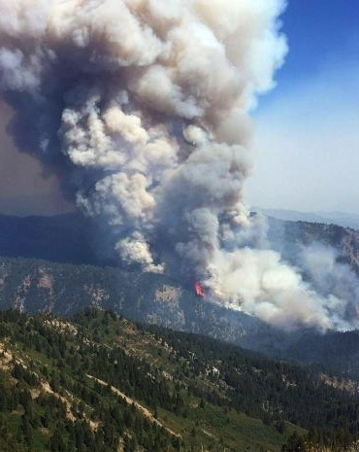
Moving to a Unified Fire CONOPs
What capabilities do we have?
Where do we have information gaps?
How are we managing the data (inputs)?
Are the investments sustainable?
Notes:
Requirements - coverage, area, reflectance, timeframe, do we need it every minute on the hour, daily pass what kind of data do we need?
real-time coverage of data of fire boundary - what can our technology actually provide us. COST.
return on investment cross with capability - what we can do and what are the cost requirements
How does the business need drive the funding source, SUSTAINABLE - how does this grow and develop in its own way
The Integrated Reporting of Wildland-Fire Information (IRWIN) service is a Wildland Fire Information and Technology (WFIT) affiliated investment, intended to provide an "end-to-end" fire reporting capability. IRWIN is tasked with providing data exchange capabilities between existing applications used to manage data related to wildland fire incidents. IRWIN is focused on the goals of reducing redundant data entry, identifying authoritative data sources, and improving the consistency, accuracy, and availability of operational data.

Slide 7
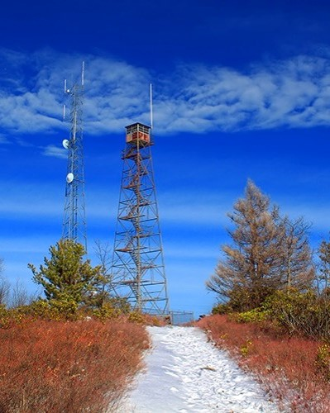
Remote Sensing and Wildland Fire
Fire Phases
Remote Sensing Tools
Pre Fire
Fuels, terrain, weather, assets at risk
Fire Ignition (starts)
Where are the ignition points?
Active Fire
Fire perimeter, hot spots, intense fire
Post Fire
Fire severity
Manned Aircraft
NIROPS
Unmanned Aircraft
Satellite systems
MODIS / VIIRS
Ground observation
Manned towers
Unmanned towers

Slide 8
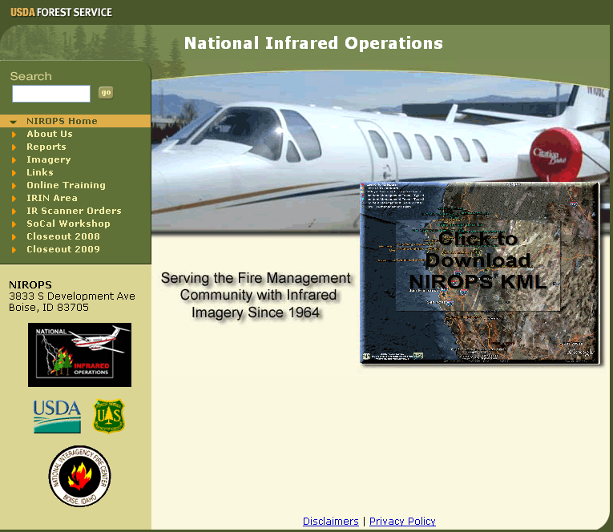
Current Capabilities - NIROPS
“NIROPS” - National Infrared Operations
Large scale fire detection/mapping to support incident command operations
Continuous operational deployment since 1967
http://nirops.fs.fed.us
Notes:
The Forest Service has been a leader in the development of infrared technology for wildland fire detection.
With the support of NASA, US Army Aviation and Missile Command, and private industry we have continuous developed and evaluated infrared technology since 1962.
RSAC/RDAS provides several operational support functions to NIFC and NIROPS
PHOENIX Thermal Infrared System
Provide technical assistance
Online IR Ordering System
Maintenance and updates
Updates based on user feedback
IR Interpreter Training
Assistance with S443 course as instructors
Maintain S443 on-line pre-work modules
Incident support as Infrared Interpreters

Slide 9
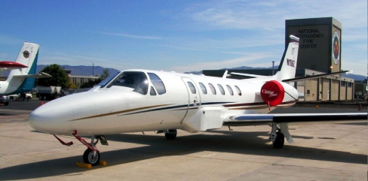
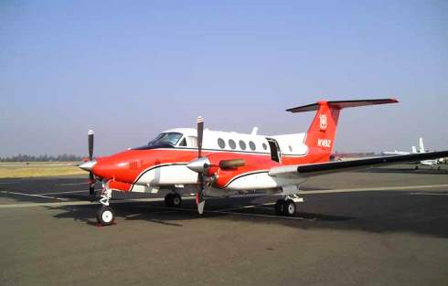
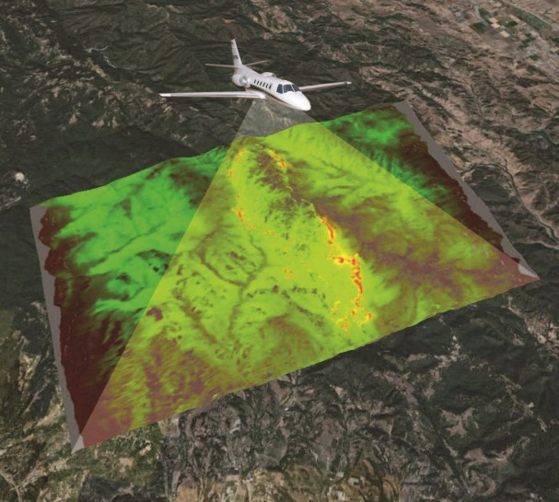
Current Capabilities - NIROPS
NIROPS Fire Mapping
144Z Cessna Citation Bravo II
2 Forest Service aircraft
3 Phoenix Imaging Systems
2 thermal bands (3-5µm, 8-12µm)
120° field of view
6 mile swath at 10,000 ft AGL
Ortho-imagery delivered via Aircell
Can image 300,000 acres per hour
Supplemental support via Aircraft 3
Overhead support ordered by the incident
Both aircraft use the Aircell telecommunications system to downlink acquired imagery to an FTP site
149Z Beechcraft Super King Air 200

Slide 10
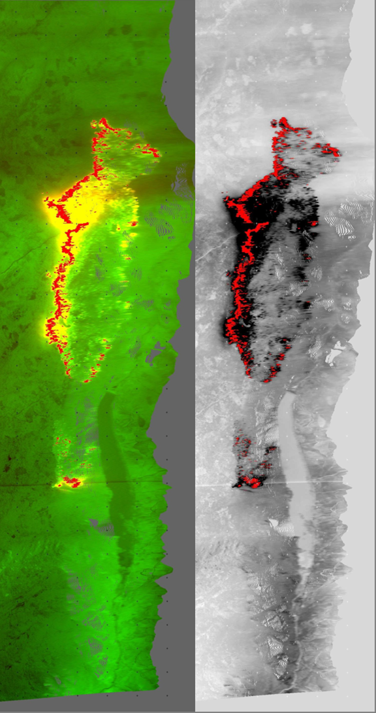
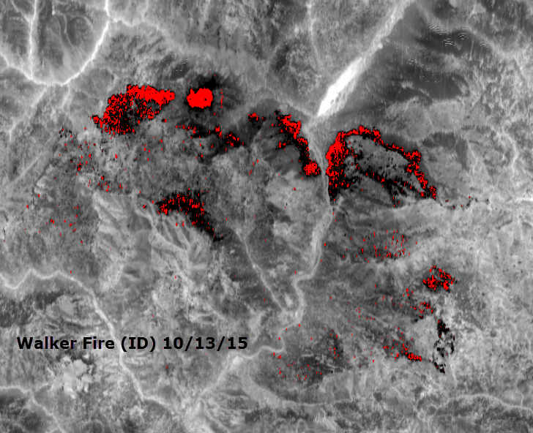
Current Capabilities - Phoenix Products
8-bit (0-255) imagery
255 pixel tagged red
3.5-meter pixels at nadir at 10,000 ft. AGL
Nominal swath width of 6 miles at 10,000 ft. AGL

Slide 11
Current Capabilities – National Systems*
Firehawk Fire Mapping Capability
The Firehawk capability provides large scale fire detection/mapping support to incident command operations. The Firehawk unclassified product is intended to have the same “look and feel” as products from NIROPS.
Hawkeye Fire Detection and Reporting System
The Hawkeye Fire Detection and Reporting System uses airborne and space borne remote sensing assets to rapidly detect and report new fire starts within the continental United States.
Detected fire starts are relayed to the Ignition Point Database (IgPoint) operated and managed by the Forest Service.

Slide 12
Current Capabilities - NIROPS
2016 Statistics
5.4 million acres mapped, 77% of the ten year average (2006-2015)
Slow start to the season
Late season (Nov) in Southern Area
More IR requests in CO, NM, AZ and WY than previous few years

Slide 13
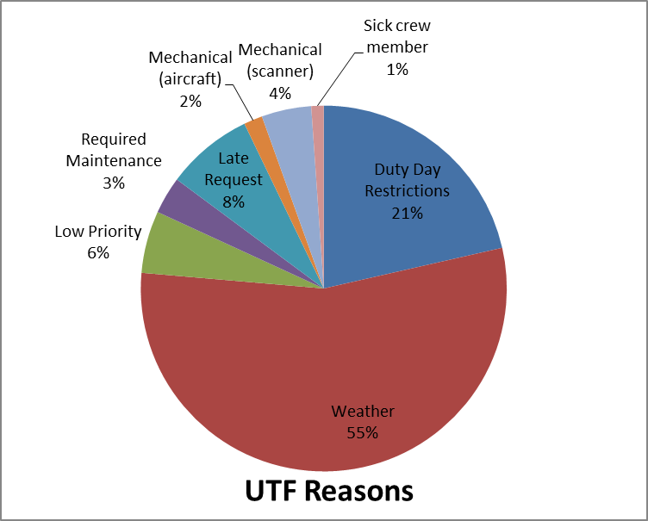
Current Capabilities - NIROPS
UTFs (Unable to Fill)
182 total UTFs (NIROPS only)
UTF rate drops from 10% to 4% when weather UTFs are not counted
UTF for Aircraft 3 - 17% (10% non-weather)

Slide 14
Looking Ahead
Continued engagement with key people throughout the fire community, the federal agencies and the DoD/IC community to ensure that information needs are well-articulated and efforts are being made to fill identified gaps.
Adding a third aircraft (an ongoing discussion)
King Air B200
Equipped with pod and Aircell
“Multi-mission” aircraft
Sensor systems (efforts ongoing)
NASA AMS Wildfire Instrument
Flown on Ikhana UAS in 2007-2009
16-channel line scanner system
NASA WAI Sensor
Wide Area Imager
Continue spiral development of unmanned airborne use in fire

Slide 15
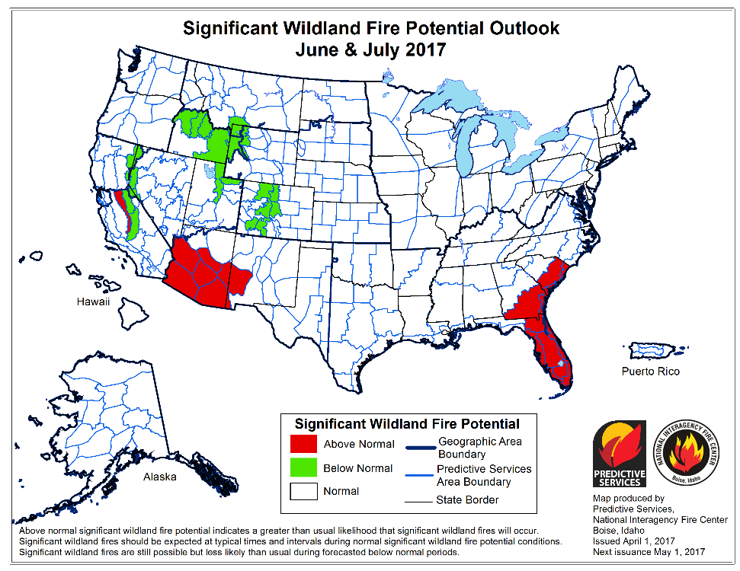
Questions?

