Slide 1
COAlition Testbed Public Safety UAS Testbed
Wildland Firefighters Welcome

Slide 2
Testbed Experience

Slide 3
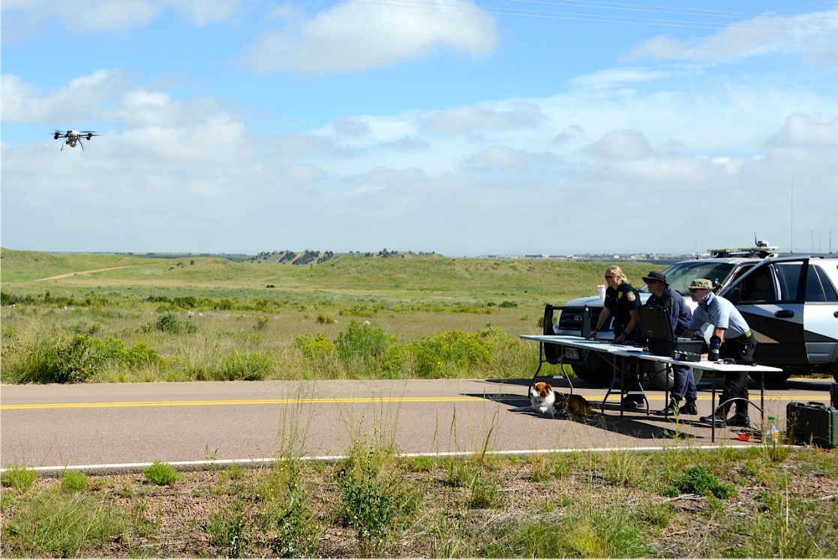
NIJ Cooperative R&D SUAS for Accident Scene Clearance

Slide 4
Common Strategy

Slide 5
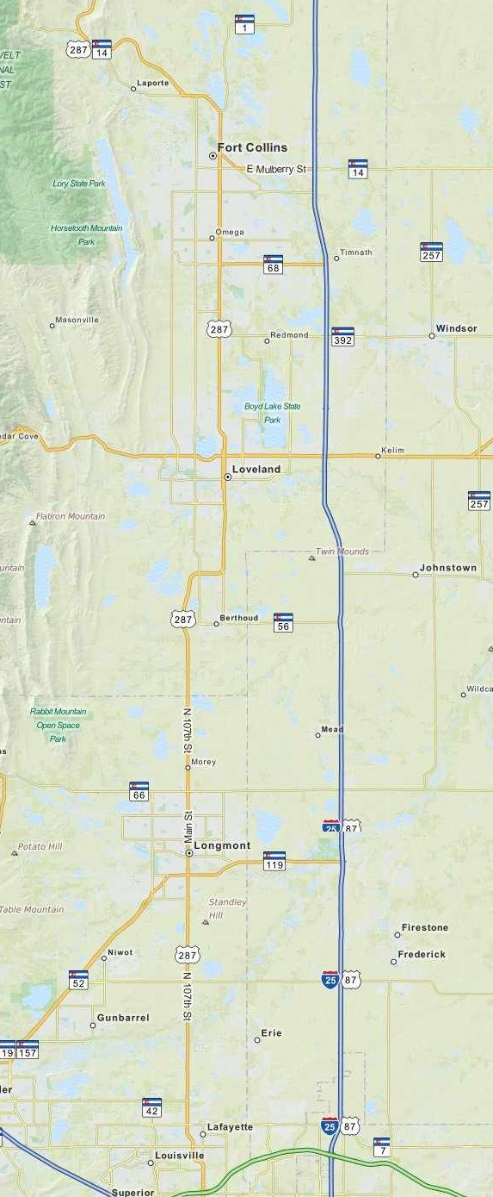
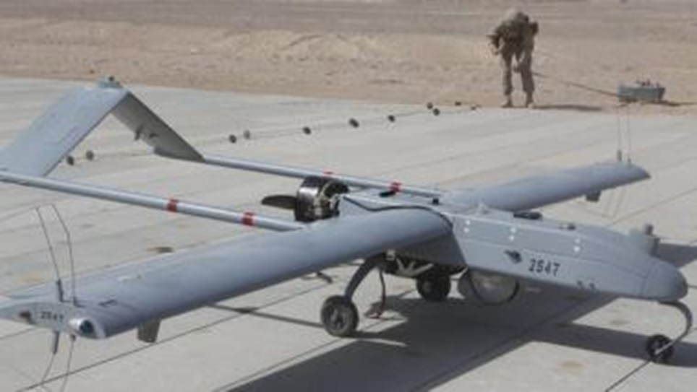
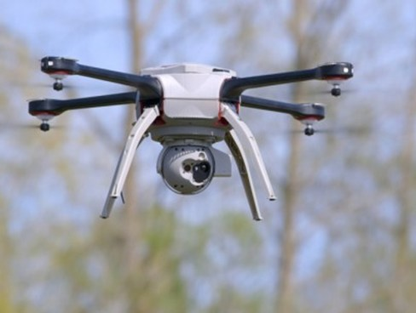
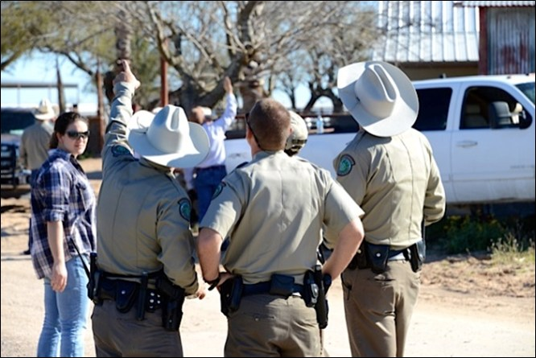
PS UAS Testbed Not quite there, yet...

Slide 6
Partners & Goals
3 LEA’s, 2 Fire Services
Targeted Domains
Situational Awareness (SA)
Photogrammetry & Remote Sensing (P&RS)
Communications Operability & Interoperability
Targeted/Required Functions
Incident Command - SA
Forensics & Analysis/Modeling - P&RS
Frequency Coordination - Comms
Airspace Management - Deconfliction
Fireground C2?

Slide 7
Invitation to Play
C’mon Down!
Anticipated kickoff this Summer
With an associated event...

Slide 8
UAS Partnerships Key Enablers (from 2011)
Understanding Public Safety’s Unique Requirements
Including Feedback to Industry to Develop Appropriate Technology
Developing the Value Proposition – WIFM?
Support for Safe and Orderly Adoption
Developing CONOPS - Integrating UAS into Operations
Outreach and Education - Including UAS adopters’ communities for 4th Amendment concerns
Honest Broker Technical Support
Risk Management and Liability Protection/ Insurance
Notes:
No particular order

Slide 9
Contact Us
Contact us via any of the media below.
Our UAV consultants are available and will immediately begin helping you define your UAS/RPAS requirements whilst planning to fulfill them.
General Enquiries. T: +1 (334) 578 2900 F: +1 (334) 460 8111
admin@unmannedexperts.com
www.unmannedexperts.com
Training. T: +1 (334) 717 0031
training@unmannedecperts.com
Americas:. T: +1 (334) 717 0031
kagambold@unmannedexperts.com
Europe & Rest of World. T: +44 (0) 7897 855 323
paulrolfe@unmannedexperts.com
Australasia. T: +61 (0) 407 292922
npmeadows@unmannedexperts.com
Business Development. T: +44 (0) 7702 085939
phil.hoole@unmannedexperts.com
We look forward to working with you.
This a time of great opportunity in the unmanned sector, let us help you seize it.

Slide 10
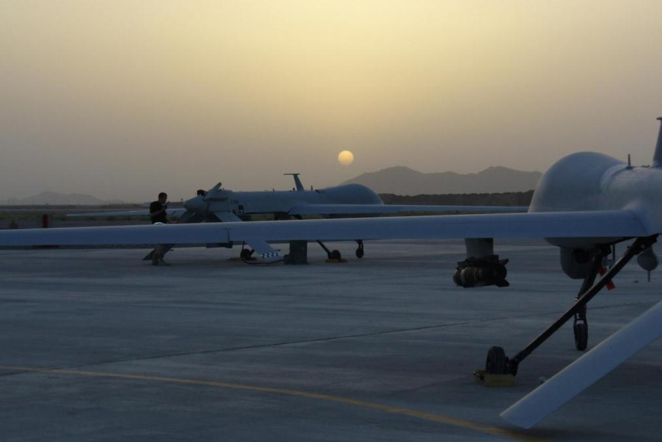
End of Brief

