Slide 1
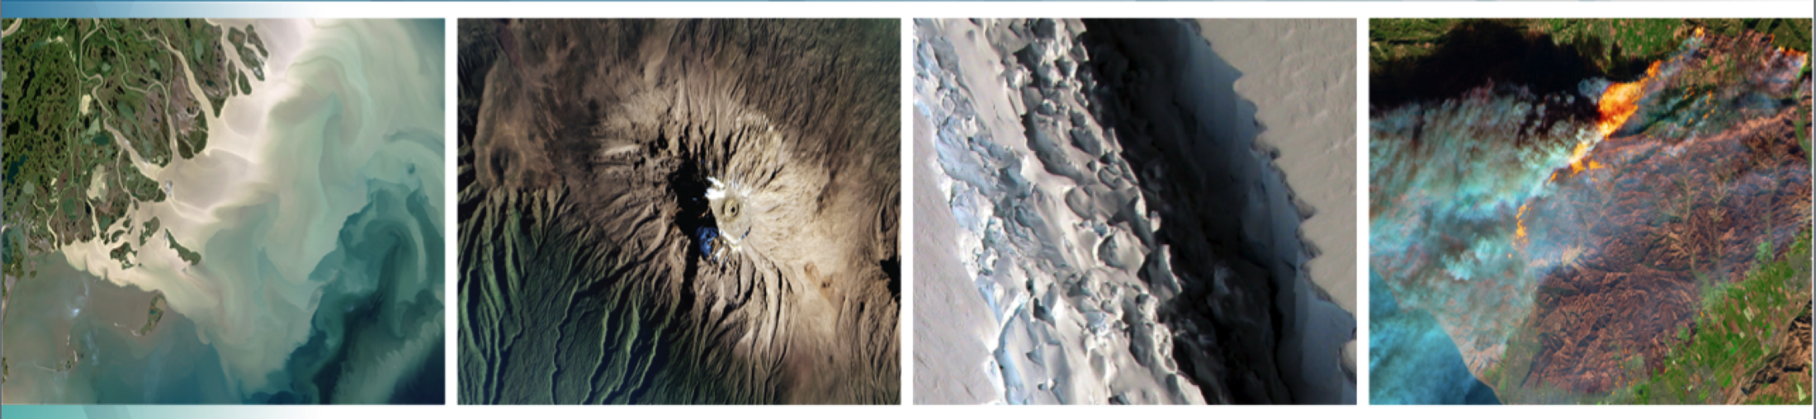
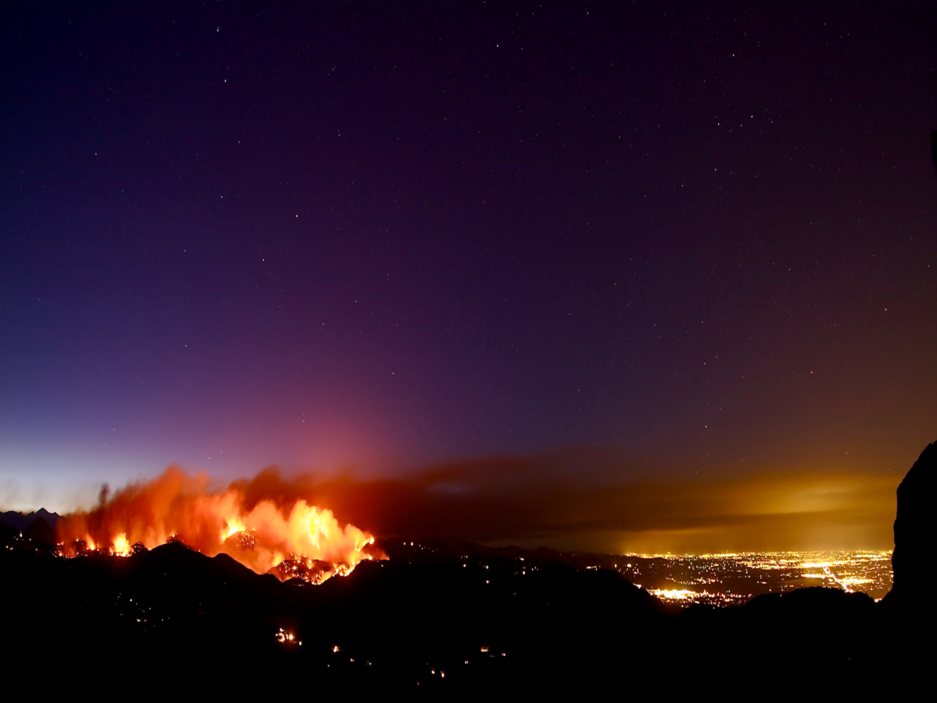


Welcome to the:
Thirty-Third Tactical Fire Remote Sensing
Advisory Committee (TFRSAC) Meeting
Hosted By:
USDA-Forest Service: Everett Hinkley
NASA Applied Science Program: Vince Ambrosia
18-19 November 2020
WebEx Virtual Meeting

Slide 2
Meeting Logistics
Please keep your connections on MUTE during all presentation times;
Tomorrow’s (Thursday) WebEx connection is different than today’s
Please post questions in Chat to presenters or contact presenters after meeting;
We will provide all contacts for attendees (email addresses of participants) post-meeting;
Presentations will be made available to all participants (author permitting) after the meetings. We will provide a link to the access point.
For issues today / tomorrow call POCs:
Vince Ambrosia cell: 408-666-7609
    Everett Hinkley cell: 801-455-8764

Slide 3
Objective / Goals of TFRSAC Meeting
OBJECTIVES
  Share wildfire EO capabilities (spaceborne, airborne, in-situ, and geospatial tools) amongst community of scientists, practitioners and management entities;
  Inform on partner affiliated programs (NASA, USFS, JFSP, DOI, DoD / Intelligence Community, Universities, NGOs, Private orgs., etc.);
  Encourage Collaborations!
GOALS
  Build new relationships / knowledge;
  Be exposed to new ideas / concepts; Learn something new today and tomorrow!
  Walk away from the meeting with a sense of accomplishment and energy for the coming year in improving fire management practices!

Slide 4
TFRSAC Agenda: 18 Nov
11:00 AM (EDT) Meeting Start (Session 1 Presentations)
Welcome and Introductions / Logistics (20) Hinkley / Ambrosia
NIFC / NIROPS / F&AM Update (20) Kuo / Mellin / Triplett
U.S.F.S. Update (20) E. Hinkley
NASA Update (10) V. Ambrosia
NASA Disaster Program and Portal (30) B. Helms / J. Kirkendall USGS Fire Program Update (20) P. Steblein
1:00 – 1:30 PM Break (30 min)
SESSION 2 Presentations
Thermal Working Group Update (20) R. Cornelius / W. Idle Canada Update: FireSat (15) J. Johnson
Pyrogence Consortium Update (15) D. Saah
CalFire Update (20) P. SeLegue
SpatioTemp Trends in Fire in Western. U.S. K. Weber
2:55 – 1:15 PM Break (20 min)

Slide 5
TFRSAC Agenda: 18 Nov (cont.)
3:15 PM EDT Session 3 Presentations
Ops Implementation of the xView2 algorithms N. Patel / R. Gupta
in the 2020 CA. Fire Season (15)
GOES Fire Detections (15) C. Schmidt
Use of USFS Prescribed Burn Policy in the Sierra Nevada (15) R. Bernknopf
Use of R. S.-based ET and Evaporative Stress Index
to Assess Pre- / Post-fire Veg Status (15) M. Pascolini-Campbell
4:30 PM Wrap-Up & Adjourn

Slide 6
TFRSAC Recap: 11-18-20
Partner Agency Status Updated (USFS, NIROPS, NASA, CalFire, Canada)
Civil Applications Committee / Thermal Working Group Updates
Evans Kuo update NIROPS NextGen (requirements matrix, understanding requirements from for management community);
UAS activity updates:
  Drones in FTAs
  UAS for post-fire mapping / fuel modeling;
  Distributed ISR with sUAS
  STEReO
Innovative fire observation tools:
  Radar for fire mapping
  WDLN Data Ferry System
  Small Sats
  Fire mapping Analytics

Slide 7
TFRSAC Agenda: 19 Nov
11:00 AM (EDT) Day 2 Meeting Start (Session 4 Presentations)
Welcome and Day 1 Recap (20) Hinkley / Ambrosia
Machine Learning: Smoke Detection From Cameras (20) Kinshuk Govil
Deploying the Team Awareness Kit on Wildland
Fires: From 2020 and looking forward (20) Brad Schmidt
LTA aircraft in Support of Wildland Fire Management (15) A. Weston
Improving Fuel Loading for Fire Emissions & Smoke N. French Modeling and Mapping (15)
12:30 – 1:00 PM Break (30 min)
1:00 PM EST (SESSION 5 Presentations)
Enhancing Wildfire Resilience in AK Through L/C Mapping Chris Waigl
with Hyper & Multispectral RS (15)
GeoCollaborate – Support to California Civil Air Patrol Dave Jones
Microwave & Optical Remote Sensing for Fire Detection (15) Kumar / Bolton
Wild Field of View Program (15) R.J. Francies (SMC)
Wildfire Interdisciplinary Research Center (WIRC SJSU) C. Clements
Mapping Tree Mortality as a Function of Canopy Cover Reduction D. Hamilton

Slide 8
TFRSAC Agenda: 19 Nov (cont.)
2:30 PM EDT Break (20 Minutes)
2:50 PM EDT SESSION 6 Presentations (15 min. each)
S/W to Output Fire Behavior Metrics For Airborne Imagery (15) Miguel Valero
Wildfire Battle Mgmt. & Tailored Overhead Sensor Layer (15) Bret Perry
Wildfire SAFE (15) Matt Jolly
Damage Assessment Using ArcGIS and Commercial Imagery (15) Matt Lemaire
NASA STEReO Effort Joey Mercer
4:35 PM EDT Wrap-up (25) Hinkley / Ambrosia
5:00 PM EDT Adjourn

