Slide 1
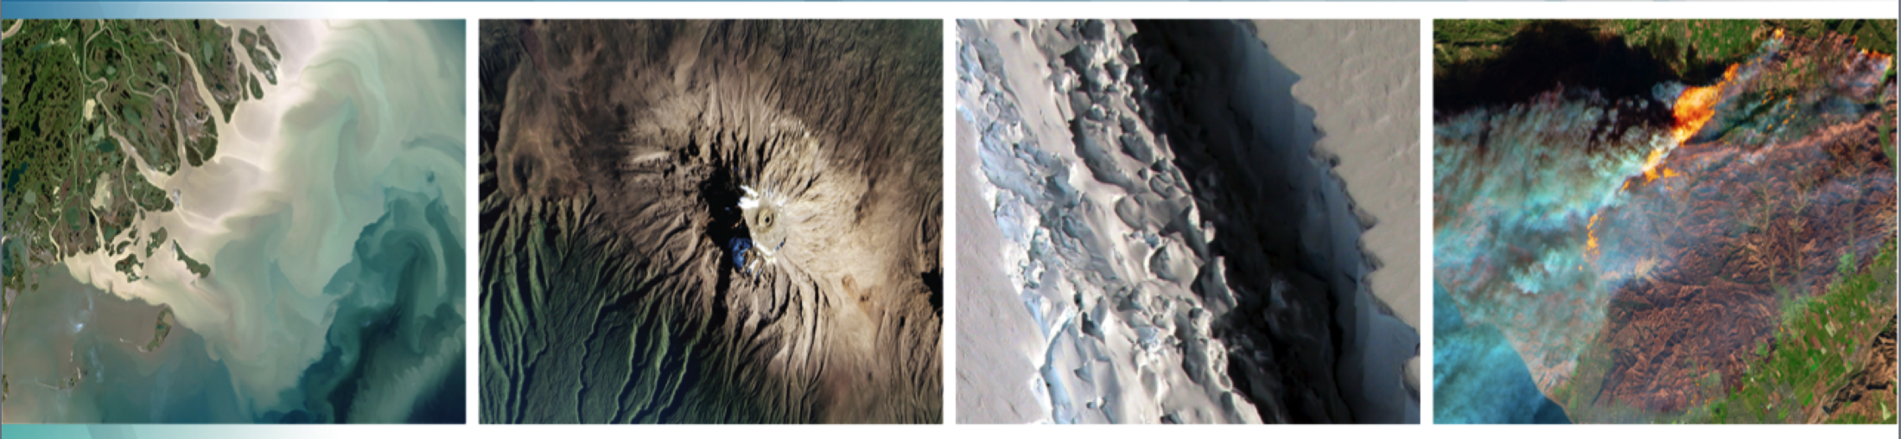
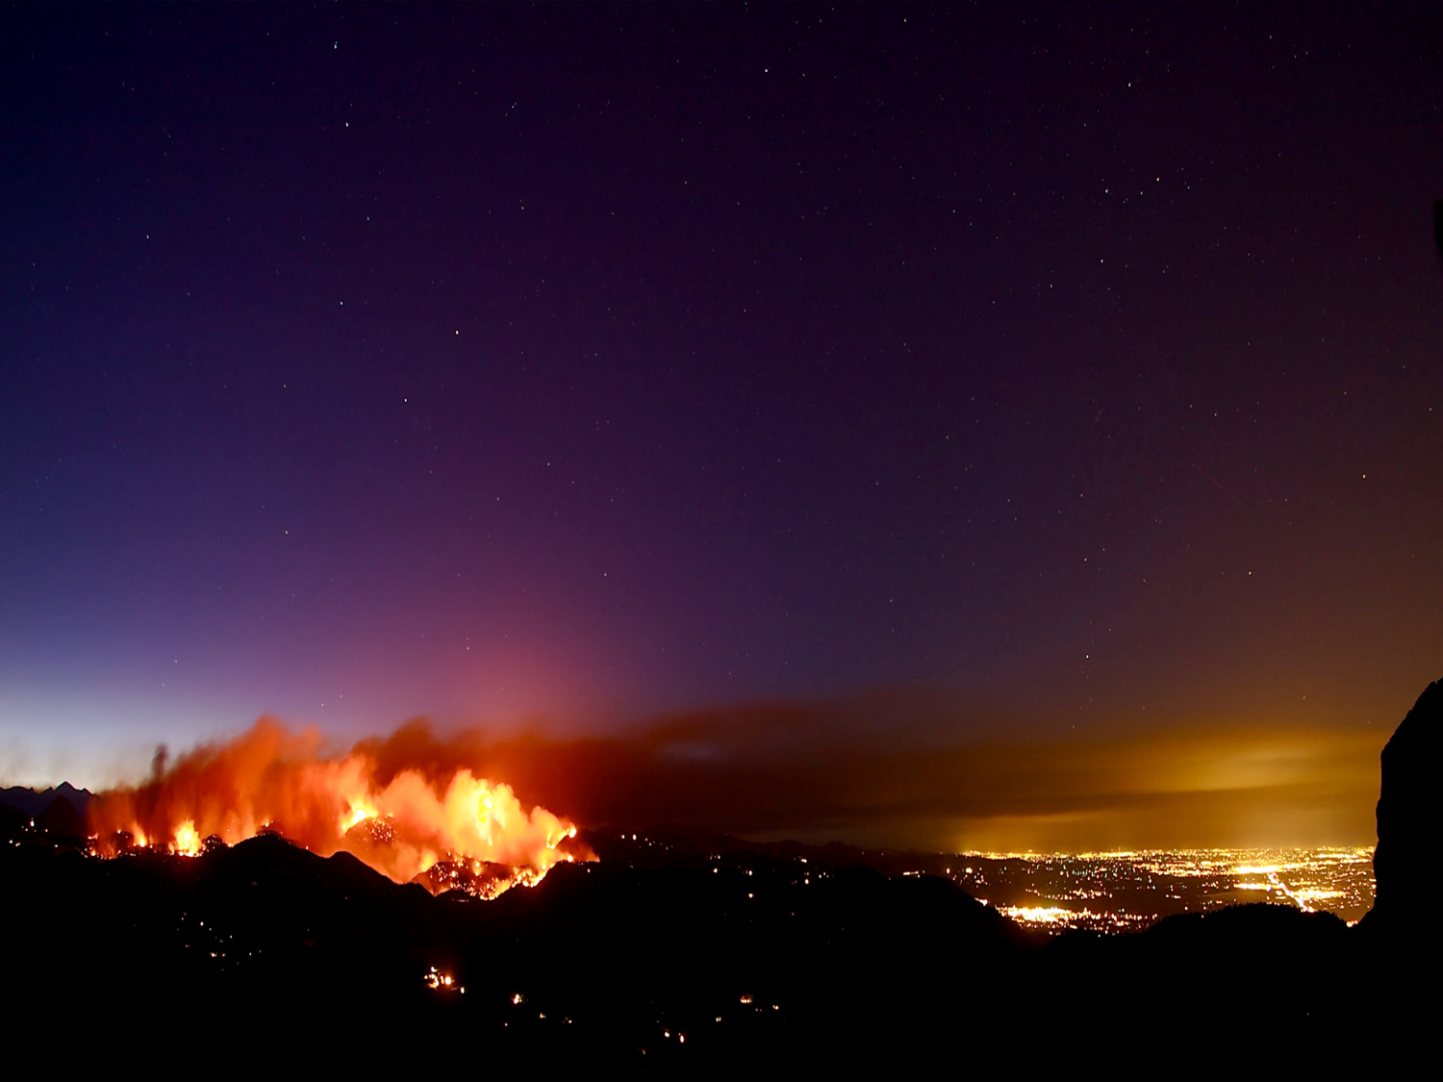


Welcome to the:
Thirty-Third Tactical Fire Remote Sensing
Advisory Committee (TFRSAC) Meeting
Hosted By:
USDA-Forest Service: Everett Hinkley
NASA Applied Science Program: Vince Ambrosia
18-19 November 2020
WebEx Virtual Meeting

Slide 2
Meeting Logistics
Please keep your connections on MUTE during all presentation times;
Tomorrow’s (Thursday) WebEx connection is different than today’s
Please post questions in Chat to presenters or contact presenters after meeting;
We will provide all contacts for attendees (email addresses of participants) post-meeting;
Presentations will be made available to all participants (author permitting) after the meetings. We will provide a link to the access point.
For issues today / tomorrow call POCs:
Vince Ambrosia cell: 408-666-7609
    Everett Hinkley cell: 801-455-8764

Slide 3
Objective / Goals of TFRSAC Meeting
OBJECTIVES
  Share wildfire EO capabilities (spaceborne, airborne, in-situ, and geospatial tools) amongst community of scientists, practitioners and management entities;
  Inform on partner affiliated programs (NASA, USFS, JFSP, DOI, DoD / Intelligence Community, Universities, NGOs, Private orgs., etc.);
  Encourage Collaborations!
GOALS
  Build new relationships / knowledge;
  Be exposed to new ideas / concepts; Learn something new today and tomorrow!
  Walk away from the meeting with a sense of accomplishment and energy for the coming year in improving fire management practices!

Slide 4
TFRSAC Agenda: 18 Nov
11:00 AM (EDT) Meeting Start (Session 1 Presentations)
Welcome and Introductions / Logistics (20) Hinkley / Ambrosia
NIFC / NIROPS / F&AM Update (20) Kuo / Mellin / Triplett
U.S.F.S. Update (20) E. Hinkley
NASA Update (10) V. Ambrosia
NASA Disaster Program and Portal (30) B. Helms / J. Kirkendall USGS Fire Program Update (20) P. Steblein
1:00 – 1:30 PM Break (30 min)
SESSION 2 Presentations
Thermal Working Group Update (20) R. Cornelius / W. Idle Canada Update: FireSat (15) J. Johnson
Pyrogence Consortium Update (15) D. Saah
CalFire Update (20) P. SeLegue
SpatioTemp Trends in Fire in Western. U.S. K. Weber
2:55 – 1:15 PM Break (20 min)

Slide 5
TFRSAC Agenda: 18 Nov (cont.)
3:15 PM EDT Session 3 Presentations
Ops Implementation of the xView2 algorithms N. Patel / R. Gupta
in the 2020 CA. Fire Season (15)
GOES Fire Detections (15) C. Schmidt
Use of USFS Prescribed Burn Policy in the Sierra Nevada (15) R. Bernknopf
Use of R. S.-based ET and Evaporative Stress Index
to Assess Pre- / Post-fire Veg Status (15) M. Pascolini-Campbell
4:30 PM Wrap-Up & Adjourn

Slide 6
TFRSAC Recap: 11-18-20
Partner Agency Status Updated (USFS, NIROPS, NASA, CalFire, Canada)
Civil Applications Committee / Thermal Working Group Updates
Evans Kuo update NIROPS NextGen (requirements matrix, understanding requirements from for management community);
UAS activity updates:
  Drones in FTAs
  UAS for post-fire mapping / fuel modeling;
  Distributed ISR with sUAS
  STEReO
Innovative fire observation tools:
  Radar for fire mapping
  WDLN Data Ferry System
  Small Sats
  Fire mapping Analytics

Slide 7
TFRSAC Agenda: 19 Nov
11:00 AM (EDT) Day 2 Meeting Start (Session 4 Presentations)
Welcome and Day 1 Recap (20) Hinkley / Ambrosia
Machine Learning: Smoke Detection From Cameras (20) Kinshuk Govil
Deploying the Team Awareness Kit on Wildland
Fires: From 2020 and looking forward (20) Brad Schmidt
LTA aircraft in Support of Wildland Fire Management (15) A. Weston
Improving Fuel Loading for Fire Emissions & Smoke N. French Modeling and Mapping (15)
12:30 – 1:00 PM Break (30 min)
1:00 PM EST (SESSION 5 Presentations)
Enhancing Wildfire Resilience in AK Through L/C Mapping Chris Waigl
with Hyper & Multispectral RS (15)
GeoCollaborate – Support to California Civil Air Patrol Dave Jones
Microwave & Optical Remote Sensing for Fire Detection (15) Kumar / Bolton
Wild Field of View Program (15) R.J. Francies (SMC)
Wildfire Interdisciplinary Research Center (WIRC SJSU) C. Clements
Mapping Tree Mortality as a Function of Canopy Cover Reduction D. Hamilton

Slide 8
TFRSAC Agenda: 19 Nov (cont.)
2:30 PM EDT Break (20 Minutes)
2:50 PM EDT SESSION 6 Presentations (15 min. each)
S/W to Output Fire Behavior Metrics For Airborne Imagery (15) Miguel Valero
Wildfire Battle Mgmt. & Tailored Overhead Sensor Layer (15) Bret Perry
Wildfire SAFE (15) Matt Jolly
Damage Assessment Using ArcGIS and Commercial Imagery (15) Matt Lemaire
NASA STEReO Effort Joey Mercer
4:35 PM EDT Wrap-up (25) Hinkley / Ambrosia
5:00 PM EDT Adjourn

Slide 9


USDA Forest Service
Fire and Aviation Management
Fire Imaging Program
Evans Kuo evans.kuo@usda.gov

Slide 10
Infrared Missions for Fire Operations
FAM-Operations continues to focus on four IR mission types:
Detection
Large Fire Mapping
Tactical Incident Awareness and Assessment
Strategic Dashboard
Each mission has different requirements/capabilities. No “silver bullet”

Slide 11
Detection Mission
Detect new fire starts (lightning and human caused)
Early-warning to support rapid response and public safety
Platforms
  Fixed wing aircraft with EO/IR camera ball*
  Ignition Point in EGP
  FireFly w/ CalGuard and CO-Guard
Issues with satellite detection:
  False positives
  Fidelity (500m to 1KM spatial resolution)
  Availability of analysts

Slide 12
Detection Deliverables
Lat/Long coordinates of new starts
Metadata
  Size up information
  Staffed or not
  Proximity to values or roads
  Map perimeter if >10 acres
Pictures (RGB and IR)
Process to disseminate information
  Real-time data transfer (air-cell, sat-link, or radio)
  Notification to Dispatch Center
  Dashboard Display (NIFC-AGOL)

Slide 13
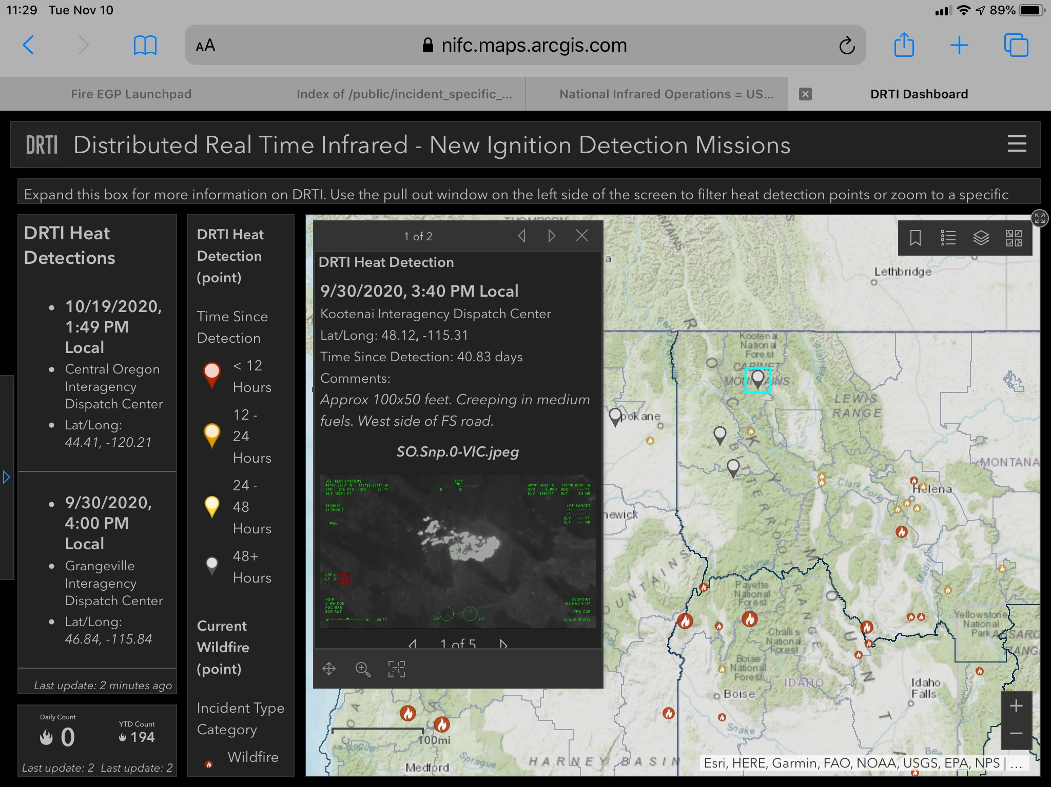

Slide 14
Large Fire Mapping Mission
National Infrared Operations (NIROPS)
  Map large fires at night
  Nation-wide scope
  Provide pdf map, KMZ/KML, GIS-ready shapefiles, IRIN log
NIROPS products and services are in high demand
Demand is increasing
2020 NIROPS Consisted of:
  (1) Agency
  (2) Exclusive Use
  (2) Call-When-Needed Contract
  (3) End Product Contract
Supplemented with:
  CO-MMA, AA-51, FireWatch Cobras, NG MQ-9, NG DRTI

Slide 15
Tactical IAA Mission
Tactical IAA and NIROPS are different “missions”
Different requirements/capabilities (some overlap)
Tactical IAA is more real-time application
Tactical IAA typically spends more time loitering over one fire
Persistent or Periodic Coverage
  Persistent: One platform assigned to one incident, such as Large UAS or short-range manned aircraft
  Periodic: One platform that can be assigned to multiple incidents, such as manned aircraft (speed and range)
Camera-ball paired with mapping software

Slide 16
Satellite Options
National Systems:
CONOPS approved for use
Support Detection, emerging fires, large fire monitoring
Strategic, not tactical
Issues:
  Coarse scale 500M to 1 KM
  <100,000+ acre fires
  Analyst support is limiting factor
Options:
  Additional analysts from partner agencies, i.e. NGB units
  Automation?
Commercial / HDDS Systems:
2018-2020 evaluated commercial imagery via HDDS sat systems for fire mapping
Some commercial systems capable of providing hi-fidelity imagery
Issues:
  Limited coverage
  Difficult to ‘task’ satellites
  12-24 hr latency
  Requires additional post-processing

Slide 17
Efforts to Support IR in 2021 and Beyond
Agency:
N149Z w/ Phoenix Next Gen
Business case to acquire (2) new B200GTs approved
Outfit AC with camera port and datalink system
Fall 2021?
Contract:
(2) Exclusive Use IR aircraft
Re-new End Product Contract for IR surge capacity
  Manned aircraft with EO/IR sensor(s)
  Multiple Line Items (Detection, NIROPS, Tactical IAA roles)
  Multiple awards

Slide 18
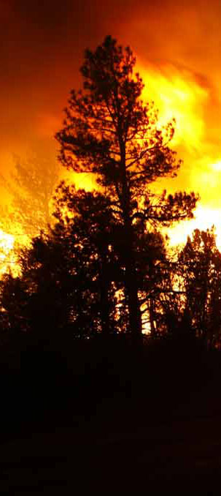
2020 NIROPS National Summary
Tom Mellin,
National Infrared Program Manager
November 18, 2020
TFRSAC

Slide 19
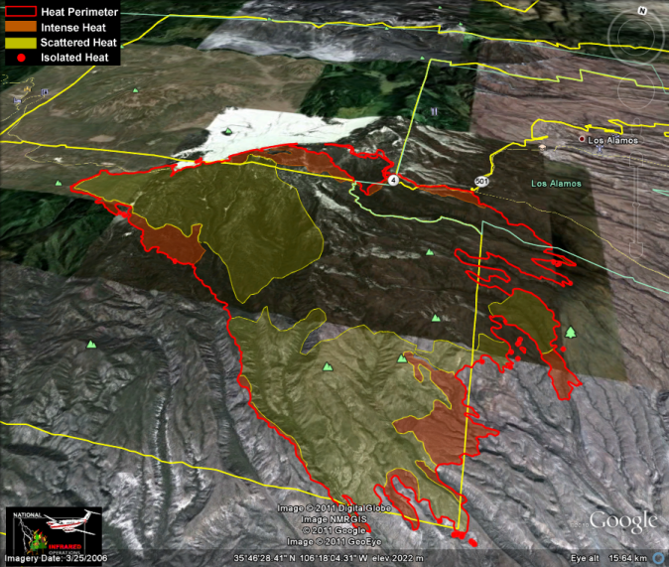
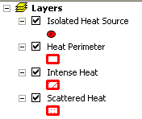
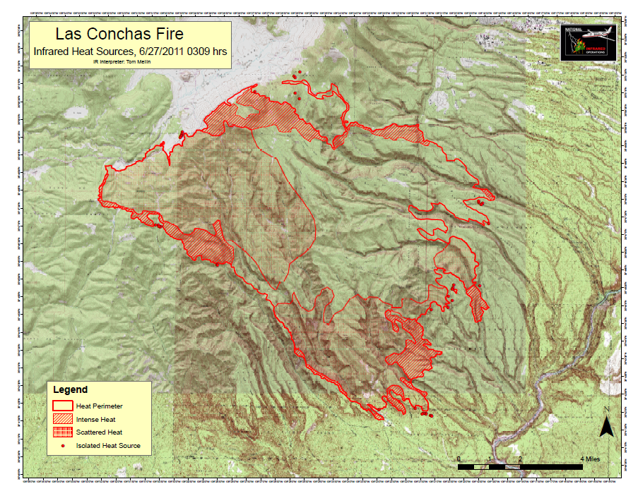
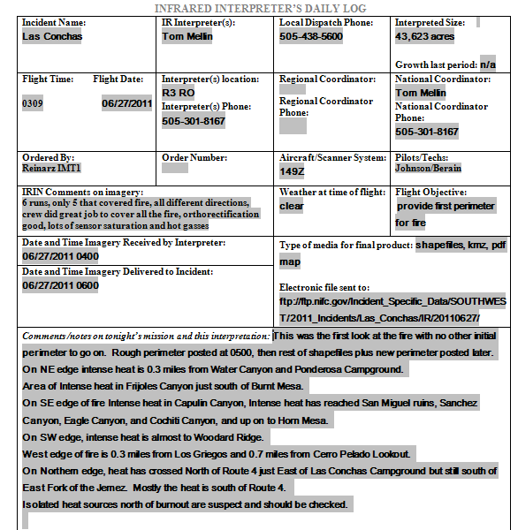
Products Delivered to Incident daily
Shapefiles, map, kmz, log
Notes:
Shapefiles for GISS to incorporate into other maps
Maps and kmzs for non-GIS folks (Ops, SITL, plans Chief, FBAN) to view information
Log acts as a briefing to discuss fire growth, imagery issues, and provides documentation
These are internal products delivered to the IMT in time for morning briefing 6am, more typically by 0400/0430.

Slide 20
2020 – A Long Season
8.73 million acres burned, 2% acres in AK
126% of the ten-year US average (2010-2019)
150% of the ten-year CONUS average
PL4 on 8/4, PL5 8/19-10/2, PL4 thru 10/13
First missions – June 1st in AZ
Last mission – Nov 12th?
Acres from IMSR 11/12/20
*PL = Preparedness Level (1 thru 5)
Notes:
2020 – 71 days at PL4/5
2019 – 4.6 million acres (56% in AK) 70% of 10 yr avg, never went to PL4 for first time since 2010
2018 – 8.8 million acres 132% of 10 yr avg, 49 days at PL 4/5

Slide 21
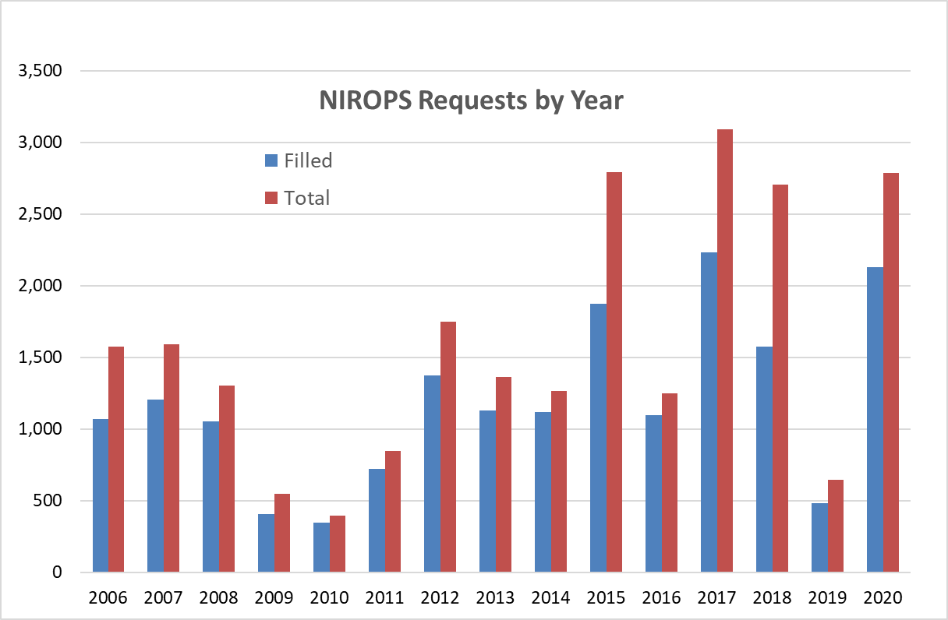
2020 NIROPS Requests
2,790 total requests with 2,128 filled
10 yr avg (2010-2019) 1,610 requests and 1,195 filled
5 yr avg (2015-2019) 2,096 requests and 1,452 filled
24% UTF rate,
20% non-Wx UTF
Aircraft 3 filled
2% of missions
Notes:
Numbers are current as of 11/12/20.
2018 – 42% UTF, 33% non-Wx UTF
2019 – 25% UTF, 13% non-Wx UTF

Slide 22
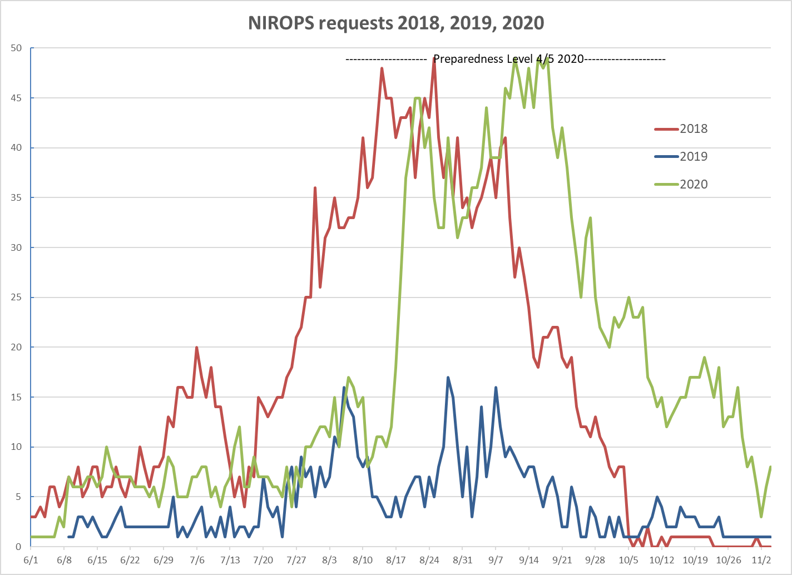
Notes:
2017 peak was 69 requests
2015 peak was 63 requests

Slide 23
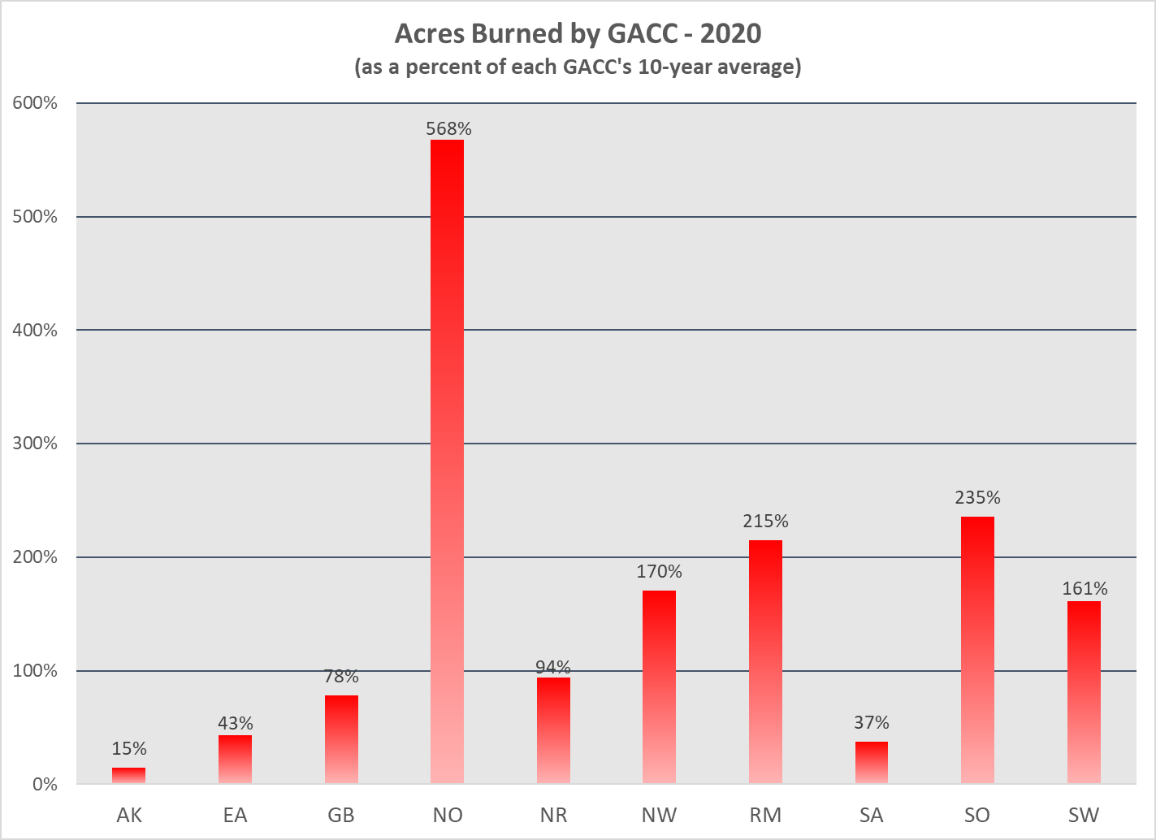
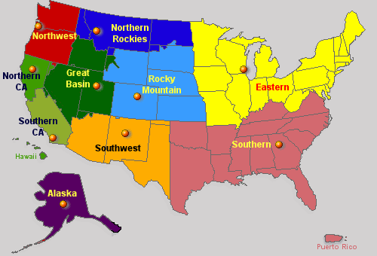
Fire Activity by GACC
Acreages from IMSR 11/12/20
Notes:
Acreages from IMSR 11/12/20

Slide 24
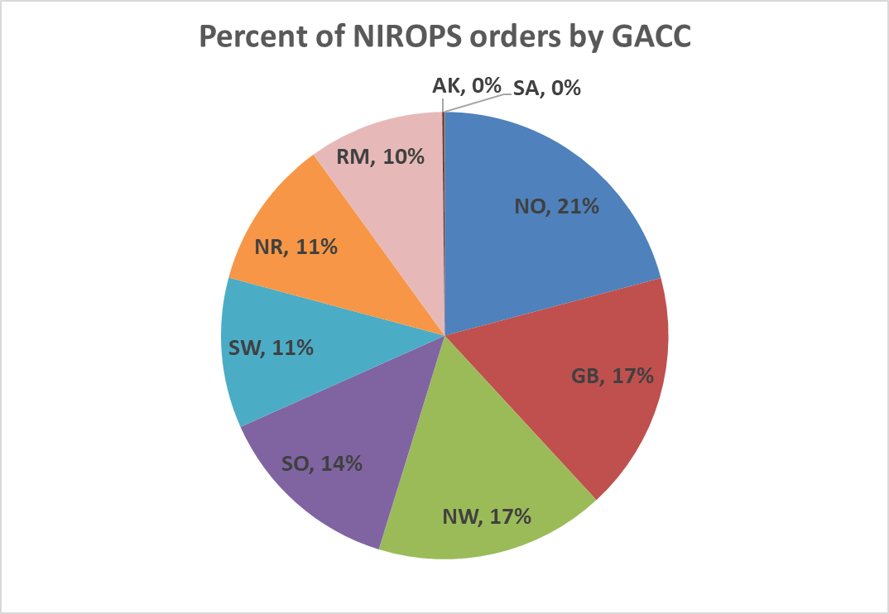
2020 – Orders by GACC

Slide 25
“Busiest” Night – Sept 5th, 38 Fires
N149Z (20 fires)
  Cameron Peak, Williams Fork (CO)
  East Fork, Phinney Lake, Center Creek Trail (UT)
  Double, Marion, Beaver, Buck, Shissler, Mocus Point, Porphyry, Warm Springs, Sponge (ID)
  State Creek, Bobcat, Bridger Foothills, Rice, Snider, Cinnabar (MT)
Courtney (3 fires)
  SQF Cx, Creek, Slink (CA)
Tenax (6 fires)
  LNU Cx, BTU/TGU Cx, MNF August Cx, North Cx, Sheep, Woodward (CA)
Owyhee (5 fires)
  Hobo, Red Salmon, W-5 Cold Springs, CZU August Cx, Dolan (CA)
Hood Tech (3 fires)
  Beachie Creek, Lionshead, White River (OR)
Kolob (1 fire)
  Evans Canyon (WA)
Notes:
2019 Busiest night was 8/6 with 16 fires flown
2018 Busiest night was 8/23 with 40 fires flown
2017 Busiest night was 9/1 with 48 fires flown

Slide 26
IR Mapping Contracts
Exclusive Use – Tenax
End Product
  Courtney Aviation
  Kolob Canyon
  Hood Tech
MAP – Owyhee Air

Slide 27
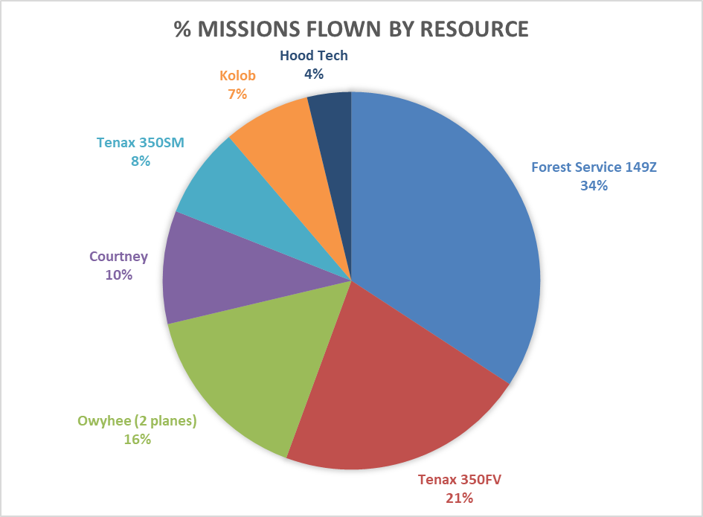
All Hands On Deck

Slide 28
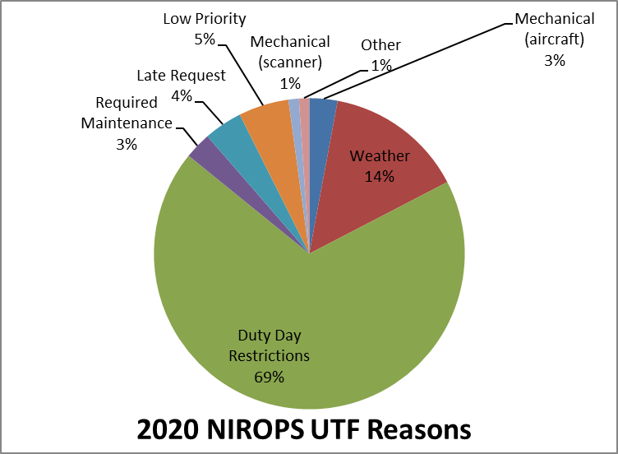
UTFs (Unable to Fill)
650 total UTFs (NIROPS only)
UTF rate drops from 24% to 20% when weather UTFs are not counted
UTF for Aircraft 3 - 21%
Notes:
2019 – weather 51%, Mechanical aircraft 29%
2018 – mechanical aircraft 28%, required maintenance 24%, weather 22%
2017 – mechanical aircraft 31%, weather 25%
2016 – weather 43%, 6% non-weather UTF rate
2015 – duty day restrictions 45% due to pilot staffing issues, 26% non Weather UTF rate

Slide 29
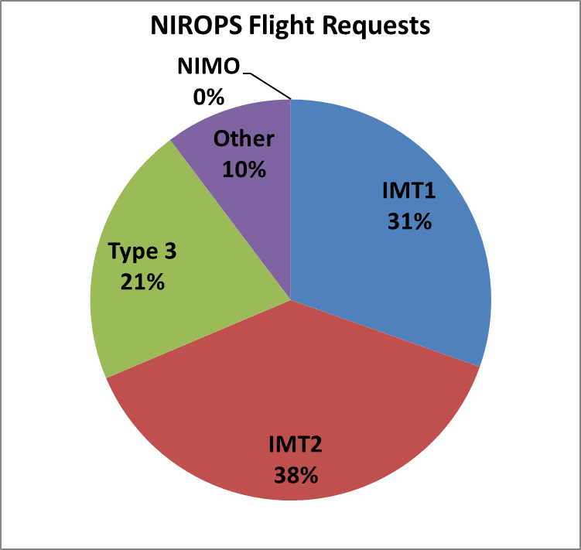
Who is Requesting?
Prioritization is key
Notes:
2019 – IMT1 18%, IMT2 33%, IMT3 36%, Other 12%, NIMO 1%
2018 – IMT1 29%, IMT2 35%, IMT3 22%, Other 12%, NIMO 2%

Slide 30
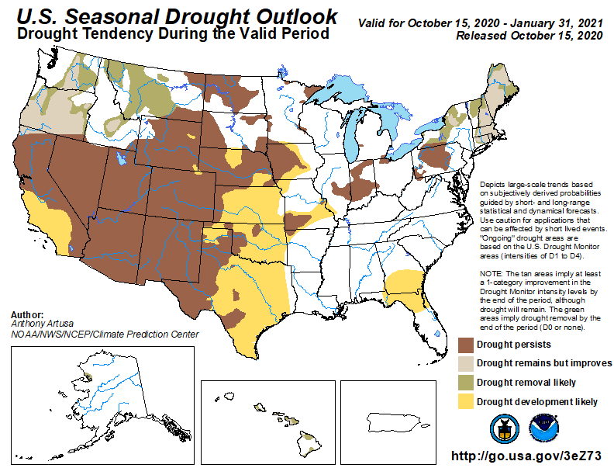
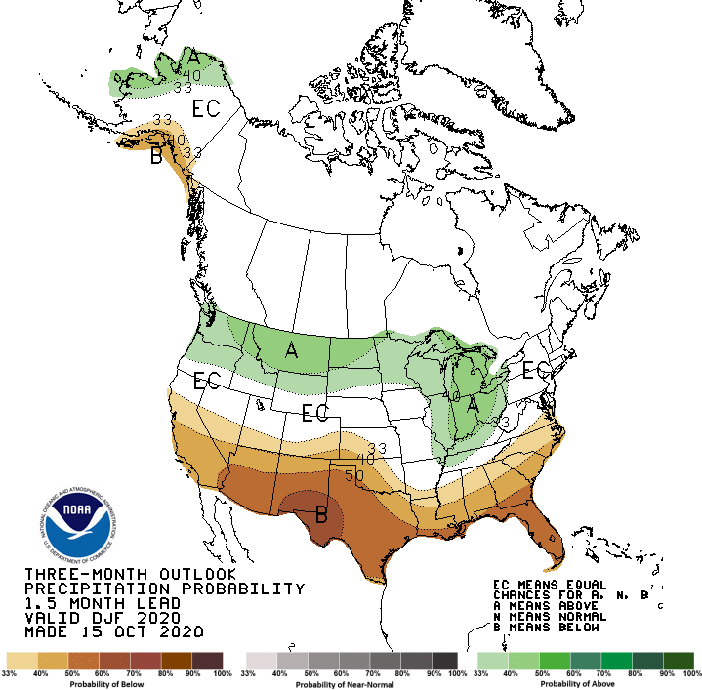
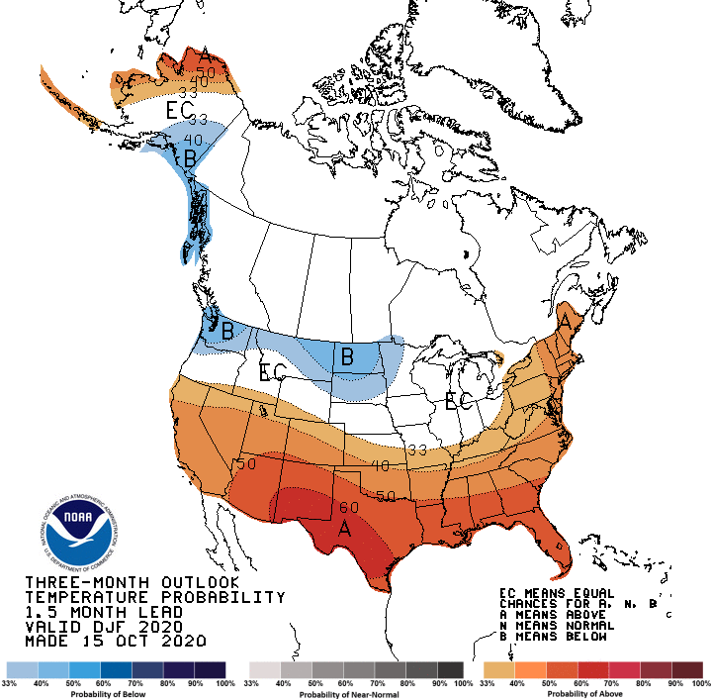
Looking ahead to 2021
Significant La Niña Event
xxx.

Slide 31
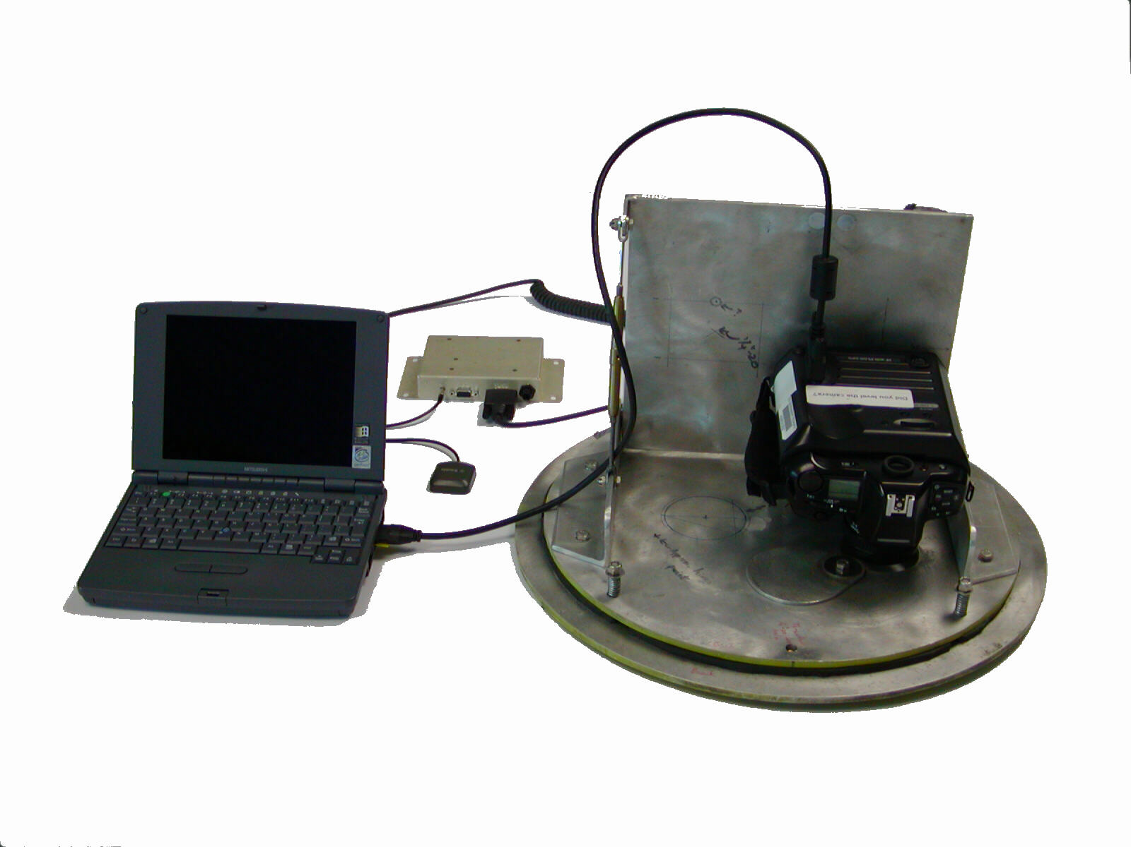
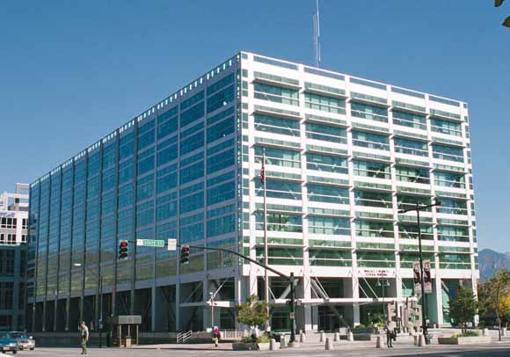
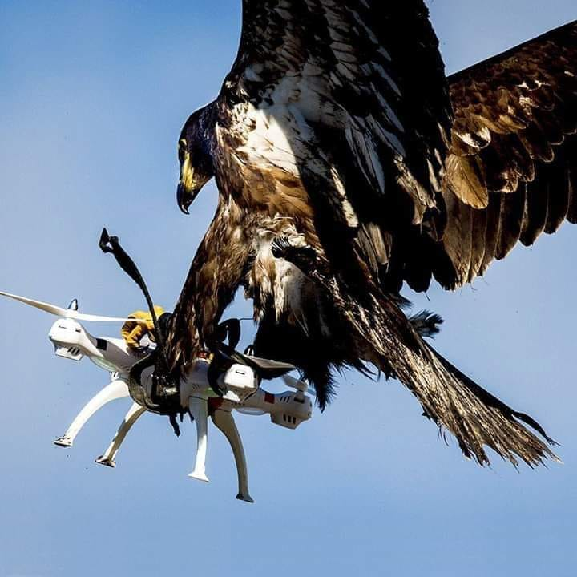


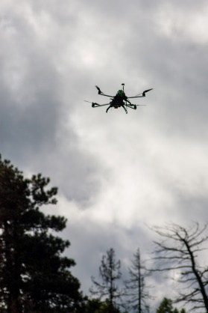
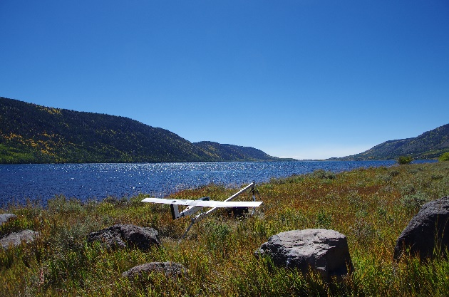
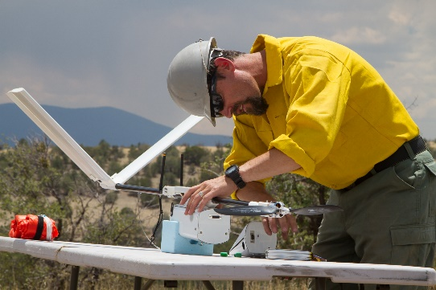
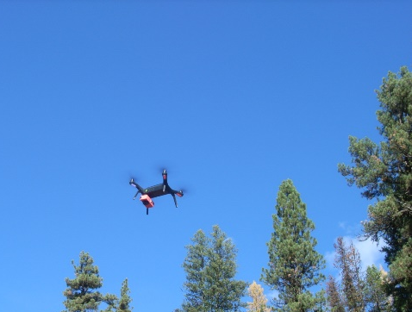
Forest Service Update
Everett Hinkley
Notes:
The purpose of this presentation is to provide a short overview on some of the commonly asked questions about current FS UAS policy.
A short overview of significant historical and recent UAS activities in the agency as well as current UAS governance bodies and their current scope and activities will also be provided.
Photos starting in upper left going clockwise
North Fire – Cibola NF.
FHP/FM aerial imagery project- Apache-Sitgreaves NF.
FHP/FM aerial imagery project- Apache-Sitgreaves NF.
North Fire. (3DR Solo quadcopter)
North Fire. (Falcon UAS).
Aquatic Milfoil Survey. Fishlake, UT.
Surface Mine Survey- Umatilla NF. (3DR Solo).
FHP/FM aerial imagery project- Apache-Sitgreaves NF.

Slide 32
High(?) Points
Fire Season
  National Systems Support & New Capabilities / Thermal Working Group
  Supporting front line personnel during COVID
Mobile Geospatial Strategy
  Improving governance to a complex process while adjusting to the new CIO structure / realignment / optimization
  GPS support / Frequency Issues / NSRS 2022 / National Coordination Office for Positioning, Navigation & Timing (PNT)
USFS – NASA Ideas Forum – November 9th and 10th
Historical Imagery Scanning – this effort has been hampered by the pandemic
Unmanned Aircraft Systems – Investigating American made equipment
Information Technology Acquisition and Management Policies
Adjusting to the “new normal” during the pandemic

Slide 33
Fire Season – Current Status
The emphasis during the fire season has been on initial attack and suppression activities; trying to keep ignitions from becoming large incidents(!) which begets fire camps and folks in close proximity to each other.
FS Fire & Aviation (and other agencies) implemented strategies to maintain social distancing, etc. in fire camps and to minimize spread of COVID. In fire and non-fire field activities this year, there is a greater emphasis in the use of remote sensing assets and data to fill the gap on information needs.
We’ve had a “barn burner” of a fire season to date…..
Notes:
Pitch fest will present additional opportunities for NASA and FS to collaborate to meet FS resource management needs (by the way, is there interest to expand this concept to other USDA agencies??). The trick will be finding funding sources to support those approved collaborative efforts.

Slide 34
Mobile Geospatial Strategy
This effort is picking up steam. We are proposing to create a Mobile Geospatial Advisory Committee (MGAC) which will serve as a governance umbrella over the pieces noted below. The initial charge to the MGAC will be to determine roles and responsibilities of key POCs within the Mobile Geospatial enterprise, and to determine authorities for the various tasks associated with Mobile Geospatial technology and use of the technology:
• Hardware / Software testing and purchasing
• Data standards for field collected data (leveraging heavily on existing standards)
• Best practices for use
• Training

Slide 35
GPS support / Frequency Issues
FCC UNANIMOUSLY APPROVES LIGADO’S APPLICATION TO FACILITATE 5G AND INTERNET OF THINGS SERVICES
Conditions Will Protect Incumbents from Harmful Interference
WASHINGTON, April 20, 2020—Today, the Federal Communications Commission announced that it has approved with conditions Ligado’s application to deploy a low-power terrestrial nationwide network in the L-Band that will primarily support 5G and Internet of Things services. The order approving Ligado’s application was adopted without dissent and will promote more efficient and effective use of our nation’s spectrum resources and ensure that adjacent band operations, including the Global Positioning System (GPS), are protected from harmful interference.

Slide 36
USFS – NASA Ideas Forum
The USFS-NASA Pitch Fest is a follow-on meeting to the Virtual Pitch Fest. The Ideas Forum, will be hosted on November 9 and 10, and is a “roll up our sleeves” meeting where pitching teams from the June meeting will meet with NASA mission specialists to work on bring ideas into operational use.
During the pitch fest in June, people from USFS, NASA and other agencies had an opportunity to present their ideas, make connections and collaborate with those in other agencies and organizations. Participants shared ideas to pilot NASA technology to help address priority land management issues.
Notes:
Pitch fest will present additional opportunities for NASA and FS to collaborate to meet FS resource management needs (by the way, is there interest to expand this concept to other USDA agencies??). The trick will be finding funding sources to support those approved collaborative efforts.

Slide 37
Unmanned Airborne Systems
Some UAS activites this year as noted by Jeremy Webb in his presentation yesterday.
Per recommendations from the FS UAS Strategic Risk Assessment, the UAS Program is actively recruiting and filling positions for national and regional staffs
  Six staff currently being onboarded to support the national program
  16 staff currently or to be onboarded at the regional level (2 staff in each region, focused on fire and resource management applications, respectively)
UAS Program is developing contracts for acquiring fleet sUAS platforms.
  Platforms will meet supply chain security requirements of pending legislation/EO
UAS Program is preparing to address the pilot training demand by FS staff, particularly resource management staff
  GTAC has developed and plans to routinely deliver a supplemental course “UAS for Resource Management” to support resource management staff to effectively plan and execute UAS missions.
FS Standards for UAS Operations (“UAS Operations Guide”) which provides policy guidance for executing resource management UAS operations was approved and signed by FS leadership in spring 2020.
Notes:
UAS: Aviation business case was signed this spring by FS leadership. The program is working on setting up contracts to buy fleet aircraft. Due to pending legislation and/or an executive order, the use of foreign made drones or drones with foreign made components will be a no go. So plans are to buy American made platforms. As discussed yesterday, the question is what is an All-American drone? Does it need to be 100% US components? 98%? 95%? For example, if non-IT components of a drone are foreign made (motors, props, etc.), is that an issue? That is being determined now. There is already interagency policy in place that provides guidance for UAS operations on Fires (NWCG Standards for Fire UAS Operations) and that policy applies to the FS. However, the FS has been working on policy/guidance for using UAS on non-fire/resource management work. That policy is in its final stages of review and is anticipated to be signed this month. The policy is called "FS Standards for UAS Operations". Once in place, there will be policy for both fire and non-fire operations. WIth all the policy/guidance in place and eventually getting aircraft, next big step is getting folks trained. So FS staff training is anticipated to increase later in the summer, this fall and into 2021.

Slide 38
Information Technology Management/Acquisition Policies
FS CIO and USDA CIO continue to implement new policies and protocol for the acquisition and management of information technology and services.
  Realignment of IT projects and investments, including sorting out “IT” vs. “Non-IT” costs (increased risk to projects if decisions on both sides are not coordinated, including funding, etc.)
  Coordination across the agency on the acquisition of information technology and services
  Limits on available IT funding in the agency/department (IT funding cap determined by Congress)
  2210 staff required to conduct and/or oversee all IT activities
  Coordination with external agency partners to leverage their IT platforms and capabilities to support FS and interagency applications
    USGS EROS – Hosting of image services, post-fire mapping activities
    NASA GSFC – Hosting of NRT satellite imagery processing, strategic active fire mapping, forest monitoring activities
Notes:
UAS: Aviation business case was signed this spring by FS leadership. The program is working on setting up contracts to buy fleet aircraft. Due to pending legislation and/or an executive order, the use of foreign made drones or drones with foreign made components will be a no go. So plans are to buy American made platforms. As discussed yesterday, the question is what is an All-American drone? Does it need to be 100% US components? 98%? 95%? For example, if non-IT components of a drone are foreign made (motors, props, etc.), is that an issue? That is being determined now. There is already interagency policy in place that provides guidance for UAS operations on Fires (NWCG Standards for Fire UAS Operations) and that policy applies to the FS. However, the FS has been working on policy/guidance for using UAS on non-fire/resource management work. That policy is in its final stages of review and is anticipated to be signed this month. The policy is called "FS Standards for UAS Operations". Once in place, there will be policy for both fire and non-fire operations. WIth all the policy/guidance in place and eventually getting aircraft, next big step is getting folks trained. So FS staff training is anticipated to increase later in the summer, this fall and into 2021.

Slide 39

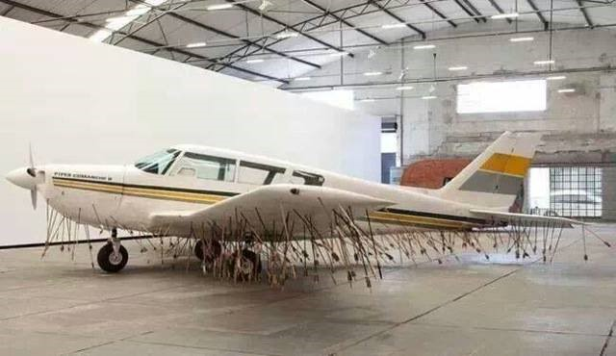
Questions?
Everett Hinkley
National Remote Sensing
Program Manager
everett.Hinkley@usda.gov

Slide 40
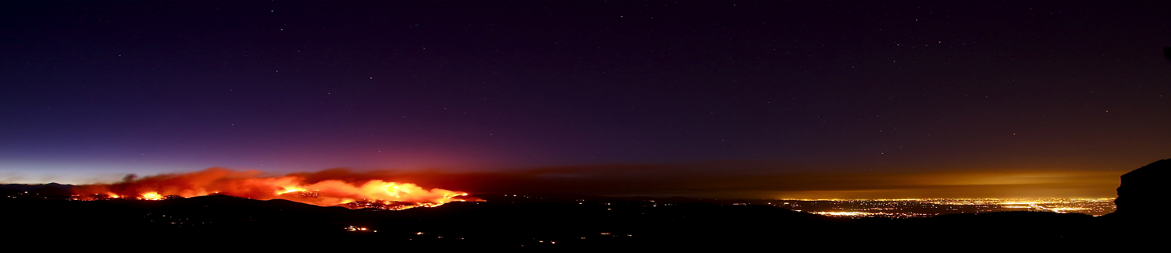


NASA Update:
Wildland Fire Element
Vince Ambrosia
NASA Applied Science Program
18 November 2020
Tactical Fire Remote Sensing Advisory Committee (TFRSAC)
WebEx Virtual Meeting

Slide 41

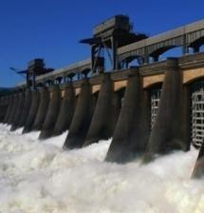
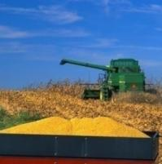
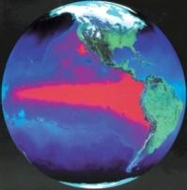
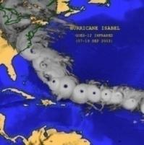




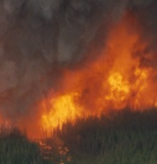
Applications Themes & Societal Benefit Areas
Emphasis in
4 Applications Areas
Support opportunities in
5 additional areas
Health &
Air Quality
Water Resources
Agriculture
Climate
Weather
Energy
Oceans
Disasters
Ecological Forecasting
Crosscutting theme:
Wildland Fires
|‌ 41

Slide 42
NASA ASP Disaster Management Team
NASA Applied Sciences Program -
Disaster Program Manager:
David Green
Associate Program Managers:
Vince Ambrosia (Wildland Fire)
Mike Goodman (Geophysical Disasters)
John Murray (Atmospheric & Hydro-meteorological Disasters)
Notes:
The NASA Wildland Fire Element / Theme is organized within the NASA Applied Science Disaster Program, led by David Green.

Slide 43
Three Elements of Disaster Program Wildfire Component
NASA ROSES-16 A.50 “GEO Work Program”, Element 3.8: Global Wildfire Information System (GWIS) (Vince Ambrosia)
  Provide support through solicitation to coordinate / harmonize information among major national and regional fire information providers:
    Harmonize fire information data sets;
    International Networking;
    Workshops & Trainings;
    Cross-Platform Information Sharing at Common Scales;
NASA Disaster Program Support to Wildfire Events (national and International Requests) in 2020 (Brady Helms)
  Supporting community requests for EO data / tools to assess wildfire conditions in 2020 season;
NASA Disaster Program Disaster Portal Description (Jeremy Kirkendall)
  Web Map Services Portal for sharing global NASA EO data and models in support of disasters;

Slide 44
NASA GEO-GWIS Investigations
A.50 GEO Work Programme
3.8 Global Wildfire Information System (GWIS)
Robert Field (Columbia University)
  “Enhancements to the Global Wildfire Fire Information System: Fire Danger Rating and Applications in Indonesia”
Wilfrid Schroeder, et al (University of Maryland / NOAA)
  “Development of a Harmonized Multi-Sensor Global Active Fire Data Set”
Luigi Boschetti / David Roy (U. of Idaho & So. Dakota State Univ.)
  “Using the NASA polar orbiting fire product record to enhance and expand the Global Wildfire Information System (GWIS)”

Slide 45
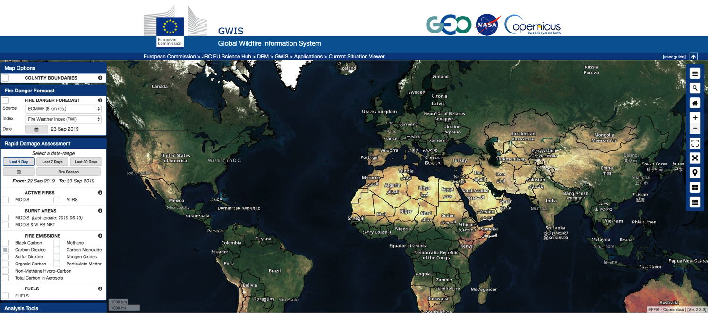
Global Wildfire Information System (GWIS)
GWIS is a joint initiative of the GEO and the Copernicus Work Programs;
GWIS brings existing information sources at regional and national level, providing a comprehensive view and evaluation of fire regimes and fire effects at global level.
GWIS builds on the European Forest Fire Information System (EFFIS), the Global Terrestrial Observing System (GTOS) Global Observation of Forest Cover- Global Observation of Land Dynamics (GOFC-GOLD) Fire Implementation Team (GOFC Fire IT), and the associated Regional Networks, complementing existing activities that are on-going around the world with respect to wildfire information gathering.
GWIS is supported by the partner organizations and space agencies. Support to GWIS was launched by NASA through its ROSES GEO solicitation (2016) program.

Slide 46
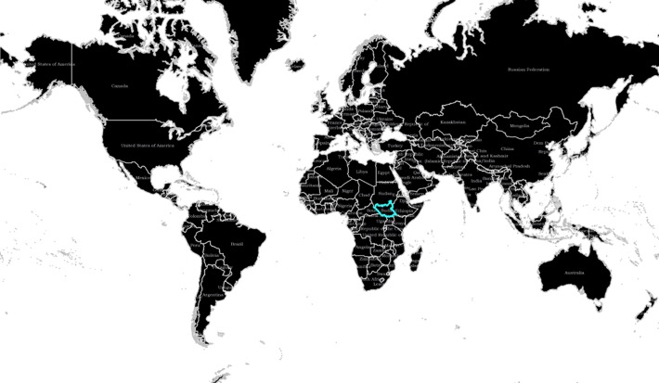
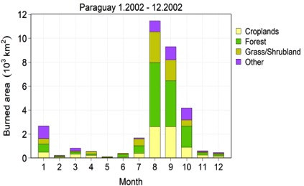
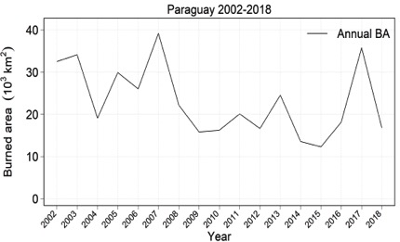
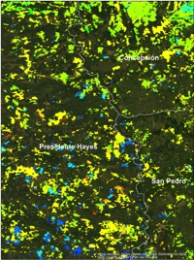
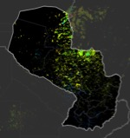
Using Polar-Orbiting Fire Product Record to Enhance / Expand GWIS
PI: Luigi Boschetti (U of ID)
The user can select region & analysis year; page spawned as a separate window (a user can spawn many windows e.g. several different years for the same region, e.g. several different regions for the same, e.g. for different regions and years).
User can interactively point & click to select country of interest (country outline shown on map)
2002 Statistics
Multi-Year Statistics
Maps
Jan 1
Dec 31
User can interactively select three options; (note, these 3 options graphics should show real results for the selected region and year)
Notes:
Recent Advances: Beta version of new GWIS tabular / graphical /statistical module currently implemented at JRC. Module currently providing support to Paraguayan Space Agency and Environmental Agency (Nov 2020) to support wildfire analysis

Slide 47
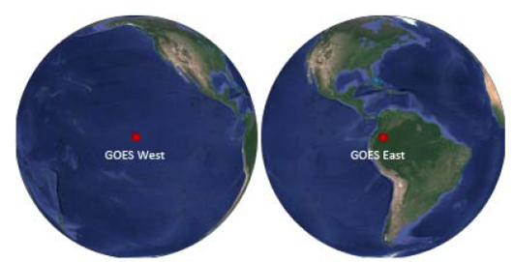
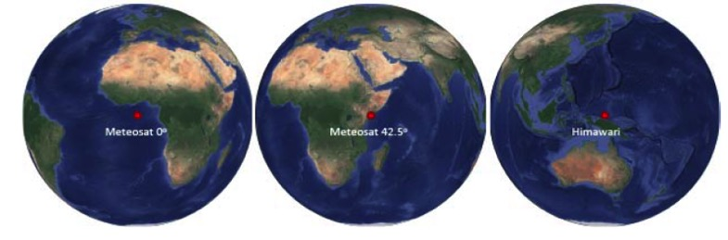
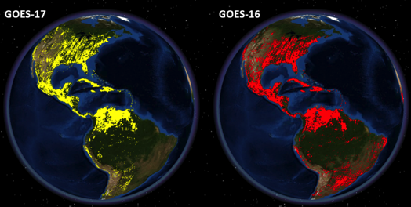
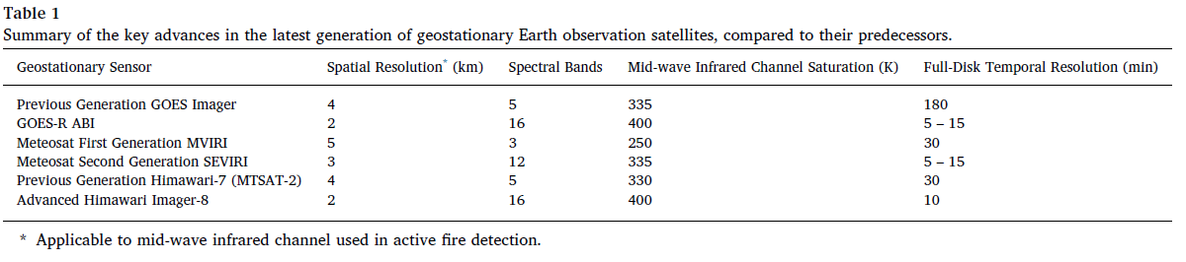
Harmonized Multi-Sensor Global Active Fire Data Set
PI: Louis Giglio (UMd)
Near real-time and near-global geostationary active fire product delivered to end users in two formats: (a) harmonized 0.25° hourly summaries of active fire properties, and (b) geocoded delimited text files that preserve the spatial and temporal resolutions of the underlying hemisphere-specific fire products.
Consistent and extensive validation of the underlying hemisphere-specific GOES-16 and -17 FDC, Himawari-8, and MSG FRP-PIXEL fire data sets using more than 50,000 Landsat reference scenes.
January – March 2020 Landsat reference points (yellow and red dots) used for GOES-16 and -17 FDC product validation.
Notes:
The recent deployment of the new generation of weather satellites provides an opportunity for the establishment of a robust global network of geostationary fire data that can greatly complement existing polar orbiting satellite fire products.
Recent Advances: Beta services of geostationary GOES, METEOSAT and HIMAWARI fire detection data has been “harmonized”, integrated, and in operational testing at JRC. Project objecive is achieved when processing steps for R/T services are turned over to JRC, and JRC, at that point will develop the operational code for inclusion into GWIS WMS.
Advanced Baseline Imager (ABI) on board the NOAA GOES-16 satellite
Spinning Enhanced Visible and Infra-Red Imager (SEVIRI) on board the ESA Meteosat Second Generation (MSG) satellite series.

Slide 48
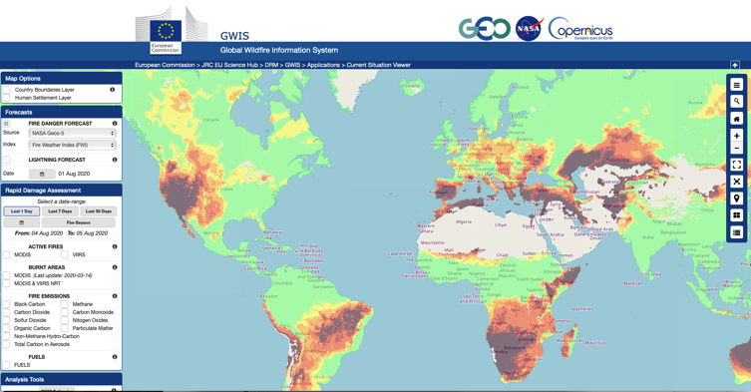
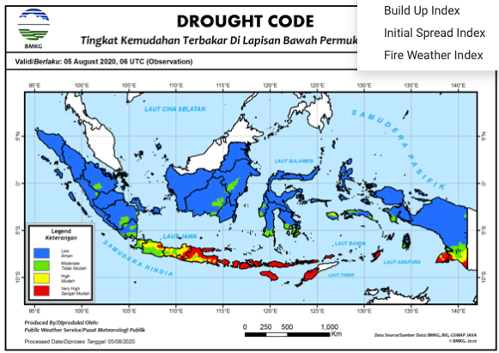
GWIS Fire Danger Rating Enhancements
PI: Robert Field (Columbia U.)
Enhance the NASA Global Fire Weather Database (GFWED) with short-term fire weather forecasts;
Contribute selected GFWED data to GWIS;
Improve the Indonesian Fire Danger Rating System using NASA Global Precipitation Measurement mission precipitation estimates to enhance fire management decision aids.
July 2020: Addition of NASA GEOS-5 based FWI forecasts to GWIS
Official launch of BMKG ‘SPARTAN’ FDRS at Indonesian Agency for Meteorology, Climatology and Geophysics (BMKG) in April 2020;
NASA GEOS-5 FWI forecasts have been added to GWIS alongside ECMWF forecasts.
July 2020: Official launch of ‘SPARTAN FDRS’ website at BMKG
Notes:
Recent Advances” NASA GEOS-5 FWI forecasts have been added to GWIS alongside ECMWF forecasts (operational); Official launch of BMKG ‘SPARTAN’ FDRS at Indonesian Agency for Meteorology, Climatology and Geophysics (BMKG) in April 2020. Field supported Venezuelan fire effort with modeled data analysis with VIIRS and GPM-based Fire Wx.
The NRT GFWED system has been modified to GEOS-5 met. fields directly, rather than through OPeNDAP, in the hope of reducing product latency by ~6 hrs.
Ingest of GFWED data into the GWIS continues. The JRC team is working on acquiring data from the new NCCS DataPortal website, with the old FTP now shut down.
Work on ingesting of GPM data into FDRS calculations at BMKG has been handed over from the Division for Remote Sensing Imagery Management to the Division for Early Warning and Weather Prediction . Single-point calculations are apparently in place, but status of spatial products is still unclear.

Slide 49
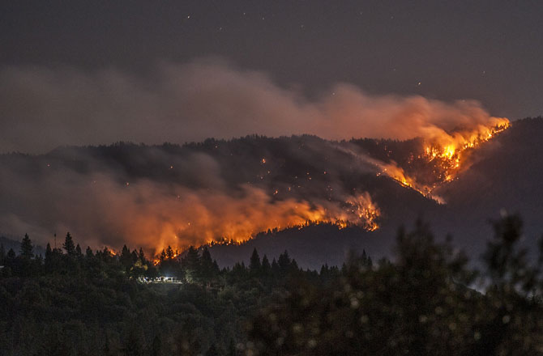
Contact Information
NASA Applied Science Program
http://appliedsciences.nasa.gov/
https://disasters.nasa.gov/
https://gwis.jrc.ec.europa.eu
David Green
NASA Headquarters
David.s.green@nasa.gov
Vince Ambrosia
NASA Ames
vincent.g.ambrosia@nasa.gov

Slide 50
Recent Recommendations From ASAC to ES Director
“…we also learned that there is no longer a dedicated program to Wildfires as has been the case in prior years. We learned that ESD has spread wildfire applications into the Ecological Forecasting, Disasters, and Health & AQ programs.”
FINDING: The current approach to Wildfires applications is minimally adequate but far from ideal. ASAC recognizes that Earth observations can play roles from before any wildfire starts in assessing and reducing risk, to during fires in supporting strategic and tactical response, to after wildfires end in supporting remediation. While ASAC recognizes that Wildfires are cross-cutting in nature and that multiple applications areas may touch on Wildfires topics, ASAC is concerned that the lack of a dedicated program is suboptimal to addressing this national issue adequately.
RECOMMENDATION: ESD should strive for a dedicated Wildfires area and a dedicated program manager. This topic represents a strong opportunity for cross-benefits within ESD and a clear way to address a topic of national importance.

Slide 51
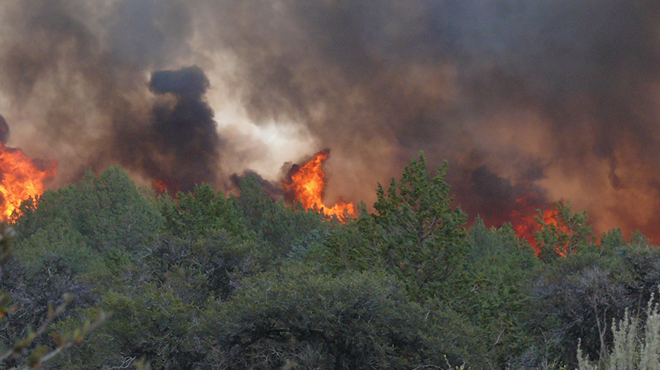

U.S. Geological Survey
A Fire Science Strategic Plan
Technical Fire Remote Sensing Advisory Committee
November 18, 2020
Paul F. Steblein
Fire science Coordinator
psteblein@usgs.gov www.usgs.gov/fire

Slide 52
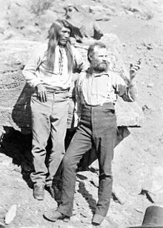

U.S. Geological Survey
Origin
  1879 by Congress after NAS report for "classification of the public lands, and examination of the geological structure, mineral resources, and products of the national domain“
Science Agency
  Value scientific excellence, integrity, and objectivity
  Peer review, documentation, transparency
  Conduct science in consistent, objective, & replicable manner
Major Disciplines
  Biology Geology
  Hydrology Geography
  Computer Science & Informatics
Workforce
  > 8,000 scientists & staff
  ~ 180 scientists work on fire science
John Wesley Powell

Slide 53

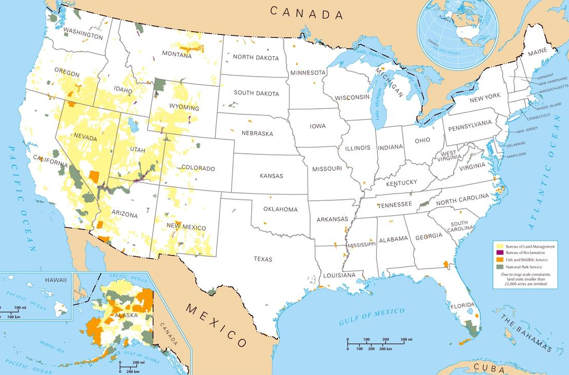
USGS Fire Science Scope
Geographic
National, International
DOI land – about 20% land surface
  NPS, NWRS, BLM, BIA, BOR
  Many non-forested sites
Local projects
Interdisciplinary
All Mission Areas
Thematic
Fire History & Management
Fire Ecology & Recovery
Post-fire Risks
Geospatial, Imagery & Tech
Science Organization & Results
~ 180 scientists in very active CoP
~90 publications/year, numerous data sets

Slide 54
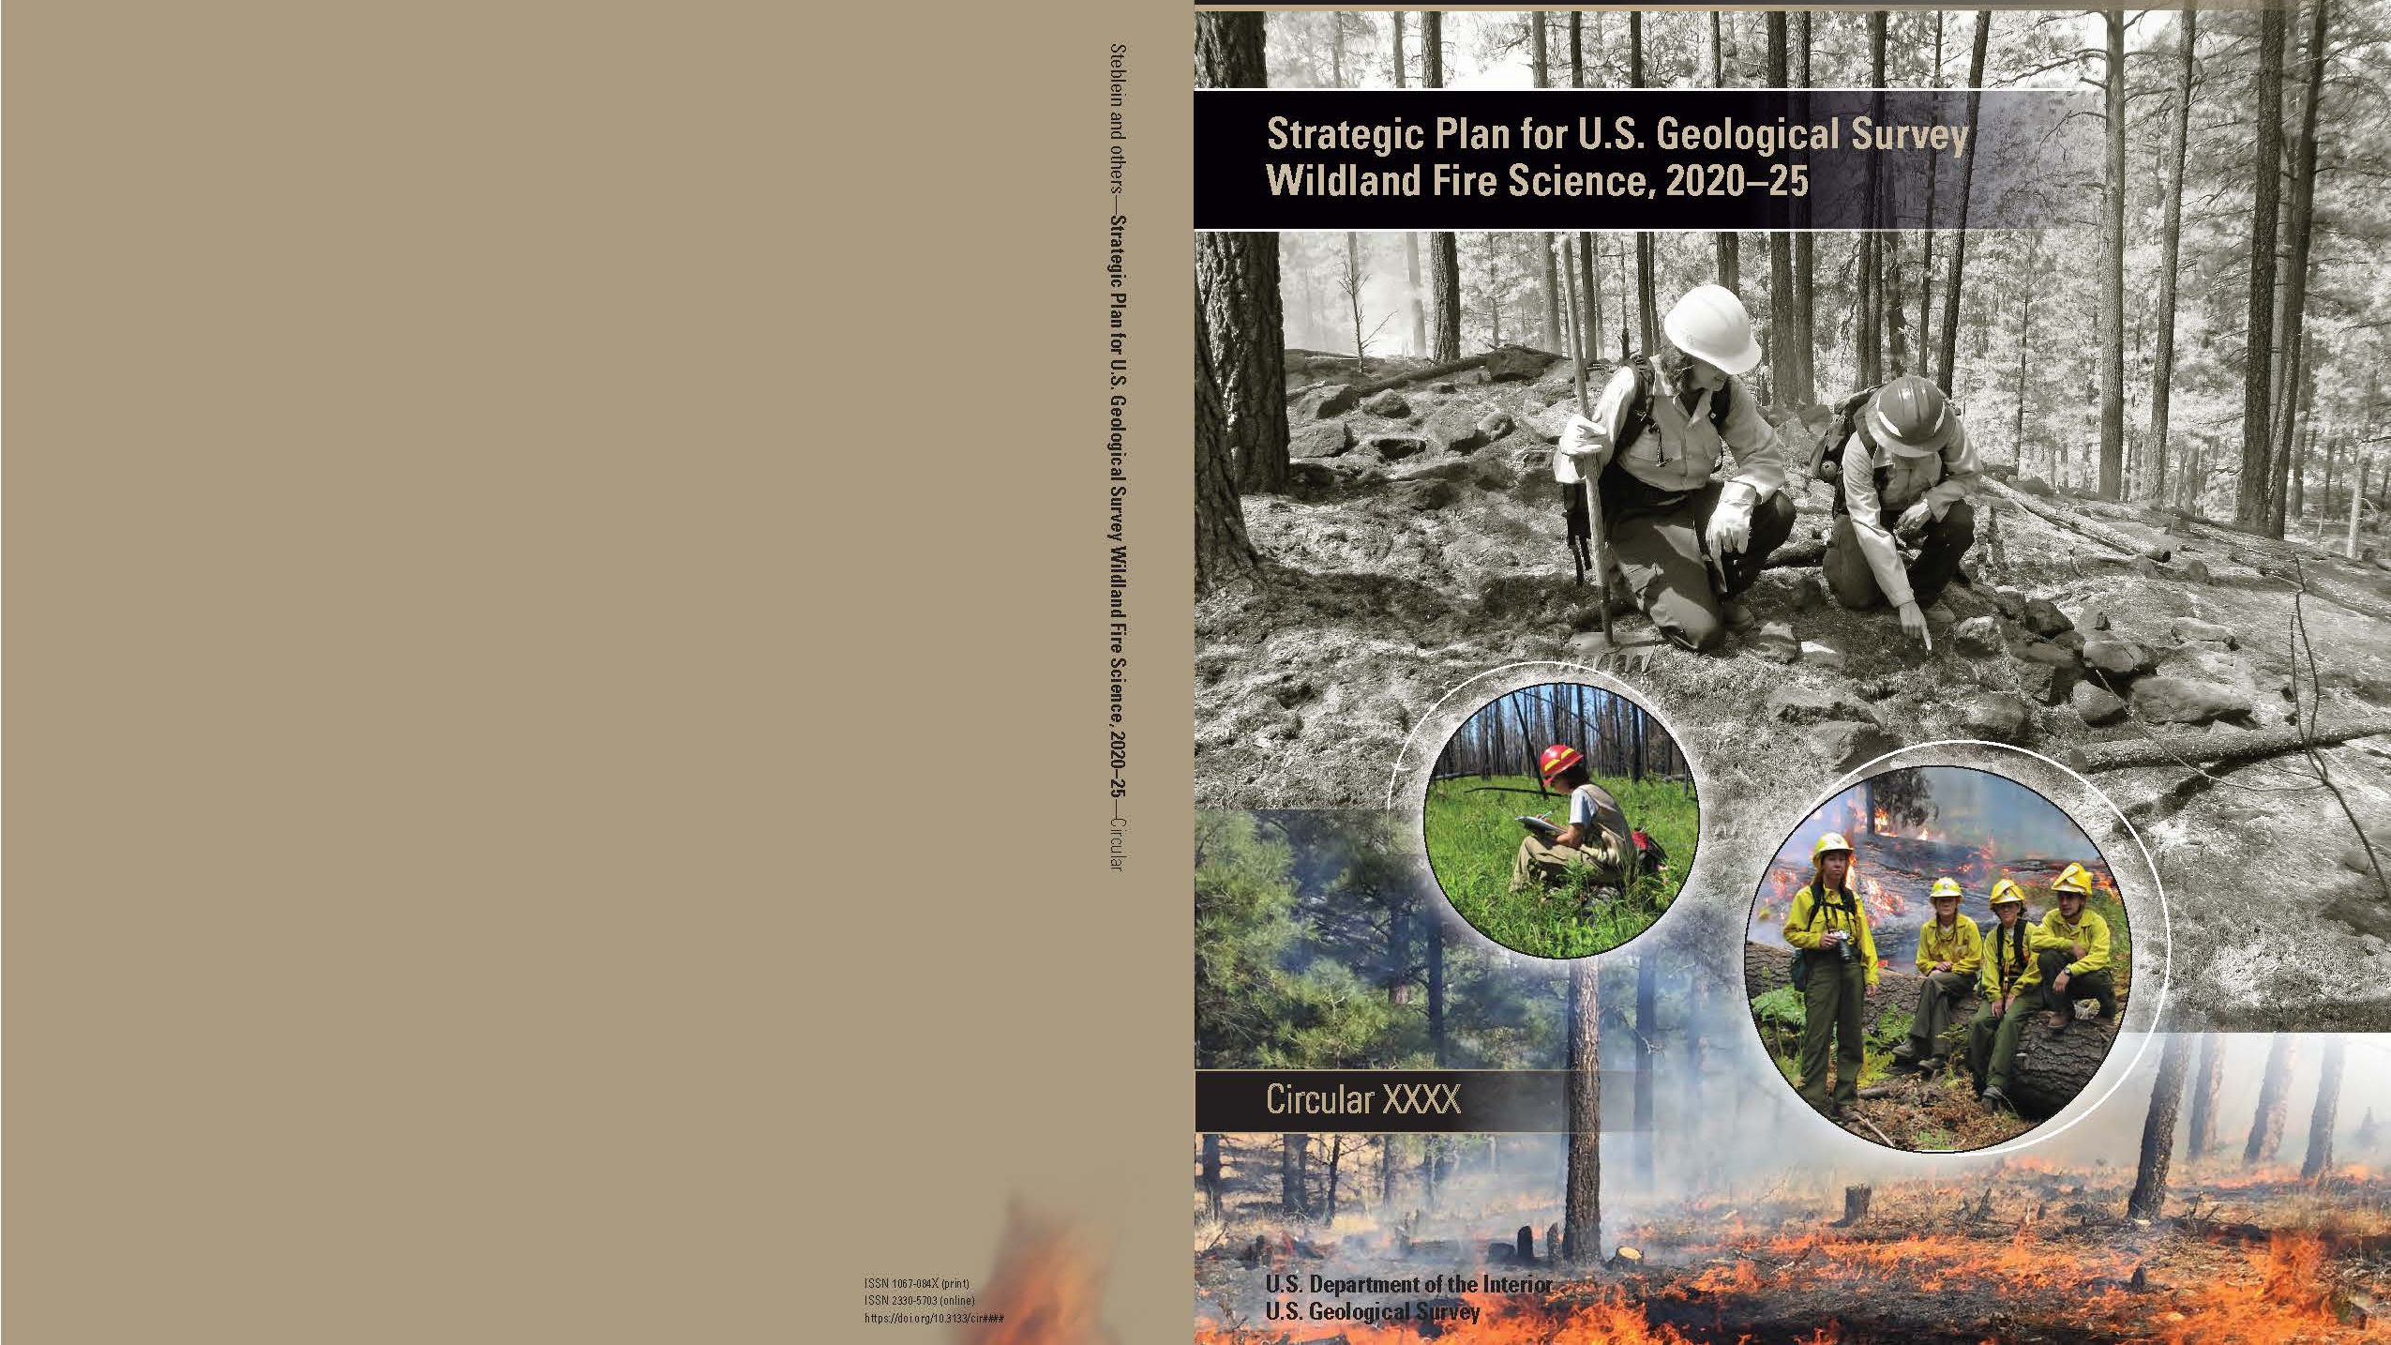

Factors Affecting Plan Development
National Cohesive Wildland Fire Management Strategy
Executive Order 13855, SO 3372
Advances USGS science capability while making significant contribution
Fire Community Needs & Partnership – WFLC/WGA Priorities, Stakeholders Interviews
Director Emphasis on AI/ML, HPC, Remote Sensing, Multi-disciplinary
1st Fire Science Strategic Plan

Slide 55
Stakeholder Interviews
40 Stakeholder Organizations Consulted
Themes
Source of new fire science
Familiarity with and use of USGS fire science
Ever collaborated with USGS on a research topic and potential impediments
Stakeholders’ specific needs that could be provided by USGS
Most pressing science needs for fire managers over the next 2-10 years and beyond

Slide 56

Fire Needs could be met by USGS
Priority Research Needs

Slide 57

Fire Science Needs 2-10 years & Beyond

Slide 58

USGS Wildland fire science strategic plan: 2020-2025
Priority 1: Produce state-of-the-art, actionable fire science: Provide scientific analyses, data, and tools that inform current and future fire and land management decision-making and promote understanding of fire-related and fire-responsive earth system processes and patterns.
Priority 2: Engage stakeholders in science production: Use a science co-production model throughout the fire-research life cycle to develop and maintain collaborations with actively and continually engaged stakeholders, and to ensure that end products and outcomes of research projects inform stakeholder needs and are relevant and useful for fire and land management decision making.
Priority 3: Effectively communicate USGS fire science capacity, products, and information: Strategically manage communications to effectively build awareness of and access to USGS wildland fire science among key external and internal stakeholders.
Priority 4: Enhance USGS organizational structure and advance support for fire science: Provide organizational structure and support that improves fire-science production, coordination, and cooperation within the USGS and with external partners.

Slide 59

PRIORITY 1: PRODUCE STATE-OF-THE-ART, ACTIONABLE FIRE SCIENCE
Goal 1: Improve understanding of the impacts of climate changes and other ecosystem stressors, and their synergistic interactions, on fire behavior, fire risk, and fire effects in natural systems and human communities.
Goal 2: Gain a better understanding of the relationships of fire and fire management to biodiversity conservation, ecosystem resilience, and post-fire recovery.
Goal 3: Conduct science to help protect human lives, livelihoods, property, and infrastructure.
Goal 4: Develop state-of-the-art tools and decision-support systems that enable land, fire, and emergency-managing bureaus and partners to obtain essential fire information.

Slide 60

PRIORITY 2: ENGAGE STAKEHOLDERS IN SCIENCE PRODUCTION AND SCIENCE DELIVERY
Goal 1: Actively and continually engage stakeholders throughout the fire-research life cycle through the use of a science co-production approach.
Goal 2: Apply effective science delivery practices to ensure USGS fire science research, data, and tools are used by the people who need them.

Slide 61

PRIORITY 3: EFFECTIVELY COMMUNICATE USGS FIRE SCIENCE CAPACITY, PRODUCTS, AND INFORMATION TO A BROAD AUDIENCE
Goal 1: Establish and maintain communication pathways for outreach to external audiences.
Goal 2: Establish and maintain communication pathways for outreach to internal audiences.

Slide 62

PRIORITY 4: USGS ORGANIZATIONAL STRUCTURE AND SUPPORT FOR FIRE SCIENCE
Goal 1: Strengthen the USGS fire science organizational structure to enhance fire science coordination and prioritize critical fire science needs.
Goal 2: Strengthen external partnerships to meet national fire science priorities and provide fire science leadership.

Slide 63




Relationship to TFRSAC
Science Integrated across disciplines, scalable
Advanced sensor data
  Data types – Lidar, Hyperspectral, SAR, Doppler
  Platforms – Satellite, UAV, stations
Advanced analytics – AI/ML
  Preprocessing data
  Pattern detection & modeling
  Decision support
Sophisticated & ensemble earth process models
High performance computing – supercomputers & cloud
Fire data/model/tool architecture, ease finding and use
Build & improve partnerships
Canopy Fuels
Data Topology (NIFC)
Fine Fuels

Slide 64

Wildland Fire – EarthMAP on Fire
USGS integrated science to enhance prediction of post-fire hazards, risk assessments, and decision making:
Concept demonstration for the Upper Colorado-Gunnison Basin with subsequent expansion
21st Century Science Strategy – How Fire teams fit together
FY2021*
FY2022
FY2023
FY2024
CSS (LR) EMA: Develop simulation models to predict fire behavior, burn area, and burn severity
EMA, CSS, NH, WMA, EMMA: Expand geographic range of models and map to West-wide
EMA, CSS, WMA, NH: Develop models of postfire vegetation risk and recovery, link to water and debris flow models
EMA: Link additional risk- based models of fish & wildlife habitat, Endangered Species, cultural resources, aquatic and other values
Outcome 4:
Expanded EarthMAP on Fire system of decision support, continually updated and expanded with new themes
NH: Link fire model predictions of burn area and severity to debris flows models
Advanced Integrated Fire Science
Outcome 1:
Predictive map of fire/post-fire risk for CO Basin
Outcome 2:
Predictive map of fire/post-fire risk for Western USA, with decision support interface
Outcome 3:
National map & decision tool of fire/post-fire risk updated annually
WMA: Link fire model predictions of burn area and severity to water models
CSS, OEI, EMA: Hold workshop and build decision support tool for scenario casting of fire/postfire risk modeling with mitigation measures
CSS, EMA: Develop model to adjust fire/post-fire risks seasonally due to weather and plant phenology
CSS, EMA: Enhance models with annual update to Landfire vegetation/fuels to reflect fuels treatment, wildfire, insect/disease outbreak, invasive spp
CSS, OEI, EMA: Enhance FireFly to link with NIFC & intersect with USGS fire/post-fire models, build dashboard for fire response
Science Support of Fire Ops
CSS, OEI, EMA, NH, WMA, EMMA: Data/model architecture for EarthMAP on Fire
Notes:
*Starting point: Implement Advanced Integrated Fire Science pilot in CO Basin, expand geographically across the West, enhance with decision support interface, add new risk components, establishing Science Support of Fire Operations team to develop scopig documents on fire mapping and next generation Landfire.

Slide 65



What does it mean
Strategic Plan Release – Soon
Advanced, integrated, actionable wildland fire science that addresses myriad and dynamic challenges
Listen to and work with stakeholders to identify needs, design the science and deliver the results
Ensure the public knows what we do, where to get results, and what it means
Enhance collaboration within USGS and with partners
QUESTIONS?

