Slide 1
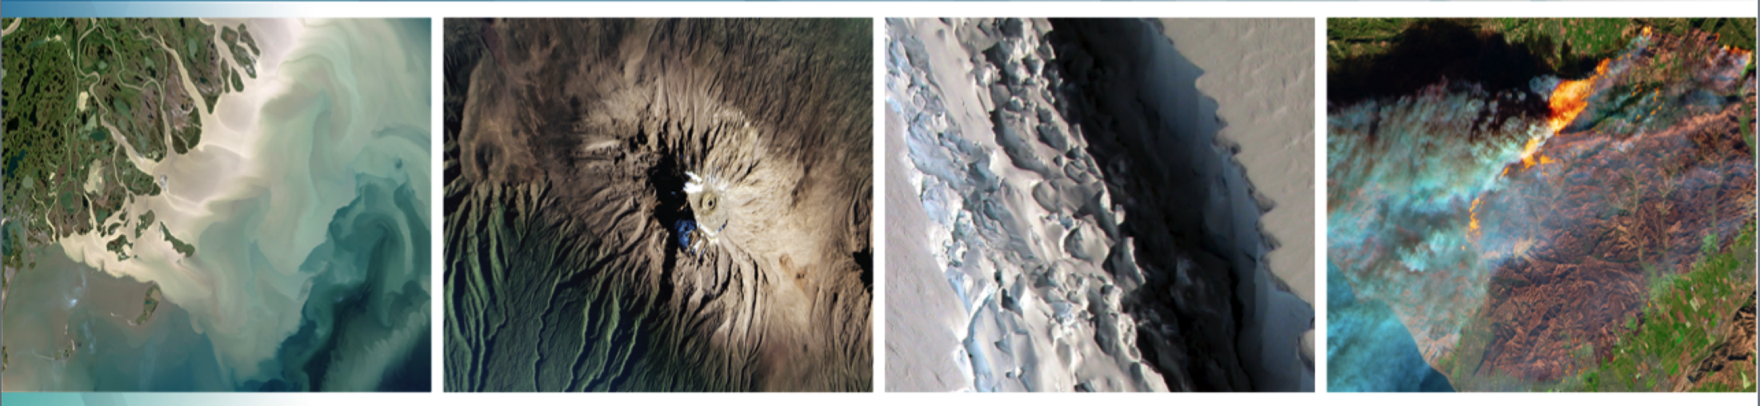
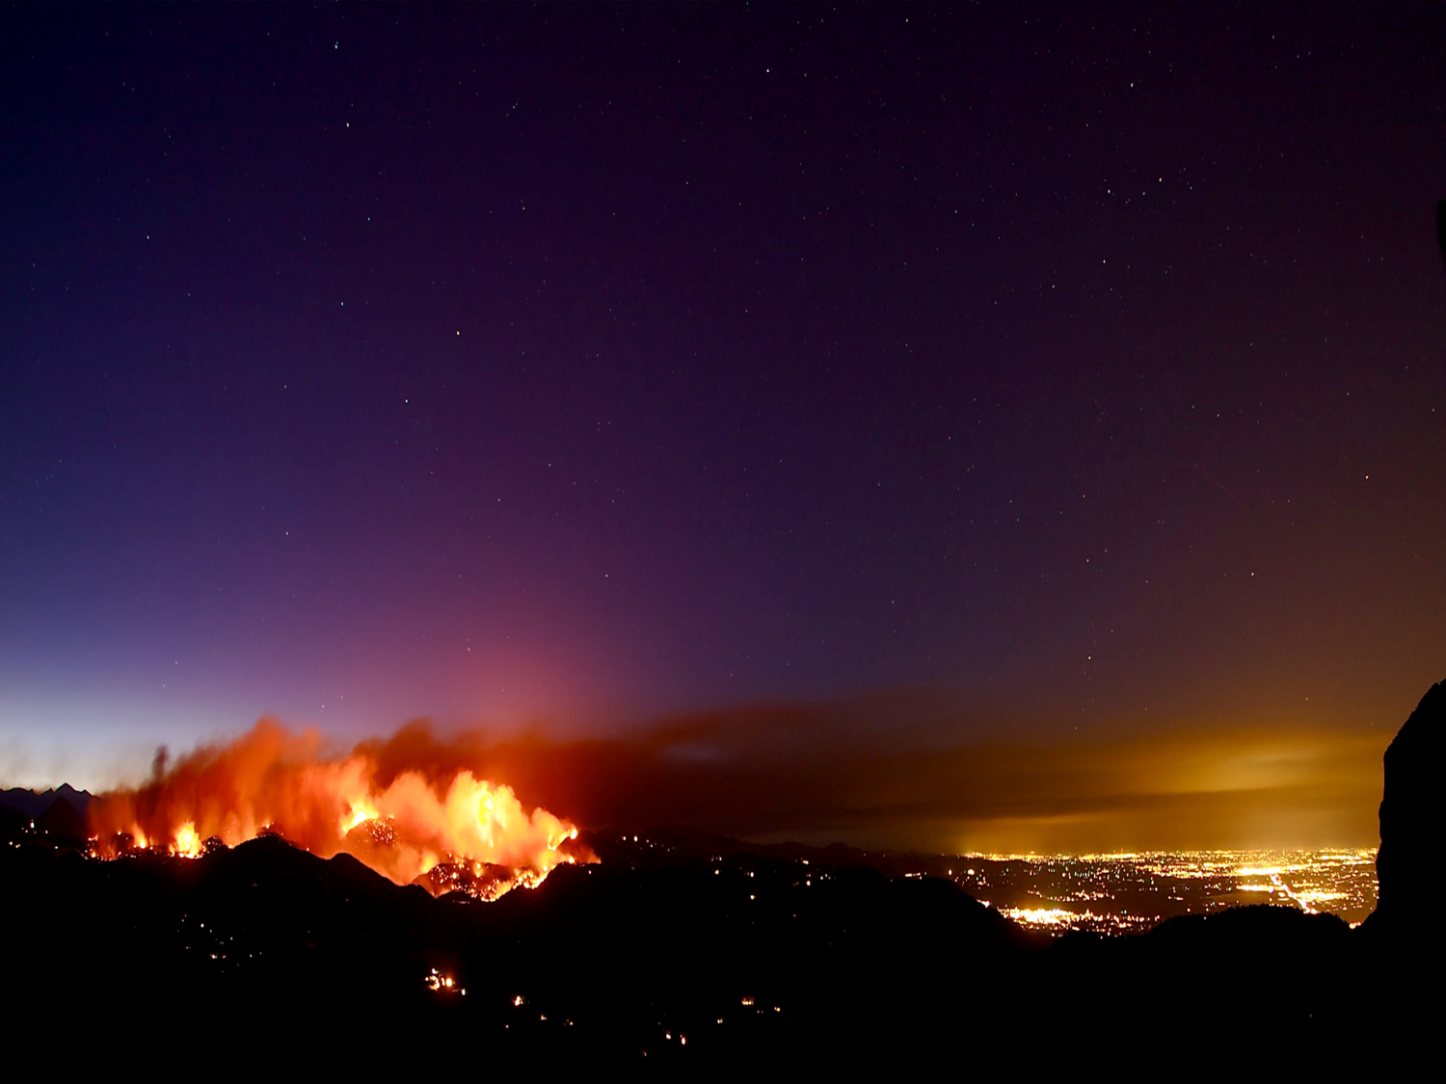


Welcome to the:
Thirty-Fourth Tactical Fire Remote Sensing
Advisory Committee (TFRSAC) Meeting
Hosted By:
USDA-Forest Service: Everett Hinkley
NASA Applied Science Program: Vince Ambrosia
11-12 May 2021
8:00AM – 2:00PM PT / 11:00AM – 5:00PM ET
(times are the same for both days)

Slide 2
Video Collaboration Platform
Platform: YouTube Live Stream
  Go to https://nari.arc.nasa.gov/tfrsac-wildfire for the link
    It will be available under the “TFRSAC Bi-Annual Meeting Details” section of the webpage
  For Closed Captions, select the CC icon (bottom right side of the YouTube menu bar)
    Subtitles can be moved if blocking important content. Just click, hold, and drag them to a better section of the video screen
  To change the video quality, select the Gear Icon (bottom right side of the YouTube menu bar) to adjust the settings
  Please ensure your YouTube Live button is on
    Hover over the bottom left of the menu and make sure the “LIVE” wording is RED
      If it is not red, click on the "LIVE" wording to turn it on

Slide 3
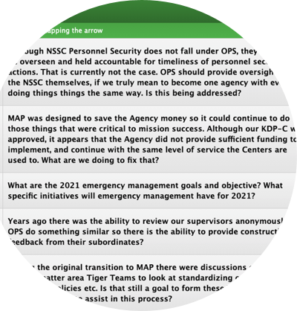
Q&A Platform
    Throughout the event, please enter your questions/comments in the conferences.io platform
    The questions/comments will be addressed (as time permits) during the Open Discussion sections at the end of each day
    To access conferences.io, enter https://arc.cnf.io/sessions/qr34/#!/dashboard into your browser

Slide 4
Connectivity Issues
Slow, delayed, poor connection or video feed:
Move closer to your WiFi router
Disconnect any devices you are not actively using from the WiFi
Close any applications or internet browsers that you are not actively using on the device
Disconnect from your organization’s VPN
Connect your device directly to the router using a Cat-5 ethernet cable
No Internet Connection:
Restart your modem and router (i.e., disconnect and reconnect to the power source)
NOTE: If there is a service outage in your area or region, you will need to contact your internet service provider directly.

Slide 5
Need Help?
If you need logistical or technological assistance throughout the meeting, you can reach out to the NARI hosts through the following platforms:
  Enter your comment or question in the conferences.io platform
  Email your comment or question to arc-cal-nari@mail.nasa.gov

Slide 6
Miscellaneous
We will provide all contacts for the attendees (email addresses) post-meeting
The meeting will be recorded, and we will be sharing the presentation materials and recording with the community at the following URL: https://nari.arc.nasa.gov/tfrsac-wildfire (within a week or so of the event)
The TFRSAC agenda can be found at the NARI website (shown in the bullet above)

Slide 7
Tactical Fire Remote Sensing Advisory Committee (TFRSAC)
TFRSAC: A “Community of Practice” (CoP) which focuses on sharing best practices and creating new knowledge to advance the wildland management domain of professional practice. TFRSAC meets twice yearly (Spring and Fall) to discuss the developments and results of ongoing investigations for new and evolving capabilities that support improved fire observation.
TFRSAC OBJECTIVES: Demonstrate evolved and evolving technologies for increasing the information content and timeliness of EO data collected for wildfires
https://nari.arc.nasa.gov/tfrsac-wildfire
Notes:
The bi-annual meeting agendas and presentations are open-access and shared with the greater community
Technology Focus Areas:
Development and demonstration of improved and emerging airborne platform capabilities (manned and UAS).
Demonstrate new sensor capabilities for enhanced fire discrimination.
Demonstrate new data communication capabilities / automated processing for real-time data distribution from sensors (airborne sensor data to end-user communities on ground).
Develop and demonstrate Collaborative Decision Environment (CDE) capabilities to effect improvements to tactical fire decision support systems.

Slide 8
TFRSAC General Agenda Overview
Tuesday & Wednesday:
  Agency briefings (USFS, NIFC-NIROPS,NASA, USGS, CALFIRE, DOI, Canada, TWG)
  Workshop and Mission Report-outs (Keck/JPL & FIREX-AQ)
  UAS Developments (inc. LTA)
  SBIR Developments (Sensors, etc.)
  Fire Management / EO Developments (inc. AI/ML)
  NASA ARMD Wildfire Gap Analysis / Support Strategies
  Orbital assets supporting Wildfire Ops., (inc. CubeSat / SmallSat)
Thursday:
  NASA ARMD Wildfire Management Workshop

