Slide 1
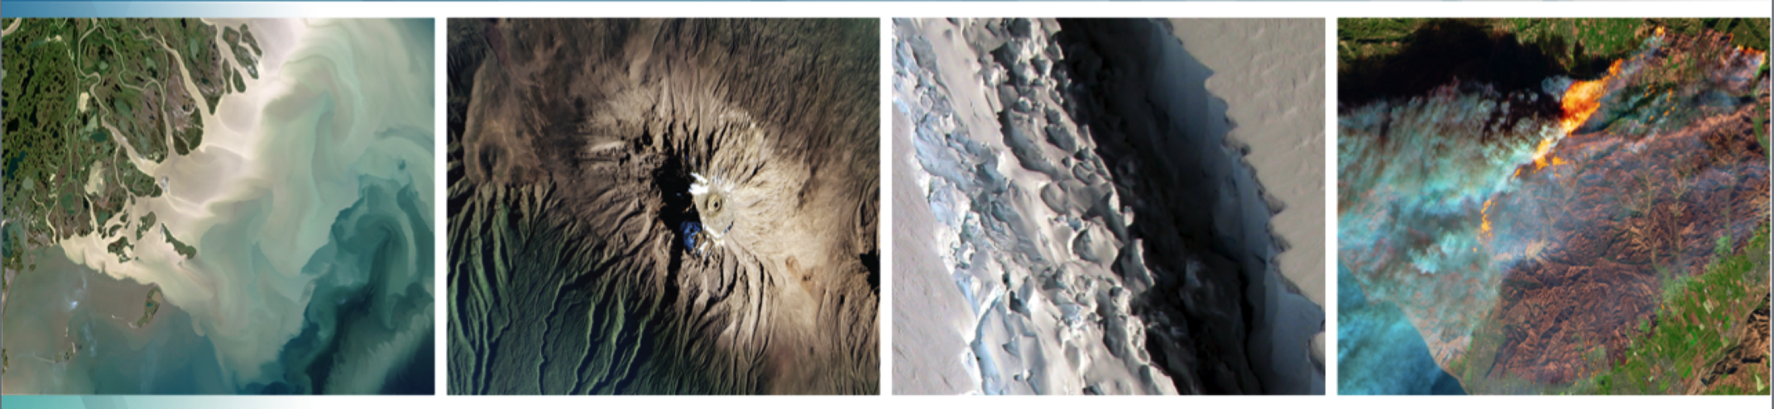
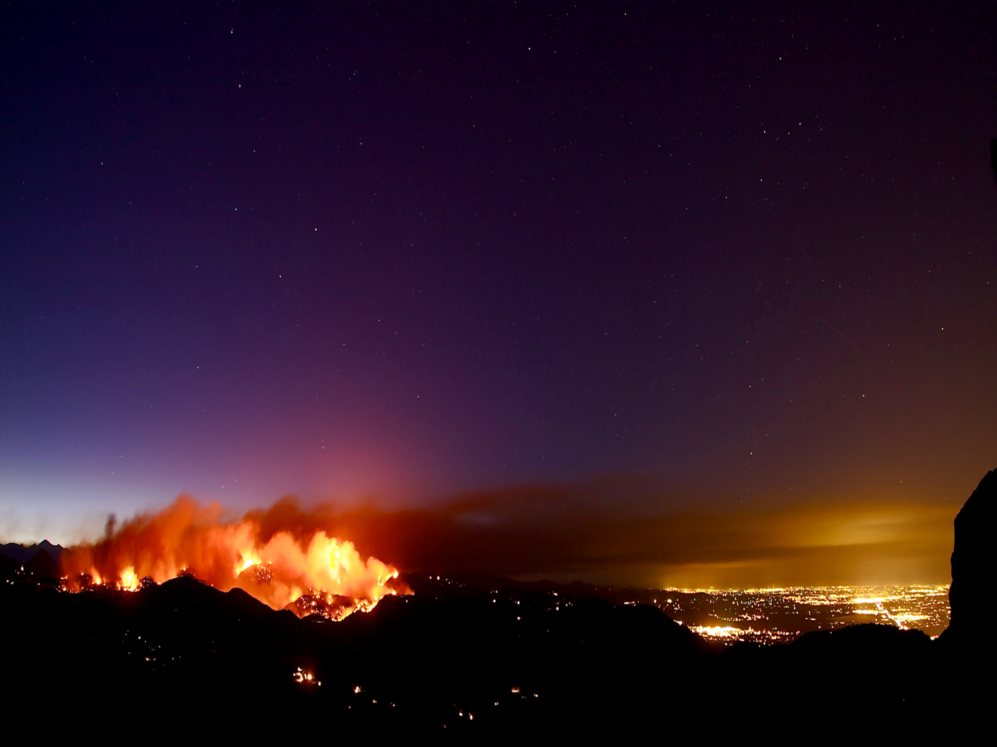




Welcome to the:
37th Tactical Fire Remote Sensing
Advisory Committee (TFRSAC) Meeting
Hosted By:
USDA-Forest Service: Everett Hinkley
USGS: Birgit Peterson
NOAA: Mike Pavolonis
NASA Applied Science Program: Vince Ambrosia
29-30 November 2022
11:00 AM – 5:00 PM Eastern Time Zone
(times are the same for both days)

Slide 2
Tactical Fire Remote Sensing Advisory Committee (TFRSAC)
TFRSAC: MEETING TWICE-ANNUALLY SINCE 2003!! A “Community of Practice” (CoP) which focuses on sharing best practices and creating new knowledge to advance the wildland management domain of professional practice. TFRSAC meets twice yearly (Spring and Fall) to discuss the developments and results of ongoing investigations for new and evolving capabilities that support improved fire observation.
TFRSAC OBJECTIVES: Demonstrate evolved and evolving technologies for increasing the information content and timeliness of EO data collected for wildfires.
Make community aware of new initiatives / solicitations / collaborative projects.
Build and mature new relationships / partnerships amongst the community.
Notes:
The bi-annual meeting agendas and presentations are open-access and shared with the greater community
Technology Focus Areas:
Development and demonstration of improved and emerging airborne platform capabilities (manned and UAS).
Demonstrate new sensor capabilities for enhanced fire discrimination.
Demonstrate new data communication capabilities / automated processing for real-time data distribution from sensors (airborne sensor data to end-user communities on ground).
Develop and demonstrate Collaborative Decision Environment (CDE) capabilities to effect improvements to tactical fire decision support systems.

Slide 3

Welcome to our Newest Co-Coordinator: Mike Pavolonis
We’ve added NOAA as a co-organizing member of the TFRSAC management community!
Mike Pavolonis is the Wildland Fire program manager at the NOAA National Environmental Satellite, Data, and Information Service (NESDIS). He has a background in atmospheric science, with degrees from Penn State (B.S.) and the University of Wisconsin (M.S. and PhD). He has been a scientist at the NOAA/NESDIS Center for Satellite Applications and Research since 2005 and is stationed at the NOAA Cooperative Institute for Meteorological Satellite Studies (CIMSS) in Madison, Wisconsin. His remote sensing expertise includes volcanic hazard, fire, and severe weather applications.

Slide 4
TFRSAC General Agenda Overview
Tuesday Sessions 1 & 2: Led by Vince & Birgit
  Agency briefings
  Decision Support Tools
Tuesday Session 3: Led by Everett
  Decision Support Tools
  AI/Machine Learning
Wednesday Sessions 4 & 5: Led by Vince & Mike
  AI/Machine Learning, Predictive Behavior, Satellite detection, near real-time monitoring, Sensors, ESRI
Wednesday Session 6: Led by Everett
  UAS-Atmospheric measurements, Fire weather prediction, Extended attack assessment, Water Drop Challenge

Slide 5
Miscellaneous
Please check your mics now: set to mute unless speaking.
Speakers: Please be mindful of your allotted speaking time. We have a tight agenda and will cut over to the title slide for the next speaker as your time expires, which is your signal to wrap up.
We will provide email contacts for the presenters post-meeting. PLEASE DO NOT USE the email addresses for solicitations!
The presentations will be shared with the community within a 1-2 weeks post-event. For those who do not want their presentations shared openly, please notify both Everett Hinkley and Vince Ambrosia via email.
We will copy and share the Chat content for each day at the same link as the presentations….so be cautious with the contents of your chat!

Slide 6
Recent & Upcoming Events
  IDGA Wildfire Management Summit, San Francisco, CA; 25-26 April 2022 (https://www.idga.org/events-wildfiremanagement)
  International Conference on Fire Behavior and Risk - 2022 (ICFBR-2022), Alghero, Sardinia (Italy), 03-06 May 2022 (https://www.icfbr2022.it/en/home-en)
  International Association of Wildland Fire (IAWF), Pasadena, CA., 23-27 May 2022 ((https://www.iawfonline.org/events)
  Association of Fire Ecology (AFE) 2022: Fire Ecology Across Boundaries: Connecting Science and Management, Florence, Italy, 4-7 October 2022;
  9th International Conference on Forest Fire Research - 2022 (ICFFR), Coimbra, Portugal, 11-18 November 2022 (https://www.adai.pt/newevent/event/home/index.php?target=home&defLang=2&event=4)
  Pecora 2022, Denver, CO., 22-28 October 2022 (https://www.adai.pt/newevent/event/home/index.php?target=home&defLang=2&event=4), ; number of fire-related sessions / panel discussions)
  Fall TFRSAC Meeting, NIFC, Boise, ID. dates: TBD (tentatively Nov. 2022).

