Slide 1
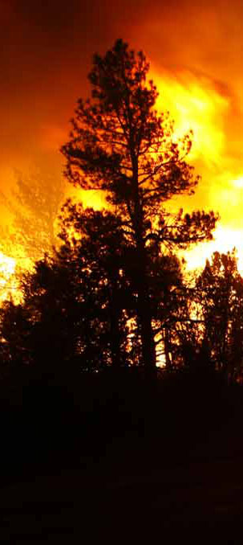
2019 NIROPS National Summary
Tom Mellin,
National Infrared Program Manager
November 14, 2019
TFRSAC, NIFC, Boise

Slide 2
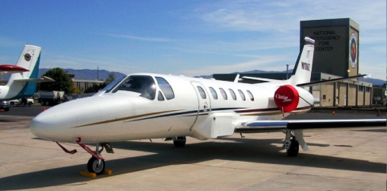
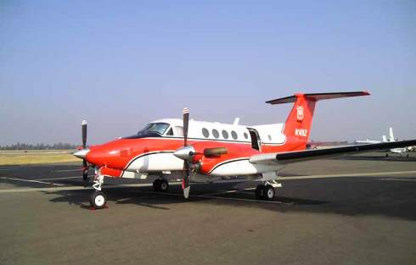
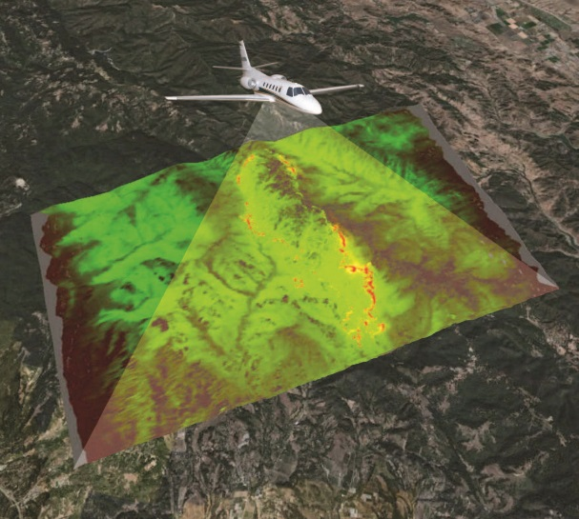
NIROPS Platforms & Systems
144Z Cessna Citation Bravo II
2 FS aircraft
3 Phoenix Imaging Systems
  2 thermal bands (3-5µm, 8-12µm)
  120° field of view
  6 mile swath at 10,000 ft AGL
  Ortho-imagery delivered via Aircell
  Can image 300,000 acres per hour
Supplemental support via Aircraft 3
Service ordered by the incident
149Z Beechcraft Super King Air 200
Notes:
Planes are managed/coordinated nationally. The incident doesn’t control the plane.

Slide 3
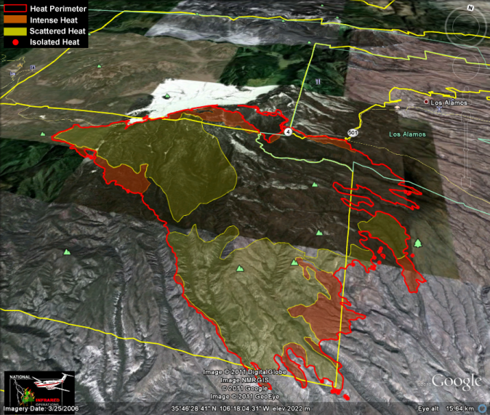
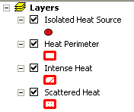
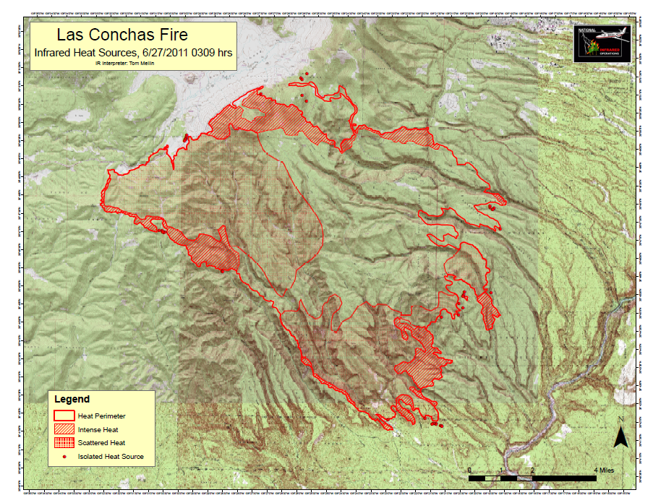
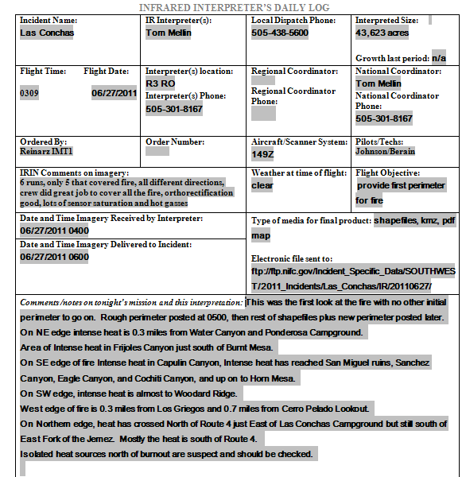
Products Delivered to Incident daily
Shapefiles, map, kmz, log
Notes:
Shapefiles for GISS to incorporate into other maps
Maps and kmzs for non-GIS folks (Ops, SITL, plans Chief, FBAN) to view information
Log acts as a briefing to discuss fire growth, imagery issues, and provides documentation
These are internal products delivered to the IMT in time for morning briefing 6am, more typically by 0400/0430.

Slide 4
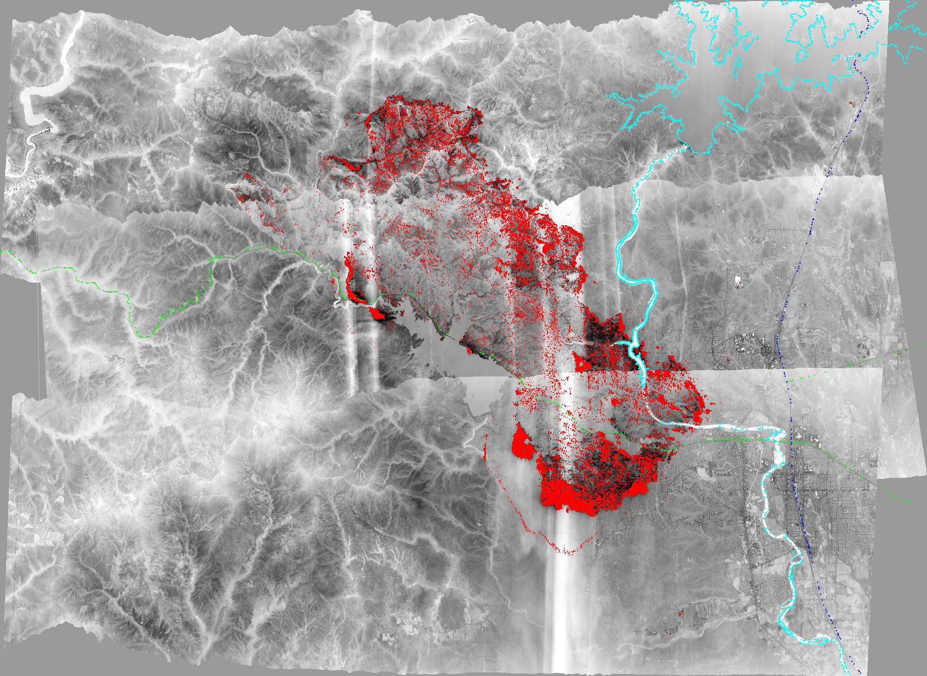
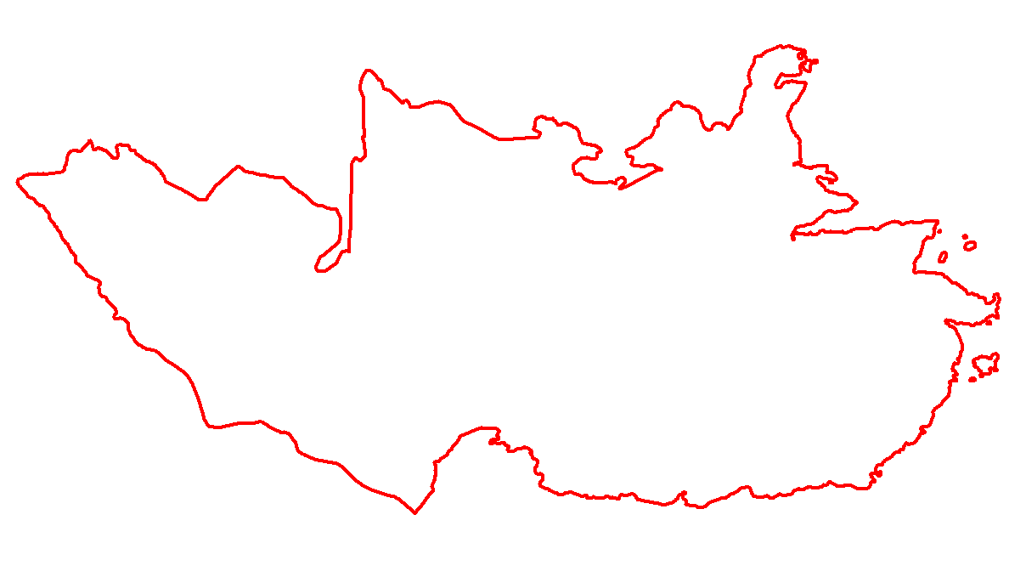
Whiskeytown Lake
Downtown Redding
Carr Fire, 0034 MDT, July 27 2018
Growth of 32,791 ac from previous IR flight
Notes:
Carr Fire in Northern CA grew 32,791 acres from 11,659 acres previous IR flight to 44,450 acres, final acreage 229,651

Slide 5
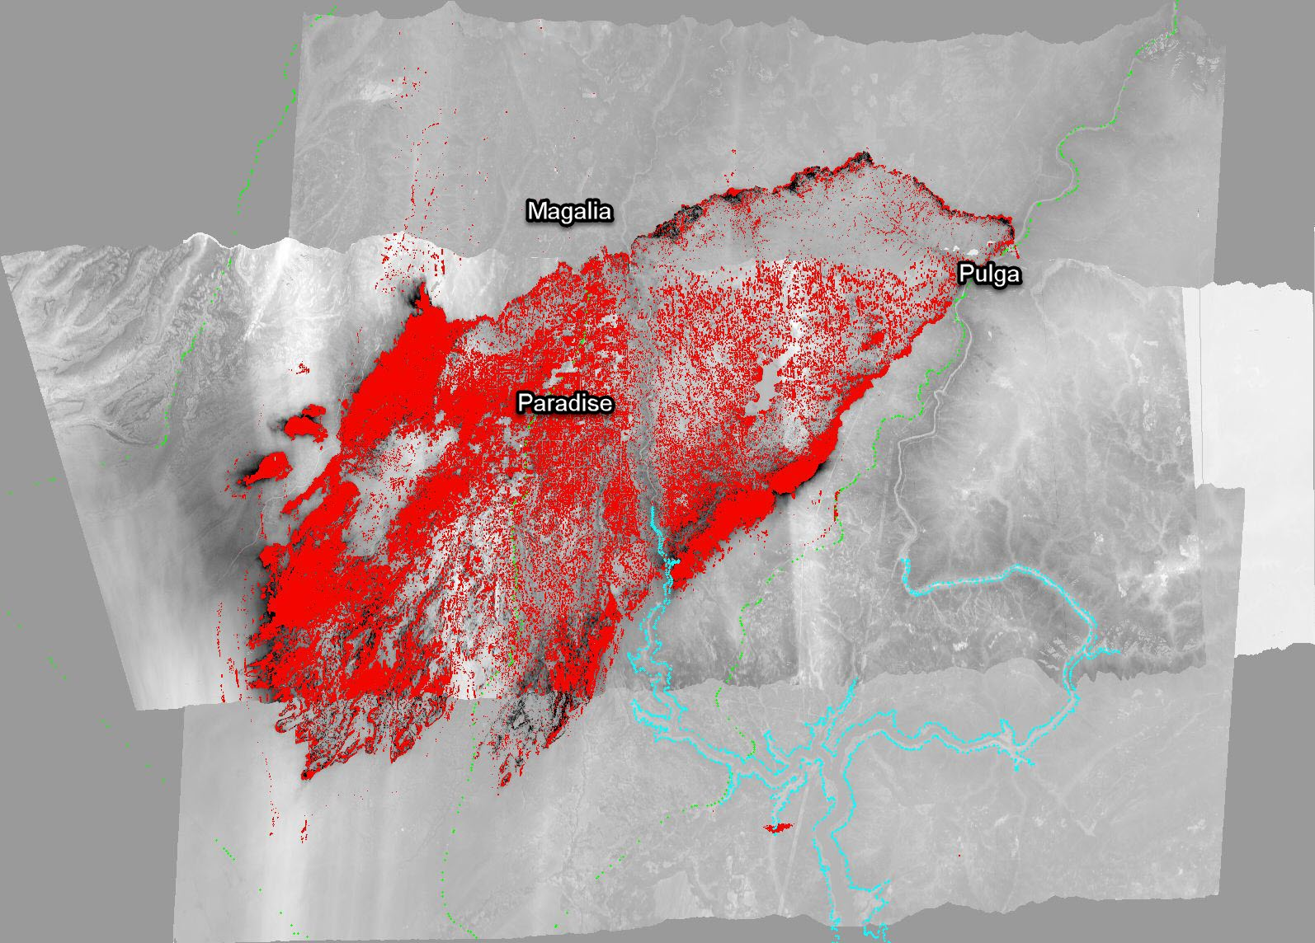
Camp Fire, 1754 PDT, Nov 8, 2018
Growth of 54,586 ac in 11.5 hours from ignition
Notes:
First IR flight on Camp Fire
Started at 0630, by 1800 was 54,586 acres

Slide 6
2019 – A Slow Year
4.6 million acres burned, 56% acres in AK
70% of the ten year average (2009-2018)
Never went to PL4*, first time since 2010
First missions – June 12 in AZ, NM, & CA
Last mission – ?
Acres from IMSR 11/5/19
*PL = Preparedness Level (1 thru 5)
Notes:
49 days at PL 4/5
2018 – 8.8 million acres 132% of 10 yr avg
2018 – 47 days at PL 4/5, 34 days at PL 5

Slide 7
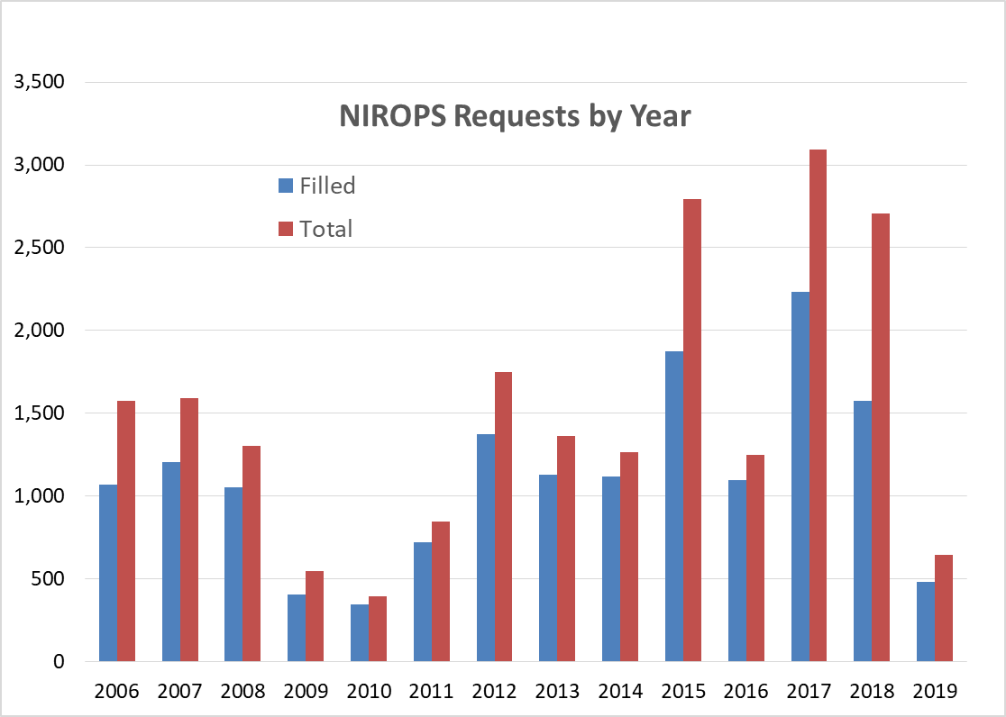
2019 NIROPS Requests
643 total requests with 483 filled
10 yr avg (2009-2018) 1601 requests and 1188 filled
5 yr avg (2014-2018) 2221 requests and 1579 filled
25% UTF rate,
13% non-Wx UTF
Aircraft 3 filled
6% of missions
(15% in 2018)
Notes:
Numbers are current as of 11/05/19.
2018 – 42% UTF, 33% non-Wx UTF

Slide 8
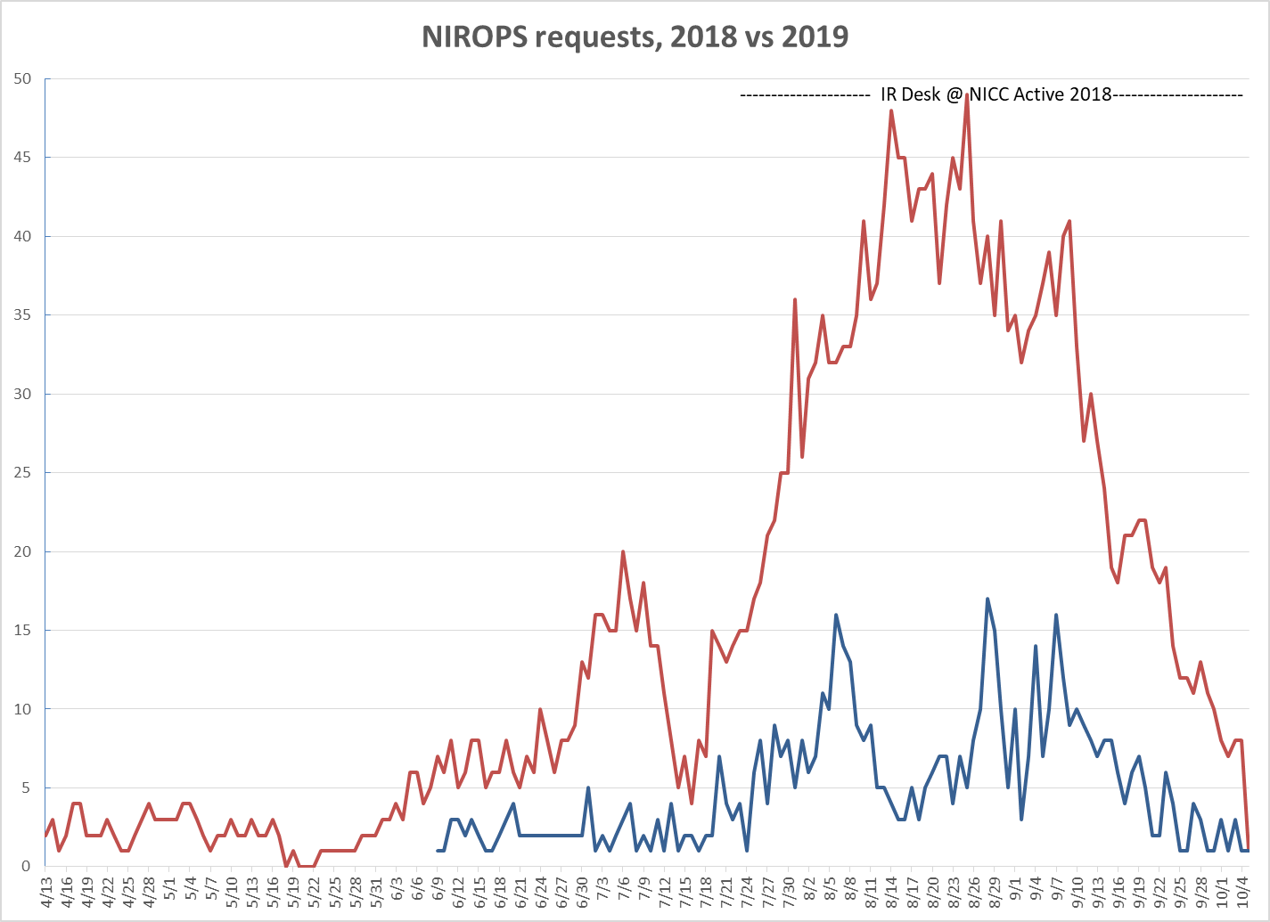
Notes:
IR desk staffed from 7/22 thru 10/1 in 2018,
2017 peak was 69 requests
2015 peak was 63 requests

Slide 9
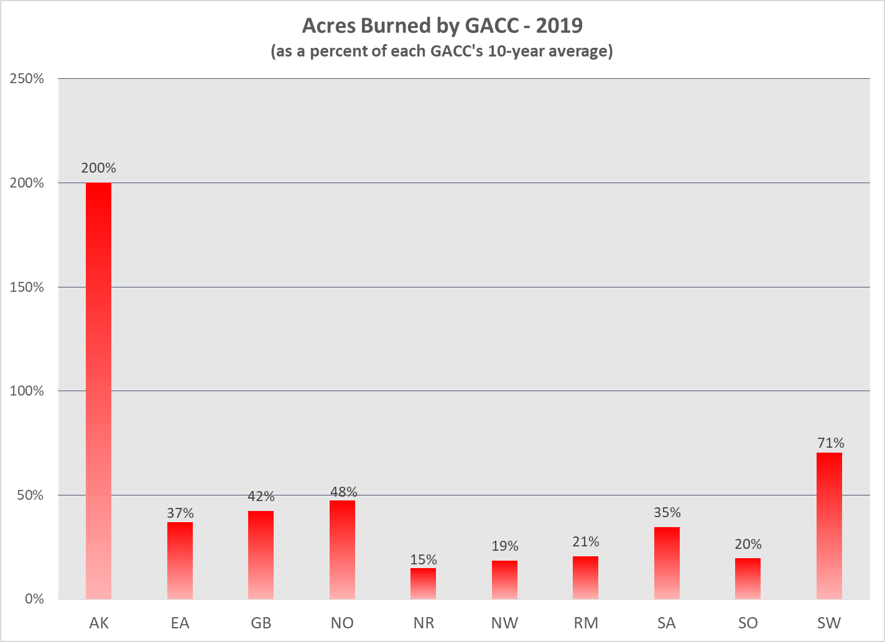
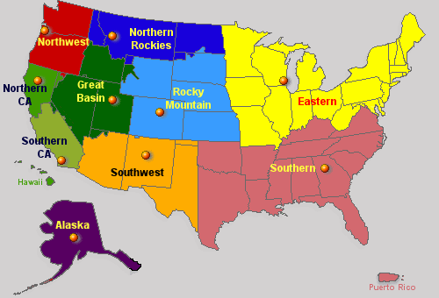
Fire Activity by GACC
Notes:
Acreages from IMST 11/5/19

Slide 10
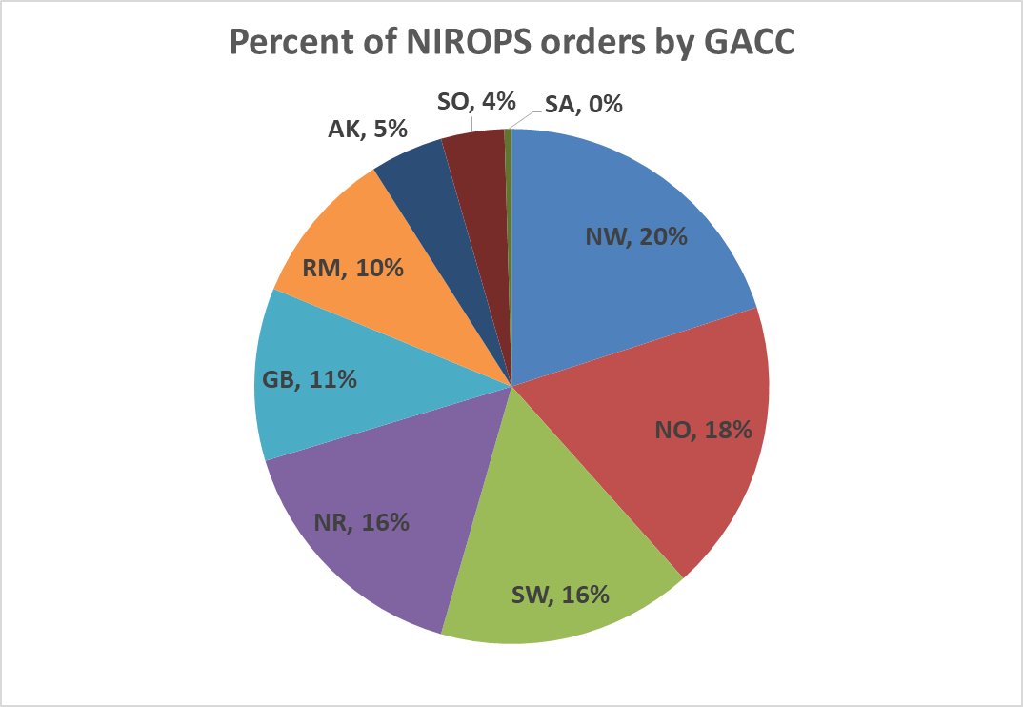
2019 – Orders by GACC
Notes:
2017 – NR 24%, NW 27%, NO 8%, GB 18%, SO 5%, SW 6%, SA 2%, RM 10%

Slide 11
“Busiest” Night – 8/6/19, 16 Fires
N149Z (14 fires)
  Horsefly, Snow Creek, Nevada Creek, Beeskove (MT)
  Cove Creek, Nethker, Crab, Ranger, Myers, Wilies, Elbow Bend, Barren Hill (ID)
  Williams Flats (WA)
Tenax (2 fires)
  East Evans, 163 HK Complex (OR)
2018 Busiest night was 8/23 with 40 fires flown
2017 Busiest night was 9/1 with 48 fires flown

Slide 12
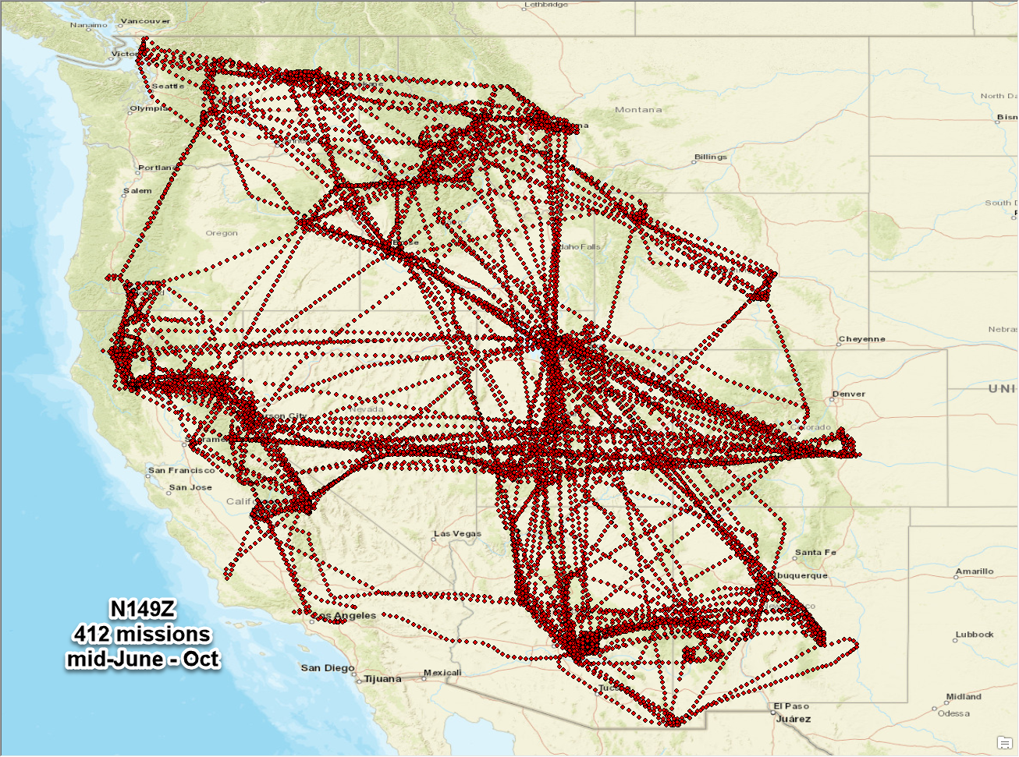
149 AFF map
Notes:
June 12 – Oct 22 shown

Slide 13
IR Mapping Contract
Awarded to 5 vendors, only 2 used in 2019
Contract good thru 2020 fire season
Delivers same suite of NIROPS products
Tenax flew 40 missions in OR, WA, CA
  July 25 – Aug 14
Courtney Aviation flew 1 mission in CA

Slide 14
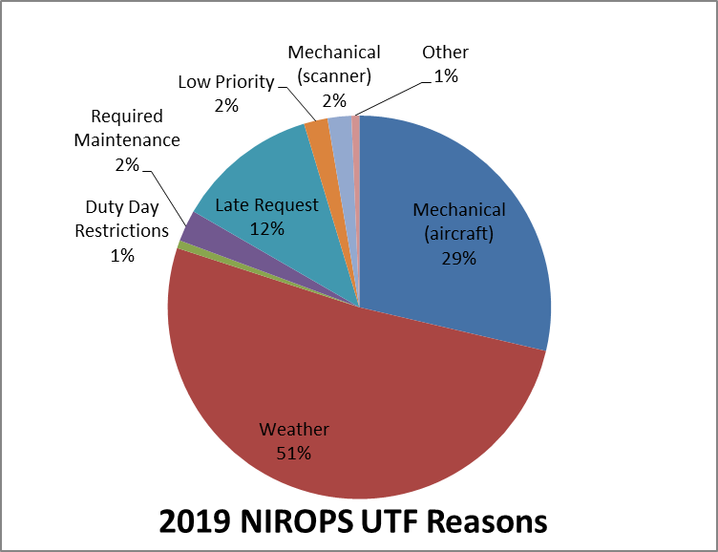
UTFs (Unable to Fill)
150 total UTFs (NIROPS only)
UTF rate drops from 25% to 13% when weather UTFs are not counted
UTF for Aircraft 3 - 25% (20% non-weather)
Notes:
2018 – mechanical aircraft 28%, required maintenance 24%, weather 22%
2017 – mechanical aircraft 31%, weather 25%
2016 – weather 43%, 6% non-weather UTF rate
2015 – duty day restrictions 45% due to pilot staffing issues, 26% non Weather UTF rate

Slide 15
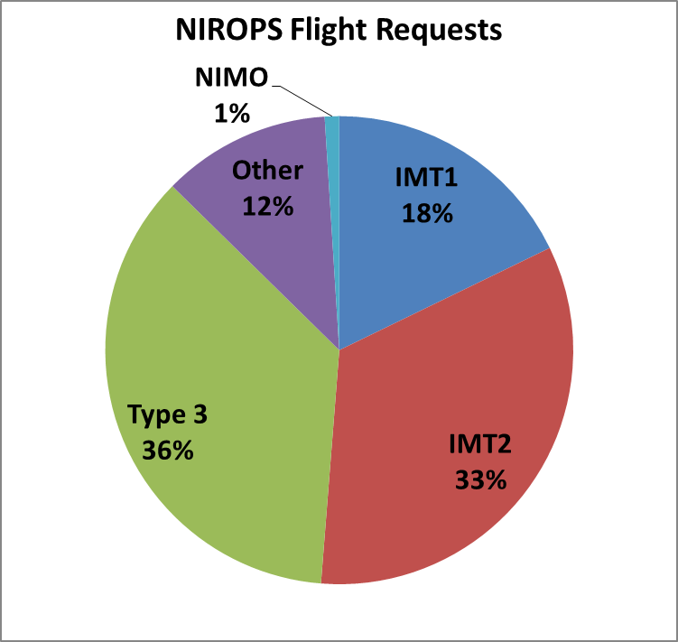
Who is Requesting?
53 orders did not fill out (out of 654)
Prioritization is key
Notes:
2018– IMT1 29%, IMT2 35%, IMT3 22%, Other 12%, NIMO 2%

Slide 16
Extended Support to Incidents
Decker (CO) – 29 flights
South (CA) – 21 flights
Woodbury (AZ) – 18 flights
Swan Lake (AK) – 16 flights
Taboose (CA) – 15 flights
Beeskove (MT) – 12 flights
Middle (CA) – 12 flights
Notes:
Increased reliance on IR as more fires are managed with a combined strategy – suppression and monitor/confine
Soberanes had 75 flights in 2016, Natchez had 63 in 2018

Slide 17
It Takes a Team!
IR Techs - x person rotation
Pilots – 3 FS fulltime
22 different IRINs, 1 trainee got assignment
Vendors – Tenax and Courtney Aviation
National IR desk never activated
Aircraft 3 (Firehawk) coverage key during maintenance on NIROPS aircraft and AK support - AC3 liaison at GTAC and NGA analysts
R4 Aviation maintenance crew
Notes:
Pilots - Dan Johnson, Don Boyce, Carl Helquist, Sam Ramsey, Jeff Watts
Techs - Kaz Kazimir, Jill Keunzi, , Rob Navarro, Josh Bayock, Mike Mann, Kelli Gammons, Bob Brantlinger, Brian Teats
Jan Johnson AC3 liaison,
AC3 analysts - Joe McQuade, Nate Meyers, Greg Smith, Troy Klinger

Slide 18
Takeaways from 2019
Vendor support helped esp. with only one plane
Planes are getting older every year!
  149Z – 35 years old (1985)
  144Z – 19 years old (2001)
Coordination with other IR resources is key
  DRTI, MMA, Owyhee Air, AA51, FS Cobras
  Can sometimes reduce NIROPS requests
We got lucky!

