Slide 1
Forest Service Update 2016
Tactical Fire Remote Sensing Advisory Committee Meeting
May 24, 2016
Everett A. Hinkley
National Remote Sensing Program Manager
USDA Forest Service

Slide 2
Talking Points
The National Remote Sensing Program
Big Changes at RSAC
Budget Challenges
Programmatic Challenges
Data Challenges
Opportunities
Unmanned Aircraft Systems – Current Status

Slide 3
The National Remote Sensing Program
The National Remote Sensing Program provides critical subject matter expertise to a wide range of agency business areas including; Engineering, Fire & Aviation Management, Forest Health Protection, Research and Law Enforcement & Investigations.
The program provides remote sensing leadership and guidance to the GMO Program Managers, Assistant Program Managers, and Geospatial Centers, as well as Forest Service regions and field units.

Slide 4
Approaching New Technology

Slide 5
Big Changes at RSAC
The Remote Sensing Applications Center (RSAC) is integrating with merging with the Geospatial Service & Technology Center (GSTC). Result: Geospatial Technology Applications Center (GTAC)
What are the impacts to remote sensing support in the integrated center?
Loss of key personnel at RSAC & GSTC
Moving to a new facility in downtown SLC
Looking for a home for the X-Band antenna
Loss of direct access to aerial film at APFO. Both a good thing and a bad thing…..

Slide 6
Budget Challenges
We continue to see downward pressure on funding for all program areas resulting in:
Inability to recruit and fill key positions
The Forest Service desperately needs young creative minds to effectively support our mission going forward. Institutional knowledge is critical.
RSAC Program Support – funding from sponsors for contract support continues to decline.
Decreased ability to fully support key programs: NAIP, Alaska Mapping Initiative, USDA Satellite Imagery Archive, USGS 3DEP, etc.
Decreased ability to research and evaluate new technologies.
INABILITY TO TRAVEL AND PARTICIPATE IN CONFERENCES!!
It’s all about “optics”
We seem to spend more time on justifying and documenting actions and expenditures than we do in actual productive work.

Slide 7
Programmatic Challenges
With reduced funding, personnel and travel, we are limited in our ability to keep up with technology and new ways of doing business.
“A vision without resources is simply a hallucination” - Robert Zitz / Leidos

Slide 8
Programmatic Challenges
21,300 cannisters of aerial film at the Aerial Photography Field Office in Salt Lake City – Going to National Archives in 5 years
Use of lidar within the agency and support to the USGS 3D Elevation Program
Collaboration, communication and support to the field in times of reduced budgets and staffing

Slide 9
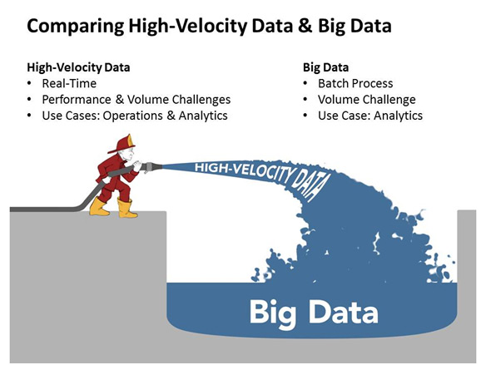
Data Challenges

Slide 10
Data Challenges
How do we manage and efficiently exploit the exploding sources of earth observation data?
Enable – Provide consistent and reliable access to data sources
Equip – Provide Forest Service analysts with the needed technology (hardware and software)
Provide – Streamlined capabilities (cloud? Storage, viewing, exploitation and analysis)
Establish – On-the-fly solutions
Develop – New tools / Crowdsourcing?
Sue Gordon / Deputy Director NGA – Move toward anticipatory analysis (disaster support, wildfire support, climate change, etc.)

Slide 11
Opportunities
Working with other agencies is clearly on the increase
Collaboration / Coordination on data collection
Communication – Sharing of expertise and best practices
Technology is ripe for the picking
Accessibility / Consistency / Accuracy / Reliability of (digital) authoritative data sources is rapidly increasing
Cloud Services is looking more attractive
Growing support for a NASA – Forest Service Forum in 2016
Intent: Put FS needs and priorities on the table and look for more efficient interaction between the two agencies.

Slide 12
Where We Want To Be

Slide 13
Unmanned Aircraft Systems
Completed Actions – UAS Executive Committee Report
Purchase cards may not be used to purchase sUAS.
RAOs shall be coordinated with on “all UAS operations, activities, concerns or requests”
UAS Incursions over wildfire - The National Interagency Aviation Committee - UAS subcommittee developed a notification protocol to help firefighters on the ground identify the process when dealing with a non-participating UAS over or near a wildfire.

Slide 14
Unmanned Aircraft Systems
Ongoing Efforts
Forest Health Protection (FHP) UAS contract - FHP and the WO have been working to finalize contract specifications for an aerial survey project. This is the first time the USFS has contracted for commercial UAS services. The intent of the FHP project is not only to acquire imagery, but to test the contracting for commercial UAS services process.
Chief’s 2016 Letter - The UAS-ESC drafted a letter for the Chief’s signature to communicate where we are today as an agency. They had specific topics to be included, such as vision, privacy, acquisition, and data collection among others.
National UAS Desk Guide- The UAS-ESC has tasked the UAS-AG to use the various regional UAS desk Guides as a basis to developing one National version.

Slide 15
Unmanned Aircraft Systems
Ongoing Efforts
FAA Memorandum(s) of Agreement - The FAA and the USFS have been working on two MOAs that would provide access to the NAS.
Interagency Fire UAS Subcommittee (IFUASS) - The NIAC sponsored subcommittee met in Boise to discuss UAS integration within the fire mission.
Aviation Business Case - The UAS-AG is working on a needs analysis and staffing out the use of and need for UAS within the agency.
Webinar for employees - A webinar to help educate employees on use of UAS is being developed.

Slide 16
Unmanned Aircraft Systems
Efforts yet to be resourced
Closure of Forest Lands for public safety and privacy - Currently no authority in the CFRs for closure of NFS lands specific to UAS
Data Management Infrastructure – The CIO is identified as the POC for establishing an infrastructure to support UAS data collection.
GAO Audit - There will be an audit of USDA agencies conducted by GAO. The USFS will be involved but the extent is not fully known yet. The focus is “risks associated with small unmanned aerial systems (UAS)”.
Testing and Evaluation of UAS in the fire mission – ongoing discussion with DOI which maintains a fleet of sUAS. The BLM is contracting for CWN UAS services this fire season
Notes:
CWN = Call When Needed contract

Slide 17
Questions
“Any sufficiently advanced technology is indistinguishable from magic” – Asimov
“A dreamer is one who can only find his way by moonlight, and his punishment is that he sees
the dawn before the rest of the world." Oscar Wilde

Slide 18
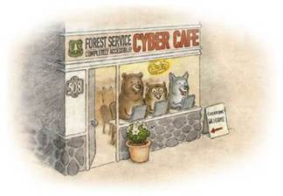
Contact Information
Everett A. Hinkley
National Remote Sensing Program Manager
USDA Forest Service
703-605-4580 / ehinkley@fs.fed.us

