Slide 1
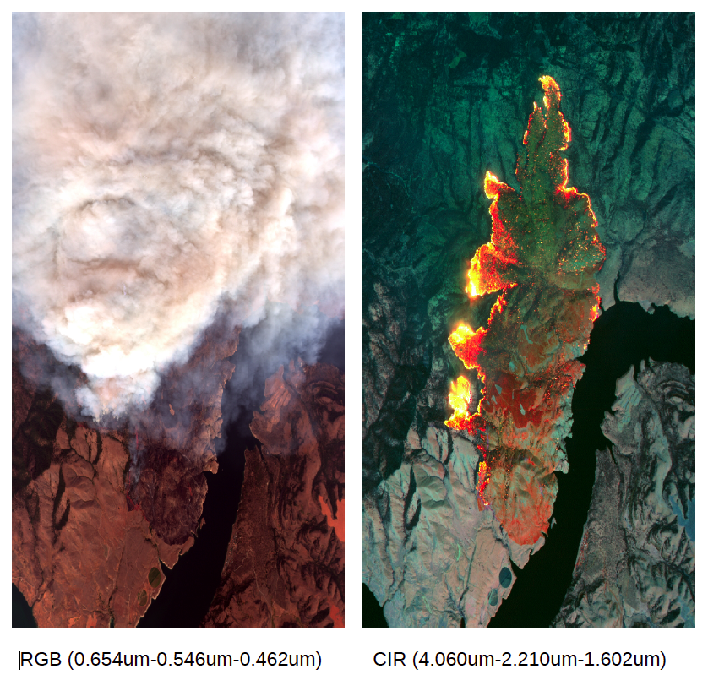
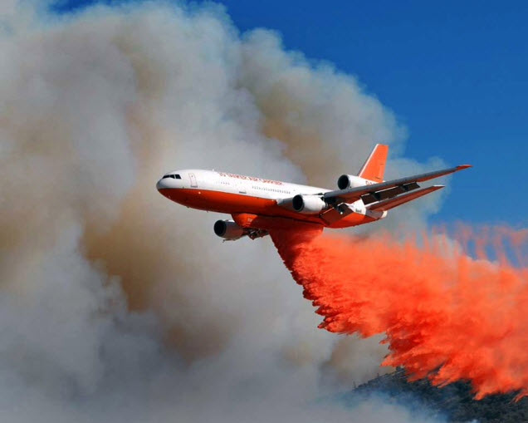
A NASA Earth Science Division Wildfire Overguide
Research, Development, and Technology Transition Program
To advance our nation’s ability to predict and manage wildfires and mitigate their impacts
Barry Lefer & Mike Falkowski
NASA Earth Science Division
1
Notes:
Title slide w/ LandSat image of Camp Fire. See alternates in backup.

Slide 2
Wildfire Capabilities & Support Delivered by NASA
NASA ESD provides significant, sustained support to US wildfire community including:
  NASA developed and sustains Fire Information for Resource Management System (FIRMS) web-based tool, to identify location, extent, and intensity of wildfire activities and provide automatic alerts
  NASA and US Forest Service tailored FIRMS for US/Canada wildfire management needs, operational as of July 2021
  NASA ESD and US Forest Service initiated and co-chair Tactical Fire Remote Sensing Advisory Committee (TFRSAC) to evaluate and implement new federal capabilities in Earth observation and geospatial technologies in support of wildland fire management communities
  NASA Applied Science Disasters Program provides real-time data and analytic support for major fires, including deploying aircraft to active and post-fire locations
  NASA was a key participant in the 2021 BurnEx exercise with the California National Guard and other key stakeholders to prepare for the FY21 fire season
  NASA ESD provides free, web-based training through the ARSET program on using remote sensing data in pre-, active-, and post- fire regimes
  NASA ESD has invested in field campaigns (e.g. FIREX-AQ) and process studies on all stages of fires, and shared those results

Slide 3
Needs Assessment Workshop (May 2021)
In conjunction with the bi-annual TFRSAC meeting, NASA and US Forest Service, conducted a workshop to understand state-of-the-art, needs, and opportunities to improve wildfire management
  Identify the needs and challenges of stakeholders at various decision cycles from planning, prediction, detection, tracking, mitigation, suppression, and post-fire remedial efforts
  154 attendees from other government organizations, academia, industry, and NASA
Main Findings
  Lack of persistent communications, aerial operations, & surveillance for fire detection and tracking
  Lack of airspace technologies to enable multiple types of aircraft operating simultaneously
  Lower aircraft safety record than other areas of aviation
  Lack of adequate coordination among multiple government agencies
  Need a clear plan to mature research for operational use in field
  Need for additional remote sensing observations for pre-, active-, and post-fire conditions
  Need for actionable information on fire risk, fire behavior, and fire impacts
Findings offer insights where NASA research and technology development
could make a significant impact
Notes:
Communications at fire fighting locations is not reliable and not always possible
Rogue drone operations result in grounding of aerial fire suppression missions-“If YOU Fly, We CAN’T”
~25% of aerial accidents due to Loss of Control, ~25% due to Controlled Flight Into Terrain, and ~15% due to Weather*
Aerial fire suppression is largely limited to visual meteorological conditions (only 4-6 hours/day)
All aerial assets are not utilized due to lack of airspace coordination
Lack of consistent data management and models – particularly harmonized, integrated decision-making in the hands of users
Lack of adequate coordination among multiple agencies for cohesive strategic plan

Slide 4
Current Wildfire Management Challenges
Detection Tracking, Surveillance, and Prediction
  Surveillance - infrequent high spatial resolution satellite (LEO) or aircraft observations miss much of the fire progression; more frequent coarse resolution satellite (GEO)
  Fire detection and location accuracy is not always precise enough
  Few reliable models for tracking and predicting fire progress
Better sensing is needed, difficult to observe through clouds and at night
Data and model fusion is limited, need for an integrated observing system
Lack of miniaturized sensor for UAS
Rogue drone operations result in grounding of aerial fire suppression missions
Multi-Agency Planning
Multi-agency collaboration for resource and technology roadmap needs to be improved
Budgets to support forest management and strategic planning are often redirected in season for tactical firefighting (limits adoption of new research and tools in fire management)
Notes:
Communications at fire fighting locations is not reliable and not always possible
Rogue drone operations result in grounding of aerial fire suppression missions-“If YOU Fly, We CAN’T”
~25% of aerial accidents due to Loss of Control, ~25% due to Controlled Flight Into Terrain, and ~15% due to Weather*
Aerial fire suppression is largely limited to visual meteorological conditions (only 4-6 hours/day)
All aerial assets are not utilized due to lack of airspace coordination
Lack of consistent data management and models – particularly harmonized, integrated decision-making in the hands of users
Lack of adequate coordination among multiple agencies for cohesive strategic plan

Slide 5
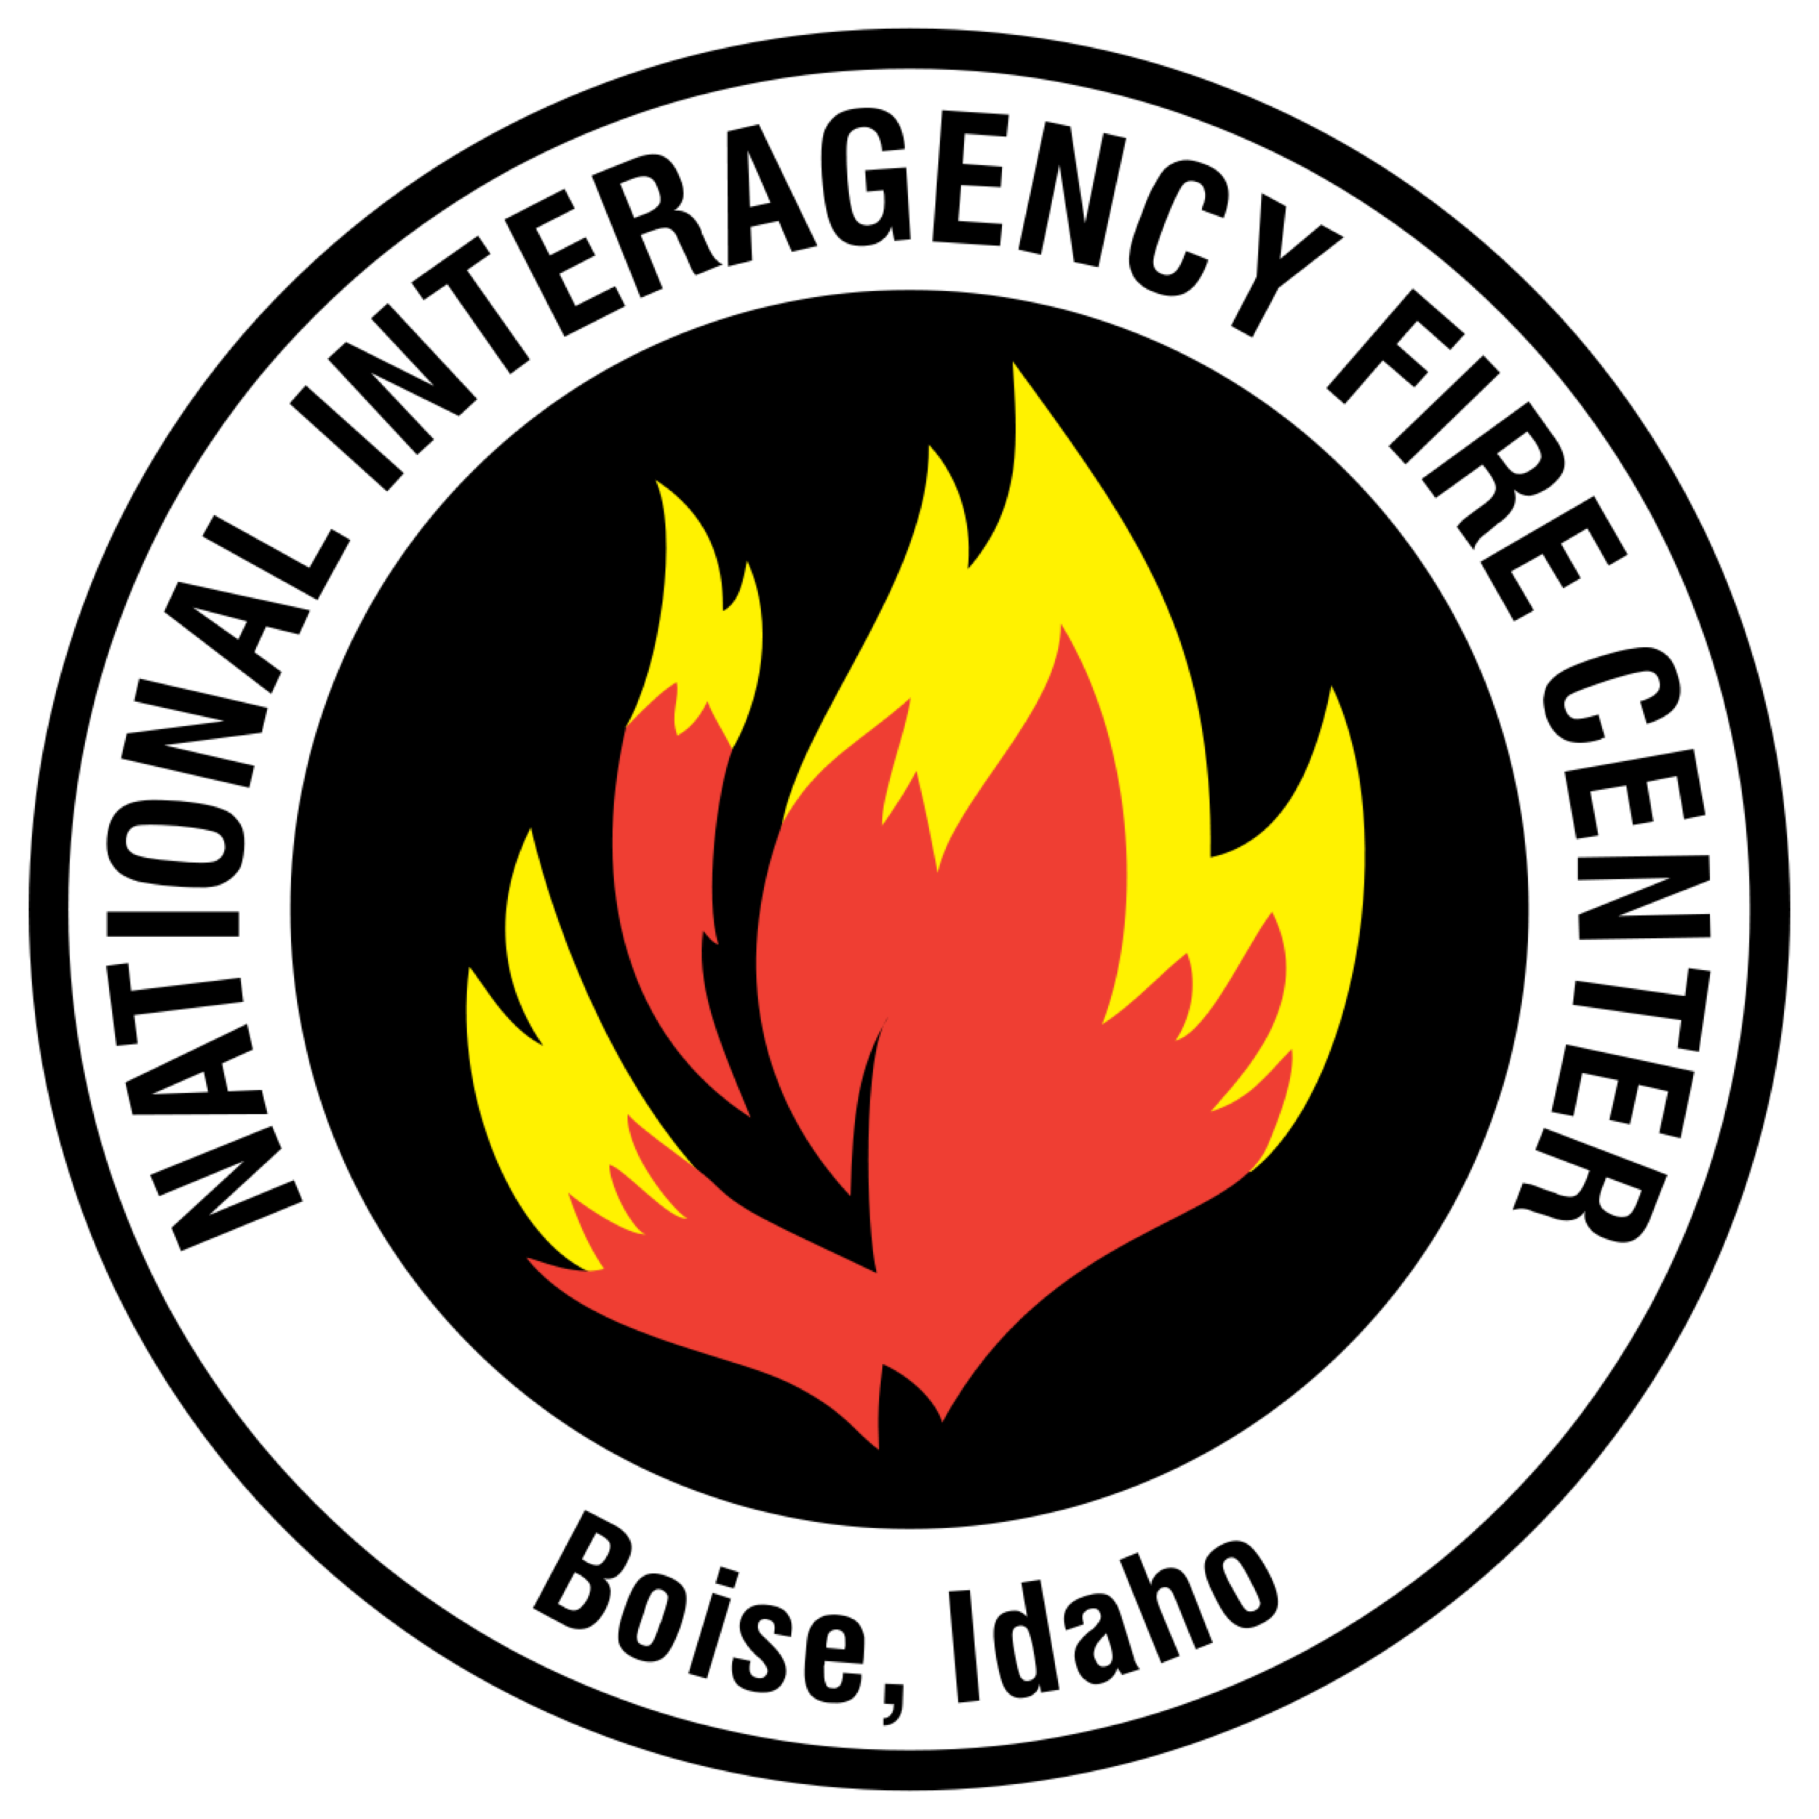
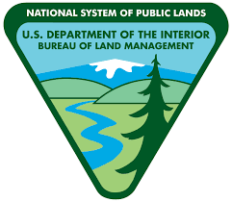


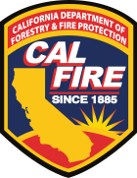







Wildfire Response is a Multi-Organizational Effort
Requires coordination among numerous local, county, state and federal authorities
  National Interagency Fire Center
  Federal Aviation Administration
  United States Department of Interior
  United States Department of Agriculture
  Joint Fire Science Program
  National Guard
  United States Department of Defense
  United States Forest Service
  Bureau of Land Management
  National Oceanic and Atmospheric Administration
  Cal Fire
  … in addition to many others
Notes:
Communications at fire fighting locations is not reliable and not always possible
Rogue drone operations result in grounding of aerial fire suppression missions-“If YOU Fly, We CAN’T”
~25% of aerial accidents due to Loss of Control, ~25% due to Controlled Flight Into Terrain, and ~15% due to Weather*
Aerial fire suppression is largely limited to visual meteorological conditions (only 4-6 hours/day)
All aerial assets are not utilized due to lack of airspace coordination
Lack of consistent data management and models – particularly harmonized, integrated decision-making in the hands of users
Lack of adequate coordination among multiple agencies for cohesive strategic plan

Slide 6
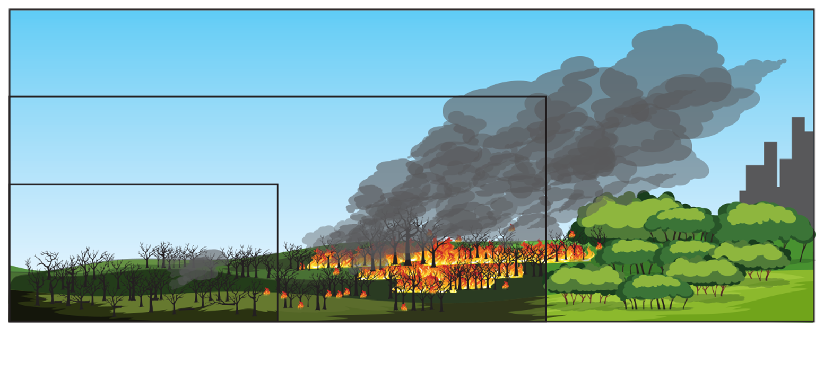
NASA ESD Wildfire Overguide:
Research, Development, and Technology Transition Program
To advance our nation’s ability to predict and manage wildfires and mitigate their impacts
Objectives
Develop and demonstrate evolving NASA tools to reduce fire risk, improve monitoring and response to wildfires while mitigating impacts to enhance safety and prevent economic loss.
Approach
Better understanding of fire across the entire life-cycle (pre-, active, and post-fire) including fire vulnerability, behavior, and impacts
Fuse satellite/airborne observations with models to support fire research and management
Engage with Stakeholders to inform the development of integrated wildfire response system (NASA Wildfire Stakeholder Meeting: February 4th, 2022)
Establish Public-Private-Philanthropic Partnerships to test and implement prototype capabilities and support transition/adoption by stakeholders

Slide 7
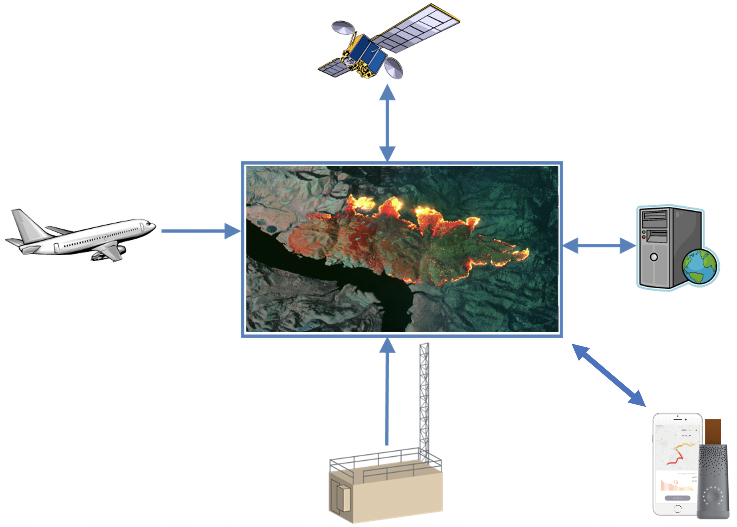
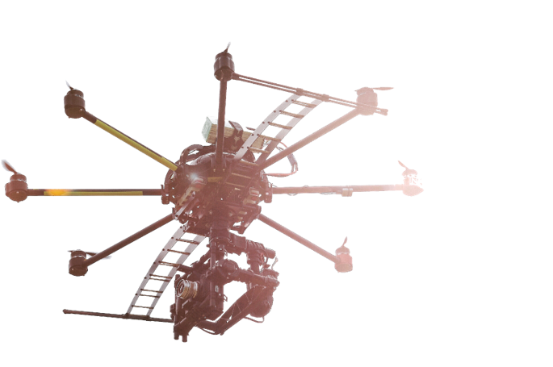
Key Areas of NASA Impact on Wildfire Management
Sensing, data fusion and multi-model integration for societal benefit
  Facilitates comprehensive data collection and development of innovative miniaturized advanced sensors/models to better detect wildfire risk, propagation, and impacts
  Predict fire spread to enhance suppression and emergency response efforts and real time resource optimization
  Integrate remote sensing and modeling to predict and mitigate wildfire impacts such as debris flows and degraded vegetation as well as air & water quality
Comprehensive pre-, active-, & post-wildfire integrated observing system
Provide open-source tools for actionable information needed by stakeholders to make informed decisions
Persistent, integrated, diverse crewed & uncrewed observations
  Integrated system requirements, design and prototype for persistent observations with multiple diverse vehicles for increased and rapid aerial response to wildfire

Slide 8
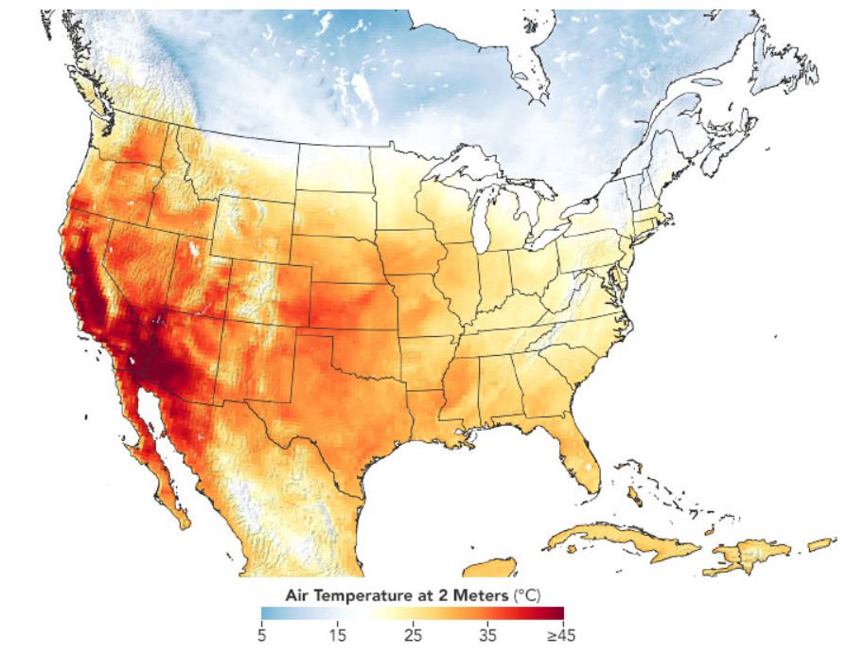
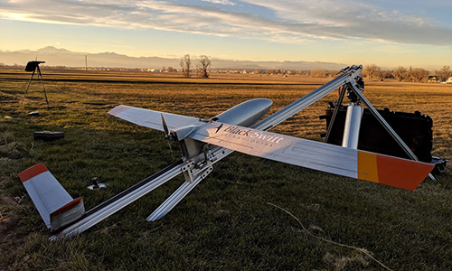
A multi-disciplinary collaboration between different NASA Centers and external partners to address wildfire needs
NASA Earth Science Division
Satellite assets Earth sensing payloads Miniaturization of key sensors for UASs Data fusion and modeling Decision support tools Crewed and Un-crewed airborne fleet On-going collaborations with multiple agencies in disaster response Open source science New integrated observing strategies from ground, to air, to LEO/GEO and beyond with model fusion
California Heat Wave - Trends
ER-2 flight tracks of NASA sensors collecting data
Blackswift UAS
Platforms

Slide 9
NASA Earth Science Division Deliverables
Early actions (first 2 years):
Engage with multi-organization partnership to understand stakeholder needs
Leverage existing wildfire modeling and observations to develop integrated wildfire dashboard
Collect targeted remote sensing observations of pre-, active-, and post-fire conditions for key partners (using existing sensors and aircraft)
Longer term impacts:
Multi-organizational, end-to-end systems approach for a stakeholder solution
Provide a fused wildfire information system for stakeholders leveraging autonomous/affordable/miniaturized sensors and modeling tools
Persistent aerial operations and communications systems to enable near 24X7 observations (NASA ARMD)
Engagement with stakeholders to transfer the benefits of NASA research and technology

Slide 10
Some Additional Details
Overguide Plan base on funding to start in FY23
Save the date: NASA Wildfire Stakeholder Workshop – February 4th 2022
NASA Earth Science Technology Office working on a ROSES Element for technology development using overguide funds
NASA R&A is planning ROSES call on Wildfire science

Slide 11
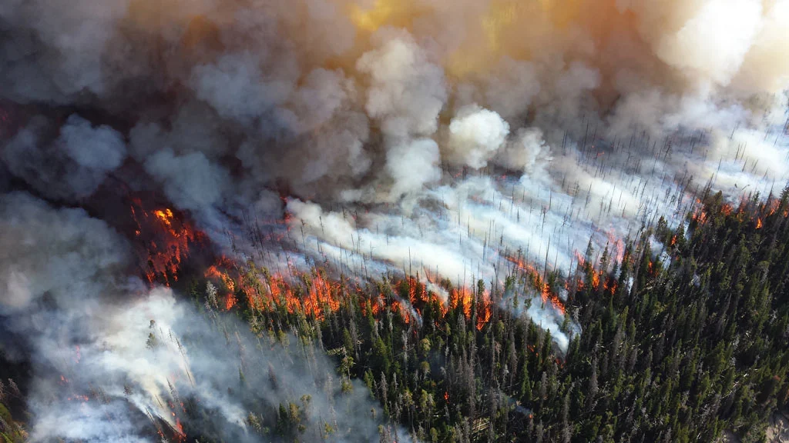
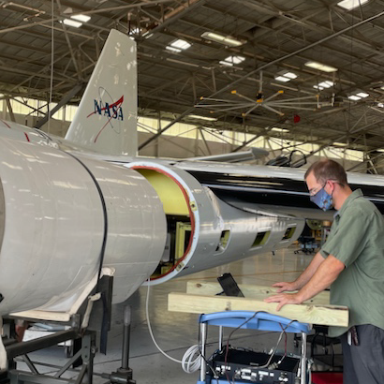
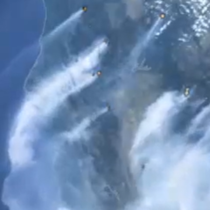
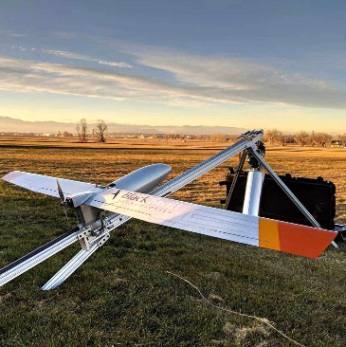
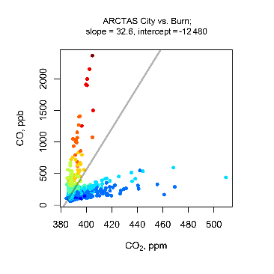
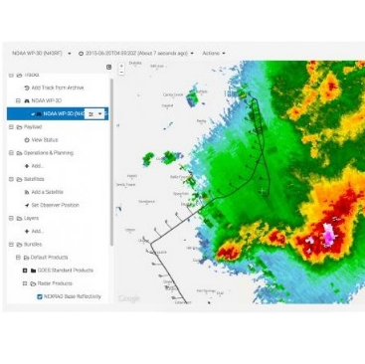

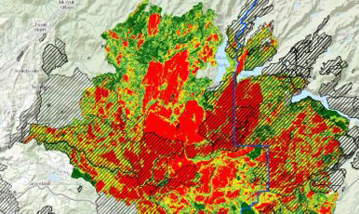




NASA Earth Division Science:
Coming Together on Wildfire Capabilities
Airborne Sensors / Instruments :: Miniaturization & Uncrewed (UAS) Systems
Technology :: Earth System Science :: Data Fusion, Modeling, Visualization, Validation
Constellations :: Fire Science & Ecology
Earth Science Division
Airborne sensors / instruments & campaigns
Wildfire data integration, modeling, & visualization​
Technology: Miniaturization & UAS platforms
Earth system science: atmospheric science, ecosystem science, hydrology
Wildfire Information System & Situational Awareness
Partnerships
Fire management support: drought & fire risk prediction, fire impact assessments
National Park Service
  Wildfire data integration, modeling, & visualization

Slide 12
Wildland Fire Applications Program
NASA
Earth Science Division
Applied Sciences Program
Earth. Science. Action.

Slide 13














APPLIED SCIENCES
Purposes
Enable people & organizations to apply insights from Earth science to benefit the economy, health, quality of life, and environment.
Work with institutions in the U.S. and worldwide to improve their decisions and actions through applications of Earth science information.
Draw on our connections with users to bring their feedback and inquiries back to ESD to further improve NASA Earth science research, missions, etc.
User-centric and
Applying the most appropriate science

Slide 14


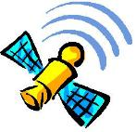
LINES OF BUSINESS
Earth Science Applications
Develop, test, prove-out, and transition uses
Capacity Building
Build capabilities in US and developing countries
Mission Planning
Support applications throughout mission lifecycles
Notes:
Strategy
Address technical and human barriers to uses of Earth science data
- technical: data formats, performance, etc. - human: NIH, risk perception, lack of resources, etc.
Increase real and perceived value
Form positive dependencies
Leverage other organizations’ motivations and networks, so the Earth observations they carry forward in their products and services created sustained and expanding benefits
-----------------
Societal and economic applications
Generate, test, develop, enable adoption, and extol applications ideas for sustained uses of Earth observations in decisions and actions.
Capacity building
Build skills, workforce, and capabilities in U.S. and developing countries to apply Earth observations to benefit society, expand diversity, and build economies.
Applications in mission planning
Identify applications early and throughout mission lifecycle, integrate end-user needs in design and development, enable user feedback, and broaden advocacy.

Slide 15

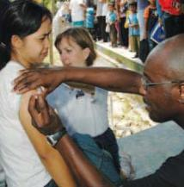
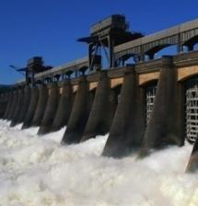
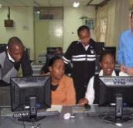
APPLIED SCIENCES
APPLICATIONS AREAS
Agriculture
Disasters
Ecosystems
Health &
Air Quality
Water Resources
Emerging Areas with FY22 PBR:
Climate & Resilience Environmental Justice
Energy Wildfires
CAPACITY BUILDING
Activities span all of the applications themes
Emerging
Indigenous People
Professional Schools
ARSET
Training
DEVELOP
Workforce
SERVIR
International Development

Slide 16


The Wildfires Application Area supports applications of Earth science for tools, collaborations, and modeling on fuel-load, fire-risk, burn perimeters, fire weather, and more.
Wildfires program spans all phases:
» Pre-Fire: Fuel loads & Fire Risk » Active Fire » Post-Fire Rehabilitation
Re-Start with
FY22 PBR
Wildfires
Proposed: Components of Program
On-going engagements with Federal and State agencies on priority topics and needs
Desire for community-based collaborations
Desire for flexibility and agility in scope and duration of projects
Key opportunities across numerous NASA platforms to support pre-fire fuel loads and better resolution on fuels across phases
Opportunity? Support more frequent updates of USGS-USFS LANDFIRE tool of fuel loads and fire risks
Notes:
NASA Internal Use Only - Pre-Decisional Information

Slide 17



APPLICATIONS
Enable innovative to practical uses of Earth science information to help public and private sector organizations make better-informed decisions
Individual Project Grants
Scores of grants to universities and agencies;
Projects develop creative uses of Earth science;
All projects are done with user organizations to support transition and adoption into their decision making
One- and Two-Step Solicitations
Sustained Engagements
For key issues that have broad impact
(e.g., agriculture, water management), we sponsor multi-sector consortia.
Approach allows flexibility in number, size, scope, and duration of projects
Problem-Solving Teams
Team Members routinely interact with managers on the ground to collaborate on topics of emerging and urgent need; Agility and responsiveness
Health and Air Quality Applied Sciences Team
NASA Harvest Agriculture Consortium
Western Water Applications Office
https://haqast.org/
https://nasaharvest.org/
https://wwao.jpl.nasa.gov/

Slide 18
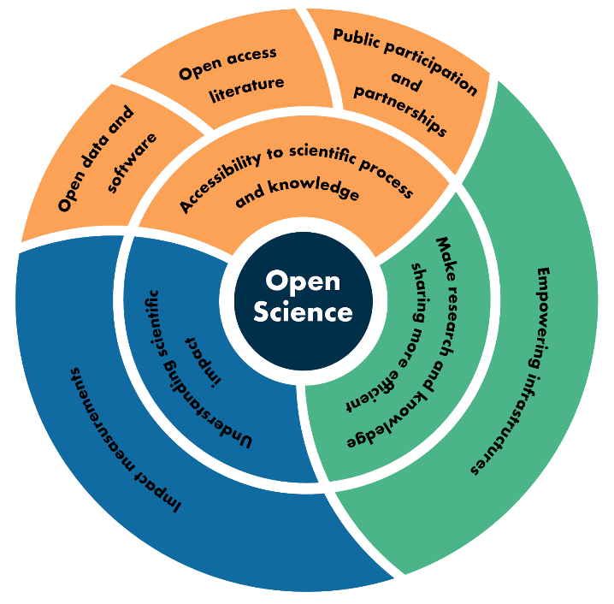
NASA EARTH SCIENCE
Directions & Priorities
INCLUSION: Improving connections with diverse, historically disadvantaged communities on products, applications, and resources
CLIMATE: Strong Administration focus on a changing climate.
Executive Order 14008.
OPEN SOURCE: NASA emphasizing Open Source Science to
broaden community engaged, advance code, exploit data, etc.
POLICY: Policy relevant but policy neutral – can support analysis,
implementation, and efficacy assessments but not advocacy
USABLE SCIENCE: Pushing researchers to build greater
familiarity in working with users

