Slide 1
UPDATE: Forest Service Wildfire Support 2018
Everett Hinkley
Forest Service GIO (acting)
Fall TFRSAC Meeting November 2018

Slide 2
What’s Eating My Lunch
Continuing loss of personnel to retirements without backfilling. We have many “actings” now and this inhibits progress.
Lack of a clear career ladder for bright and motivated people.
Inability to travel and attend conferences. Face-to-face is best for idea exchanges.
Downward spiral in funding having significant impacts on testing and deploying current and emerging technologies.
Enterprise architecture does not support remote sensing needs fully.
Lack of understanding of the value of remote sensing and geospatial data in a land management agency.
Aging sensors, platforms and people (me!).

Slide 3
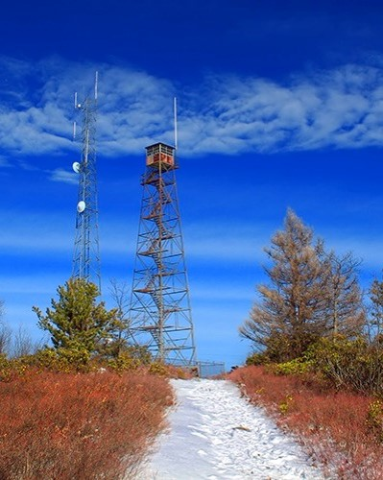
Remote Sensing and Wildland Fire
Fire Phases
Remote Sensing Tools
Pre Fire
Fuels, terrain, weather, assets at risk
Fire Ignition (starts)
Where are the ignition points?
Active Fire
Fire perimeter, hot spots, intense fire
Post Fire
Fire severity
Manned Aircraft
NIROPS
Unmanned Aircraft
Satellite systems
MODIS / VIIRS
Ground observation
Manned towers
Unmanned towers

Slide 4
Current Capabilities – National Systems
Firehawk Fire Mapping Capability (Aircraft 3)
The Firehawk capability provides large scale fire detection/mapping support to incident command operations. The Firehawk product is designed to have the same “look and feel” as products from NIROPS.
Hawkeye Fire Detection and Reporting System
The Hawkeye Fire Detection and Reporting System uses airborne and space borne remote sensing assets to rapidly detect and report new fire starts within the continental United States.
Detected fire starts are relayed to the Ignition Point Database (IgPoint) operated and managed by the Forest Service.

Slide 5
Fire Mapping- 2018 Additional
AC3 Statistics
Overall support: 93 days/nights (!)
Monthly breakdown:
April – 5
May – 12
June – 18
July – 30
August – 28
All GACCs except Eastern have had AC3 support.
AC support was almost entirely Type 1 or 2 fires.
Bottom Line: Without AC3, those Type 1 and Type 2 fires (162) would not have received overhead support. The value of National System support to wildland fire cannot be overstated.

Slide 6
Hawkeye Fire Detection & Reporting 2018 to date
HawkEye anomalies for FY2018 for all U.S. and Canada
Hawkeye Anomaly Detection Stats – FY2018
Quarter | Anomalies
FY2018Q1 | 26,491
FY2018Q2 | 33,309
FY2018Q3 | 22,573
FY2018Q4 (thru Aug 28) | 20,466
Total Anomalies | 102,839

Slide 7
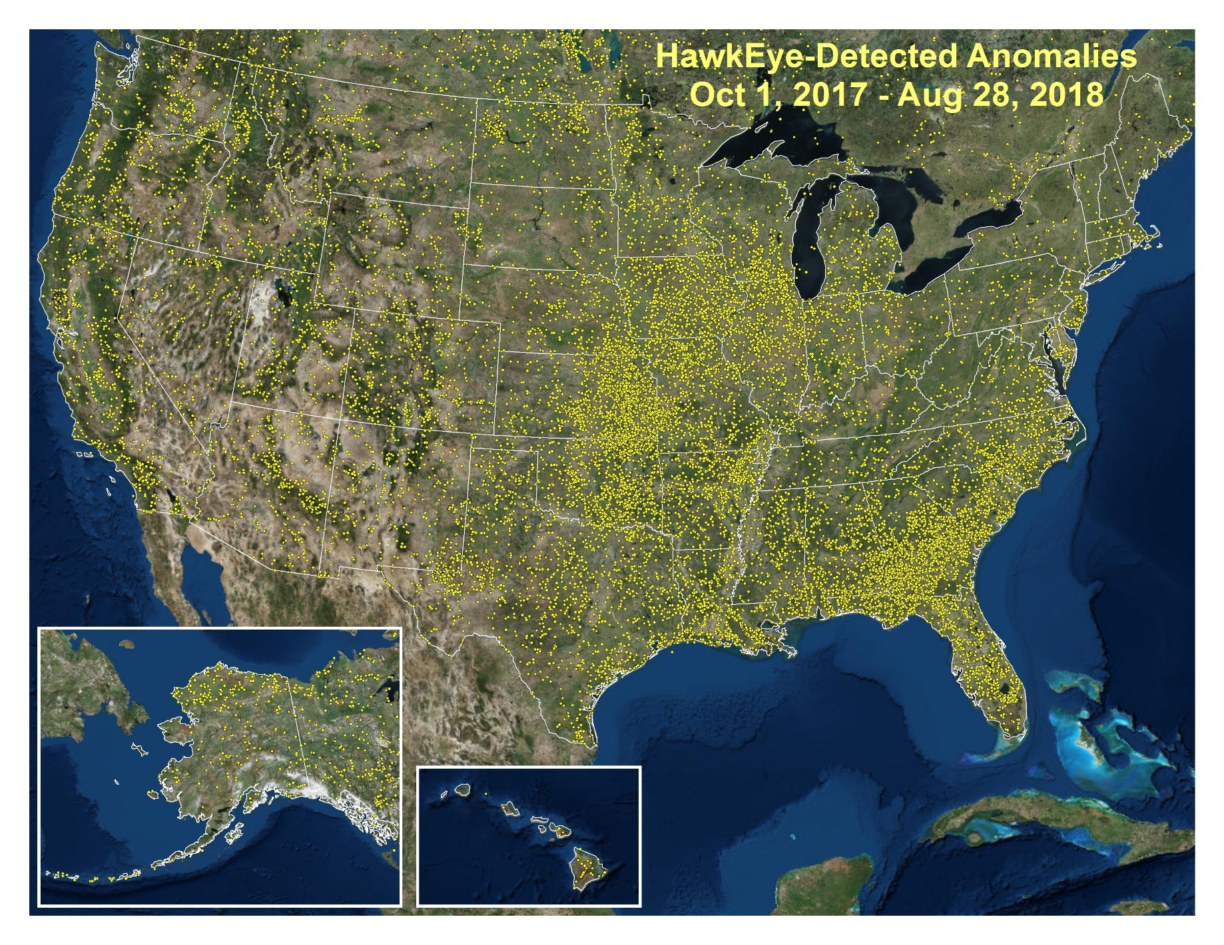
Hawkeye Anomalies 2018 – Central US

Slide 8
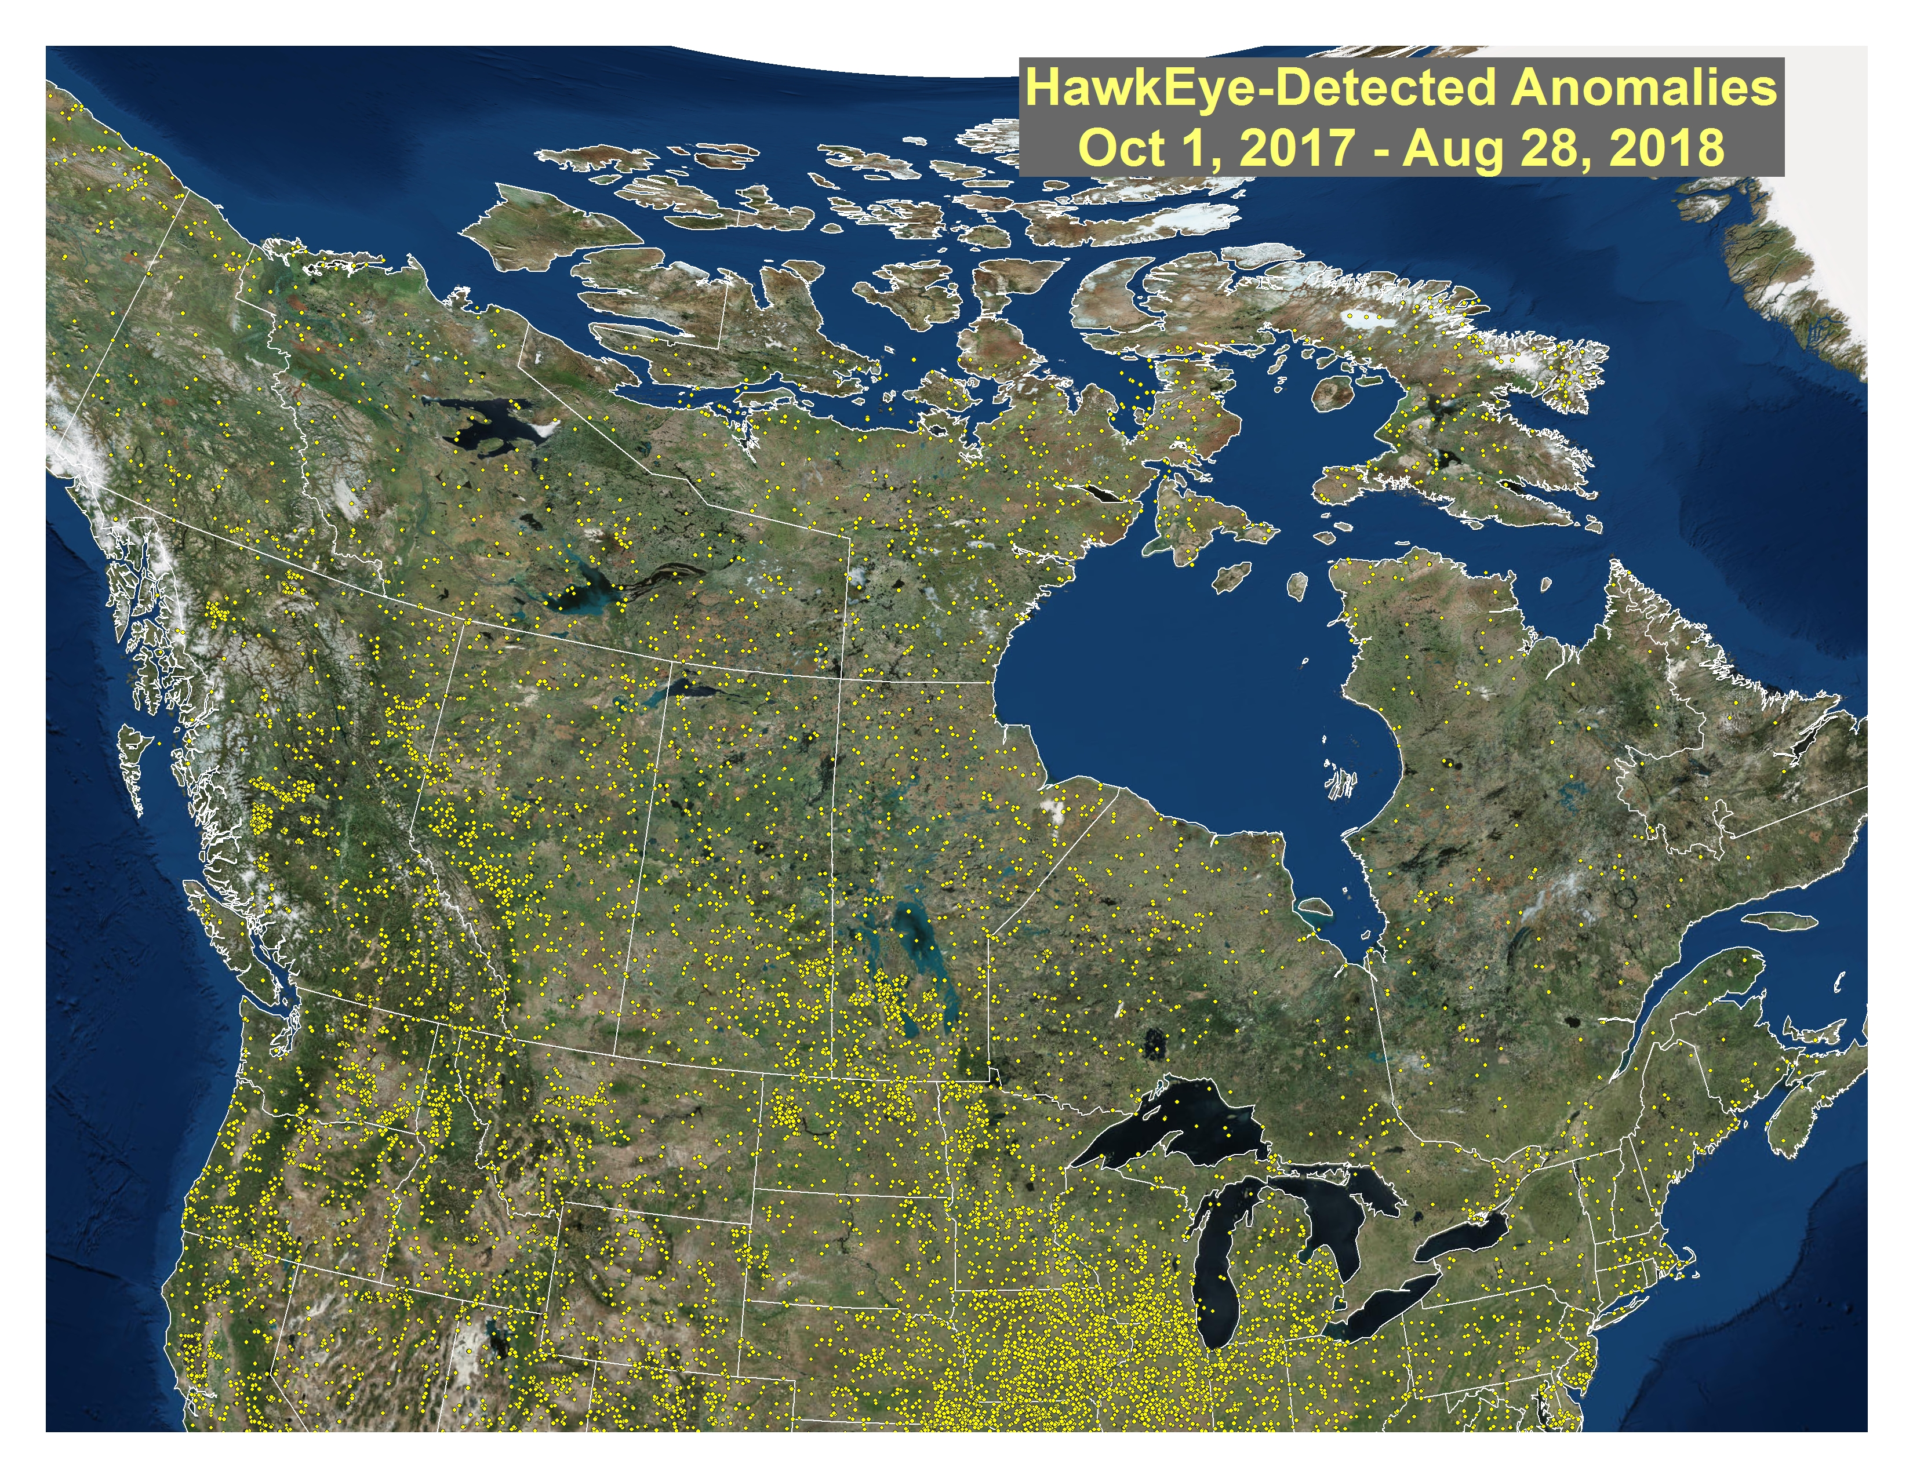
Hawkeye Anomalies 2018 – Northern Latitudes

Slide 9
Remote Sensing Working Groups
Tactical Fire Remote Sensing Advisory Committee (TFRSAC) The TFRSAC is co-hosted by NASA and the Forest Service and is a broad collaborative forum for advancing and enabling the development and delivery of remote sensing platforms, sensors and decision support tools to the wildland fire community. Focus: largely unclassified.
The TFRSAC meets biannually and includes representatives from federal and state agencies, academic institutions, international partners, and the vendor community.
Thermal Working Group (TWG) - has authority and responsibilities as a standing sub-working group under the Overhead Persistent Infrared (OPIR) Working Group (OWG) and Civil Applications Committee (CAC). The TWG is the coordinating body for advancing and enabling the development and delivery of data, information or products derived from classified thermal remote sensing platforms to civil users. Focus: largely classified.
The Thermal Working Group meets frequently, often in concert with the TFRSAC meetings.

Slide 10
Remote Sensing Working Groups

Slide 11
Aircraft 3 – Manpower Issues
All 2018 AC3 work has been done by two primary analysts (Earl Wilson and Joe McQuade), with Elise Bowne helping out the last few weeks.
In 2017, we had 9 to 11 analysts supporting the program.
We desperately need existing/new cleared support from the federal-civil community to provide the needed manpower to support the program during the fire season.
There is an ongoing effort to locate already cleared people that have ready access to appropriate facilities across the country.
It is quicker to train cleared people than get trained people through the clearance process.
Currently, a new clearance takes 18 to 24 months

Slide 12
From Kim Christensen
“We need to put some effort into getting clearances for people who have the right background and training. I think historically it has been linked to position/PD, but in today’s world we have a number of folks that provide support as a collateral duty. The NG rep at NIROPS mentioned a number of cleared analysts that may be available for us to tap into but they would need training. And we would need DoD/NG to agree to providing only those we had invested training in.!”

Slide 13
Looking Ahead
Continued engagement with key people throughout the fire community, the federal agencies and the DoD/IC community to ensure that information needs are well-articulated and efforts are being made to fill identified gaps.
Adding a third aircraft (an ongoing discussion)
King Air B200
Equipped with pod and Aircell
“Multi-mission” aircraft
Sensor systems (efforts ongoing)
NASA AMS Wildfire Instrument
Flown on Ikhana UAS in 2007-2009
16-channel line scanner system
NASA WAI Sensor
Wide Area Imager
Continue spiral development of unmanned airborne use in fire

Slide 14
Takeaways
The value of National System support to wildland fire cannot be overstated.
We need a new cadre of trained personnel to support AC3, and we need to employ them often to keep the skill sets sharp.
We are actively working to find new cleared civil personnel to support exploitation.
We are working to develop enhanced capabilities that build on Hawkeye.
We need to continue to work together, to collaborate, to communicate and to share ideas and best practices.

Slide 15
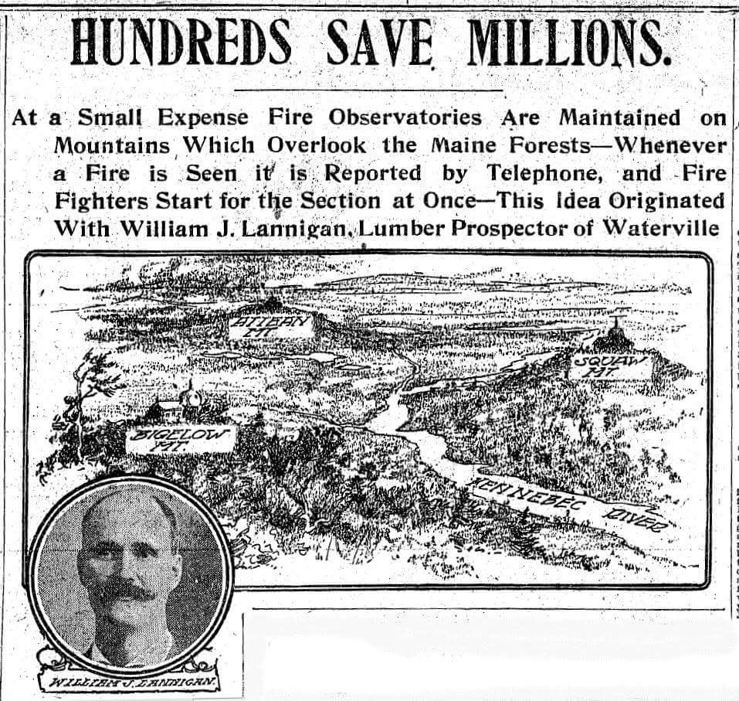
Comments / Questions?

