Slide 1
Forest Service – Fall 2019
Everett Hinkley
National Remote Sensing Program Manager
Everett.hinkley@usda.gov
Fall TFRSAC Meeting November 14, 2019

Slide 2
Components of the Geospatial Management Office
Geospatial Information Officer
Deb Oakeson – Acting GIO
Headquarters Program Leads
Remote Sensing- Everett Hinkley
Geospatial Products & Services - Betsy Kanalley
GIS- Lisa McBride
Data Management - Lisa Delmonico
Geospatial Technology& Applications Center
Deb Oakeson – Center Director
Brian Vanderbilt – Ass’t Director, Geospatial and Remote Sensing Services
Melissa Hamid – Ass’t Director of Data, Technology and User Services

Slide 3
GMO Stakeholder Relationships – As Is
9/20/19
Information Resources Decision Board (IRDB)
Mobile Geospatial Tech Advisory Group
(MGTAG)
CAs
Geospatial Management Advisory Group (GMAG)
Information Management Advisory Board (IMAB)
National Forest System (NFS)
Research and Development (R&D)
Office of Sustainability and Climate
Recreation
(RHVR)
RIM
Mapping Strategy Team
(MST)
State and Private Forestry (S&PF)
Engineering
(ETG)
Lands
Ecosystem Management Coordination (EMC)
Forest Inventory and Analysis (FIA)
Strategic Plng, Budget, and Accountability (SPBA)
Business Operations
(BusOps)
Fire and Aviation Management
(FAM)
National Technology Development Program (NTDP)
RIM
Geospatial Technology Apps Steering Com
(GeoTASC)
RIM
Automated Lands Program (ALP)
Inventory, Monitoring, and Assessment (IMA)
Geospatial Services Branch
Chief Information Office
(CIO)
Forest Health Protection
Office of Tribal Relations
RIM
Natural Resource Manager (NRM)
Enterprise Business Solutions Svcs
(EBSS)
Enterprise Data Warehouse
(EDW)
Information Resource Management (IRM)
Forest Health Assessment and Applied Sciences Team (FHAAST)
Pacific NW Research Station (PNW)
Legislative Affairs
Enterprise Business Solutions Svcs
(EBSS)
Chief’s Office
WWETAC
Pacific SW Research Station (PSW)
Law Enforcement and Inv. (LEI)
Rocky Mtn Research Station (RMRS)
Office of Communication
IMD
Geospatial
Management Office (GMO)
International Programs
Northern Research Station (NRS)
EWETAC
IMD
GIS, RS,
GeoSvcs
GIS, RS,
GeoSvcs
GIS
IMD
Southern Research Station (SRS)
Engineering
IMD
Engineering
RS, GeoSvcs
Region 1
Engineering
IMD
GIS, RS,
GeoSvcs
Region 10
GIS, RS,
GeoSvcs
GIS, RS,
GeoSvcs
IMD
USDA and USDA Agencies
Engineering
GIS, RS,
GeoSvcs
GIS
GeoSvcs
Region 2
IMD
RS Lab
IMD
GIS, RS,
GeoSvcs
IMD
Region 9 (Includes Former NE Area)
DOI and DOI Bureaus
NOAA
Stakeholder Relationships
 | Predominantly strategic
 | Mix of operations/tactical and strategic
 | Governance
 | External – Mix of ops/tac and strategic
 | Line authority
Region 3
IMD
Region 8
NASA
DOD
Region 4
Region 5
Region 6
Others
Academia

Slide 4
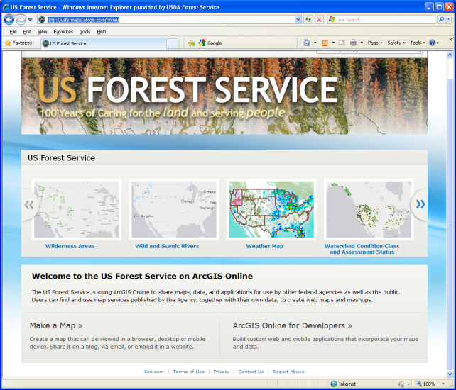
Strategic Focus Areas
Support to Wildland Fire
Land use planning and resources management
GPS and Mobile technologies
Unmanned Aircraft Systems
Integration of remote sensing, GIS, and cartography in the USFS
Mapping standards
Map production and usability improvements
Data lifecycle management
Enterprise Architecture (Geospatial)
Training
Web-based and other interactive maps
Digital map product distribution and delivery

Slide 5
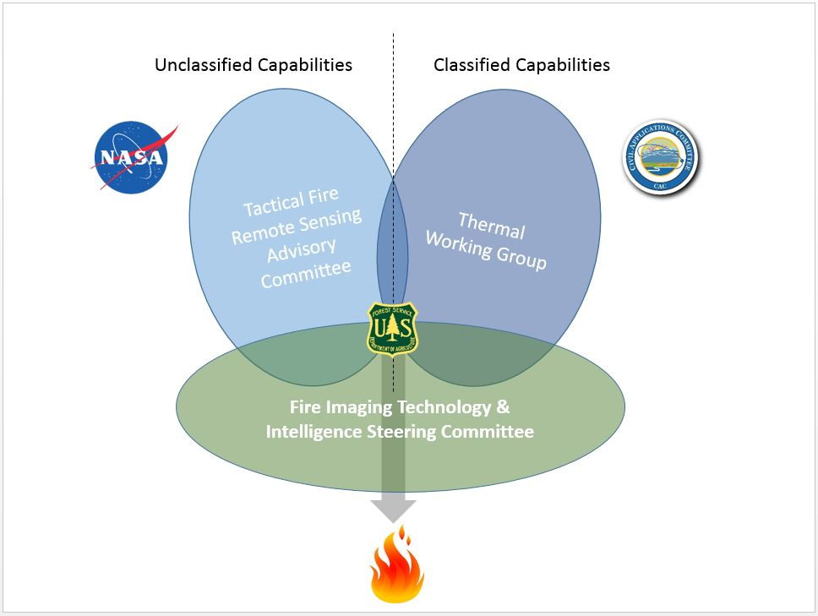
Questions

Slide 6
Challenges / Opportunities
Across our agency, a general lack of understanding of the value of remote sensing and geospatial data in a land management agency.
Aging sensors, platforms, etc.
Inability to travel and attend conferences. Face-to-face is clearly preferred for idea exchanges.
Enterprise architecture does not support remote sensing needs fully.
Managing access to classified data for applications to support agency business needs

Slide 7
Challenges / Opportunities
Working with declining budgets and work force
Downward spiral in funding having significant impacts on testing and deploying current and emerging technologies.
Integrating UAS into remote sensing business needs
Working more collaboratively with the USDA department and other government agencies
Adapting to and incorporating new remote sensing data streams
Data center movement (disruption and cost issues)
Scanning hard copy aerial film at SLC facility (FSA)

Slide 8
Questions
Current What do we need to continue or keep? What’s working and adding value? What are our best practices? | Improve What do we need to do to improve? What’s working satisfactorily, but needs improvement or refinement? What do we need to modify?
Stop What do we need to stop doing? What are we doing that is not adding value? What can we omit? | Start What do we need to start doing? What new approach could we use? What do we need to add?
Current State Analysis

Slide 9
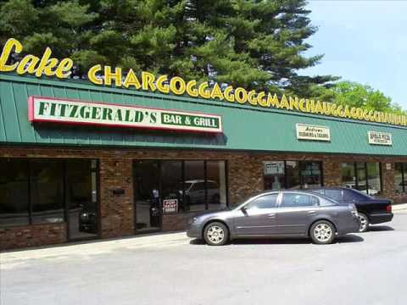
Contact Us
Geospatial Management Office
Everett Hinkley National Remote Sensing Prog. Mgr.
USDA Forest Service HQ Sidney R. Yates Federal Building
201 14th St SW, Washington, DC 20227
Voice: 703.605.0830
Email: everett.hinkley@usda.gov

