Slide 1
Michael Falkowski
Mike Seablom, Barry Lefer, David Green
NASA Headquarters
The NASA FireSenseProject
Notes:
ANIMATED-option 1

Slide 2
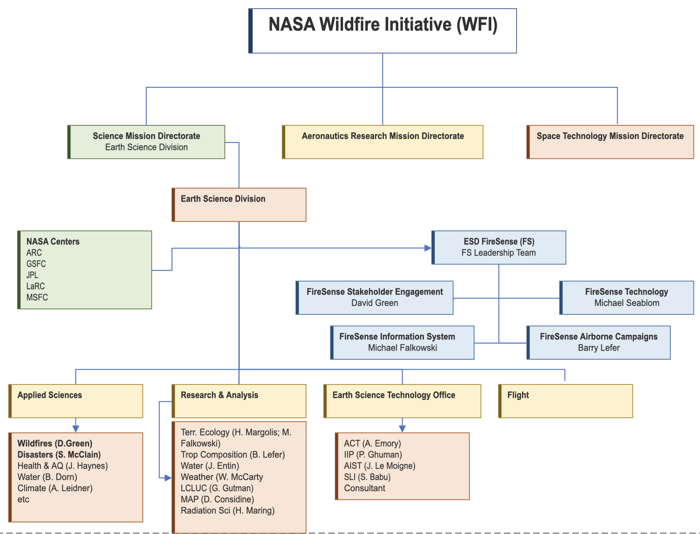
NASA Wildfire Initiative Org Chart
Notes:
NASA Earth Science Division has end-to-end integrated effort.
NASA has been observing wildires fires (fire locations, smoke, forest ecosystems, burn scars) for 50 years using LandSat.
And 2x daily global coverage with MODIS for the past 20 years.
We don’t know where/when fires are going to occur, so satellites observations are needed.
Theme Mangers:
Weather and Information Systems Tsengdar Lee
Disaster Response & Resilience Shanna McClean
Health & AQ John Haynes
Water Resources & Hydrology Brad Doorn, Jared Entin
Land Cover Use & Change Garik Gutman /

Slide 3
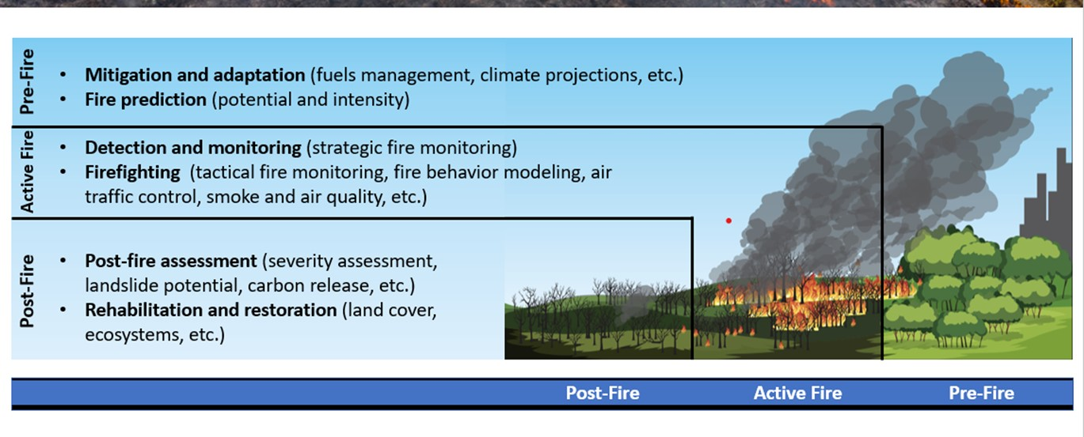
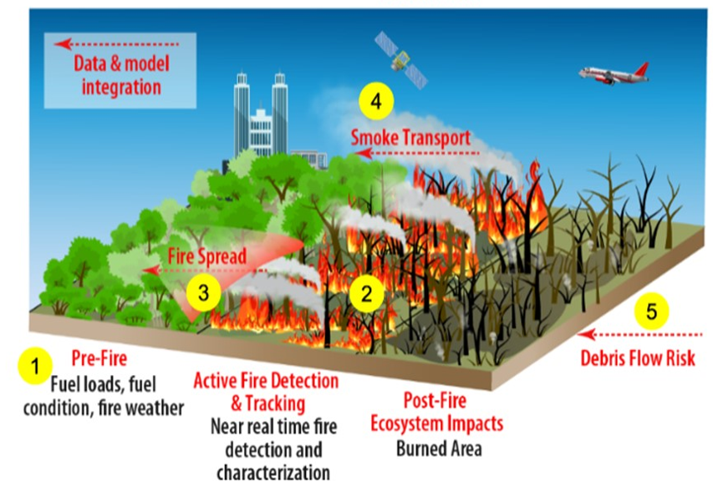
The NASA FireSesne Project
The NASA Science Mission Directorate (SMD) FireSense project is a 5-year effort focused on delivering NASA’s unique Earth science and technological capabilities to operational agencies toward measurable improvement in US wildland fire management. The NASA SMD FireSense project is part of a larger NASA wide Wildland Fire Initiative involving SMD, the Aeronautics Research Mission Directorate (ARMD), and the Space Technology Mission Directorate (STMD).
Goal: Over the next 5 years we will continue to work across the agency to reduce current barriers faced by fire management agencies and related stakeholders by integrating NASA’s core competencies in the areas of technology development, remote sensing, & predictive modeling. Through innovation NASA will help society thrive with future fire.

Slide 4
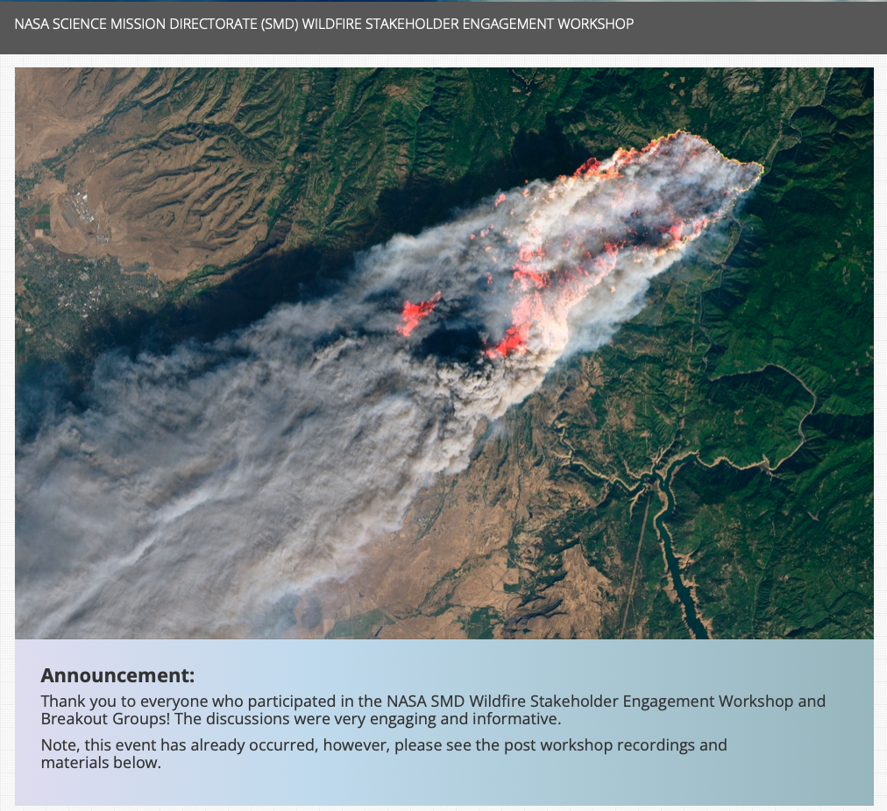
NASA Wildland FireSense is driven by Stakeholder Needs
NASA SMD Wildfire Stakeholder Engagement Workshop – Held Early Feb 2022
Workshop Purpose:
To hear wildfire management stakeholders visions for successful wildfire management.
Participants asked to identify the following:
Barriers the community has in integrating science, technology, and knowledge into the fire management problem.
Areas where NASA can help enable collaborative programs and partnerships across the fire lifecycle, including preparedness and adaptation, response, and recovery.
Key opportunities and priorities to make progress in pre-, active, and post-fire management.
Identify partnerships and programmatic activities to guide near term action in the wildfire management space
Over 800 participants!
https://nari.arc.nasa.gov/smdwildfire
Notes:
First thing the FireSense team did was have a stakeholder engagement workshop where we listened to wildfire managers needs for 2.5 days (with more than 800 stakeholders participating.
We used what we herd form stakeholders in this workshop to set the goals and objectives of the the NASA Wildland FireSense Project.
Specifically we asked asking: What are your key barriers to managing fires?
We heard that they need better NRT observations. Higher spatial resolution 5 m or better. Persistent observations 24/7. Better observations of species composition, fuel loadings, soil/fuel moisture. Better communications in the field – the last mile problem. Do not need another website.

Slide 5
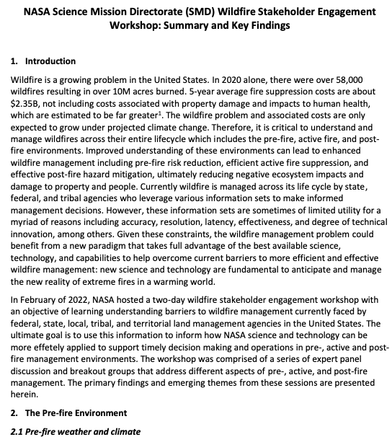
NASA Wildland FireSense is driven by Stakeholder Needs
NASA SMD Wildfire Stakeholder Engagement Workshop – Held Early Feb 2022
Workshop Outcomes: Primary deliverable - whitepaper describing current barriers faced by agencies responsible for managing fire across its life cycle (pre-, active, and post-fire).
Some of What we heard*:
Pre-fire –
Current fuels map of limited utility for operational management
Fire behavior models do not have the necessary fidelity to accurately predict fire behavior and fire spread
Current observations and forecasts of winds, humidity, and fuel moisture are insufficient for fire risk assessment and prediction
Active Fire –
Must reduce of time from ignition to detection and response
Need persistent (24/7) IR imagery of active fires to support fire management and monitoring (and fire science)
Lack of Reliable, high-speed communications/data
Need instruments capable of mass/power limitations of new suborbital platforms
Post-fire –
Improved mapping of forest burn extent and fire severity
Understand impacts to air and water quality and human health
Reduce debris flow prediction uncertainty: landslides, floods, impacts to watersheds
https://aam-cms.marqui.tech/aam-portal-cms/assets/ki2yd52vavkccskc
* In the context of operational fire management
Notes:
Biggest take away…. All the data, capabilities, tech we have to offer is drastically underutilized in terms of operation fire management.

Slide 6
Current Challenges in Operational Wildfire Suppression
NASA ARMD Wildfire Stakeholder Engagement Workshop – Held May 2021
~150 participants
Aerial Suppression Support
Duration of aerial firefighting limited to daylight, clear visibility (4-6 hours/day)
Airspace operations is manual and workload intensive; only a few aircraft allowed at a time
Not able to accommodate drones in the same airspace as other aircraft
Lower aircraft safety record in aerial firefighting than other areas of aviation
Multi-Agency Planning
Multi-agency collaboration for resource and technology roadmap does not exist
Budgets to support forest management and strategic planning are often redirected in season for tactical firefighting (limits adoption of new research and tools in fire management)
Detection Tracking, Surveillance, and Prediction
Surveillance - infrequent high spatial resolution satellite or aircraft observations
Fire detection and location accuracy is not precise enough for effective targeting
Few models for tracking and predicting fire progress, many are unreliable
Better sensing is needed, difficult to observe through clouds and at night
Data and model fusion is limited, need for an integrated observing system
Notes:
Note Common themes

Slide 7
Stakeholder needs/knowledge gaps
Notes:
Note Common themes

Slide 8
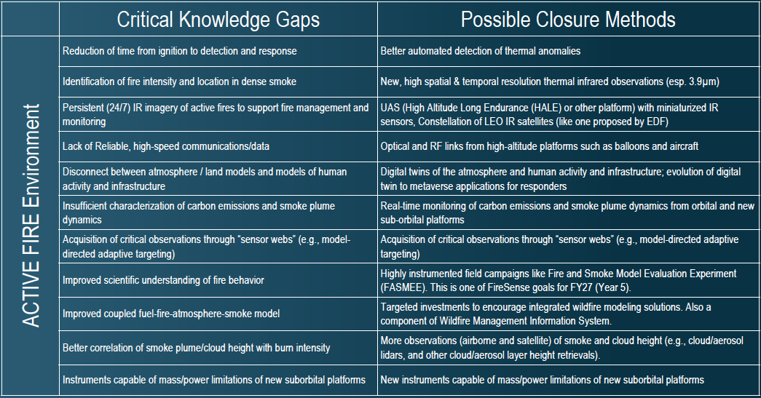
Stakeholder needs/knowledge gaps
Notes:
Note Common themes

Slide 9
Stakeholder needs/knowledge gaps
Notes:
Note Common themes

Slide 10
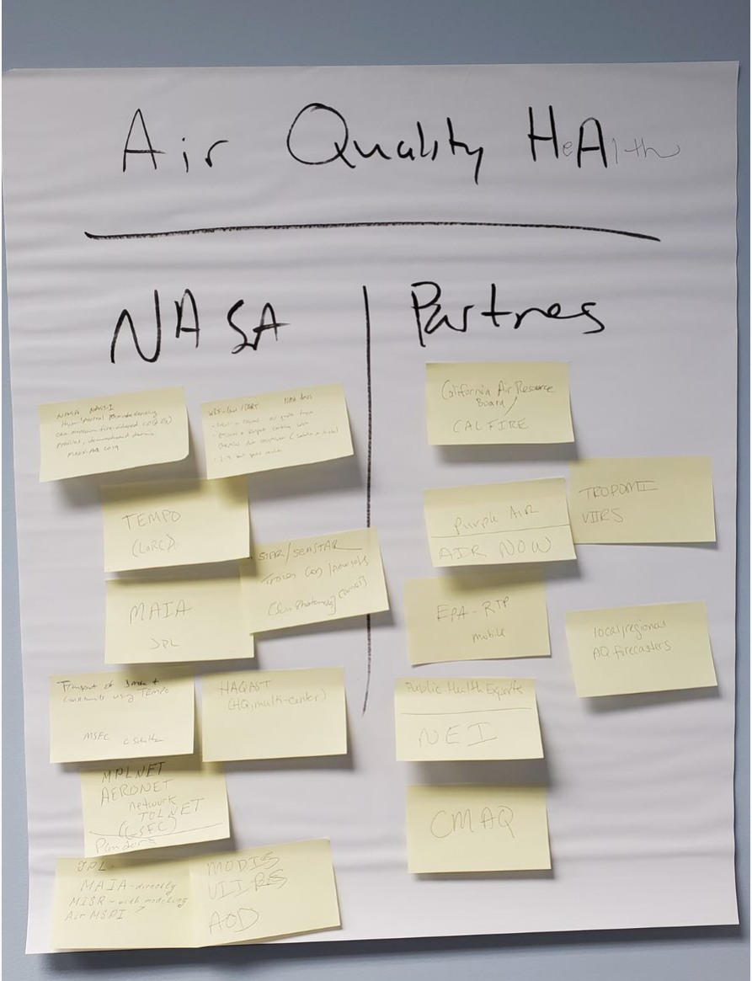
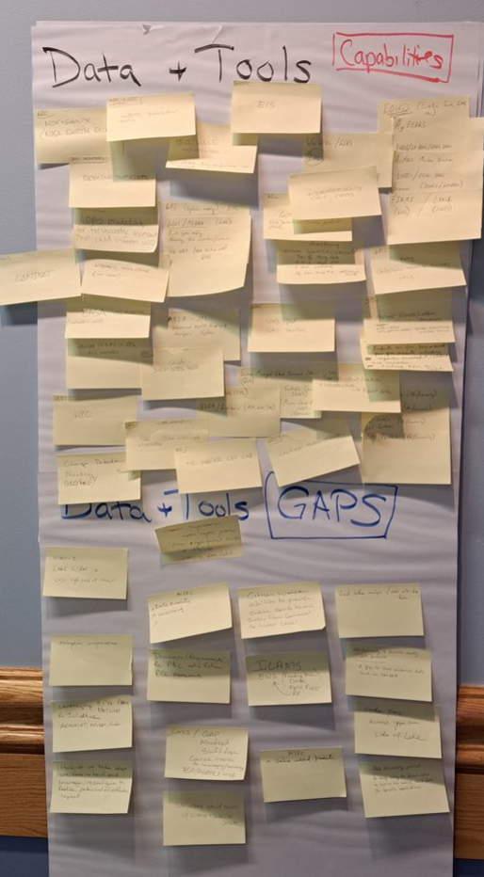
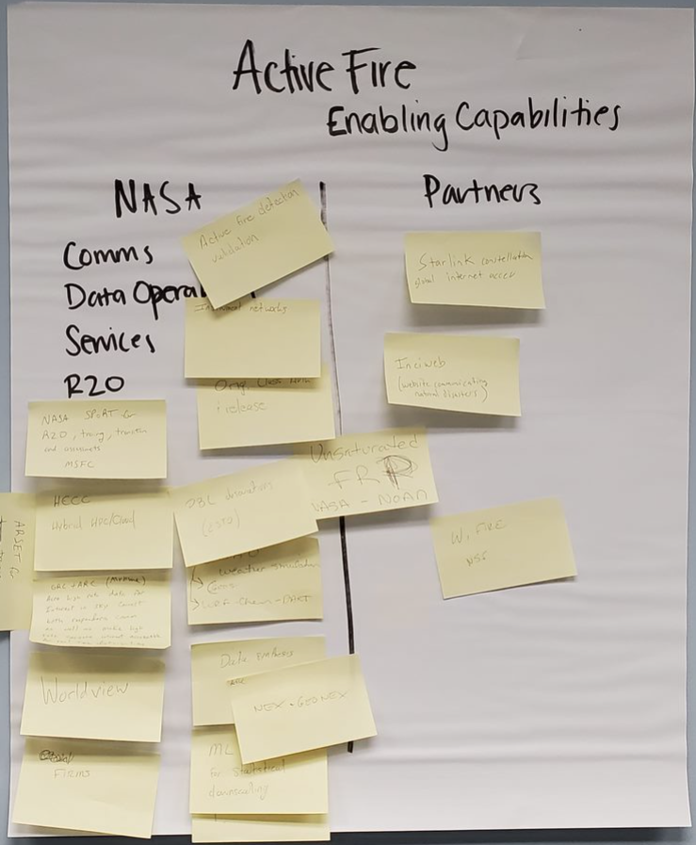
NASA Response to Stakeholder Identified Needs
NASA Center & Partners Capability Mapping Workshops
A series on internal NASA Workshops have been/will be held
Workshop Objectives: Map NASA Research Center (ARC, GSFC, JPL, LRC, MSFC) capabilities to stakeholder needs. Identify gaps in NASA capabilities and identify partners (govt agency, industry, academia) with capabilities that can help fill those gaps.
Workshop Outcomes: A workplan identifying overall goals, implementation strategy and milestones for the NASA SMD Wildland FireSense project as well as the NASA Wildland Fire Initiative
Future Stakeholder Workshops
Plan to hold annual stakeholder workshops to assess progress and adaptively plan initiatives going forward

Slide 11
NASA Wildland FireSense – Integrated & Targeted Activities
Applications:
Working with interagency and community stakeholders to identify barriers in wildfire management (pre-, active, and post fire)
Accelerate, empower and improve wildland fire adaptation: community planning, infrastructure and supply line protection, landscape conservation and restoration strengthening the collective outcome of thriving sustainably with fire
Delivering trans-disciplinary and multisector solutions across the fire cycle (pre, active, post) at societal scale
Technology:
Instruments & Information Systems:
Reduce mass and power requirements for next-generation small sat and aerial platforms
Observations from new vantage points
“Sensor webs” enabled by autonomous tasking from numerical models
High performance computing and new algorithms
New on-board computing
Machine learning for modeling, data fusion, and processing in real-time environments
Technology transfer to commercial partners
Research & Analysis:
Improve estimation of fire fuels information (structure, composition, moisture) with NASA observations
Leverage NASA observations to better understand and predict fire behavior
Understand the cumulative impacts of smoke plumes on air quality
Integrate data and create analysis-ready products for fire managers
Provide near real-time fire risk assessments based on improved characterizations fuel loading, fuel moisture and weather (e.g., temperature, lightening potential, etc.)
Improved (accuracy, speed) fire behavior models to aid in the management of prescribed fire and wildfire

Slide 12
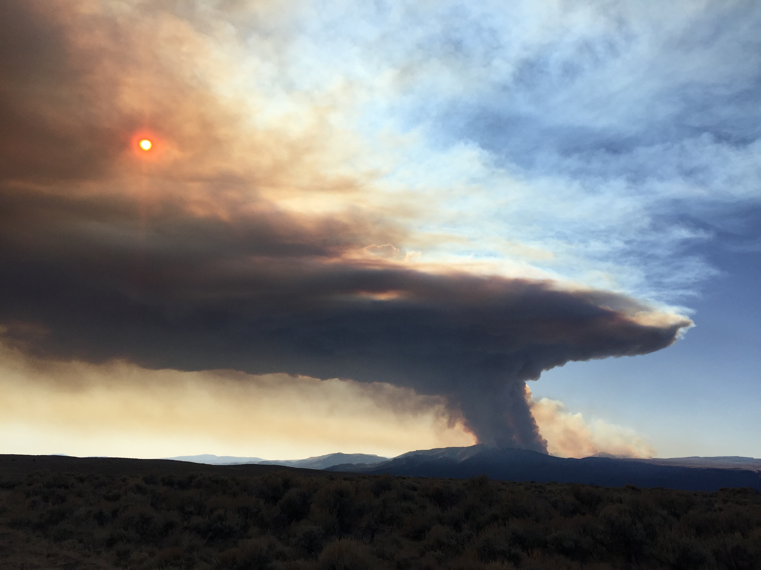
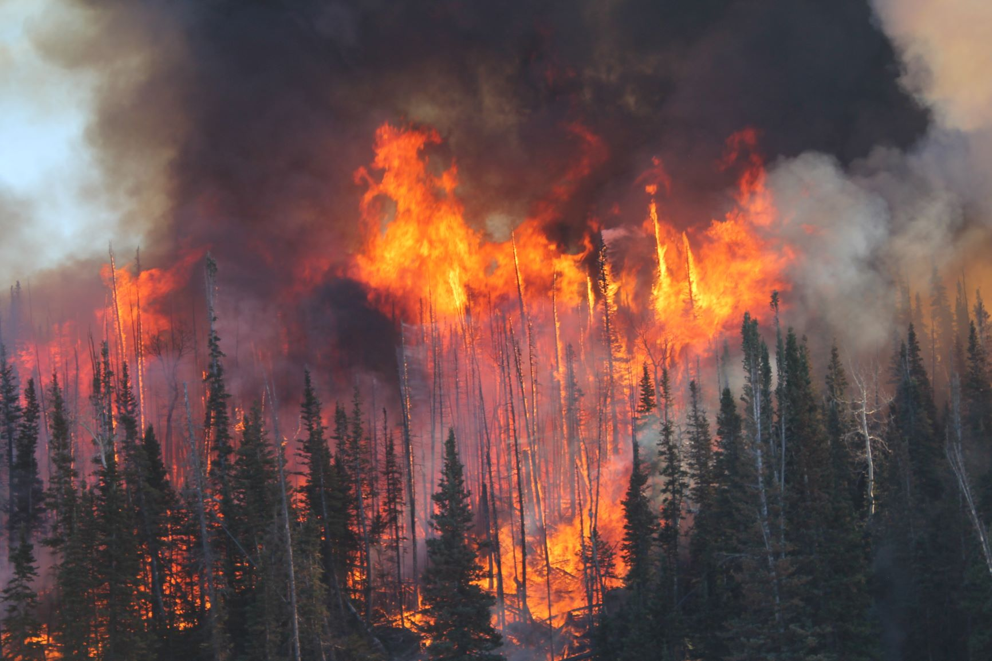
Initial FireSense Field Campaign in Fall 2023
NASA SMD and ARMD have partnered with USFS Fire and Smoke Evaluation Experiment (FASMEE) team to execute a large prescribed burn in the Fishlake National Forest in central UT, planned during October-November 2023. This a dense stand replacement burn will result in a large crown fire. (see FASMEE photos from Langdon Mountain Burn)
Stakeholder Desired Observations
Species Composition (AVIRIS-ng)
3-D Forest Structure (LIDAR)
Soil Moisture (SAR)
Fuel Moisture (SAR)
Fire Radiative Power (MASTER)
Fire Perimeter (MASTER)
Flaming/Smoldering (MASTER)
Aerosol Optical Depth (MASTER)
Plume Height (LIDAR)
Burn Area and Severity (AVIRIS-ng/MASTER)

Slide 13
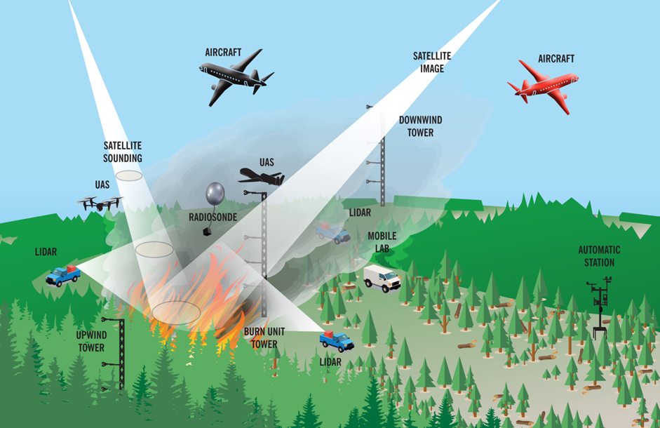
Capstone Field Campaign in Year 5 (2027-28)
The Capstone Field Campaign will serve as a technology demonstration event for stakeholders to use/evaluate the tools, products, sensors, and capabilities developed during the first four years of FireSense.
The hope is that the success of the Capstone Field Campaign will enable the successful adoption/transition of FireSense developed capabilities by our stakeholder/operational agencies.
Started conversations with NOAA, EPA, and USGS. Need to have good stakeholder engagement (years in advance) for this effort to succeed.

Slide 14
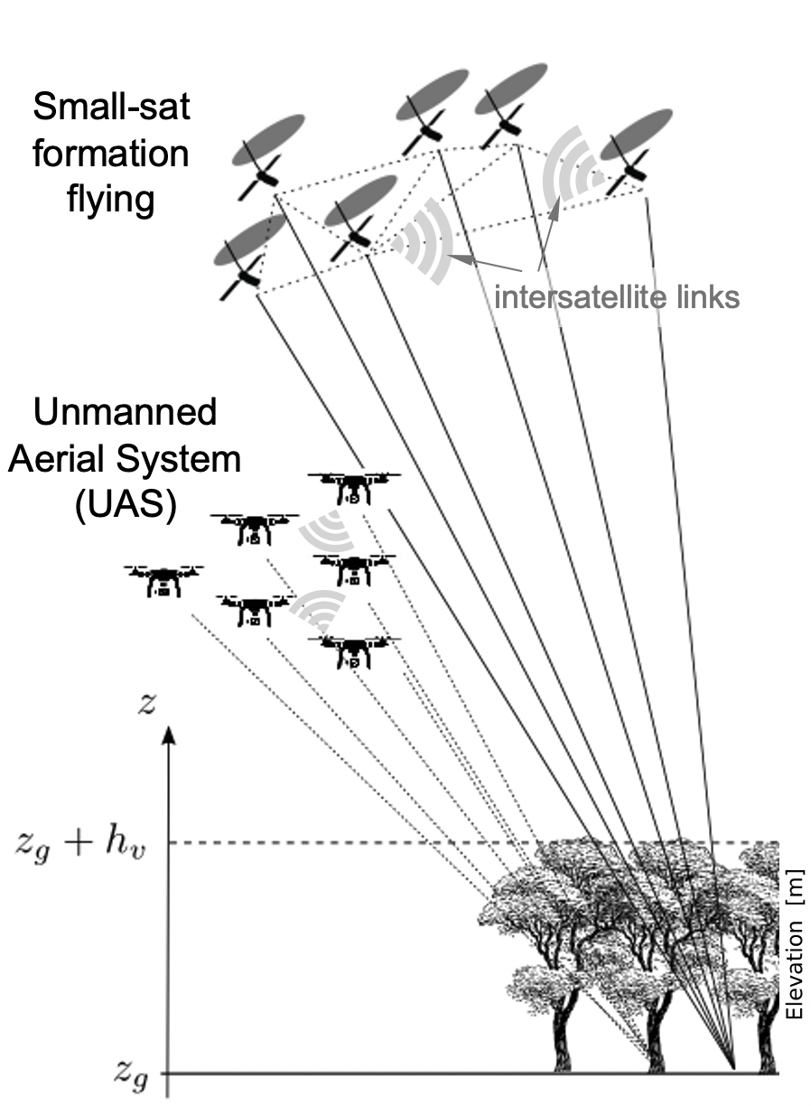
NASA ESD Wildland FireSense - Execution
Work to date:
Hosted a stakeholder engagement workshop in Feb 2022 to better understand current barriers to fire management faced by fire management agencies (~800 participants)
Hosted internal NASA workshop (May 2022) at GSFC to map NASA center capabilities to the previously identified stakeholder needs
Coordinating with ARMD on UASs, scalable traffic management, and aerial operations for emergency response (August 2022 meeting at ARC, regular virtual meetings)
FireSense Technology solicitation released in June 2022
Wildland Fire Management Program funded nearly 40 projects in fire applications (late FY22) and developed the Actionable Fire Science Information Hub
SBIR partnership and selections through new “Climate Sequentials” program (2 awards for new instruments)
The Research and Analysis program released a wildfire focused topic under the Interdisciplinary Science Solicitation in ROSES 2022

Slide 15
NASA ESD Wildland FireSense - Execution
Planned work:
Continue to engage with NASA centers and stakeholders through regular meetings and workshops (next workshop in Nov 2022 at ARC)
Continue to collaborate with ARMD on scalable air traffic management to support wildfire management (e.g., tabletop exercises)
Make selections for the FireSense Technology and Interdisciplinary Science solicitations, which are expected to start work in the second half of FY23
Continue to partner with STMD through SBIR, expect to have a topic in FY23 “Climate Sequentials” program
Conduct annual targeted airborne campaigns to test new technology and also further improve characterization of the prefire (fuel characteristics), active fire (fire spread and smoke) and postfire (burn severity and impacts) environments
Develop technology and modeling to support a capstone airborne field campaign in 2027 to demonstrate the tools we develop to support fire management in near-real-time

Slide 16
Position Announcement: Project Scientist for the NASA FireSense Project
The NASA Science Mission Directorate (SMD) FireSense project is a 5-year effort focused on delivering NASA’s unique Earth science and technological capabilities to operational agencies toward measurable improvement in US wildland fire management. The NASA SMD FireSense project is part of a larger NASA wide Wildland Fire Initiative involving SMD, the Aeronautics Research Mission Directorate (ARMD), and the Space Technology Mission Directorate (STMD).
The Project Scientist will be responsible for coordinating science and engagement activities for the FireSense project.
Duties will include:
Coordinate with other NASA Mission Directorates and research centers on fire science activities that contribute to meeting FireSense project goals.
Assist in the identification, development, and maturation of science and technology capabilities to address key gaps in fire management across the entire fire lifecycle. Develop and maintain partnerships with national, state, tribal, and local US fire management agencies to co-develop capabilities for improved fire management that leverage NASA expertise, observations, and models.
Develop and maintain awareness and partnerships on science and technology maturation with external organizations including the commercial sector, other state, tribal, and federal agencies, non-governmental organizations, and academia. Assist in the planning and execution of field and airborne campaigns to demonstrate new capabilities and progress towards operational readiness.
Assist in the planning and execution of internal and external FireSense meetings and workshops and present project reports and updates at internal and external meetings.
Work with SMD managers to develop and refine a strategic plan for the FireSense project, and co-present annual reports to SMD managers.
Participate in and provide input to the SMD internal funding decision making processes.
Co-lead the FireSense project office.
Desired qualifications:
Ph.D. or Terminal degree plus experience in a relevant field.
Extensive knowledge of fire science and fire management.
Experience leading complex federally funded projects.
Relationship building experience and skill.
Be a recognized leader in the fire science and management community, as demonstrated through a record of invited presentations, authorship of per-reviewed articles, and service on conference organizing committees or to professional societies, or related activities.
Possess strong verbal and written communications skills.
Knowledge of operational fire management protocols and practices of state, federal, and tribal agencies.
Have recent experience working in a team environment, where consensus building was required
Possess technical knowledge of remote sensing and modeling tools that support fire science and management.
Demonstrate a strong record of practices that uphold values including openness, integrity, quality, innovation, and diversity, equity, inclusion, and accessibility
This is a NASA Excepted (NEX) Service Appointment (up to 6 years Civil Servant Term position – NEX is a NASA specific hiring authority). Inter-federal agency details may be possible.
The duty station for this position is at NASA Ames Research center in Mountain View, CA.
If interested, contact Dr. Michael Falkowski (Michael.Falkowski@nasa.gov) by Friday December 6th, 2022.
The position will be filled as soon as possible. Desired start date: as soon as possible.

Slide 17
Thank You – Questions?

