Slide 1
Observation and Information Shortfalls in Support of Wildland Fire and Related Activities Rapid Assessment to Support FY24 Budget Planning Carolyn Vadnais cvadnais@contractor.usgs.gov 1 Dec 2021

Slide 2
Rapid Assessment Objectives
ICAMS, USGCRP and USGEO joined forces to complete a rapid assessment focused on wildland fire
OMB interest in both the approach (something quick) and outcomes
Specific actionable recommendations to Federal agencies to better meet the wildland fire community’s observation and information needs
Support FY2024 budget initiatives
Finished by 15 March 2022
ICAMS: Interagency Council for Advancing Meteorological Services
USGCRP: U.S. Global Change Research Program
USGEO: U.S. Group on Earth Observation

Slide 3
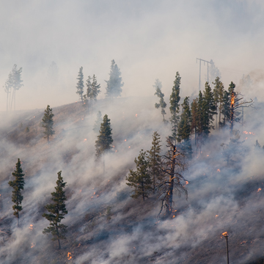
Possible Recommendations
New or upgraded observing systems
New products
Access to new datasets
Improved commercial data sharing and data buys
Applications of machine learning
Improved inputs to fire models
Other related needs or services

Slide 4
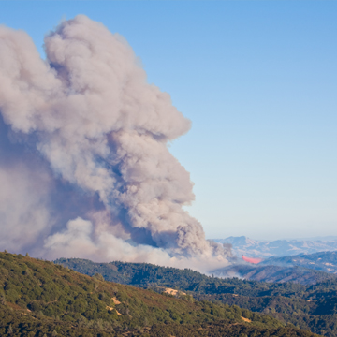
Assessment Team
Rapid Assessment Leadership Team:
ICAMS: Sally McFarlane (DOE)
USGCRP: Barry Lefer (NASA), Diane Stanitski (NOAA), Michael Falkowski (NASA)
USGEO: Meredith Wagner (NOAA)
Greg Snyder (USGS)
Emily Sylak-Glassman (NASA)
Assessment Support
Contract Staff (USGS)
Many other agencies and SMEs involved in the assessment and recommendation development

Slide 5
Scope
The rapid assessment will focus on key earth observations, data and tools needed to characterize the pre-, active, and post- fire environments. The observations and data will include space-based, airborne and in-situ observing systems, as well as other sources of information. Specific questions that will be addressed:
What observational/informational gaps hinder our ability to perform the range of activities above?
What aspects of climate change point to additional data gaps that could help predict, mitigate and adapt to future fire regimes?
What initiatives have been proposed to address these gaps?
What is the current status of these initiatives?
What new initiatives are needed to address gaps?
What are the priorities among the possible initiatives?

Slide 6
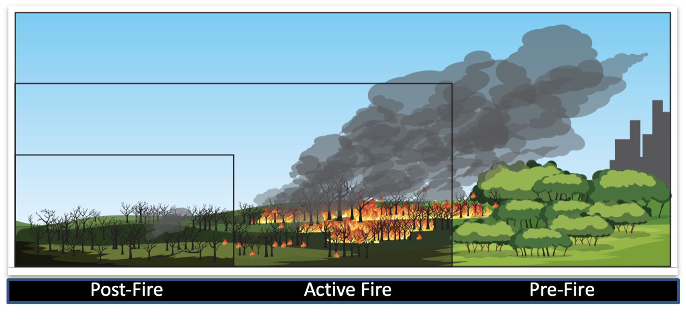
Fire Phases Addressed
Pre-Fire
Mitigation and adaptation (fuels management, climate projections, etc.)
Fire prediction (potential and intensity)
Detection and monitoring (strategic fire monitoring)
Fire-fighting (tactical fire monitoring, fire behavior modeling, air traffic control, smoke and air quality, etc.)
Active Fire
Post-fire assessment (severity assessment, landslide potential, carbon, etc.)
Rehabilitation and restoration (land cover, ecosystems, etc.)
Post-Fire
Post-Fire Active Fire Pre-Fire

Slide 7
Approach
Leverage and build on existing information:
Publications and reports
Working Groups/Committees
SME interviews
User needs and user satisfaction data
USGS, NOAA, others
Meetings/Workshops
Tactical Fire Remote Sensing Advisory Committee (TFRSAC) 1-2 Dec 2021 Meeting
NASA Wildfire Workshop: 4 Feb 2022
Others

Slide 8
Rapid Assessment Phases
Assessment Decision
Final Product Preparation and Delivery
Information Gathering and Recommendation Development
Phase I
Phase II
Phase III
Introduction
Methodology
Findings
Recommendations
Summary
Develop strawman plan (due 5 Nov)
ICAMS, USGCRP and USGEO co-chair review, final decision and guidance
Study kick-off
Review existing documents, relevant workshop outcomes, etc., and capture information about data gaps, agency initiatives, and potential solutions for filling gaps
Interview SMEs to gather more information
Review gaps and solutions with the team and subject matter experts
Prioritize recommendations
Finalize recommendations
Develop final presentation [and report?]
Complete final coordination steps
Deliver final products
~40 business days for data collection!
1 Nov 22
18 Nov 22
1 Feb 22
15 Mar 22

Slide 9
Thank you!
If you want to contribute: cvadnais@contractor.usgs.gov

