Slide 1
The NASA FireSense Project
Michael Falkowski, Barry Lefer, Haris Riris, Michael Seablom, Theresa Kauffman, Melissa Martin, Emily Sylak-Glassman
NASA Headquarters

Slide 2
The NASA Science Mission Directorate (SMD) FireSense project is a 5-year effort focused on delivering NASA’s unique Earth science and technological capabilities to operational agencies, striving towards measurable improvement in US wildland fire management. The NASA SMD FireSense project is part of a larger NASA wide Wildland Fire Initiative involving SMD, the Aeronautics Research Mission Directorate (ARMD), and the Space Technology Mission Directorate (STMD).
The FireSense project will include an airborne science component (annual campaigns) where improved capabilities and technologies will be developed and evaluated, and ultimately demonstrated to agency stakeholders in a large capstone airborne campaign in year 5 of the project (2027-2028).
Through initial stakeholder engagement activities, the FireSense project will begin by focusing on four uses-cases focused on characterization and measurement of (i) pre-fire fuels conditions, (ii) active fire dynamics, (iii) post fire impacts and threats, and (iv) air quality impacts and forecasting, each co-developed with identified stakeholders.

Slide 3
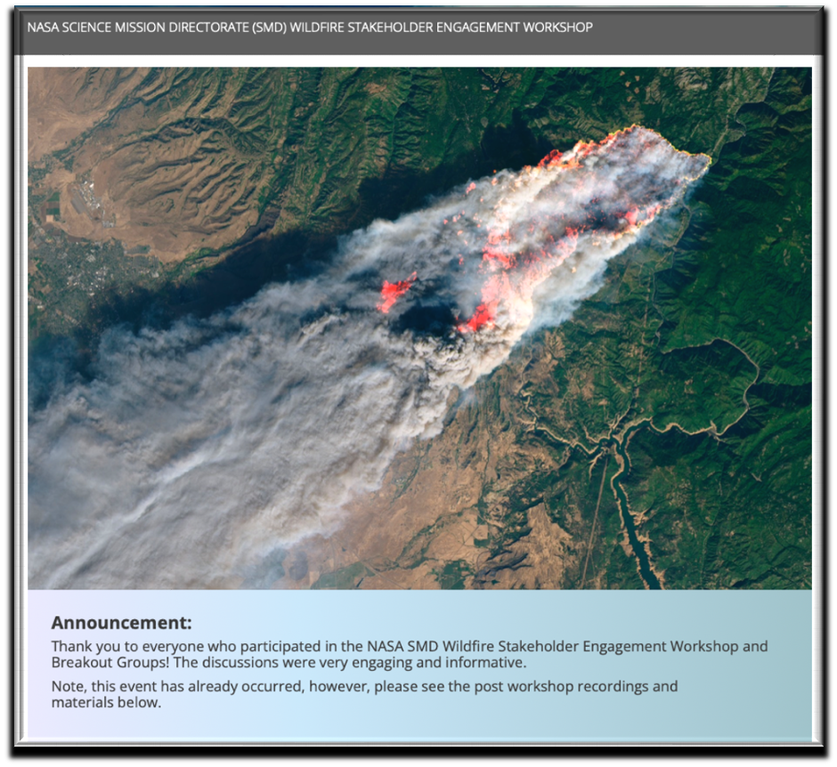
NASA FireSense is driven by Stakeholder Needs
NASA SMD Wildfire Stakeholder Engagement Workshop – Held Early Feb 2022
Workshop Purpose:
To hear wildland fire management stakeholders identify gaps and visions for successful wildland fire management.
Participants asked to identify the following:
Barriers the community has in integrating science, technology, and knowledge into the fire management problem.
Areas where NASA can help enable collaborative programs and partnerships across the fire lifecycle, including preparedness and adaptation, response, and recovery.
Key opportunities and priorities to make progress in pre-, active, and post-fire management.
Partners and programmatic activities that guide near- and long-term action in wildland fire management
Over 800 participants!

Slide 4
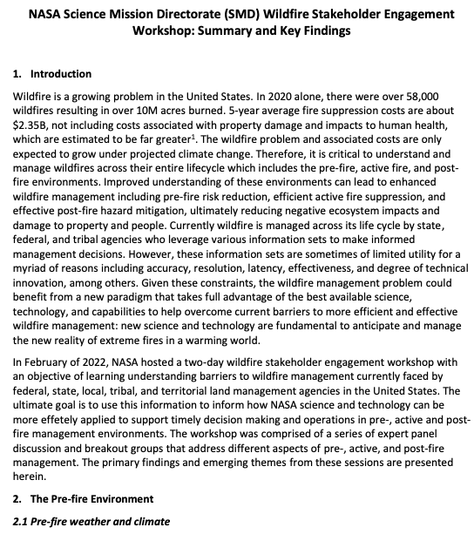
NASA FireSense is driven by Stakeholder Needs
Workshop Outcomes: Primary deliverable - whitepaper describing current barriers faced by agencies responsible for managing fire across its life cycle (pre-, active-, and post-fire).
Some of What we heard*:
Pre-fire –
Current fuels map of limited utility for operational management (increase accurate updates)
Fire behavior models do not have the necessary fidelity and/or timeliness to accurately predict fire behavior and fire spread
Current observations and forecasts of winds, humidity, and fuel moisture are insufficient for fire risk assessment and prediction
Active Fire –
Must reduce of time from ignition to detection and response
Need persistent (24/7) IR imagery of active fires to support fire management and monitoring (and fire science)
Lack of Reliable, high-speed communications/data
Need instruments capable of mass/power limitations of new suborbital platforms
Post-fire –
Improved mapping of forest burn extent and fire severity
Understand impacts to air and water quality and human health
Reduce debris flow prediction uncertainty: landslides, floods, impacts to watersheds
https://aam-cms.marqui.tech/aam-portal-cms/assets/ki2yd52vavkccskc

Slide 5
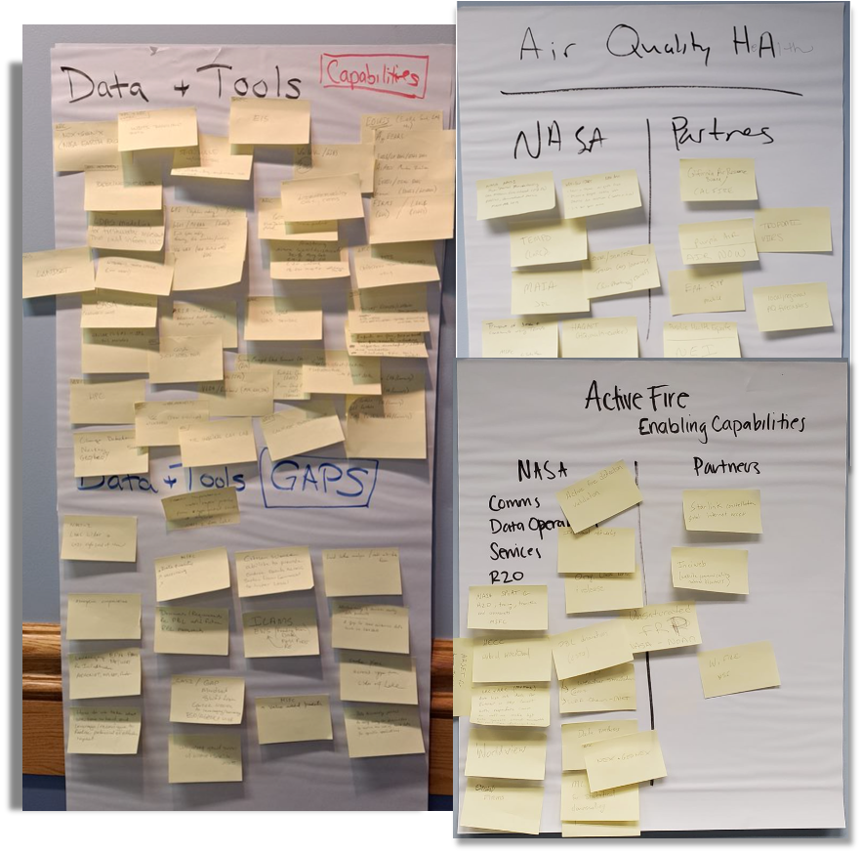
NASA Response to Stakeholder Identified Needs
NASA Center & Partners Capability Mapping Workshops
A series on internal NASA Workshops were held
Workshop Objectives: Map NASA Research Center (ARC, GSFC, JPL, LRC, MSFC) capabilities to stakeholder needs. Identify gaps in NASA capabilities and identify partners (govt agency, industry, academia) with capabilities that can help fill those gaps.
Workshop Outcomes: An identification of overall goals and an implementation strategy for the NASA SMD Wildland FireSense project.
Key takeaway: NASA has current capabilities that are underutilized in operation fire management across the entire fire lifecycle.

Slide 6
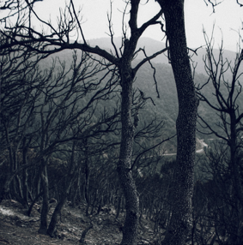
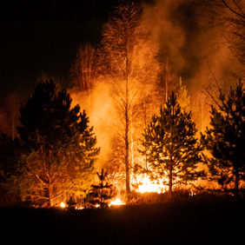
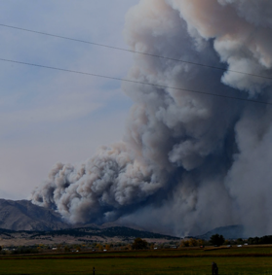
FireSense Use Cases
Pre-fire: Improved fire prevention by providing fire fuel maps with higher accuracy and resolution.
Provision of near real-time fire risks assessments based on fuel conditions, soil moisture, surface temperature, etc.
Stakeholders: USFS and USGS
Post-Fire: Improved maps of burn severity to aid in post-fire ecosystem rehabilitation efforts.
Predictions of post fire hazards and impacts including debris flow and landslide risks and water quality impacts.
Stakeholders: USFS and USGS
Active Fire: Better detection and tracking of fire via satellite and airborne imagery with higher spatial resolution and update frequency
Development of new, innovative sensors and models for precisely tracking and locating fires, fuels conditions, and smoke.
Stakeholders: USFS, CalFire, FEMA
Air Quality: Enhanced tracking and characterization of smoke plumes and smoke transport.
Improved forecasts of air quality impacts to human health and safety.
Stakeholders: NOAA and EPA

Slide 7
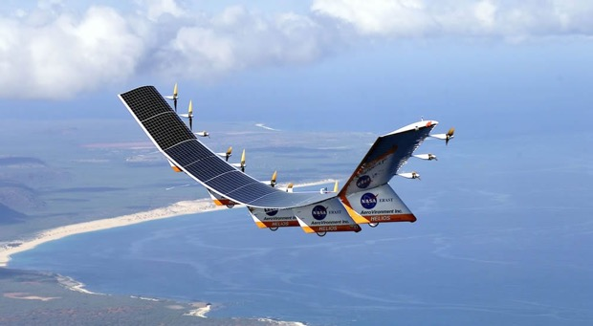
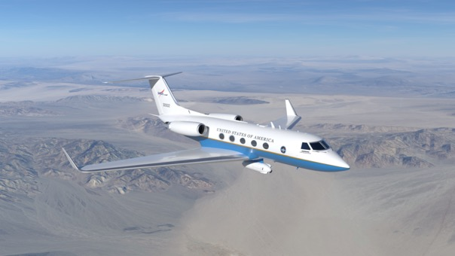
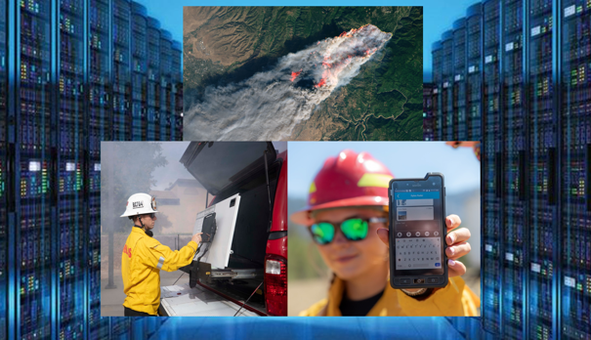
FireSense Implementation
Technology Development
Airborne Demonstration
Information Delivery
Enhance existing instruments used for monitoring pre-fire, active-fire, and post-fire environments
Develop next-generation aerial platforms as well as instruments for small spacecraft and aerial platforms for wildland fire applications
Enable measurements from multiple vantage points through model-directed, coordinated observations
Address computational challenges for modeling and for data acquisition, fusion, and real-time processing
Facilitate artificial intelligence to create new data products needed for wildfire management and for management of of observing platform constellations
Test existing and enhanced instruments used for monitoring pre-fire, active-fire, and post-fire environments
Evaluate existing and novel aerial platforms and next-generation instruments for wildland fire applications
Leverage airborne data to support research and application development in the for FireSense use cases
Demonstrate to key stakeholders the utility of existing and newly developed technology in the management of wildland fire across the pre-fire, active-fire, and post-fire environments
Work with stakeholders to develop wildland fire data systems and solutions that are flexible and aligned with desired capabilities
Ensure existing and new datasets (static and real-time) can be integrated into existing user-friendly web platforms (e.g., USFS WildfireSAFE, FIRMS, etc.)
Work with NASA ARMD and commercial and agency stakeholders to bridge the current communication gap in wildland fire management
Enable the seamless exchange of information between spaceborne, airborne, and in situ assets

Slide 8
Tech Solicitation and Active Projects
Fire Sense Technology Solicitation Overview/Goals​
Goal​
Introduce new, innovative NASA Earth system observation capabilities to predict and manage wildfires and their impacts ​
Approach​
Enhance capabilities of existing science instruments needed for monitoring all stages of the wildfire environment​
Reduce mass and power of instruments for accommodation by next-generation small spacecraft and aerial platforms​
Enable unprecedented measurements from multiple vantage points through model-directed, coordinated observations using autonomous tasking​
Address computational challenges for modeling and for data acquisition, fusion, and processing in a real-time environment​
Improve numerical models of the pre-, active-, and post-fire environments​
Leverage multiple programs​
Engage universities and small businesses​

Slide 9
Tech Solicitation and Active Projects
Fire Sense Technology – Active Projects
Organization | Title
University of Maryland, Baltimore County | Towards a NU-WRF based Mega Wildfire Digital Twin: Smoke Transport Impact Scenarios on Air Quality, Cardiopulmonary Disease and Regional Deforestation
Makel Engineering, Inc. | Chemical and Particulate Microsensor Instrument for UAV Airborne Measurements Near Wildfires (SBIR)
Xiomas Technologies, LLC | Thermal Mapping Airborne Simulator for Small Satellite Sensor (SBIR)
Selection announcements for first round of full proposal reviews is imminent

Slide 10
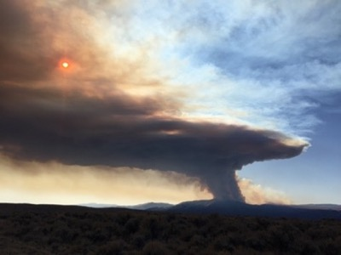
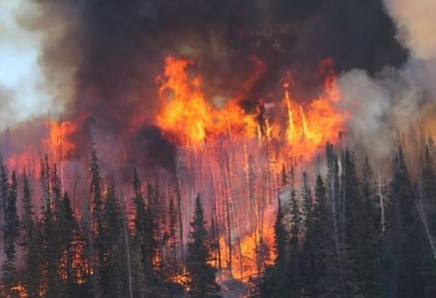
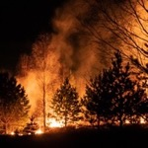
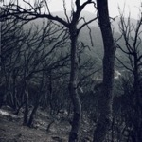
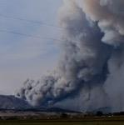
Fall 2023 Field Campaign
The Fire and Smoke Evaluation Experiment (FASMEE) is a multi-agency, interdisciplinary collaborative effort that utilizes large, planned, prescribed burns to evaluate and advance operational fire and smoke models. An upcoming field campaign is being planned for Fishlake National Forest, Utah, in October-November 2023.
Photos from Langdon Mountain Burn, a previous FASMEE campaign.
Planned Observations
Pre-fire (Attribute and Sensors):
Fuel composition (AVIRIS-NG)
Fuel Structure (Vegetation LiDAR)
Fuel Moisture (UAVSAR & AVIRIS-NG)
Active Fire (Attribute and Sensors):
Fire Intensity (MASTER)
Post Fire (Attribute and Sensors):
Burn Area, Burn Severity, Vegetation Mortality (AVIRIS-NG and MASTER)
Air Quality (Attribute and Sensors):
Aerosol Optical Depth (MASTER)
Plume Height (atmospheric LiDAR)

Slide 11
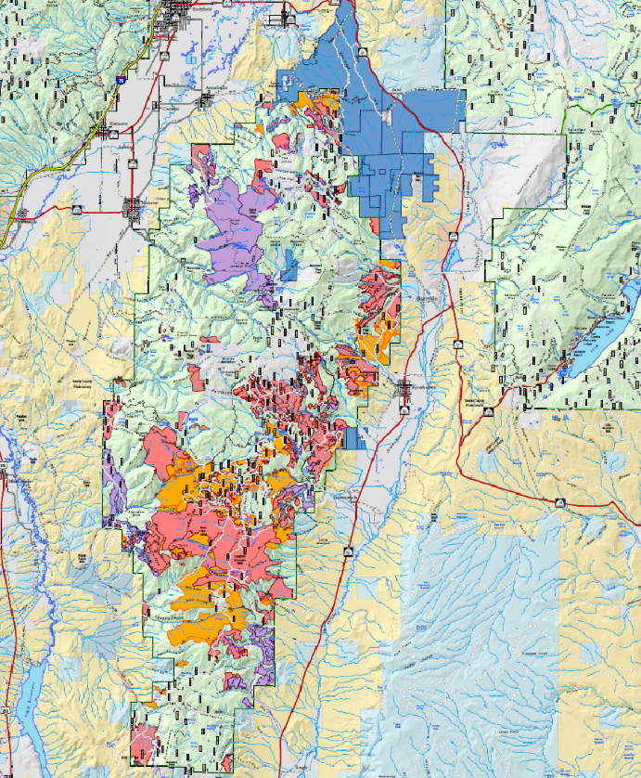
Fall 2023 Field Campaign
Objectives in 2023:
Test technologies and collect data to help fire modeling community
Targeted FireSense use cases:
Dates: October 15 - November 22, 2023
Burn plan: prescribed burn window (1 to 2 days)
Prescribed Location: Monroe Peak , Fishlake National Forest, UT
Basing locations:
Palmdale, CA (outside of prescribe burn)
Richfield Municipal Airport (one week, surrounding prescribe burn)
Plan: 6-week deployment window. While waiting for prescribe burn, will fly targets of opportunities
Coordination with U.S. Forest Service
Land managers, Burn Boss, Aviation Management services

Slide 12
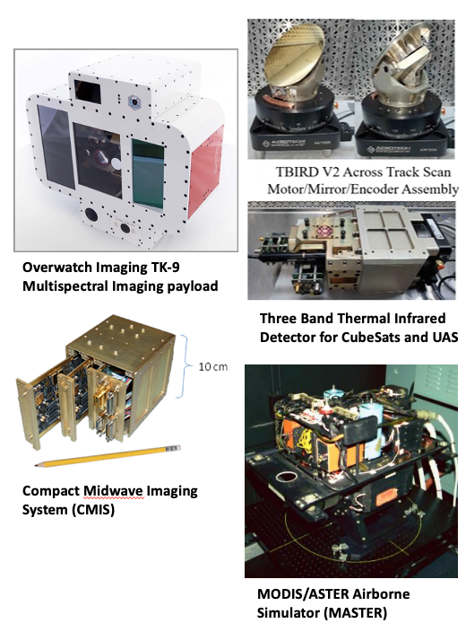
Fall 2023 Field Campaign
Objectives in 2023:
Test technologies with heritage instrument; collect data to help fire modeling community
Targeted FireSense use cases:
Pre-Fire (AVIRIS-NG, UAVSAR, LIDAR)
Active Fire (SWIS, JH CMIS, ARC TBIRD, MASTER, AVIRIS-NG)
Post-Fire (AVIRIS-NG, UAVSAR)
Build up to Year 5: Capstone event, demonstration to stakeholders
Aircraft: 4 manned aircraft (Multiple aircraft, multiple payloads)
AFRC B200 (N801NA):
MASTER + Instruments of interest (SWIS, JH CMIS, ARC TBIRD)
AFRC G-III (N801NA):
UAVSAR
DA B200:
AVIRIS-NG/-3
Forest Service B200:
Overwatch Imaging TK-9 Multispectral Imaging
Phoenix IR system
sUAS: sensors on drones (from Forest Service) - TBD
Visual line of sight requirements; payload - TBD

Slide 13
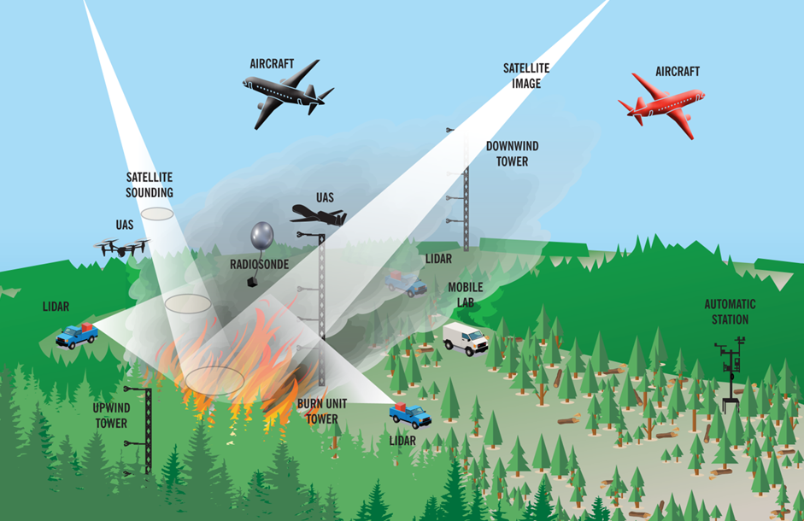
Fall 2023 Field Campaign
Annual Field Campaigns (2023-28): Field campaigns will be conducted annually, with increasing sophistication in the sensors and platforms tested. Targeting areas across the US, not just western forests.
Capstone Field Campaign in Year 5 (2027-28): The Capstone Field Campaign will serve as a technology demonstration event for stakeholders to use/evaluate the tools, products, sensors, and capabilities developed during the first four years of FireSense.
The goal is that the success of the Capstone Field Campaign will enable the successful adoption/transition of
FireSense developed capabilities by our stakeholder/operational agencies.
Graphic from FASME

Slide 14
NASA’s Wildland Fire Initiative Multi-Disciplinary Collaboration in Wildfire
ARMD
Concept of Operations Development
Integrated Systems Architecture to ensure persistent communication and remote sensing
Airspace Management Technologies
UAS technology enabling communications, logistics, and 24-hour aerial suppression
Aircraft and operations safety technologies
SMD
Tools and technology to more effectively manage wildland fire across the entire fire life cycle (pre-, active, and post-fire)
Improved fire prevention via improved risk assessments
Better detection and tracking of fire
Improved predictions of post fire hazards
Improved monitoring and forecasting of air quality
STMD
Early Stage Technology Development, Maturation, and Demonstration
SBIR / STTR
Prizes, Challenges, and Crowdsourcing
Transfer NASA Technology to spinoff products and service
Flight Opportunities for technology testing through the TechFlights solicitation, TechLeap prize, and OGA partnerships
Aerial Suppression, Safe Airspace Operations, and Logistics
Prediction, Detection and Tracking, Mitigation Support
Technology Advancement

Slide 15
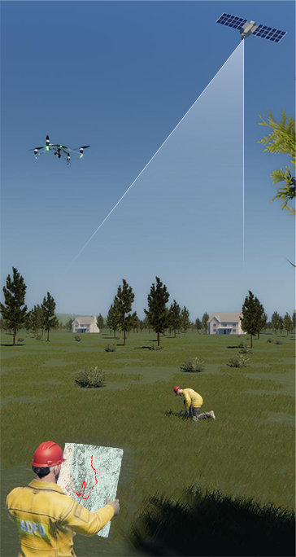
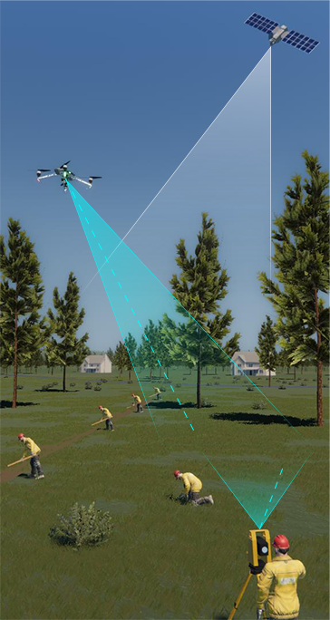
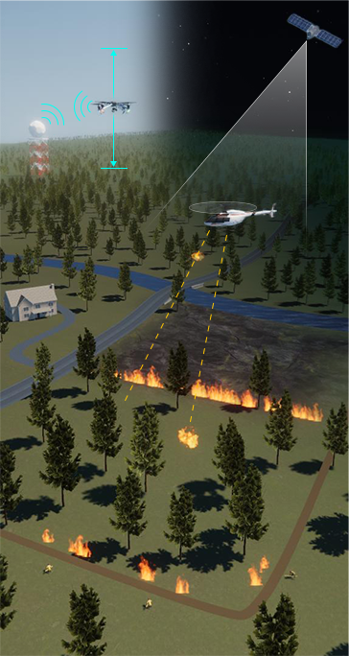
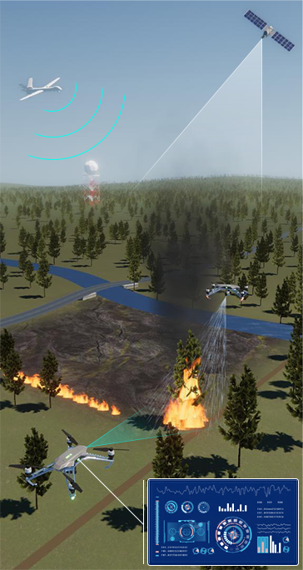
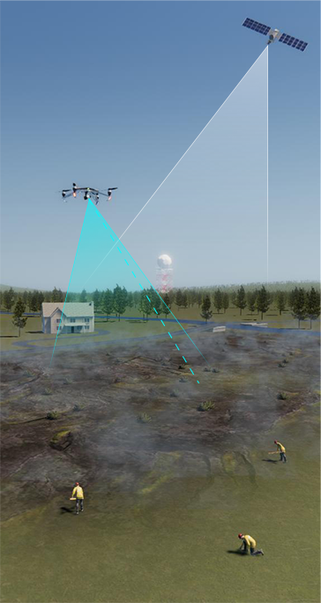
NASA Wildland Fire Capstone Demonstration
MONTHS
DAYS
DAY / NIGHT OPERATIONS
DAYS
DAYS
Planning and Monitoring
Site Conditions
During Prescribed Burn
Contingency Management / Active Fire
Mop-up and Rehabilitation
Real-time data
An end-to-end demonstration that integrates technology, modeling, and information from across ARMD, SMD, and STMD to enable different phases of a prescribed burn operation

Slide 16
CONOPS Stakeholder Involvement
Airspace Operations
Prescribed Burns
Remote Sensing
USFS
DOI
National Guard
FAA
NOAA
BLM
DoD / Air Force
USGS
US Parks Service
Fish & Wildlife Service
CALFIRE
Colorado Fire

Slide 17
FireSense Team
ESD FireSense Program (HQ)
Lead:
Michael Falkowski
Airborne Campaigns:
Melissa Martin and Barry Lefer, Research & Analysis
Modeling and Information Systems:
Michael Falkowski, Research & Analysis
Stakeholder Engagement and Capacity Building:
Emily Sylak-Glassman, Applied Sciences
Technology Development and Demonstrations:
Haris Riris and Teresa Kauffman, Earth Science Technology
ESD FireSense Project
Project Manager (ARC): Vacant
Project Scientist (ARC): Announcement forthcoming
Systems Engineer (JPL): Justin Boland
FireSense Implementation Team Lead:Vacant
FireSense Science and Applications team lead and membership to be competed
FireSense Partners
NASA Partner Organizations:
ARMD and STMD
External Partner Organizations:
EPA, NOAA, USFS, USGS, EDF, CalFire, Many Others

Slide 18
Thank You
Please contact Michael Falkowski for further information:
michael.falkowski@nasa.gov

