Slide 1
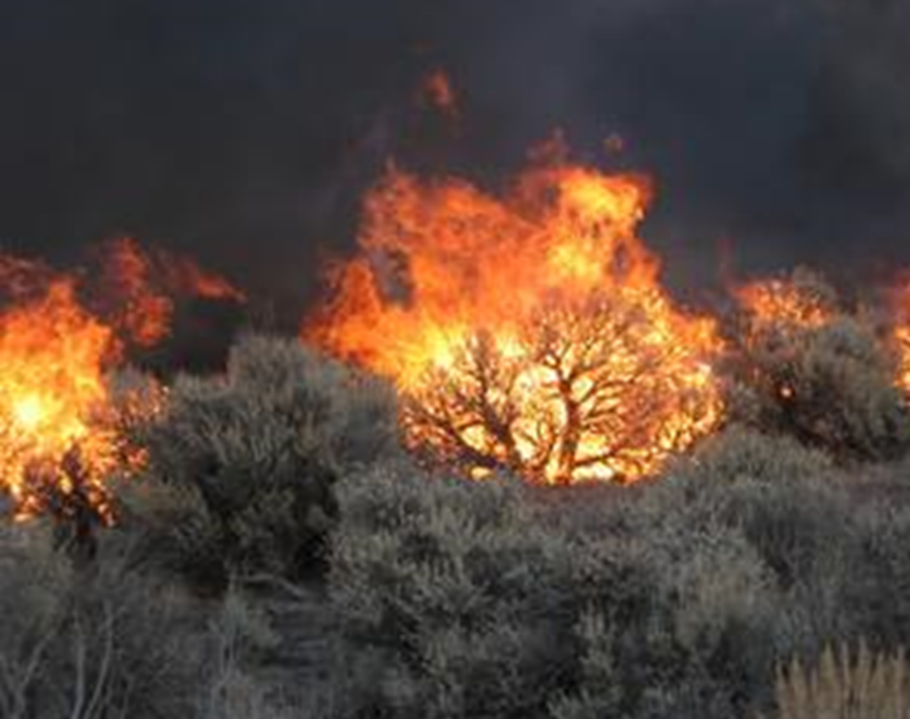

Implementing USGS Wildland Fire Science Strategic Plan to
Support Fire Management
TFRSAC - December 1, 2021
For additional information:
www.usgs.gov/fire
USGS Fire Science Fact Sheet
https://doi.org/10.3133/fs20193025
12-year compendium of fire science at USGS
https://doi.org/10.3133/ofr20191002
USGS Wildland Fire Science Strategic Plan https://doi.org/10.3133/cir1471
Paul Steblein
USGS Wildland Fire Science Coordinator
JFSP Governing Board
pfsteblein@usgs.gov
J. Kevin Hiers
Deputy Fire Science Coordinator

Slide 2
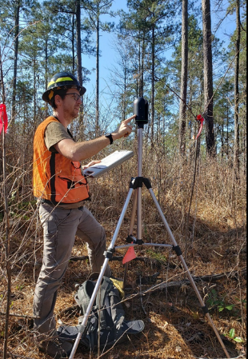
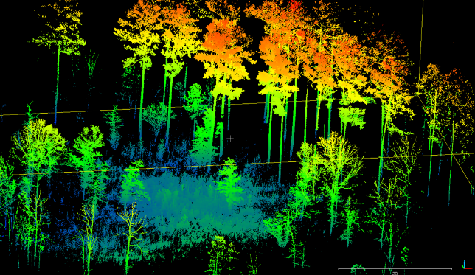
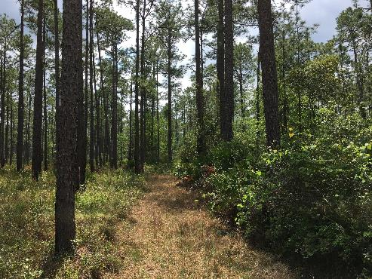

Objectives today
Quick review of USGS Wildland Fire Science Strategic Plan
4 major efforts to implement Strategic Plan
  Integrated fire research
  Enhanced fire & ecosystem modeling
  Science applications at landscape level
  Fire science enterprise architecture

Slide 3
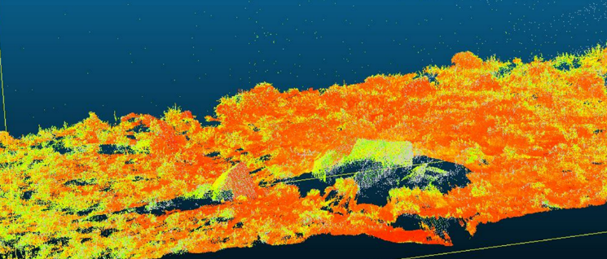


USGS Wildland fire science strategic plan: 2021-2026
Priority 1: Produce state-of-the-art, actionable fire science
Goal 1: Improve understanding of the impacts of climate changes and other ecosystem stressors, and their synergistic interactions, on fire behavior, fire risk, and fire effects in natural systems and human communities.
Goal 2: Gain a better understanding of the relationships of fire and fire management to biodiversity conservation, ecosystem resilience, and post-fire recovery.
Goal 3: Conduct science to help protect human lives, livelihoods, property, and infrastructure.
Goal 4: Develop state-of-the-art tools and decision-support systems that enable land, fire, and emergency-managing bureaus and partners to obtain essential fire information.
Priority 2: Engage stakeholders in science production
Priority 3: Effectively communicate USGS fire science capacity, products, and information
Priority 4: Enhance USGS organizational structure and advance support for fire science
USGS Wildland Fire Science Strategic Plan
https://doi.org/10.3133/cir1471

Slide 4


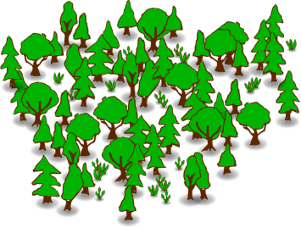
Forest & Rangeland
Mgmt Pract
USGS Fire Science
Wildland Fire Threat, Hazard,
Risk & Mitigation
Landfire &
WFDSS
Prescribed Fire
Inv Spp
Control
Restore & Maintain
Landscapes
Wildfire
Suppression
Manage Fire for Resource Objectives
Fuel Breaks
Escaped
Fire
Insects
Human
Caused
Ignitions
Improve
Wildfire Response
Wildfire Prevention
Cultural
Resources
Disease
Create
Fire-Adapted Communities
Plants & Wildlife
Homeowner
Actions
Invasive
Species
Job
Hazards
Fire Resistant Buildings
Community Wildfire Protection Plan
Drought
Public
Warning
Systems
Ash
Human Health & Safety
Climate Change
Smoke
Before a Fire
Fire
Public
Evacuation
Phases of
Wildland Fire
After a
Fire
Infrastructure
Integration with
Other Hazards & Risks
During a Fire
Invasive Spp
Response
Economic Costs
Direct & Indirect
Wind
Erosion
Ecosystem
Services
Plants & Wildlife
Lost Vegetation &
Organic Matter
Debris-Flows
& Flooding
Threat/Hazard
Public
Warning
Systems
Land Uses
Restore
Vegetation
Inv Spp
Control
Values at Risk
Human Health & Safety
Water Quality/Quantity
& Supply Systems
Public
Evacuation
Burn
Severity
Maps
BAER
Plans
Infrastructure
Mitigation
Notes:
This high-level conceptual diagram illustrates the complexity and interconnectedness of phases of fire, and relationship to options in recovery
Many different values at risk during each phase of fire, and w
Each of the threats & hazards here, values and mitigation have layers of data and tools that are important to have available
Vegetation is a key part in all phases, and recovery
Fuel for the fire
Information about vegetation help identify where to mitigate before a fire
Where to position response assets before a fire
Drive fire behavior models to determine how to attack fire and when to back off
Determine burn severity to look at potential for debris flow, flooding, and how to restore vegetation and control invasive species

Slide 5




Integration of Fire Behavior with
Post-fire & Ecosystem Processes
Invasive
Species
Critical Role of Partnerships
Internal across disciplines
With other agencies & programs
Remote sensing, process research, modeling & application
Current Fuels & Vegetation
Land Uses
Wildfire
Insects
Fuel Treatments
RxFire
Fuel Breaks
Mech Trt
Inv Spp Trt
Disease
Remote Sensing
Ground Sampling
Modeling
Before a Fire
Fire
Behavior
Other Data & Models
Weather/climate
Terrain
After a
Fire
During a Fire
Fire Monitoring
Detection
Perimeter mapping
Intensity
Burn severity
Weather/climate
Terrain
Veg regrowth
Predicted & Observed Fire Character
Input to decision support systems
Couple with post-fire hazards
Couple with other models (carbon, emissions)
Predicted & Observed Post-fire Hazards
Input to decision support & monitoring system
  Debris flow, water flow/quality, sedimentation
  Mitigation options
Couple with other ecosystem & socioeconomic models
  Vegetation, wildlife habitat, invasive spp, health & safety, infrastructure
Fire character
Burn severity
Notes:
Build connection between fire behavior (characterize fire hazard) and post-fire hazard, establishes a framework for connecting many other fire related research and models

Slide 6
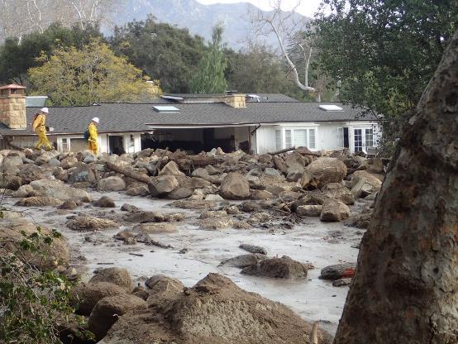
Advanced Integrated Fire Science
Conceptual Model
Fire behavior & post-fire risks
Topography & Soils
Concept application
CO River Basin
CA/WA Disasters
Debris flow,
Water quality, &
Revegetation
Ignition probabilities
Fire spread & behavior
Burn severity
Fire/Post-Fire Risk
Decision making
Land-use /
land-cover change, pre-fire management, and post-fire response
Vegetation & fuels
Weather

Slide 7

Interagency Virtual Fire & Ecological Modeling Center
What
  Community of willing experts – modeling, analytics, data
  Extend concept of NSF-funded WiFire Commons – we are all partners
Why
  Need to join efforts to solve science and management problems – transformational
  Complicated, quickly changing, existential need
    Fire linked to climate, carbon, wildlife, ecosystem services (e.g., water, grazing), invasive species, vegetation growth, …
How
  Organized partnership – MOU, charter
  Core & contributed funding, home agency, operational principles
  Open source; model code and data curation
  Easy access to data and models
  Application targets – science and management
  Identify near-term demonstration targets
  Establish Enterprise Architecture
Core
Groups
Virtual Modeling
Center
Los Alamos National Lab
WiFire
UC – San Diego
Tall Timbers Res Stn
USFS Res & Dev
USGS – CSS, EMA, NHMA, WMA, EMMA
National
Assessments
Research
AIFS: Link Fire-Postfire
Innovation
Landscapes
Land Managers

Slide 8

Landscape scale application
Problem statement
Measuring the success of fuel treatments on risk reduction nationally is poorly quantified and fails to adequately reflect risks across DOI.
National level metrics do not account for local or regional variation in fuels, values at risk, or ecosystem outcomes, particularly on DOI lands.
Fuel treatment longevity is poorly understood in fire risk planning and strategies.
Designing and evaluating landscapes for successful risk reduction is not possible on DOI lands with existing methods and models.
Existing monitoring methods are detailed, time consuming, and difficult to analyze for landscape scale fire risk and treatment effectiveness. They are often not performed in a timely manner or integrated with land management.
Treatment evaluations at plot levels do not capture landscape aggregate effects at the scales of large damaging wildfires.
Notes:
While the emphasis here is on fire, the connection to land management is critical. Both fire and land managers are dealing these complex, interacting factors that are affecting fire hazard and risk to values.

Slide 9
Innovation Landscape Structure
Data Sets
EROS - Landfire
MTBS & Fire Boundaries
Model & Science Support
Fire Behavior & Risk
Climate Change
Landscape Team
Land Manger(s) – Treatments, Values/outcomes, Plans
Post-Doc & Scientists – Modeling & Analysis, Data, Monitoring
Invasive Species
Invasive Spp Spread
Post-fire Risks
Fire Ecology
Wildlife Habitat
Water Flow & Quality
Facilitator/Planner
Plant & Wildlife Distribution
Ecosystem Status
Weather
Values – e.g., infrastructure, ecosystem services
Each landscape will have a team
  Continuous focus - Local managers/staff, post-doc, facilitation, regional experts
  When needed – special expertise and support
Multiple landscapes will have guiding science team, interdisciplinary
National coordinator and access to national data and science support
Converging local to national

Slide 10

Roadmap for Fire Science IT
USGS Science Disciplines Geology, Hydrology, Biology, Computers, Physics, Climate, Engineering, Hazards, Socioeconomics
USGS Fire Science Environment
Sociological – relationships, organizations
Rapid change – environment, technology, knowledge
Enterprise Architecture - technical efficiency
FWS, NPS, BIA, BLM,
OWF, USFS, States, Tribes
Science Collaborators
JFSP
USFS R&D
Many Universities
NASA
DOE
NOAA
NIST
ARS
NGOs – TTRS, DRI
USFWS
NPS
BLM
USGS Fire Science
Fire Ecology & Management
Invasive Spp, Landuse, Fire Behavior, Fire Effects, Vegetation, Ecosystem Processes, Fuel Dynamics
Postfire Effects, Assessment
Debris Flow, Water Supply, Air/Water Quality, Vegetation Recovery
Risk Assessment & Mitigation
Defining risk, SocioEconomic,
Mitigation cost/efficacy/practices
Remote Sensing/Geospatial/Analytics/HP Computing
Mapping, AI/ML, Data Production, Modeling, Supercomputers, Sensors, Decision Support Tools
Fire Management & WFIT
e.g., Landfire
MTBS
Fire Mapping
Discovery, Access, Adaptation &
Use of Knowledge, Data & Tools
Interdisciplinary science
Foster collaborations
Ensembles of coupled models
Adapt to new sensors/analytics
Efficient curation & serving
Improved onramp for WFIT
Land & Species Management
DoD, DOE, IC
National/Global Security
High/Low side
Emergency, Water, Community Managers
Notes:
Projects and Partners define multilateral need for discovery, access, & collaboration of knowledge, data, & models/tools
Rapidly changing knowledge, sensors, tools
What are IT requirements to support integrated research, improve partnerships with scientists and managers, and efficiently manage enterprise architecture?

Slide 11
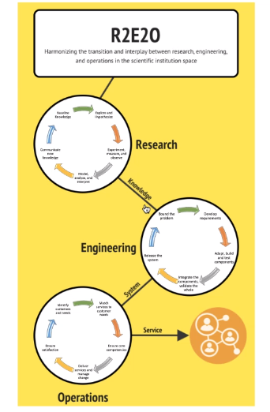
Purpose and Goals
There is a growing need for interagency, integrated science to address complex and interacting phenomena which requires easier discovery, access and collaboration on knowledge, data and models.
Growing gap between the pace of technological advancement of fire science and operational application.
Research "on ramps" are needed to bring innovation into operational environments currently in use or being developed.
Incorporating R2E2O cycle and principles (attached) help capture the dynamic data and technology needs to advance the research part of the cycle and transition them to operational use.
Examples 3D fuels mapping, WIFIRE enabling next generation modeling, laser-based monitoring, and AIFS projects.
How can investment in the fire science "research to engineering" help engage and enable fire science in this context?
Credit:
Sky Bristol, USGS
Notes:
Derived from concept by Sky Bristol, USGS, CSS

Slide 12


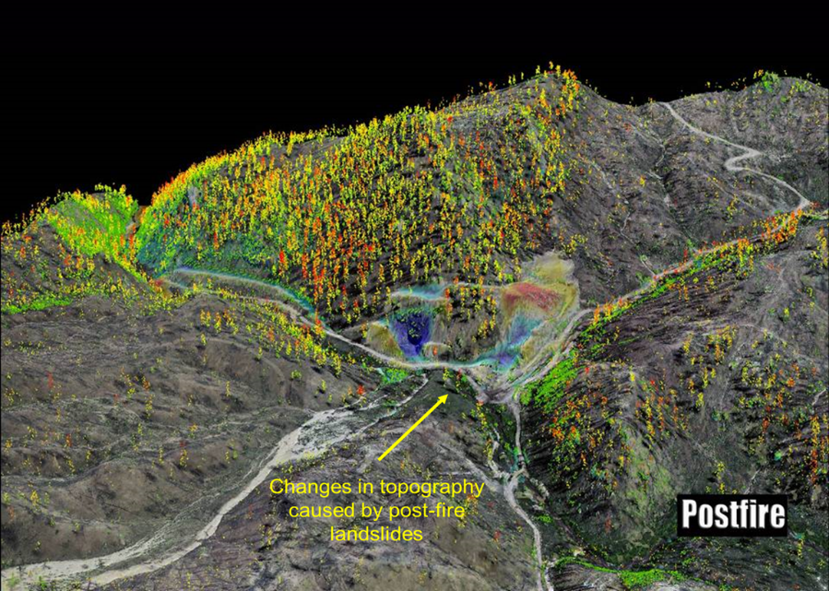
Fire science for a changing world
Questions?
Summary
  Advanced, integrated, actionable wildland fire science that addresses the many, complex and dynamic challenges
  Listen to and work with stakeholders to identify needs, design the science and deliver the results
  Ensure the public knows what we do, where to get results, and what it means
  Organizational excellence across Missions and with partners
USGS Wildland Fire Science Strategic Plan https://doi.org/10.3133/cir1471

